Slide 1
FCC-ee tuning simulations
LNO meeting, November 2021
Tessa Charles ^{1,2}, Bernhard Holzer ³, Katsunobu Oide ³, Dmirty Shatilov, Frank Zimermann ³
Rogelio Garcia ³, Leon Van Riesen-Haupt ³ and the FCC-ee optics team
1. University of Liverpool,
2. Cockcroft Institute
3. CERN

Slide 2
Assigning misalignments
CEPC workshop 2021
Tessa Charles
  - Misalignments are randomly distributed via a Gaussian distribution, truncated at 2.5 sigma.

Slide 3
Assigning girder misalignments
Tessa Charles
sextupoles/ quadrupoles
girder
girder
(not to scale)
dipole
dipole
  - 2 independent DX and DY misalignments for each end of the girder, and which can be used to calculate DTHETA and DPHI.

Slide 4
Misalignments and field errors
Tessa Charles
  Misalignments are randomly distributed via a Gaussian distribution, truncated at 2.5 sigma.
Notes:
This table summarises the current set of misalignments. That’s not to say that this wont’ change. This talk is an update on going work.
\begin{table}[htb!]
\centering
\begin{tabular}{p{3cm}cccccc}
\hline
Type & $\Delta$X & $\Delta$Y & $\Delta$PSI & $\Delta$S & $\Delta$DTHETA & $\Delta$DPHI \\
& ($\mu$m) & ($\mu$m) & ($\mu$rad) & ($\mu$m) & ($\mu$rad) & ($\mu$rad) \\
\vspace{.1cm} \\
\hline
Arc quadrupole* & 50 & 50 & 300 & 150 & 100 & 100 \\
Arc sextupoles* & 50 & 50 & 300 & 150 & 100 & 100 \\
\hline
Dipoles & 1000 & 1000 & 300 & 1000 & 0 & 0 \\
\hline
Girders & 150 & 150 & - & 1000 & 0 & 0 \\
\hline
IR quadrupole & 100 & 100 & 250 & 250 & 100 & 100 \\
IR sextupoles & 100 & 100 & 250 & 250 & 100 & 100 \\
\hline
BPM** & 40 & 40 & 100 & - \\
\hline
\end{tabular}
\end{table}

Slide 5
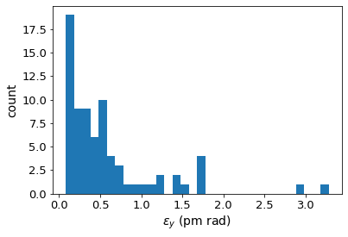
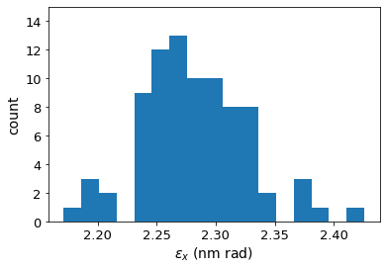
Tessa Charles
FCC-ee emittance tuning results
ttbar (182.5 GeV) 4IP lattice,
after correction strategy:
RMS misalignment and field errors tolerances:
Notes:
Ttbar, 4IP lattice. These are the main results.
run_fccee_girs150_arcs50r400s150pt100_dip1000_IP100r250s250pt100_field_23b_3_gradual2
%$\epsilon_{x, \textrm{median}} = 2.276$ nm rad \\
%$\epsilon_{y, \textrm{median}} = 0.242$ pm rad \\
$\frac{\epsilon_{y}}{\epsilon_{x}} = 0.011$ $\%$ \\

Slide 6
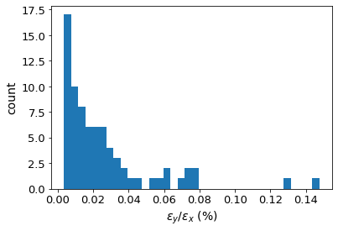
Tessa Charles
FCC-ee emittance tuning results
ttbar (182.5 GeV) 4IP lattice,
after correction strategy:
RMS misalignment and field errors tolerances:

Slide 7
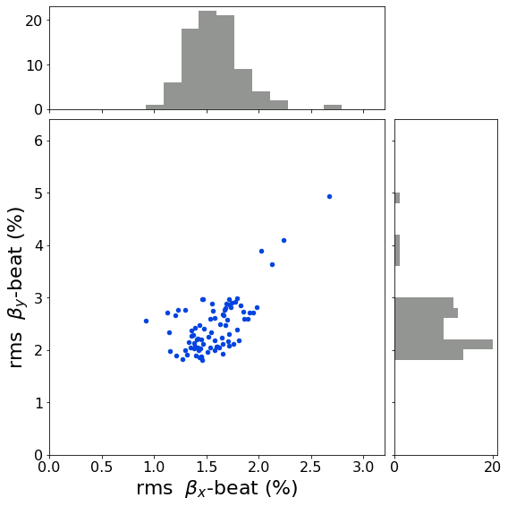
Tessa Charles
FCC-ee emittance tuning results
ttbar (182.5 GeV) 4IP lattice,
after correction strategy:
RMS misalignment and field errors tolerances:

Slide 8
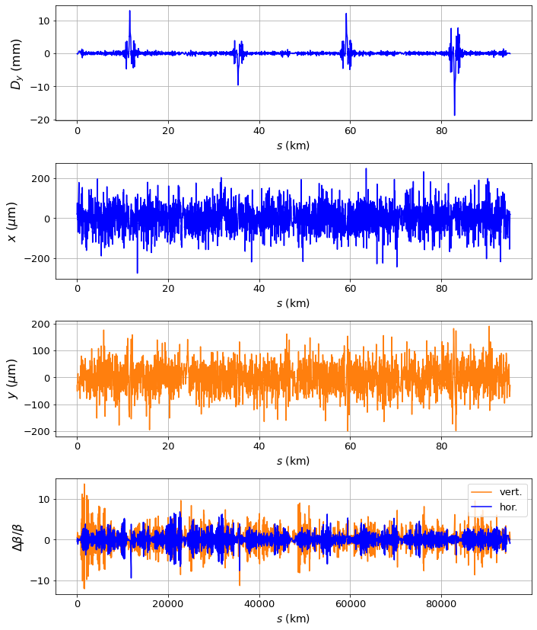
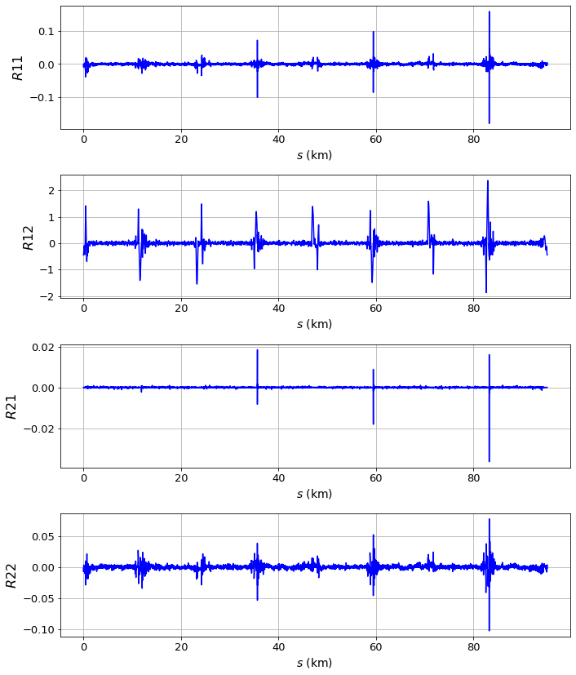
Tessa Charles
After corrections, ttbar 4 IP lattice:
Notes:
It can be quite informative to look at single seeds, to see how various properties vary around the ring. Here is one random seed, chosen at random, showing the vertical dispersion around the ring before and after correction.

Slide 9
Tessa Charles
9
What’s been adjusted (since last time I presented)?
Inclusion of BPM roll angles as additive to Quad roll angle.
Fixed error in BPM misalignment (MREX, MREY)
Chromaticity correction added
  Need to calculate DA with these results
  Didn’t include SY* sextupoles
Correcting the phase advance between IPs

Slide 10
Tessa Charles
10
What I’ve made available (or will do in the coming days)
Latest results (including changed from the previous slide)
Results for half misalignment values (for certain studies, e,g, beam-beam simulations.)

Slide 11
Tessa Charles
11
What I’ve made available (or will do in the coming days)
Latest results (including changed from the previous slide)
Results for half misalignment values (for certain studies, e,g, beam-beam simulations.)
In progress
Relaxed optics
Weighted coupling and dispersion correction
Applying to new FCC-ee ttbar 4 IP lattice.

Slide 12
Tessa Charles
12
Still to do… (there are many things)
BPM orthogonality errors are not included
DA calculation
Solenoid imperfections to be considered
Tapering imperfections
Local corrections need to be implemented to target spikes in Dy and coupling matrix elements.
Non-linear corrections (with impact on DA)
Profiling simulation and look towards speeding up algorithm
Simulate optics measurements
Apply correction technique to low energy, Z lattice
Determine how to apply measure optics quickly
  LOCO is too slow on such a large machine
  AC dipole method may run into problems due to strong damping
Simulation of commissioning process
Notes:
These aren’t in any order of priority, and some bullet points are larger chunks of work that others.

Slide 13
Thank you for your attention.

Slide 14
Correction Strategy (1/2)
CEPC workshop 2021
Tessa Charles
Sextupoles strengths set to zero.
  Gradient errors applied
    Weighted beta-beat correction was performed and tune re-matched
    Sextupole and dipole field errors introduced
    Weighted beta-beat correction was performed and tune re-matched
  Misalignments applied to arc magnets and girders
    Tune re-matched to the nominal tune, and orbit correction performed
    Initial beta-beat correction and coupling correction
  Misalignments applied to IR magnets
    Tune re-matched to the nominal tune, and orbit correction performed
    Beta-beat correction applied, and if needed orbit corrected and tune rematched
    Coupling correction, followed by beta-beat correction and coupling correction
Sextupoles set to 10% of their design strength
(details on next slide)
Final correction (at 100% sextupole strength)
(details on next slide)
Notes:
We introduce the field errs and misalignments in two stages. Here we’re not trying to simulate the commission process from day 0. Instead we want to demonstrate that there is a set of corrector strengths, and magnet strengths, that result in a very well corrected lattice. It would be a different type of simulation to mimic the commissioning process.

Slide 15
Correction Strategy (2/2)
CEPC workshop 2021
Tessa Charles
Sextupoles strengths set to zero.
  (details on previous slide)
Sextupoles set to 10% of their design strength
  Orbit correction
  Combined coupling and dispersion correction
  Beta-beating correction applied.
  Sextupole strengths increased by 10%
Final correction (at 100% sextupole strength)
  Additional coupling, dispersion and beta-beating correction was applied.
  Step through corrections until beta beating threshold is reached (trade-off between beta beating and vertical emittance can be varied).
  Vary SV cut off values
Constant checking of the tunes and orbit avoids running into resonances, or failure to find the closed orbit.
These two steps repeated ~12 times.

Slide 16
Colors
Backgrounds
Background Blue
Background Purple
Background Yellow
Background Grey
Use for Layout
Radiant Blue
Flash
Energy
Green
Red
Deep
Blue

Slide 17
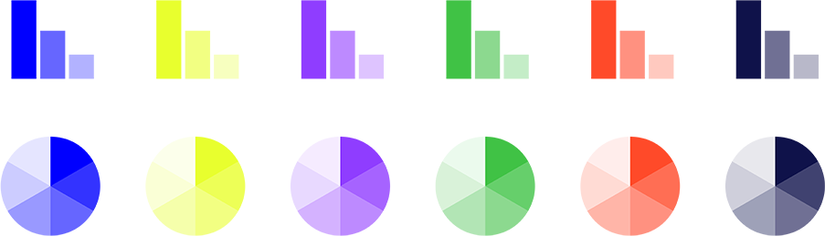
Graphical Elements
Badges
This information is a badge because it is important!
This information is a badge because it is important!
Separation lines 1.5 pt
Arrows
Use blue badges on light backgrounds
Infographics
This information is a badge because it is important!
This information is a badge because it is important!
Use light badges on dark backgrounds

