Slide 1
Welding lathe MFHX70-004 replacement
Laurent Prever-Loiri (EN-MME-FW)
26th November 2021

Slide 2
Welding lathe for Ultra-High-Vacuum aluminium chambers
Specificities of this unique welding equipment & main applications
Design of the new welding Lathe
CE Certification Process
Planning of Manufacturing & cost of Fabrication

Slide 3
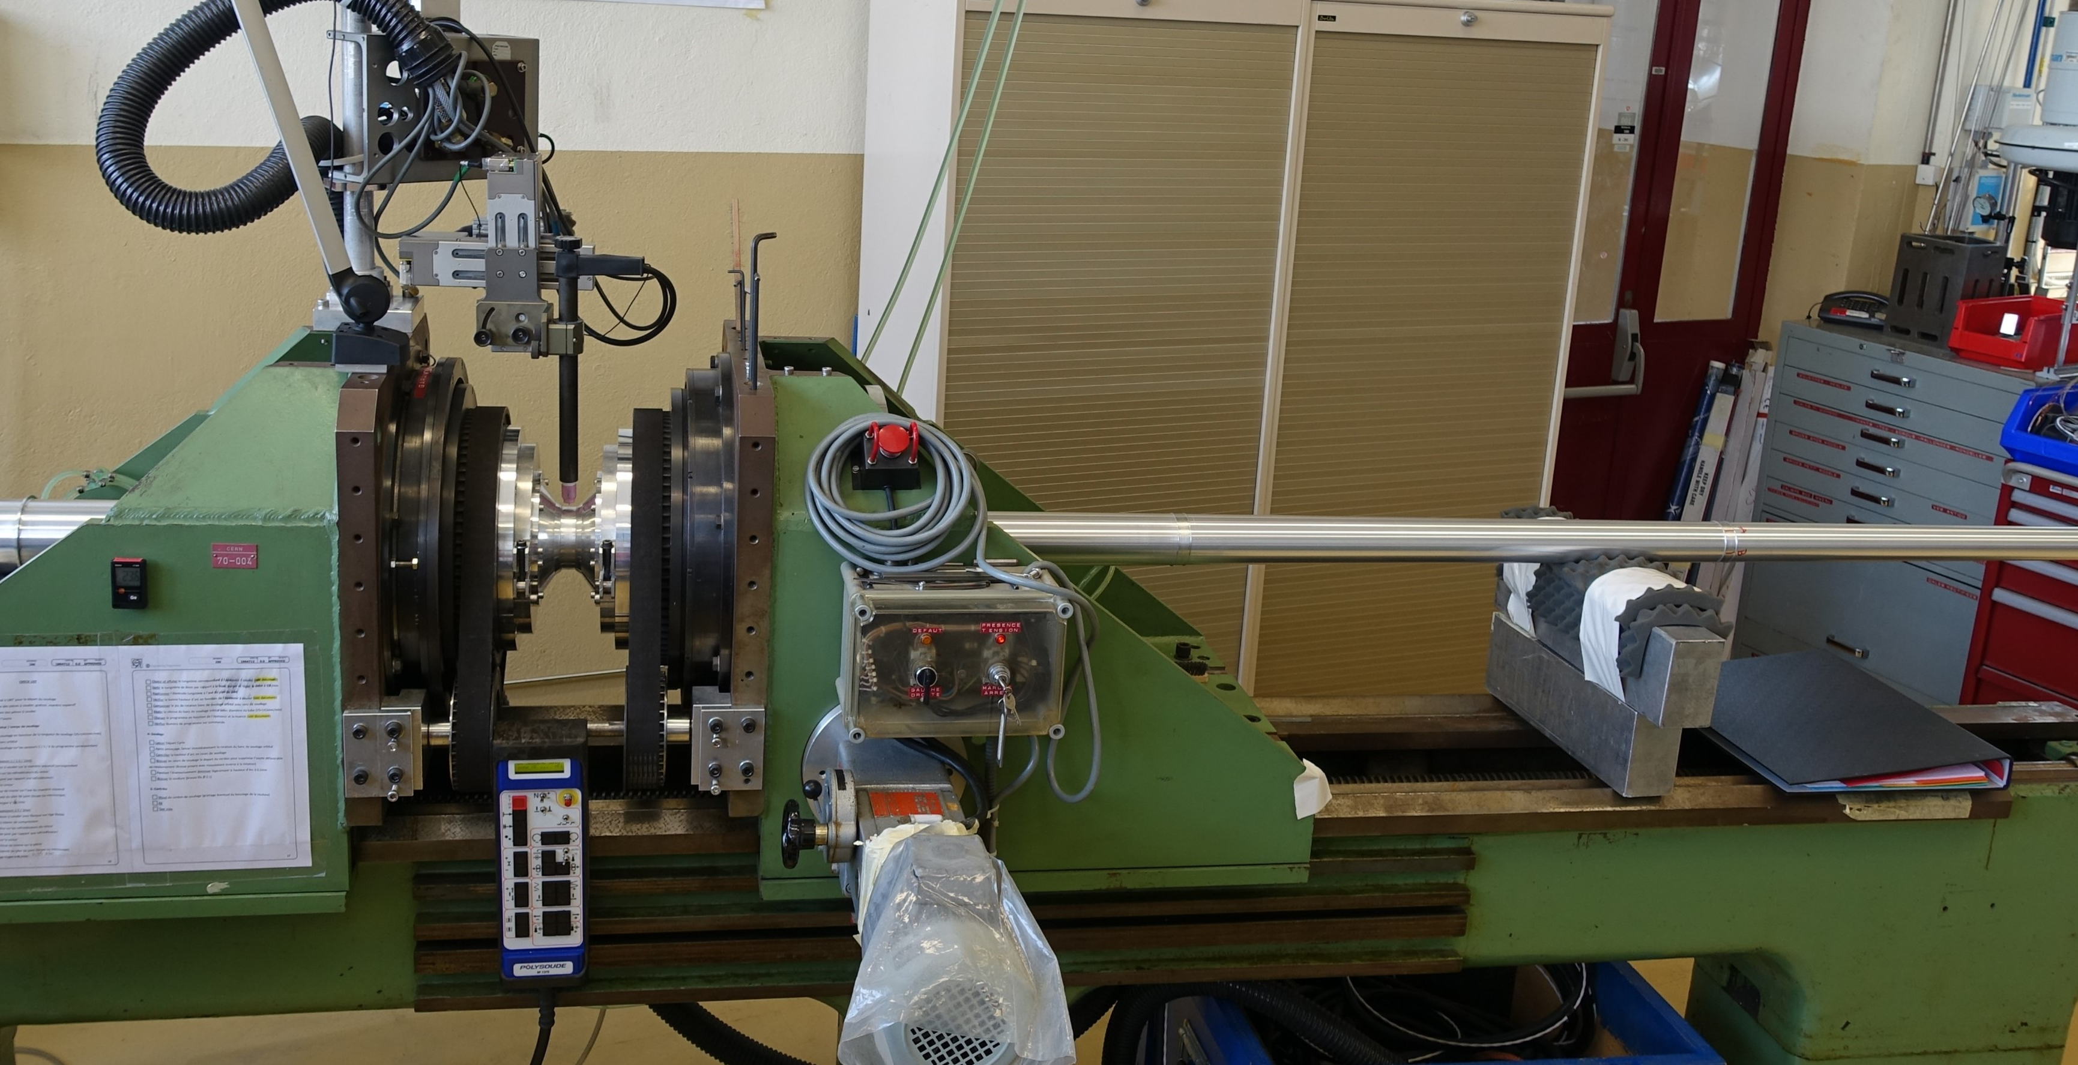
Welding lathe MFHX70-004:
  Length. 3800 mm
Length: 3800 mm
Height of welding axis: 1200 mm
Aperture: 250 mm
Date of commissioning January 1960
Thermalized Clamping Tool
Synchronized
Rotary device
Aluminium Chamber
Base
Brackets

Slide 4
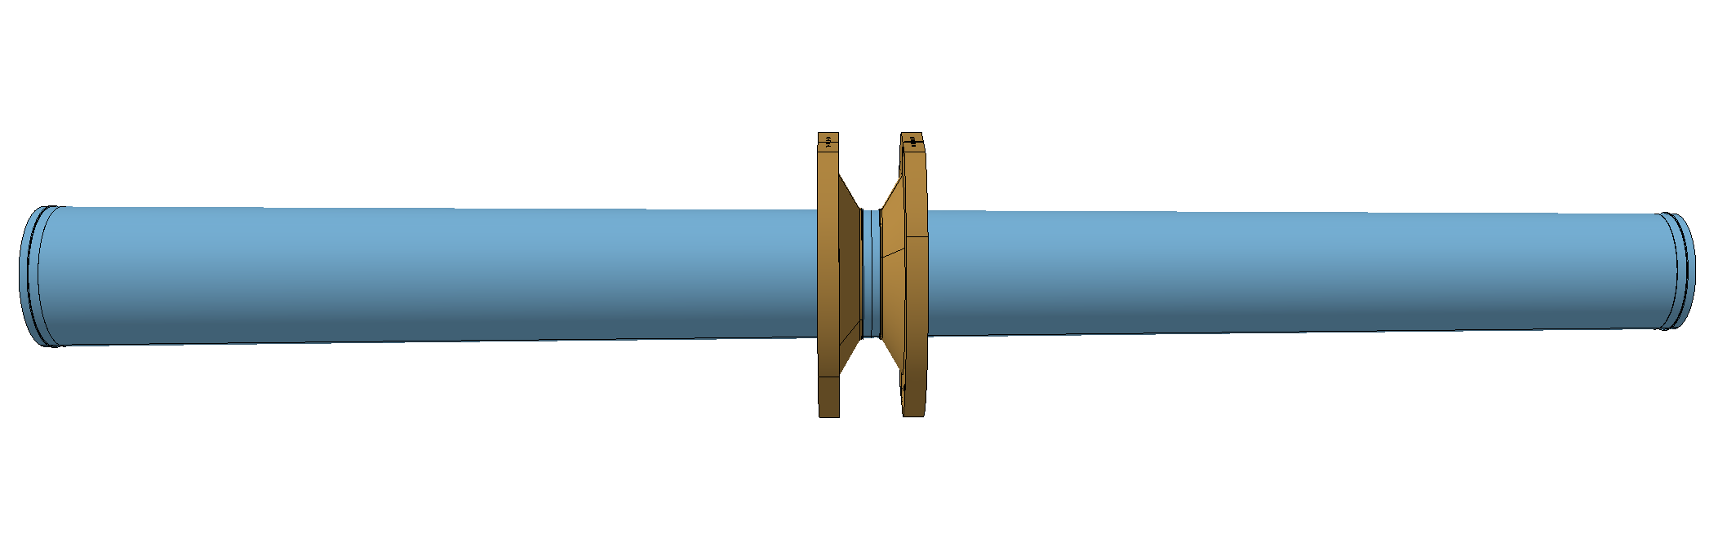
Experiments aluminium chambers welding requirements
No tack welding
Clamping Tool + Thermal regulation
DC current Welding
Cooling tubes
Segments of chambers
Contact force
Contact force

Slide 5
Examples of Welding Assembly
Aluminium Chambers for detectors

Slide 6
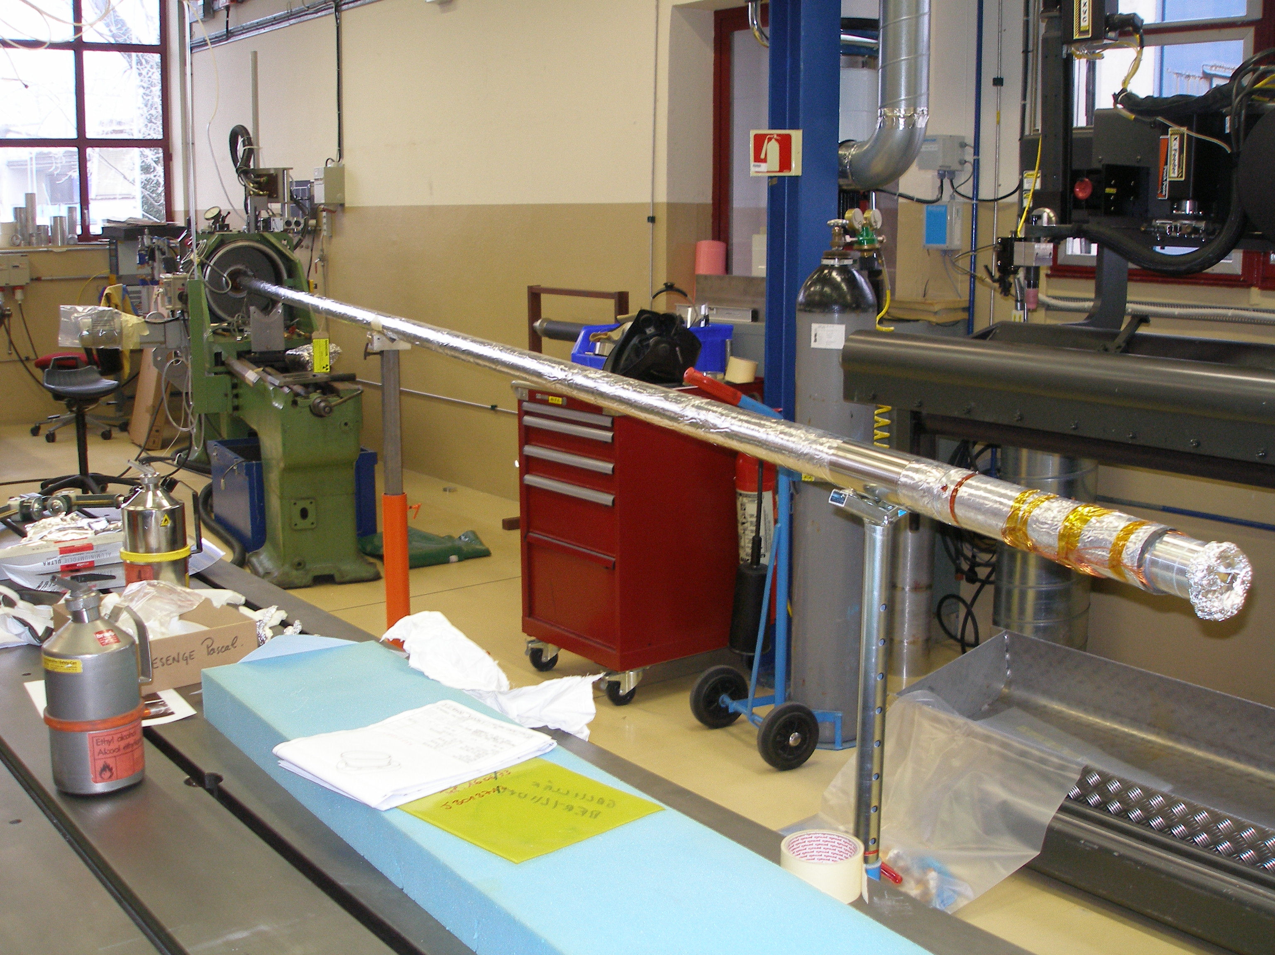
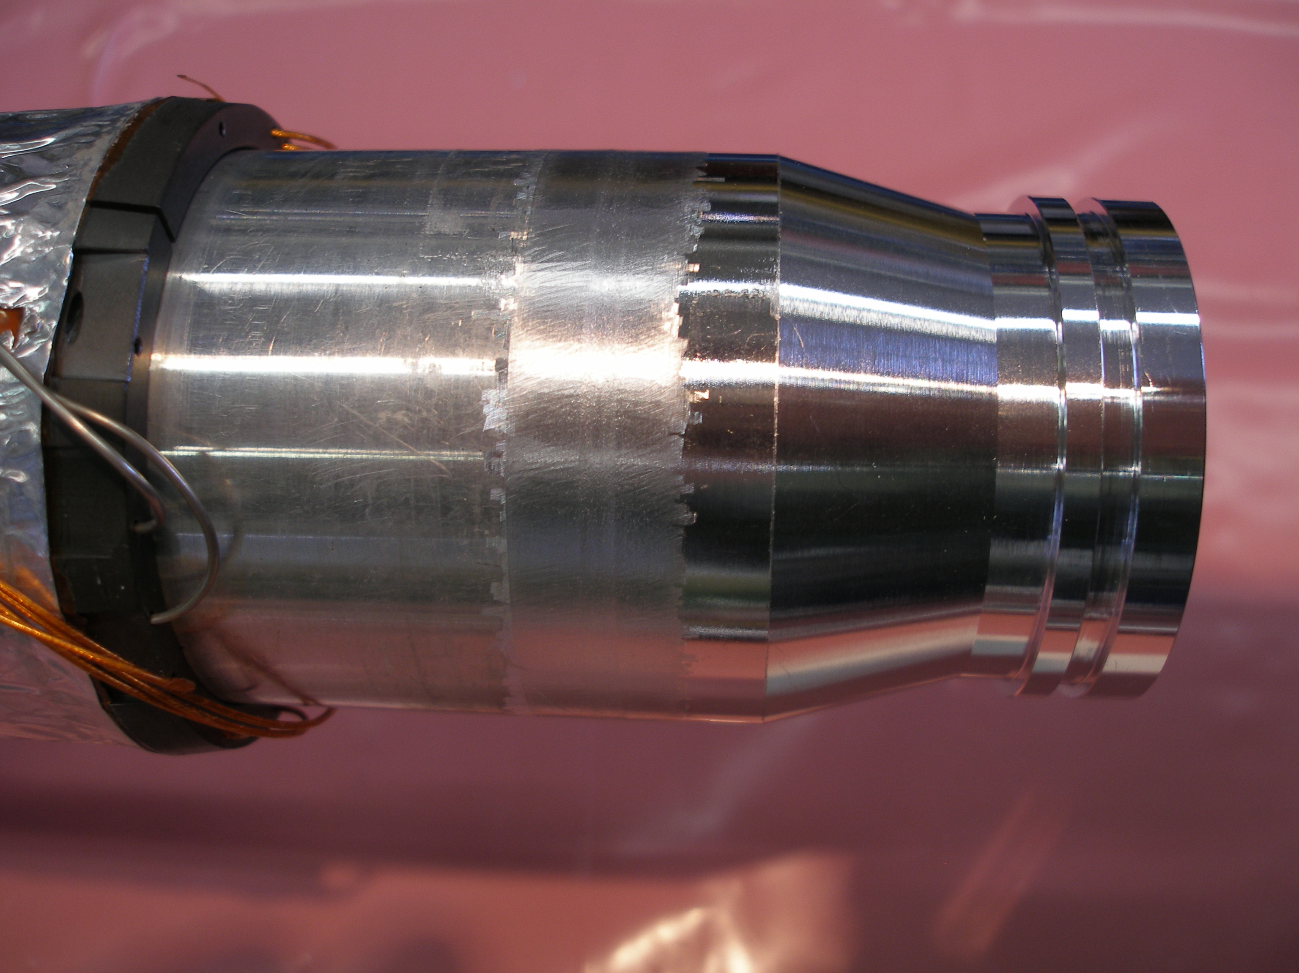
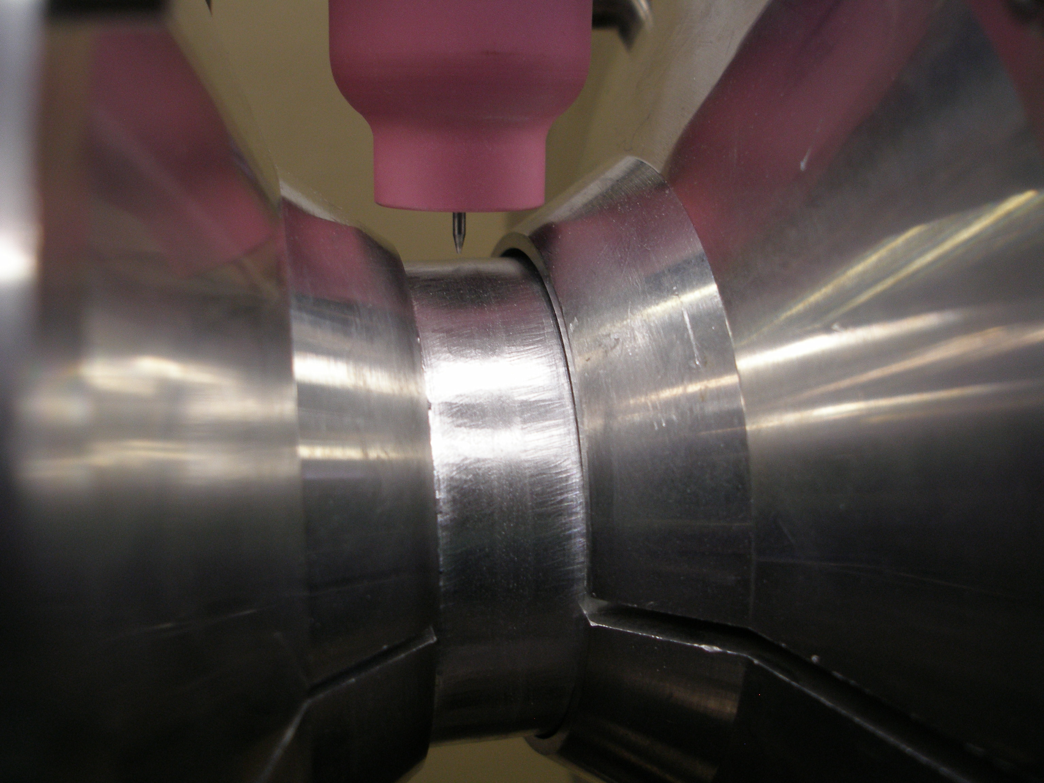
Modification of Beryllium Chamber VI ATLAS

Slide 7
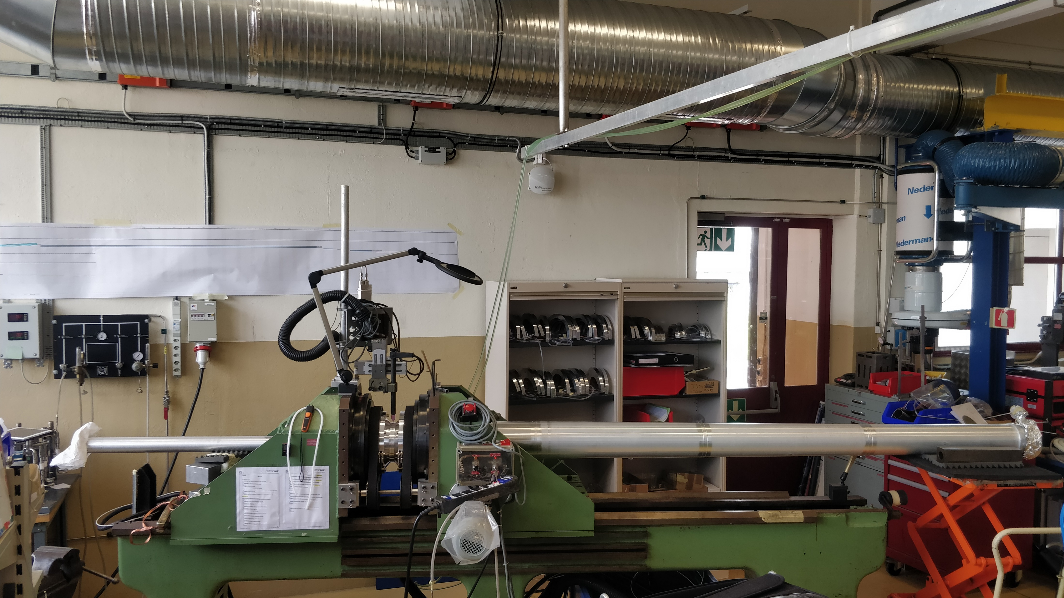
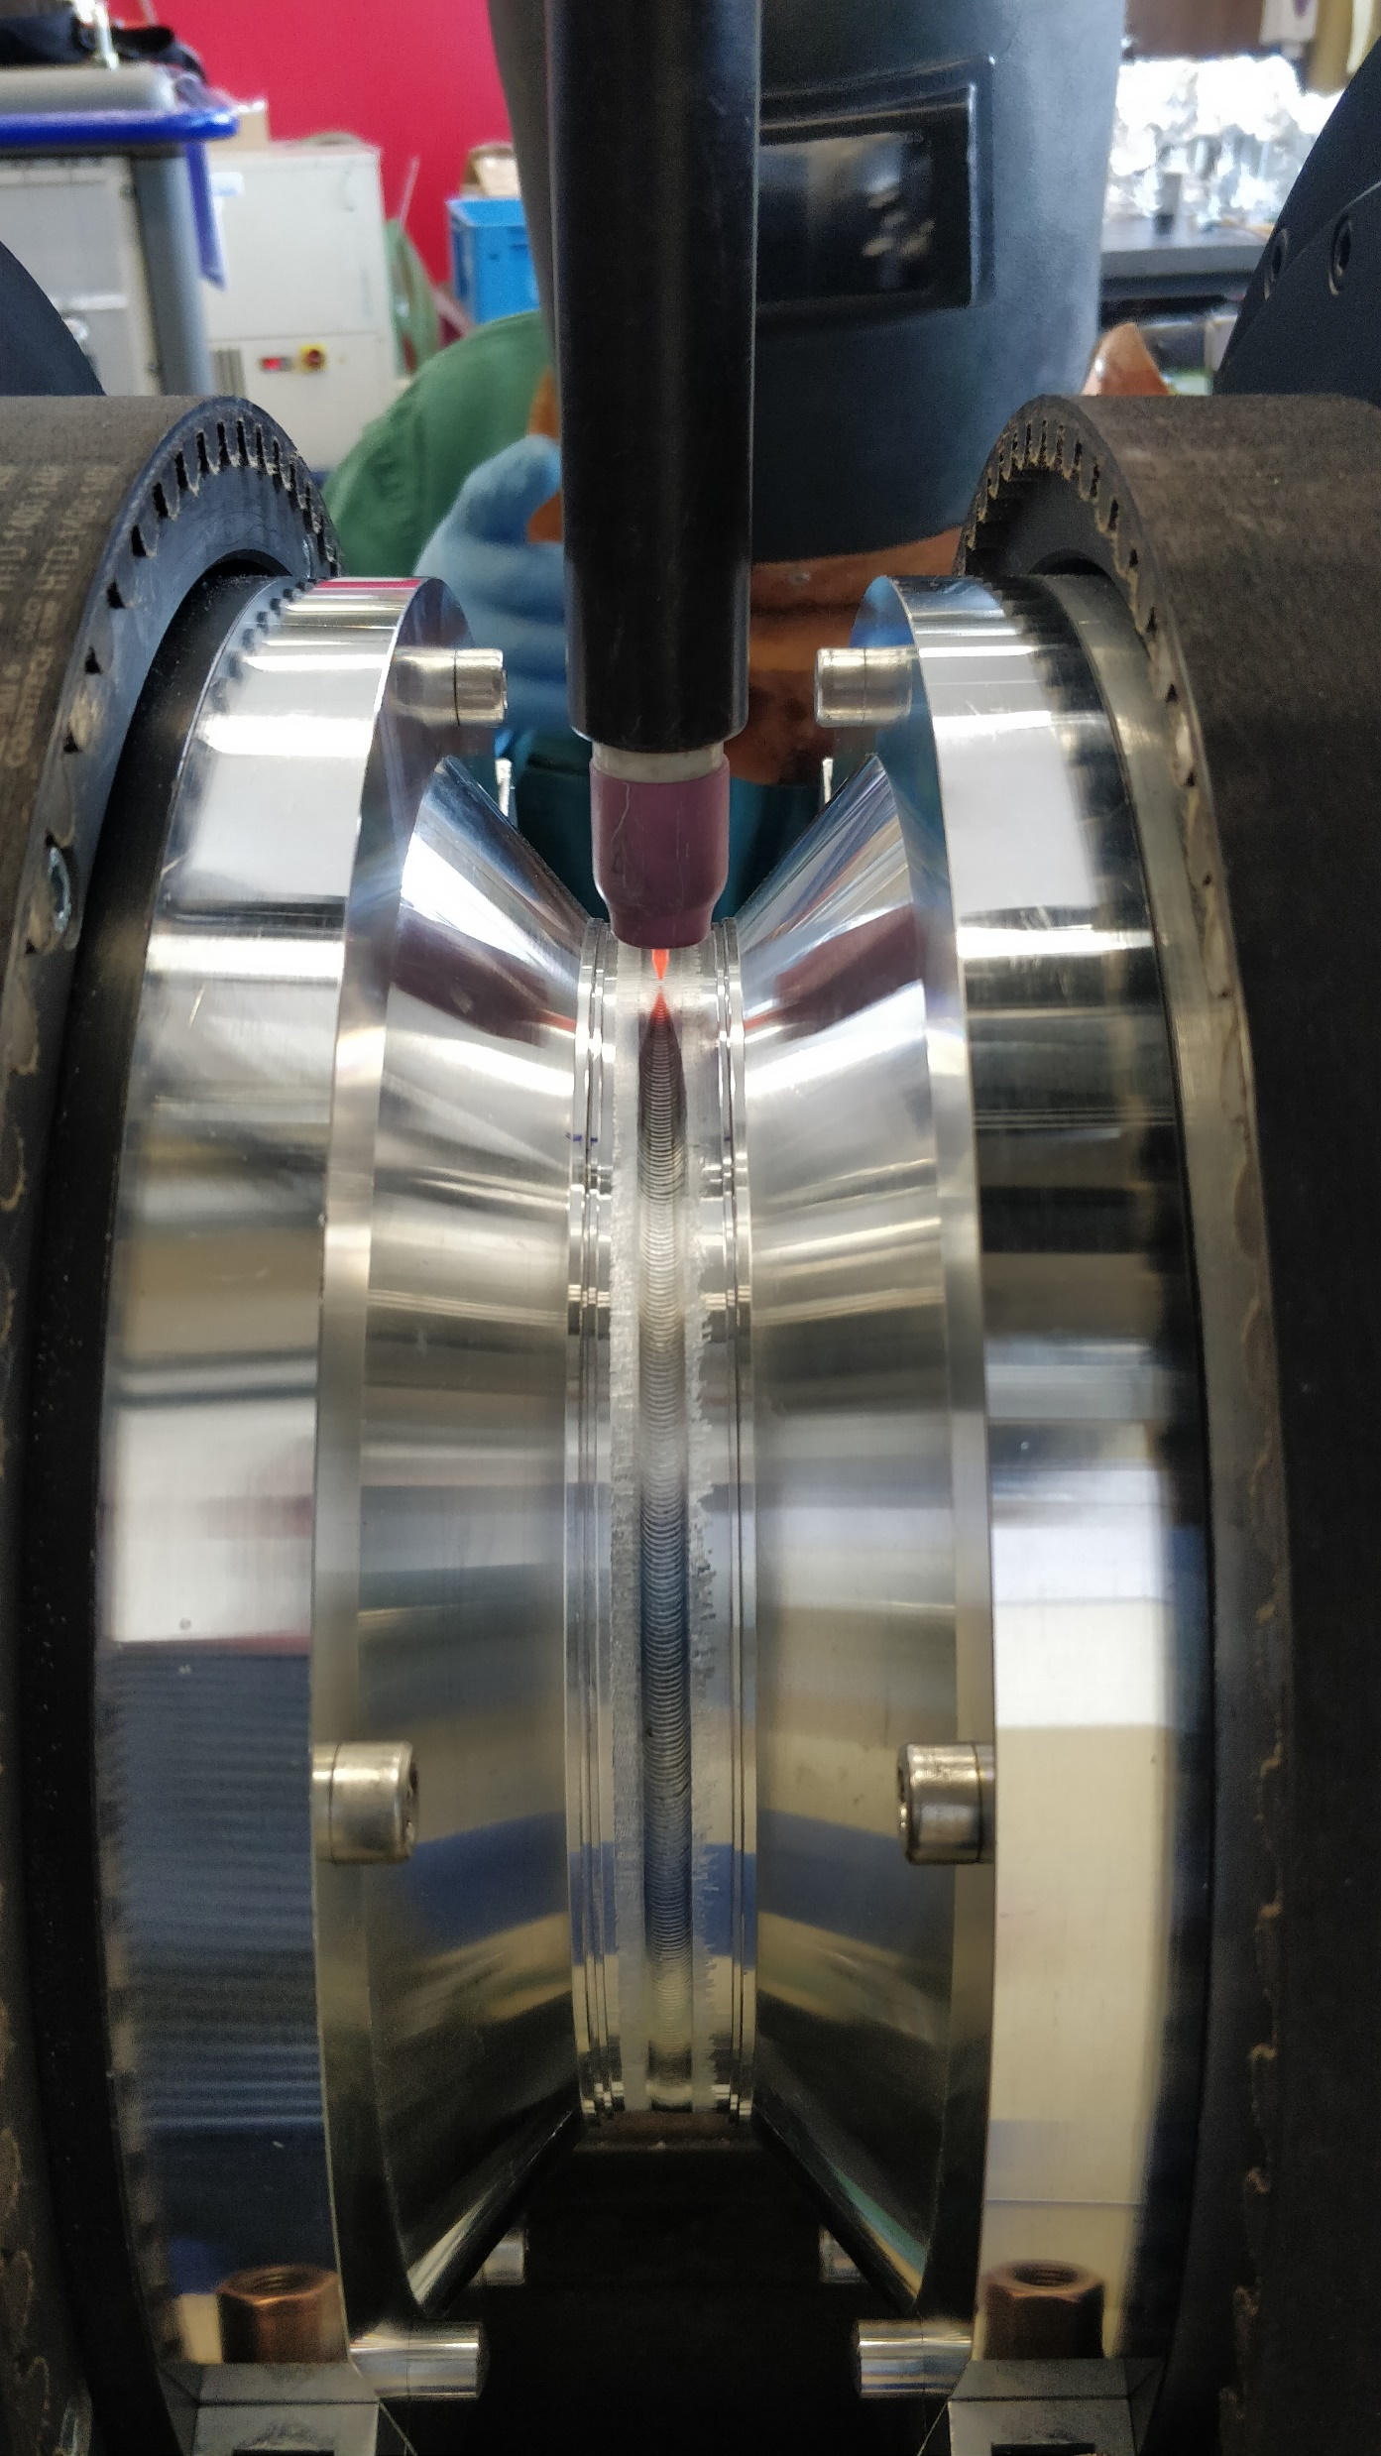
CMS HF CT2 Chamber

Slide 8
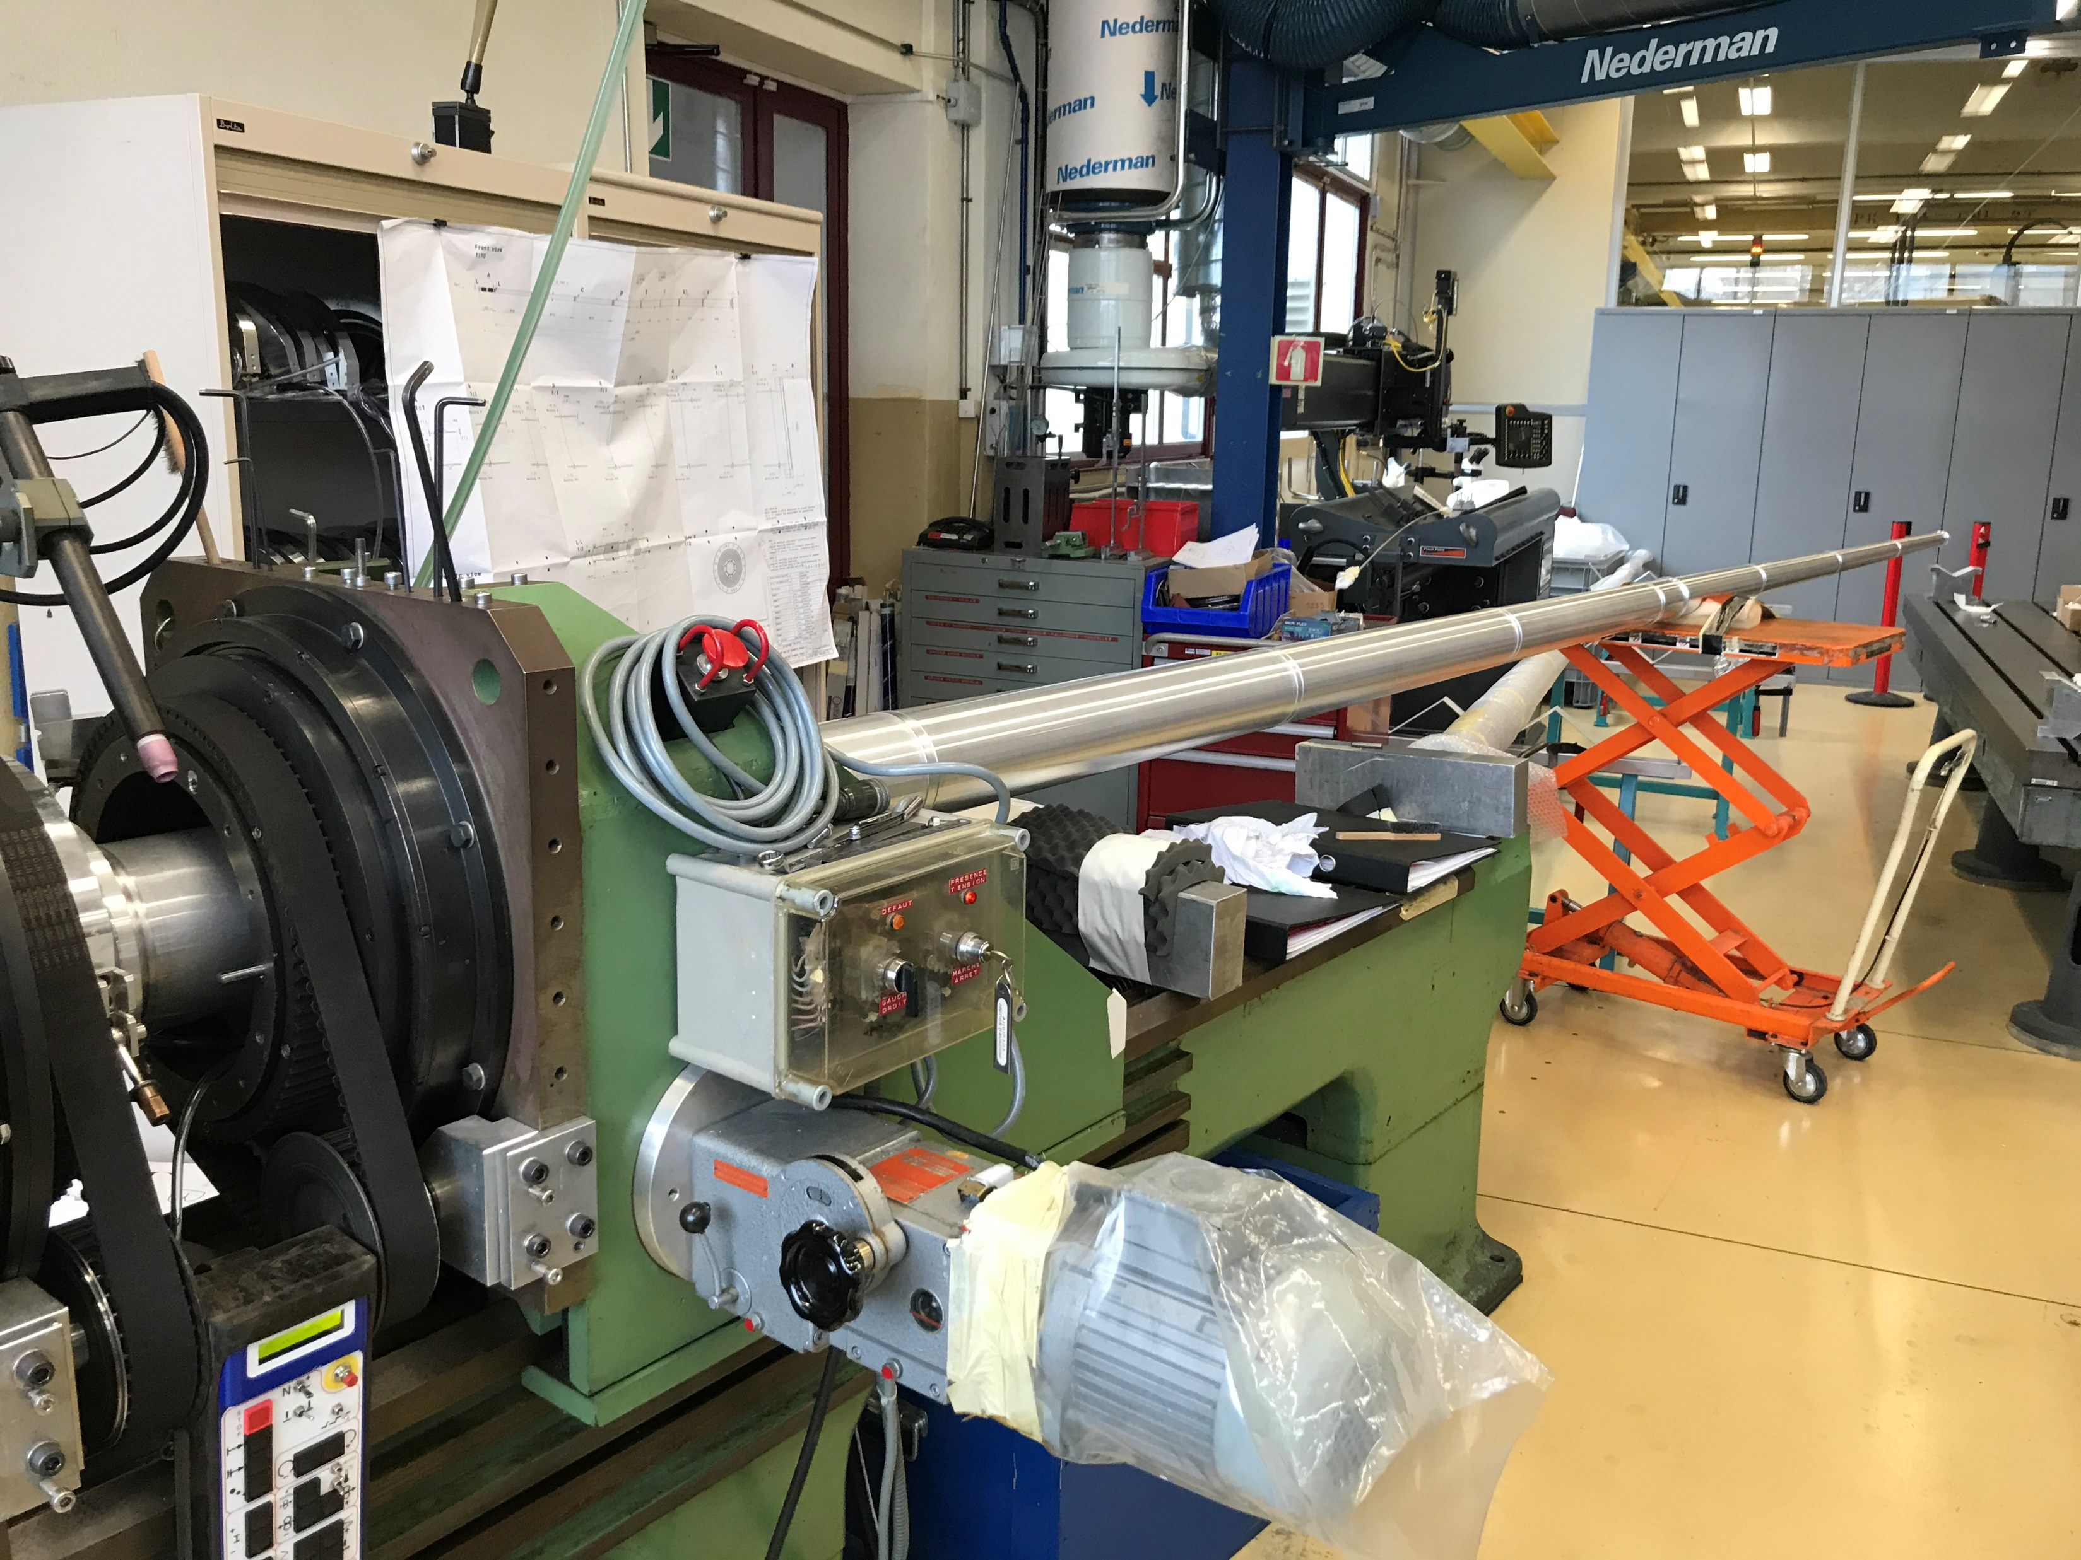
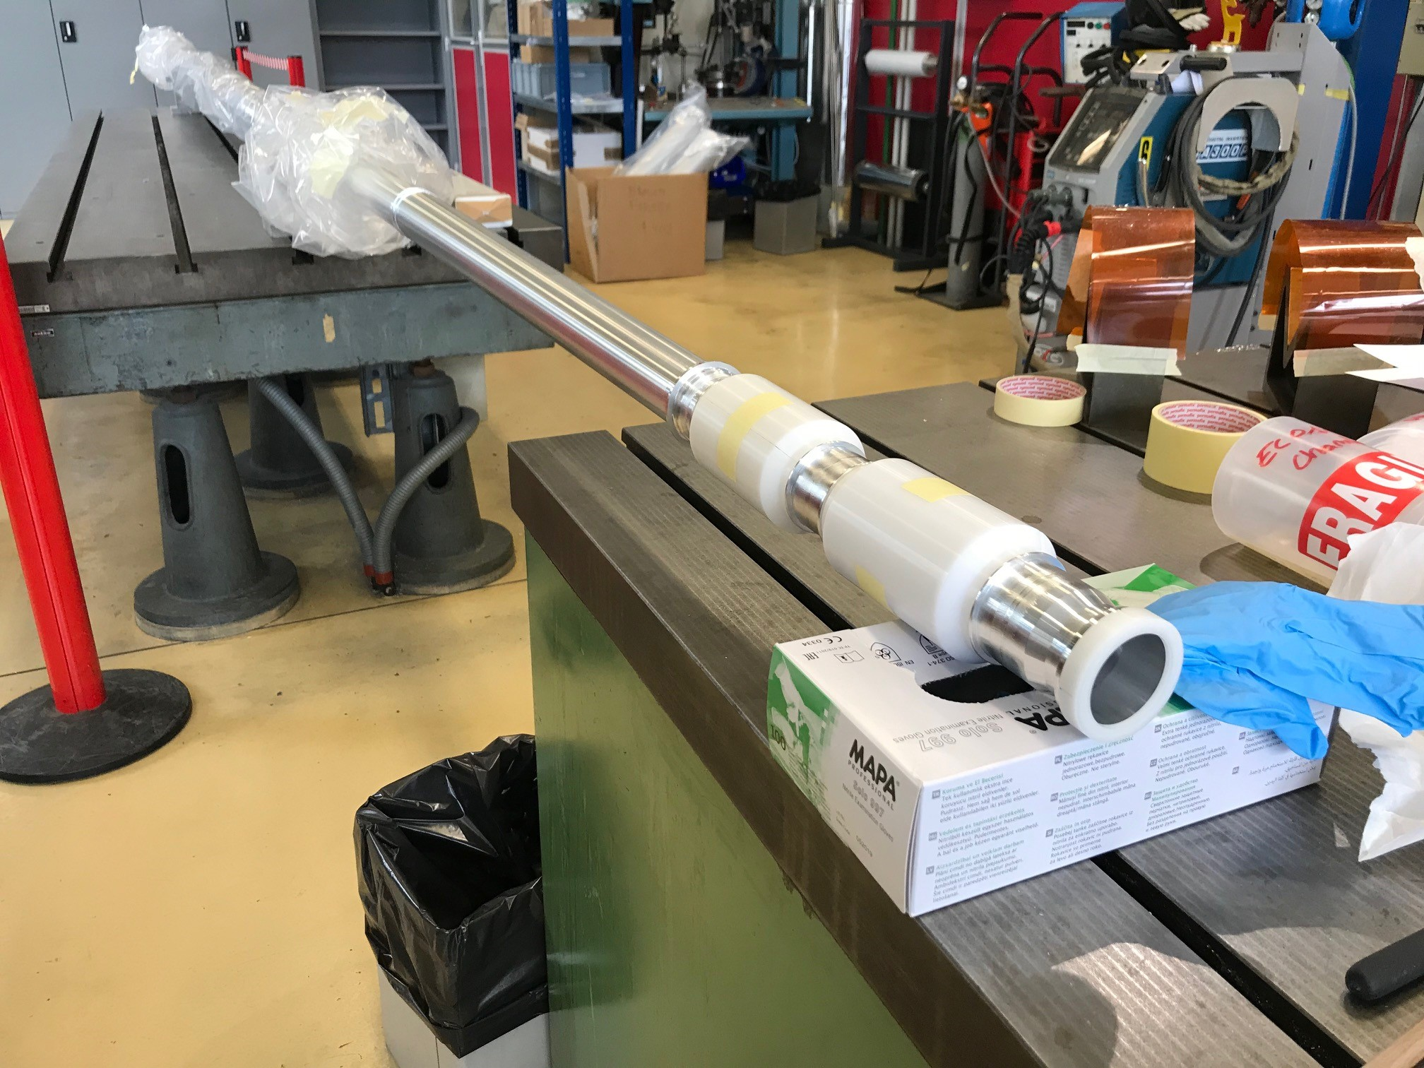
CMS End Cap Chamber

Slide 9
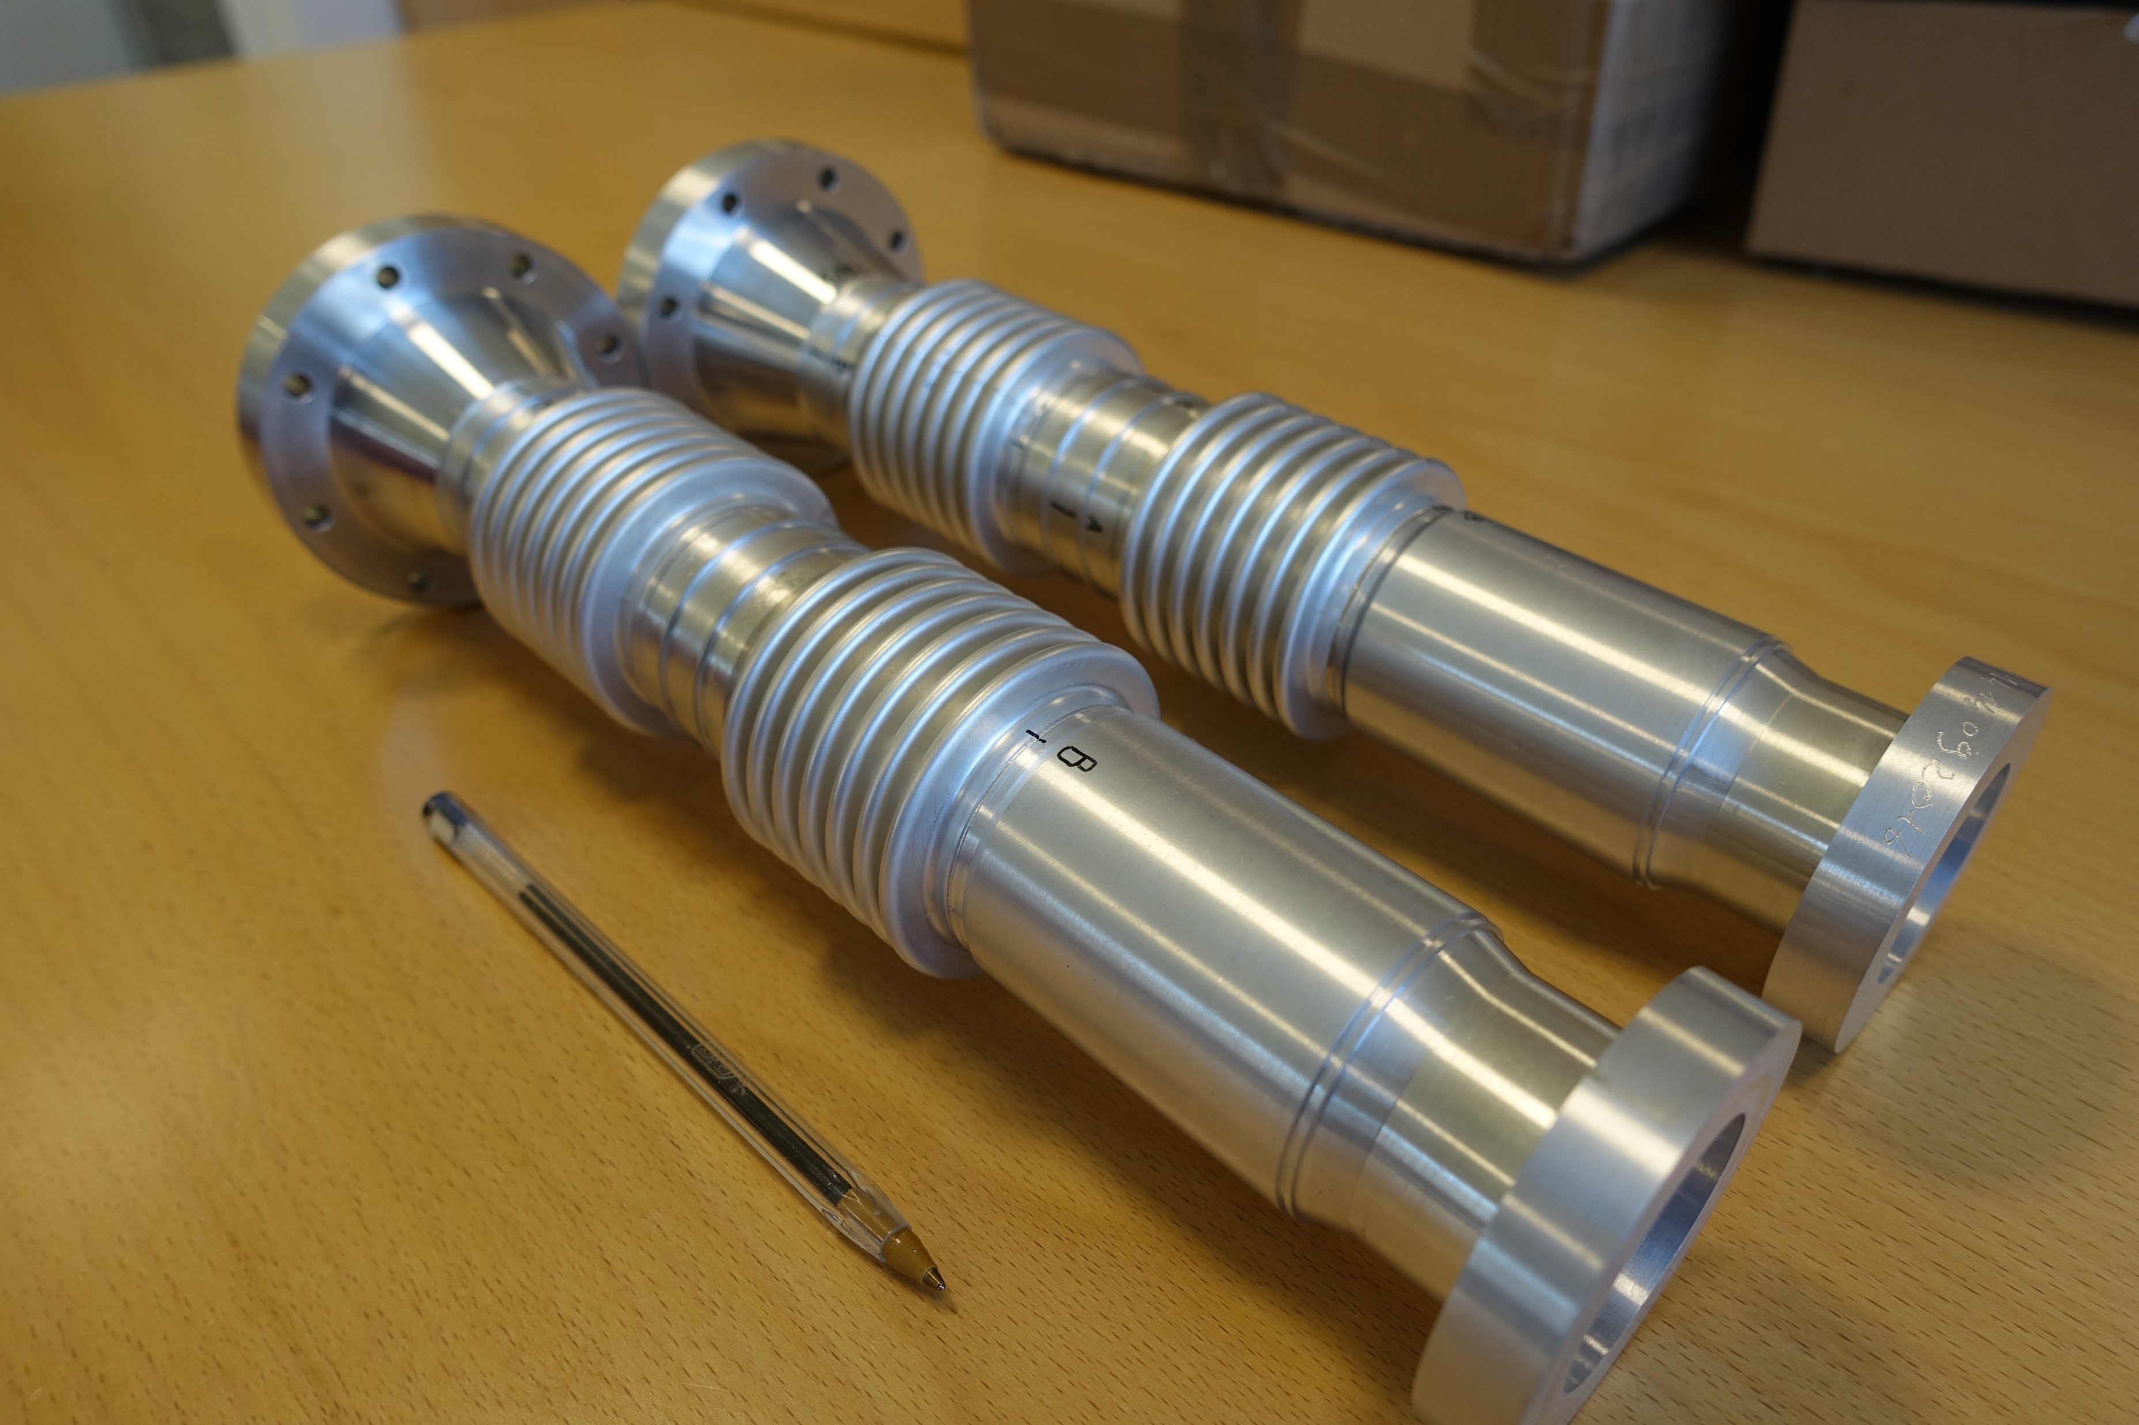
Double Aluminium Bellows for ALICE

Slide 10
Why this equipment shall be consolidated?
Reliability issues (recurring failures e.g. driving system, control system)
Safety issues (danger of catching or entrapment)
Compatibility issues with UHV applications (risk of oil pollution, air stream perturbation)
Refurbishment would not be adapted, decision to replace the equipment
No similar equipment available on the market → in house design and fabrication

Slide 11
Study of the new welding lathe
  Definition of technical requirements
  Standard components research
  Design of 3D model
  Integration of safety aspects

Slide 12
Technical Requirements
Mechanical Characteristics:
Welding lathe shall have a synchronized a double rotary system to avoid a twist effect
The system shall guaranty a very good alignment between components to be welded
Compression device ensuring contact of the pipe before welding and allowing free dilatation and shrinkage during welding
Aperture diameter of motorization need to be large, more of 310 mm
Shall be compatible with existing clamping tools
Brackets shall be movable to allow extraction of chambers with specific shape
Dimension of base : 3500 mm x 600 mm x 400 mm
Height of the welding rotation axis: 1200 mm

Slide 13
Technical Requirements
Operational Characteristics:
Compatibility with various welding sources
Welding lathe shall be compatible with UHV requirements
Shall be operated by one or two operators in direct contact with the moving parts
Possibility to work with one or two rotary system
Shall be easy to operate; intuitive HMI interface

Slide 14
Call for tender motorisation + HMI
Technical Specification Supply of two of High Accuracy Large Aperture EDMS 2616612
DO-33019
Mechanical Characteristics
External dimensions | Maximum 550 mm x 550 mm x 120 mm
Aperture | Minimum 310 mm
Type of motorization | Direct-drive (permanent-magnet synchronous motor)
Positioning accuracy | ≤ ± 10 µrad
Bidirectional Repeatability | ≤ ± 5 µrad
Load capacity | Radial: ≥ 250 kg at 100 mm from the faceplate Axial: ≥ 250 kg
Maximum Torque | ≥ 200 Nm
Speed range | From 0.04 to 32 rpm
Position feedback | Incremental Encoder
Compact motorisation
Large aperture
High accuracy

Slide 15
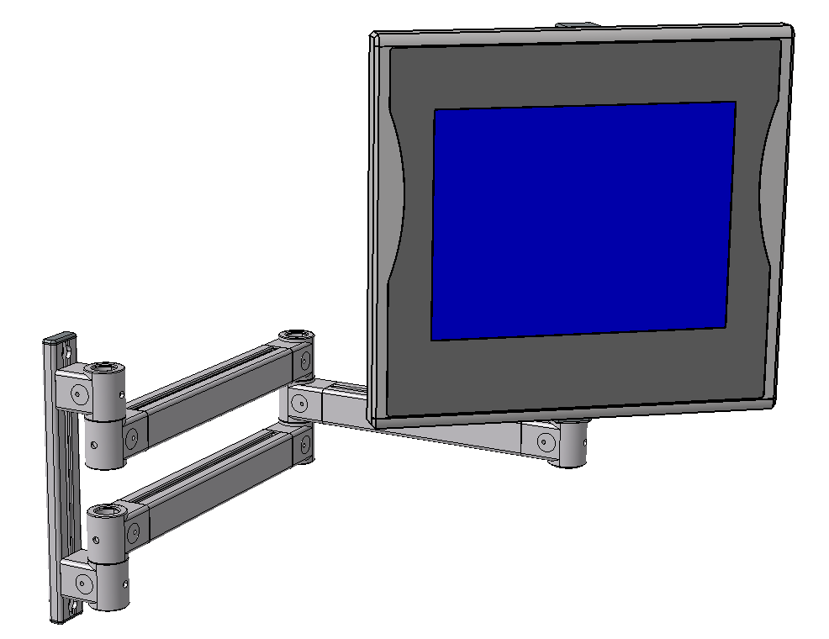
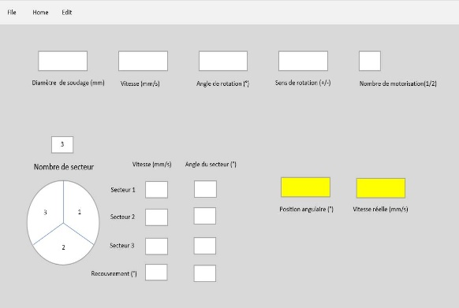
Human Machine Interface (Hardware)
Control panel with the following features:
  Two Emergencies stop buttons;
  A start cycle button;
  A stop cycle button;
  A potentiometer to adjust the rotation speed;
  A home button to return to home position;
  A Joystick to rotate the selected Stage(s) in a direction specified by the button.
Emergency stop
Joystick for manual rotation
Start cycle
Computer screen
/ HMI Tactile
Stop cycle
Home

Slide 16
Human Machine Interface (Software)
  A simplified graphical user interface operating the controller. The screen shall include the following functions:
    Saving and loading of programs
    Welding diameter display and input
    Speed display and input;
    Angular position display and input;
    Selection of motor (left, right or both)
    A sector graph enabling variable speed for up to 8 sectors with the following information and inputs:
File
Home
Edit
Welding Diameter (mm)
Speed (mm/s)
Rotation Angle (°)
Direction (+/-)
Number of motor (L, R, Both)
3
Nombre de secteurs
Sector 1
3
1
Sector 2
Angular Position (°)
Real Speed (mm/s)
2
Sector 3
Over Lapp (°)
Vitesse (mm/s)
Angle du secteur (°)

Slide 17
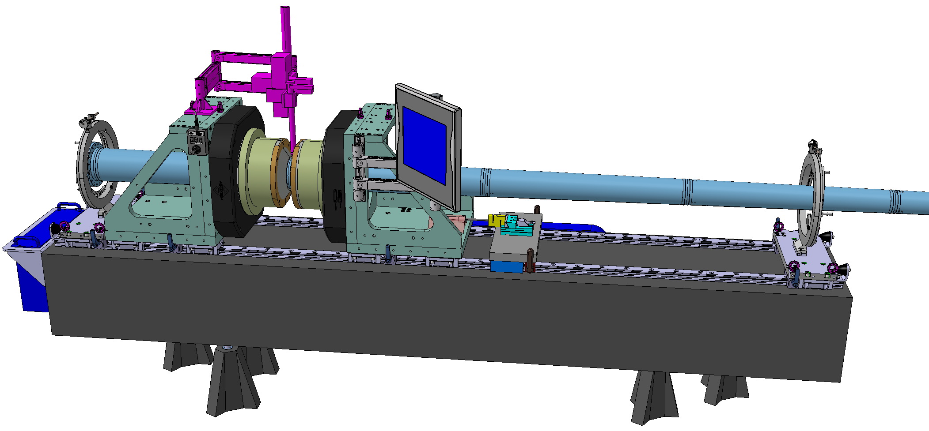
Design of a new Welding Bench
Articulated arm with a welding torch
and his setting system
Adjustable compression device
Centering tool
Centering tool
Two rails with 14 trolleys
Two adjustable mounting brackets
Granit base

Slide 18
Design of a new Welding Bench
Two synchronised motorisations
Articulated arm or pedestal with a HMI interface
Rack with controllers

Slide 19
Questions

Slide 20
CE Certification Process

Slide 21
CE Certification Process
  Risk analysis
  Risk mitigation and implementation in design
  Manufacturing of the welding lathe
  Drafting of the instruction manual
  Final conformity check
  CE Certification provide by CERN
  Decision to be assisted by a Notified Body : DEKRA

Slide 22
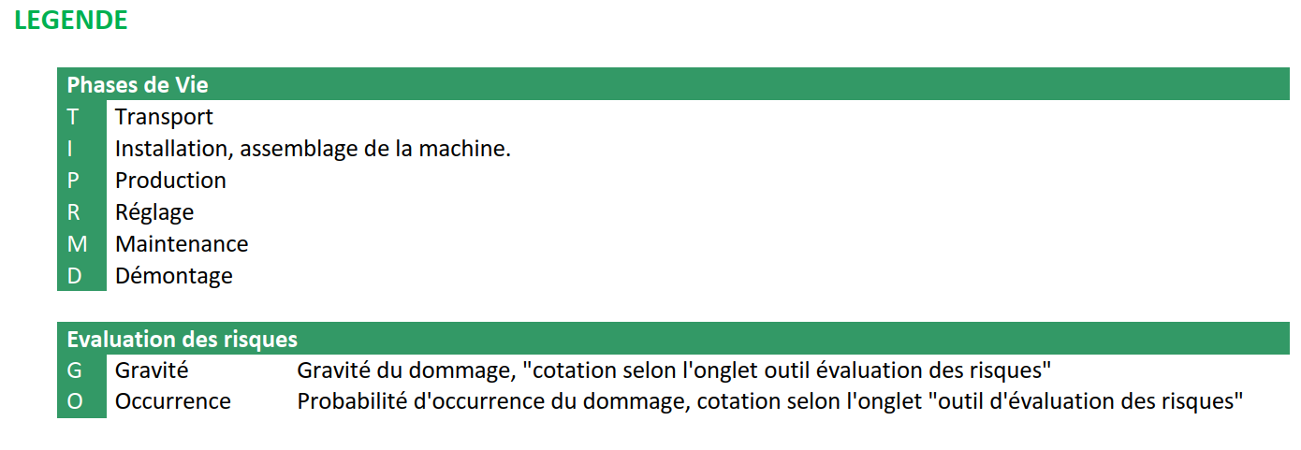
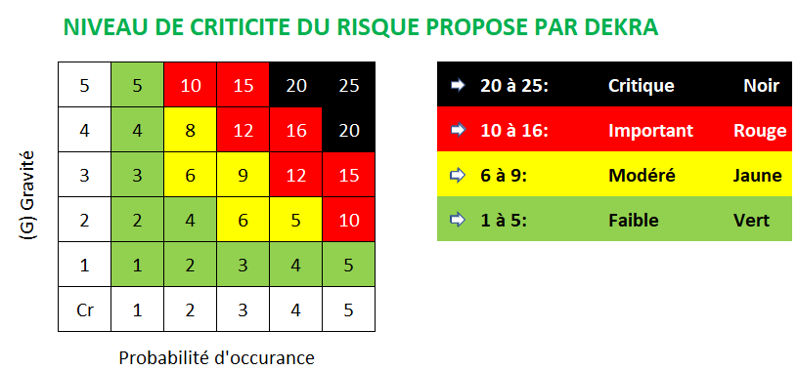
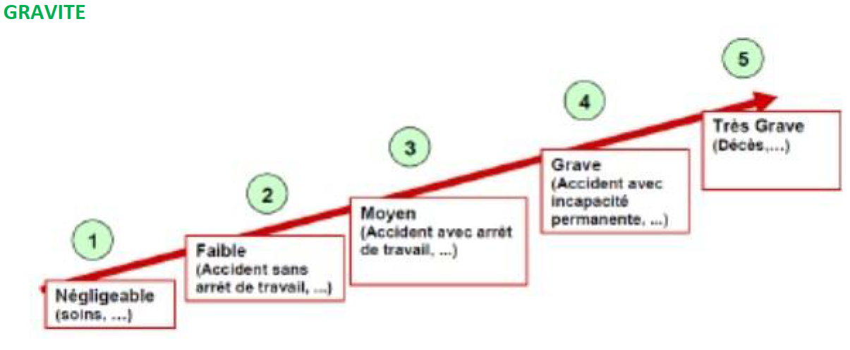
Risk Analysis
    Risk analysis EDMS 2664483 “DEKRA report”

Slide 23
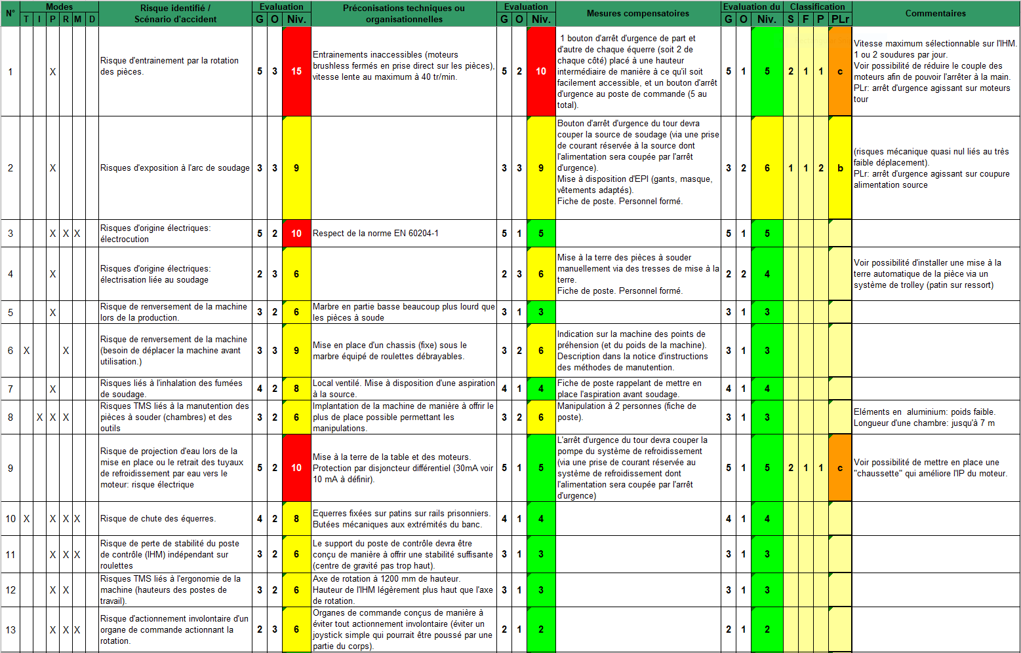
Risk Analysis

Slide 24
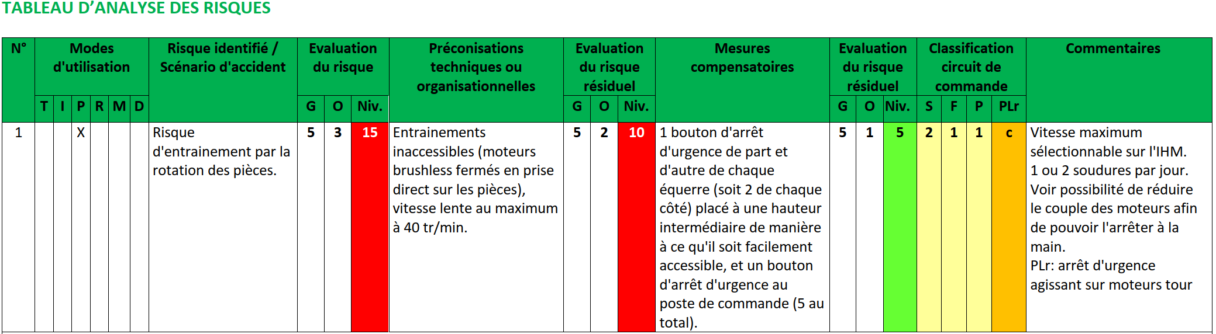
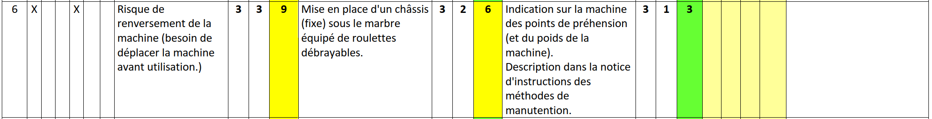
Risk Analysis: highlights

Slide 25
Where are we now?
  Risk analysis: done
  Risk mitigation and implementation in design: ongoing
  Manufacturing of the welding lathe
    Complete 3D design (already done at 90%), detailed drawings: to be done
    Call for tender for the Motorisation and HMI procurement: done
    Cost estimate 256 kCHF, in accordance with ACC-CONS budget
  Drafting of the instruction manual: to be done
  Final conformity check

Slide 26
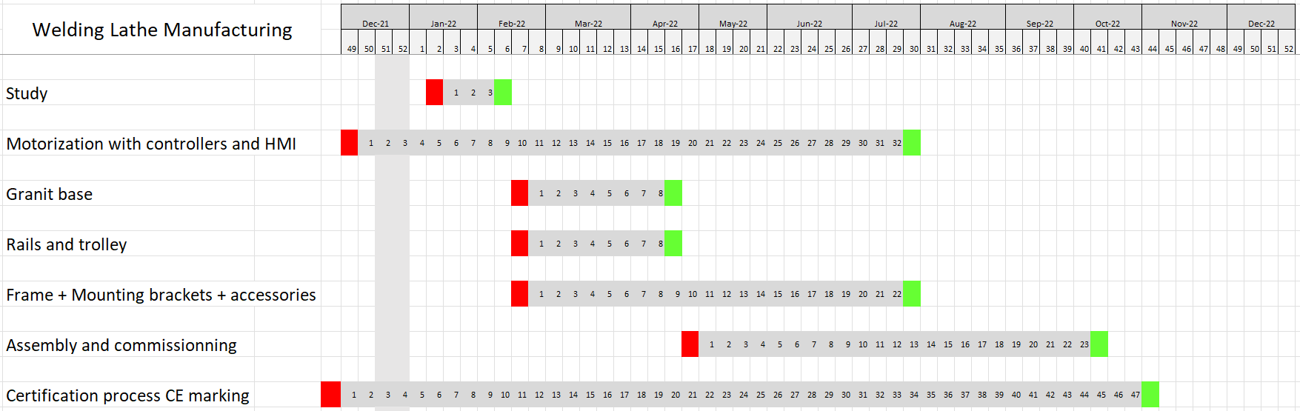
Planning of Manufacturing
In line with ACC-CONS schedule

Slide 27
Thank you

Slide 29
Cost of Fabrication
Study: 30,000 CHF
Motorization with controllers and HMI: 140,000 CHF
Granit base: 8,000 CHF
Rails and trolley: 8,000 CHF
Frame + Mounting brackets + accessories: 50,000 CHF
CE Certification process including DEKRA support: 10,000 CHF
Welding lathe assembly & commissioning: 10,000CHF
Total cost: 256,000 CHF
In line with ACC-CONS budget

