Slide 1
Design Review
Manufacturing of an automated welding bench for UHV aluminium chambers assembly
G. Favre (EN-MME-FW)
26th November 2021

Slide 2
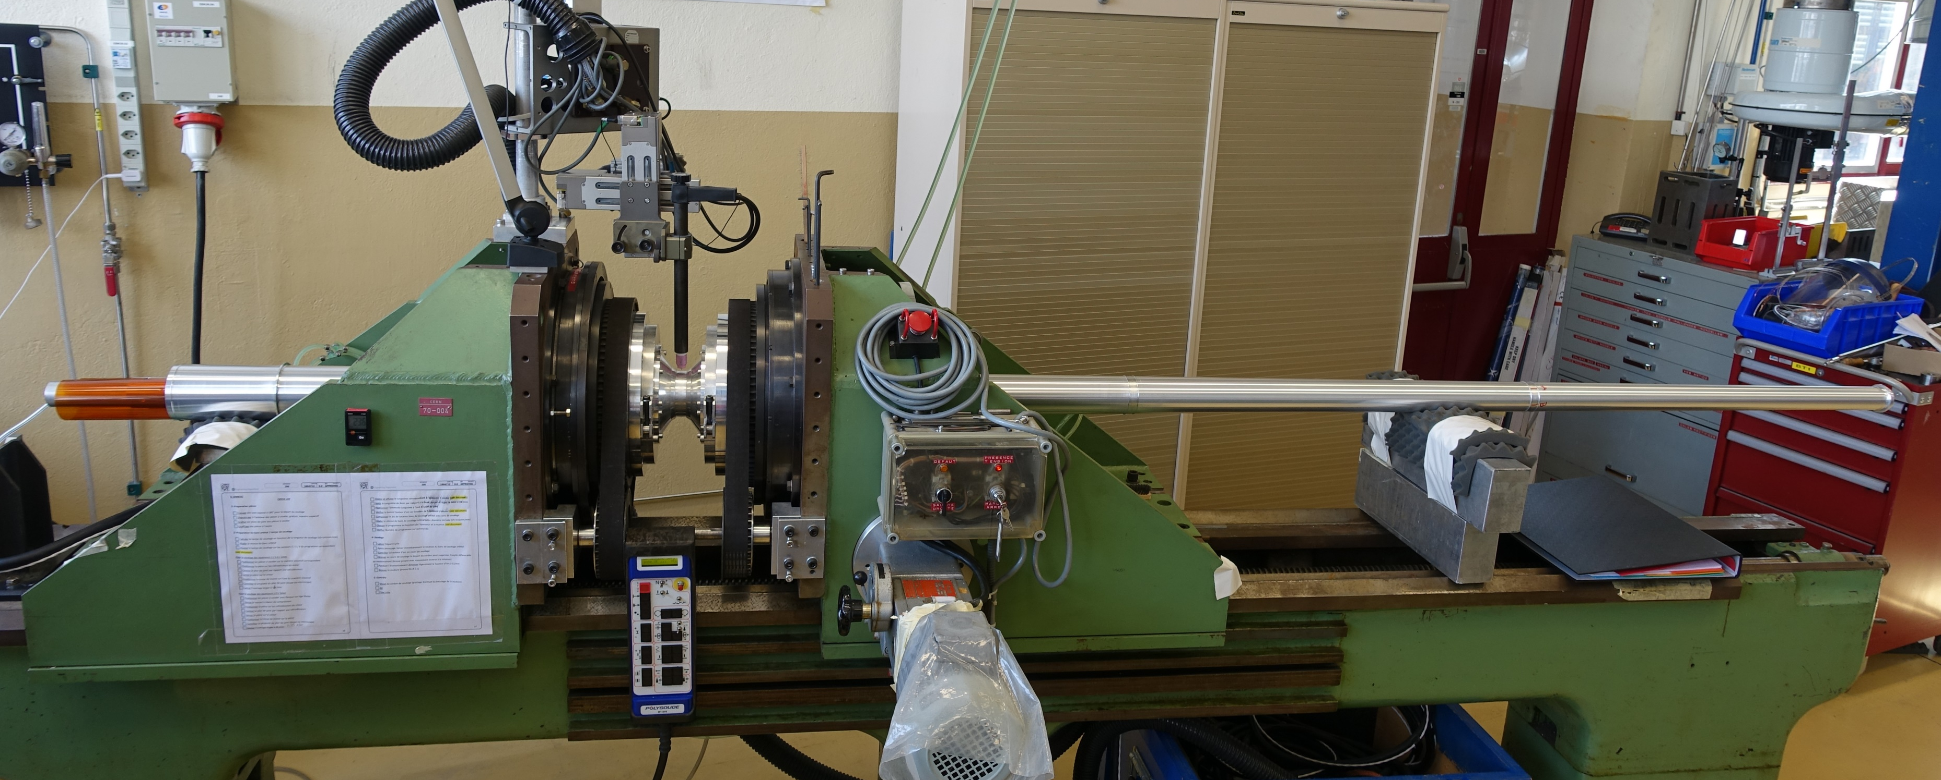
Objective and requests
The Committee is requested to conduct a Design Review for the manufacturing of a welding bench
This project concerns the renewal of an existing automated welding bench in the framework of Accelerator Consolidation (ACC-CONS) plan
Manufacturing of the new equipment is foreseen in 2022
Existing welding bench commissioning 1960

Slide 3
Welding bench design reviewers
D. Foresy (EN-MME-FW) (Chair)
A. Bertarelli (EN-MME)
M. Garlasche (EN-MME-MA)
JP. Julien (HSE-OHS-IB)
J. Sestak (TE-VSC-BVO)

Slide 4
Reviewer’s charge
The main scope of the Design Review is to assess the readiness of the Project before launching the fabrication
The review panel is requested to:
  Analyze the proposed design of the new welding bench. A 3D design will be presented.
  Assess if the proposed solution will fulfill the requirements of the foreseen welding applications
  Identify any showstopper or missing aspect that might compromise the successful manufacturing and operation of the bench
  Make any suggestions and recommendations

Slide 5
Questions for reviewers
  Is the welding bench design appropriate to the welding applications to be performed with this equipment?
  Have the safety constraints been correctly taken into account to allow CE certification of the equipment?
  Are the cost and the manufacturing schedule realistic and in line with the objectives defined by the ACC-CONS plan?

