Slide 1
HTCondor Week 2022 Review to
WLCG Grid Deployment Board (GDB)
June 2022
Todd Tannenbaum
Center for High Throughput Computing
Department of Computer Sciences
University of Wisconsin-Madison

Slide 2
HTCondor Week History
Brings the HTCondor Community together
Annually each spring in Madison, WI
  Since 1993 - 22-year tradition!
Typical year pre-covid:
  3.5 days, ~100 in-person attendees
Yr 2020 and 2021 were virtual only
  Free event via WebEx / Zoom
  Shorter days (11am-4pm, combat screen fatigue)

Slide 3
HTCondor Week 2022: Hybrid!
First time ever: hybrid event
  In-person attendees : Conference center w/ snack breaks, lunch, social events
  Virtual attendees : Zoom
  3.5 full days, 9am – 5pm Mon/Tues/Weds, 9am-1pm Thurs
  All presentations streamed over Zoom and recorded, virtual attendees raised hands to ask questions via microphone

Slide 4
Attendees
174 registered participants
  63 in-person
  111 virtual
167 institutions represented
International participation
  23 attendees from outside USA
  12 distinct countries:
    USA, CSK, Germany, UK, Switzerland, Spain, China, Croatia, Austria, Belgium, New Zealand, Canada
  Most people know about the fall European HTCondor Workshops ?

Slide 5
Agenda
46 presentations via 42 different speakers over 3.5 days
Presentation Categories
  Introductory Tutorials (Mon AM)
  Advanced Tutorials (Mon PM)
  Keynote: Radio Astronomy (Tues AM)
  Technical Talks (Tues/Weds)
  Town Hall (End of day Weds)
  → Future of Computation: Needs and Trends
  Campus Research Talks (Thurs AM)
Social Events

Slide 6
(HT)Condor -> HTCSS
Researcher places workloads at an Access Point (AP)
Execution Point (EP) joins an HTCondor Pool
AP can use the capacity of an EP to execute a job
AP can delegate a job for execution by a remote batch system
AP + HTCondor Pool = HTCondor System
HTCondor CE, HTMap, …

Slide 7
An AP is (much) more than a SchedD!

Slide 8
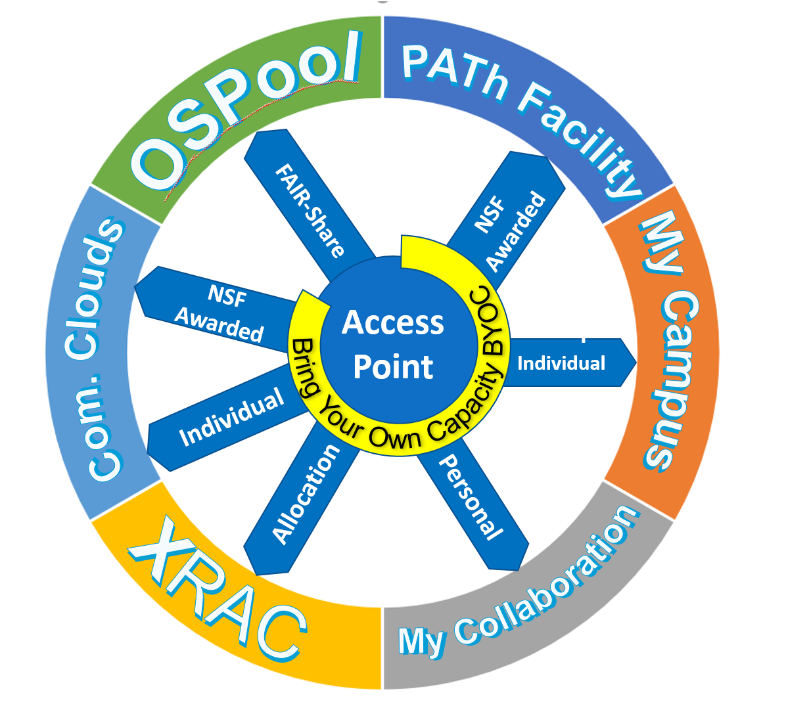

Slide 9
New in v9.0 for end-users
- Transfer job data to/from web servers, Box.com, Amazon S3, Google Drive, MS OneDrive via file transfer plugins now supporting uploads, authentication, and improved error handling
- Improved support for GPUs, including GPU utilization info and support for using GPUs in containers
- New condor_watch_q tool that efficiently provides live job status updates
- New tools and mechanisms to support jobs that checkpoint
- Fixed interactive submission of Docker jobs
- Many improvements to the Python API, including Python 3 support and new bindings for DAGMan and chirp
- DAGMan now provides a method for inline jobs to share submit descriptions
- You may now change some DAGMan throttles while the DAG is running
- You can assign priorities to DAGMan (scheduler universe) jobs
- And more…

Slide 10

New in v9.0 for sys admins
Fundamental security model changes:
- Secure by default
- Authorization via Tokens: IDTOKENS, SciTokens
- Oauth2 workflow to interoperate with other services
New packaging
  Native packaging has releases, release candidates, and daily builds
  Official containers on Docker Hub designed to work well with k8s
  Conda
Push job information into Elastic Search
More powerful classad transform language for HTCondor-CE, schedd
Dataflow mode for jobs
Container support improvements
Cgroup limit improvements
Cap the number of cores allocated to individual users
New platforms (e.g. EL8, Ubuntu 20)
And more…

Slide 11
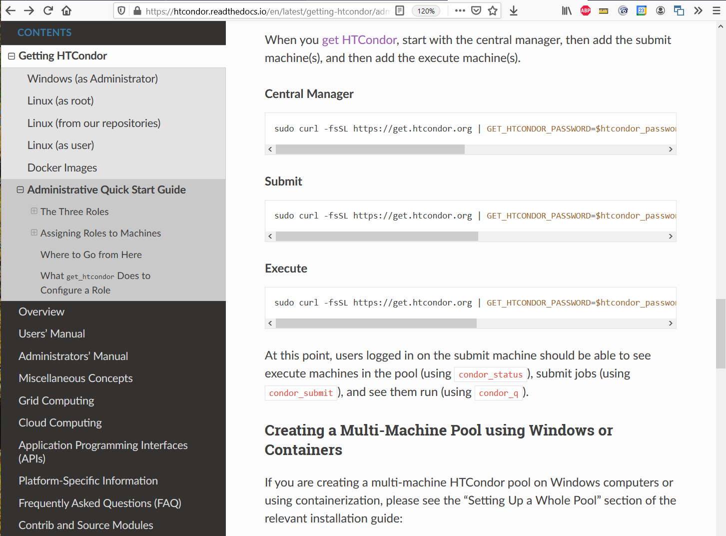
Fast "one-line" install & configure
Secure by default using tokens
Watch demo of install and setup in a three minutes (demo starts at minute 4:00):
https://youtu.be/BsE0xvts-iA

Slide 12
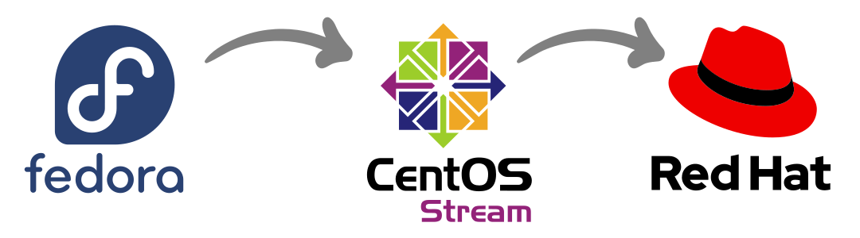
Upcoming OS and Architecture Support
Enterprise Linux 8 / Stream 8
ETA: Available Now
Currently based on Rocky8, planning to switch to Alma
ARM and PowerPC architectures
ETA: Summer
Enterprise Linux 9 / Stream 9
Challenges due to shifts in several libraries
(e.g. OpenSSL, cgroups)
Interoperability with HTCSS v8.x may be limited (upgrade to v9.x!)
ETA: End of the year

Slide 13


Containers
Docker and Singularity (Apptainer) support in HTCondor is very popular
BUT… does the user really care about the CR?
Current world order:
universe = docker
docker_image = Debian
Or
universe = vanilla
requirements = HAS_SINGULARITY == True
+SingularityImage = "/cvmfs/…"

Slide 14

New "Container Universe"
EP advertises container runtimes available, and uses whichever one can get the job done
New world order:
universe = container
container_image = /cvmfs/my/image/dir/
# Or container_image = docker://Debian
# Or container_image = myImage.sif
# Or container_image = http://xxx/image.sif

Slide 15
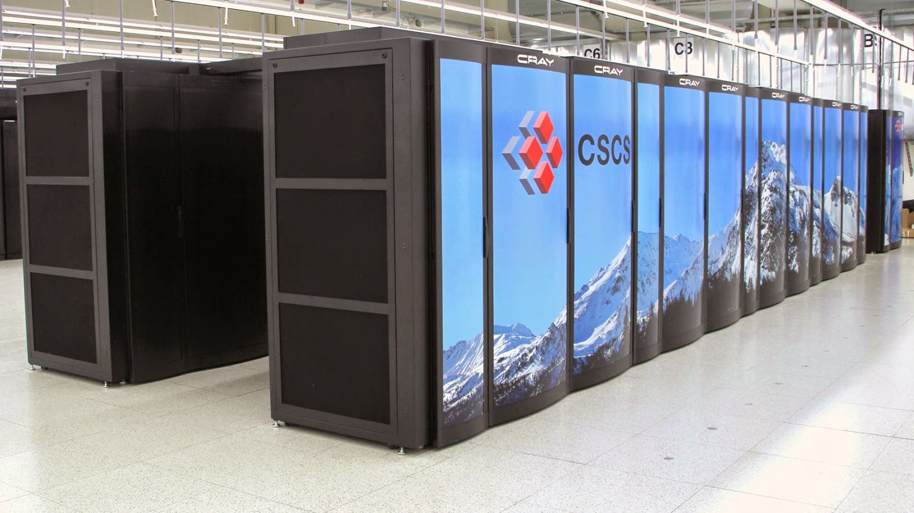
Bring Your Own Capacity
Add additional Execution Points that your Access Point can leverage to run your jobs!
Continue work on mechanisms to enable end-users to provision computing capacity from
  Local Clusters (e.g. campus Slurm HPC clusters)
  Clouds
  HPC Centers / Supercomputers
Run a job set as a campaign at an HPC site
  Now available for users in OSG OSPool
  More presentations and demos today and tomorrow

Slide 16


Security Enhancements
Host-based security is no longer the default. ☺
Turn-key installation with "get_htcondor" tool sets up all the security knobs for you
For IDTOKENS authentication, no longer need a signing key on every EP host in your pool
  EP belongs to a pool and trusts the Central Manager
  Central Manager can give capabilities for admin tools
TOFU ! "Trust on First Use" ability for SSL
Improvements against replay attacks

Slide 17
GSI to Tokens Transition
Grid Community Toolkit support is going away, so HTCSS use of GSI authentication phased out
  Use tokens instead (SCITOKENS, IDTOKENS)
  Full details here:
  https://htcondor-wiki.cs.wisc.edu/index.cgi/wiki?p=PlanToReplaceGridCommunityToolkit
Mostly done, a few improvements remain todo
NOTE: HTCSS will still delegate and manage an X.509 proxy with the job, but the GSI authentication method is gone from v9.4 +

Slide 18
HTCondor-CE Work
New syntax for writing job routes (classad transform syntax) has nice benefits including:
  Statements evaluated in the order the are written
  Use of variables that are not included in resultant job ad
  Use of simple case statements
  See https://htcondor.com/htcondor-ce/v5/configuration/writing-job-routes/
Mechanism for a (hosted) CE to access capacity needing 2fa
Ability for a job route to insert an IDTOKEN

Slide 19
Hybrid is here to stay
Instead of Zoom, maybe try Zoom Events next year
What about social events for virtual attendees?
Charge $ for virtual attendees?
Survey shows more "Beginners" attending HTCondor Week than in the past
Record Q&A sessions or not?

Slide 20
Links
HTCondor Week 2022 Indico Page
    https://htcondor.org/HTCondorWeek2022
Slides and Video Recordings
  From HTCondor Week 2022:
    https://agenda.hep.wisc.edu/event/1733/timetable/?view=standard
  From all past workshops:
    https://htcondor.org/past_condor_weeks.html
HTCondor Week 2022 in Photos
    https://htcondor.org/featured-users/2022-06-01-HTCondorWeek-Photos.html
Lots of Twitter Tweets about HTCondor Week 2022
    https://twitter.com/HTCondor
    For the month of May in the HTCondor Twitter account we posted 75 tweets, gained 9, 374 impressions and picked up 15 new followers

Slide 21

Finally… Keep in an eye out for
European HTCondor Workshop Fall 2022
Thank You!
Follow us on Twitter! https://twitter.com/HTCondor
This work is supported by NSF under Cooperative Agreement OAC-2030508 as part of the PATh Project.

