Slide 1
https://indico.cern.ch/e/tCSC-Security-2022
Sebastian Łopieński
CERN School of Computing director
GDB meeting, 13 July 2022
https://indico.cern.ch/event/1096032/

Slide 2
Introduction to
CERN School of Computing

Slide 3



CERN’s mission
Innovation
Education
CERN
uniting people
We are here
Research
?
Discovery
Accelerating beams
(accelerators)
Detecting particles
(experiments)
Large-scale computing (analysis)

Slide 4
A school with a long history
The school was created in 1970
  43rd edition in 2022
2900 students of ~80 different nationalities
have followed the school
  usually 60-80 per year
  alumni web site: https://cern.ch/CSC/history/alumni/
The school has visited 22 countries
  https://cern.ch/CSC/history/past-schools/
  recent: France, Romania, Croatia, Israel, Spain, Belgium, Greece, Portugal, Cyprus

Slide 5
Mandate and mission
Create a common culture in scientific computing
among young scientists and engineers involved
in particle physics or other sciences,
as a strategic direction to promote mobility
and to facilitate the development of
large computing-oriented transnational projects.

Slide 6
Bridging science and computing
Technological evolution in computing empowers science
  especially in data-intensive domains such as High Energy Physics
  computing is the main strategy for many scientific fields
  to do research efficiently on a large scale
It is nowadays essential that:
  scientists master computing technologies
  as a main tool for their research
  computer engineers understand the scientific needs
  in order to deliver computing services to research projects

Slide 7

Academic dimension
CERN School of Computing…
is not a conference
  lecturers do not present their work
  or promote their projects
is not a training session
  not a replication of training courses
  available at home institutes or online
  focus on persistent knowledge,
  less on know-how
Training
Programme
C++
Java
Python

Slide 8
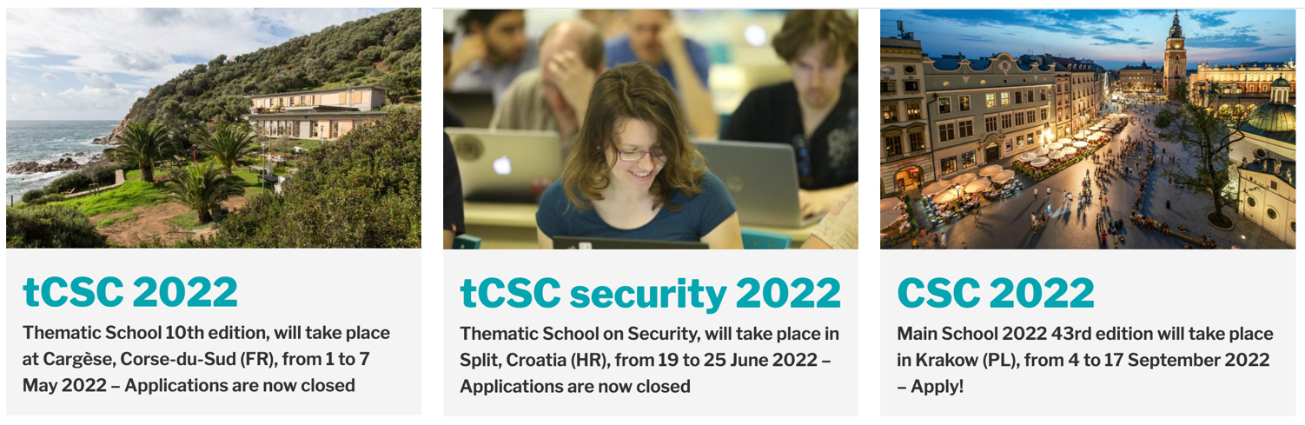
Three CERN Schools of Computing

Slide 9
Thematic CSC on Security 2022

Slide 10
Security CSC 2022
Applications → student selection
June 19-25, 2022 (Sunday to Saturday) at MEDILS institute, Split, Croatia
  Sunday afternoon: arrival and informal welcome, visit of Split city
  Monday to Friday: official opening, lectures and exercises
  Wednesday afternoon: excursion / outdoor acitivty
  Saturday morning: departure
Lectures and hands-on exercises: ~30 hours in total
  including a guest lecture, student lightning talks etc.
Exam → diploma
Optional social and sport activities
Registration fee: 550-750 EUR (covers acommodation, meals, tuition, activities)
  depending on the accommodation (twin vs. single rooms, place)

Slide 11
Programme committee https://indico.cern.ch/event/1106023/page/24209-programme-committee
Ian Collier UKRI-STFC
David Crooks UKRI-STFC / EGI CSIRT / IRIS CSIRT
Sven Gabriel Nikhef / EGI CSIRT
David Groep Nikhef
David Kelsey UKRI-STFC
Sebastian Lopienski CERN / CSC
Hannah Short CERN / GÉANT GN4-3
Romain Wartel CERN / WLCG

Slide 12
Topic and target audience
CERN School of Computing “Security of research computing infrastructures”
The programme of this school is targeted at people working in academia and research institutes, who as part of their job need to ensure security and resilience of computing resources they manage, and want to be prepared to detect and handle possible security incidents:
service managers and service providers of distributed scientific computing infrastructures, both from IT departments and from experiments,
people in charge of deploying cloud services used by scientists,
security professionals, who would like to expand their knowledge in a more holistic fashion.

Slide 13
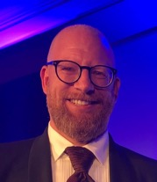
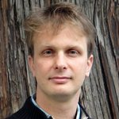
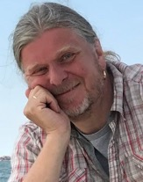
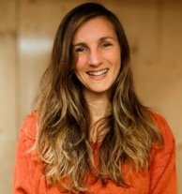
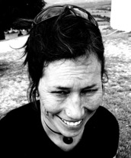
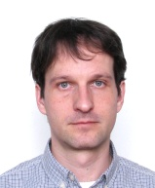
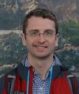
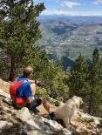
Lecturers https://indico.cern.ch/event/1106023/page/23919-lecturers
Stefan Lüders
CERN
Sebastian Łopieński
CERN
Sven Gabriel
Nikhef, the Netherlands
Hannah Short
CERN
Barbara Krašovec
ISJ, Slovenia
Daniel Kouřil
CESNET, Czech Republic
David Crooks
UKRI-STFC, UK
Romain Wartel
CERN

Slide 14
Programme https://indico.cern.ch/event/1106023/program
Introduction Security in research and scientific computing
Security operations
Track 1: Protection Identity, authentication, authorisation
and prevention Security architecture
Vulnerability management
Application security and penetration testing
Track 2: Detection Logging and traceability
Intrusion detection with SOC
Track 3: Response Introduction to forensics
Incident response
Coordination of security incidents
30 class hours
Lectures and exercises,
but also
group discussions
and role-playing

Slide 15
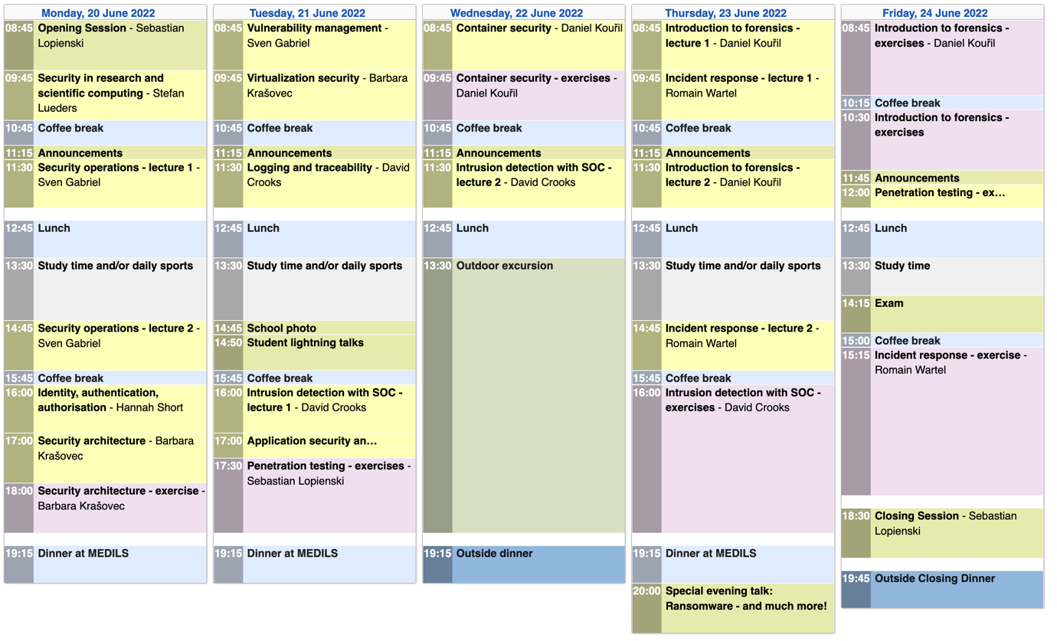

Slide 16
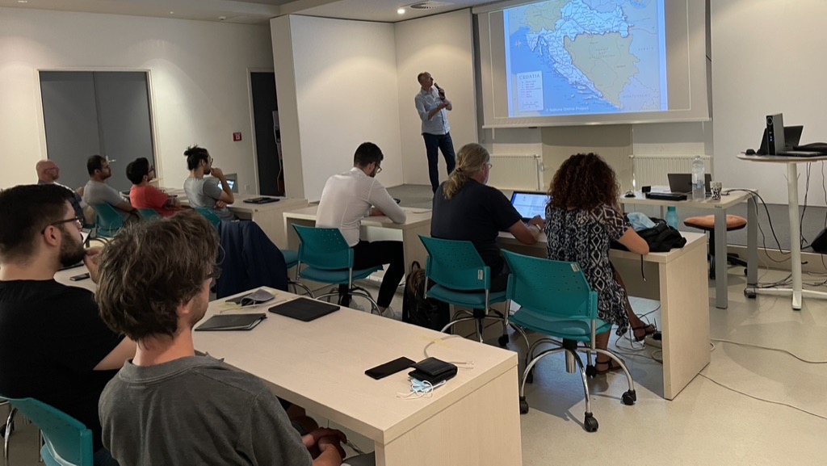

Slide 17
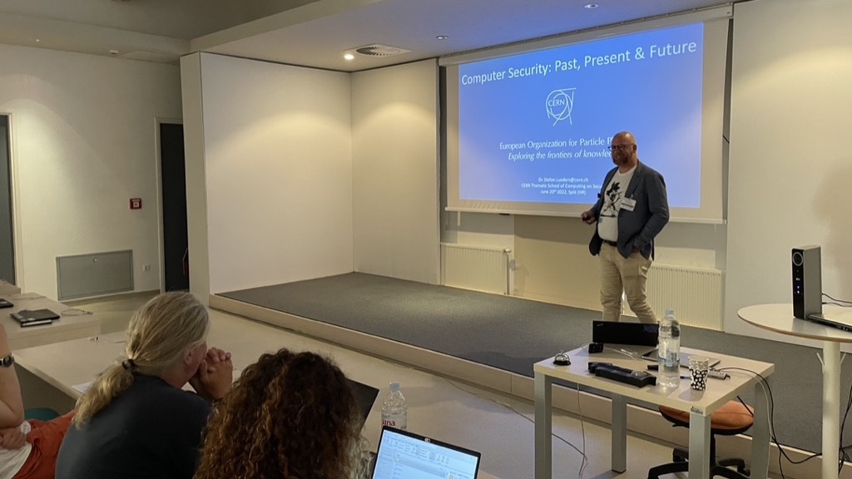

Slide 18
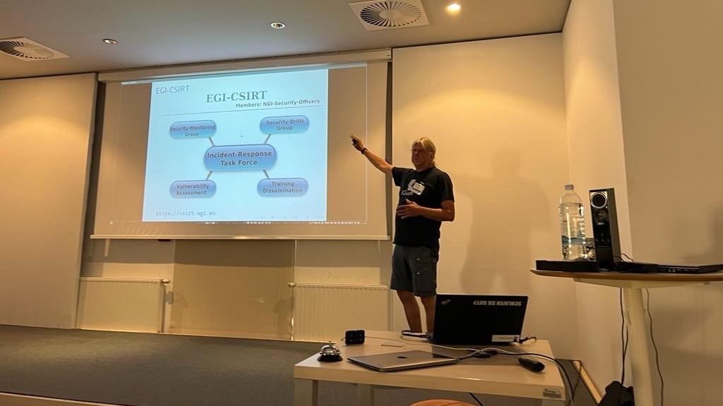

Slide 19
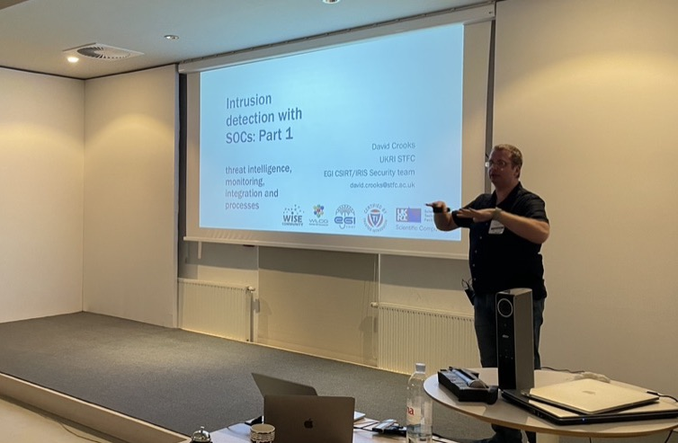

Slide 20
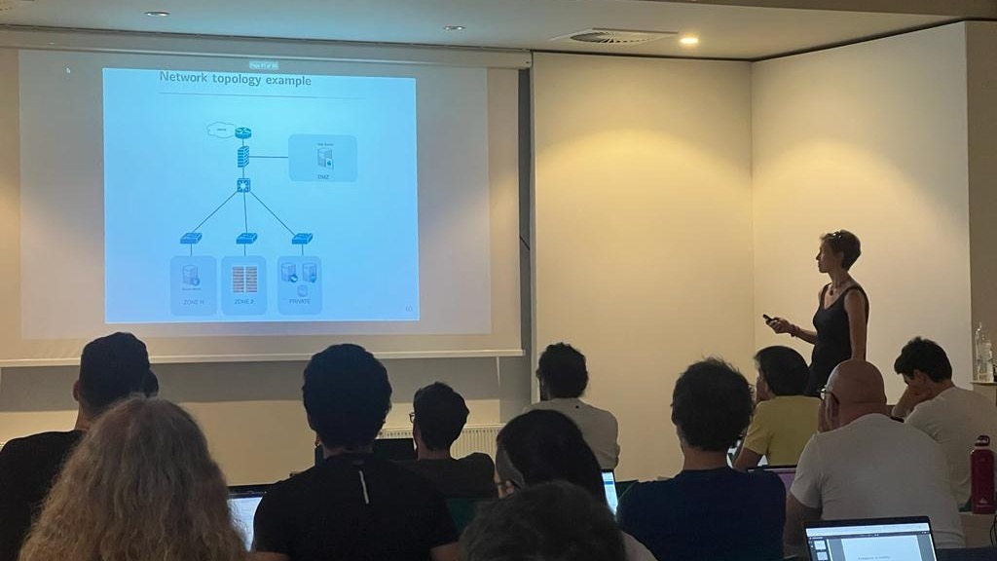

Slide 21
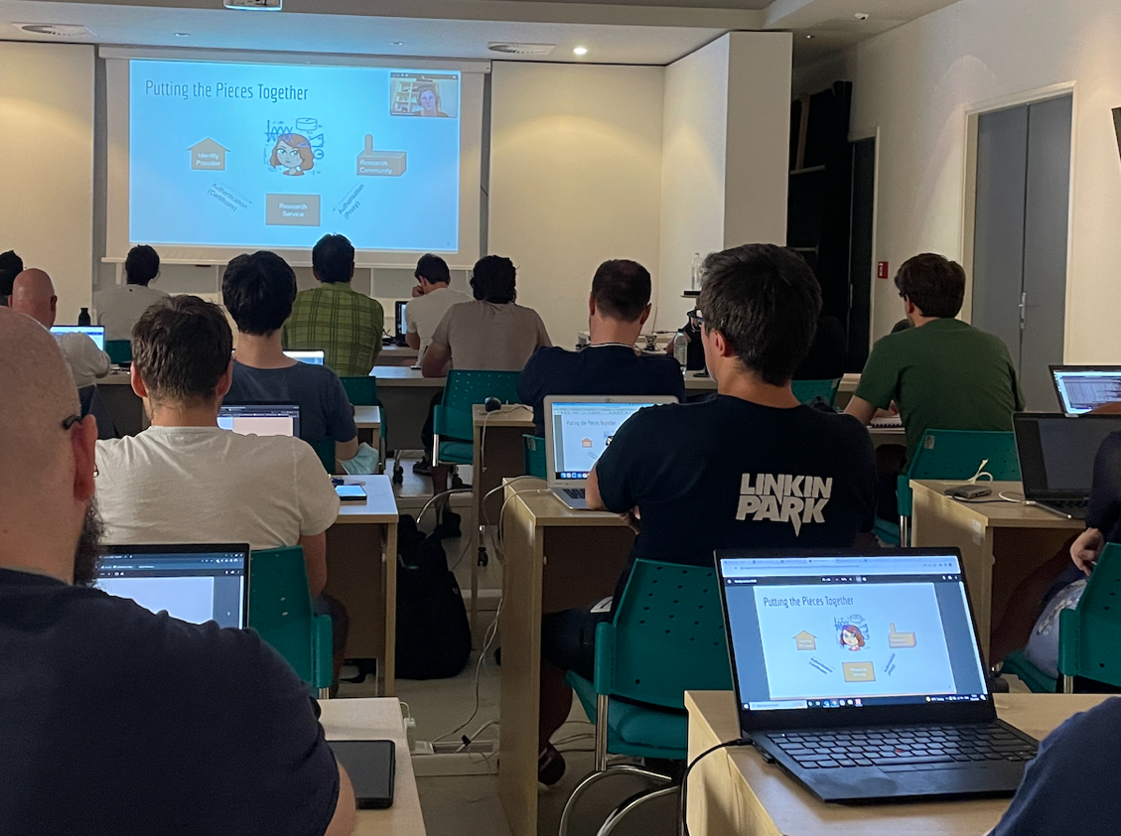

Slide 22
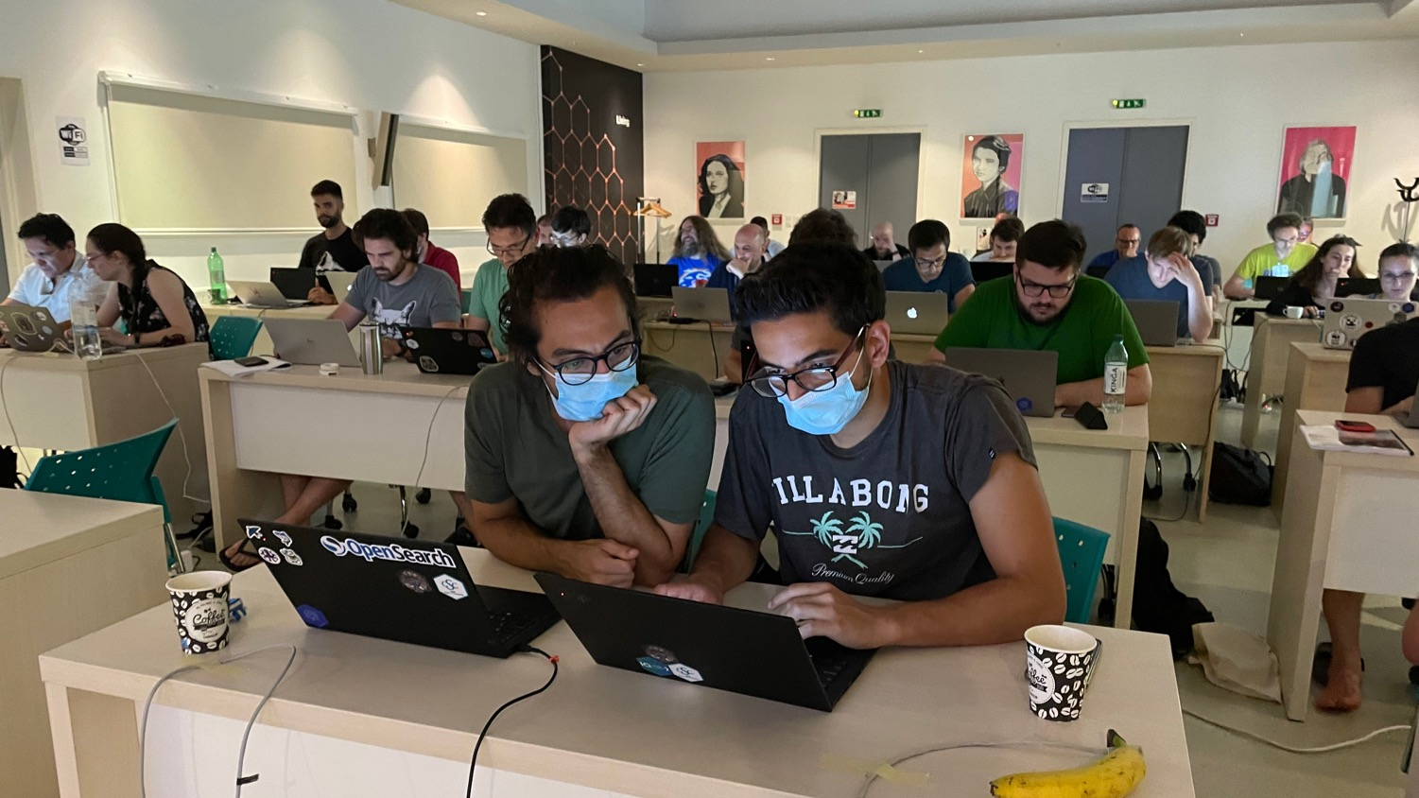

Slide 23
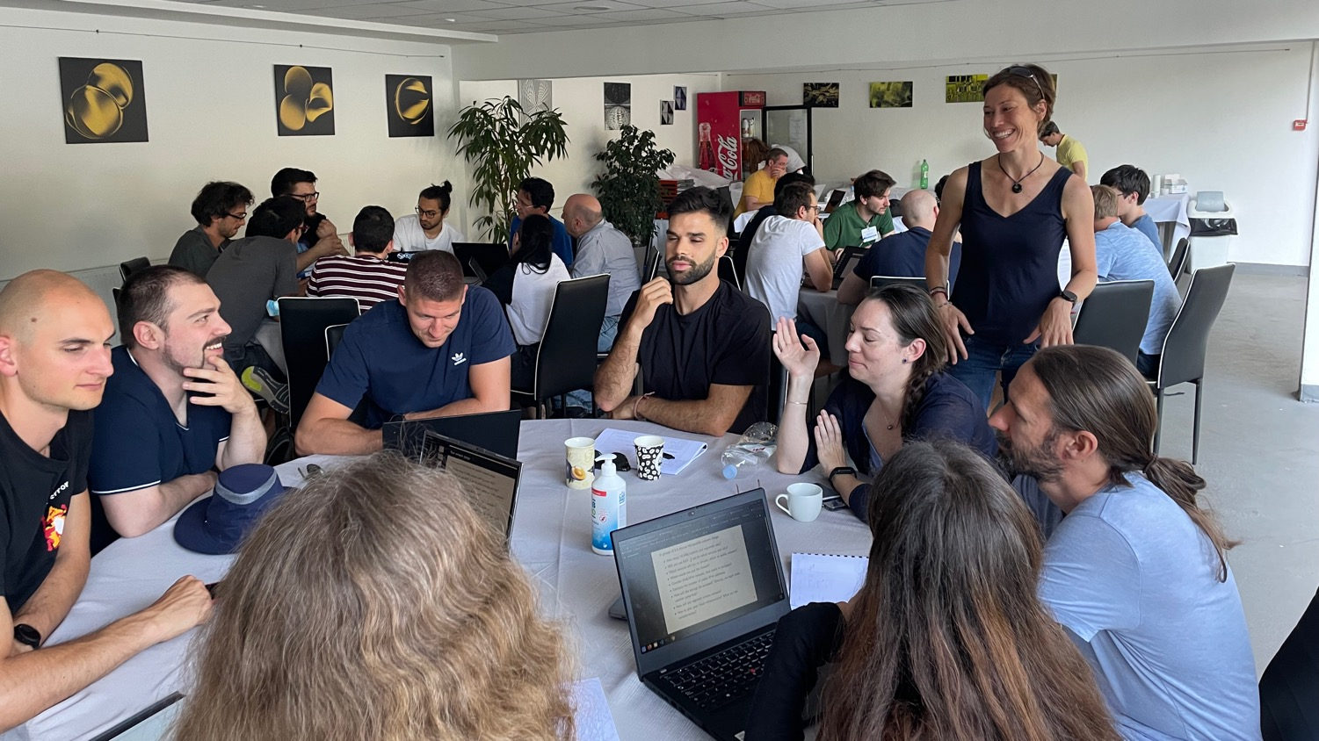

Slide 24

Participants https://indico.cern.ch/e/1106023/page/23920-participants
36 students selected and invited
(minus 3 late withdrawal)
18 different nationalities
5 female participants
20 different institutes
from 14 countries
27 different nationalities
9 female applicants
32 different institutes
from 20 countries
Diverse, talented, passionate about science and technology

Slide 25
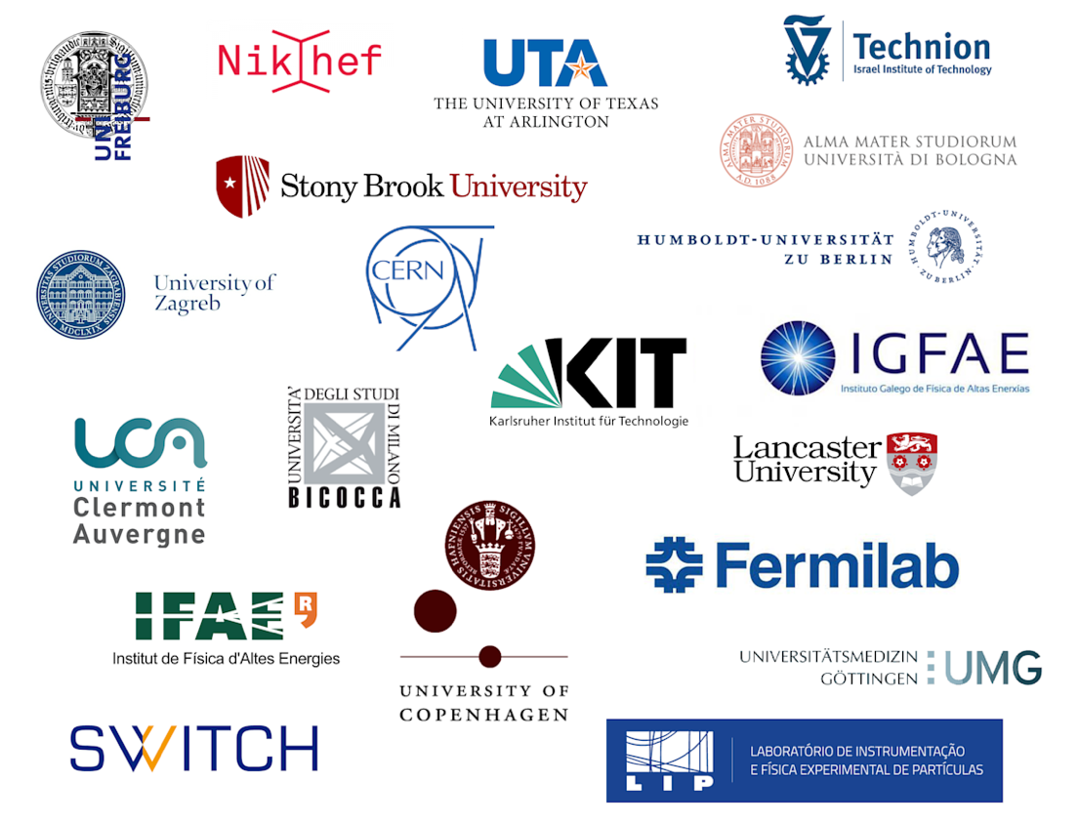

Slide 26
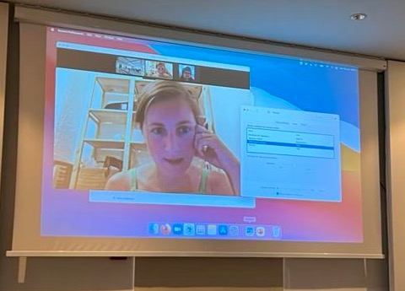
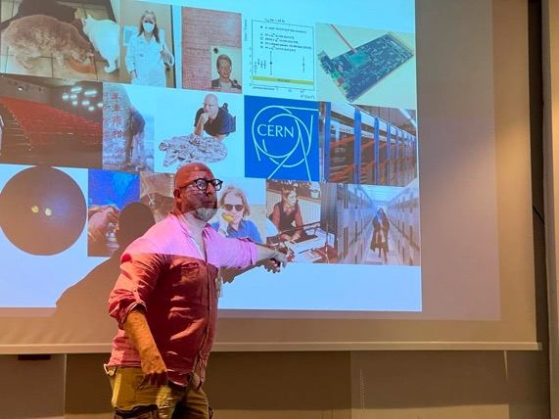
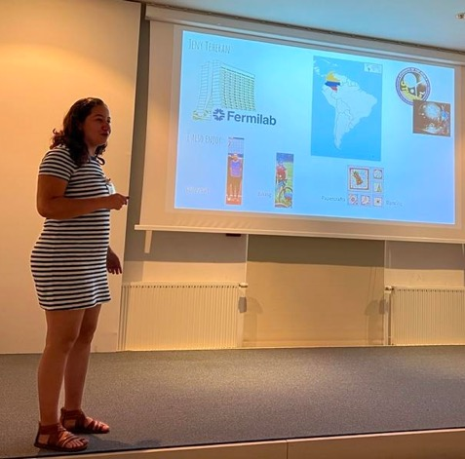
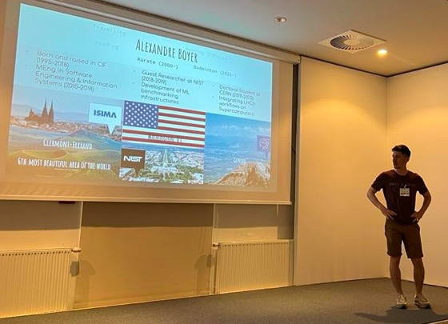
Self-presentation session

Slide 27
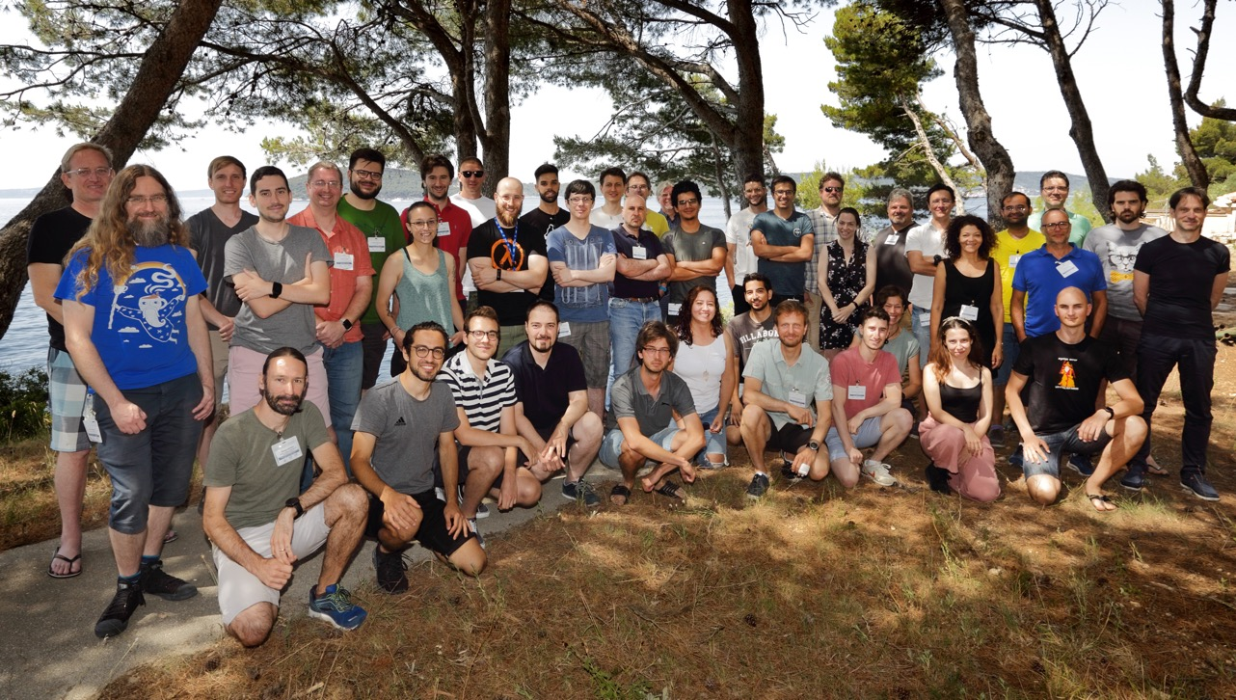
Security tCSC 2022 participants

Slide 28
tCSC on security 2022: Student lightning talks
Björn Leder (Humboldt University of Berlin, Germany)
"Why to hack your vacuum cleaner?"
Jack Henschel (CERN)
"Pulumi: Infrastrucutre-As-Actual-Code"
Jeny Teheran (Fermi National Accelerator Laboratory, US)
"Compute node scanning tool for Open Science Grid"
Brice Copy (CERN)
"Software supply chain security"
Luca Giommi (University of Bologna and INFN, Italy)
"Machine Learning as a Service for High Energy Physics"
Pau Cutrina Vilalta (CERN)
"Cyber threat vectors in the space industry"
Andrei Dumitru (CERN)
"Dark Patterns"

Slide 29
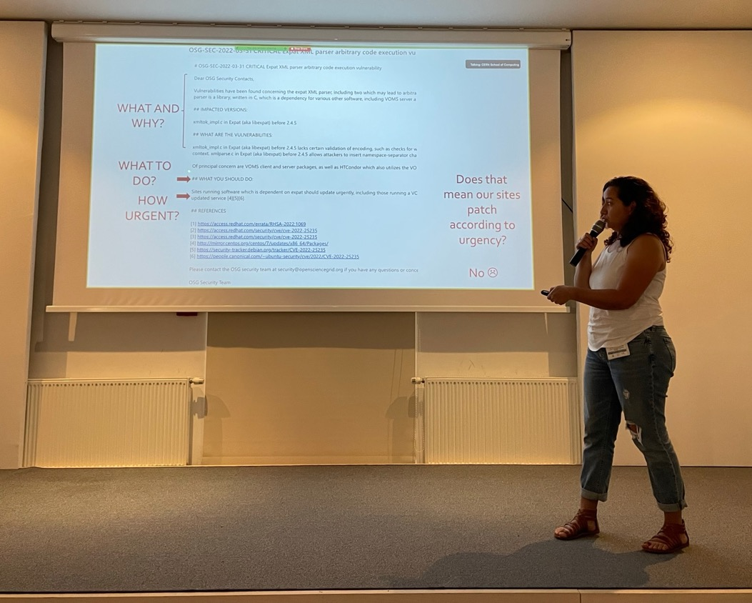

Slide 30
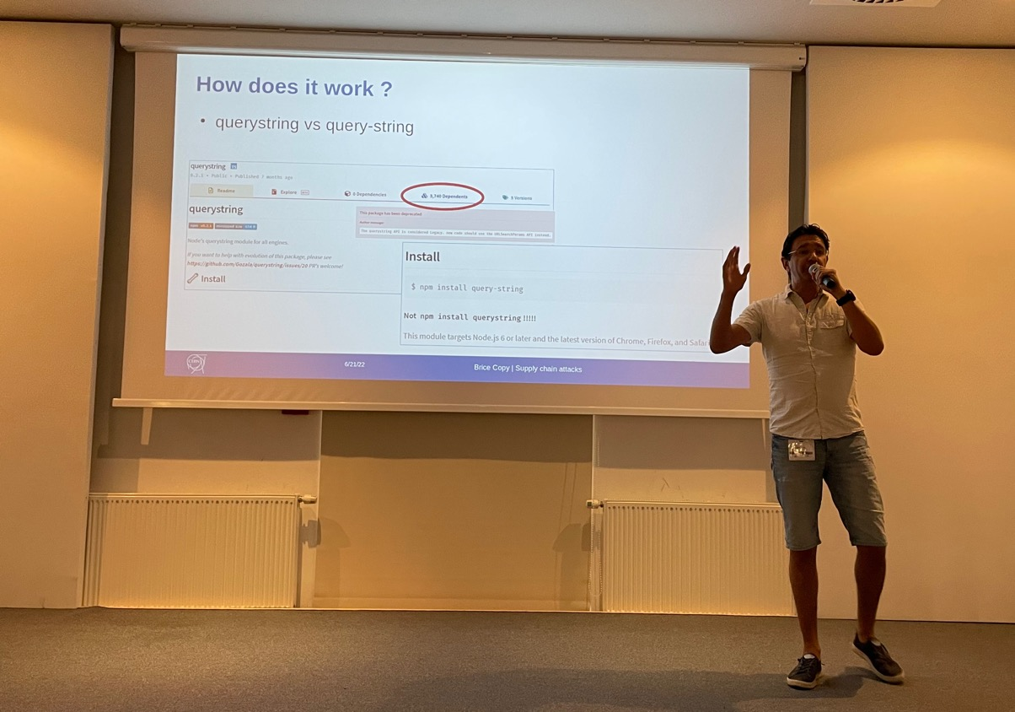

Slide 31
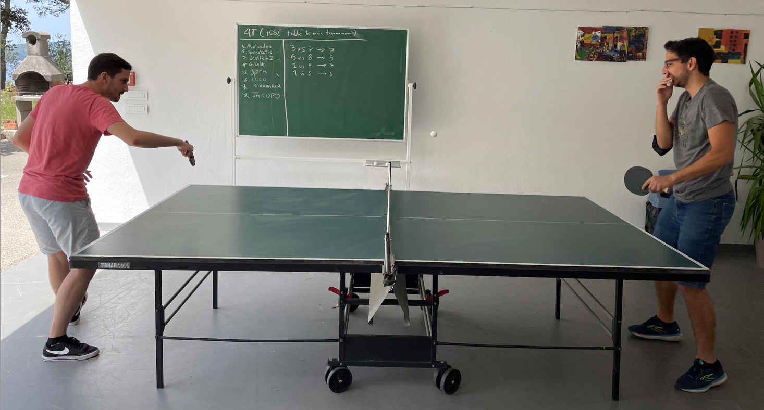

Slide 32


Slide 33
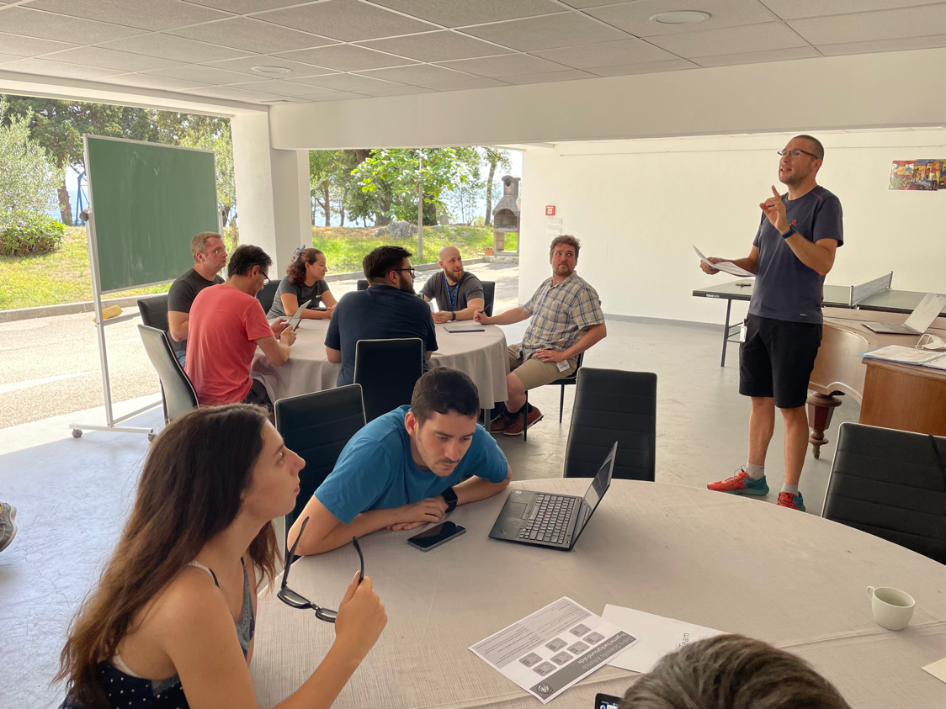

Slide 34
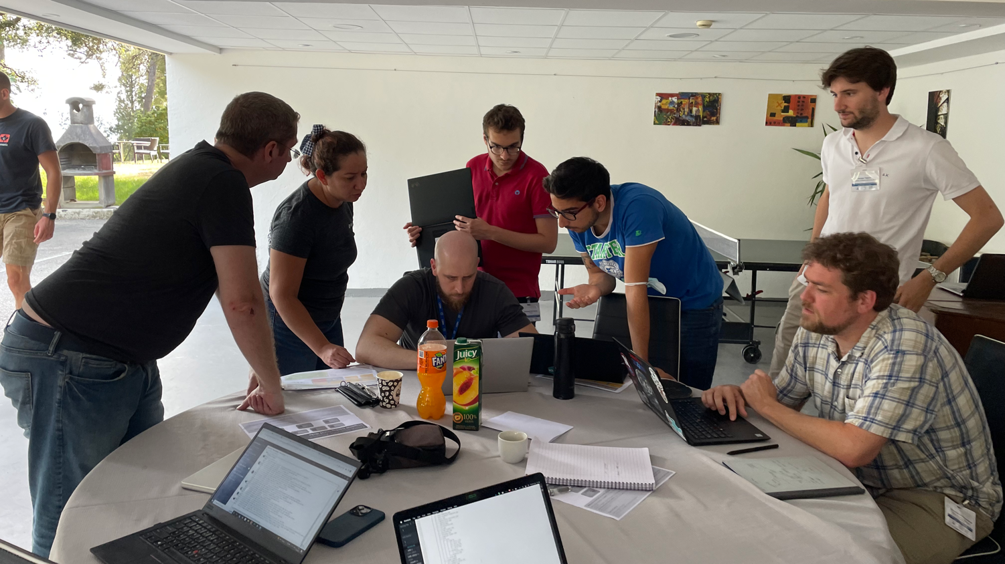

Slide 35
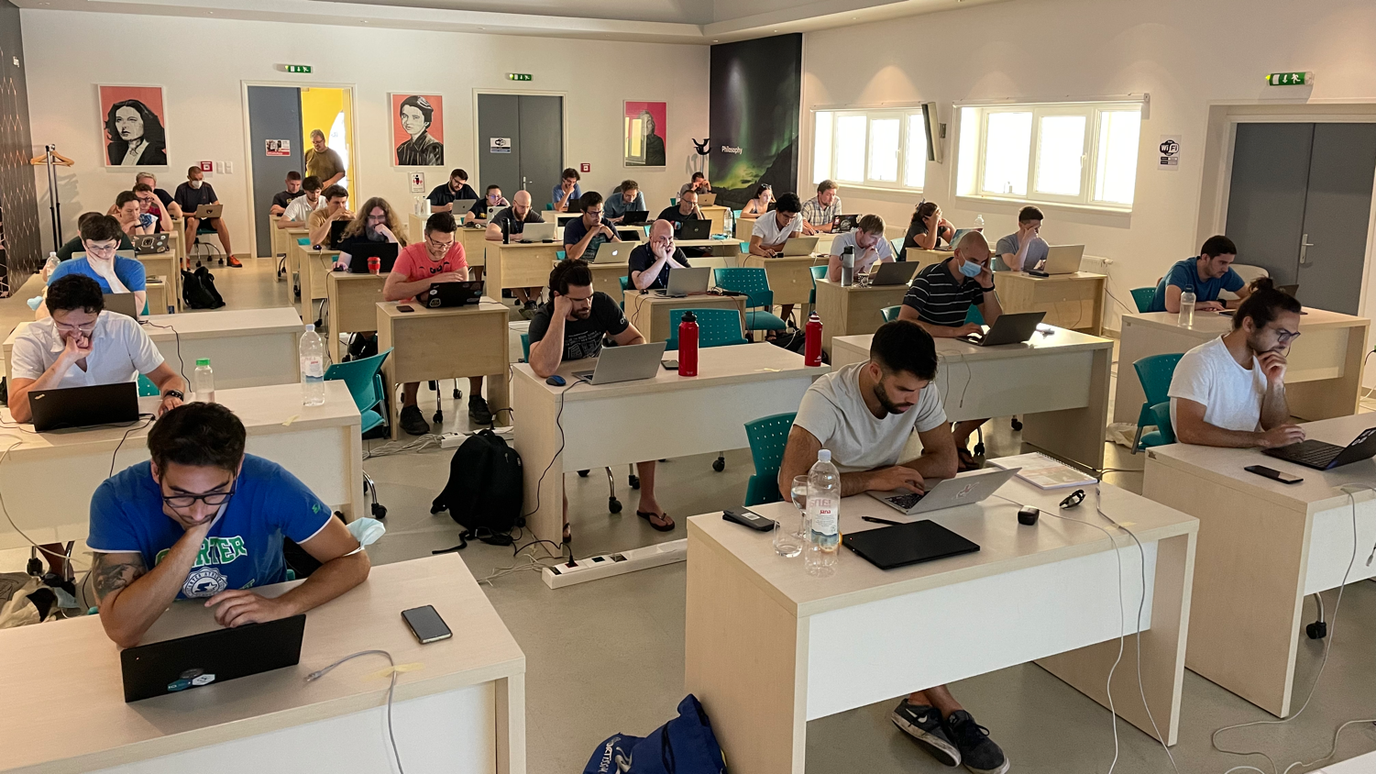

Slide 36


Local organizers

Slide 37
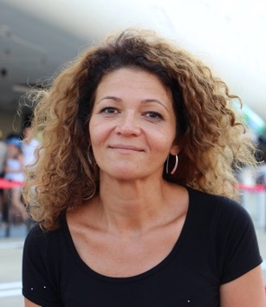
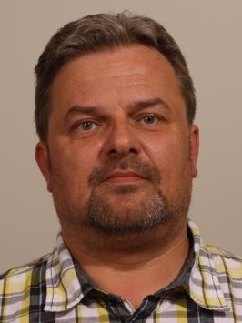
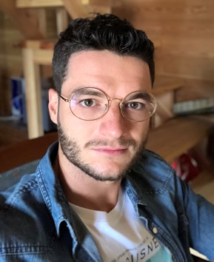
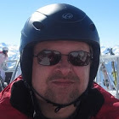
CSC Organizers https://indico.cern.ch/event/1106023/page/23921-organisers
Joelma Tolomeo
Administrator
Jarek Polok
Technical Manager
Sebastian Łopieński
Director
Toni Šćulac
Local Organiser

Slide 38
Summary
The first Thematic CSC on Security
An ambitious and exciting academic programme
Lots of interest from the community (HEP and outside)
  2 x more applications than places available
Lots of interactions, discussions and networking
  between the students and with lecturers
Very good feedback (programme, format etc.)
The plan is to organize this school regularly
  every year, or every two years (depending on the resources)

