Slide 1
ARC7 features and release plan
July 13, 2022 GDB
Balázs Kónya, Lund University
NorduGrid Technical Coordinator

Slide 2

Previous ARC major release: ARC6
ARC 6, May 2019: lots of backward incompatibility
  ARC.CONF
  Event-driven internal job loop
  Re-engineered RTE framework
  ARCCTL utility
  Accounting system changes
  ARCHERY
Postponed to ARC7
Completion of the tech preview solutions: REST Interface, Internal Interface,Python LRMS,Candypond service
Any major work on the client-side
Embracing non-x509 security trends
Controldir restructuring
Phasing out gridftp and glue-1
Better error messages

Slide 3
Since then on the ARC6 code line... several releases came out
Switching from ARC5 to ARC6
  was painfull but not that bad
ARC5 reached its end-of-life in 2020
  although we still provide some „minimal operation site support”
„Only” ... regular bug fix and enhancement releases on the ARC6 code line:
  6.1 June 2019, . ... 6.15.1 March 2021
  6.4: introduction of a new accounting subsystem
  6.6: OIDC tech preview release
  6.8: removal of the pre 6.4 accounting subsystem
  6.8.1 express release (fix for a too strict validator option)
  6.9.0: REST tech preview re-implemented
  6.10-DO-NOT-USE RELEASE
  6.15.1 python3 related fix

Slide 4
Development targeted for ARC7
ARC 7 as the next major ARC Release
  Backward incompatibilities are allowed
  One can remove not-used components, obsolete interfaces
„Final”, production version for the REST interface
Production OIDC support as to satisfy the WLCG experiments... (?)
Major internal ARC CE restructuring (controldir, scalability)
Lots of discussion to drop-not to drop gridftp jobsubmission and/or LDAP infosys from ARC7

Slide 5
ARC7: REST CE interface
REST specification
  www.nordugrid.org/arc/arc6/tech/rest/rest.html
  API endpoint: https://arc-ce.example.org:443/arex/rest/1.0/<functionality>
  Supported functionalities: info, delegation, jobs
    post <base>/jobs?action={new,info,status,kill,clean,restart}
    get <base>/jobs/<job id>/session/<file>, <base>/jobs/<job id>/diagnose
  V1.0 spec is complete and „closed”, already since ARC 6.9 release
    All defined functionality got implemented as part of ARC CE (server-side)
    The code is released and enabled as a technology preview within 6.9
    The ARC client SDK and the „arcsub” CLI supports REST
  REST is used in production
    ATLAS sites enabling REST on ARC-CE: http://novastore.farm.particle.cz/ce/arc-rest/
REST in ARC7:
  Intensive testing (stress tests): ACT (25-30 Hz bulk submission), DIRAC, Condor teams
  V1.1 specification extension: queue parameter, better support for bulk jobs, and token-delegation may need additional changes
  ARC7 will support both v1.0 and 1.1
  Switching from gridftp/emies to REST as the default and only ARC CE job management interface!

Slide 6
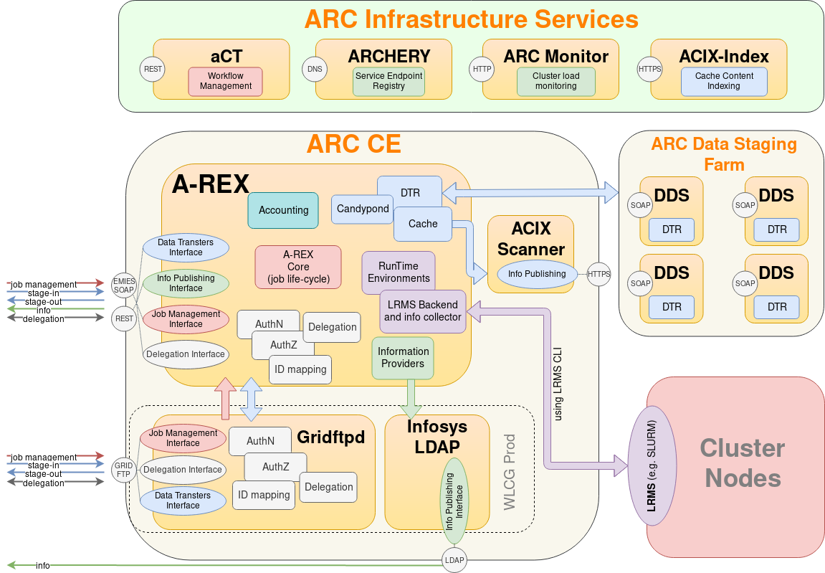
ARC CE interfaces in ARC7
REMOVED
DEFAULT
REMOVED
DEPRECATED

Slide 7
Tokens in ARC7 (support for OIDC)
Not a new feature in ARC7
  technology preview of the handling of OIDC tokens, ARC 6.6, April 2020
Need a third-party tool to obtain a token and store it in „BEARER_TOKEN” variable
Tokens can be used as a replacement of x509 for authenticating against ARC-CE
  But: data staging still requires x509 proxies
Tokens-based server-side authorization and user identity mapping on the ARC-CE
  Tokens are processed by ARC-CE by enabling [authtokens] config block
  „Token information” can be used in server-side authorization and identity mappings: subject, issuer, audience, scope, group
ARC-CE and HTCondor token hackathon, Amsterdam
  Any necessary code change will be included to ARC7
TESTING:
  Done: tokens conforming to the WLCG profile, Atlas and IAM (Petr Vokac)
  Soon: EGI profile with EGI Check-in as a token issuer

Slide 8
Controldir restructuring in ARC7
A-REX stores information about jobs in files in the control directory
Previously all files were kept in one single flat directory: scalability isssue with 100k jobs
ARC7 introduces a hierarchy of subdirectories:
  jobs/SUBID/SUBID/SUBID/SUBID
  SUBID are arbitrary ASCII string which if put together form ID of the job.
  each SUBID consists of 3 lowercase+ hex symbols. But that may change.
Internal change, should not have any effect on 3rd party software
  All ARC internal components were ported to use the new structure (e.g. LRMS scripts, accounting, etc..)
  BUT: some site admins may have developed scripts against controldir files.... Those may be broken with ARC7

Slide 9
REMOVED or OBSOLETED in ARC7
gridftp interface on ARC-CE: both for job submission and as a storage element, data staging
  ARC7 will be „globus free”
EMIES as a job interface (older SOAP WS interface)
LDAP infosys is kept but to be marked as DEPRECATED
ACIX component
LRMS-ssh backend, Python LRMS scripts
Support for python2
Use C++11
Support for every interface (both job and infosys) in the ARC7 client except the REST

Slide 10
REMOVED or OBSOLETED in ARC7
Smaller features, options to be removed from ARC7:
Glue1 schema
Provisioning of the „Fake site-bdii” instance
Support for Argus
Nordugridmap-like gridmapfile generation
Resubmit option in xrls should be retired (related to the accounting and diag file discussion)

Slide 11
ARC7 compatibility statements
ARC7 packages and distribution will be very similar to ARC6, no major changes expected
  ARC7 packages in all distributions will be named arc7 in their package names
ARC7 configuration: no major changes, ARC6 config file will be compatible with ARC7 CE
  modulo discontinued blocks/functionality
Controldir restructuring is the major change in ARC7
  it is a transparent internal change within ARC7
ARC7 will deliver a REST-centric ARC CE with production-level token support.
Server-client compatibility, based on REST (ARC 6 and ARC 7):
  ARC6 clients will work with ARC7 CE-s (only via REST)
  ARC7 clients will work only with REST-based ARC6 CE-s.
  ARC7 server will be compatible with ARC7 and ARC 6 (REST) client, i.e. accept both REST 1.0 and 1.1
  Neither ARC7 server nor the client will support gridftp and LDAP

Slide 12
ARC7 Release timeline
Documentation branching for ARC7: done
Technical description of the restructured controldir is available: pending
Propose a working process for the branch(es) for the ARC7 release work: done
Controldir new structure is available /up-to-date/merged into the ARC7 branch: done
Bug review day, decide what to fix for ARC7: done
Testing campaign for both controldir structure and REST interface: started
Very first alpha for ARC7 is announced for developers: after summer
REST 1.1 defined and implemented: ongoing
All obsoleted components, code, library removed from ARC7 branch: after the summer
Upgrade procedure in place: early September
  No draining needed, the conversion happens by ARC automatically
First release candidate late September
ARC7 is announced 5th November 2022

Slide 13
Not for ARC7: ARC8 candidate content
LRMS Backend rationalizing, cleanup
Json as a supported job description language
REST-based webmonitor
Some replacement for ganglia
Containerized version of the ARC-CE REST only server
ARC storage element (drop-in replacement for gridftp-storage server)
Intelligent Garbage collector for controldir leftovers
LRMS error propagation
possibility to keep the *.errors file of jobs for sysadmin
Find some alternative to swig
Integrated own minimalistic internal task scheduler, an “ARC batch system”,
[lrms/slurm] [lrms/condor] etc configuration subblocks
Generalise the job concept so that ARC e.g. could handle data transfer jobs
Complete, powerful rest-based new generation client replacing the “old cli”
Support for “modern” openpbs/pro
A mechanism to blacklist DNs dynamically

Slide 14
Support statements for ARC6
No new feature development is planned or going on for ARC6 and no bug-fixing development will happen on ARC6 code base in the future except for security issues.
Security fixes for ARC6 will be provided till the end of <release-date+1 yr>.
Production sites already running ARC 6 will be able to get deployment and configuration troubleshooting help via GGUS till <release-date + 2 yrs>. This we call "operational site support".
ARC 6 will be available in EPEL 7- 9, in the future EPEL10, only ARC7 will be available. ARC 7 will be available in EPEL 7-9 with a different package name as arc7
  EPEL 7: arc, arc6, arc7
  EPEL 8: arc (arc 6), arc7
  EPEL 9: arc (arc 6), arc7 to-do rename to arc6
  EPEL 10: arc7

Slide 15
ARC FACTSHEET
Code:
  https://source.coderefinery.org/nordugrid/arc
Installable packages:
  Global Linux repositories (CentOS, Debian, EPEL)
  Upstream: http://download.nordugrid.org/repos.html
Documentation:
  ARC6: complete documentation online at http://www.nordugrid.org/arc/arc6
    Including tech specifications and internals such as the OIDC tokens and REST interface
  ARC7: will have its own documentation area, work started here: http://www.nordugrid.org/arc/arc7
Support:
  Dedicated skype support channel: https://join.skype.com/dyf3A6Uutjy2
  Email lists: nordugrid-discuss@nordugrid.org – generic, CERN e-group wlcg-arc-ce-discuss@cern.ch – WLCG-specific
  Own bugzilla and EGI GGUS: https://bugzilla.nordugrid.org; “ARC” unit in GGUS
Latest version: ARC 6.15.1
ARC7 pre-view: early autumn...

Slide 16
Summary
ARC 7: is going to be a SOFT major release
  Almost transparent for sysadmins!
New developments to be released with ARC7:
  either internal restructuring, improvements
  or already available on the ARC6-line as tech preview
ARC7 backward incompatibility is mostly due to
  OBSOLETED interfaces, components
ARC-CE from ARC7 will be a very clean single interface CE
  REST-only
Lots of cleanup, consolidation, internal improvements

