Slide 1
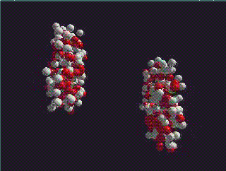
Heavy Ion Physics
Short overview by Urs for TH retreat
4 Nov 2010, Thoiry
How do collective phenomena and macroscopic properties of matter emerge from fundamental interactions?

Slide 2
QCD @ high temperature / density
Aim: calculate from 1st principles properties of QCD plasma
- Equation of state
Transport coefficients (viscosities, conductivities)
Susceptibilities
Relaxation times
…
Tools:
Lattice QCD at finite T
Wuppertal-Budapest,
arXiv:1005.3508,
arXiv:1007.2580
Finite temperature
perturbation theory
(for T >> T_{c} )
AdS/CFT correspondence to study properties of non-abelian plasmas
(not really QCD, but provides generic insight)

Slide 3
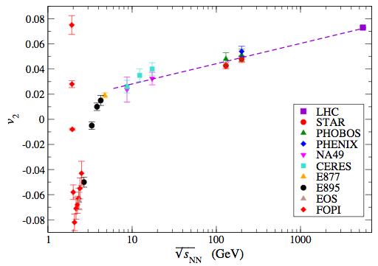
Heavy Ion Phenomenology: bulk evolution
Mean free path vs. collectivity
Theory tools:
Particle cascade
(QCD transport theory)
Dissipative fluid dynamics
Perfect fluid dynamics
Free streaming

Slide 4
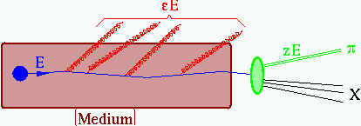
Hard Probes in Heavy Ion Collision
partonic energy loss
How does this radiation fragment/ propagate through the medium?
How does this parton
thermalize?
What is the dependence on parton identity?
Characterize Recoil: What is kicked in the medium?

Slide 5
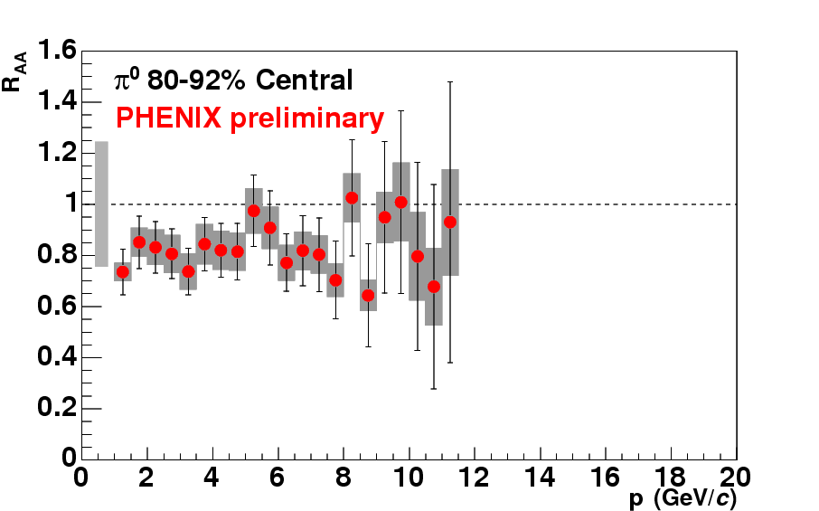
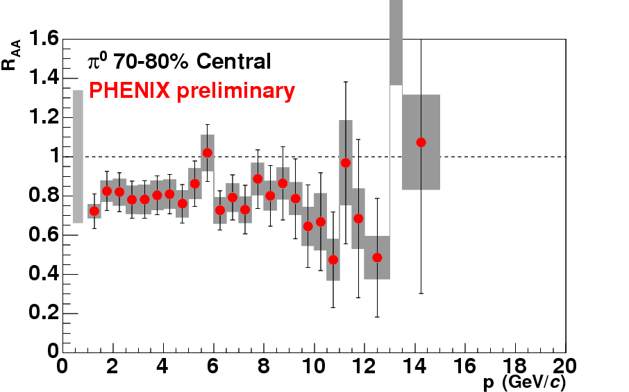
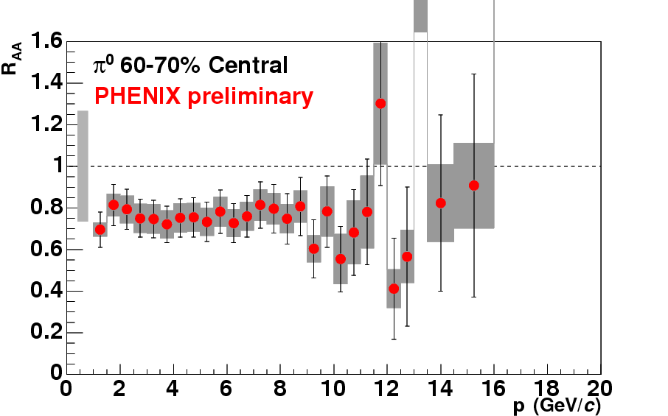
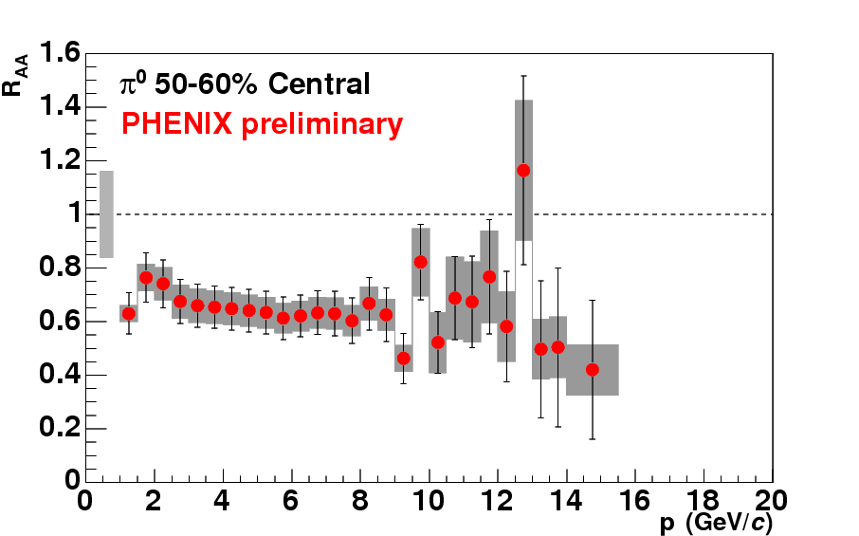
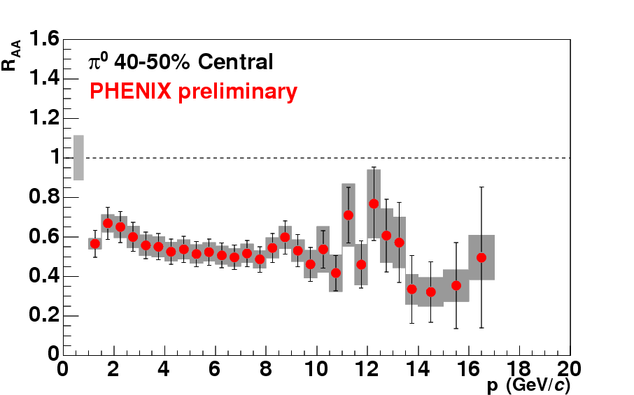
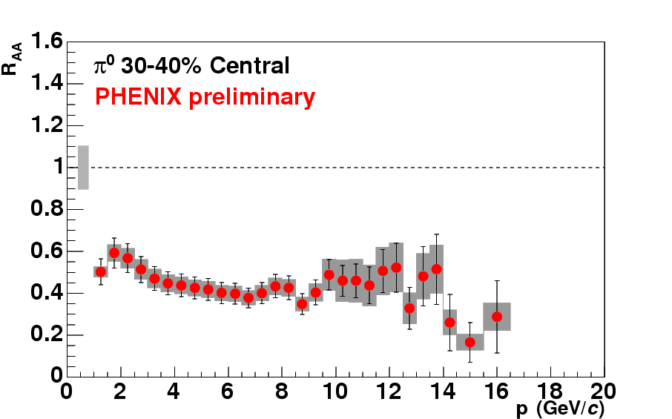
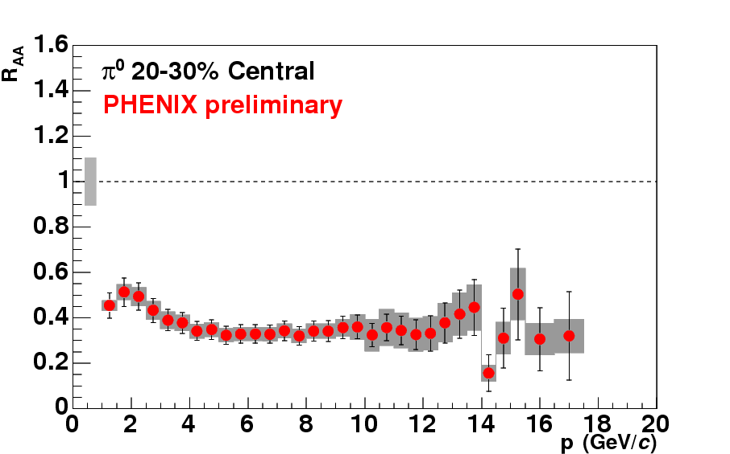
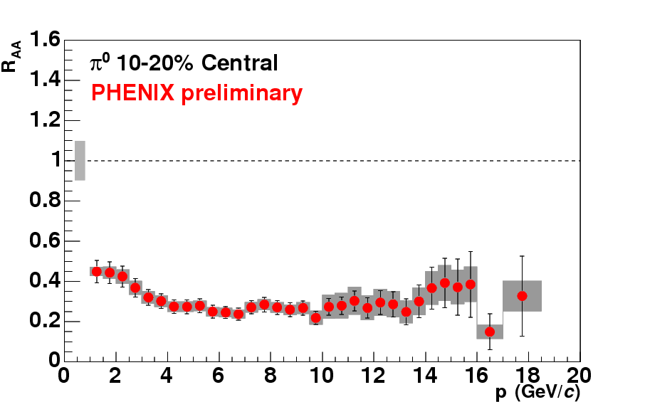
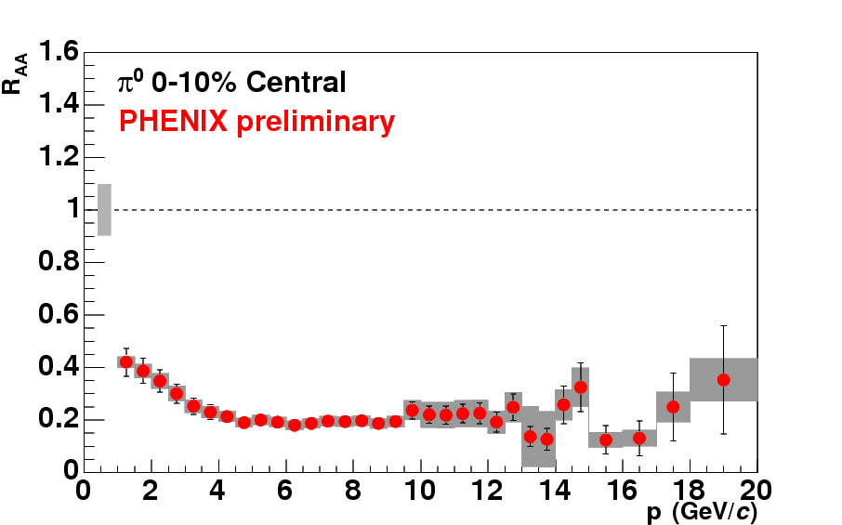
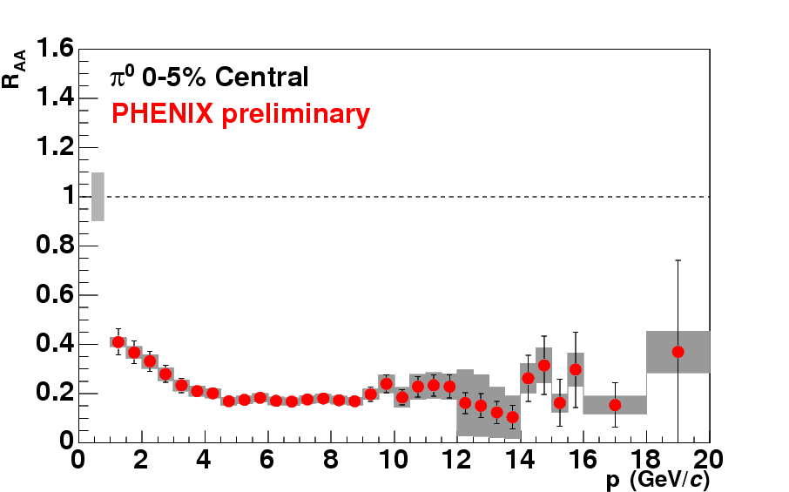
“Jet Quenching” at RHIC
0-5%
70-90%
L large
L small
Enhanced
Suppressed

Slide 6
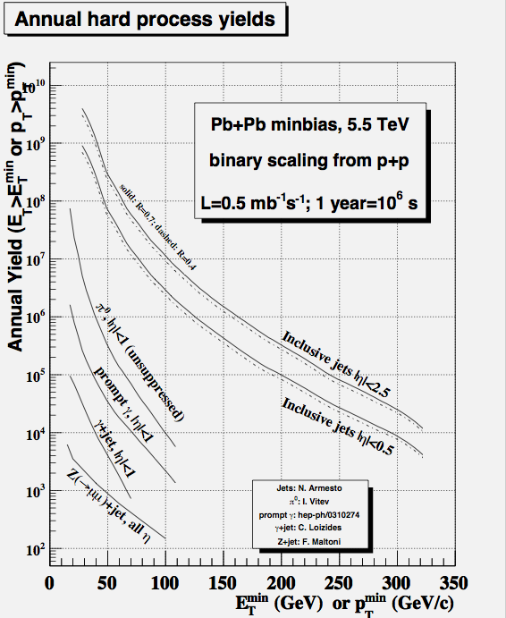
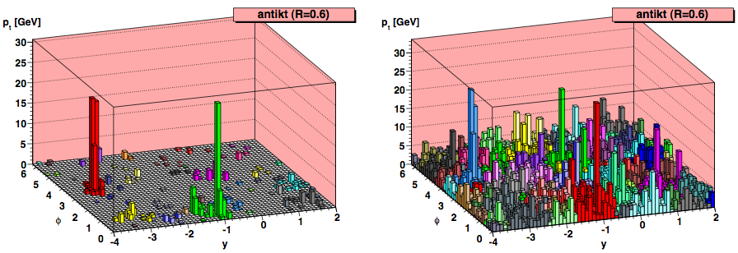
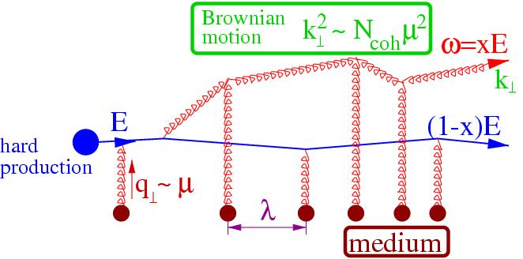
TH Challenges for Hard Probes @ LHC
Abundant yield of hard processes
+ robust signal
(medium sensitivity >> uncertainties)
= detailed understanding
How to find jets in HICs?
Medium-induced modifications of jets: theory tools
- How to interface ‘standard’ description of hard processes with medium effects?
- Non-abelian LPM-effect, MC implementation?

Slide 7
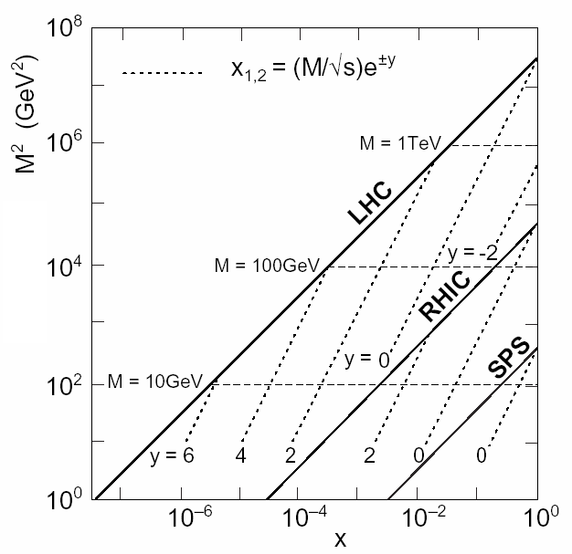

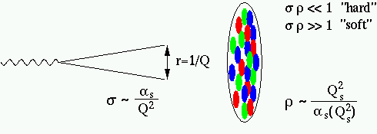


QCD @ high parton density
At high , standard distinction between hard and soft breaks down:
At small-x, parton densities are saturated
up to large scales
Coupling constant is small
Non-linear QCD evolution in perturbative regime.

Slide 8
BACK-UP

Slide 9
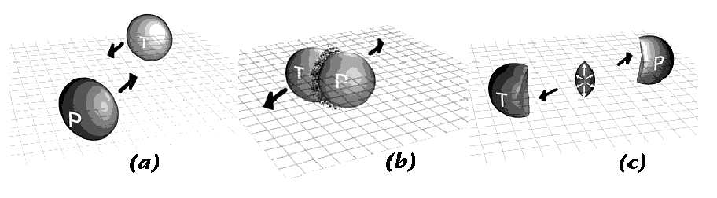
I. Elliptic Flow:
Hallmark of a collective phenomenon
??

Slide 10
II. Hard Probes
In Pb+Pb @ LHC embed hard processes
in dense nuclear environment
Hadronization in vacuum vs. thermalization in medium
in vacuum
h
in QGP
h
h
Jets stuck
in medium
PID ratios
modified
10 fm
Jets punch
through
1 fm
soft
hard
1GeV
10 GeV
100 GeV

