Slide 1
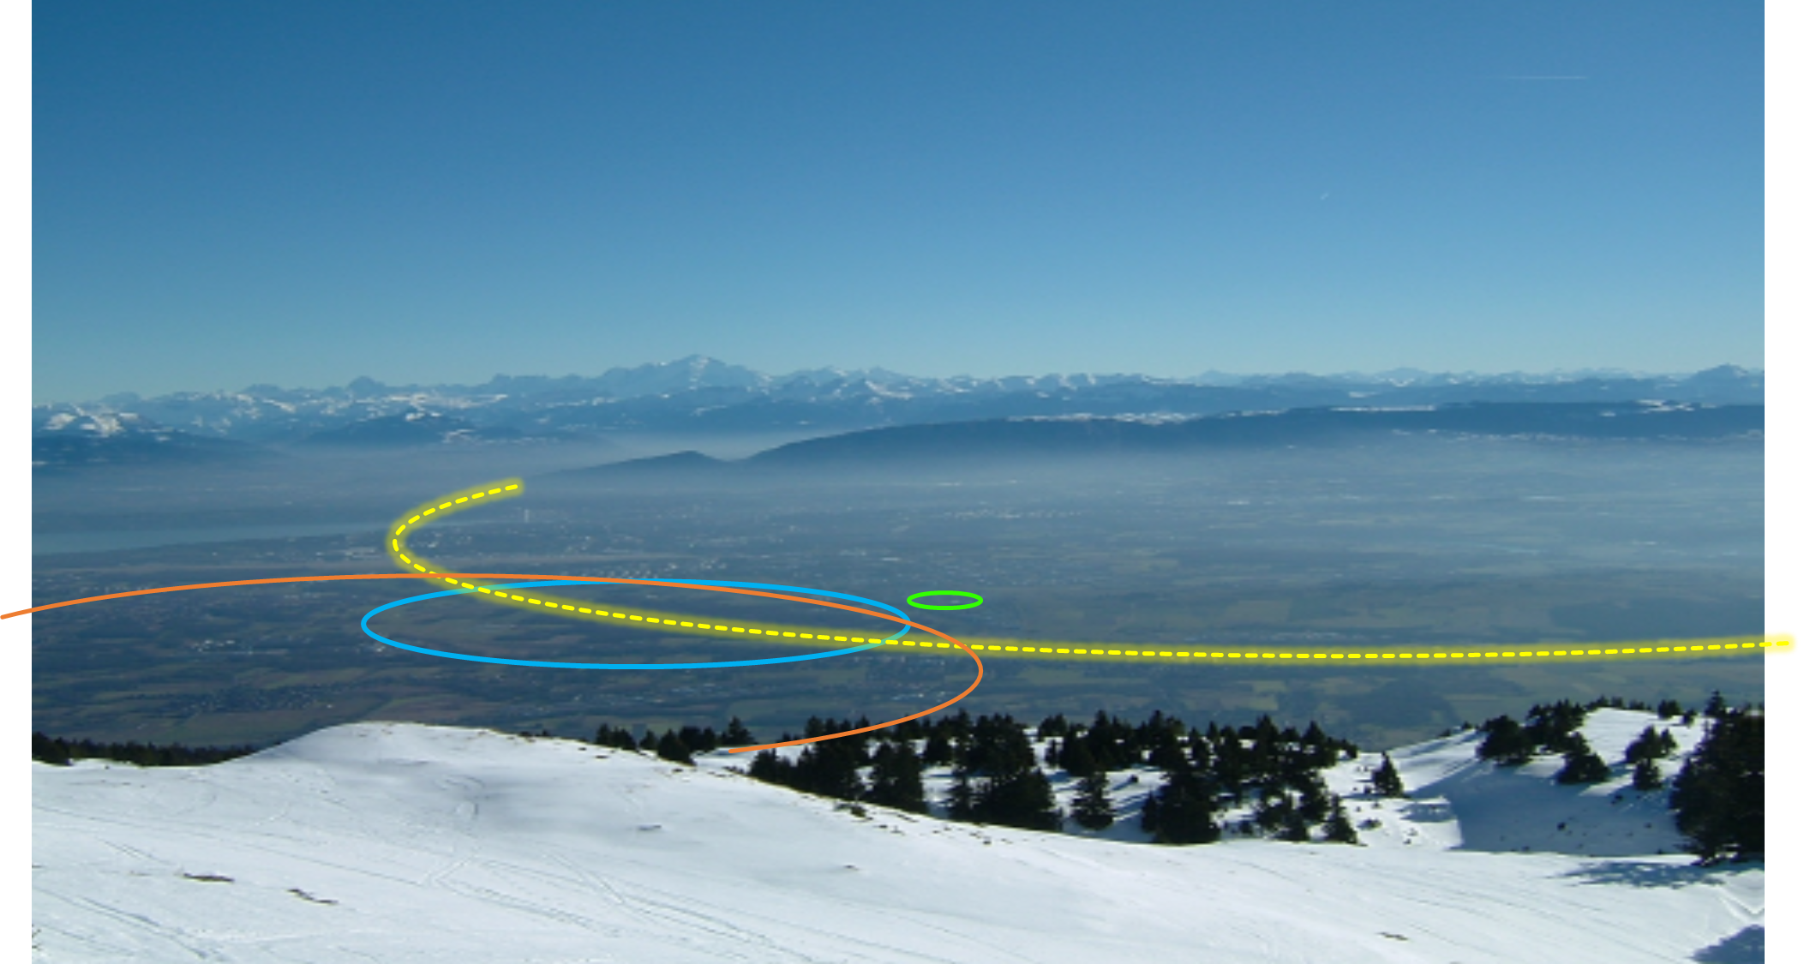
The FCC Feasibility Study and Global Collaboration
Emmanuel Tsesmelis
CERN
Head of Associate Member State and Non-Member State Relations
Convenor of FCC Global Collaboration Working Group
FCC Engagement Meeting – Portugal
26 November 2021
PS
LHC
FCC
SPS
Work supported by the European Commission under the HORIZON 2020 projects EuroCirCol, grant agreement 654305; EASITrain, grant agreement no. 764879; ARIES, grant agreement 730871, FCCIS, grant agreement 951754, and E-JADE, contract no. 645479
Photo: J. Wenninger

Slide 2
CERN International Collaboration

Slide 3

Science for peace
CERN was founded in 1954 with 12 European Member States
CERN’s annual budget
is 1200 MCHF (equivalent
to a medium-sized European university)
23 Member States
Austria – Belgium – Bulgaria – Czech Republic
Denmark – Finland – France – Germany – Greece Hungary – Israel – Italy – Netherlands – Norway
Poland – Portugal – Romania – Serbia – Slovakia Spain – Sweden – Switzerland – United Kingdom
As of 31 December 2020
Employees:
2635 staff, 756 fellows
Associates:
11 399 users, 1687 others
3 Associate Member States
in the pre-stage to Membership
Cyprus – Estonia – Slovenia
7 Associate Member States
Croatia – India – Latvia – Lithuania – Pakistan
Turkey – Ukraine
6 Observers
Japan – Russia – USA
European Union – JINR – UNESCO
More than 50 Cooperation Agreements
with non-Member States and Territories
Albania – Algeria – Argentina – Armenia – Australia – Azerbaijan – Bangladesh – Belarus – Bolivia
Bosnia and Herzegovina – Brazil – Canada – Chile – Colombia – Costa Rica – Ecuador – Egypt – Georgia – Iceland
Iran – Jordan – Kazakhstan – Lebanon – Malta – Mexico – Mongolia – Montenegro – Morocco – Nepal
New Zealand – North Macedonia – Palestine – Paraguay – People's Republic of China – Peru – Philippines – Qatar
Republic of Korea – Saudi Arabia – Sri Lanka – South Africa – Thailand – Tunisia – United Arab Emirates – Vietnam
Notes:
The speaker can highlight CERN’s second mission as stated when it was established: to foster peaceful collaborations between nations that had recently been at war.
Additional information (OPTIONAL)
More than 40% of CERN’s budget is returned to industry through materials, utilities and services

Slide 4
FCC Global Collaboration Working Group

Slide 5
Strategic Framework (I)
The ESPP update of June 2020 calls for wider scientific & technological support for CERN endeavours, from full exploitation of LHC to preparation of longer-term future of CERN.
Alongside completion of HL-LHC, ESPP objectives for future projects require a multi-tiered engagement with government entities, as well as individual national laboratories, institutes and universities, in the MS, AMS & NMS (including Observer States).

Slide 6
The FCC Approach to Global Collaboration
FCC Collaboration being formed through a global, two-way and integrative process, while being geographically balanced and topically complementary.
Open to areas beyond conventional accelerator R&D (environment & sustainability; education & training; knowledge transfer to society; & public engagement) and in areas that are non-core activities for CERN (geology, geodesy, logistics & material science).
Prepare foundations for industrial research and contributions via national laboratories, institutes and universities.
CERN is engaging in discussions with potential major partners as part of the FCC Feasibility Study for such a global project being hosted at CERN.

Slide 7
Mandate of FGC Working Group (I)
Engage with countries with mature communities, a long-standing participation in CERN’s programmes and the potential to contribute substantially to the Organization’s long-term scientific objectives, to facilitate opportunities for national participation in the FCC Feasibility Study through:
  Membership or Associate Membership, as provided by CERN’s geographical enlargement policy.
  Long-term bilateral agreements.

Slide 8
Mandate of Working Group (II)
Engage with the participants - national laboratories, institutes and universities as well as industry in the MS, AMS and NMS - to carry out the following mandate:
  Encourage an expanded membership.
  Explore opportunities for future prospective participants.
  Support new participants in application process.
  Assist the new participants in defining areas of collaboration.
  Conclude relevant agreements.
  Facilitate the integration process.
  Facilitate interest in CERN non-core areas - geology, geodesy, logistics, materials science.
  Prepare the foundations for research and contributions by industry.
  Liaise with national contact persons and forums.

Slide 9
FGC Working Group Membership
Emmanuel Tsesmelis (Convenor)
CERN International Relations
Michael Benedikt (CERN), Frank Zimmermann (CERN)
FCC Feasibility Study Leader and Deputy
Alain Blondel (IN2P3 & UNIGE), Patrick Janot (CERN)
FCC PED Coordinators
John Ellis (King’s College London), Panagiotis Charitos (CERN)
FCC Coordination Group
Gregorio Bernardi (IN2P3), Tadeusz Lesiak (IFJ PAN), Marcin Chrzaszcz (IFJ PAN)
Convenors of FCC-PED Informal Forum of National Contacts

Slide 10
FCC Collaboration

Slide 11
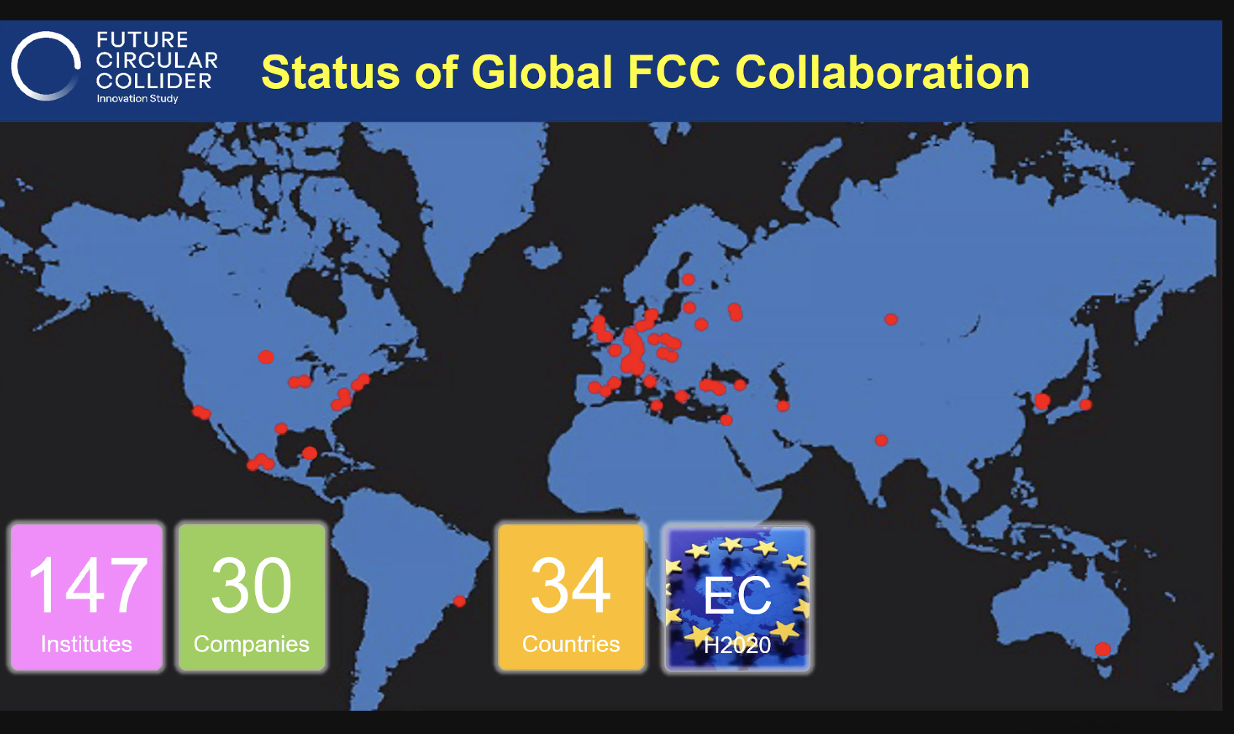

Slide 12
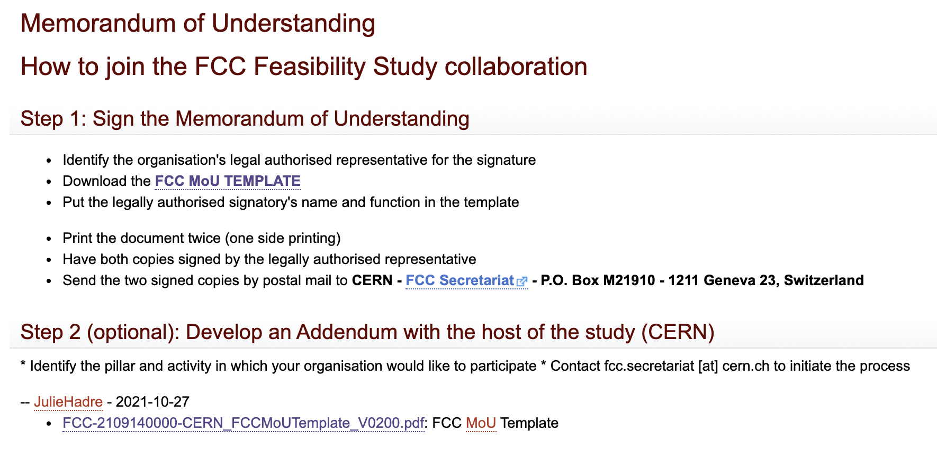
Joining the FCC Feasibility Study Collaboration
https://twiki.cern.ch/twiki/bin/view/FCC/FCCMoU

Slide 13
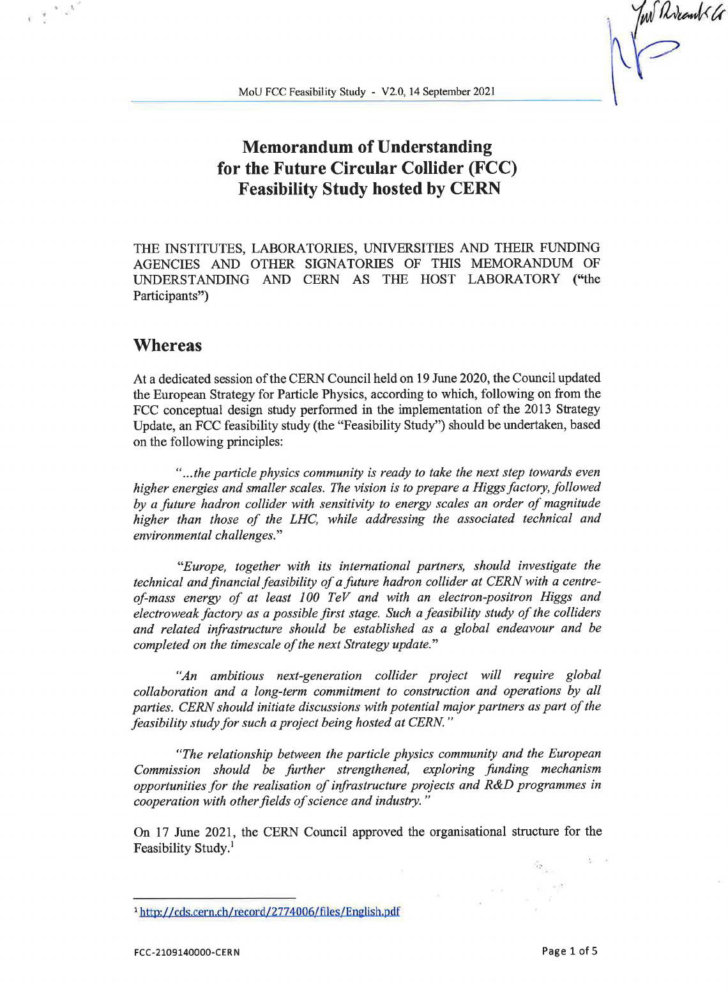
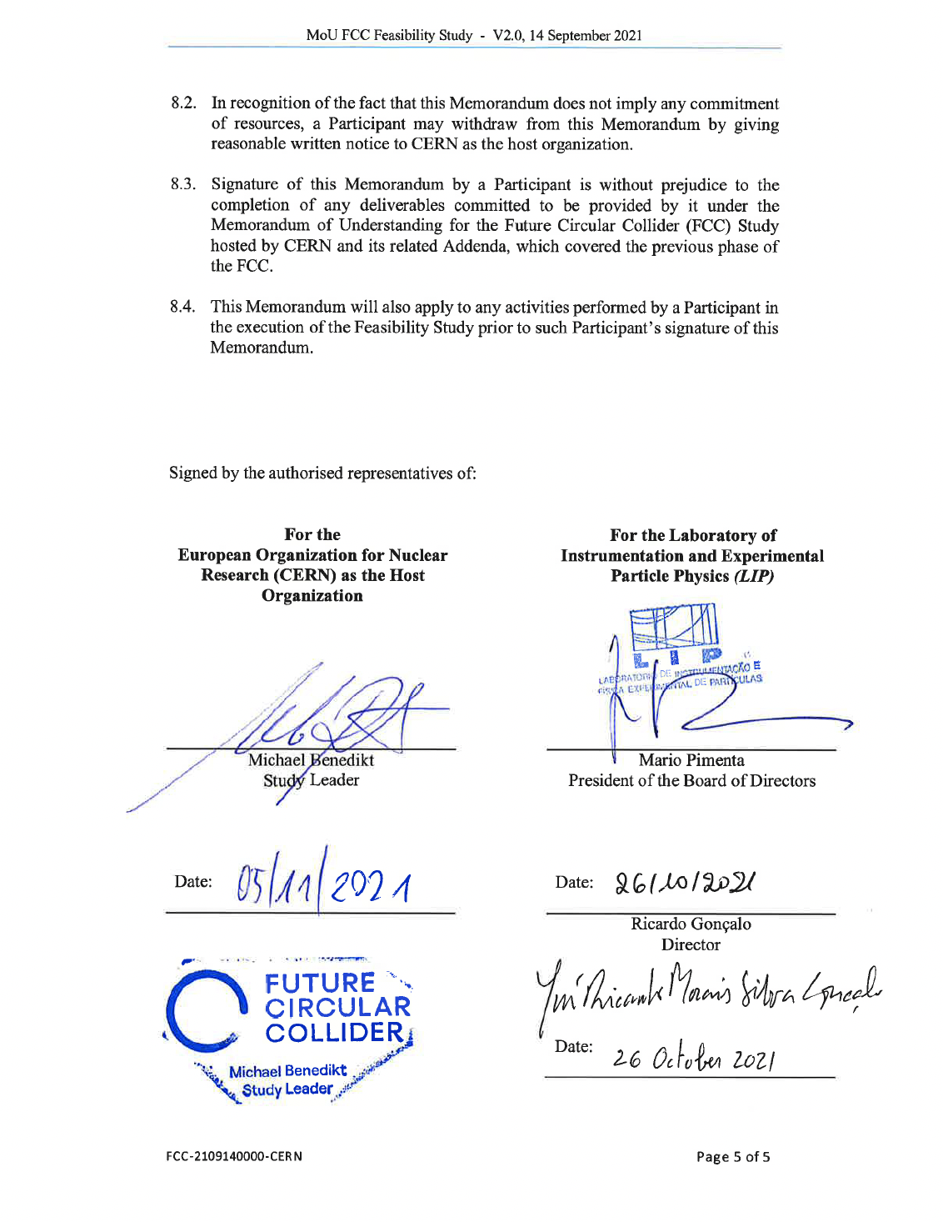
MoU for the FCC Feasibility Study with LIP

Slide 14
Concluding Remarks
Aim is to grow and strengthen FCC collaboration on a global scale:
  Countries with mature communities, long-standing participation in CERN’s programmes & potential to contribute substantially to Organization’s long-term scientific objectives.
  National laboratories, institutes and universities in support of the FCC Feasibility Study. Conclude relevant bilateral agreements for their participation.
Continue the two-sided approach from the FGC Working Group and from the FCC-PED Informal Forum of National Contacts to strengthen the global FCC collaboration.
The FCC looks forward to develop a strong collaboration with Portugal.

Slide 15

Thank you

