Slide 1
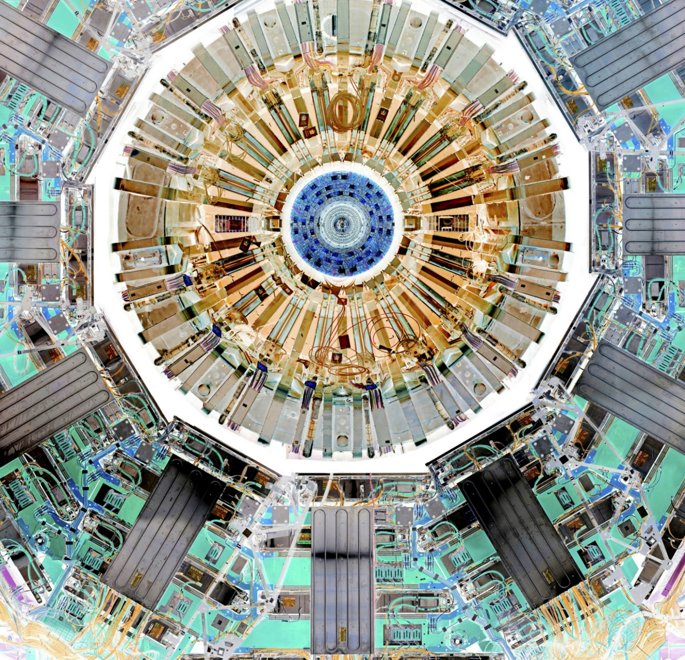
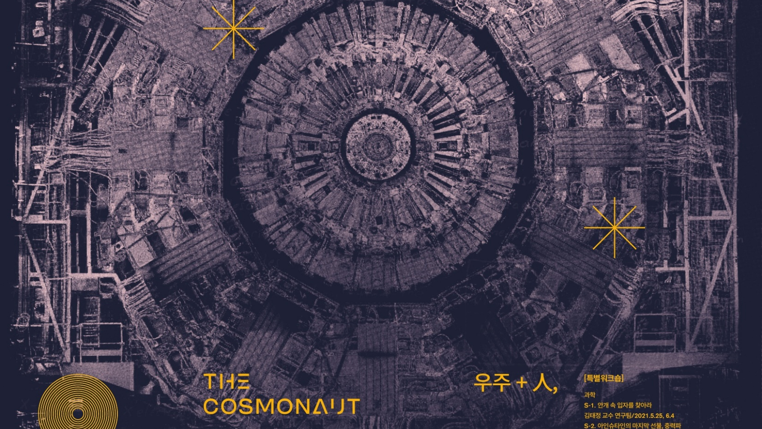

Slide 2



Slide 3
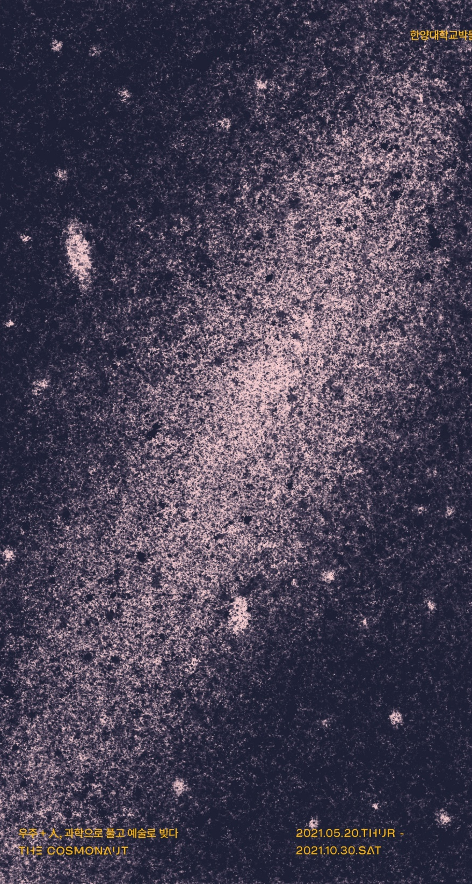
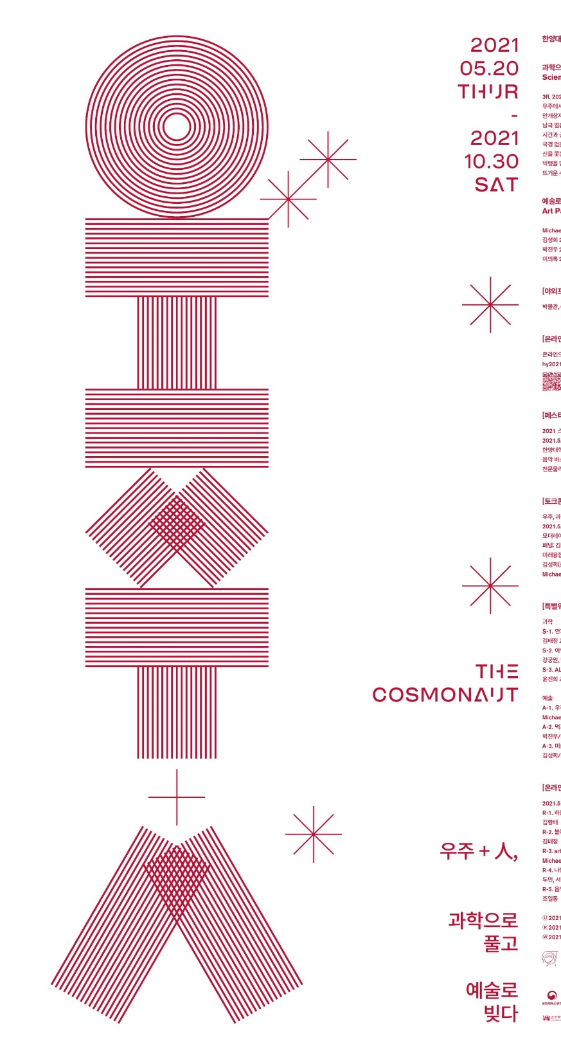
The Cosmonaut by ORIGIN-CMS
Where: Seoul /South Korea
Venue: Hanyang Museum, ~ 800m² exhibition
When: opening 20th May– 30th October 2021
Topics: from particle physics to astrophysics
Who: CMS, ALICE, CERN, LIGO, ICEcube = reginal ORIGIN network
Artists: 4 Local artist and M. Hoch
Local responsible: Tae Jeong Kim
Concept: Michael Hoch

Slide 4
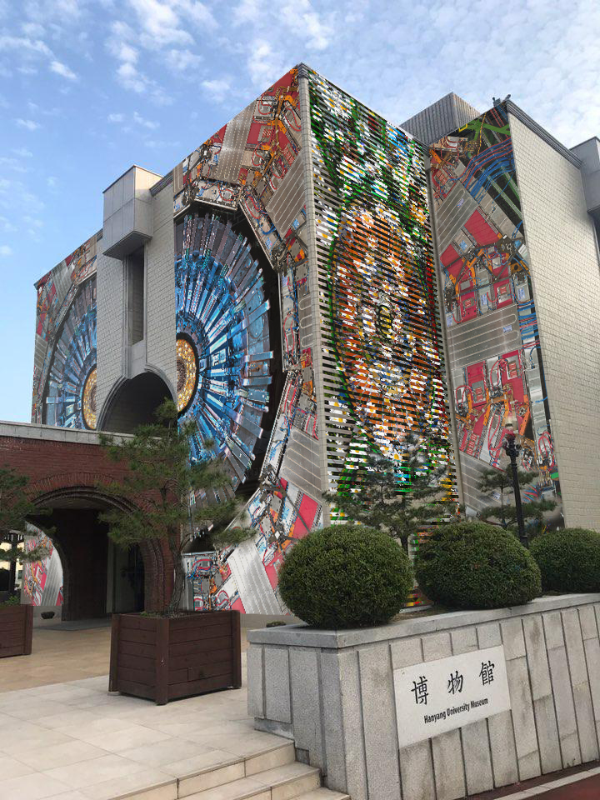
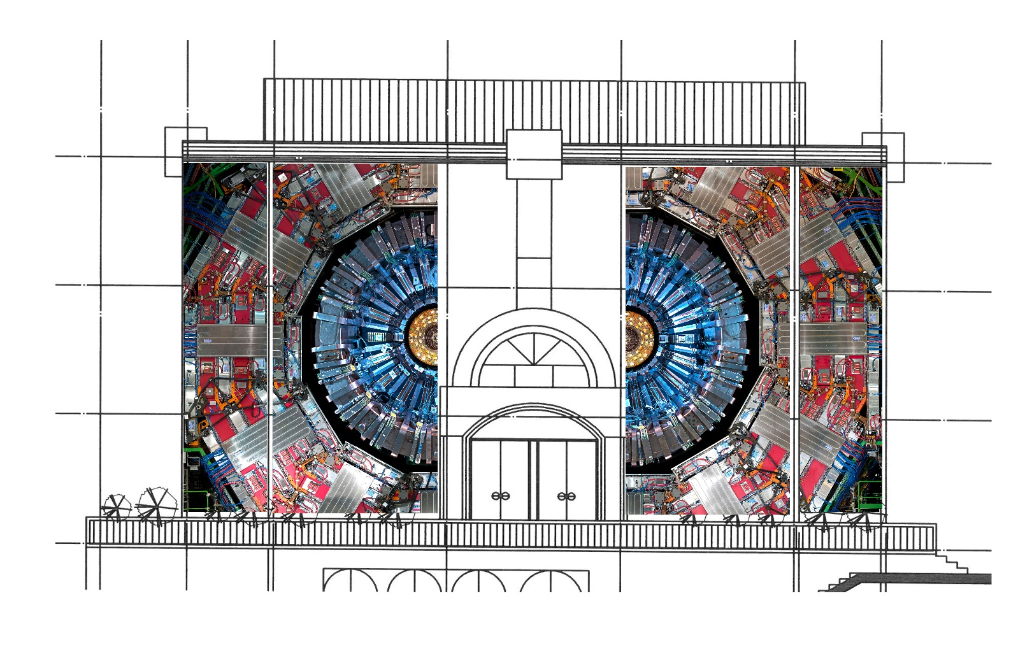

Museum becomes CMS
Video: “MUSEUM becomes CMS”: https://youtu.be/91rQ2irmsjo
Art Teaser Video
(274) 메인서브 합 마이클호치박사님 - YouTube

Slide 5
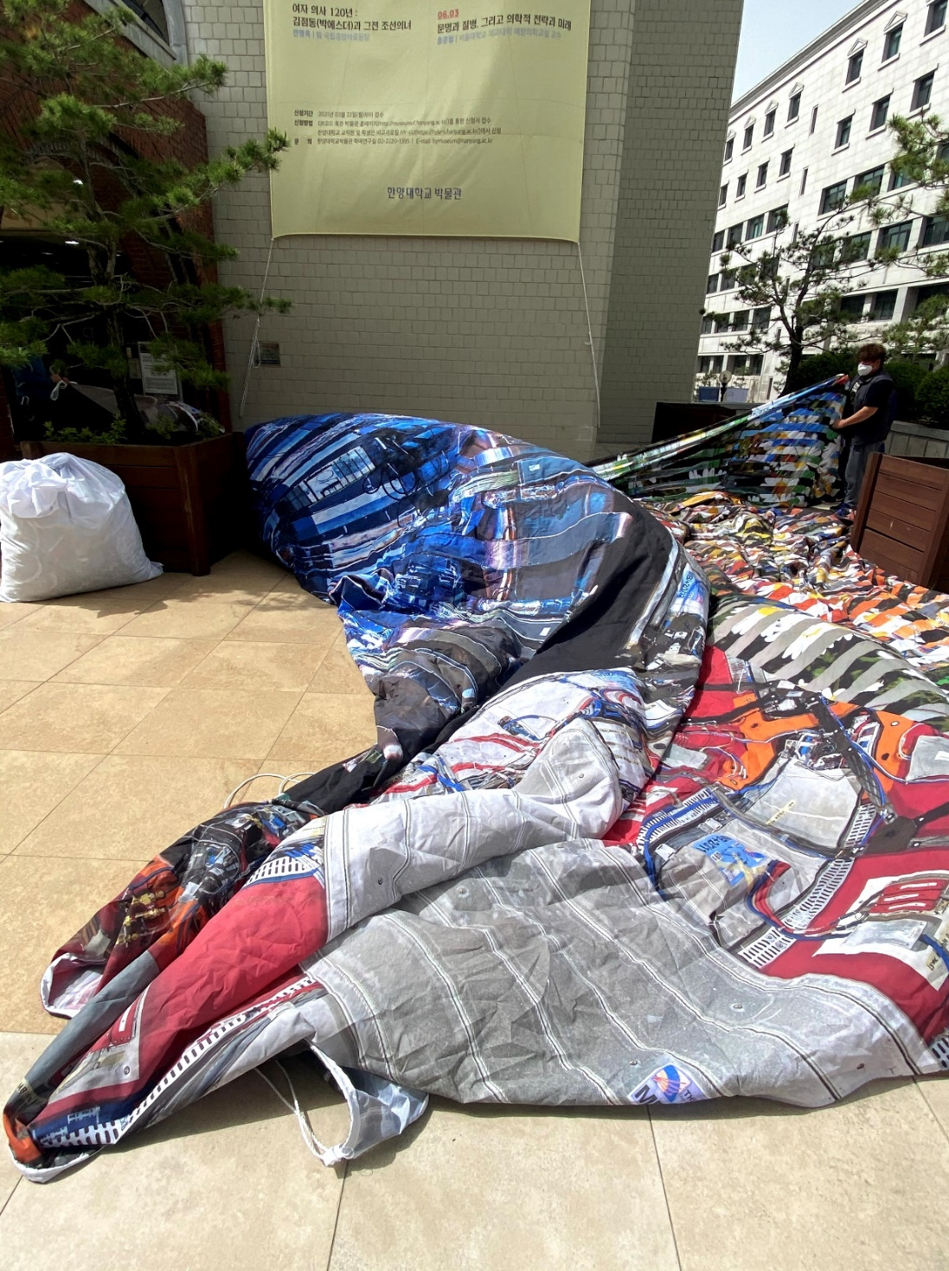
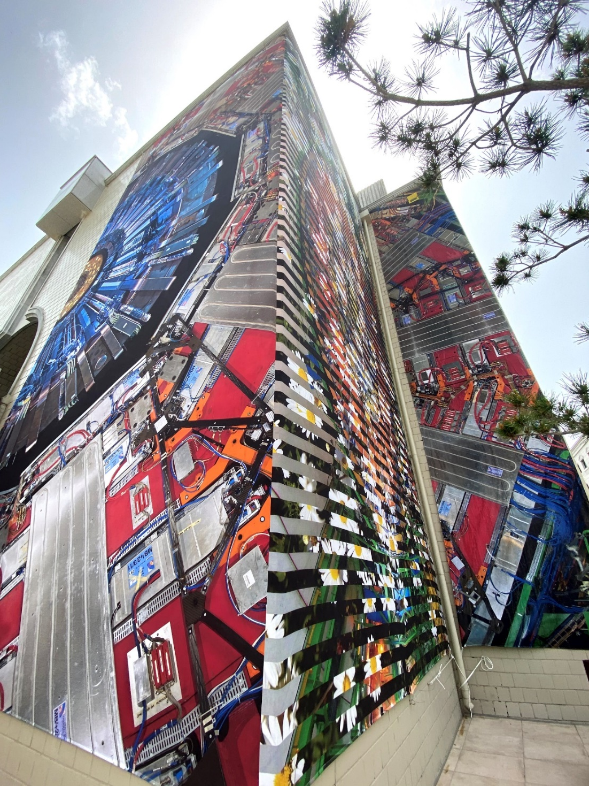

Slide 6
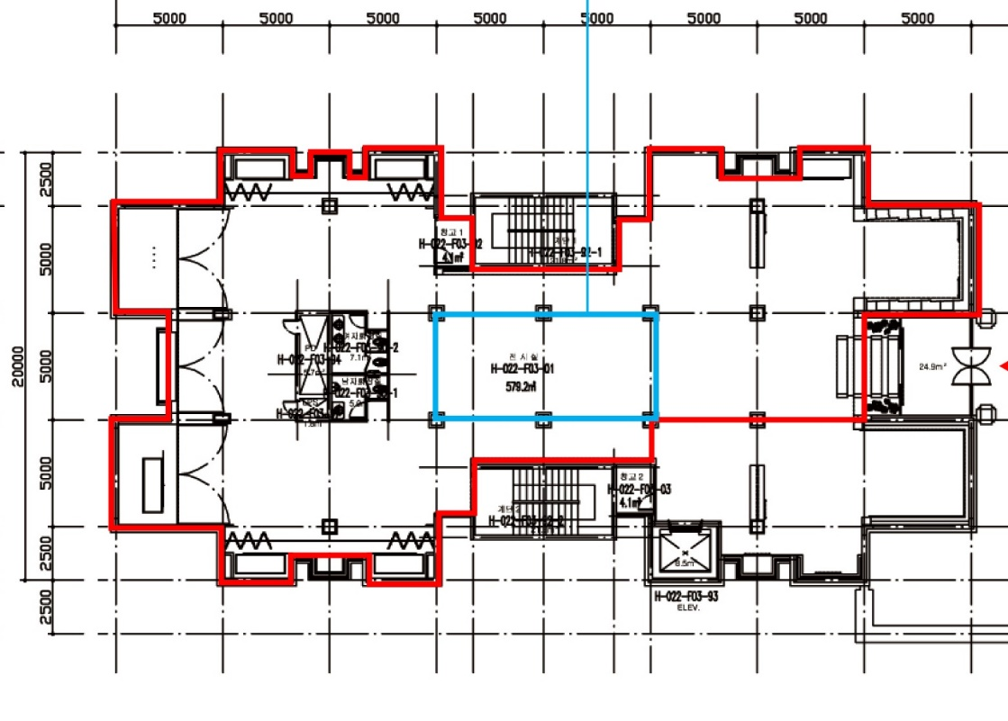
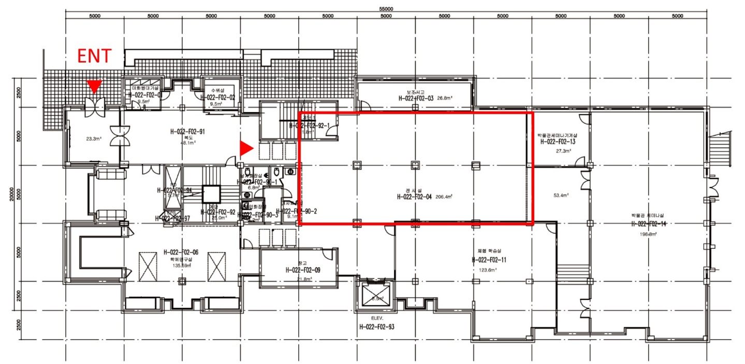
Floor plan
3rd floor : science path
Exhibition space: 508 m²
Floor Height: 270cm
2nd floor art space
Exhibition space: 207m²
Floor Height: 350cm

Slide 7
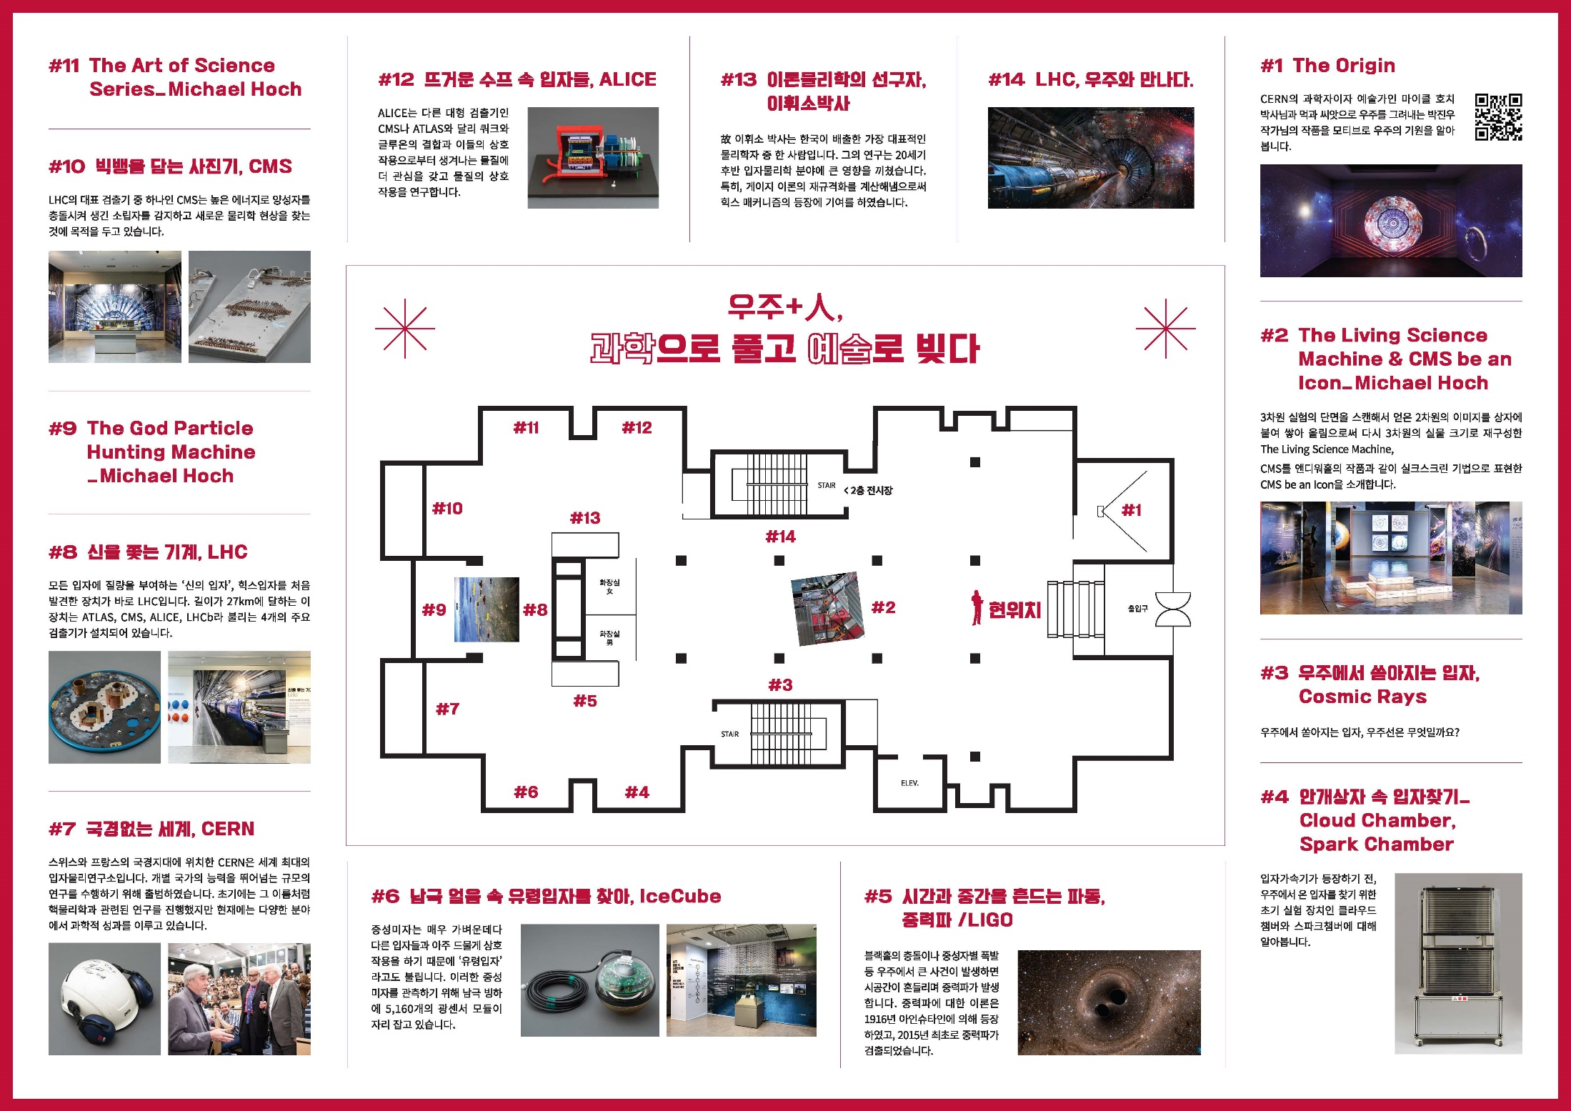

Slide 8
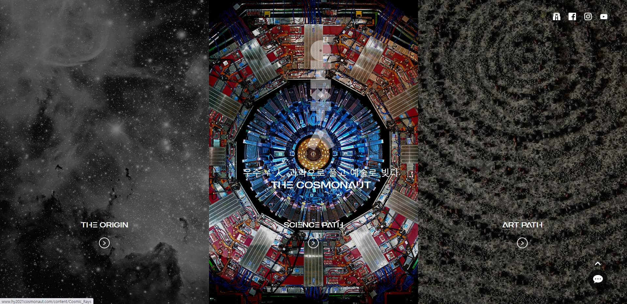
Online Exhibition
http://www.hy2021cosmonaut.com

Slide 9
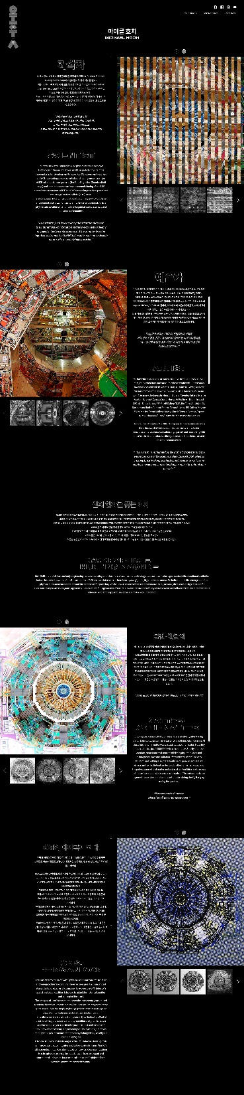
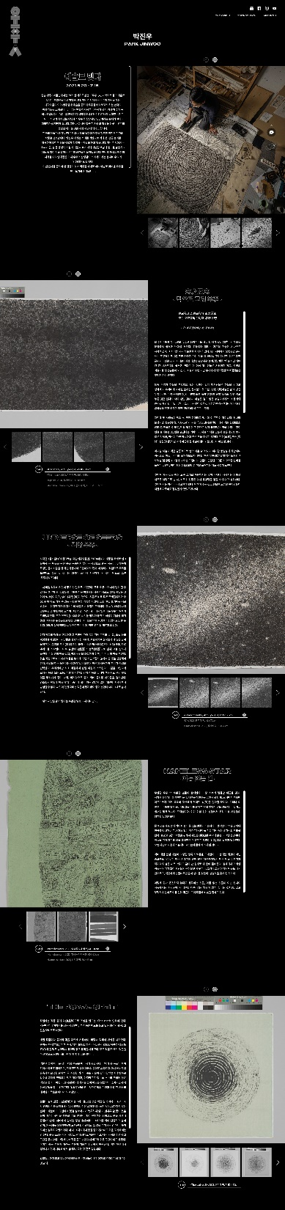

Slide 10
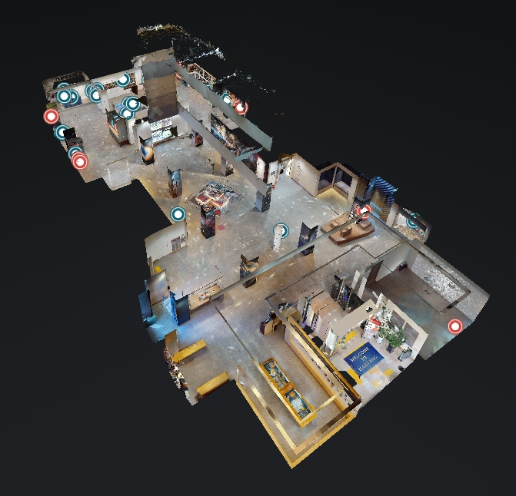
Virtual Museum :
To visit virtual and archive the exhibition
https://my.matterport.com/show/?m=nsafzyhGnic
https://my.matterport.com/show/?m=cCZF48ZqEyF

Slide 11
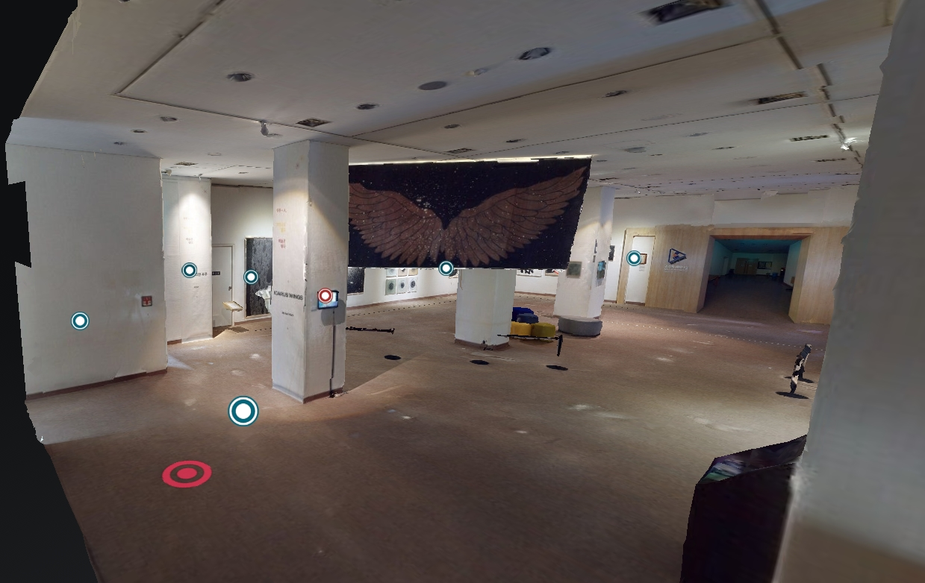

Slide 12
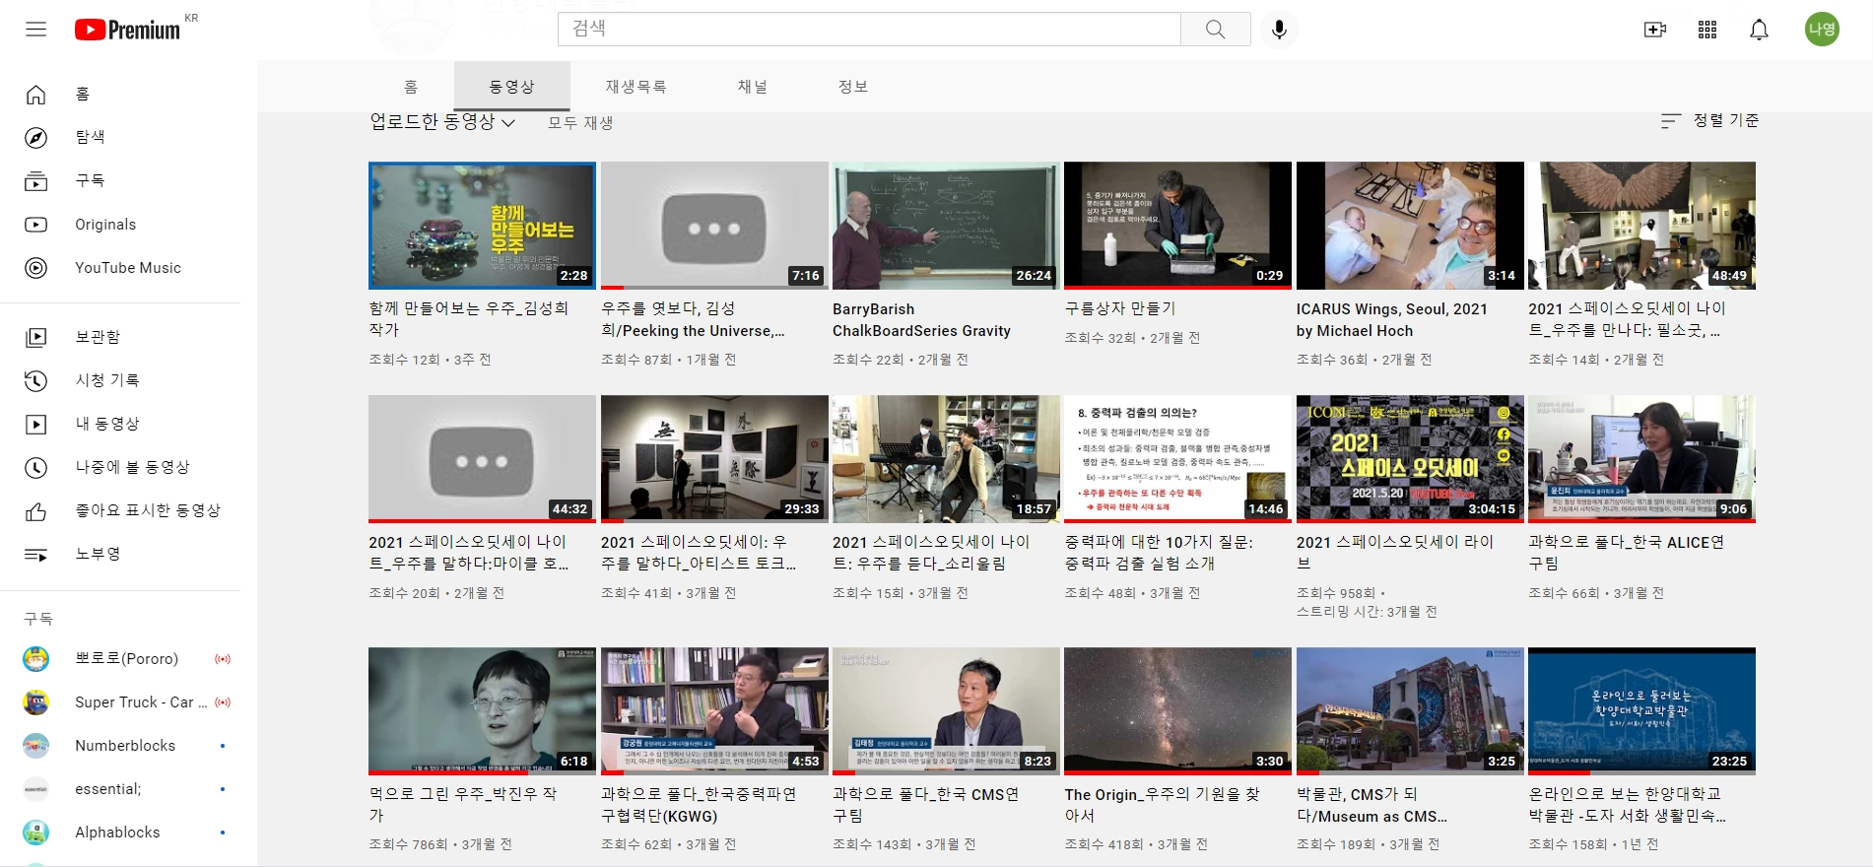
https://www.youtube.com/channel/UCtGodNT4WNL_Acn5xq1bfGQ/videos

