Slide 1
ABT proposal for MKDV1 stress test
Etienne Carlier for SY/ABT
11/11/2021

Slide 2
MKDV1 high-voltage conditioning history
11-Nov-2021, ABT proposal for MKDV1 stress test
SPS Beam Dumping System (SBDS) relocated from LSS1 to LSS5 during LS2. Vertical deflection kickers (MKDV) increased by one (now three was two).
MKDV conditioning started in pulse mode in W2 (11/01). Smooth conditioning (2 weak sparks) up to first strong flashover on MKDV1 (new magnet) at 37.5 kV on 25/01 (target conditioning voltage was 38 kV).
Conditioning restarted and stopped with a second strong flashover on MKDV1 at 32.9 kV on the 05/02
Decision to start beam operation with reduced MKDV1 voltage at flat-top (28 kV) and reduced vacuum interlock threshold
(5e-8 mbar instead of 1e-6 mbar)
Third strong flashover during operation (15/08). 8 hours necessary to recover correct vacuum level before starting magnet high-voltage re-conditioning
MKDV1 voltage at flat-top further reduced to 26 kV and MKDV2 & 3 voltage at flat-top increased from 35 kV to 36 kV.

Slide 3
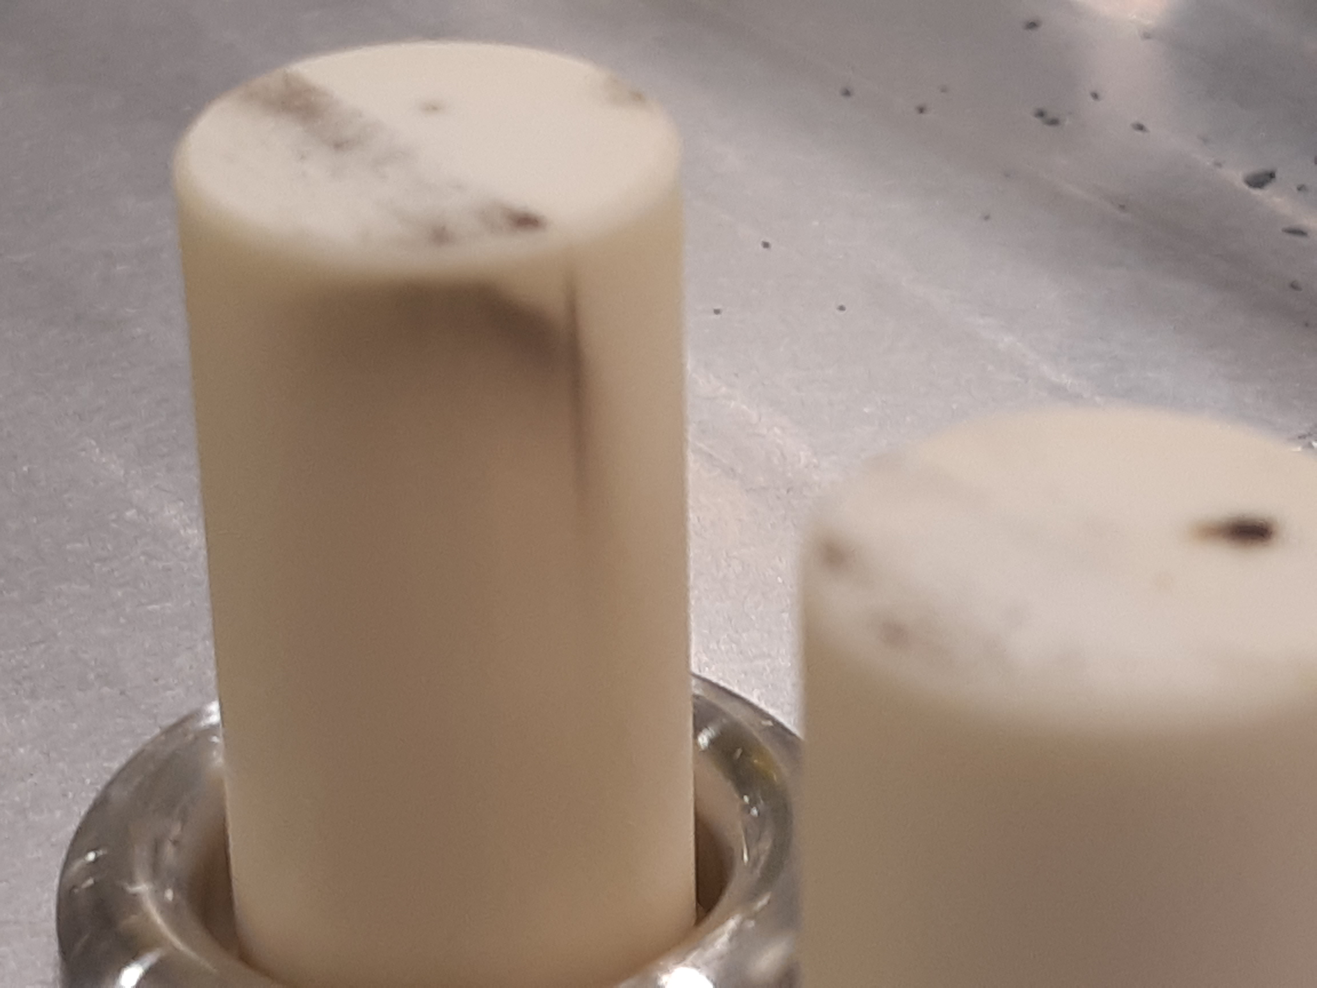
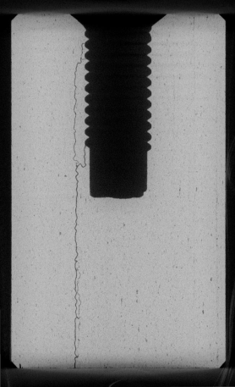
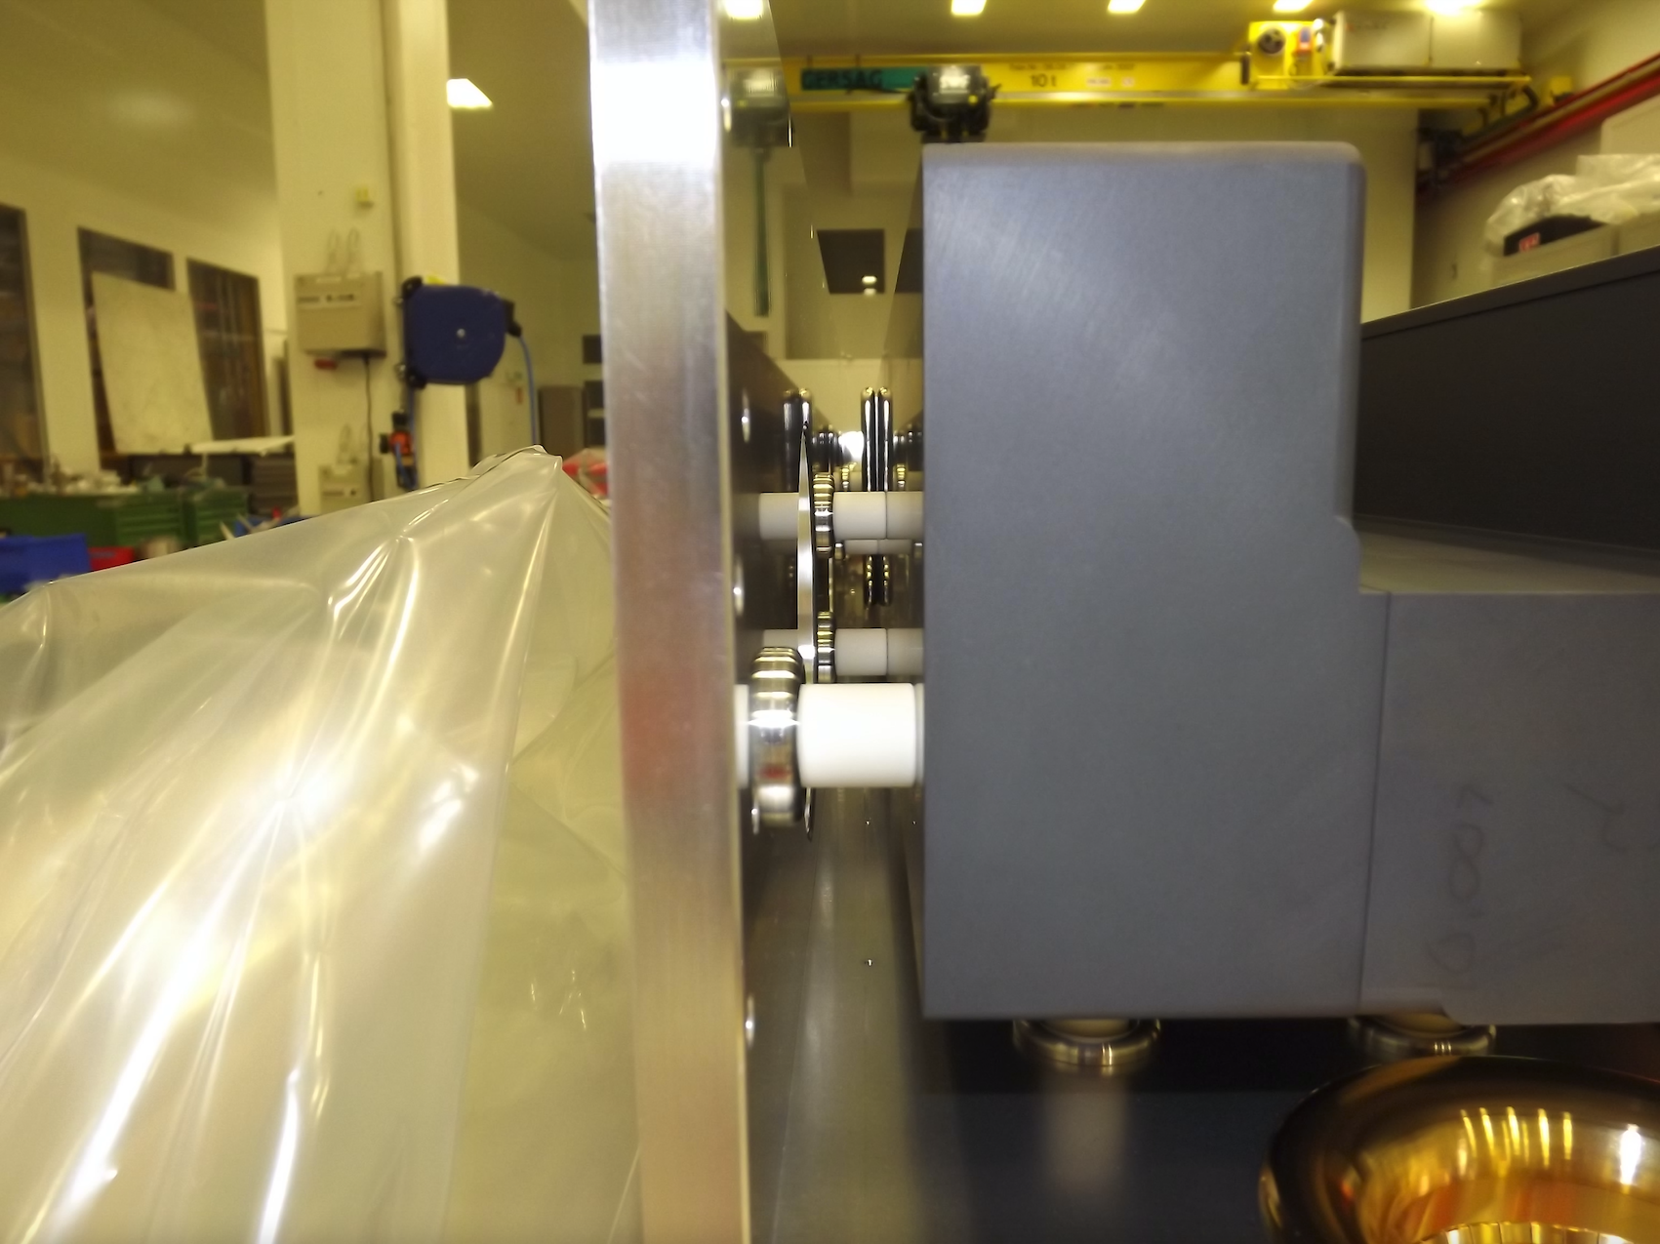
MKDV1 weak w.r.t. high voltage due to ceramic spacers
11-Nov-2021, ABT proposal for MKDV1 stress test
Analysis of spare MKDV magnet (same production than installed new MKDV1)

Slide 4
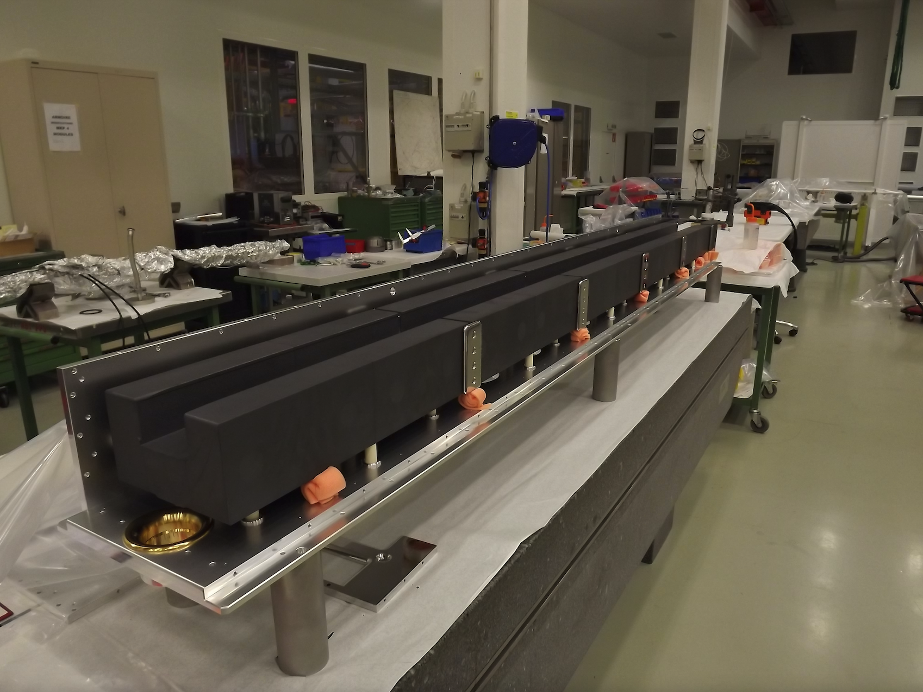
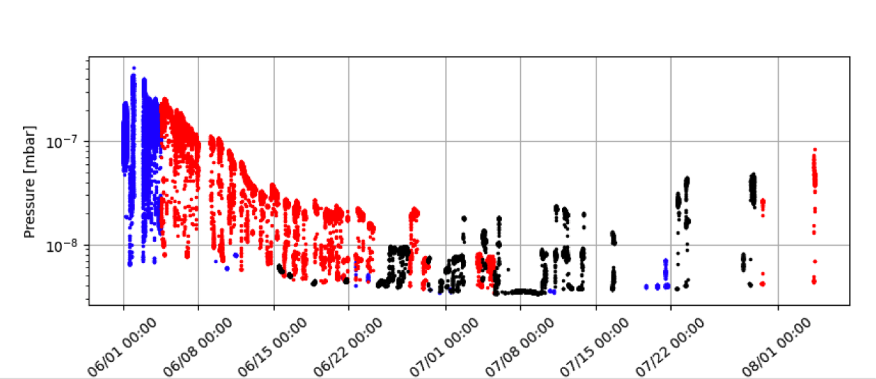
MKDV1 scrubbing
11-Nov-2021, ABT proposal for MKDV1 stress test
High dynamic vacuum activity on MKDV1 during scrubbing (beam conditioning)
Scrubbing performance limited in 2021 due to bulk out-gassing of the ferrite + reduced vacuum interlock threshold (5e-8 mbar)
Vacuum interlock threshold relaxed to
1e-6mbar for dedicated scrubbing run (26 GeV)
Charge accumulated in magnet during scrubbing cycle (proportional to ppb intensity) removed at “next” high energy pulse (same or next cycle). Higher risk of flashover.
Degradation of dynamic vacuum performance of MKDV1 observed (de-conditioning) when no or little LHC25 beam in the machine.

Slide 5
MKDV1 stress test proposal
11-Nov-2021, ABT proposal for MKDV1 stress test
MKDV1 will be replaced in YETS due to weak voltage hold-off
Need to decide on the vacuum threshold for the new magnet, this value decides on how transparent scrubbing will be after the YETS (dedicated or interleaved)
Idea is to test the vacuum vs beam intensity behavior of the weak magnet to have a reference for the new magnet (same construction type, new components)

Slide 6
Test program
11-Nov-2021, ABT proposal for MKDV1 stress test
Add Hiradmat in supercycle at around Sunday midnight, 6h before YETS
Keep operational voltage
Relax vacuum threshold to 5e-7 mbar, tbc
Inject up to 4 batches of moderate 25 ns beam ~1e11 ppb
Monitor vacuum level, bunch length, beam quality along the batch (FBCT) and losses around the machine
Increase bunch intensity step wise

Slide 7
Potential consequences / Risks
11-Nov-2021, ABT proposal for MKDV1 stress test
Beam intensity can’t be increased due to other limitations
→ no impact on NA but duty cycle
We reach the vacuum threshold at MKDV
→ short recovery needed as in normal operation (vacuum acknowledge + kicker SoftStarting)
There is a risk of voltage breakdown in the magnet
→ this would stop the operation

