Slide 1
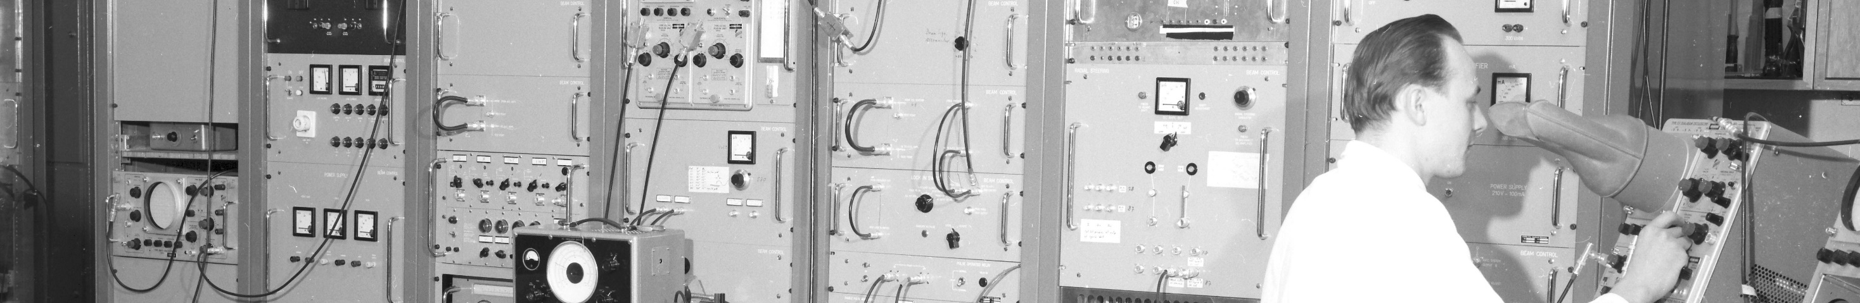
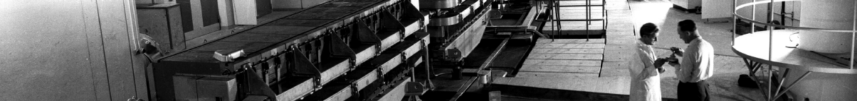
PS Report W45
Many thanks to the PS operations and coordination team
as well as all related equipment and support teams

Slide 2
Main issues during the week
Unexpected side effects
of radial loop sign switching test and → ~50 min lost for HiRadMat
RF PLC firmware upgrade → ~15 min no beam
on Friday
Issues resolved
Cavity C10-96 intermittently out of phase → In shadow of Linac4 stop
on Friday evening
Cavity controller resynchronization issue disappeared by itself while investigating
Observation put in place, but no further events
C10-81 gap relay exchange → In shadow of Linac4 stop
on Friday evening
Injection kicker module 2 trips → ~2h40 downtime in total
on Saturday
RF issues

Slide 3
Main issues during the week
Injection bumper 42 trips → 2h no beam
on Tuesday morning
Circuit breaker exchanged and expert monitoring
Injection kicker KFA71 vacuum spike → 1h no beam
on Wednesday morning
Expert monitoring
RF cavity tuning issue (10 MHz) → 2h without beam
on Tuesday evening
RF cavity 66 amplifier (10 MHz) → 2 accesses with 2h downtime in total
on Wednesday
Timing issue → 1h15 without beam
on Thursday morning

Slide 4
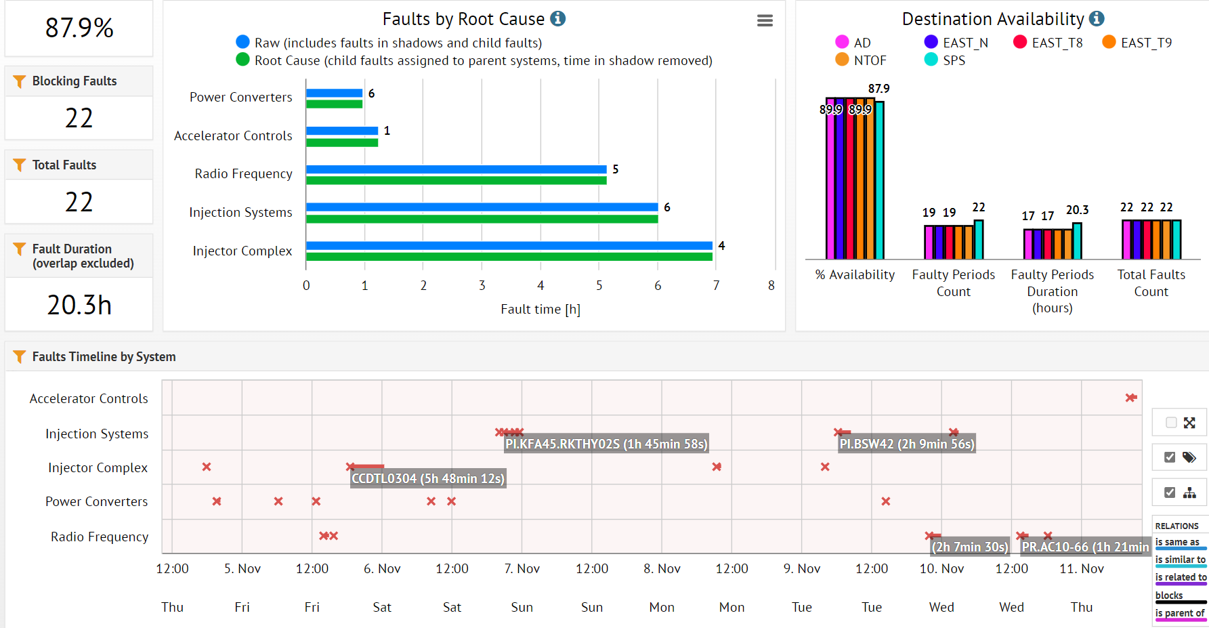
Timing system
Injection kicker KFA45
Injection bumper BSW42
Injection kicker KFA21
Linac4 RF
Linac4
RF issues
Cavity tuner
Cavity 66 amplifier

Slide 5
News from beams
nTOF
Steering FTN line MDs
  Difficult to steer large beam size through the line with acceptable losses
Another FTN MD planned tomorrow morning to continue
Vertical and horizontal beam displacement on target ongoing
Intensity scan planned (50e10 ppp up to nominal intensity)
EAST
Ions to EAST T8:
  Managed to steer down the T8 line despite the very low duty cycle and the instrumentation
  Optimization left for the weekend before the ion run
DSO tests completed for T11

Slide 6
Status of operational beams
MD planning for this week (link)
Fixed target beams | Status | Comment
SFTPRO (MTE 5 turn extraction) | Operational | Up to ~2 ∙ 10¹³ p/p delivered to SPS
AD | Operational | 1.55 ∙ 10¹³ p
TOF | Operational | Delivered at 8.5 ∙ 10¹² p/b with pre-LS2 optics
EAST | Operational | Up to 6 ∙ 10¹¹ p/p to EAST dump, T8 (slow and fast), T9 and T10/11 Fast and slow extracted ions to EAST dump
LHC-type beams | Status | Comment
LHCPROBE, LHCINDIV | Operational
LHC25 (72b) | Operational | Polished up to 1.3 ∙ 10¹¹ ppb; set up up to > 2.6 ∙ 10¹¹ p/b ε_{h} / ε_{v} (FT) ≈ 1.2 / 1.1 mm mrad (for 1.3 ∙ 10¹¹ p/b)
LHC25 (12 to 48b) | Operational | Settings synchronized with high-intensity variant
LHC25 BCMS (48b) | Operational | Available up to 1.3 ∙ 10¹¹ p/b (3 basic periods)
AWAKE | Operational | 3 ∙ 10¹¹ p/b
Ion beams | Status | Comment
EARLY | Operational | ~1.5 ∙ 10¹⁰ p/p
NOMINAL | Operational | 8 ∙ 10¹⁰ p/p
EAST_ION_24GeV | Operational | Slow extraction to EAST hall, EARLY beam in LEIR

