Slide 1
SuperKEKB collimation system
IAS Program on HEP 2022
2021-07-01
Mini-workshop: Accelerator Physics
Key Beam Physics and Technologies Issues for Colliders
Day 1 - Session 3 (MW-AP-D1-S3)
KEK Accelerator Laboratory
Takuya Ishibashi
on behalf of KEKB Vacuum Group

Slide 2
Contents
Beam collimators in SuperKEKB main ring
Design
  Basic design
  RF shield
Experience
  BG suppression
  Damage
  Low-Z collimator
  Mis-fire of injection kickers
  Beam instability caused by impedance in LER
Summary

Slide 3
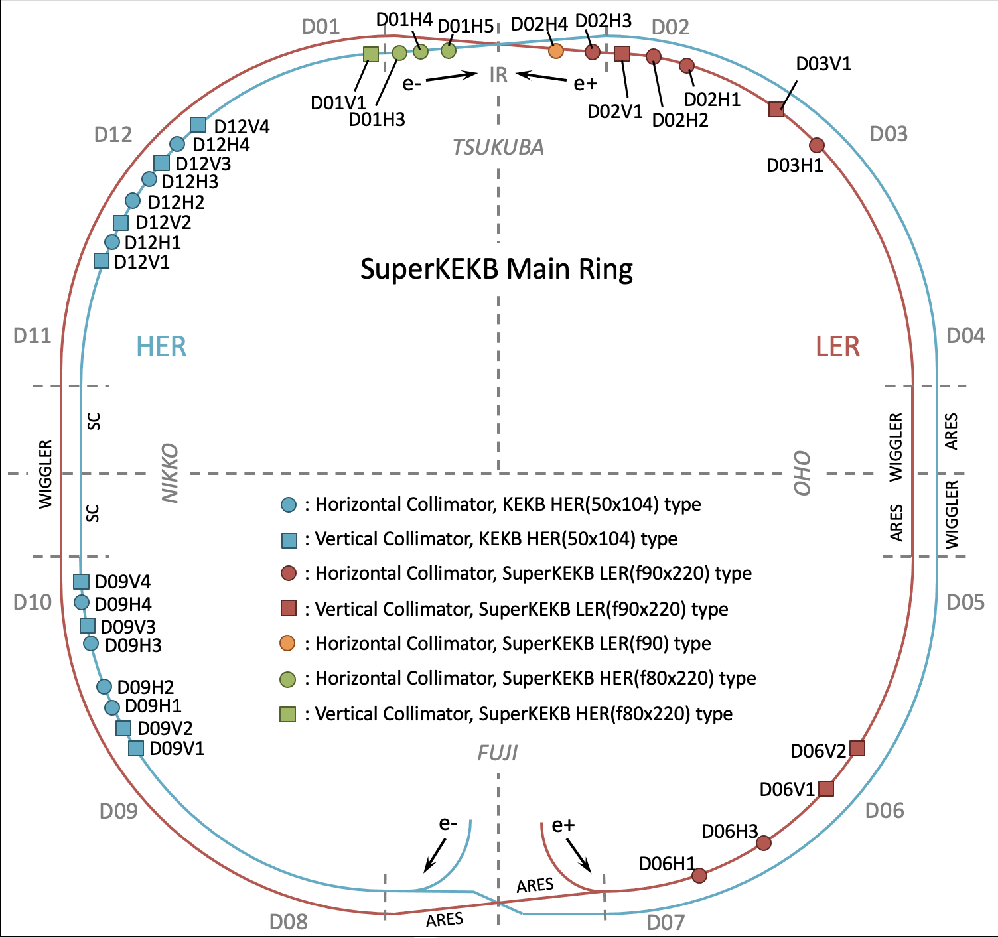
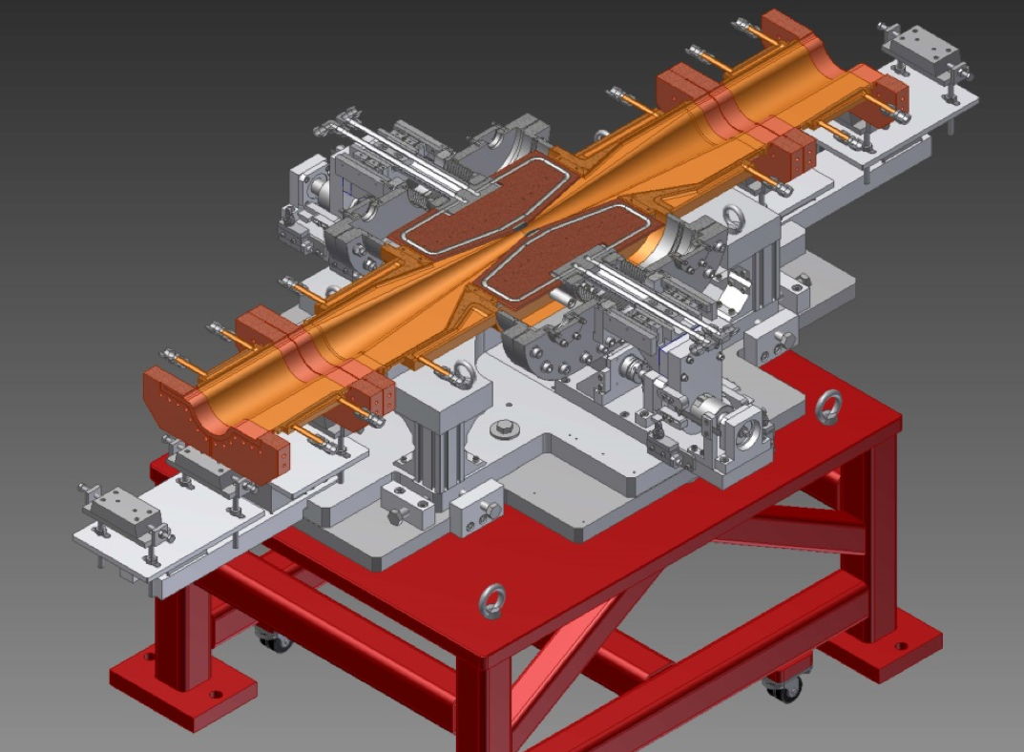
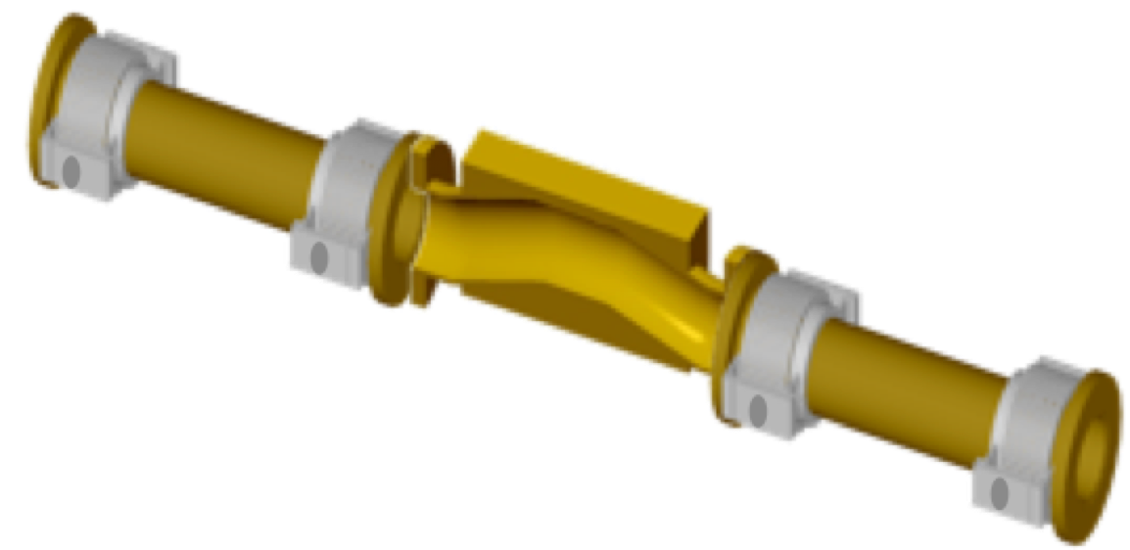
Beam collimators in SuperKEKB
There are two types of collimators in SuperKEKB MR.
  KEKB type: Tapered chamber itself approaches the beam. The tip is made of Cu coated titanium.
  SuperKEKB type: A chamber has two movable jaws, and they approaches the beam.
In HER, 8 horizontal and 8 vertical KEKB type collimators have been reused at the same location as KEKB era. 3-horizontal and 1 vertical SuperKEKB type collimators have been installed in Tsukuba straight section.
In LER, 7 horizontal and 4 vertical SuperKEKB type collimators have been installed.
KEKB type
SuperKEKB type
[Y. Suetsugu et al., NIM A 513, 465 (2003)]
[T. Ishibashi et al., PRAB 23, 053501 (2020)]
Location of collimators in MR

Slide 4
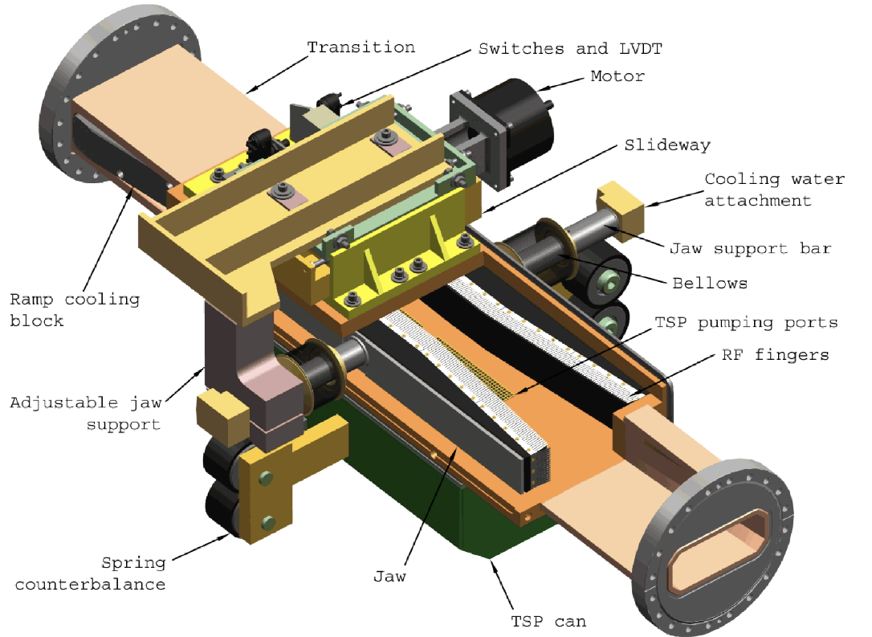
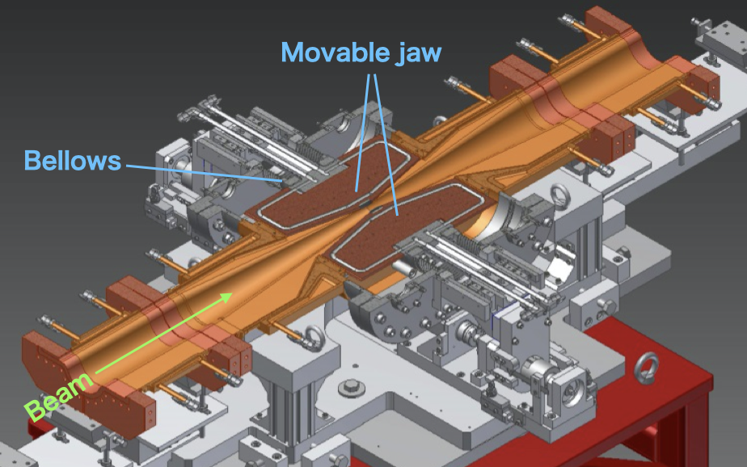
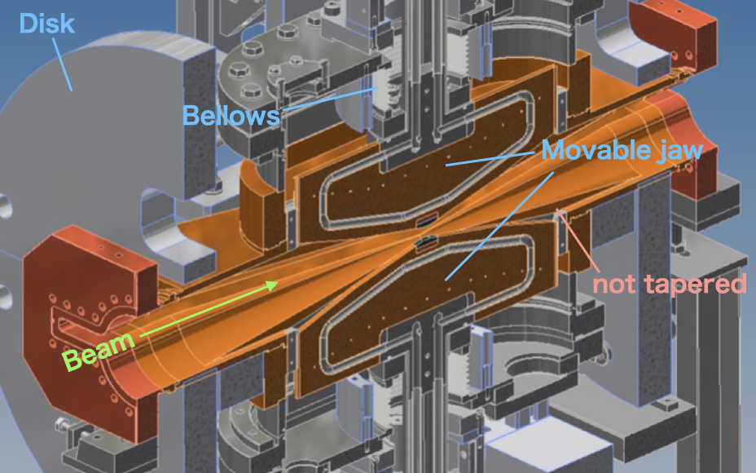
Design
We referenced movable collimators for PEP-II in SLAC for the basic design of the SuperKEKB type.
A collimator chamber has two movable jaws, which are placed the horizontal/vertical direction.
Part of the movable jaws is hidden inside the antechambers to avoid a trapped mode in gaps between the movable jaw and the chamber.
The chamber is tapered to the center of the collimator in order to avoid excitation of trapped-modes.
Materials at the tip of the jaws are tungsten (1st ver.), tantalum (2nd ver.), and carbon (low-Z, special ver.).
Collimator in PEP-II
Horizontal direction
Vertical direction
[S. DeBarger et al., SLAC-PUB-11752]
SuperKEKB type collimator

Slide 5
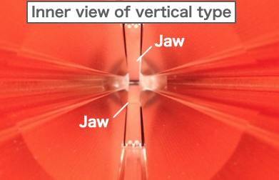
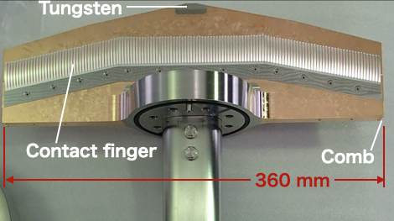
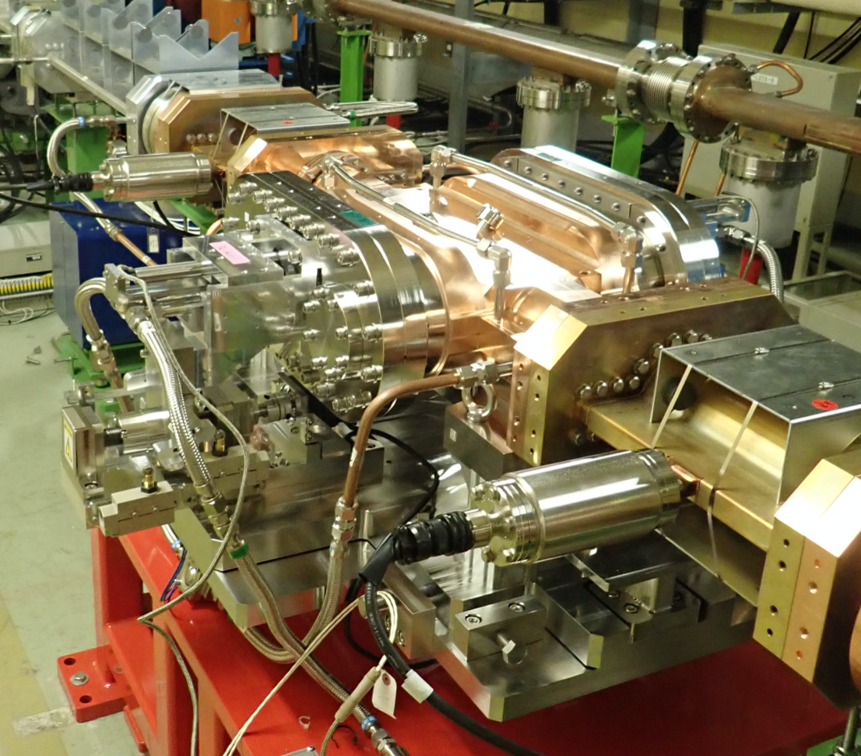
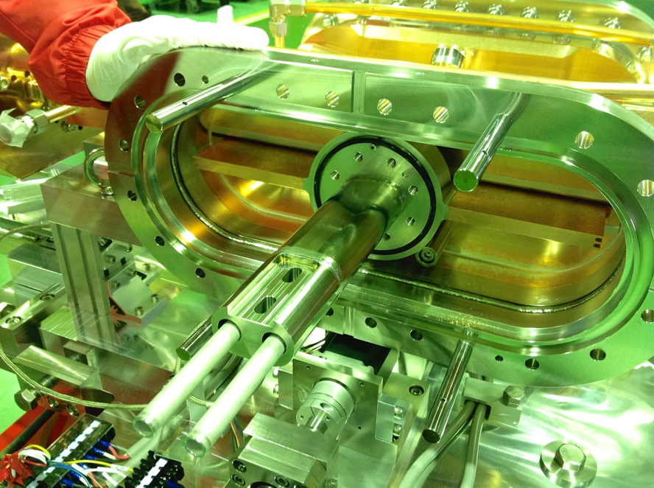
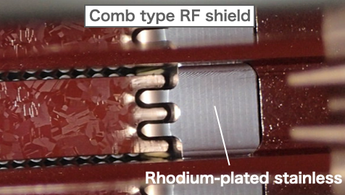
Design - RF shield
Contact finger-type RF shield is attached on the side wall of each jaw.
  The fingers are made of silver-plated INCONEL.
  The contact surface on the chamber is made of rhodium-plated stainless steel.
Contact-less comb-type RF shield is adopted between the longitudinal end of the jaw and the facing surface on the chamber.
Jaw with RF-shield

Slide 6
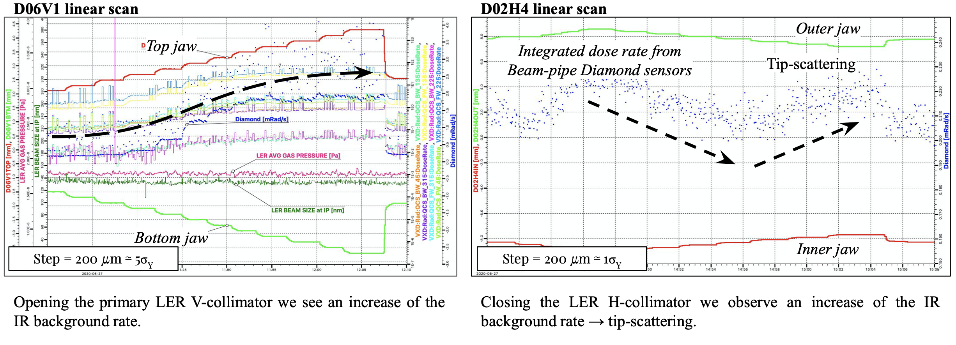
Experience - BG suppression
The SuperKEKB type collimators have been working well up to the beam current of 1.02 A in LER.
These collimators have been indispensable for Belle II and SuperKEKB.
[Andrii Natochii (Univ. of Hawaii) et al.]

Slide 7
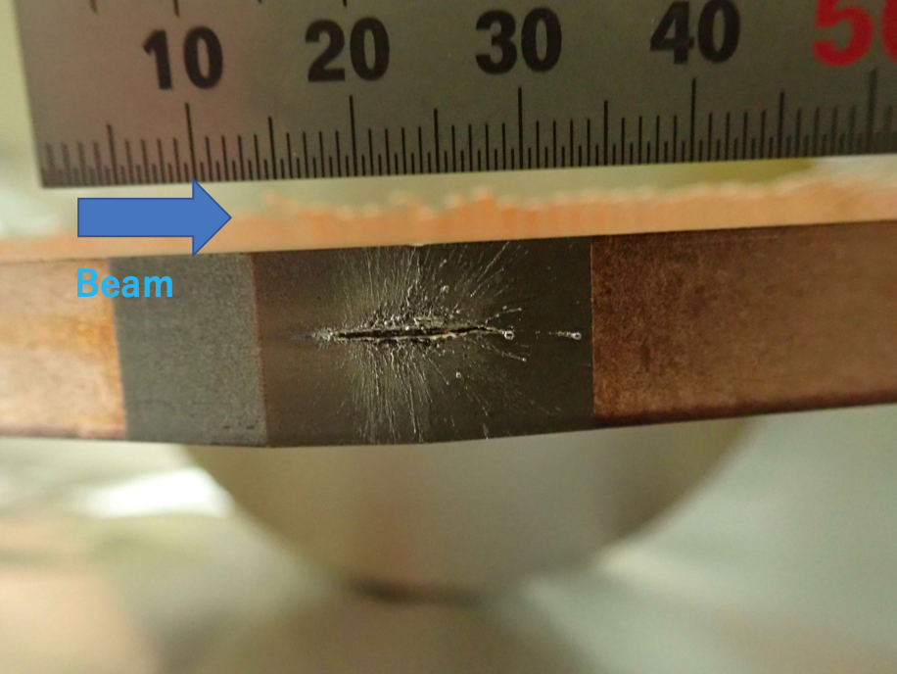
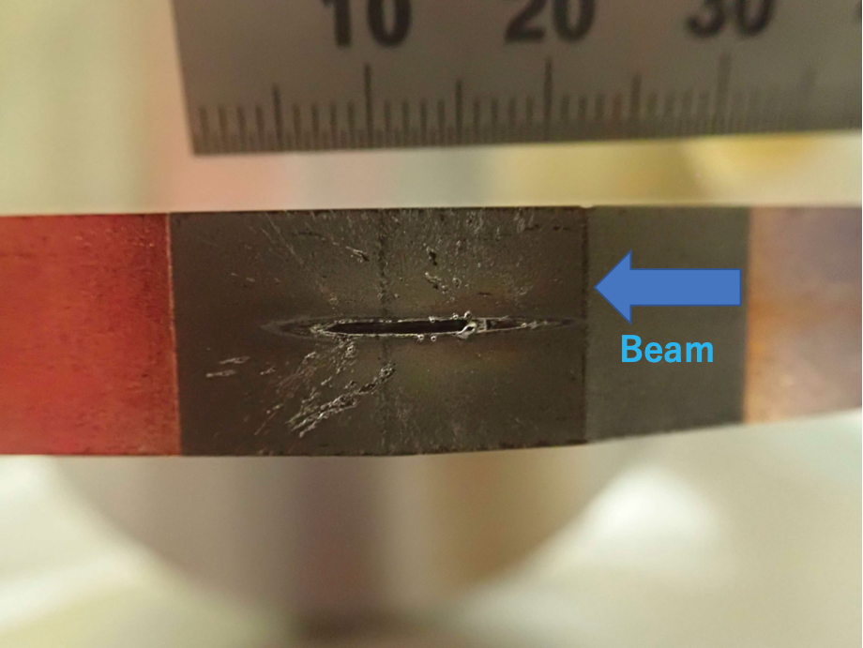
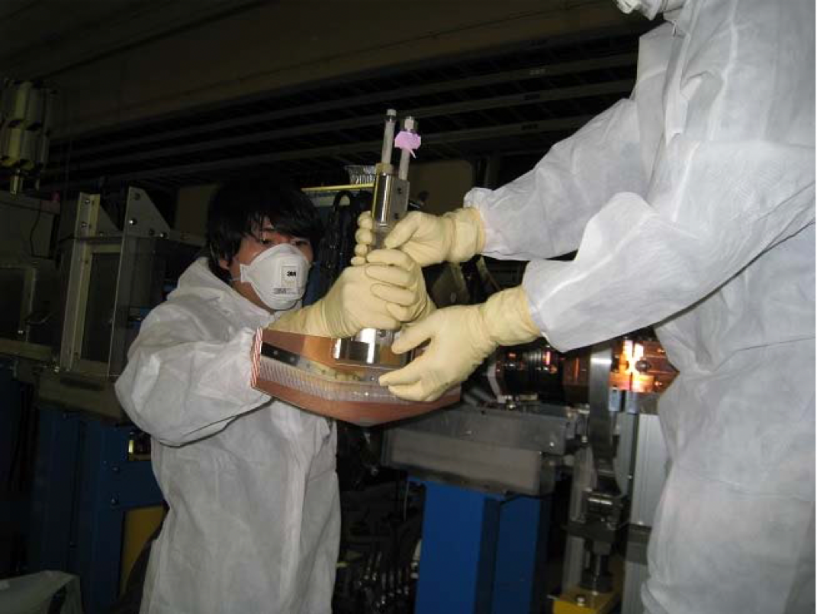
Experience - Damage
* short tantalum tip which has 5 mm.
Jaws of vertical collimators were damaged by beam hit.
  LER: D02V1 (2021ab), D06V1(2021ab)*, D06V1 (2020ab)*, D06V2 (2019c), D02V1 (2019ab), D02V1 (Phase-2)
  HER: D01V1 (Phase-2)
A huge beam loss and pressure burst has happened near them with a QCS quench .
The damaged tungsten tip has embrittled. For the tantalum tip, it did not embrittle.
The cause is unknown. A candidate is an interaction between the beam and a dust in the beam pipes.
The damaged jaws of D02V1 were replaced once during 2020c and 2021b because of the high BG level.
D02V1 bottom side (38 μSv/h)
D02V1 top side (95 μSv/h)
Replacement work in the presence of Radiation Science Center .
2021-06-08

Slide 8
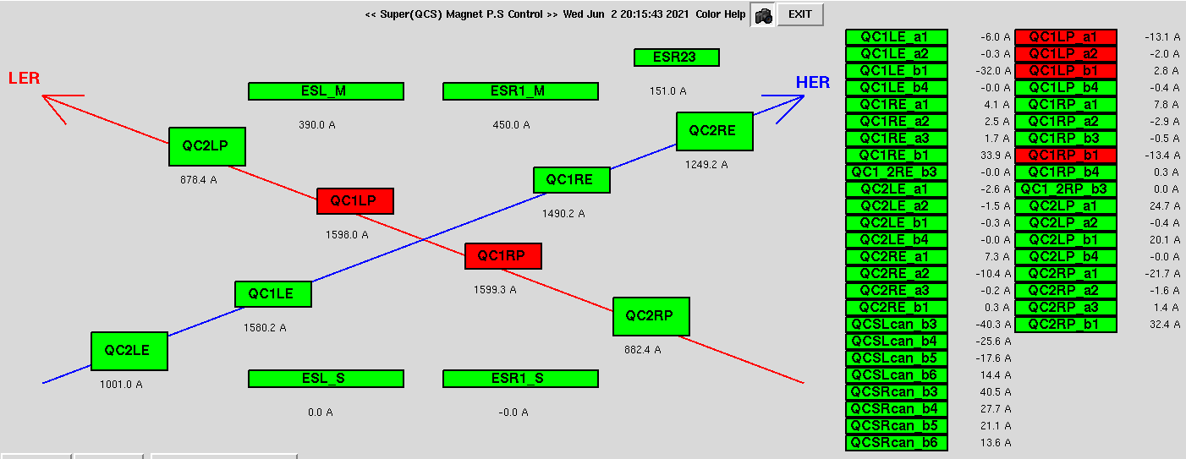
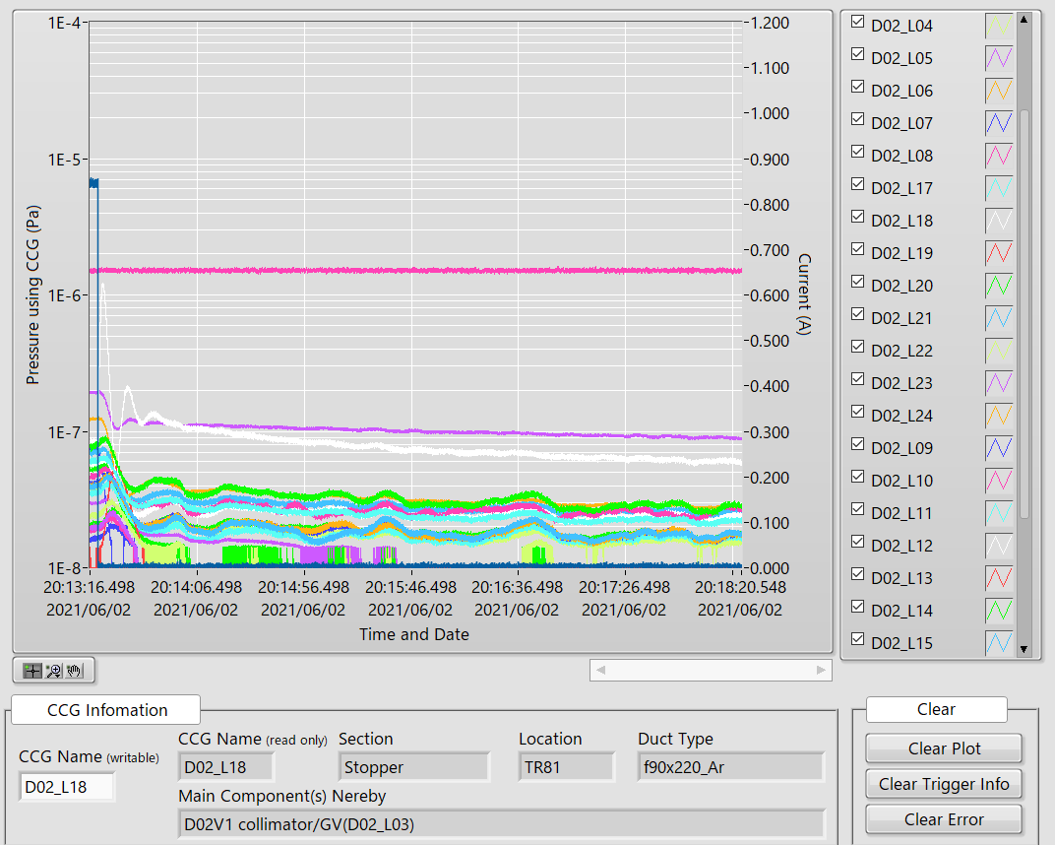
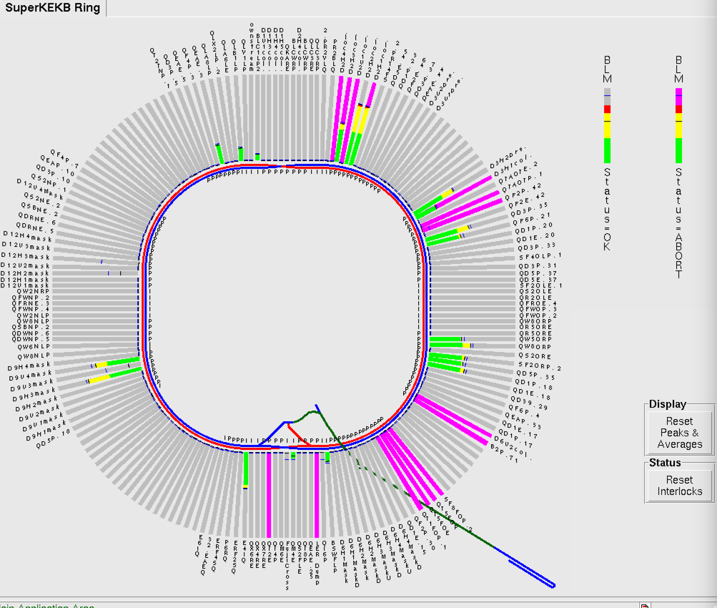
Experience - Damage
In case of a damaged event in 2021-06-02 20:13 (2021b run).
Pressure near CCG D02_L18 and D06_L12, which are placed near D02V1 and D06V1 collimator respectively, was increased instantaneously (beam hit the jaws probably).
QCS quench happened (QC1LP, QC1RP in LER).
Status of QCS
Pressure and beam current
LER Current
CCG D02_L18
Loss monitors in the rings

Slide 9
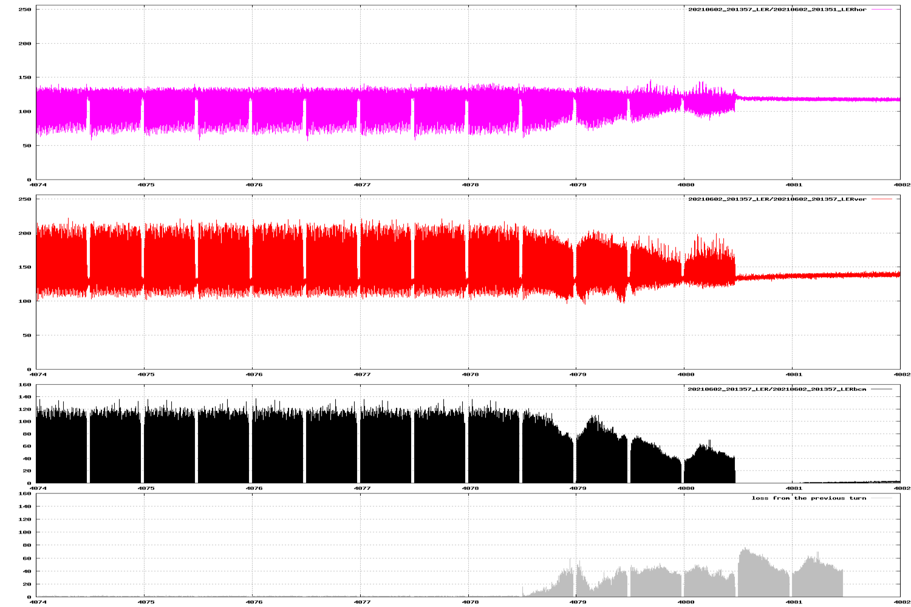
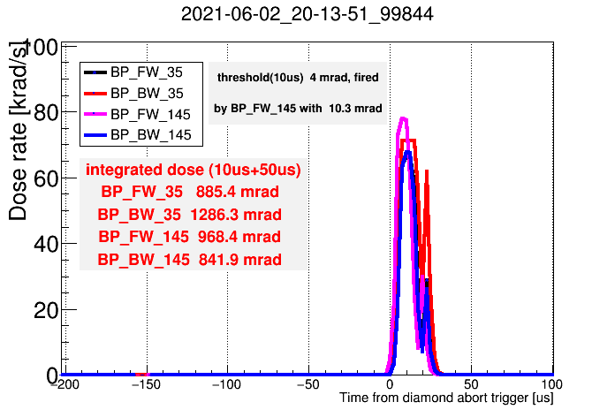
Experience - Damage
Sudden beam loss happened within 2-turn before the beam abort.
Dose on VXD diamond sensors of Belle II were extremely high and the signal saturated (usual beam loss abort: ~50 mRad or less).
The cause of the huge beam loss is unknown so far. One of the candidates is the interaction between the beam and a dust in the beam pipe.
  Results of simulations indicate that the beam loses at not the vertical collimators but the horizontal collimators mainly [Y. Funakoshi].
BOR(LER H)
a turn
1st train
2nd train
BOR(LER V)
BCM
BCM loss
Bunch oscillation recorder (BOR) and bunch current monitor (BCM), BOR signal is proportional to (bunch displacement)×(bunch intensity).
Dose in VXD diamond sensors of Belle II

Slide 10
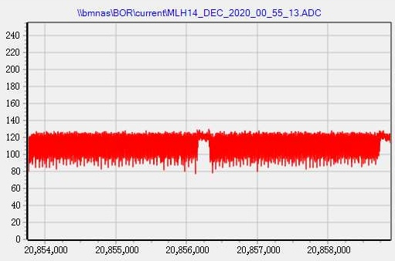
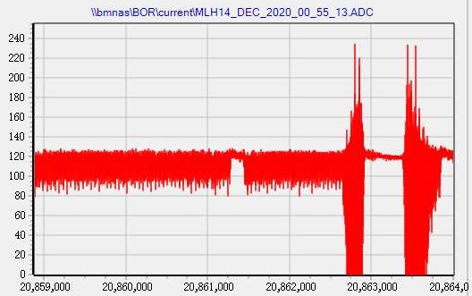
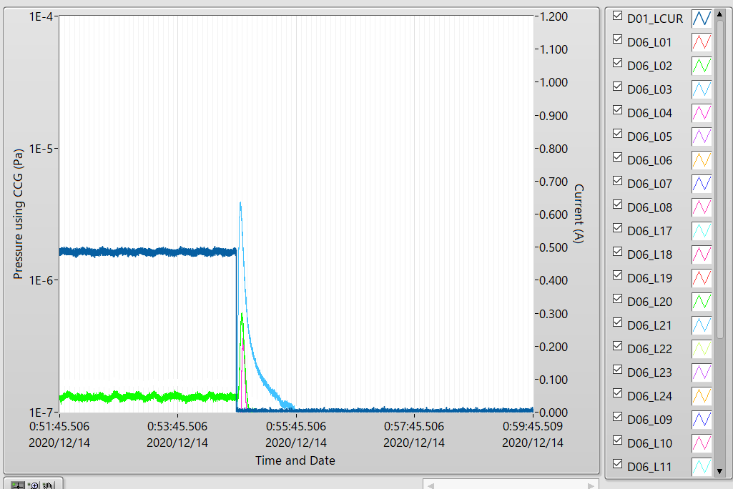
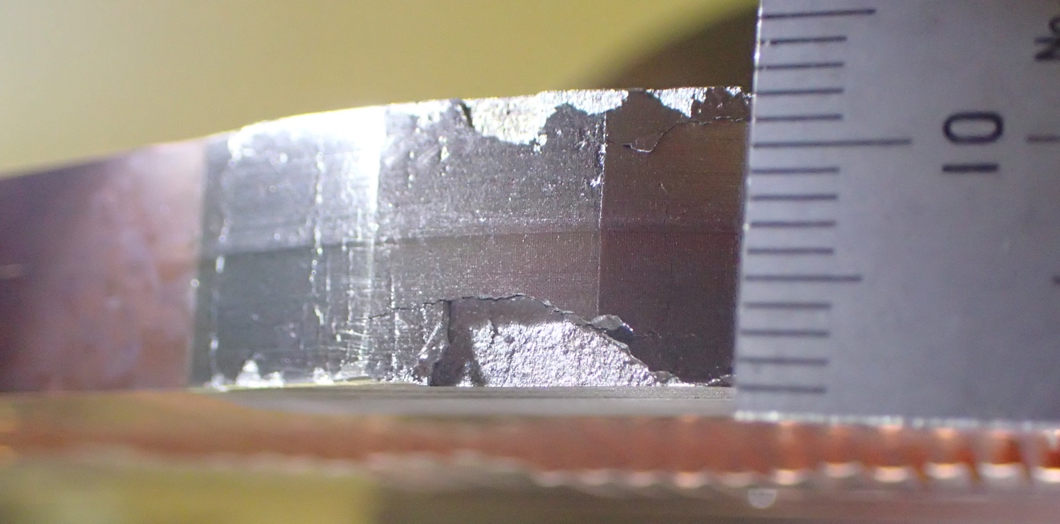
Experience – Accidental firings of injection kickers
Accidental firings of injection kickers have happened in LER.
(example) 2020-12-14 0:55, beam abort (VXD diamond) with pressure burst at D06H3.
  LER: 480 mA, HER: 449.9 mA
  A part of the bunches was suddenly kicked caused by an accidental firing of the injection kickers.
  Tips of D06H3 were seriously damaged by the beam hit.
In the current system, we cannot make the probability of the accidental firing zero, so some horizontal collimators in each ring has been used to protect the components against this. Carbon jaw in horizontal can be a better option.
[S. Terui]
LER current
CCG D06_L03
kicker misfire

Slide 11
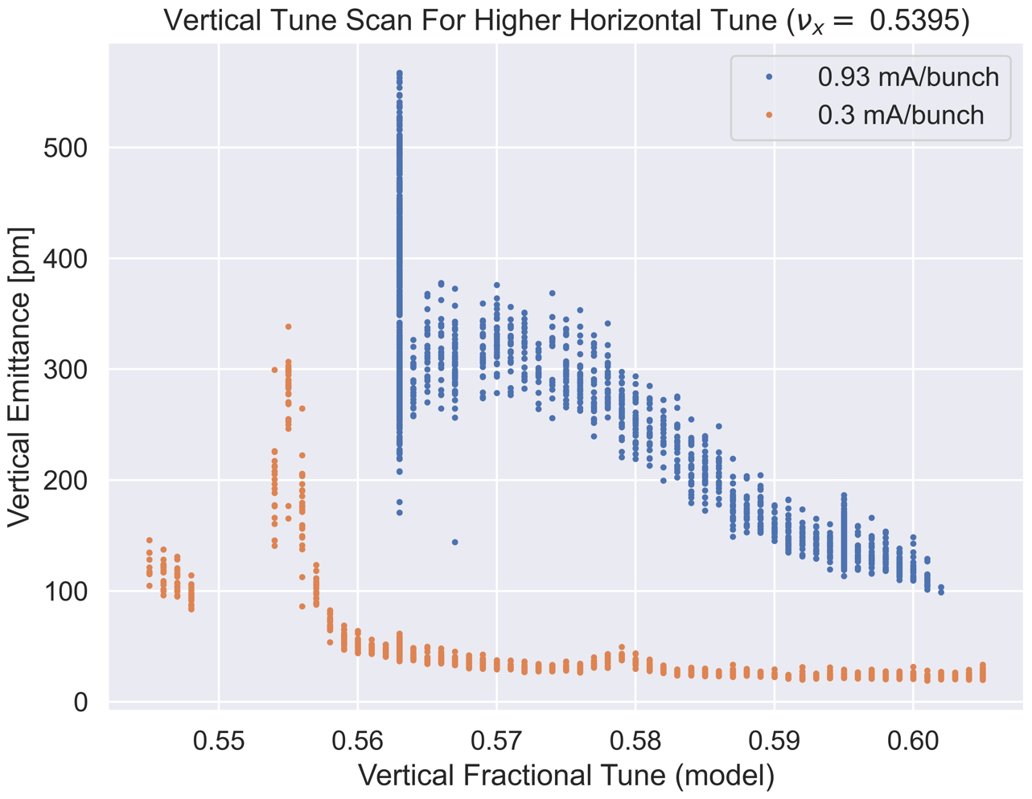
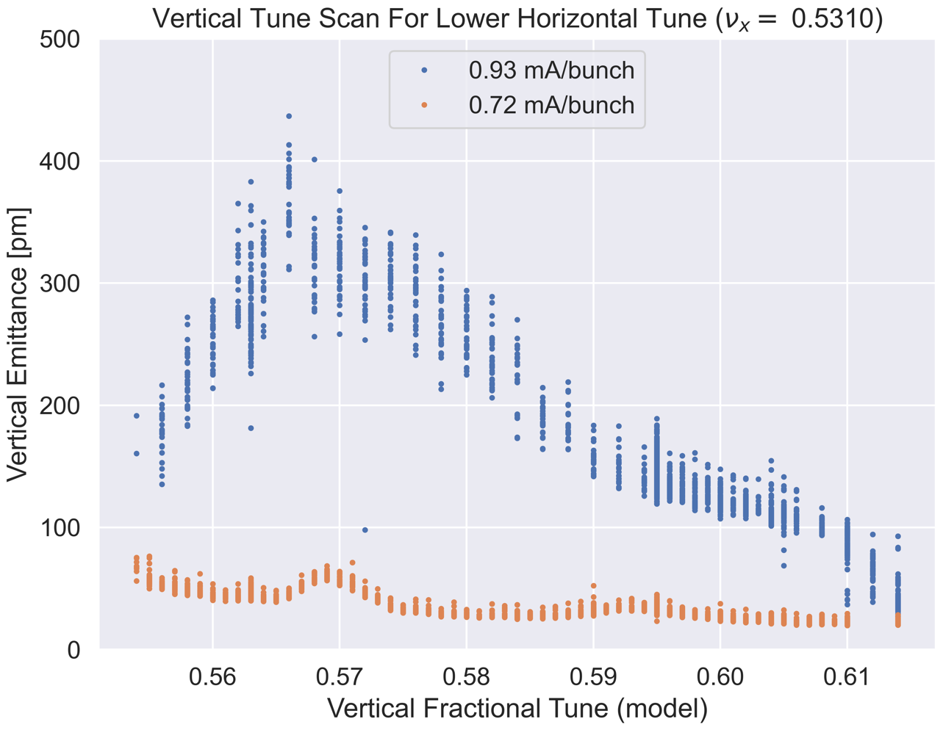
Experience – Vertical Beam-size blow-up
ν_{y} – ν_{x} + ν_{s}
ν_{y} – ν_{x} + 2ν_{s}
ν_{y} – ν_{x} + 2ν_{s}
?
ν_{y} – ν_{x}
ν_{y} – ν_{x} + ν_{s}
Vertical beam-size blow-up related to impedance in LER has observed in the single-beam operation.
The calculated bunch current threshold of Transverse Mode Coupling Instability (TMCI) is about 1.6 mA/bunch or more, but this blow-up has occurred around ~1.0 mA/bunch.
The bunch current threshold depends on the vertical tune, so this is caused by not the ordinary TMCI but the localized wake in the vertical collimators.
The tune scan had performed for βy*=1 mm, no collision, 97 bunches.

Slide 12
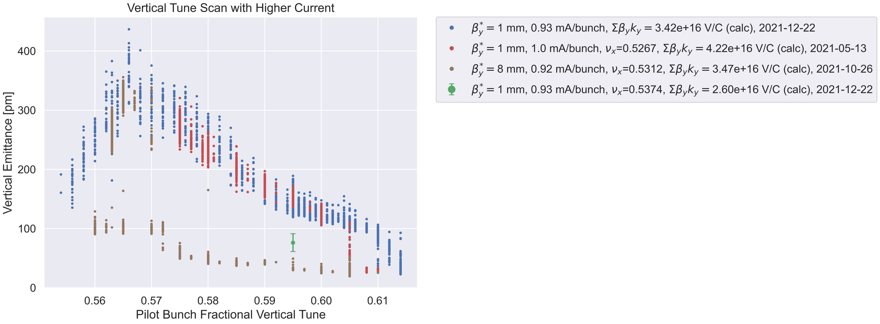
Experience – Vertical Beam-size blow-up
The bunch current threshold for the vertical beam size blow-up decreases in the situation of βy* = 1 mm compared with βy* = 8 mm.
In the study on Dec. 22nd, there were no damaged vertical collimators, but the situation looks same as that on May. 13th.
  There had been damaged vertical collimators on May. 13th.
When we opened apertures of some vertical collimators, the beam-size decreased (green colored dot with error bar).
The stop-band is remarkably spread when the instability occurs.

Slide 13
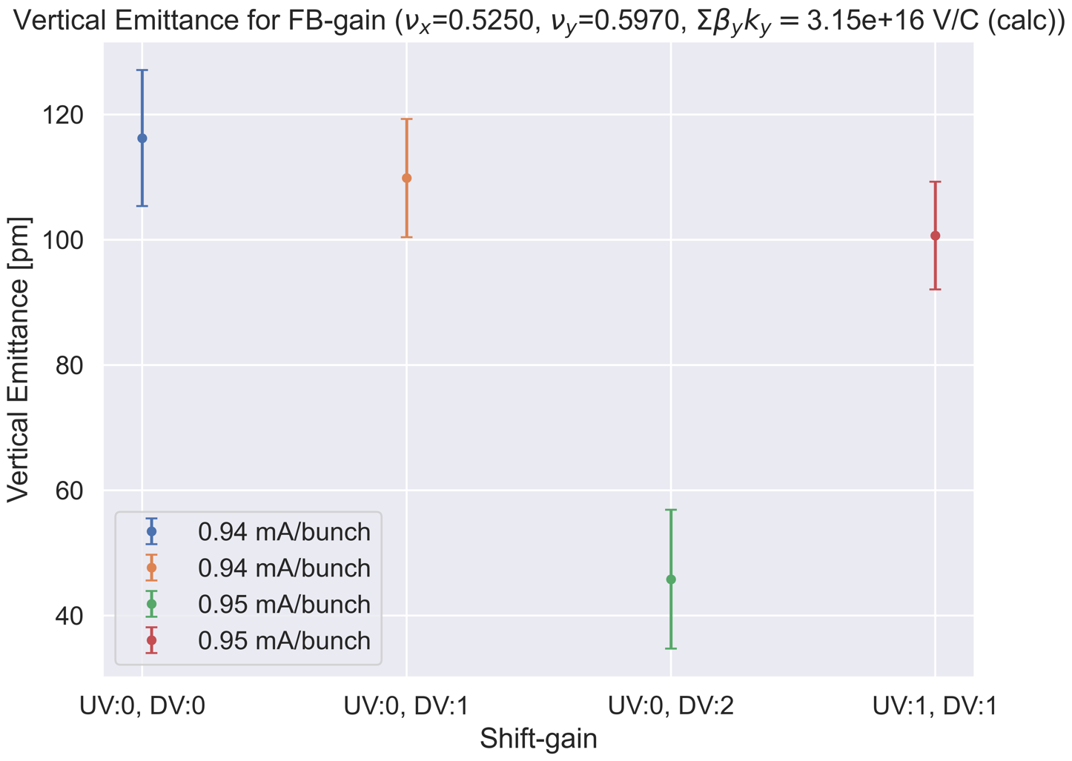
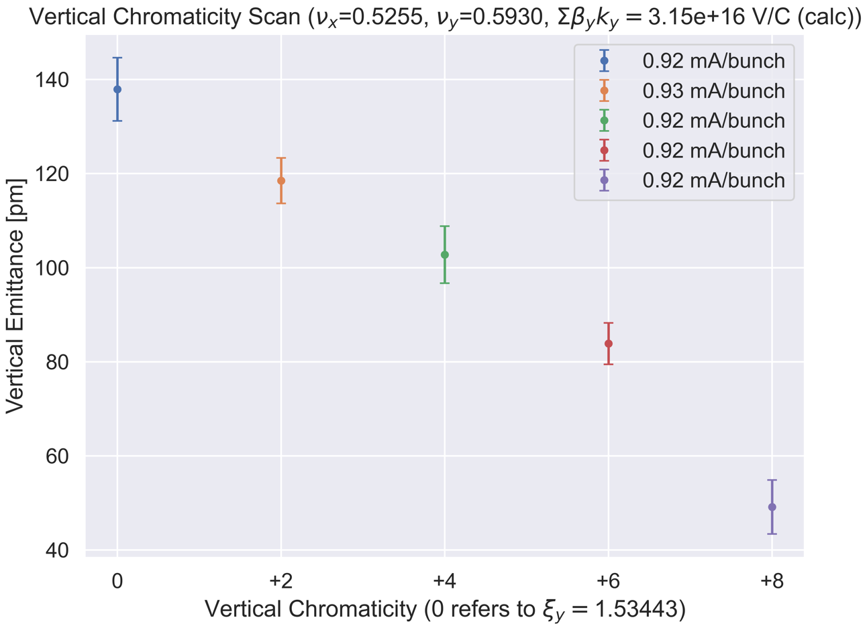
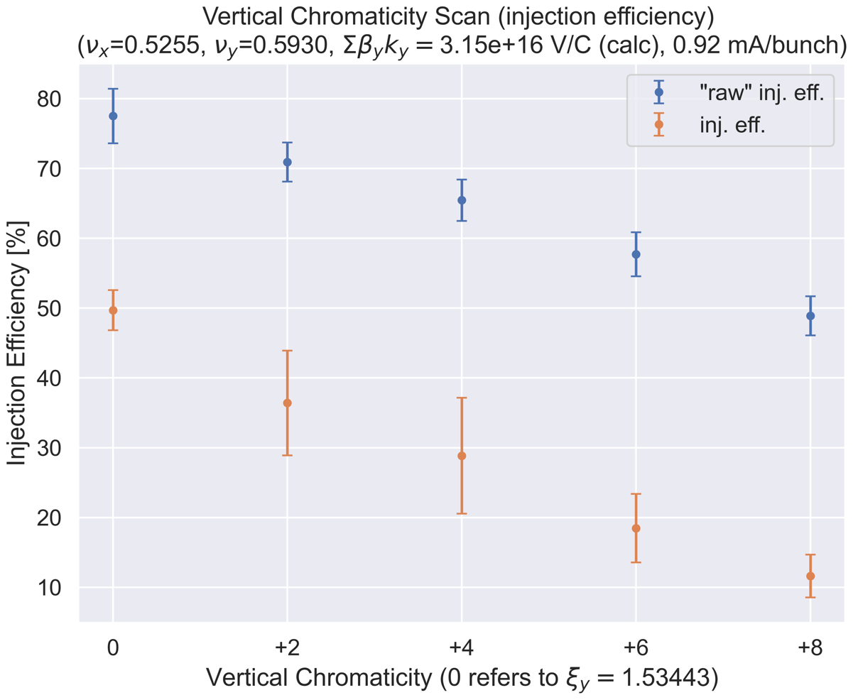
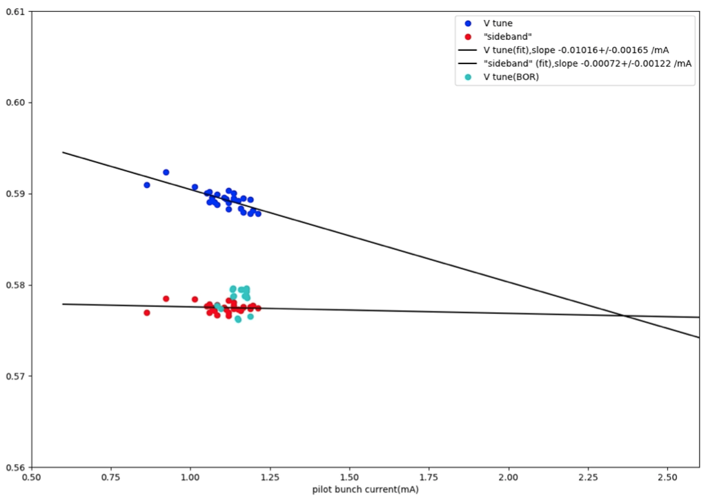
Experience – Vertical Beam-size blow-up
BxB FB can suppress the beam size blow-up.
We can also suppress the beam size blow-up by increasing the vertical chromaticity, however the injection efficiency becomes lower and lower.
The bunch current threshold of this beam size blow-up is ~1.0 mA/bunch.
However, the mode 0 and -1 seems to be coupled ~2.3 mA/bunch.
[H. Fukuma]

Slide 14
Summary
The SuperKEKB type collimators have been working well up to the beam current of approximately 1 A in LER.
These collimators have been indispensable for Belle II and SuperKEKB.
However, there are serious issues:
  Beam induced damage
  Vertical beam-size blow-up in LER caused by localized wake in vertical collimators.
Non-linear collimator at LER OHO section could relax the instability. We have plans to construct this during Long Shutdown-1 (LS1), 2022.
We’re also working to understand the observed transverse blow-up through machine studies, building a machine impedance model able to reproduce the instability in a TMCI working group of SuperKEKB International Task Force. If there is a person who are interested in or wants to join this TMCI sub-group, let me know (takuya.ishibashi@kek.jp).
Contact person: Mauro Migliorati (SAPIENZA - Università di Roma)
Sub-contact person: Takuya Ishibashi (KEK)

Slide 15
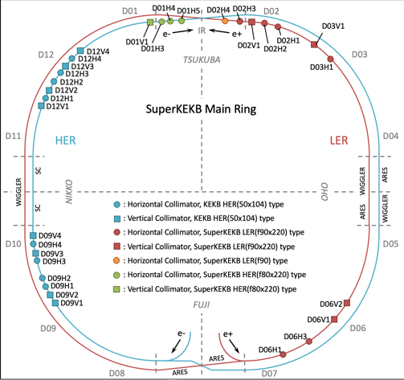
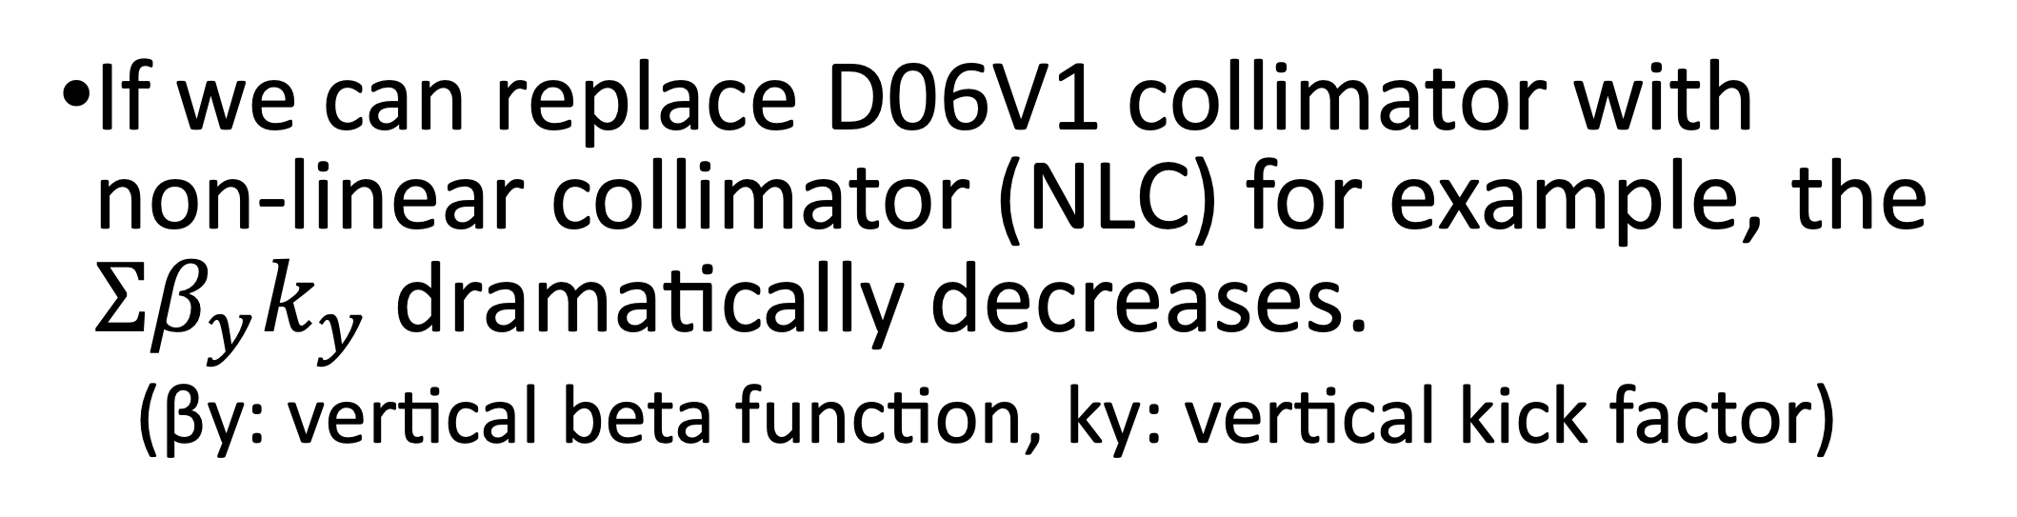
Plan – Non-linear collimator at LER OHO section
Present collimator setting (2021ab)
  D06V1: primary collimator: most tightly closed and suppresses the injection BG.
  D02V1: second collimator: closest vertical collimator to IP and very important to suppress BG
  D06V2, D03V1: backup: not so tightly closed. D03V1 can be used for a backup of D02V1.
If we can replace D06V1 collimator with non-linear collimator (NLC) for example, the $Σβ_{y}k_{y}$ dramatically decreases.
(βy: vertical beta function, ky: vertical kick factor)
NLC

Slide 16
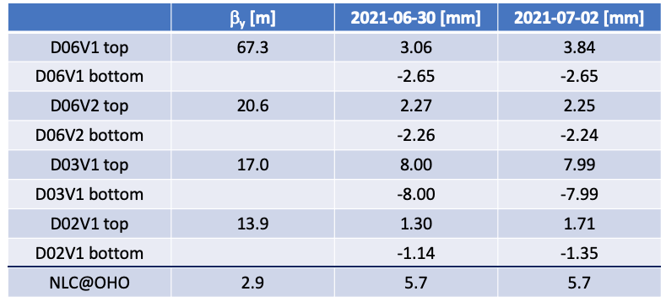
Plan – Non-linear collimator at LER OHO section
Collimator setting (half-aperture) during physics run in 2021b (βy*=1 mm)
The β_{y} at the D06V1 is large, and the aperture is narrow.
The β_{y} at the NLC is small, and the aperture is wide.
→ We could dramatically decrease the $Σβ_{y}k_{y}$ if we can replace D06V1 with NLC.

Slide 17
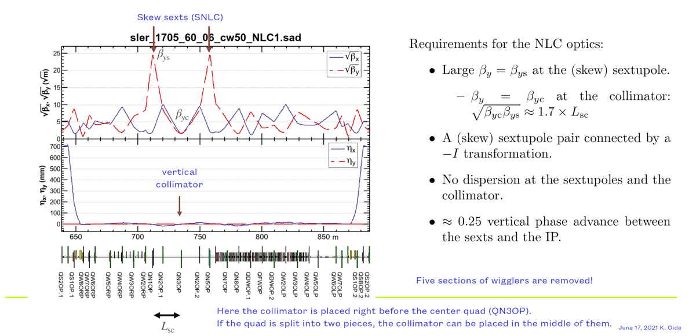
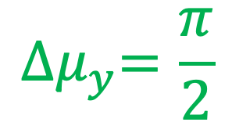

Plan – Non-linear collimator at LER OHO section
Scheme
$$−I$$
[K. Oide]
$${∆μ}_{y}=\frac{π}{2}$$

Slide 18
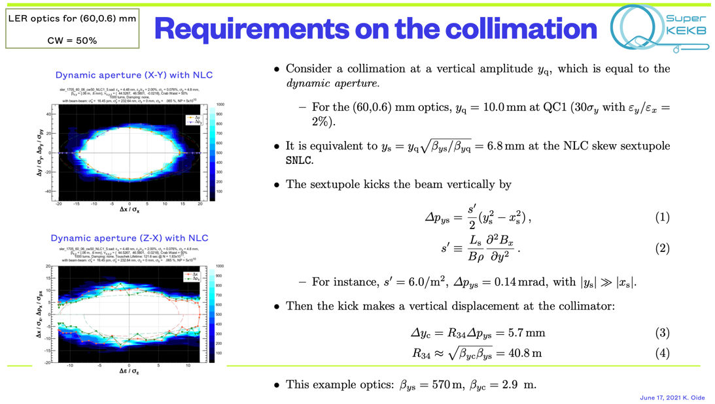
Plan – Non-linear collimator at LER OHO section
[K. Oide]

Slide 19
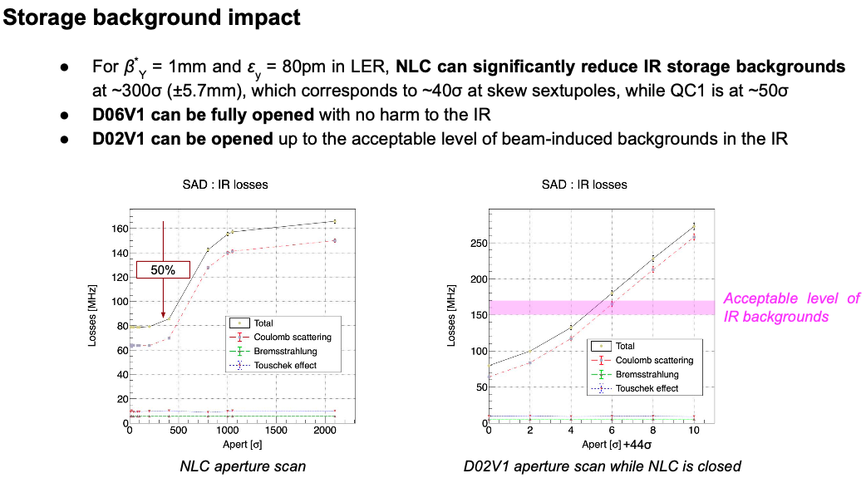
Plan – Non-linear collimator at LER OHO section
[A. Natochii]

Slide 20
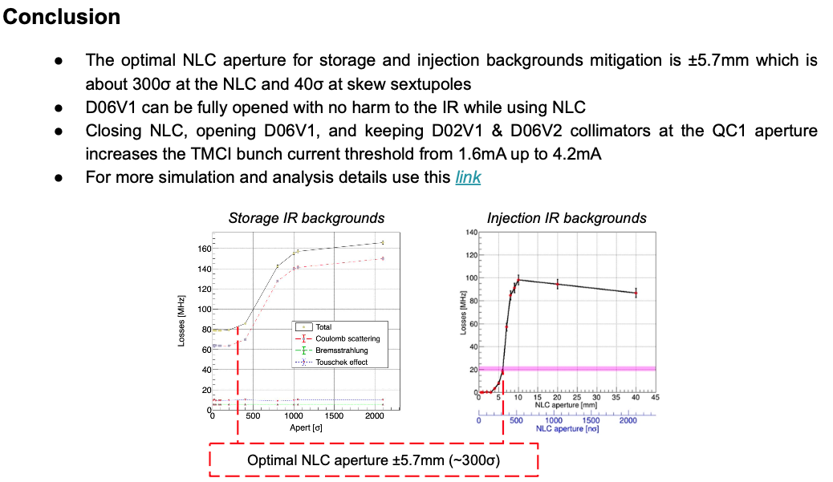
Plan – Non-linear collimator at LER OHO section
[A. Natochii]

Slide 21
backup

Slide 22
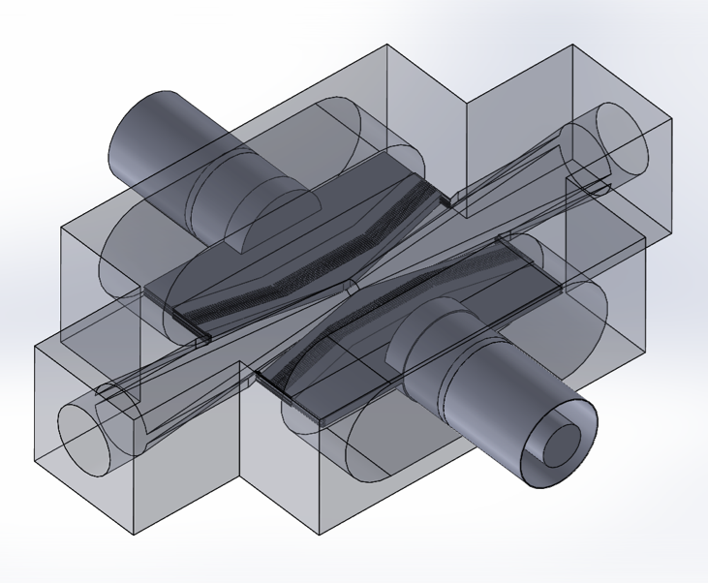
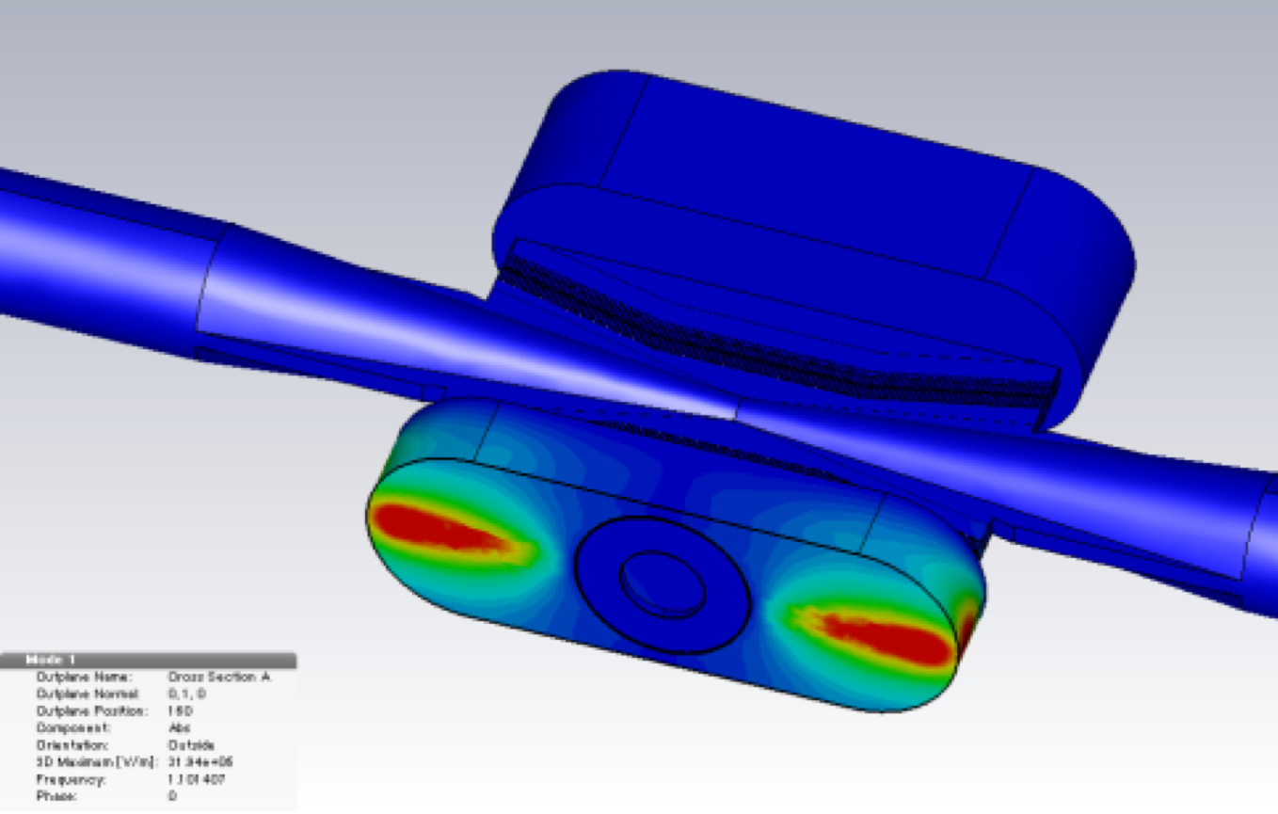
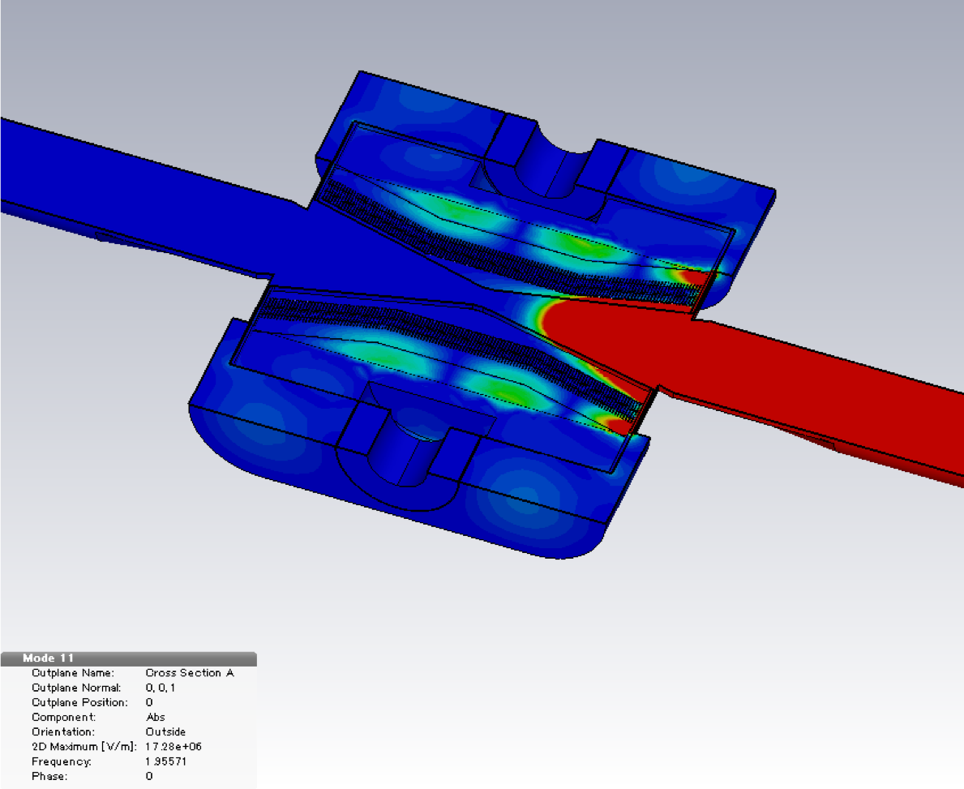
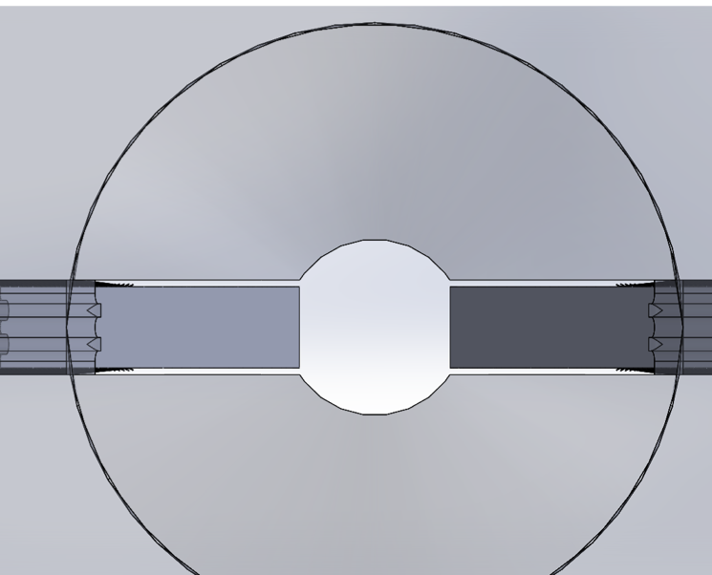
Design - RF property
We estimated effectivity of the RF shields using Eigen-mode solver in CST Studio.
The maximum electric field strength in the beam channel is 1.7x10⁷ V m⁻¹, and 10 V m⁻¹ in a gap between the jaw and the chamber wall.
RF in the beam channel is intruded into the chamber placed the jaw. However, the coupling between the beam channel and the chamber is small.
[T. Ishibashi et al., PRAB 23, 053501 (2020)]
E-field strength in jaw’s chamber
(1.1014 GHz)
E-field strength in beam channel
(TE111: 1.9557 GHz)
Simulation model in CST Studio

Slide 23
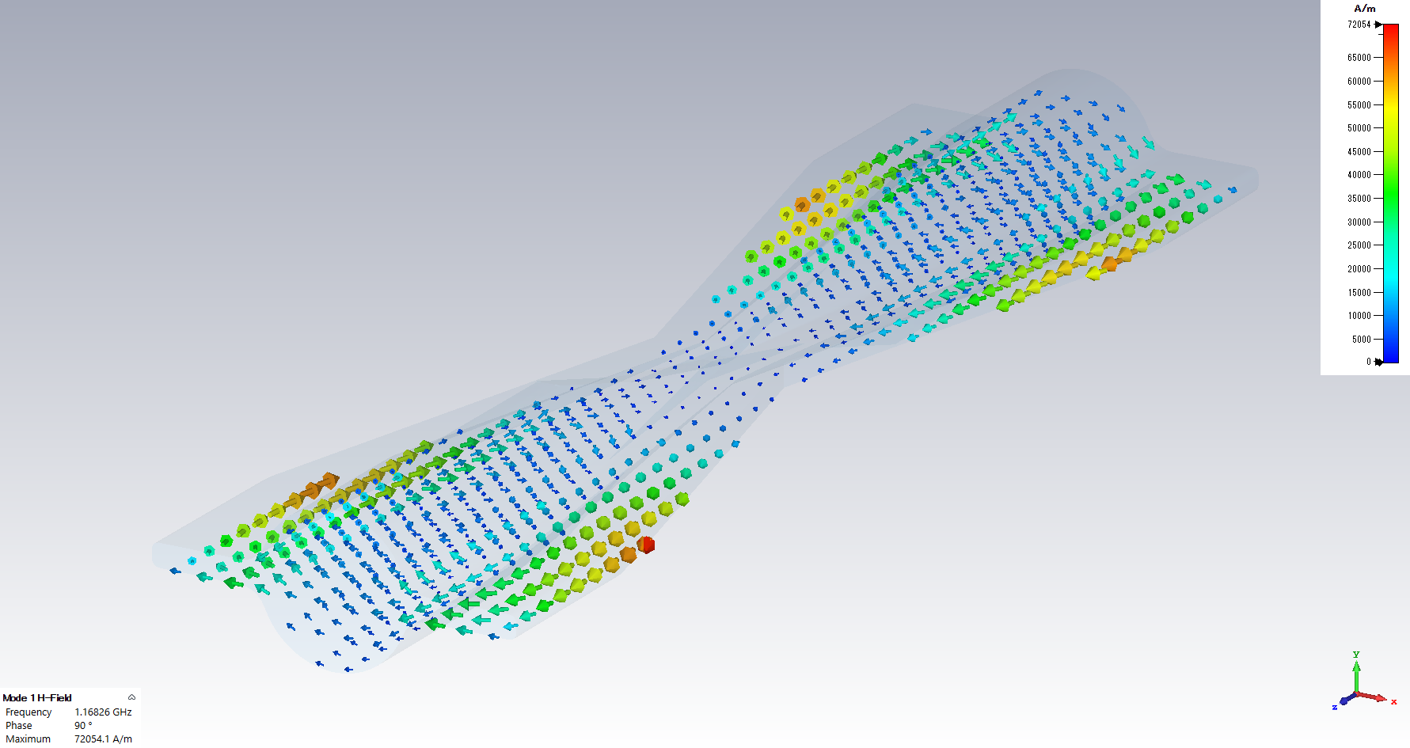
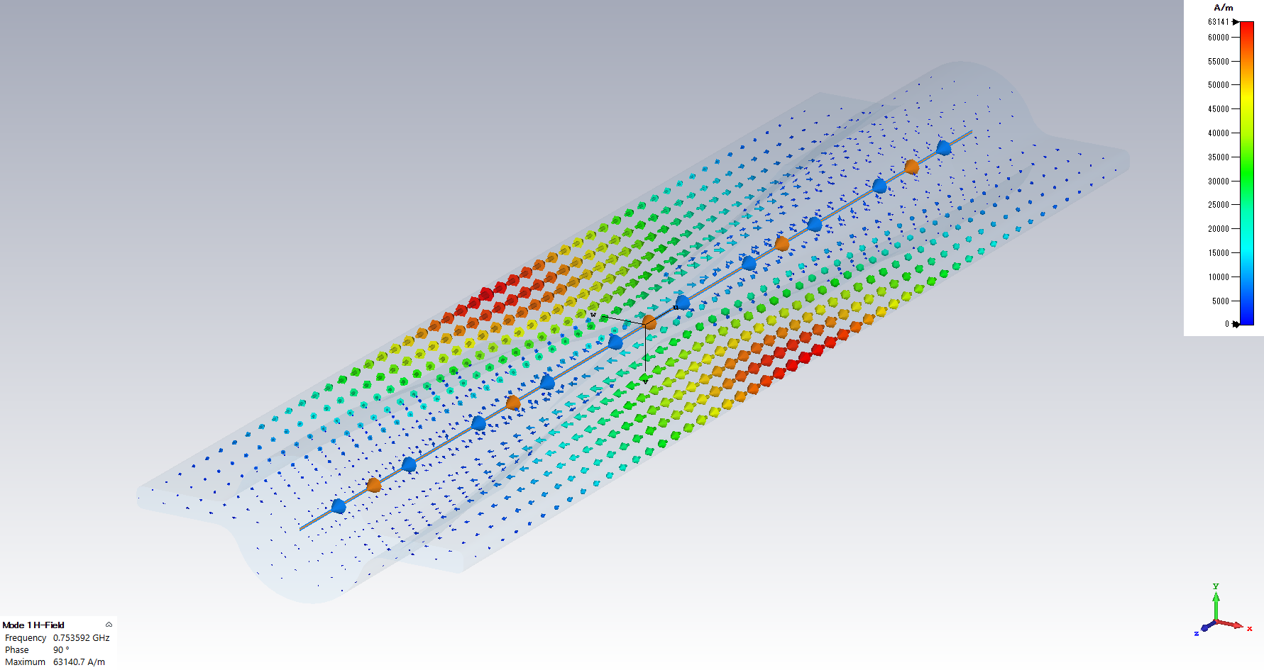
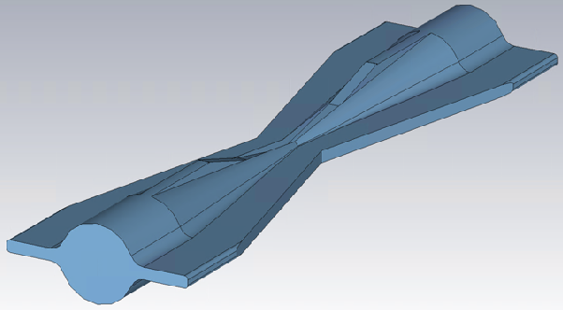
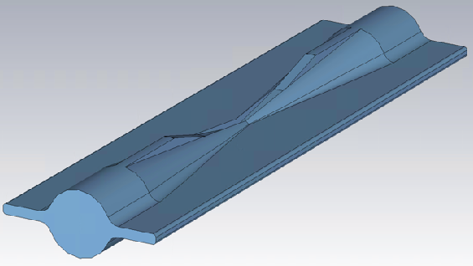
Design - RF property
A trapped mode is excited around the jaws in the vertical collimator with straight shaped antechambers.
The excitation of the trapped mode is avoided by means of tapering the inside of the antechambers to the center of the vertical collimator.
[T. Ishibashi et al., PRAB 23, 053501 (2020)]
Height in antechambers at center: 0 mm
(0.7536 GHz)
Height in antechambers at center: 70 mm
(1.1683 GHz)
E-field

Slide 24
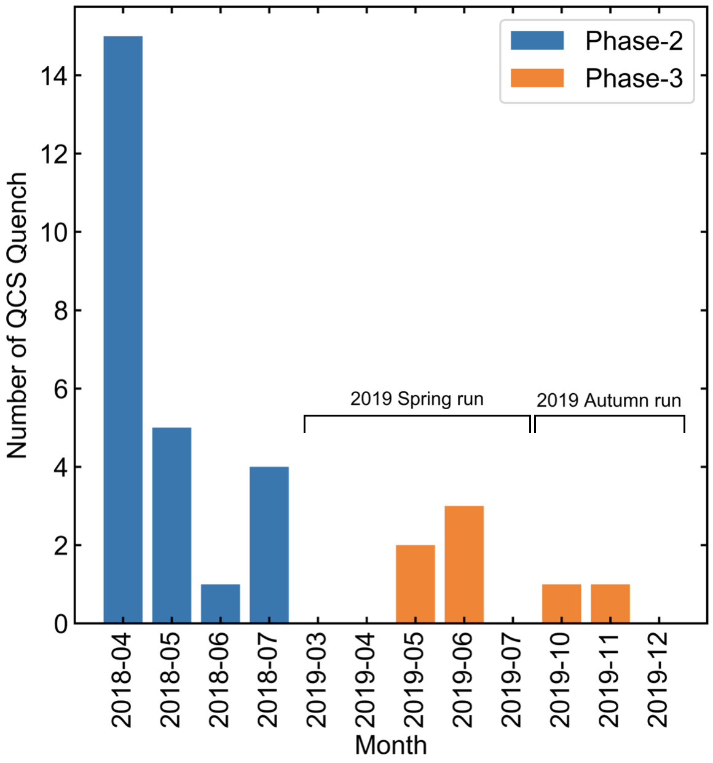
Experience - QCS protection
The collimators were tuned on April 23rd in 2018, and there were no QCS quenches in that month after this tuning.
Then, the number of the occurrences was dramatically decreased.
Number of QCS quenches derived from beam loss in QCS (monthly).
[T. Ishibashi et al., PRAB 23, 053501 (2020)]

Slide 25
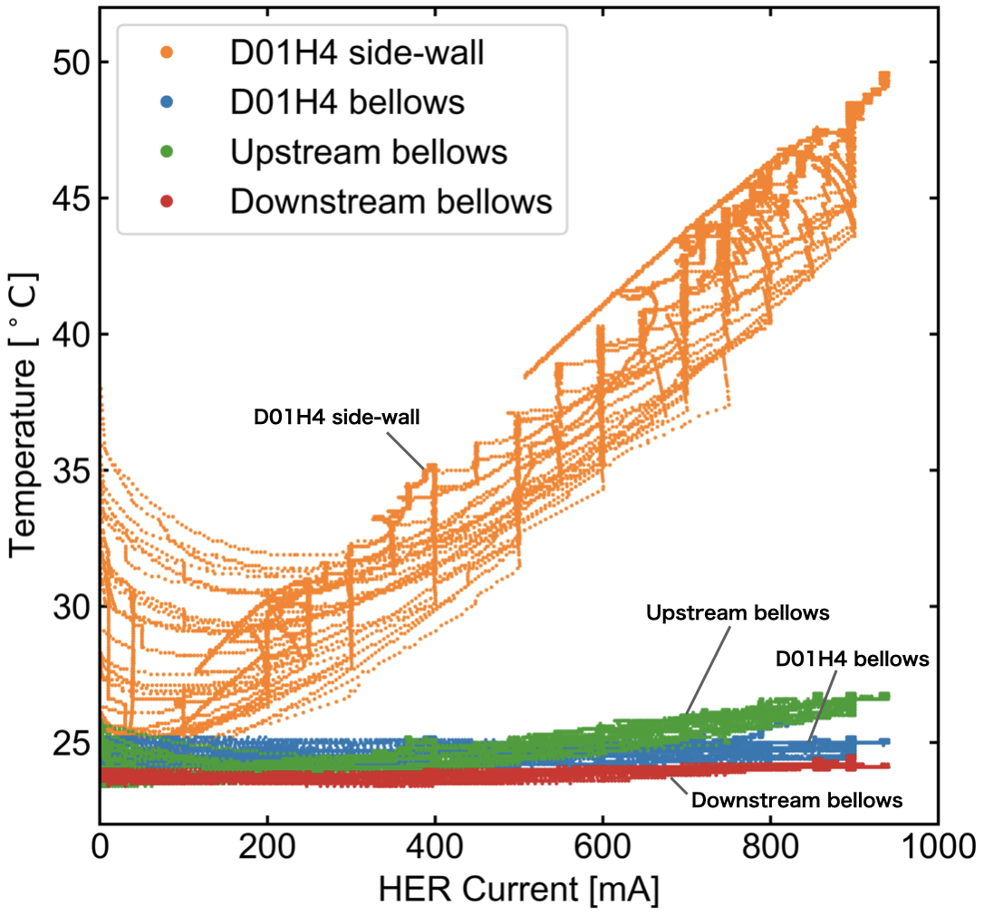
Experience - Heating
An abnormal heating in the collimators themselves and components near them has not been observed.
We cannot see any temperature rise with an RTD on a bellows, which is a connection part between the movable jaw and the chamber in the collimator.
[T. Ishibashi et al., PRAB 23, 053501 (2020)]
The temperature on the collimator and the bellows chambers beside it increases linearly. This heating is derived from the SR mainly.
The SR power density on the tapered wall with 12 degrees is approximately 18.2 kW m⁻¹ in D01H4 collimator. This is the highest power density in all of the collimators in SuperKEKB MR.
Temperature on D01H4 collimator using RTD.

Slide 26
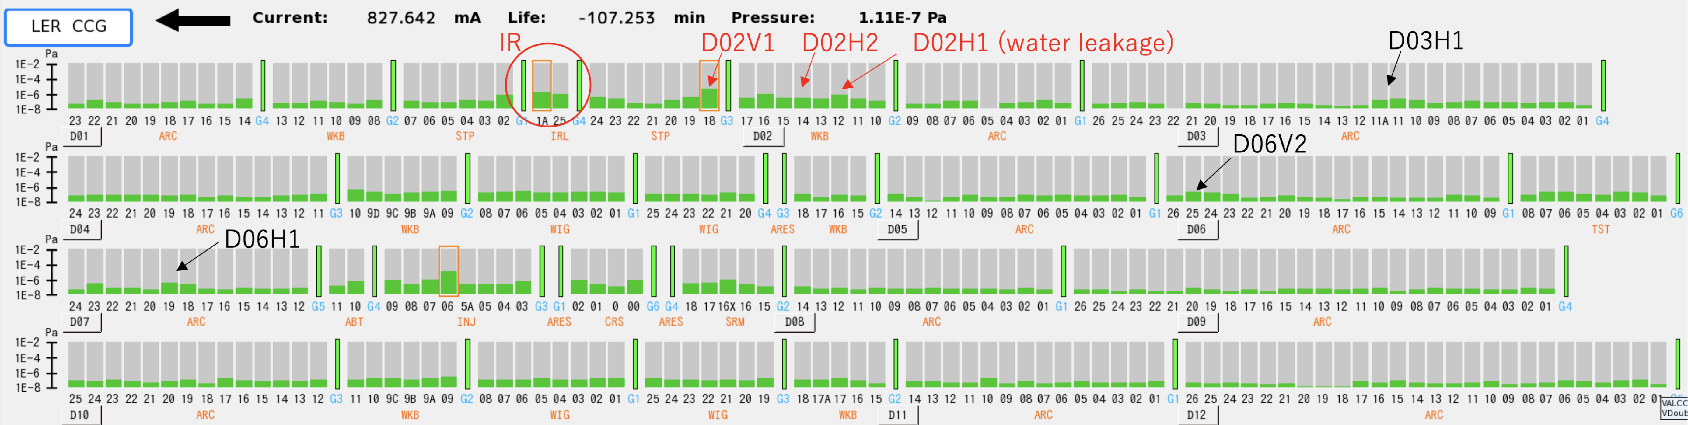
Experience - Pressure
Pressure upstream of IP in LER.
  Vacuum component is dominant for BG in LER.
  Especially, pressures near D02V1 and D02H1 had been high during 2019 spring run.
    D02H1 collimator had had a water leakage trouble before the run, so it could raise the pressure.
→ baked out these collimators and beam pipes in tunnel before 2019 autumn run.
LER pressure distribution in 2019 Spring run.

Slide 27


Experience - Pressure
D02H1, H2 collimator:
  ion pumps bake-out: ~32 hours (2019-09-03 10:00 ~ 09-04 16:00)
  NEG activation: ~33 hours (2019-09-04 10:00 ~ 09-05 17:00)
D02V1 collimator:
  ion pumps bake-out: ~24 hours (2019-09-11 10:00 ~ 09-12 10:00)
  NEG activation: ~43 hours (2019-09-11 15:00 ~ 09-13 10:00)

Slide 28




Experience - Pressure
The bake-out was very effective for D02H1 collimator especially, because there was a water leakage trouble.
Reduction effect for the dynamic pressure in D02V1 seems to be small because of the history effect.

Slide 29


Experience -Short Tip
After the damaged accident, the background level became higher.
  horizontal orbit bump
  horizontally shift the collimator
  replace them to new ones during shutdown
We developed a tantalum tip with a short length (5 mm).
This jaw was also damaged during 2020 Spring run, however we didn’t observe the background growth (we didn’t notice that until we opened the collimator chamber for a carbon jaws’ installation work).
We didn’t observe any embrittlement on the damaged tip (In a way, good news).
beam
beam
top side jaw
bottom side jaw
Tantalum jaw with 5 mm length

Slide 30
Low-Z collimator
Feasibility of titanium for the collimator had been already checked in KEKB.
We’ve started checking the feasibility for a C/C composite material.
 | Electrical conductivity [μΩ m] | Thermal conductivity [W m⁻¹ K⁻¹] | Density [g cm⁻³] | Melting point [℃] | Radiation length [mm] | Tensile strength [MPa] | Bondability | Outgassing | Dust generation
C/C composite* | 2.7, 3.4, 5.1 (x, y, z) | 390, 320, 190 (x, y, z) | 1.65 | 3800 | approx. 200 | 35, 30, 11 (x, y, z) | OK | Low | High
Titanium | 0.42 | 21.9 | 4.5 | 1663 | 35.6 | 350 | OK | Low | Low
Tantalum | 0.131 | 57.5 | 16.65 | 2985 | 4.0 | 200 | OK | Low | Low
Tungsten | 0.528 | 173 | 19.25 | 3422 | 3.5 | >800 | OK | Low | Low
Diamond | >10¹⁶ | 2000-2300 | 3.5 | (2000) | 120 | 1000 | TBC | Low | Low
* CX2002-U (carbon fiber felt), Toyo Tanso Co.,Ltd.

Slide 31

Low-Z collimator
Samples were baked with 250 ℃ for approximately 24 hours.

Slide 32

Low-Z collimator
[Andrii Natochii (Univ. of Hawaii) et al.]

Slide 33


Topics: Low-Z (Carbon) collimator in D06V1 collimator
Materials with a short radiation length is very effective as a beam tail shield, however the beam loss is localized and the temperature of that exceeds the melting point.
In order to protect the collimators for BG suppression from abnormal beams, we developed a collimator with carbon* and installed it in D06V1 during 2020 summer shutdown.
No abnormal pressure rise and heating are observed, however its impedance lower the bunch current threshold.
* Glass like carbon coated and impregnated C/C composite (GCX2002-U_GP2B, Toyo Tanso Co.,Ltd.).
H. Nakayama
D06V1 aperture
Carbon (L=60 mm)
background

Slide 34

Topics: Trial of phase matched optics between collimators in LER
In its final stage (Dec. 14th), LER optics was changed to one where the phase advance between D02V1-D03V1 and D02V1-D06V1 are 3.5 and 16, respectively.
  Protecting D02V1 by the two collimators.
By closing the D03V1 aperture to ±1 mm、the storage BG in TOP was decreased by 30-40%. However, injection BG in VXD was increased and the effect of collimators’ impedance became prominent (talk later).
Hit rates of TOP and CDC
H. Nakayama

Slide 35


Topics: Bunch length measurements for collimator apertures
We measured the bunch length in LER in the collimators’ impedance study simultaneously.
No correlation for the collimators’ apertures.
However, it’s longer than expected.
H. Ikeda

