Slide 1
CEPC alignment and Installation
Wang xiaolong
On behalf of CEPC Installation and Alignment Group
HKUST IAS Mini Workshop of Accelerator (HEP 2022)
Jan. 13-14, 2022, online Hongkong

Slide 2
Contents
  CEPC alignment strategy
  CEPC installation strategy
  Summary

Slide 3
  一、CEPC alignment strategy

Slide 4
Component alignment precision requirement
Provide by physics group
Component | Transversal/mm | Vertical/mm | Longitudinal/mm | Pitch /mrad | Yaw /mrad | Roll /mrad
Arc Dipole | 0.1 | 0.1 | 0.1 | 0.1 | 0.1 | 0.1
Arc Quadrupole | 0.1 | 0.1 | 0.1 | 0.1 | 0.1 | 0.1
Arc Sextupole | 0.1 | 0.1 | 0.1 | 0.1 | 0.1 | 0.1
IR Quadrupole | 0.05 | 0.05 | 0.05 | 0.05 | 0.05 | 0.05
IR SCQ | 0.05 | 0.05 | 0.05 | 0.05 | 0.05 | 0.05
IR Sextupole | 0.05 | 0.05 | 0.05 | 0.05 | 0.05 | 0.05
RF、injection、Linac alignment requirement reference to the arc region components
Error sources
Alignment control network error
Component fiducialization / pre-alignment error
Measurement error
Installation adjustment error

Slide 5
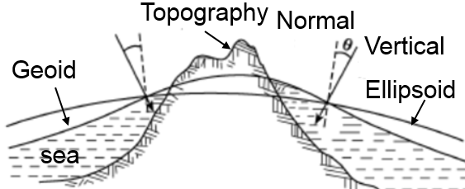
一、CEPC alignment strategy
CEPC alignment global datum
  Reference Ellipsoid: the base to establish projection plane, Quasi-Geoid model and vertical deflection model.
  Quasi-Geoid model: global datum for the height coordinate calculation.
    Vertical deflection model: global datum for the vertical axis of the instrument coordinate system directional in the CEPC coordinate system.

Slide 6
一、CEPC alignment strategy
CEPC alignment control network
Control network：provide an unified location reference frame for CEPC alignment and control the error accumulation；
3 levels control network
  Surface control network
  Backbone control network
  Tunnel control network

Slide 7
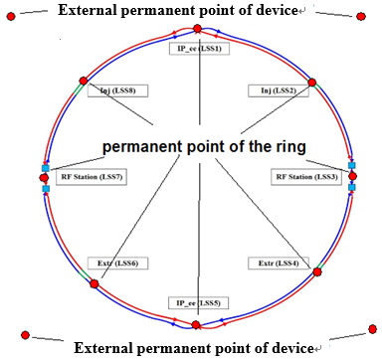
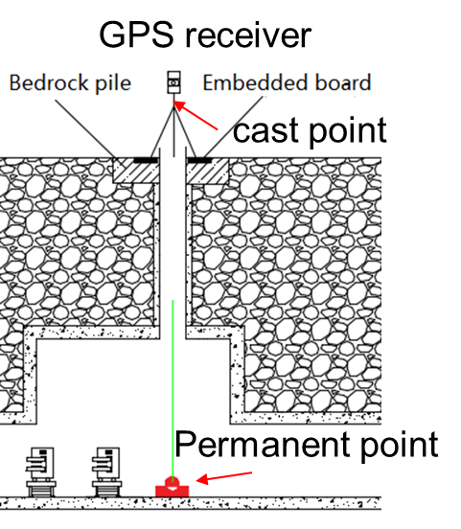
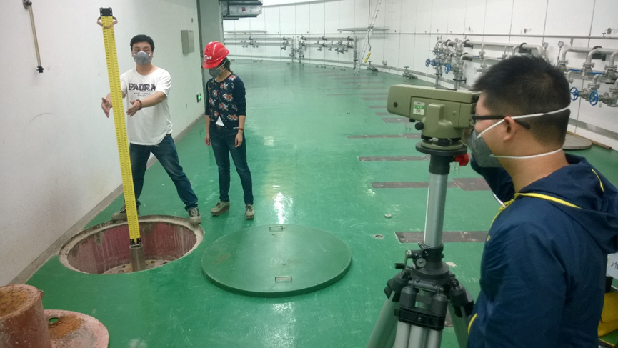
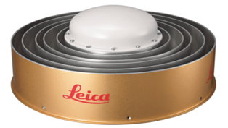
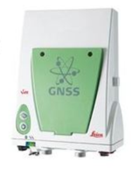
一、CEPC alignment strategy
Surface control network
CEPC global position control, high precision constraint points for tunnel control network.
Composed of 14 points
10 points are in CEPC tunnel, a part of the tunnel control network.
Control point accuracy：8mm；

Slide 8
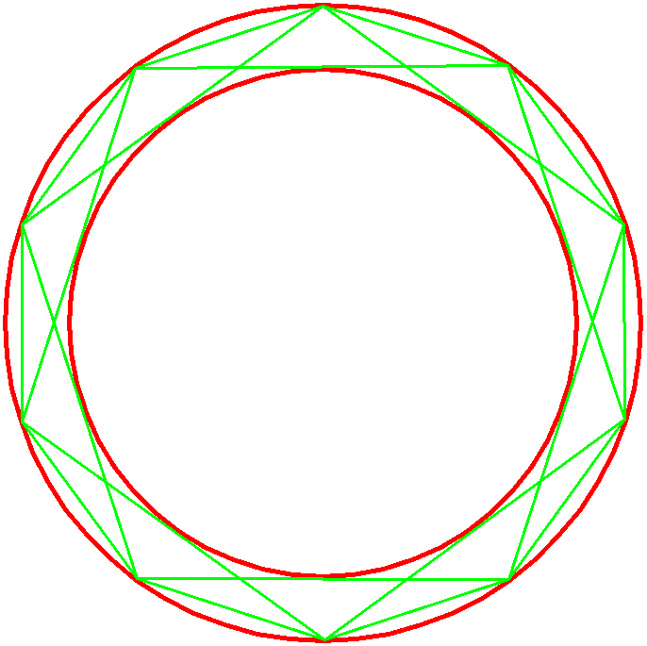
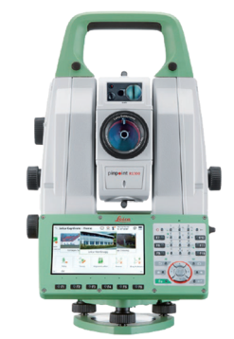
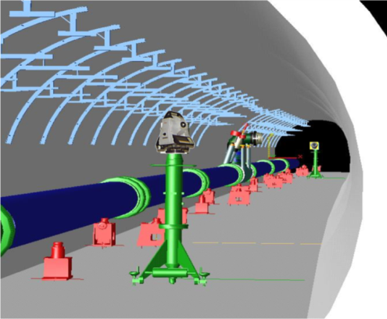
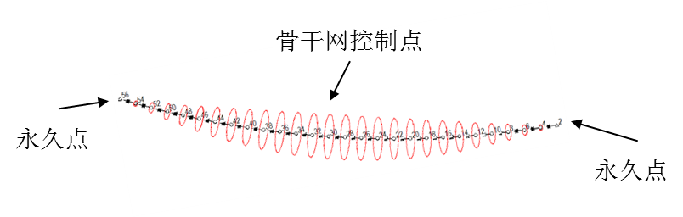
一、CEPC alignment strategy
Backbone control network
  Strengthen the tunnel control network，reduce error accumulation.
  Straight line triangulation network，short line 300m，long line 600m.
total station TS60
Measurement range:1.5m~>3500m
Distance precision：0.6mm+ 1ppm
Angle precision：0.5’’
  Simulation
  Using surface control network points as known point to constrain backbone control network adjustment.
  Simulation condition: angle 1 sec. distance 1mm+1ppm，12.5km, station 42
  The average point error is 6.8mm，biggest error is 8mm, relative error is 0.89mm.
Backbone control network
Known point

Slide 9
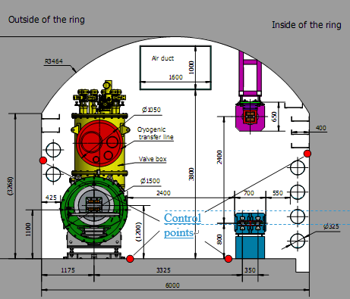
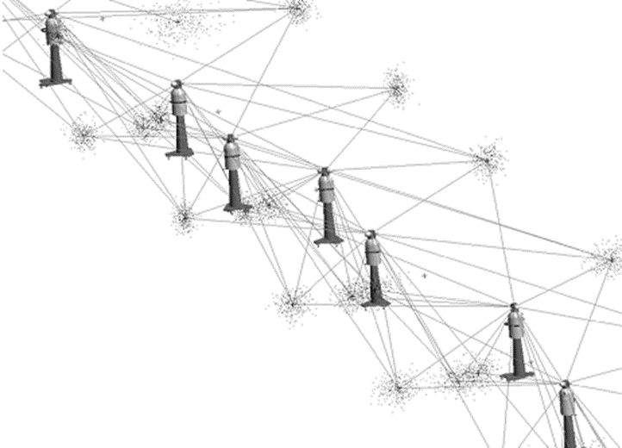
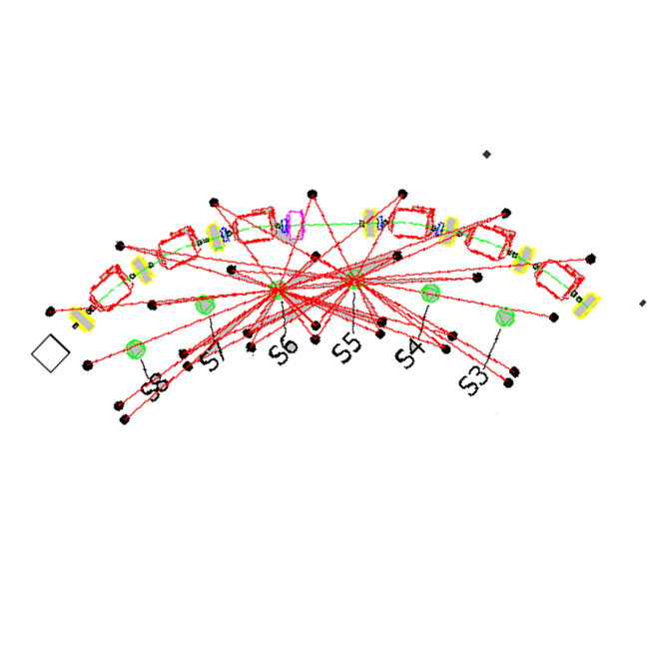
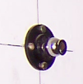
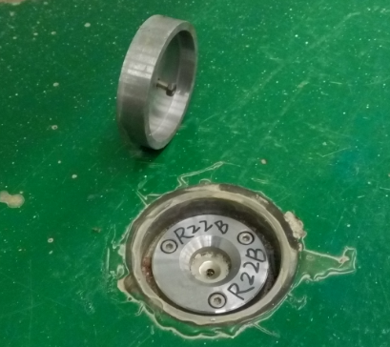
一、CEPC alignment strategy
Tunnel control network
Providing position reference for component installation and alignment
Along CEPC tunnel, will be evenly distributed with an interval of 6 meters
4 control points each section
Using laser trackers and levels carry out tunnel network survey
墙面控制点
地面控制点

Slide 10
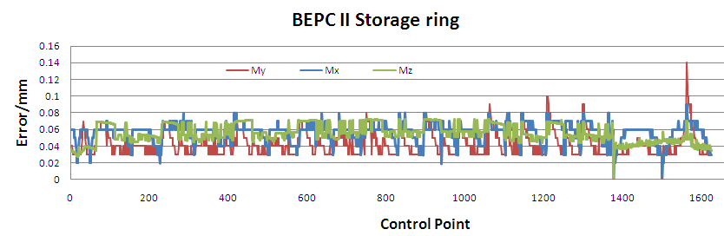
  Simulation
  Using backbone control network points as known point to constrain tunnel control network adjustment.
  Simulation condition: angle 2 sec. distance 0.015mm+2ppm，300m, station 50
  The average point error is 0.38mm，relative error is 0.047mm,
  Add 2mm error to the known points, the average point error is 0.6mm， relative error is 0.074mm.

Slide 11
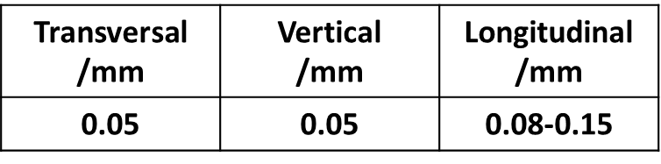
一、CEPC alignment strategy
  Component fiducialization
  Component fiducialization is to relate component beam center with its fiducials, then the fiducials coordinates can be transferred to CEPC global coordinate system and used for component tunnel alignment
  Geometric measurement：laser tracker、 Articulated arm
  Magnetic field measurement：rotate coil、vibrating wire、magnetic target cooperated with CMM
Transversal /mm | Vertical /mm | Longitudinal /mm
0.014 | 0.014 | 0.05

Slide 12
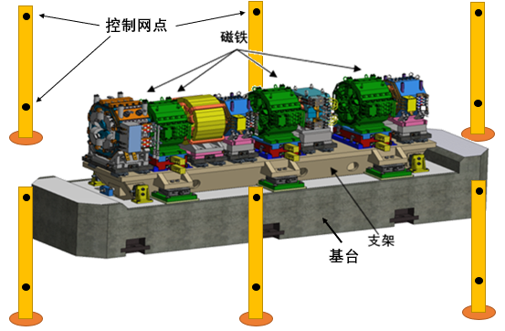
一、CEPC alignment strategy
  Component pre-alignment
Alignment the components on the girder in advance.
The cell can be installed and adjusted as one unit in tunnel。
Can get higher relative position accuracy of the components on one girder.
Can save tunnel installation time.

Slide 13
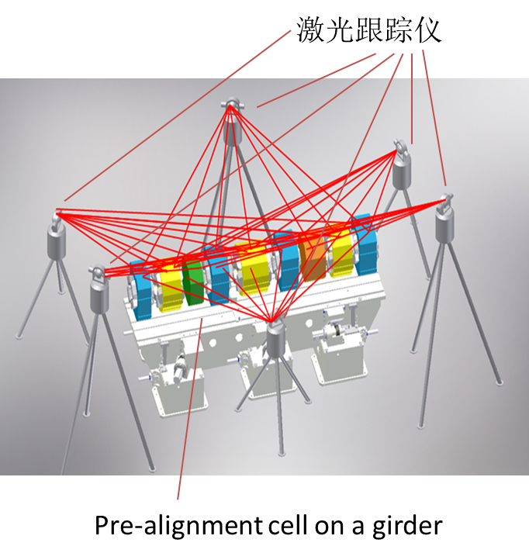
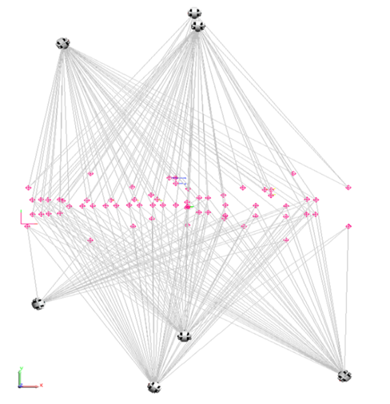

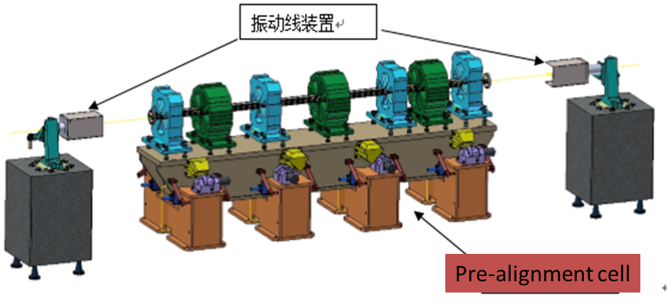
一、CEPC alignment strategy
By using laser tracker, the accuracy is about 0.082mm
To improve magnet alignment accuracy can use the vibrating wire system, the accuracy of magnet can reach 0.056mm

Slide 14
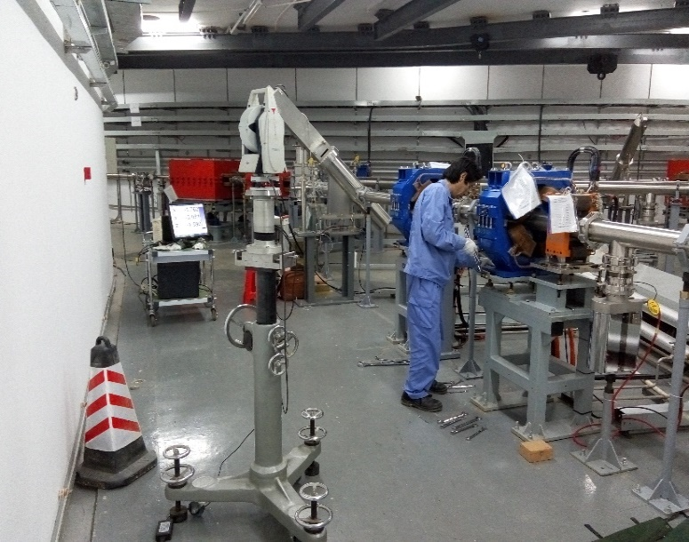
一、CEPC alignment strategy
Tunnel installation alignment
Use tunnel control network and laser tracker to perform tunnel components alignment.
Measure the tunnel control network and through best-fit to determine the laser tracker position in CEPC global coordinate system.
Using laser tracker measure the component fiducial points to obtain the component position.
Adjust the component to the required tolerance.
Fiducialization /mm | Control network /mm | Measurement /mm | Adjustment & fix /mm | Totall /mm
0.05-0.15 | 0.07 | 0.05 | 0.05 | 0.11—0.18

Slide 15
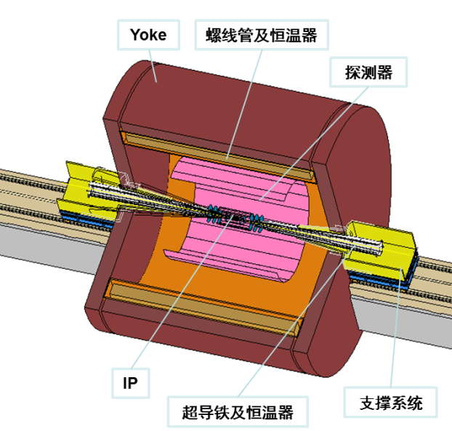
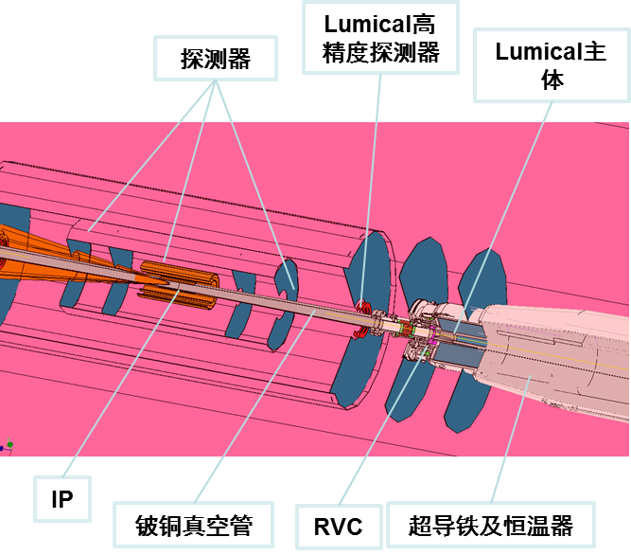
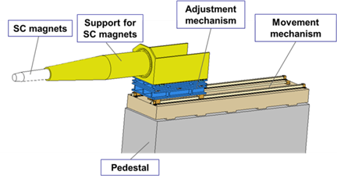
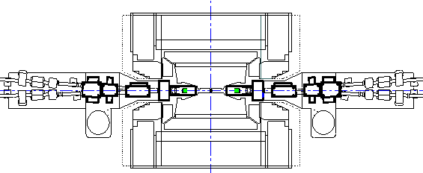
一、CEPC alignment strategy
MDI alignment
Using vibrating wire to do Cryomodule pre-alignment.
Establish a Laser-based alignment system precision:30m offset 0.02mm
Use laser-based alignment system as a reference adjust the rail and components to the designed position in vertical and transversal.
Push the unit into detector along the rail.
rail
rail
Laser-based alignment system
Laser tracker

Slide 16
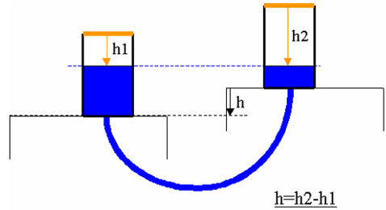
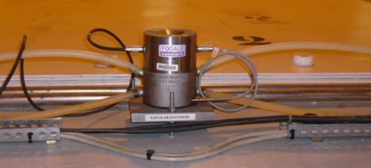
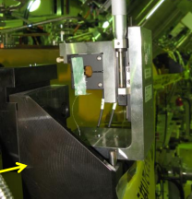
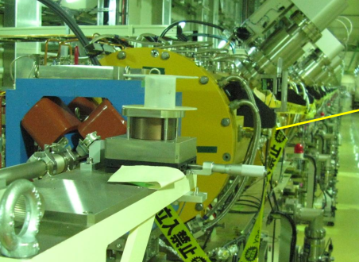
一、CEPC alignment strategy
Monitoring system
Settlement monitor
  Hydrostatic Levelling System(HLS)
  HLS sensors will be installed on the ground near the components.
  Accuracy ±0.01mm
  Component transversal and vertical monitor
  Wire Positioning System (WPS)
HLS
WPS

Slide 17
  二、CEPC installation strategy

Slide 18
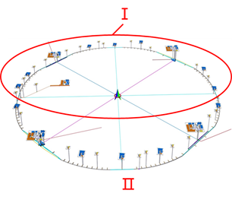
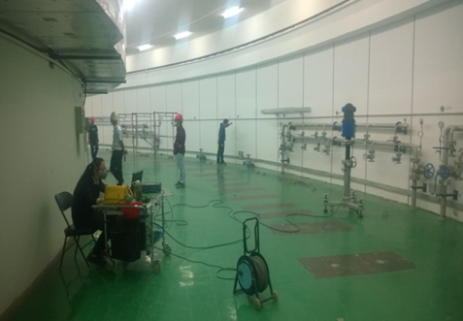
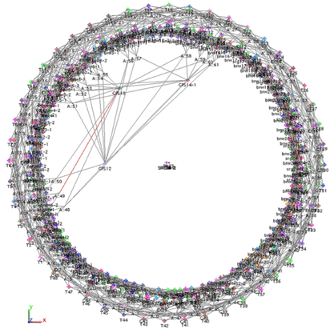
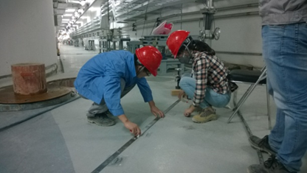
二、CEPC installation strategy
  HDEC, Civil construction will be divided into two phases.
  Installation scheme is made based on the civil construction schedule, includes two phases.
  project period is :3 years and 9 months
  Tasks:
  Control network construction.
  Control network measurement
  Support setting out and installation
  Component fiducialization
  Component installation and alignment.
  Smooth alignment
Control network measurement
Setting out

Slide 19
二、CEPC installation strategy
  Manpower and time arrangement of ring installation and alignment
Phase | Group | Month | 1 | 2 | 3 | 4 | 5 | 6 | 7 | 8 | 9 | 10 | 11 | 12 | 13 | 14 | 15 | 16 | 17 | 18 | 19 | 20 | 21 | 22 | 23 | 24 | 25 | 26 | 27 | 28 | 29 | 30 | 31 | 32 | 33 | 34 | 35 | 36 | 37 | 38
Ⅰ | 8 | Network construction
 | 16 | Network measurement
 | 16 | Support setting out
 | 16 | Support installation
 | 32+32 | Ring installation
Ⅱ | 8 | Network construction
 | 16 | Network measurement
 | 16 | Support setting out
 | 16 | Support installation
 | 32+32 | Ring installation
Peak time Ⅰ
Peak time Ⅱ
  The peak time Ⅰ, it needs 64 alignment groups and 56 installation groups.
  The Peak time Ⅱ, it needs 48 alignment groups and 48 installation groups.

Slide 20
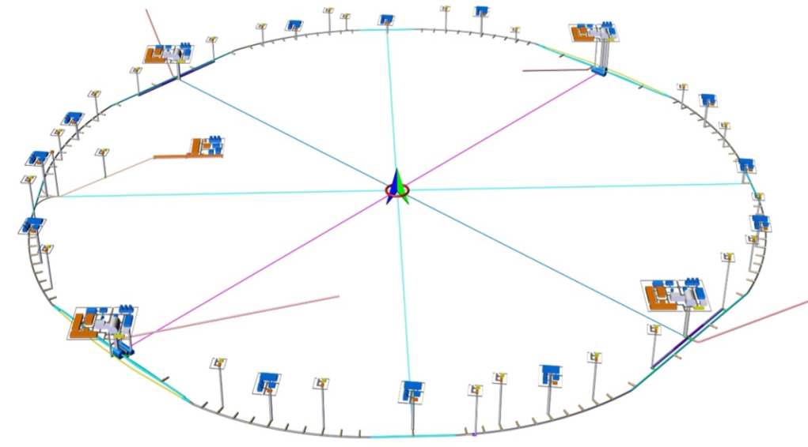
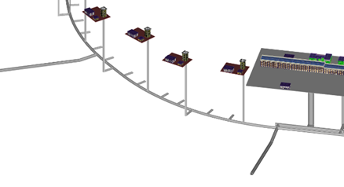
二、CEPC installation strategy
  Installation and alignment scheme
    Ring installation: phaseⅠ, phaseⅡ， each phase：half a ring
    Each phase: installation is divided into four sections to be carried out in parallel.
    Take one section as an example
2
3
4
    Length : 12.5km
1
Phase Ⅰ
Phase Ⅱ
Transport corridors

Slide 21
二、CEPC installation strategy
  The middle transport corridor divides the section into two installation sections.
  Each installation section: 2 teams for collider ring and booster installation separately
  Each team includes 1 installation group and 1 alignment group
  Working process
    The first working day : the installation group should finish the components transportation and installation which will be used in the second working day.
    The second working day: the alignment group should finish the components alignment which is installed in the first working day. The installation group should finish the components transportation and installation which will be used in the third working day.
  Challenge: many works will be carried out in parallel (setting out, transportation, installation, alignment), how to avoid the interruption between different works?

Slide 22
二、CEPC installation strategy
an installation section
middle transport corridor
Left transport corridor
booster
Collider ring
  Installation scheme
    Installation will begin from the middle and the directions of collider ring and booster installation will be opposite
    Collider ring components will be transported from the left corridor, booster components will be transported from the middle corridor. After finish their half section, they will switch installation direction to each other.
  Advantages
    Alignment is always behind installation, transport do not interrupt alignment
    Collider ring and booster installation be carried out in different places.

Slide 23
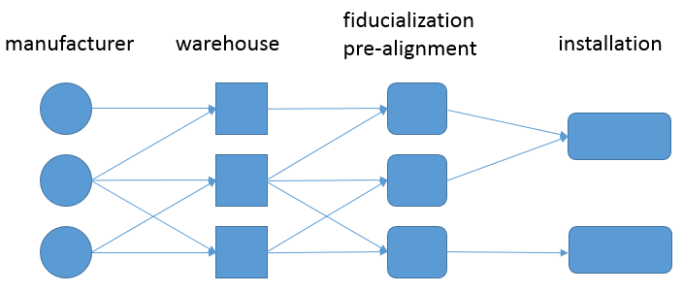
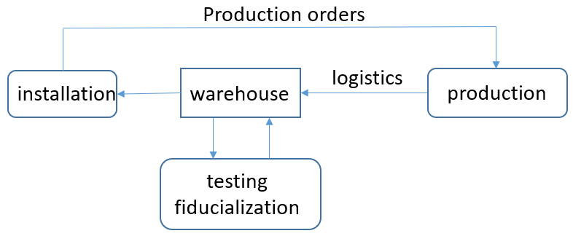
二、CEPC installation strategy
  Components supply chain
    From manufacture to installation needs four stages
    Operational logic diagram
    Manufacturers will distribute all over the country or even abroad, warehouses will be built near CEPC campus, trucks will be the main means of transport

Slide 24
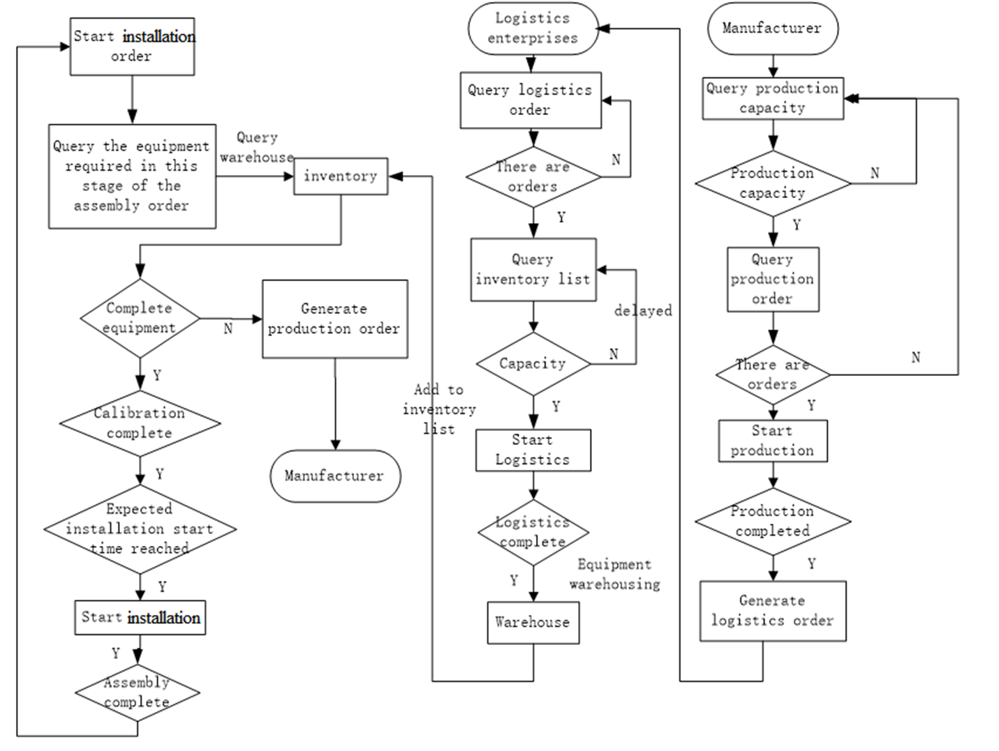
二、CEPC installation strategy
  A management system from installation schedule to production, logistic and storage is under studying.(by professor Wang Jiabin)

Slide 25
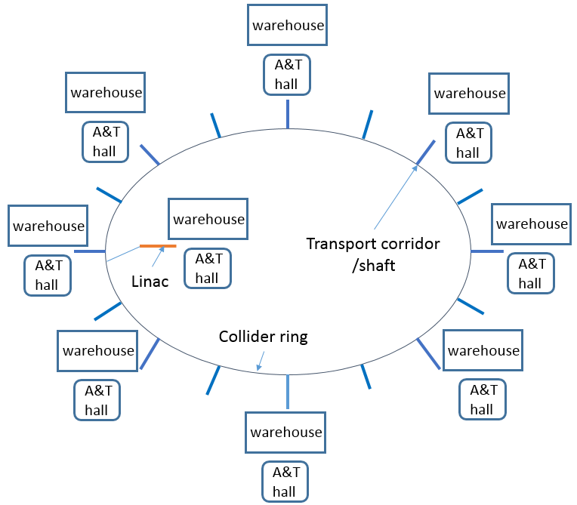
二、CEPC installation strategy
  Around the ring 8 warehouse areas and 8 assembly and testing areas will be built.
  1 warehouse area and 1 A&T area for Linac
  Components will be transported from the warehouse to tunnel through the corridors(slope 5%) or the shafts

Slide 26
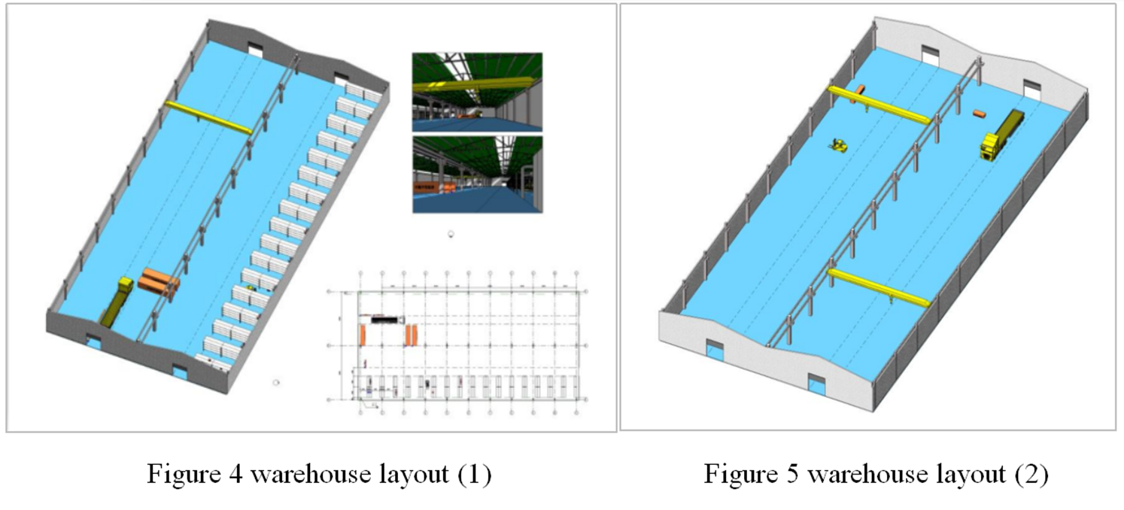
二、CEPC installation strategy
  2 types warehouse are optional.
    warehouse type1（with shelf）， the areas is about 3000m²
    warehouse type2（only stacking area），the areas is about 4000m²。
  A simulation has been made according to the speed of installation, production, logistic , testing and utilization rate, result shows 9 warehouses should be built in each warehouse area.

Slide 27
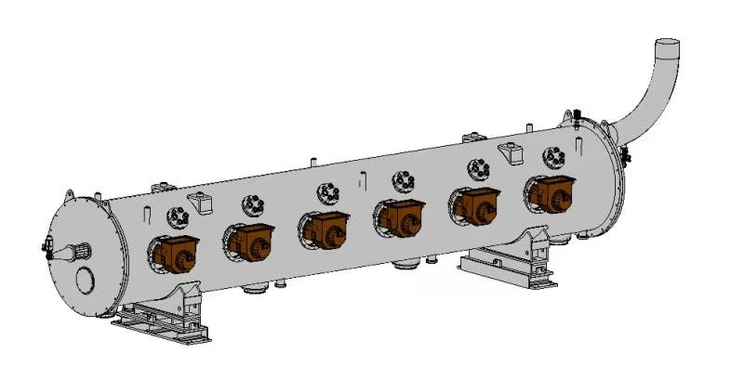
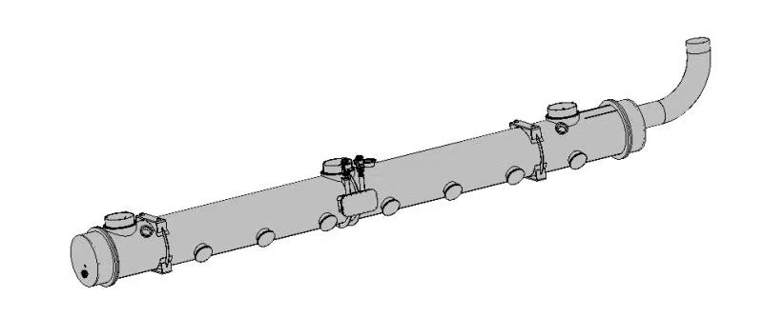
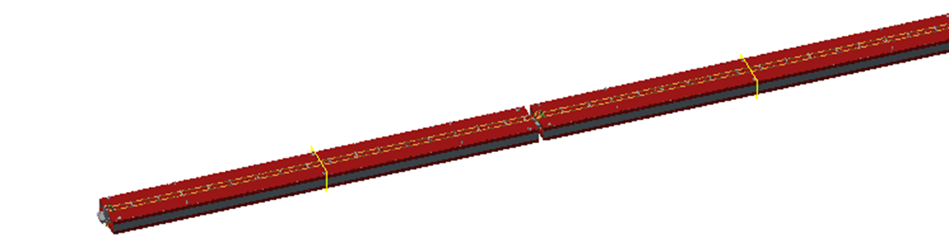
二、CEPC installation strategy
  Transport, 2 types component need special attention
    Cryomodule （amount: 52 ）
    Collider ring dipole （amount: 2546,length: ＞28m）, long dipole will be divided into small parts:
Dimension: 10×Ø1.5 m
Weight: 15 T
Dimension: 11×Ø1 m
Weight: 8 T
Collider ring cryomodule
booster cryomodule
Dimension: 5.67×0.7×0.7 m
Weight: 2 T
Long dipole

Slide 28
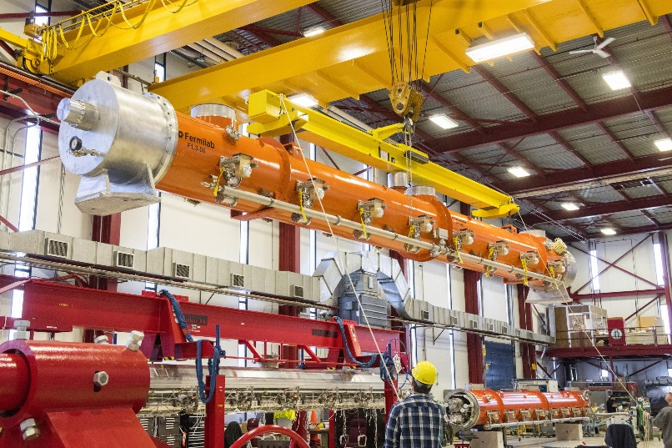
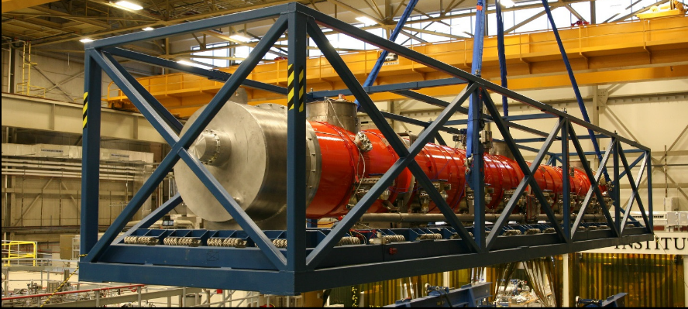
二、CEPC installation strategy
  Transport requirement
    Compared with other components, the cryomodules demand higher for transport
    Maximum dimensions: length 11m, diameter 1.5m, weight 15T
    Maximum tilt: ＜±15°
    Maximum shock: ＜1.5g in X Y Z direction.
    Roads and transport vehicles should meet these requirements.
    Special facilities should be made to fix and protect the cryomodule

Slide 29
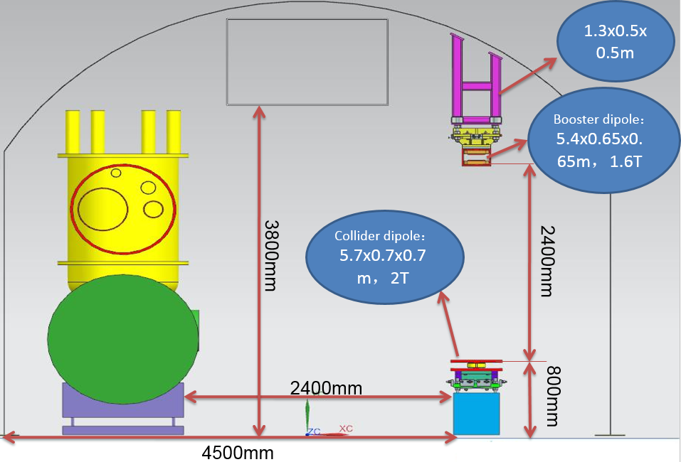
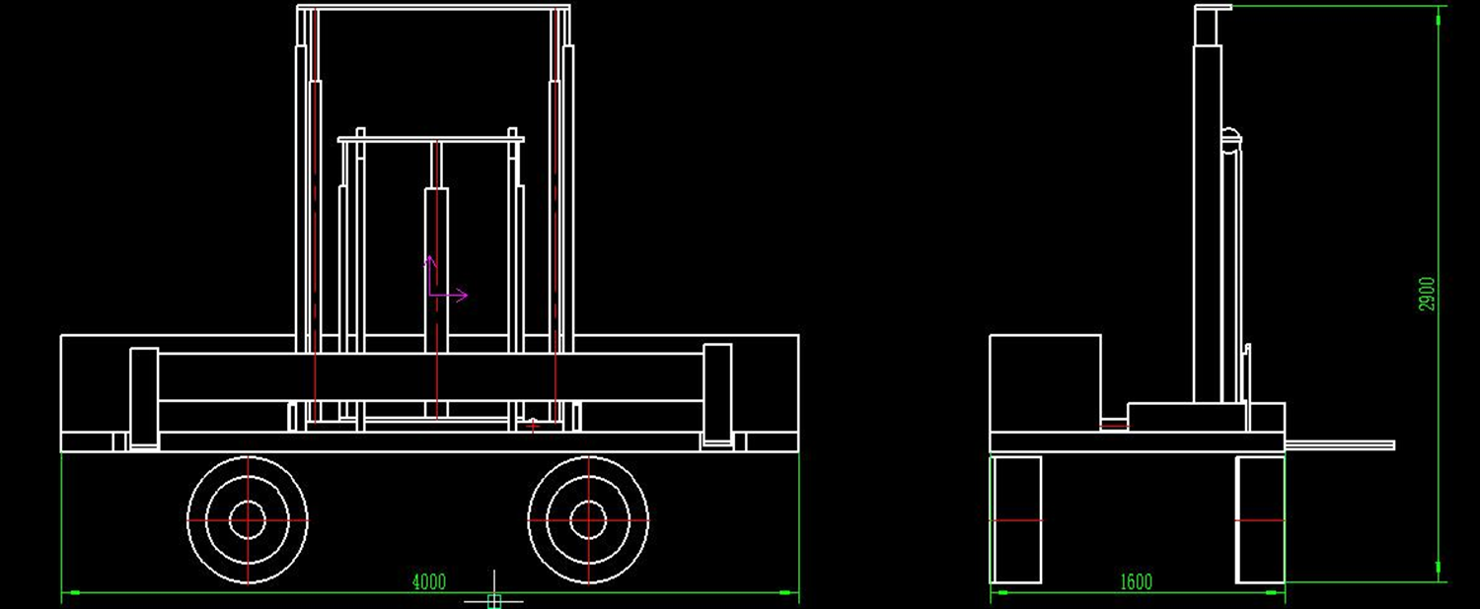
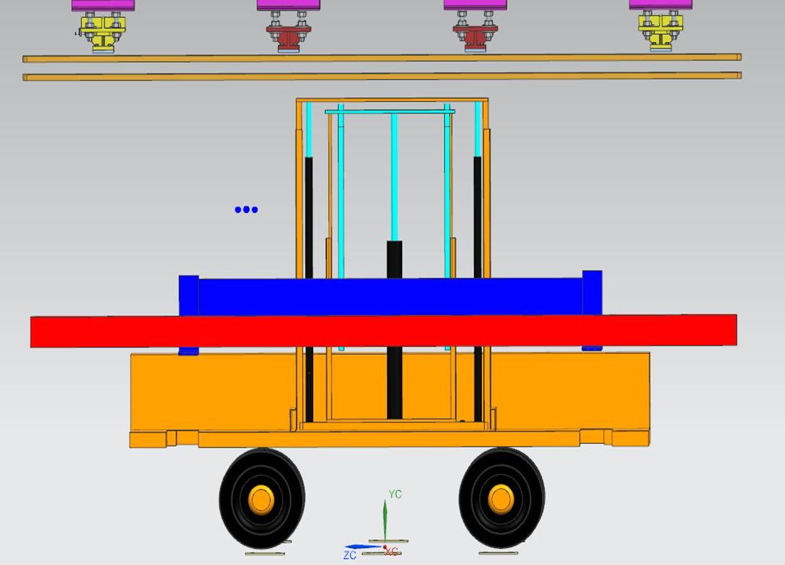
二、CEPC installation strategy
  Magnet transport and installation in tunnel
    A vehicle model is designed
    Vehicle dimension: 4×1.6×2.9m
    Driving mode : manned
    Maximum load: 3T
    Maximum transverse load distance: 0.9m
    Maximum lift height: 2.9m
lifting device
horizontal move device
vehicle model

Slide 30
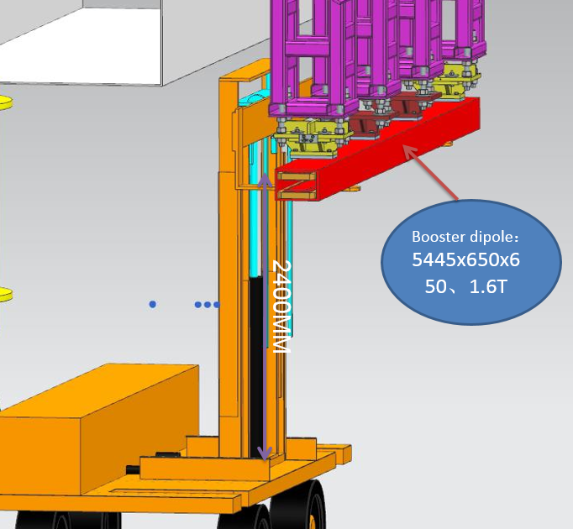



二、CEPC installation strategy
  Collider ring and booster installation sketch map

Slide 31
Summary
  The overall alignment strategy was introduced.
  A 3 years and 9 months installation schedule and manpower requirement has been made.
  To improve installation efficiency a segments parallel strategy is adopted.
  Logistic and storage are studied, warehouse layout is designed, a logistic management system will be built for CEPC.
  A vehicle model is designed for magnet transport and installation in tunnel.
  NEXT
    High efficiency and high precision measurement method.
    Components delivery from ground to tunnel.
    Cryomodule transport in tunnel.

Slide 32
Thank You !

