Slide 1
SPPC Study Status
TANG, Jingyu
for the SPPC study group
IAS Program for High Energy Physics (HEP2022)
January 13-19, 2022, HKUST/ZOOM

Slide 2
Outline
Ongoing SPPC study
Considerations for a new design - 125 TeV
Preliminary main parameters
Summary

Slide 3
Ongoing SPPC Study
  A very limited resource working on the accelerator physics studies
  Strong R&D efforts on high-field magnets which is integrated in the national effort for HT superconducting technology
  Following the CEPC study in the TDR stage

Slide 4
SPPC main parameters (in 2017)
Parameter | Unit | Value
 |  | PreCDR | CDR | Ultimate
Circumference | km | 54.4 | 100 | 100
C.M. energy | TeV | 70.6 | 75 | 125-150
Dipole field | T | 20 | 12 | 20-24
Injection energy | TeV | 2.1 | 2.1 | 4.2
Number of IPs |  | 2 | 2 | 2
Nominal luminosity per IP | cm⁻²s⁻¹ | 1.2e35 | 1.0e35 | -
Beta function at collision | m | 0.75 | 0.75 | -
Circulating beam current | A | 1.0 | 0.7 | -
Bunch separation | ns | 25 | 25 | -
Bunch population |  | 2.0e11 | 1.5e11 | -
SR power per beam | MW | 2.1 | 1.1 | -
SR heat load per aperture @arc | W/m | 45 | 13 | -

Slide 5
Accelerator Physics
Still active:
  Longitudinal dynamics (collider and injector chain): Zhang Linhao, Tang Jingyu
  Instabilities: Zhang Linhao, Wang Lijiao, Tang Jingyu
  Beam-beam and Luminosity leveling: Wang Lijiao, Tang Jingyu, Tanaji Sen (FNAL)
  Lattice, layout, dynamics aperture: Xu Haocheng, Chen Yukai, Wang Yiwei
  Injector chain AP – p-RCS: Zhang Linhao
  Synchrotron radiation – beam screen (Gerardo Guillermo)

Slide 6
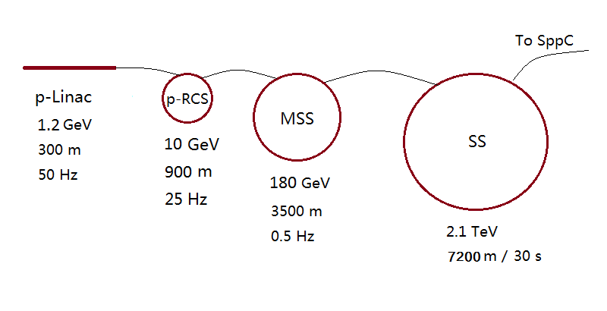
Injector chain
(for proton beam)
p-Linac: proton superconducting linac
p-RCS: proton rapid cycling synchrotron
MSS: Medium-Stage Synchrotron
SS: Super Synchrotron
Ion beams have dedicated linac (I-Linac) and RCS (I-RCS)

Slide 7
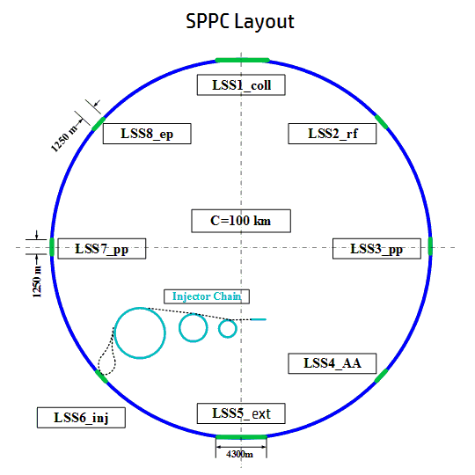
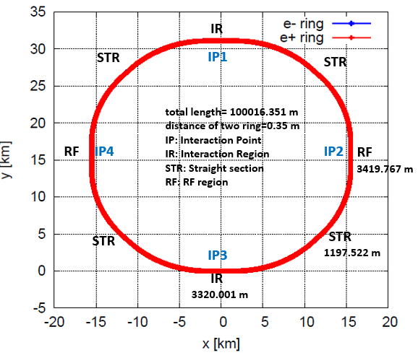
Lattice design
Xu Haocheng, Wang Yiwei, Chen Yukai
Updated lattice design with 125 TeV
  To be compatible with the CEPC lattice that has been evolving in the TDR design, modification is needed
  With the new SPPC design goal of 125 TeV with 20-T magnets, modifications also needed
  Bypass is no longer a necessity but a possibility in the future.
CEPC Layout

Slide 8
Longitudinal beam dynamics
Zhang Linhao, Tang Jingyu
The work concerning long. Dynamics in both collider and injector chain (five accelerators in series)
Concerns:
  Bunch filling schemes
  Luminosity leveling schemes
  Instabilities
  Requirement to the RF systems
  Global study with the injector accelerators
Study focusing on:
  Instabilities suppression in the collider
  Longitudinal dynamics in the injector chain, especially bunch splitting in the MSS
JINST 16, P03035 (2021)

Slide 9
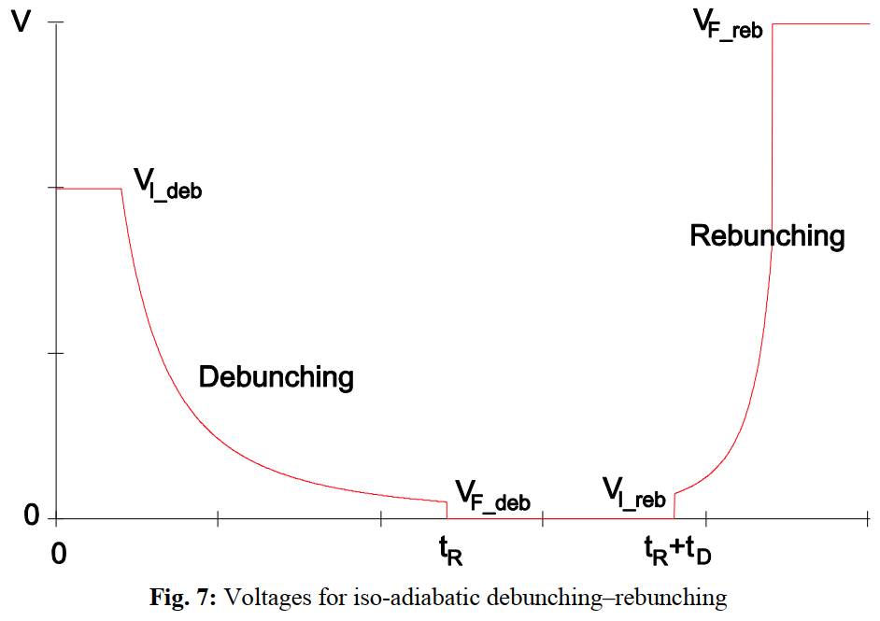
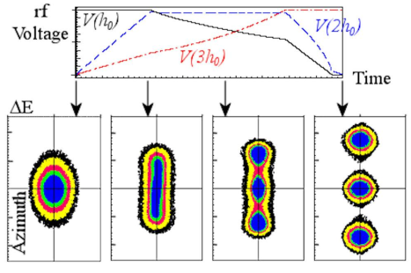
Bunch splitting in MSS
Motivation
  Mitigate the pileup effects and collective instabilities of a single bunch in the SPPC
  Bunch spacing: 25 ns → 5 ns (five-splitting of single bunch)
Bunch splitting methods in proton synchrotrons
(1) Debunching and rebunching
(2) Multi-harmonic RF bunch splitting
Triple-splitting in LHC/PS

Slide 10
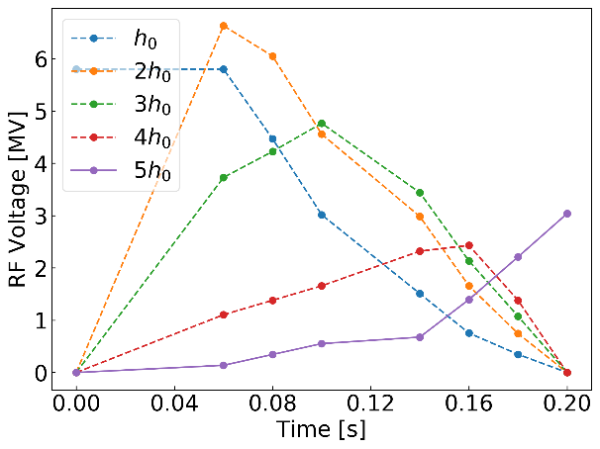
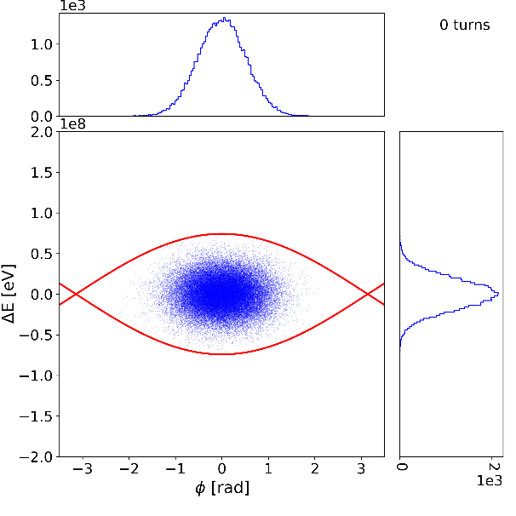
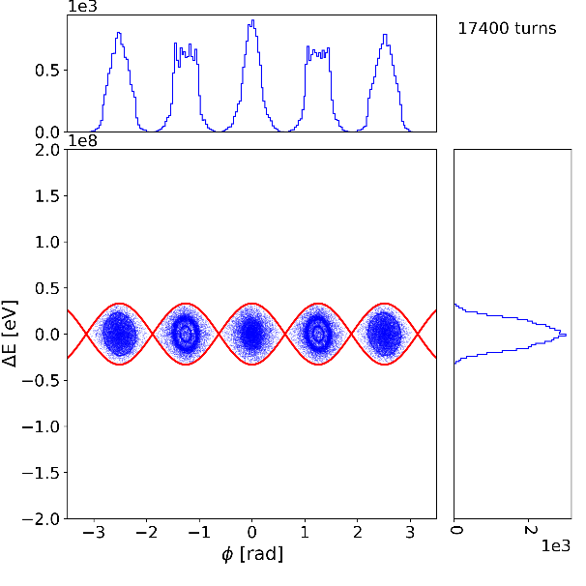
Bunch splitting at the MSS injection energy
Beam loss rate:
0.094%
Published in Results in Physics 32 (2022) 105088

Slide 11
Luminosity optimization
Wang Lijiao , Tang Jingyu, R.Palmer (BNL)
Luminosity optimization and leveling schemes
  Goal: 30 ab⁻¹ in 10–15 years
  Increasing integrated lumi: adopting dynamic β*, emittance damping, crab cavities
  Flat beam optics instead of round ones when no crab cavities
RDTM 5, 245–254 (2021)

Slide 12
Beam-beam effects and compensations
Wang Lijiao , Tang Jingyu, collab. with Tanaji Sen (FNAL)
Effects and compensation of head-on interactions
  Reduction on dynamic aperture
  Large tune shift causing resonances
  Compensation by electric lens
Effects and mitigation of long range interactions
  Dynamic aperture limited mainly by the long-range B-B effects
  Balance between the B-B effect and luminosity loss with a large crossing angle
  Compensation method: current wires
B-B effects with a realistic operation scenario
  Emittance damping and bunch particles burning-off
  Combined influence on the B-B effects and luminosity leveling

Slide 13
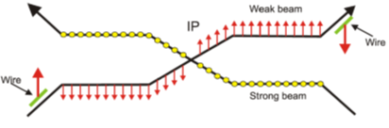
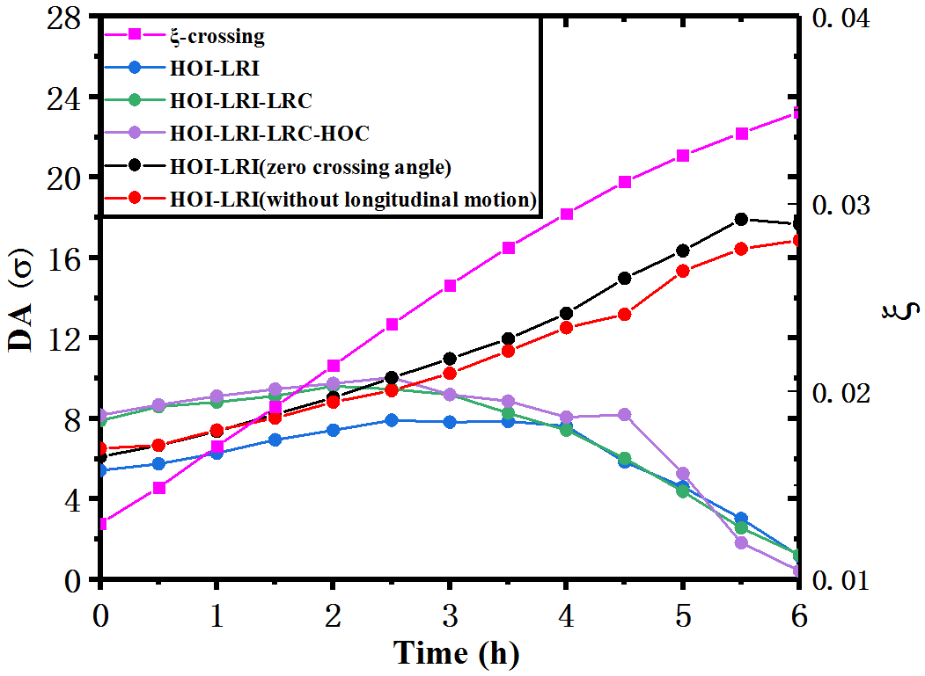
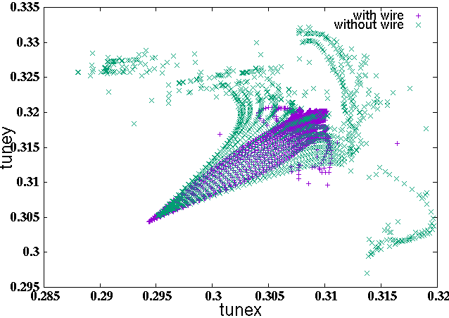
DA evolution with time for natural emittance damping and particle burning-off
Tune footprint with wire compens. (violet points) and without compens. (green points)
To be submitted to NIM-A

Slide 14
Considerations about a new SPPC design -125 TeV
SPPC has been planning to use Iron-based HTS magnets, till-now technical progress very encouraging
  We are investigating the possibility to go to 20-24 T directly (formerly called ultimate stage), to reach C.o.M. energy of 125-150 TeV
  Since the last CEPC day, we proposed to adopt a design of 125 TeV using 20-T magnets (international sounding, technical development, balanced performance )
Compatibility with CEPC
  Currently taking the full CEPC tunnel, but a bypass scheme is always possible in the future in order to keep the whole CEPC (including detectors) when building SPPC
Synchrotron radiation problem
  Radiation power per particle increased by 7.7 times (∝ γ⁴)
  Reducing bunch population and keeping bunch numbers unchanged: circulating current largely reduced
  SR power per aperture at arcs: 20 W/m (12.8 W/m CDR)
Notes:
Bypass问题：采用现在有CEPC Lattice，SPPC尽量绕圈，最高磁场可以适当高一些，如26-30T，或者24T磁场，对撞能量125TeV。哪个优先级高？（Bypass区）给出具体的比较。要给一个Bypass的总长度，而且CEPC土建时预建一段Bypass隧道，以避免SPPC建造时影响全环，需要确定两个隧道分开多大后，可以认为是后建时不影响。新的讨论：尽量达到150TeV能量，两个选择：一是Bypass采用30T，另一是原隧道采用24T。
提供Bypass方案的非共享隧道长度（可以不需要Bypass的直线段：SPPC注入和RF；2个pp对撞区、2个ee对撞区-引出-准直、预留AA对撞区。e-p）。
同步辐射问题：我自己的事。

Slide 15
Luminosity and pileup problem：significant reduction in initial luminosity due to much smaller particle number, recovery measures needed
  Higher bunch population helps on luminosity, but introduces data pileup problem (current LHC: ~30 per cross, HL-LHC: 140-200, possible ~400-500 in the future, goal for FCC-hh; eventually >1000)
    Keeping the same bunch spacing of 25 ns but lower bunch population (1.5➔0.3) *10^11
  Luminosity optimization and leveling with dynamic β* and emittance shrinking
  Nominal B-B parameter increased from 0.015 to 0.03 (two IPs)
  Beta* dynamically changing from 0.5 m to 0.25 m
  Best case: peak lumi. 1.4*10^35, average lumi 0.43*10^35 (~30% of that in CDR), annual integrated 0.42 ab⁻¹ (best CDR: 1.3 ab⁻¹)
Further luminosity optimization: using higher bunch population (4-5)*10^10 (higher SR), and smaller initial emittance (2.4➔1.0 um)
Notes:
亮度：优先级低于对撞能量，尽可能提高。
注入器链：可以考虑等离子体加速，作为并行方案研究，11月的CEPC Workshop可以组织一个Session，将国内相关人员找来，一起讨论一下。可能的选择是代替SS级，从造价的角度和可行性（束流尺寸小，重复频率低）的角度。（难点还在于单束团所带的能量非常高，MSS引出时RCS束团串的能量为，RCS引出时束团串能量为28kJ，MSS引出时束团串能量504kJ，SS引出时束团串能量为10MJ。即使RCS束团数减半，仍是非常大的能量）。
环布局：与Bypass情况类似，只能做拍脑袋的事，直线节长度估计只能跟随CEPC。
ep问题：可以暂不考虑。

Slide 16
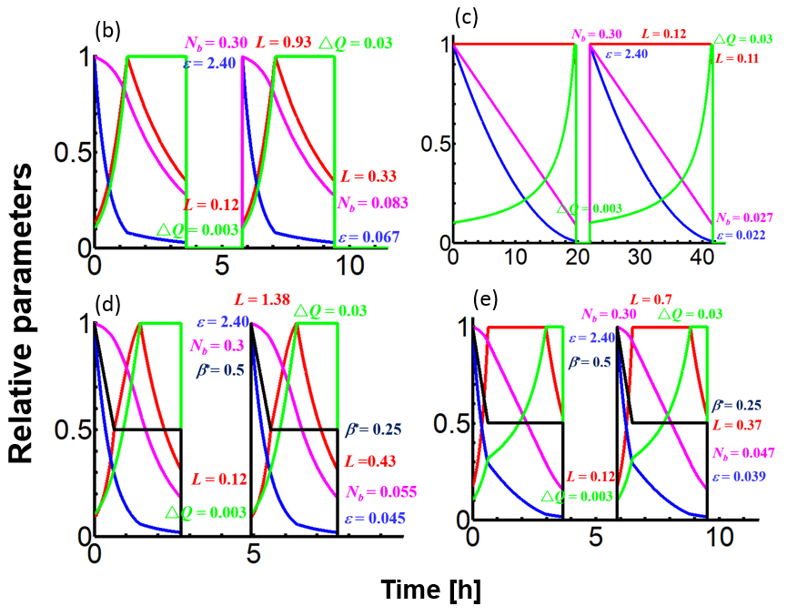
Luminosity optimization and levelling scenarios
Pileup: 348
Pileup: 45
Pileup: 514
Pileup: 260

Slide 17
Injector chain problem
  Maintain original structure (four stages)
  SS energy increased from 2.1 TeV to 3.2 TeV, others unchanged (p-Linac: 1.2 GeV, p-RCS: 10 GeV, MSS: 180 GeV)
Ring layout:
  IR layout as before; arcs cells modestly changed
  Collimation section length ~4.2 km, five-stage, superconducting magnets
  Energy stored in beam: 3.0 GJ (9.1 GJ in CDR)
Staged operation
  Stage I: CoM energy 75 TeV, high luminosity to meet most CDR goals especially Higgs related (CDR: 30 ab⁻¹ in 10-15 years)
  Stage II: CoM energy 125 TeV, lower luminosity to push the energy frontier
  Stage III: beyond the current design
Notes:
亮度：优先级低于对撞能量，尽可能提高。
注入器链：可以考虑等离子体加速，作为并行方案研究，11月的CEPC Workshop可以组织一个Session，将国内相关人员找来，一起讨论一下。可能的选择是代替SS级，从造价的角度和可行性（束流尺寸小，重复频率低）的角度。（难点还在于单束团所带的能量非常高，MSS引出时RCS束团串的能量为，RCS引出时束团串能量为28kJ，MSS引出时束团串能量504kJ，SS引出时束团串能量为10MJ。即使RCS束团数减半，仍是非常大的能量）。
环布局：与Bypass情况类似，只能做拍脑袋的事，直线节长度估计只能跟随CEPC。
ep问题：可以暂不考虑。

Slide 18
SPPC updated parameters (preliminary)
Parameter | Unit | Value
 |  | PreCDR | CDR | TDR
Circumference | km | 54.4 | 100 | 100
C.M. energy | TeV | 70.6 | 75 | 125
Dipole field | T | 20 | 12 | 20
Injection energy | TeV | 2.1 | 2.1 | 3.2
Number of IPs |  | 2 | 2 | 2
Initial luminosity per IP | cm⁻²s⁻¹ | 1.2e35 | 1.0e35 | 1.2e34
Beta function at collision | m | 0.75 | 0.75 | 0.5
Circulating beam current | A | 1.0 | 0.7 | 0.15
Bunch separation | ns | 25 | 25 | 25
Bunch population |  | 2.0e11 | 1.5e11 | 0.3e11
SR power per beam | MW | 2.1 | 1.1 | 1.7
SR heat load per aperture @arc | W/m | 45 | 13 | 20

Slide 19
Under study
  Lattice update with higher energy
  Try to raise initial and integrated luminosity (based on B-B effects)
  Keep the original CDR goal with lower CoM energy (early stage)
  Possibility to increase SR limits (total power consumption and beam screen)(20➔30 W/m/beam)
  Previous collimation scheme still work?
  Updated design for the injector chain

Slide 20
Summary
SPPC study continues but at a low profile to follow CEPC in the TDR stage
New baseline scheme: 125 TeV with 20-T magnets (original ultimate stage)
  Basically no show stopper
  More design study is needed
  Staged operation useful
Thank you for your attention!

