Slide 1
CEPC Beam Instrumentation R&D
Yanfeng Sui
On behalf Beam Instrumentation Team
Accelerator Center, IHEP
Mini-Workshop: Accelerator Physics — Key Beam Physics and Technologies Issues for Colliders
Jan. 13-19, 2022 （Online）

Slide 2
Outline
Overview of CEPC beam instrumentation systems
Beam instrumentation R&D
Summary

Slide 3
The beam instrumentation in CEPC Linac
 | Item | Method | Parameter | Amounts
Linac | Beam position | Stripline BPM | Resolution ：30um | 140
 | Beam current | ICT | 2.5%@1nC-10nC | 42
 | Beam profile | YAG/OTR | Resolution: 30um | 80
 | Beam emittance | Q+PR | 10% | 3
 | Beam energy & spread | AM+PR | 0.1% | 3
Damping ring | Average current | DCCT | Resolution :50uA@0.1mA-30mA | 1
 | Beam position | Button BPM | Resolution : 20um @ 5mA TBT | 40
 | Tune measurement | Frequency sweeping | Resolution:0.001 | 1

Slide 4
The beam instrumentation in CEPC booster
 | Item |  | Method | Parameter | Amounts
Booster | Beam position monitor | Turn by turn | Button electrode BPM | Measurement area (x × y)：±20mm×±10mm Resolution：<0.02mm Measurement time of COD：< 4 s | 1808
 |  | Bunch by bunch | Button electrode BPM | Measurement area (x × y)：±40mm×±20mm Resolution：0.1mm
 | Bunch current |  | BCM | Measurement range：10mA / per bunch Relatively precision：1/4095 | 2
 | Average current |  | DCCT | Dynamic measurement range：0.0~1.5A Resolution:50uA@0.6-8mA Linearity：0.1 % Zero drift: <0.05mA | 2
 | Beam size |  | Double slit interferometer x ray pin hole | Resolution:0.2 µm | 2
 | Bunch length |  | Streak camera Two photon intensity interferometer | Resolution:1 ps | 2
 | Tune measurement |  | Frequency sweeping method | Resolution:0.001 | 2
 |  |  | DDD | Resolution:0.001
 | Beam loss monitor |  | optical fiber | Space resolution:0.6m | 400
 | Feedback system |  | TFB | Damping time<=3ms | 2
 | Feedback system |  | LFB | Damping time<=35ms（50ms） | 2

Slide 5
The beam instrumentation in CEPC ring
 | Item |  | Method | Parameter | Amounts
Storage ring | Beam position monitor | Closed orbit | Button electrode BPM | Measurement area (x × y)：±20mm×±10mm Resolution：<0.02um Measurement time of COD：< 4 s | 2900
 |  | Bunch by bunch | Button electrode BPM | Measurement area (x × y)：±40mm×±20mm Resolution：0.1mm
 | Bunch current |  | BCM | Measurement range：10mA / per bunch Relatively precision：1/4095 | 2
 | Average current |  | DCCT | Dynamic measurement range：0.0~1.5A Linearity：0.1 % Zero drift: <0.05mA | 2
 | Beam size |  | Double slit interferometer x ray pin hole | Resolution:0.2 µm | 4
 | Bunch length |  | Streak camera Two photon intensity interferometer | Resolution:1ps@10ps | 2
 | Tune measurement |  | Frequency sweeping method | Resolution:0.001 | 2
 |  |  | DDD | Resolution:0.001
 | Beam loss monitor |  | PIN-diode | Dynamic range:120 dB Maximum counting rates≥10 MHz | 5800
 | Feedback system |  | TFB | Damping time<=47ms | 2
 |  |  | LFB | Damping time<=100ms | 2

Slide 6
Beam instrumentation R&D

Slide 7
R&D Motivation
To reduce the budget of The BI system due to a large number of monitors and the high price of commercial products. Such as BPM and beam loss monitor
Key technologies of beam diagnostics. Beam instrument at IP and beam feedback system
Easy to maintain and upgrade

Slide 8
CEPC beam instrumentation R&D
Beam position monitor system
  BPM electronics
  Feed through R&D
Feedback systems

Slide 9
Overview of the BPM electronics R&D
The R&D of BPM electronics founded by seed money of IHEP and other funding（HEPS-TF etc.）
Kicked off at the start of 2015
Finished the first version(V1.0) of the electronics in 2018.
The second version(V2.0) was finished in the middle of 2019. The modification was done to improve the performance of the electronics.
The BPM electronics were installed and operating in BEPCII Linac in 2019
BEPCII SR BPMS were upgrading to homemade electronics in 2020.
8 versions of BPM electronics have been tested in the past six years.

Slide 10
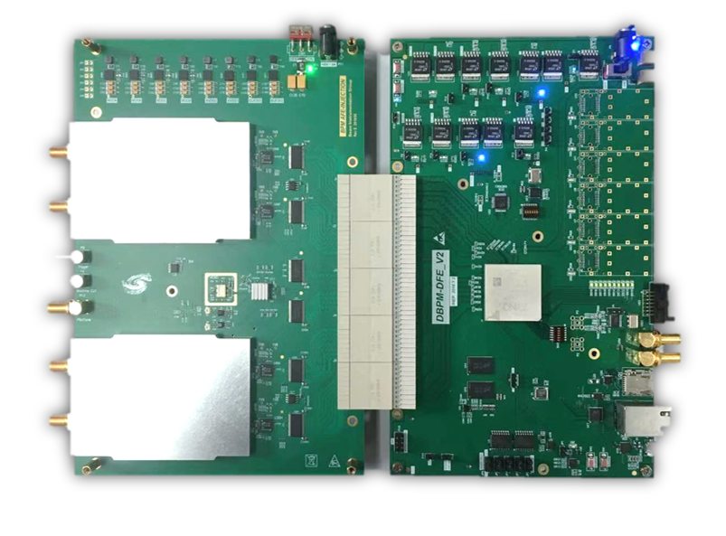
Overview of the BPM electronics
ADF
ADF
Since of ADF interface is not suitable for RF signal transmission,
so we developed new hardware, ADC&CLK in AFE board.
AFE board：RF Processing+ ADCs + Clock + Pilot tone;
DFE board：FPGA(ZYNQ) + DDR3 memory + SFPs + Ethernets;
EPICS IOC：In ZYNQ FPGA, Increase the convenience of the BPM system;

Slide 11
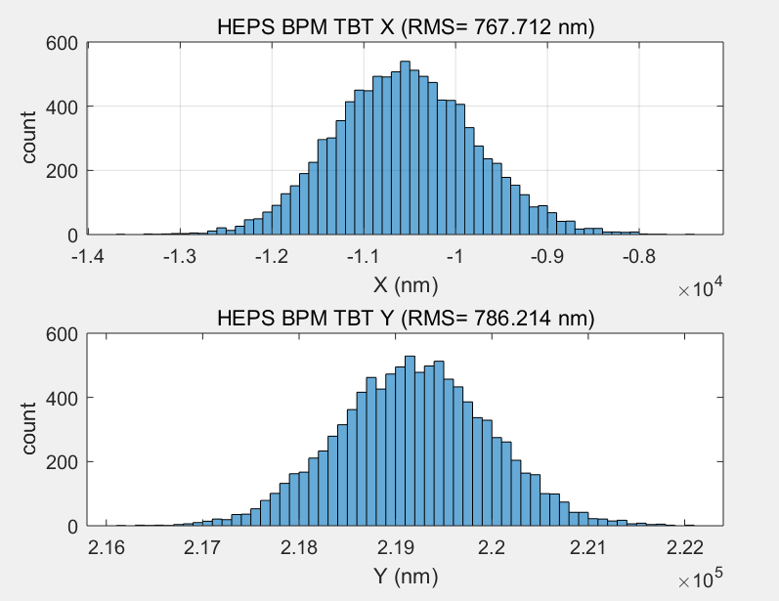
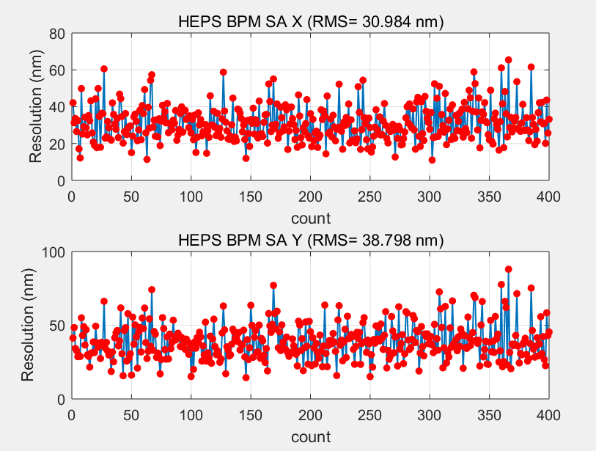
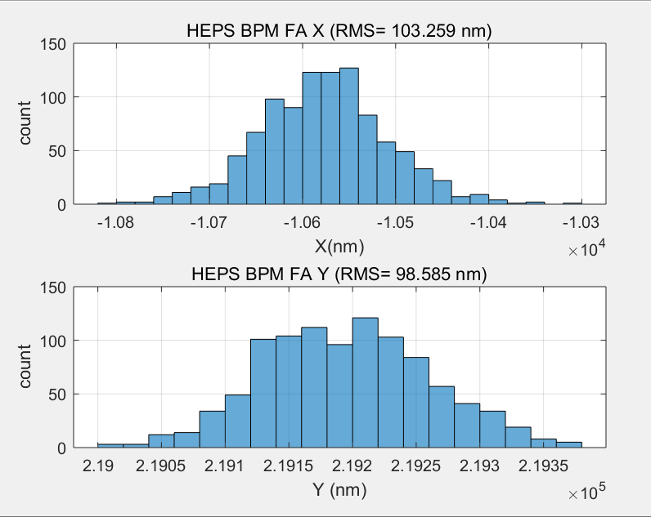
BPM TbT/FA/SA resolution test in lab
TBT RMS (X=767nm,y=786nm)
SA RMS(X=30nm,Y=38nm) 10points STD
We test the performance of DBPM in lab
RF frequency is 499.8MHz(-15dBm) from R&S SMA100
TBT data rms xpos ≈767nm, ypos ≈786nm;
FA data rms xpos ≈103nm, ypos ≈98nm;
SA data rms xpos ≈30nm, ypos ≈38nm;
Kx=Ky=8.26mm;
FA RMS (X=103nm,y=98nm)

Slide 12
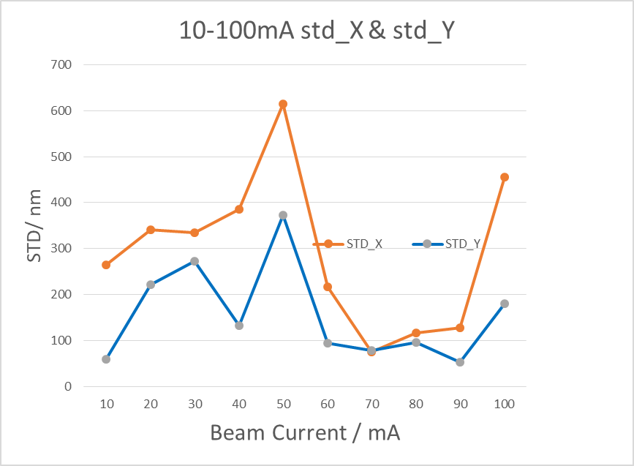
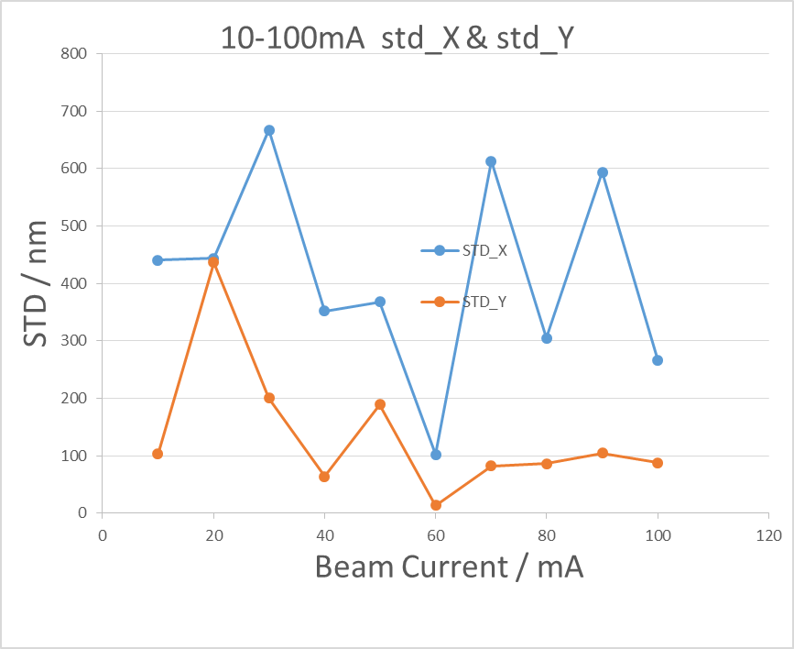
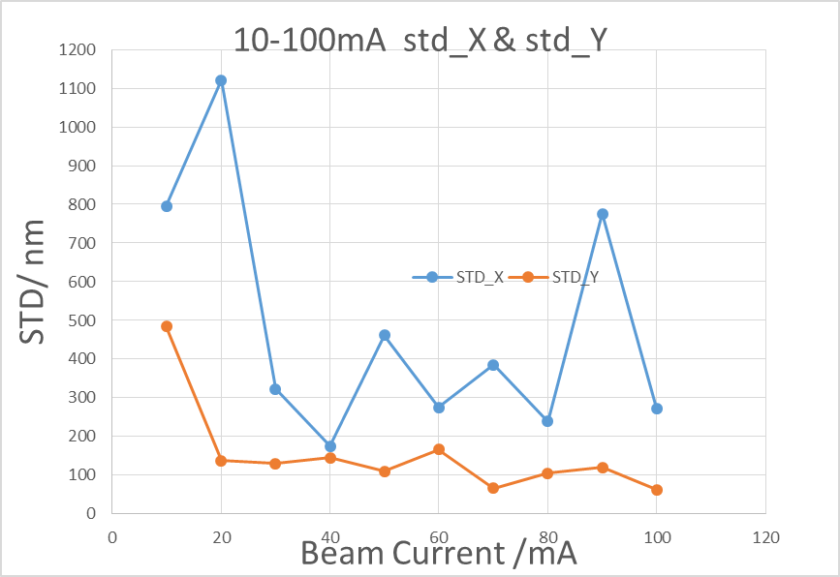
Beam test in BEPCII
Resolution of BPM electronics （110 bunches, 1/3）
BPM3
BPM4
BPM5
BPM electronics NO. | Beam current（10-20mA） |  | Beam current（20-818mA）
 | ΔX(um) | ΔY(um) | ΔX(um) | ΔY(um)
Commercial product | - | - | 6 | 7
BPM1 | - | - | 10 | 17
BPM3 | 22 | 11 | 29 | 11
BPM4 | 71 | 61 | 11 | 36
BPM5 | 5 | 17 | 4 | 31
Beam current dependence of BPM electronics

Slide 13
Home made products VS commercial products
BPM pick up
Cable
Comparative test of self-developed product and commercial product

Slide 14
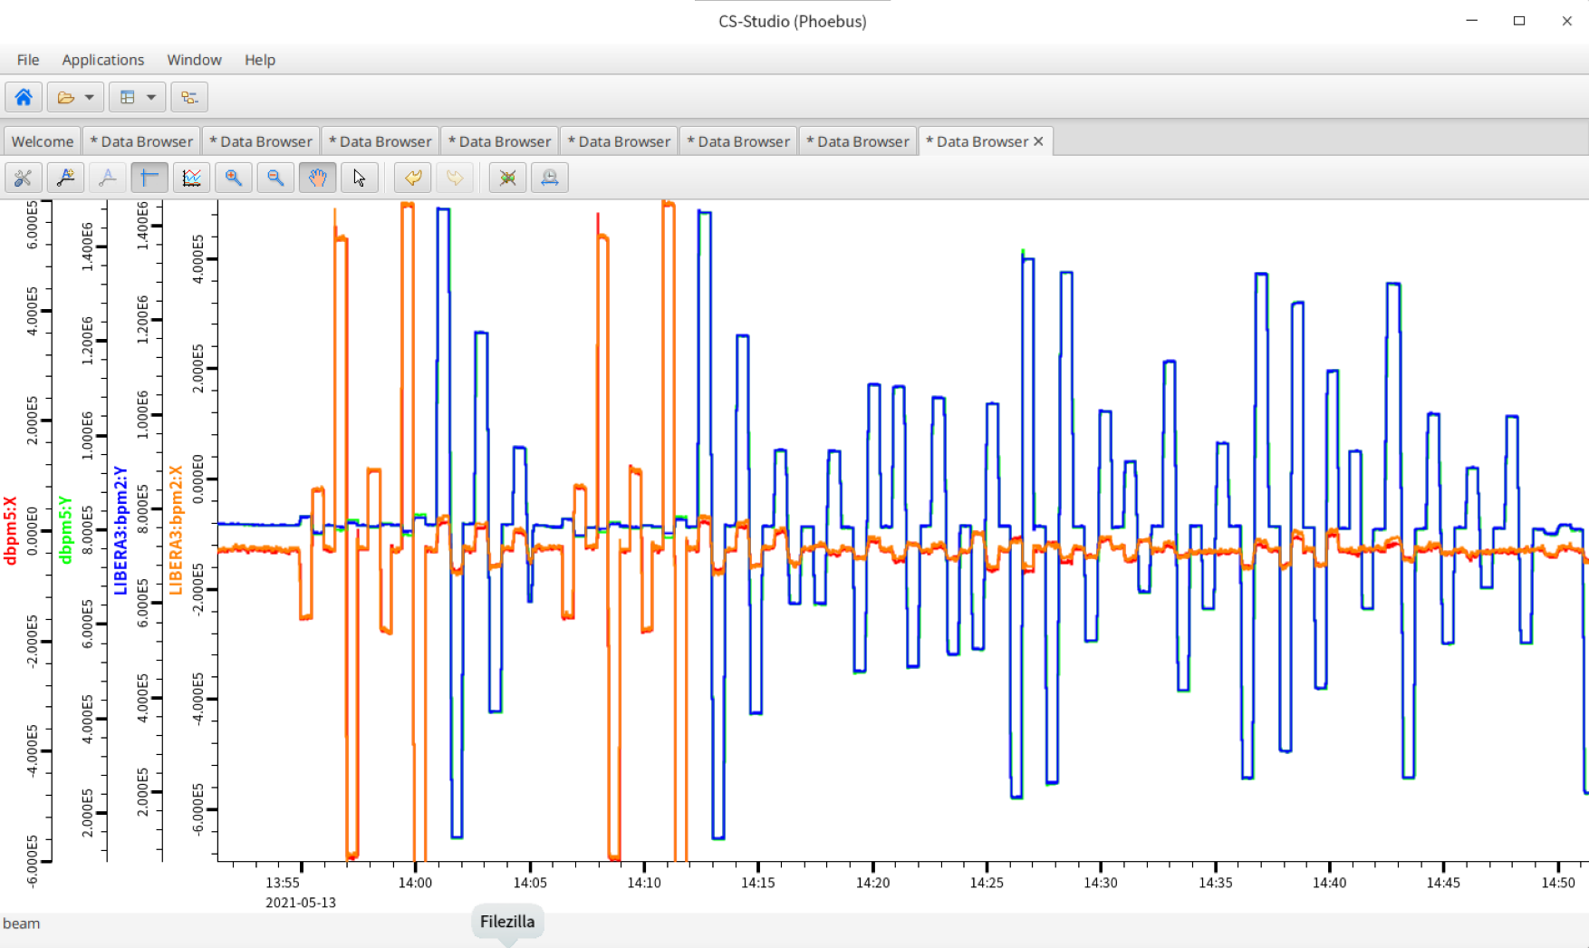
Long time stability（1 hour）

Slide 15
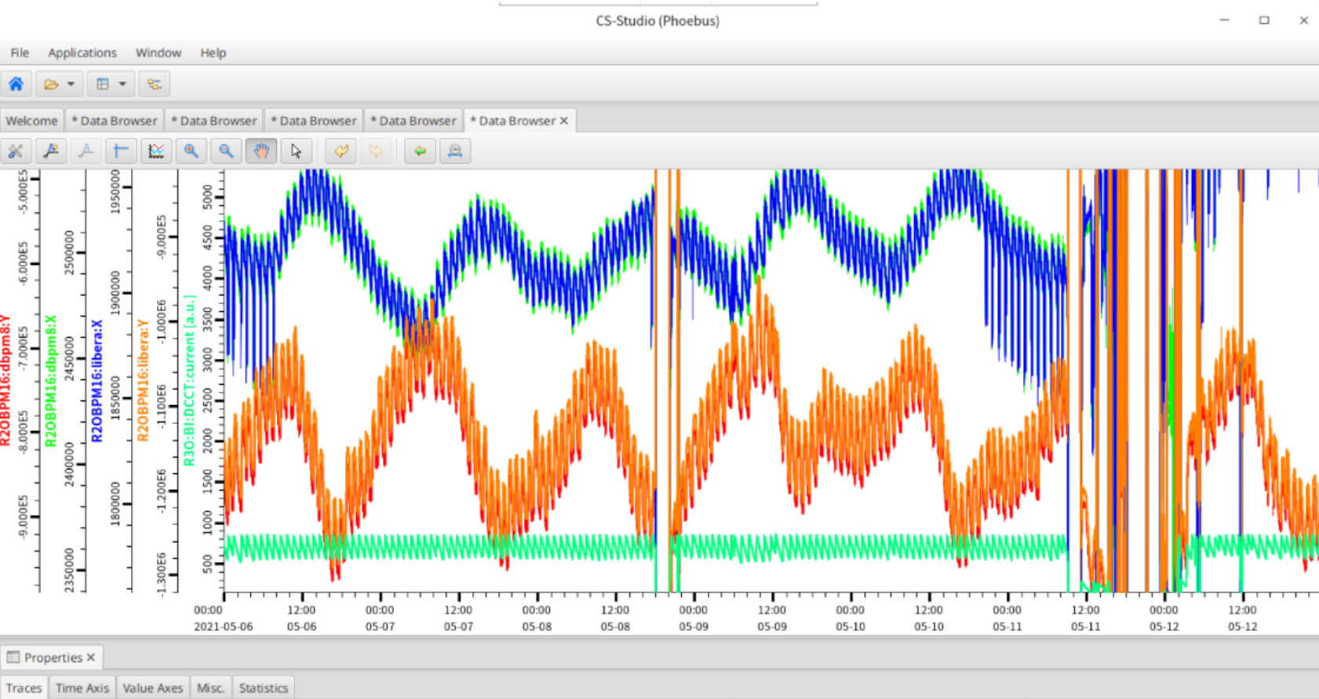
Long time stability（7 days）

Slide 16
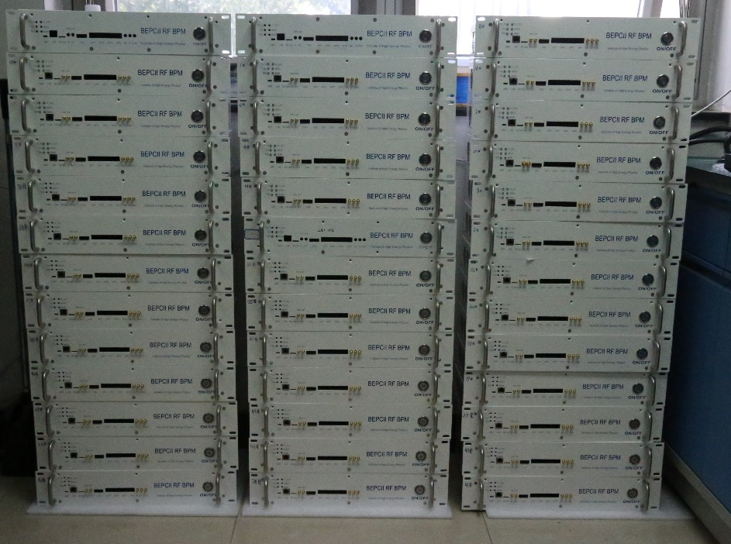
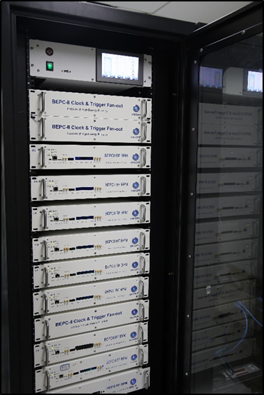
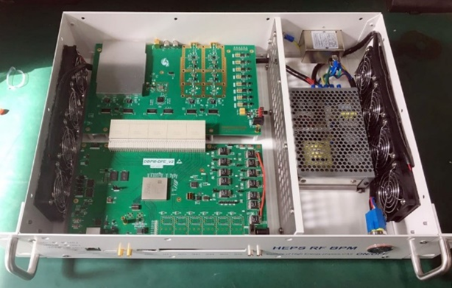
Application of BPM electronics in BEPCII
After finishing the prototype test, small batch production and application has been made in BEPCII
20 sets of single-pass mode BPM electronics were developed for the linac and put in operation in the middle of 2019.
Totally, 60 sets including SR mode and Collider mode BPM electronics were upgraded in the BEPCII storage ring.

Slide 17
Bunch by bunch BPM electronics R&D
The beam trip is an important problem for accelerator operation. Because the accelerator system is very complicated, involves many subsystems, and various conditions are mixed, it is difficult to get to the real cause for beam trip.
At present, many accelerators worldwide have established a powerful beam trip diagnostic system.
The other reason is preparing instrumentation for bunch by bunch current and beam position measurement

Slide 18
Bunch by bunch BPM electronics
Trigger
Buffer of bunch by bunch raw ADC data

Slide 19
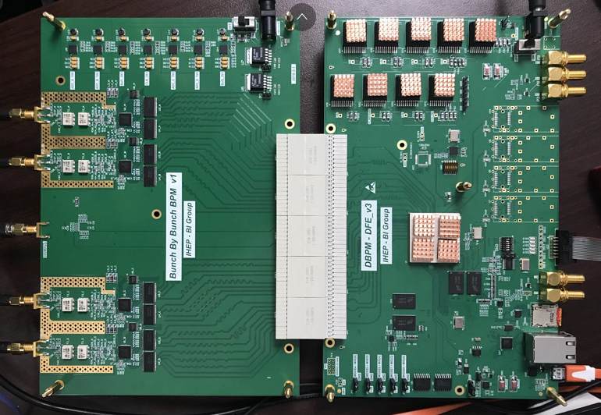
Bunch by bunch BPM electronics
Sampling clock: 500MHz,free running clock or externally clock locked with beam signal
ADC_a
ADC_b
AFE
DFE
clock
ADC_c
ADC_d

Slide 20
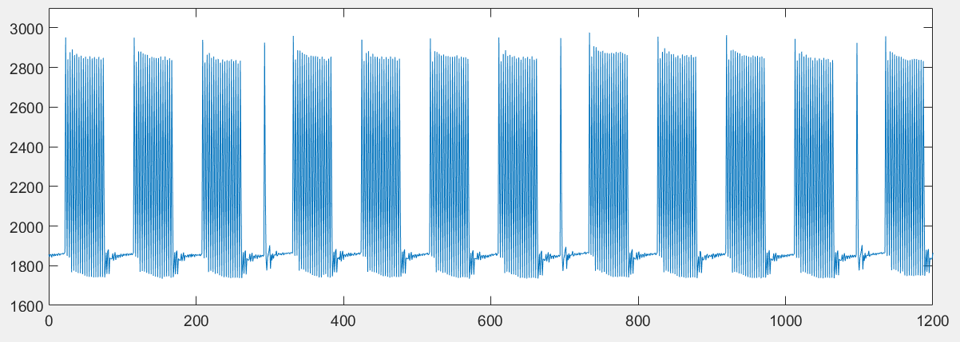
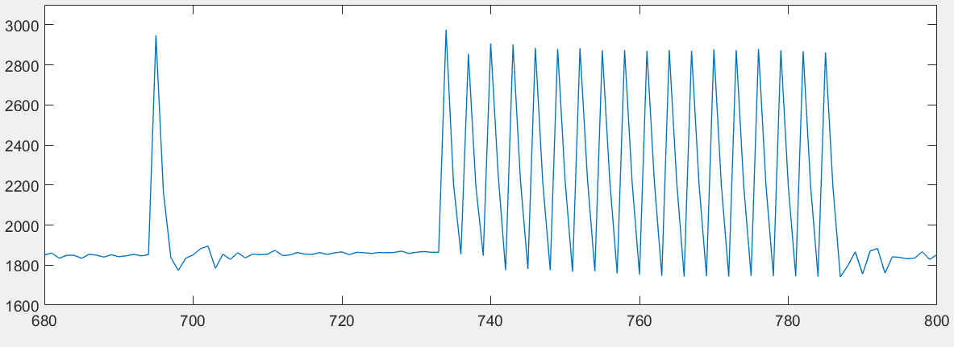
Bunch by bunch BPM electronics
Input: simulation pattern of BEPCII , repetition period 6ns

Slide 21
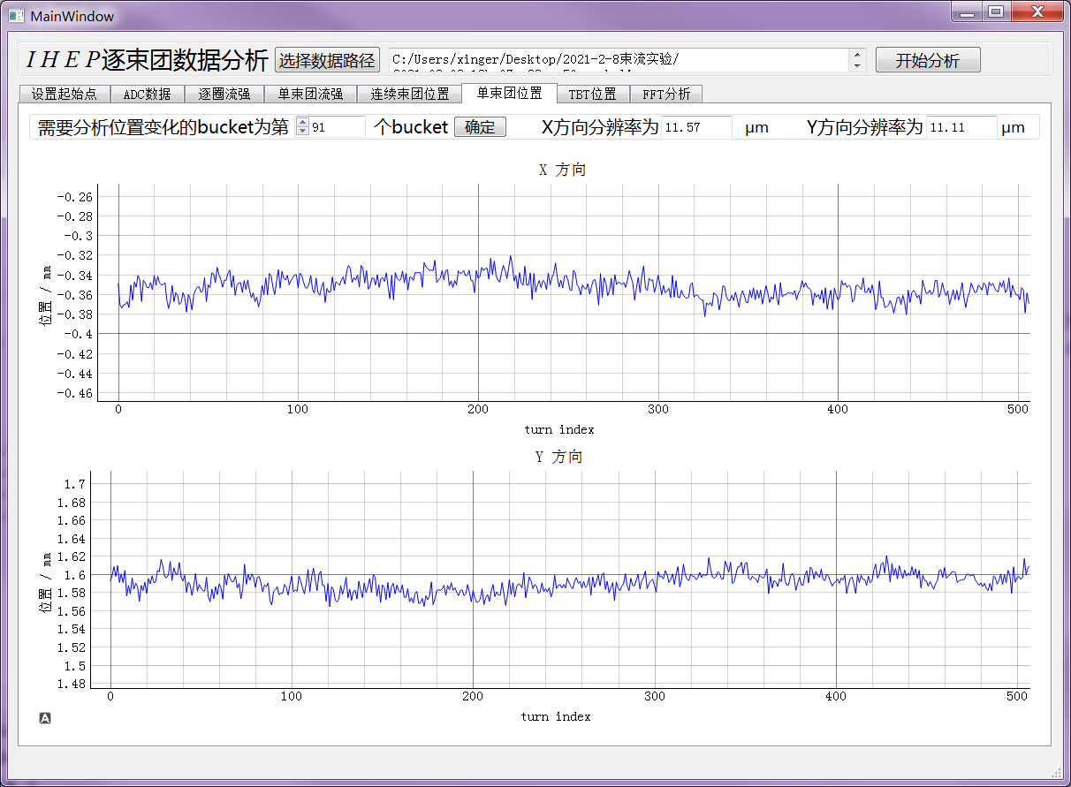
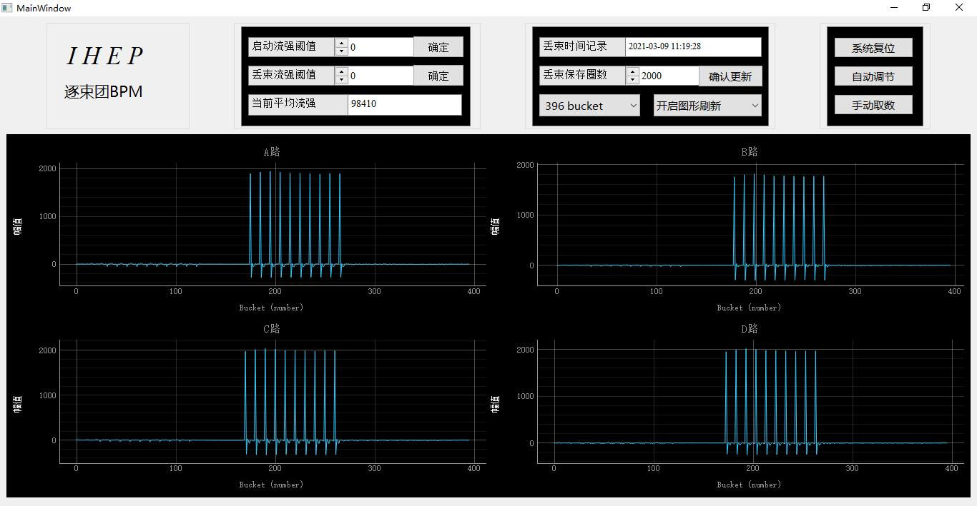
Bunch by bunch BPM electronics
The bunch by bunch BPM electronics was test in BEPCII.
The bunch by bunch BPM electronics measured the bunch current and bunch position
The 91st bunch position were traced in 500 turns
The bunch current were measured by electronics

Slide 22
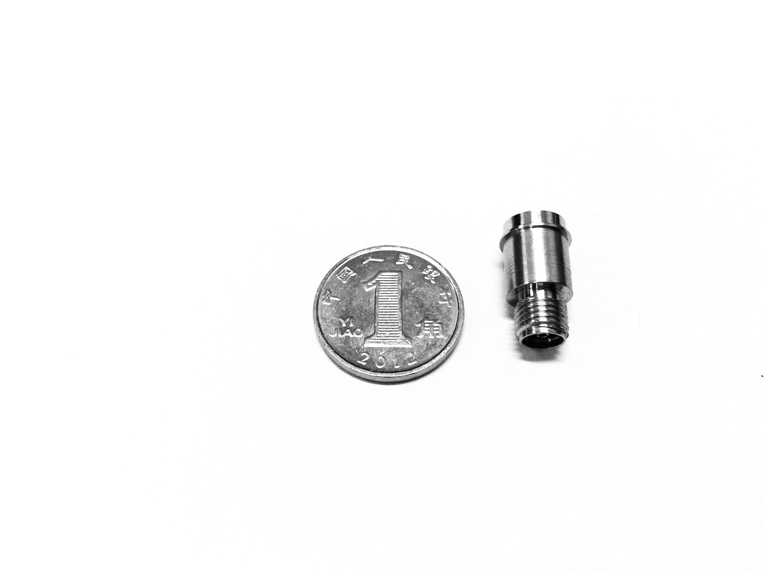
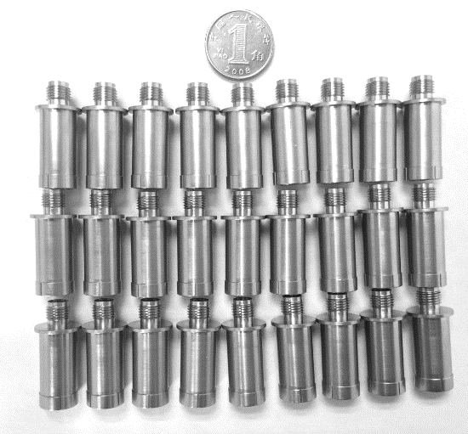
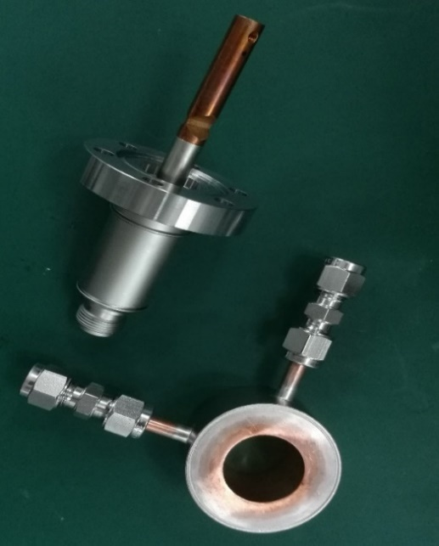
Feed-through R&D
Finished the study of feed-through in beam instrumentation.
Independent research and development of feed-through was kicked off
Two versions of feed-through have been made with the help of the CIPC Member Company.
BPM feed-through V1.0
BPM feed-through V2.0
Kicker feed-through

Slide 23
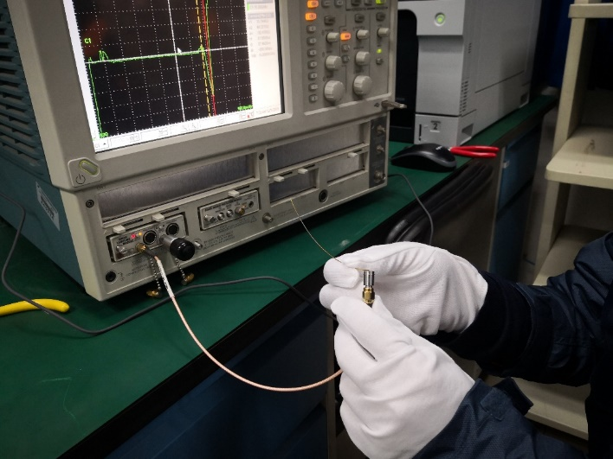
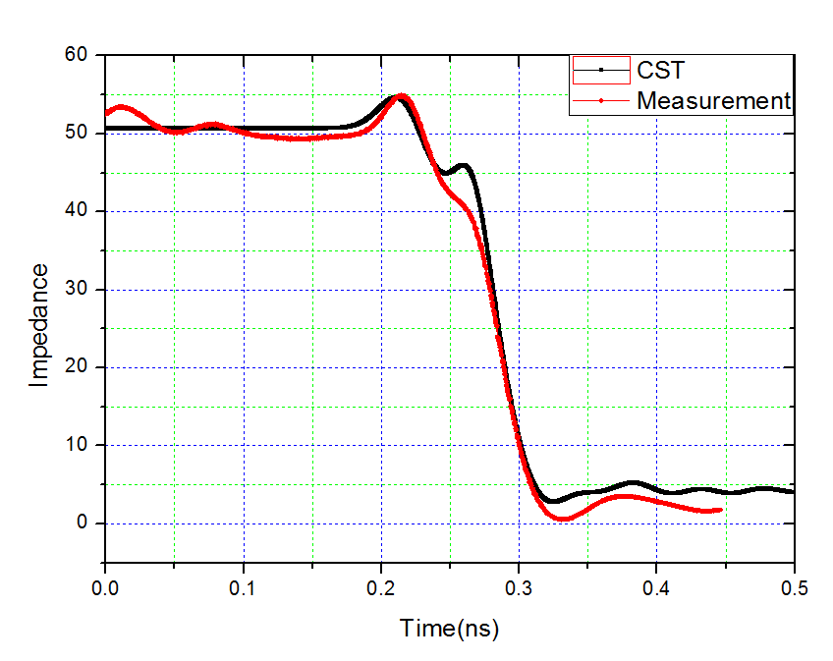
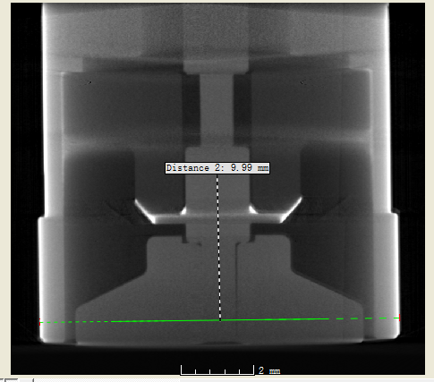
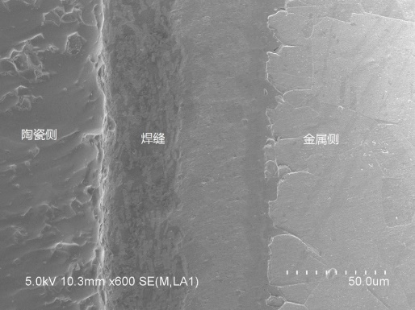
Feed-through R&D
The test result of the feedthroughs shows that the mechanical properties, high-frequency characteristics， and vacuum performance can meet the demands of the CEPC BPM.
TDR for impedance test and X-ray tomography for inner structure check.
Morphology of solid surface by SEM.
TDR test

Slide 24
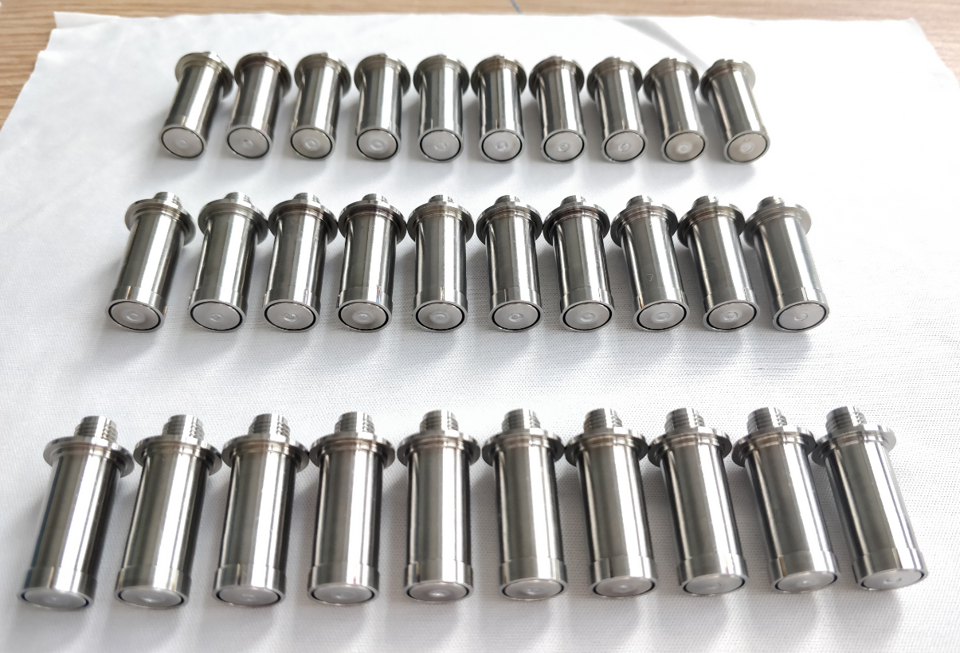
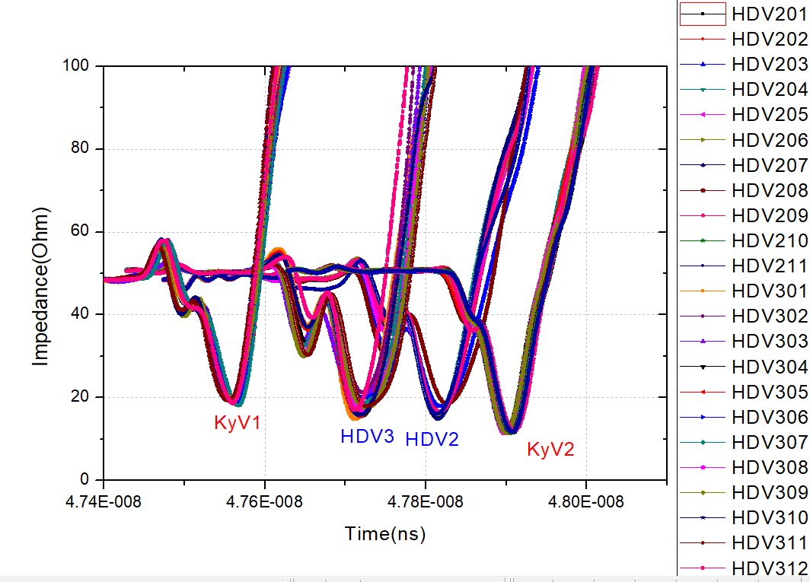
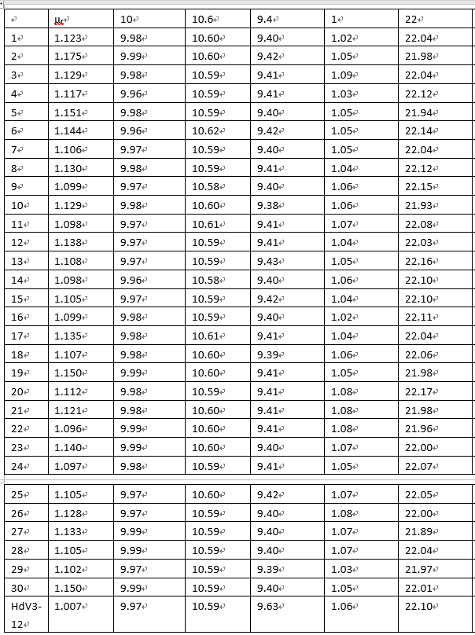
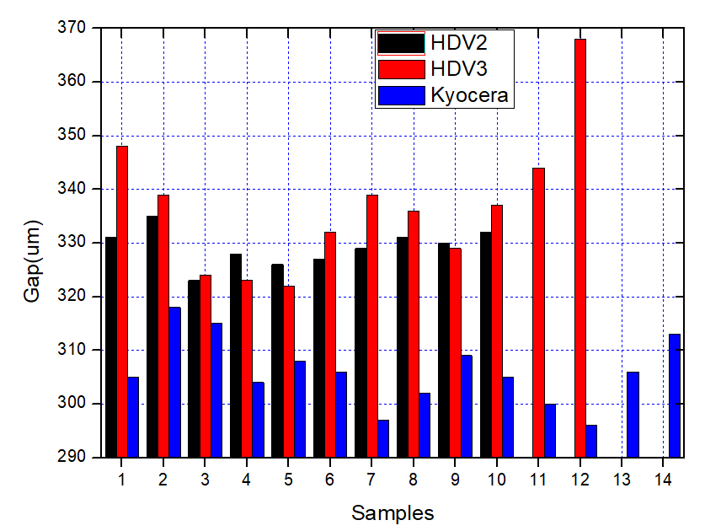
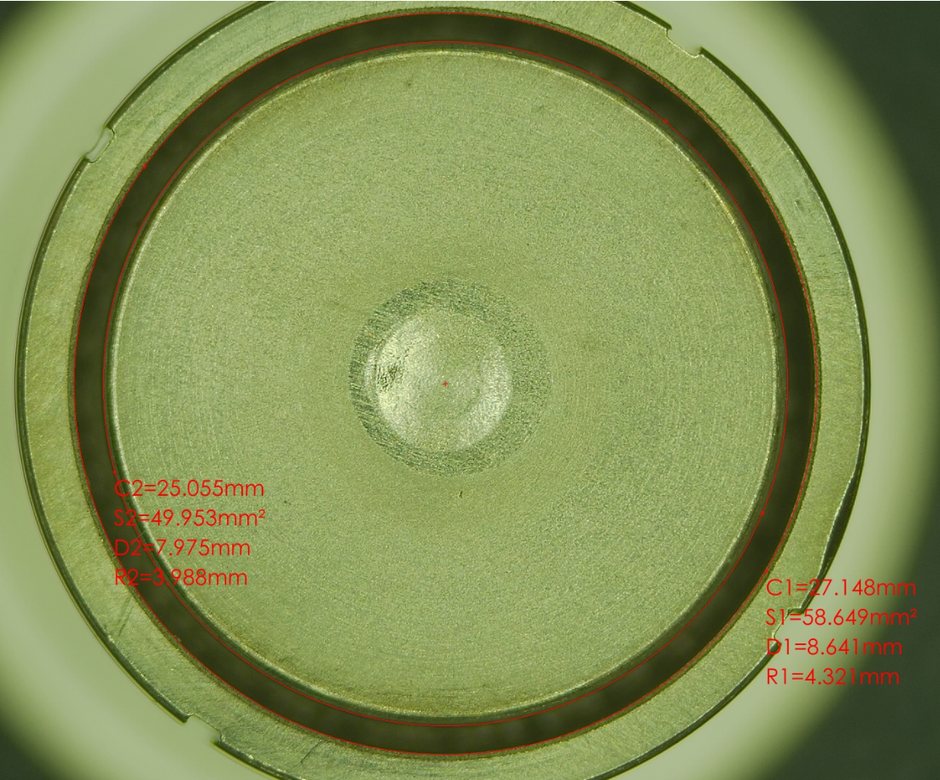
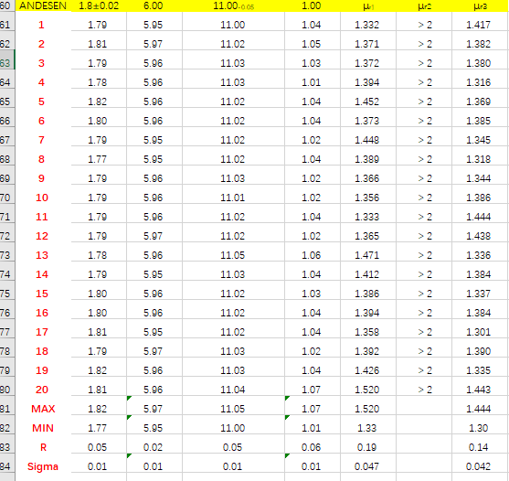
Feed-through R&D
3 Candidate manufacturers, the same design , batch products consistency test

Slide 25
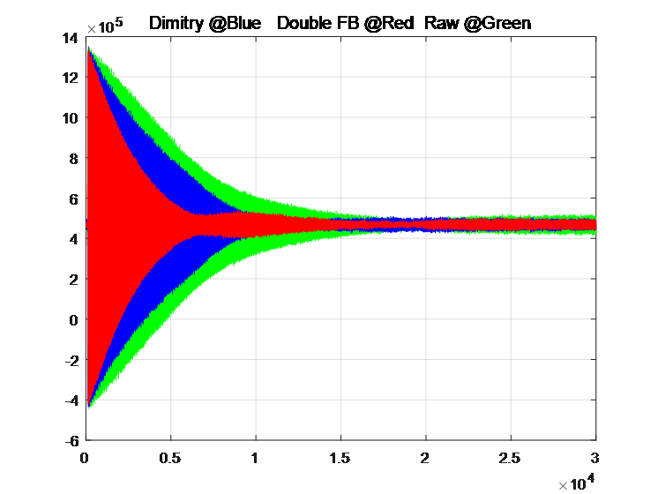
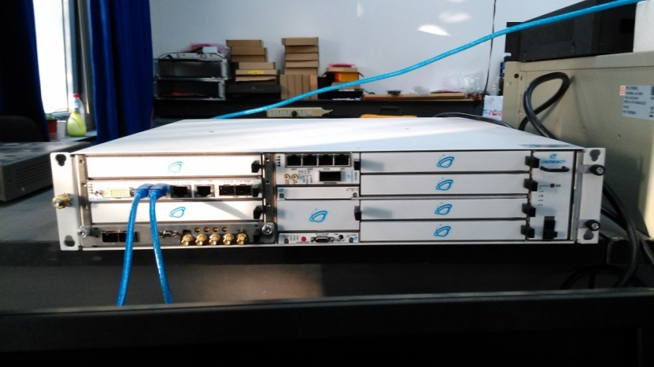
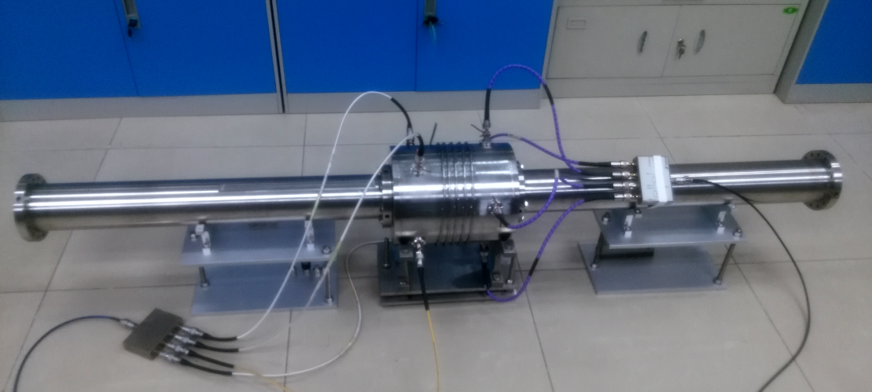
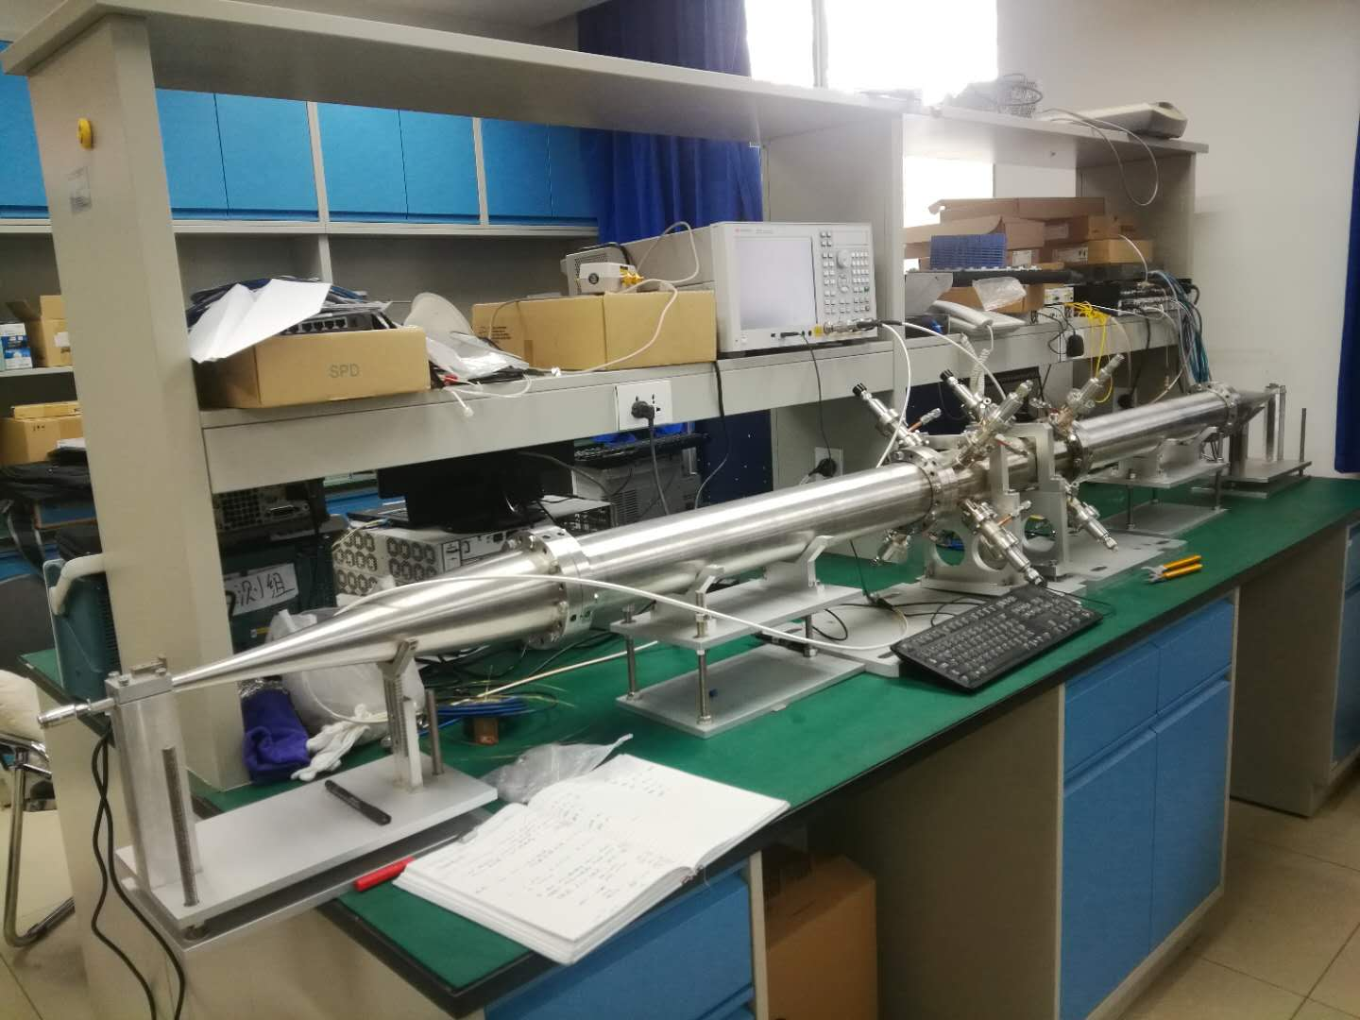
Feedback system R&D
FB electronics R&D based commercial product
The damping time of two TFBs
The kicker design and test in the lab

Slide 26
Status of CEPC beam instrumentation R&D
System | R&D Work supported by |  |  | Work to be done
 | BEPCII | HEPS/HEPS TF | Funding
BPM electronics | √ | √ | √ | Radiation hardness Industrialization
Beam position monitor fabrication |  | √ | √ | Feed through product and detection; BPM pick-up design,
Longitudinal feedback system | √ | √ |  | Electronics development
Transverse feedback system | √ | √ |  | Electronics development Longer kicker design
Synchrotron radiation monitor |  |  |  | Cooling of SR extraction mirror; X-ray interferometer; Gas jet scanner
BI at the interaction point |  |  | √ | Special beam monitor design at IP
Bunch current monitor |  | √ |  | BBB electronics R&D based home-developed and company
Beam loss monitor |  |  | √ | beam loss detector R&D Industrialization

Slide 27
Summary
The beam position monitor, feedback system， and other key technologies R&D has been carried out.
In-house developed BPMs were tested in the lab and with actual beam in BEPCII. Small batch production has been used online in BEPCII linac and storage ring.
After three months of trouble-free operation in BEPCII storage ring and linac, more units will be commissioned soon.
The feedthrough R&D was carried out as planned, and more studies will be done on the consistency of batch products.

Slide 28
Thanks for your attention !

