Slide 1
Cleanroom refurbishment in SM18
Upgrade for the SPL high gradient resonators

Slide 2
Reminders:
Why?:
  Cleanliness becomes very important for gradient > 20 Mv/m
Upgrade based on coupler experts recommendations (March 2010)⁽¹⁾:
  Get the needed infrastructure into one location
  Class10 / ISO 4 is a must for gradient >25MV/m
  SM18 facility has the best potential for high gradient component manufacturing
Visit of CEA-Saclay and DESY cleanroom facilities
(1): E. Montesinos, SPL Main power Coupler (SPL-MC) Cleanroom requirements, May 17th, 2010

Slide 3
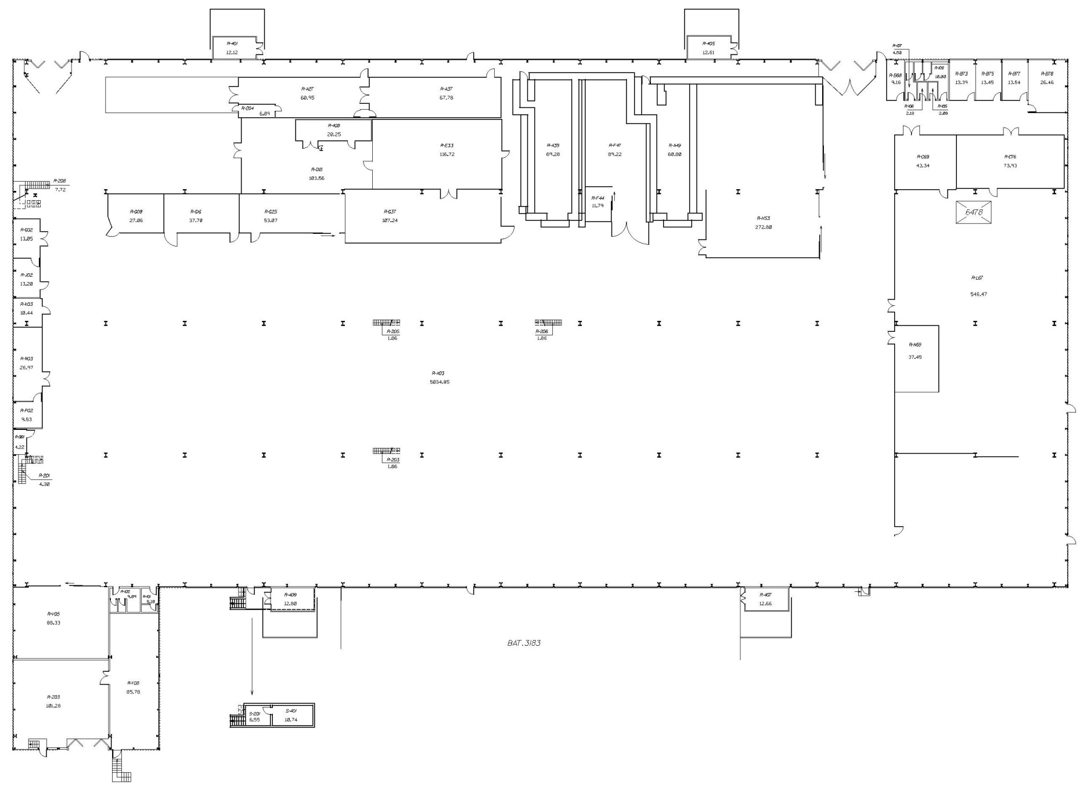
Existing facility at SM18
Cleanroom facility
RF facilities
Cryogenic
Magnet

Slide 4
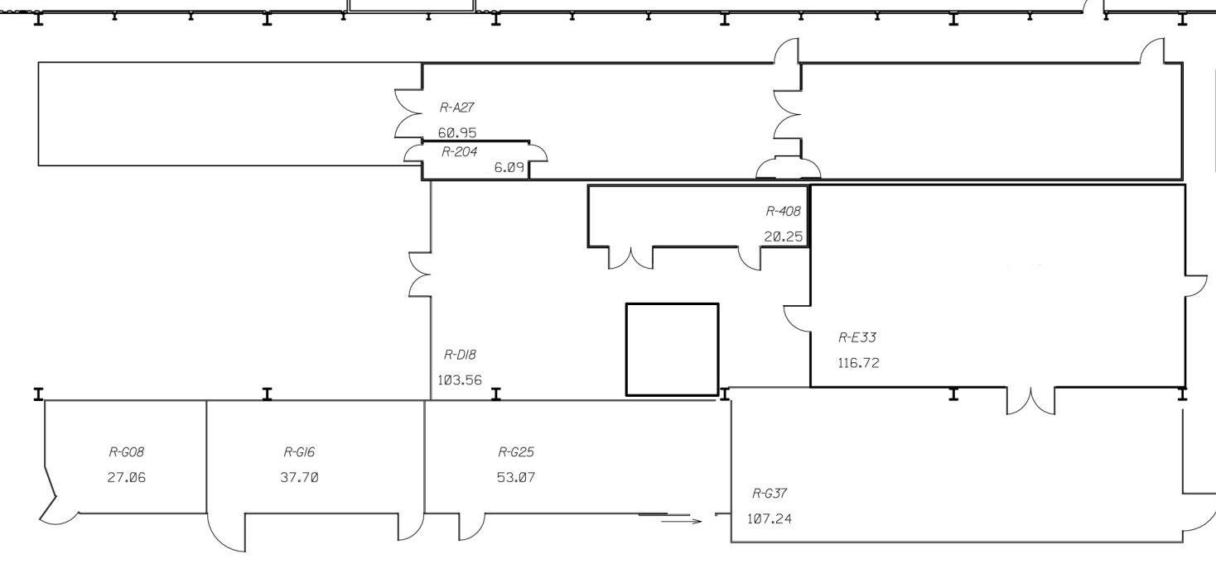
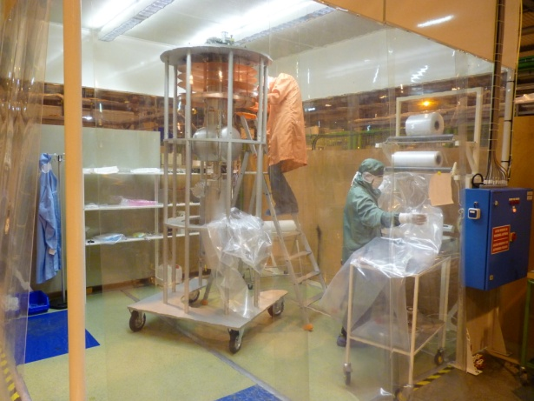
Existing facility at SM18
Outer working place
Class 10 000
Class 10
Air shower
Personnel access
Air supplier
Control room
Useful space = 13m×2.10m
Magnet equipment storage
Baldaquin Class 100
What is missing for high gradient resonators?
High Pressure Rinsing (HPR)
Ultra Pure Water (UPW)
Clean space dedicated to the cleaning operations
Better cleanliness
More space

Slide 5
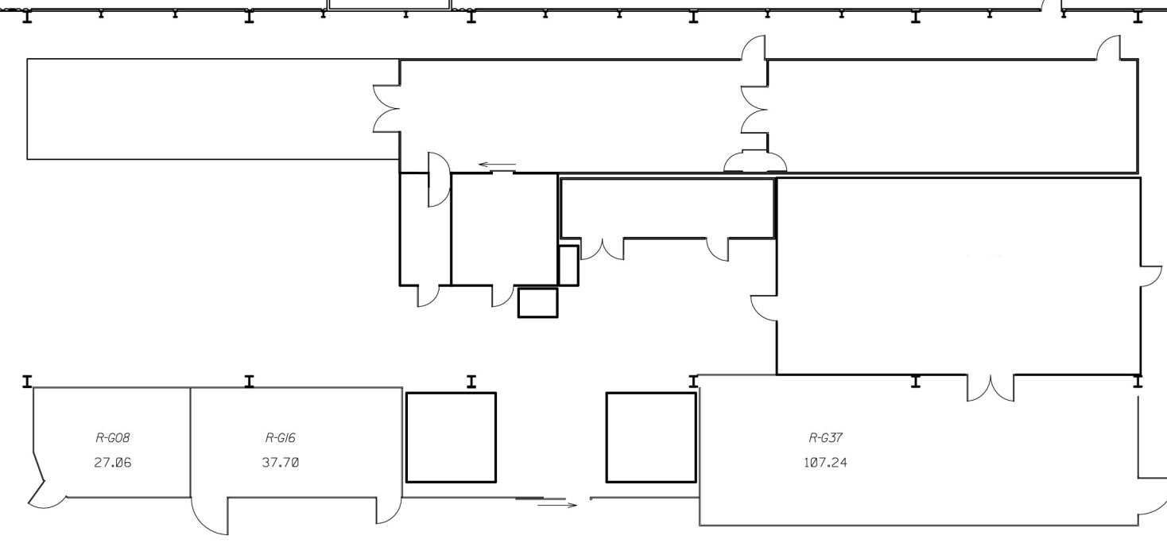
Upgrade proposal
Outer working place
Class 100
Class 10
Ionized air shower
Personnel access, with air shower Class 1 000
Air supplier
Control room
HPR system
Cleaning & rinsing room Class 100
UPW production
Baldaquin 2
Storage area Class 100
Baldaquin 1
Class 100
Class | Price per m² (€)
100 | 6 000 to 10 000
1000 | 4 000 to 8 000

Slide 6
Ultra Pure Water (HPW)
UPW, new machine with monitoring of the water quality ^{(1,2,3)}
  Particle counting
  Water resistivity (>18 MΩ.cm)
  Total organic carbon measurement (TOC < 60 ppb)
  Bacteria analysis
  Expensive equipment
(1): Quality control at the TTF-Cleanroom infrastructure for cavity-processing , N. Krupka, T. Ebeling, K. Escherich, A. Matheisen, Morales Zimmermann, B. Petersen, D. Reschke, N. Steinhau-Kuehl, F. Zhu
(2): Clean-room facilities for high gradient resonator preparation, K.Escherich, A.Matheisen, N.Krupka, B.Petersen, M.Schmökel, contribution to the SRF2005, Ithaca, New-York, USA
(3): Quality control update of the cleanroom for superconducting multi cell cavities at DESY N. Krupka, K. Escherich, M. Habermann, K. Harries, A. Matheisen, B. Petersen, contribution to the SRF2005, Ithaca, New-York, USA

Slide 7
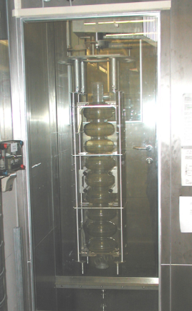
High Pressure Rinsing (HPR)
HPR: nozzle moving through a rotating cavity
  Collaboration with DESY ⁽⁴⁾ is welcome (but XFEL remains priority)
  New HPR in Brookhaven and Saclay
  Expensive equipment
Control done at outlet used as cleanliness indicator:
- Water resistivity
- TOC measurement
- Particle counting (limited by bubbles in water)
- Analysis of a filter at water outlet under microscope (2h long by analysis, up to 6 analyss per cavity)
DESY’s HP rinsing system
(4): A new high pressure rinsing system established at DESY, A. Matheisen, K. E scherich, R. B andelmann, H. M . Zimmermann, N. K rupka,DESY

Slide 8
Comments:
1st step: Cleanroom upgrade + HPR + UPW
    => 90% of the total refurbishment cost
If we obtain good results with CERN’ HPR on SPL prototype
    New HPR can be postponed
    1st step cost drops to 58% of the total refurbishment cost

Slide 9
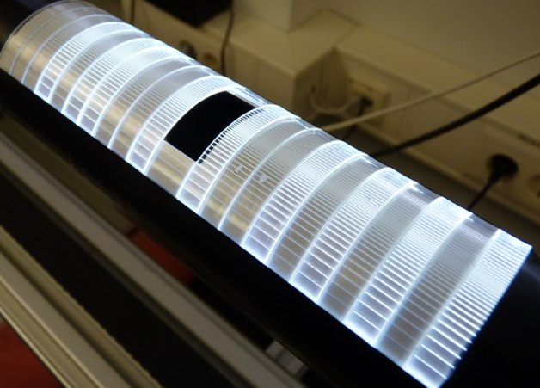
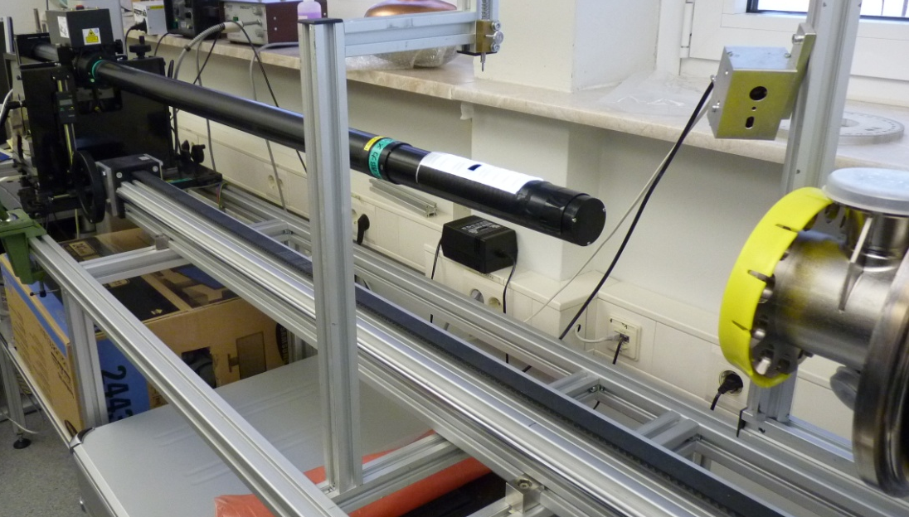
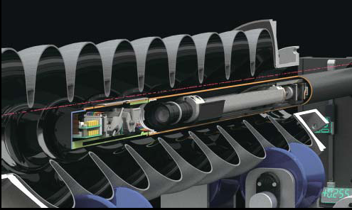
Optical inspection of cavities
Developed at KEK/Kyoto ⁽⁵⁾:
  Study cavity surface defects
  In use at DESY (under improvement)
Kyoto cavity inspection system
(5): Review of optical inspection method and results, K. Watanabe, KEK, Ibaraki, Janpan

Slide 10
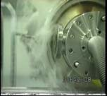
Additional equipment
Equipments | Comments
Air monitoring system / Particle counter | Control air quality, online monitoring
Temperature & humidity sensors | Permanent control
O₂ monitoring system | Survey of the O₂ level, online monitoring
Fog generator | Study and check air flow movement⁽⁶⁾
Ultrasound cleaning bath | Removal of dust
Air tight boxes & cabinets | Long term storage of clean component, have to be in stainless steel
Primary & secondary vacuum pumps | Oil free
Leak detection system | He test
Flow pattern at power coupler port at DESY (argon overlay flow from cavity switched on)
(6): Quality control at the TTF-Cleanroom infrastructure for cavity-processing, N. Krupka, T. Ebeling, K. Escherich, A. Matheisen, Morales Zimmermann, B. Petersen, D. Reschke, N. Steinhau-Kuehl, F. Zhu

Slide 11
Acknowledgments:
Colleagues from CERN
Berry Stéphane, CEA-Saclay
Aderhold Sebastian, DESY
Schlander Felix, DESY
The end
Thank you for your attention

Slide 12
Reminders:
ISO 14644 | 0,1 µm | 0,2 µm | 0,3 µm | 0,5 µm | US FED STD 209E
ISO 1 | 10 | 2 | 0 | 0
ISO 2 | 100 | 24 | 10 | 4
ISO 3 | 1,000 | 237 | 102 | 35 | Class 1
ISO 4 | 10,000 | 2,370 | 1,020 | 352 | Class 10
ISO 5 | 100,000 | 23,700 | 10,200 | 3,520 | Class 100
ISO 6 | 1,000,000 | 237,000 | 102,000 | 35,200 | Class 1000
Cleaner

