Slide 1
Status of 704 MHz developements
at CEA-Saclay

Slide 2
Outline
Status of components for high beta cavities
Helium tanks
Tuners
Status of equipments for preparation and test
Vertical EP
2nd Sound system
RF power test stand

Slide 3
Introduction
CEA-Saclay is involved in programs aiming at designing and prototyping 700 MHz sc cavities and components
  European program FP7 (EuCARD, CNI-PP-SLHC)
  Contribution Exceptionnelle de la France au CERN
  ESS collaboration (MoU to be signed)
We participate in several tasks consisting in:
  the design of 704 MHz cavity, He tank, frequency tuner
  the prototyping of 704 MHz cavity(ies)
  the construction of equipments needed for preparation and test of components (vertical EP station, HPR station, vertical and horizontal cryostats)
  the RF tests at cold of components (power couplers, tuners) and optimization of algorithm for LFD compensation
  the processing of 704 MHz power couplers up to 1MW
  the fabrication of sets of He tank and frequency tuners

Slide 4
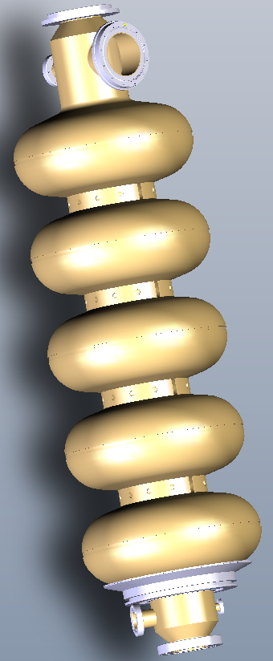
Optimized design of 704 MHz β=1 cavity
Presented at the last meeting
With this optimized design, prototypes would fit on our frames for surface preparation (BCP, VEP, HPR) and test in vertical cryostat
assymetric cavity
  beam tube ø140 mm with a ø100 mm port for power coupler
  beam tube ø130 mm with a ø10 mm port for pick-up probe
stiffening rings between adjacent cells
inner diameter of the cavity flanges fixed to 80 mm
To perform qualification tests in horizontal cryostat or cryomodule, study of a fully equipped cavity (tuner, coupler, tank, …) is necessary
power coupler port cooled by LHe
lateral frequency tuner (similar to Saclay IV)
each beam tube equipped with one ø40 mm HOM port
fabrication of cavity and He tank without brazing
  Helium tank made of Ti ; flanges made of NbTi

Slide 5
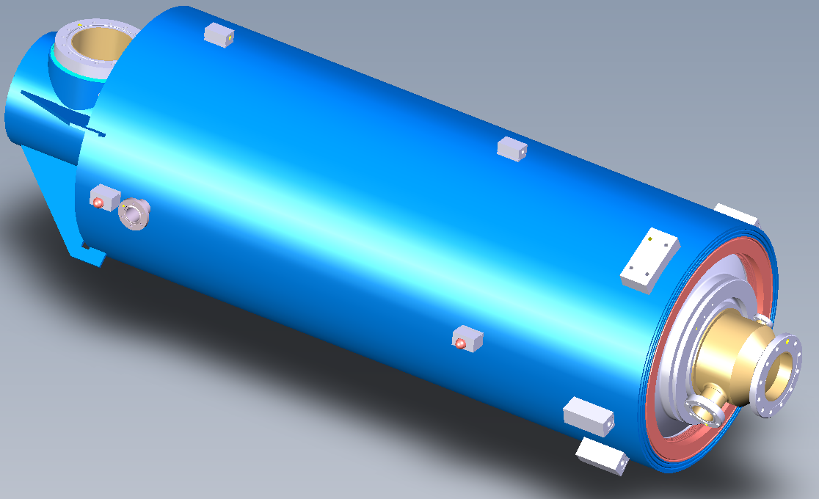
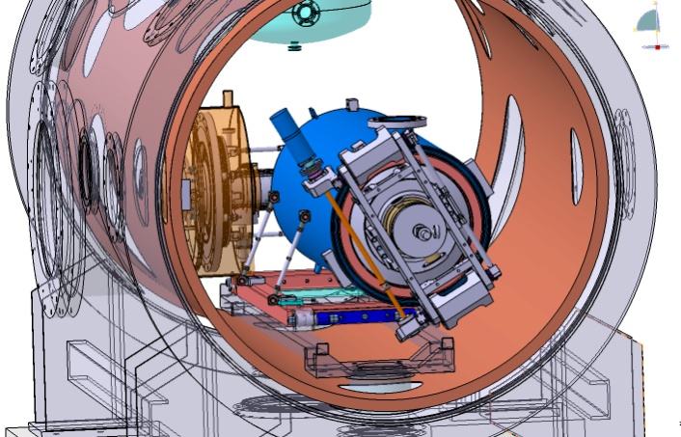
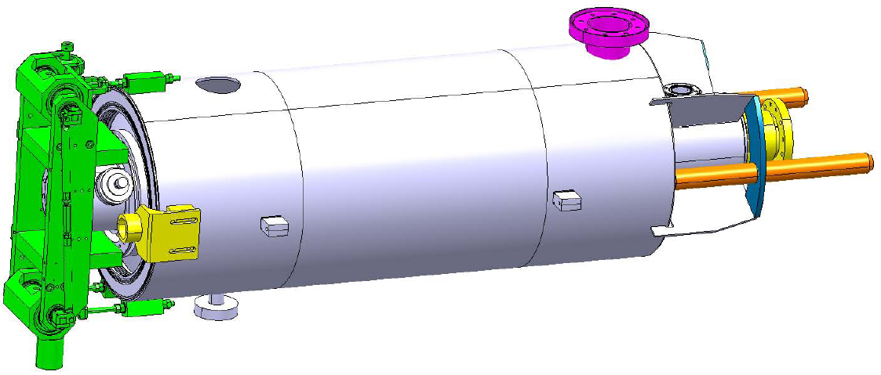
Helium tanks for 704 MHz β=1 cavities
Since the 4th SPL Collaboration meeting
Completion of the design compatible with the Saclay 704 MHz β=1 cavity
Assessment of modifications for integration in the “short cryomodule”
⇨ several pieces of interface have to be modified
Two models of tanks are studied in parallel
(validated at CEA/CERN/IN2P3 meeting held at IPN-Orsay (15/10/ 2010)
Tank designed for the tests in CryHoLab
Tank designed for integration of cavity string in short cryomodule (CERN concept)

Slide 6
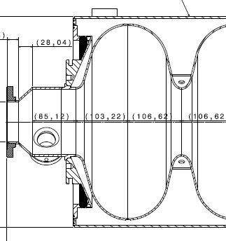
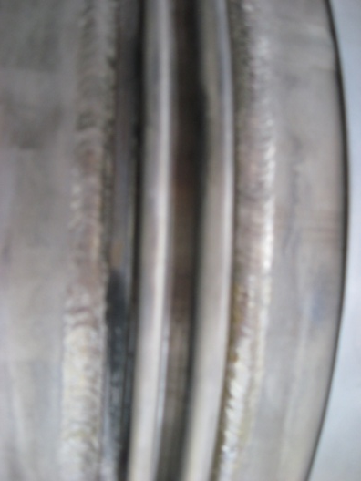
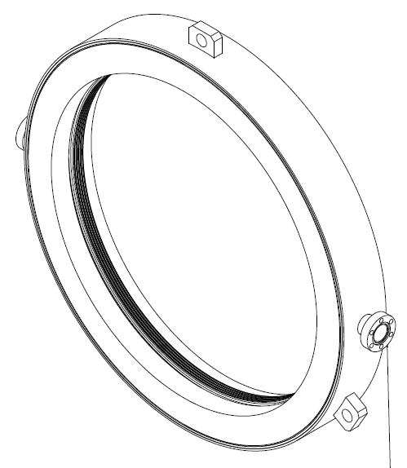
Helium tanks for 704 MHz β=1 cavities
Modification of Ti bellow
- Ti bellow to be welded on the Helium tank made out of Titanium
axial stroke of +/- 3 mm w/o plastic deformation (tuning range)
small stiffness with respect to the cavity
Hydroformed Ti waves
Easy to clean
Stiffness with wall thickness 0.25mm: 700 N /mm
Cheapest option
Offer received from Skodock GmbH for a 2 waves bellow :
Ti bellow qualified at 3 bars in a temperature range +50/-271 °C
If needed, we are ready to prepare a test at Saclay
(mechanical measurements, thermal cycling, tightness, deformation under pressure forces)

Slide 7
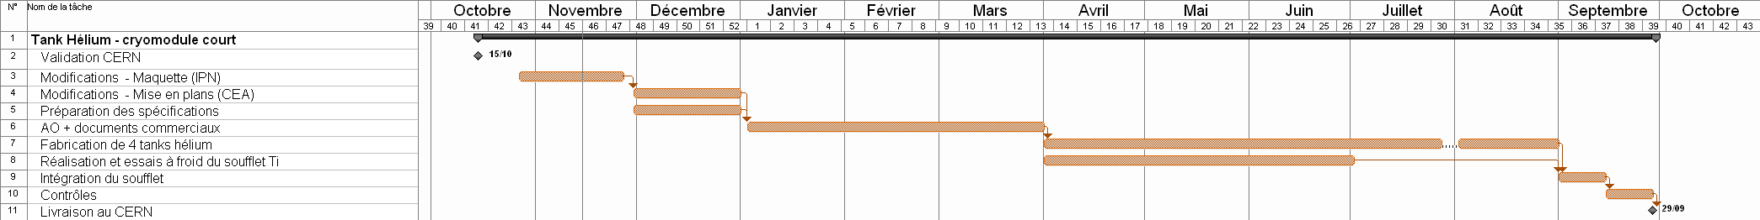
Helium tanks for 704 MHz β=1 cavities
Drawings almost completed
(3D model done by IPN and detailed drawings by CEA)
To be submitted to CERN for validation
Technical specifications ongoing

Slide 8
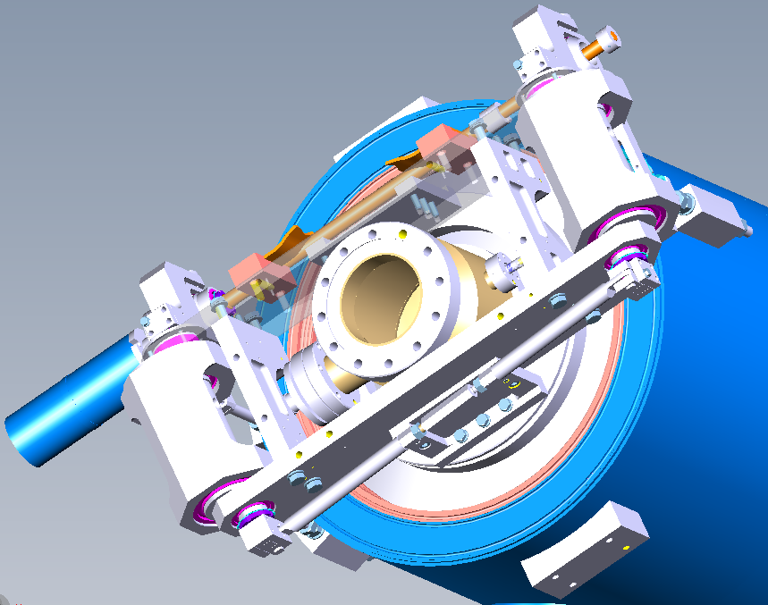
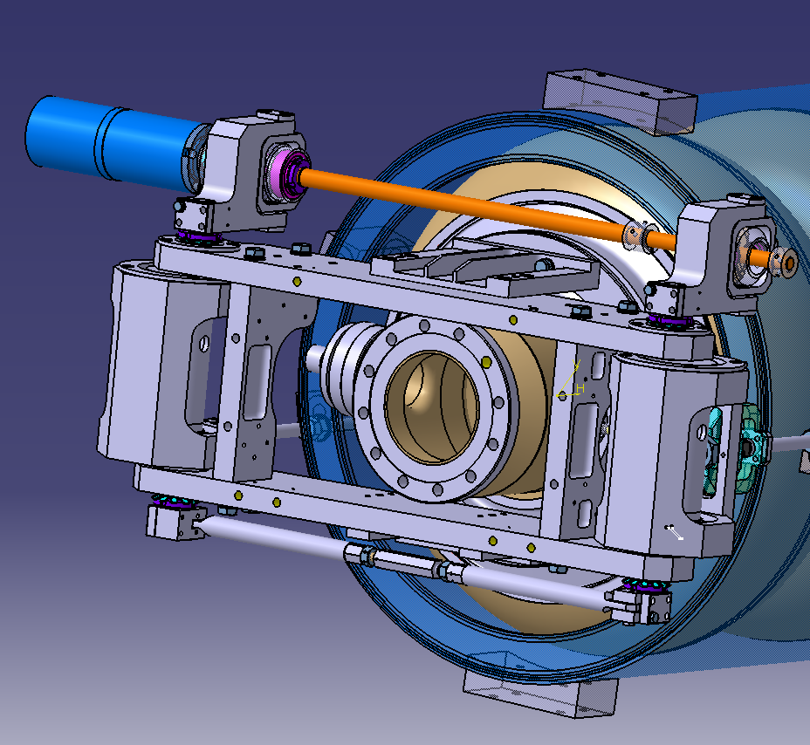
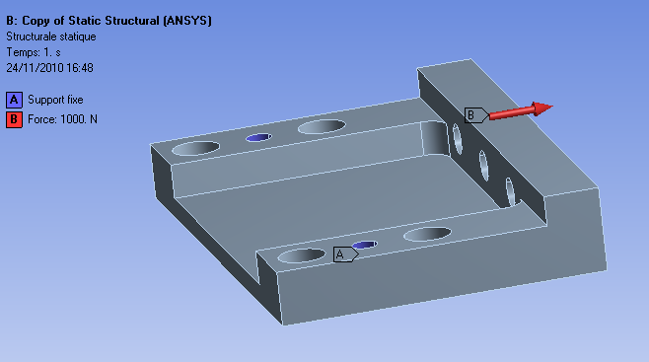
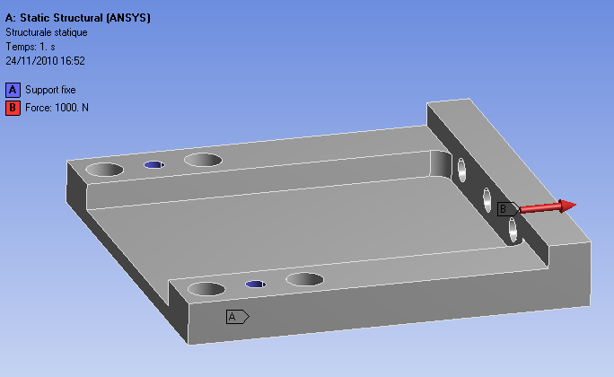
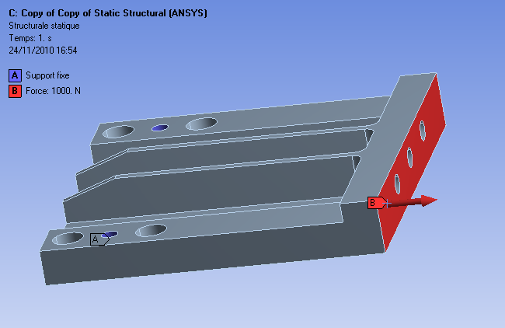
Frequency Tuners for 704 MHz β=1 cavities
Since the 4th SPL Collaboration meeting
Completion of the tuner design compatible with the Saclay 704 MHz β=1 cavity
Assessment of necessary modifications for integration in the “short cryomodule”
⇨ Only one piece of tuner has to be modified
Validation by CERN at CEA/CERN/IN2P3 meeting held at IPN-Orsay (15/10/ 2010)
Tuner Saclay V
(with one piezo actuator)
Lengthening of the
connecting piece of 45mm
Optimization of the connecting piece to recover an acceptable stiffness
>100 kN/mm
60 kN/mm
90 kN/mm

Slide 9
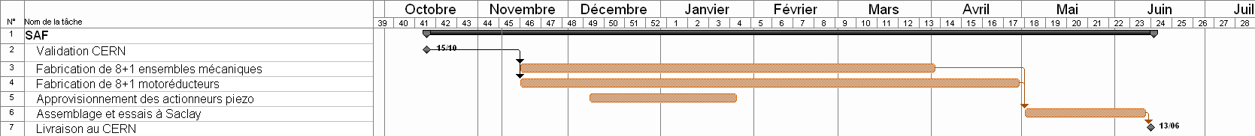
Frequency Tuners for 704 MHz β=1 cavities
Call for offers launched in June and commercial offers received:
- in August for the mechanical set of pieces
- in September for the Phytron motor+gear box
Contracts for fabrication/delivery of 9 tuners are ready
(signature expected for next week)
Piezo assembly, final assembly and test to be done at Saclay
Delivery to CERN in June 2011

Slide 10
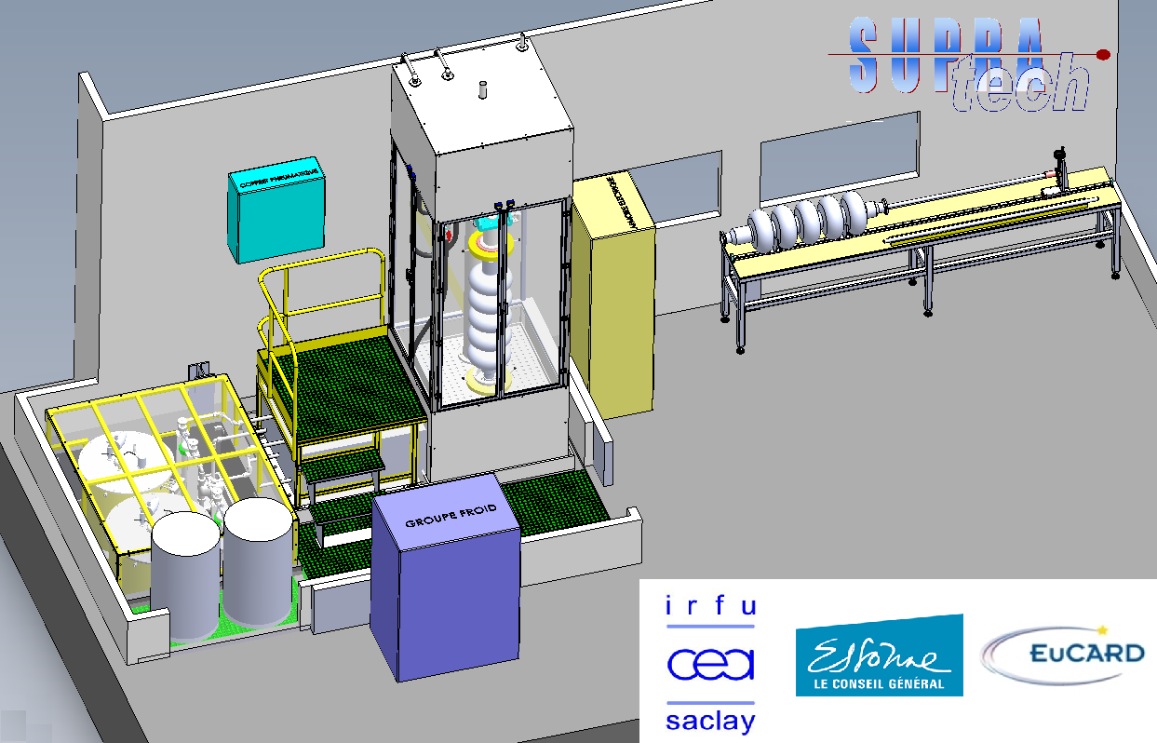
Vertical EP station
Fabrication starts (contract signed in Nov. 2010)
VEP station should be tested in April 2011
F. Eozénou

Slide 11
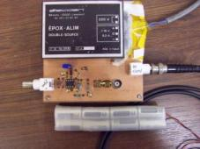
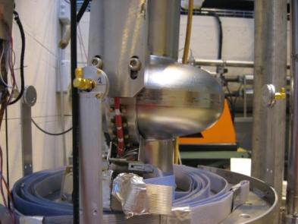
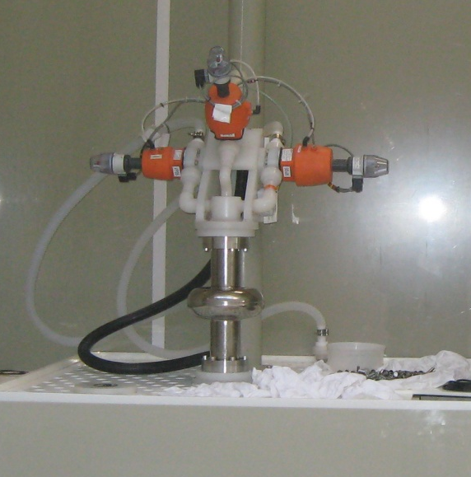
Quench localization by 2nd sound detection
Sensors:
8 Oscillating Superleak Transducers (OST) received from Cornell
1 prototype electronics circuit developed at Saclay
Tests in VC with a 1-Cell 1.3 GHz cavity were undertaken:
With a T-mapping system for quench localisation
With 3 OST sensors for qualification of the instrumentation and acquisition
OSTs
Unfortunately, no signal was measured from the OST sensors due cavity FE
New BCP & VT in progress
T map sensors
J. Plouin

Slide 12
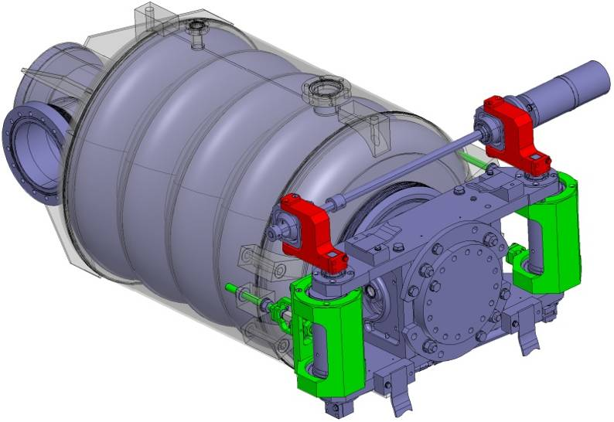
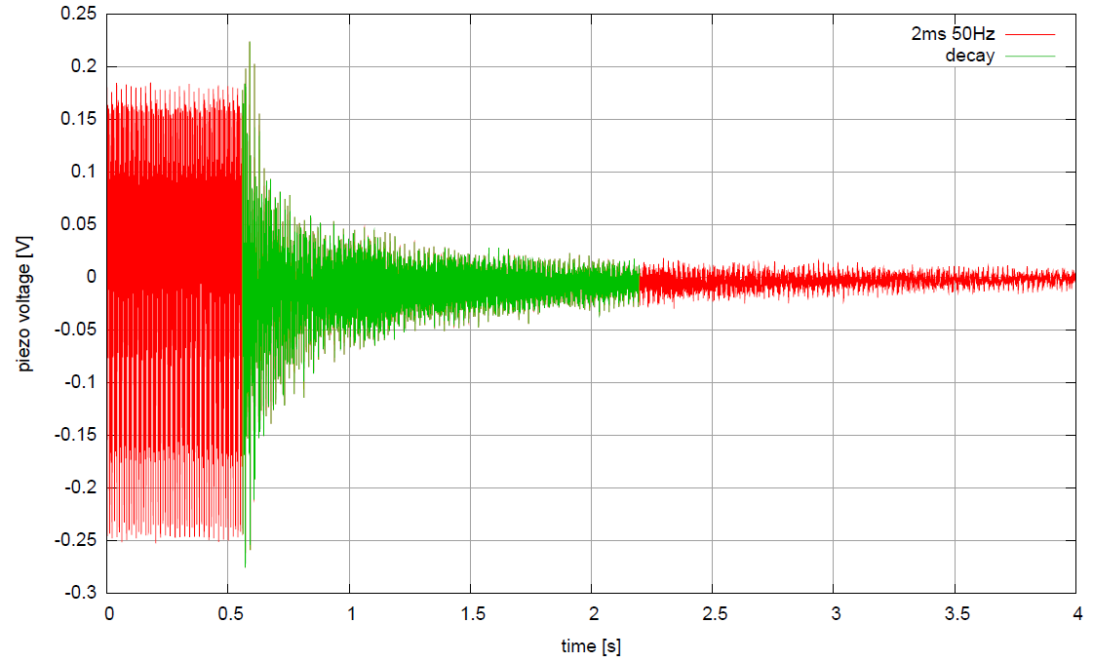
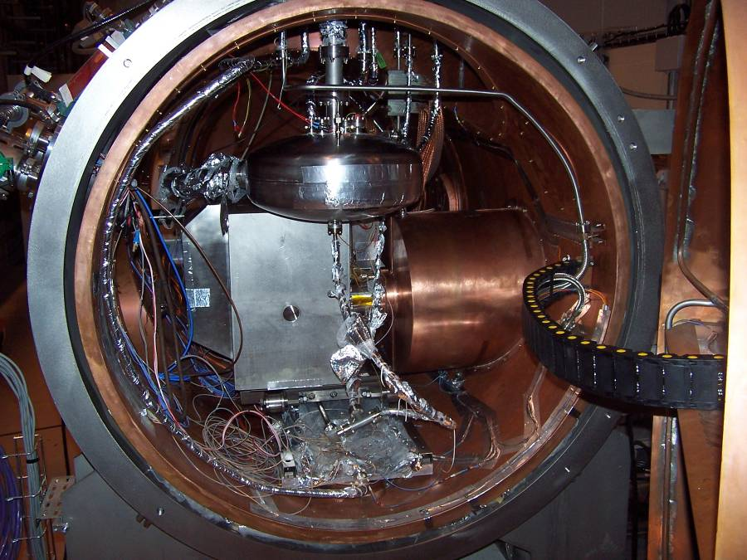
SLHC-PP: test in pulsed mode
Test done on « HIPPI » cavity (beta=0.5 – 704 MHz – 5cells) in CryHolab
Piezo signal used as a sensor
1
2
3
4
1 : Mechanical excitation due to LFD ; RF pulses 50 Hz, 2 ms, Eacc = 14.5 MV/m
Only stable oscillation observed ; 20 ms between pulses is too short for the modes to decay.
2 : RF is switched off
3 : mechanical modes decay for approx. 2 s
4 : mechanical vibration due to the environment
G. Devanz

Slide 13
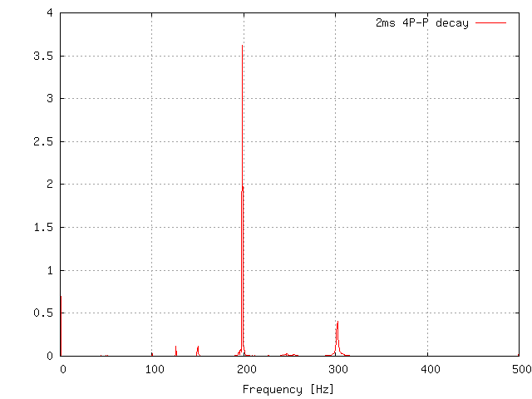
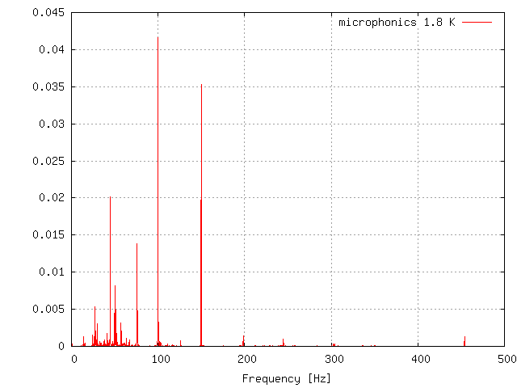
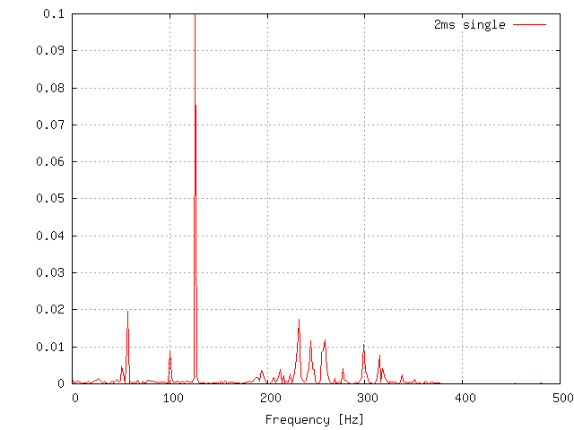
SLHC-PP: test in pulsed mode
Analysis of piezo signals from the previous slide:
decay spectrum
Q estimates:
400 for 198 Hz mode
300 for 301 Hz mode
RF is off :
Mechanical virbration due to the cavity environment
Spectrum due to a single RF pulse
G. Devanz

Slide 14
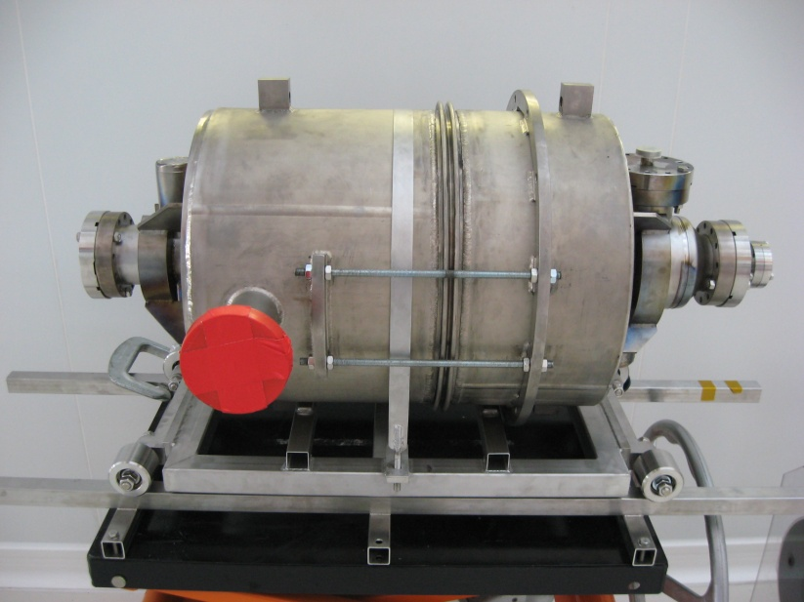
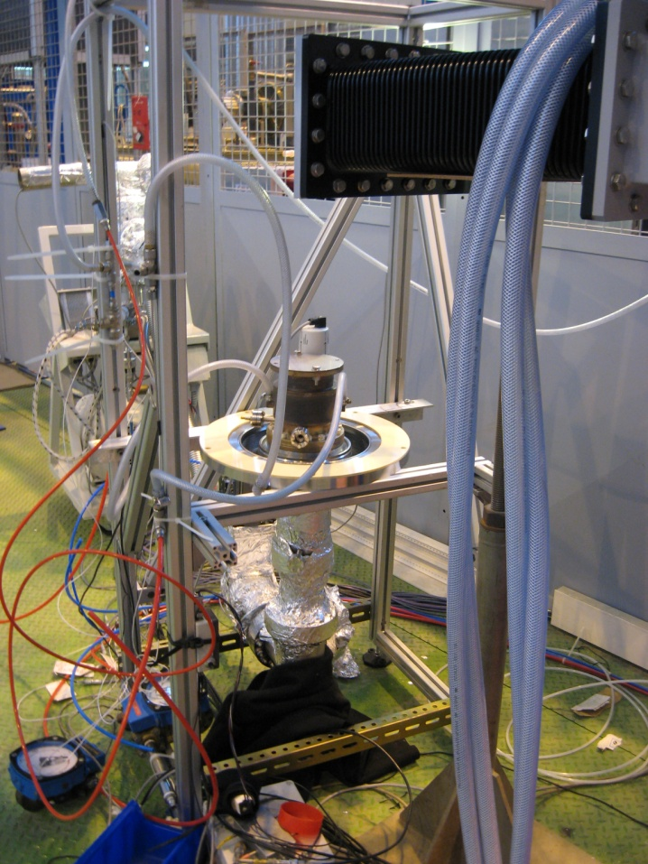
SLHC-PP: preparation of tuner test
INFN cavity (beta=0.5 – 704 MHz – 5cells) with a blade tuner in preparation
700 MHz-1MW coupler from CEA with a modified manchette
Coupler processing:
SW - 500 kW @ 50 Hz – 2ms
(reached in 2 days)
Diameter of the cavity flange (80 mm) NbTi flange with Al hexagonal gasket
Tests with INFN cavity scheduled in January 2011
Availibilty of the RF power test area in April 2011
⇨ Processing of pairs of couplers (E. Montessinos presentation)
G. Devanz

Slide 15
Summary
Fabrication of tuners started
Design of tank completed, drawings & specs in progress
Equipments for surface preparation and vertical test of 704MHz cavities should be ready mid-2011
High power RF tests are going on in the frame of te SLHC-PP program ; processing of new couplers from CERN will follow
Proposal for power upgrade (2MW) is in preparation

Slide 16
Thank you
for your attention

Slide 17
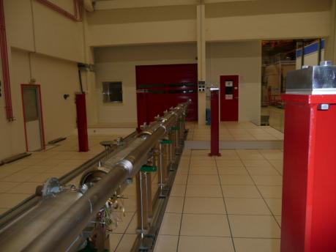
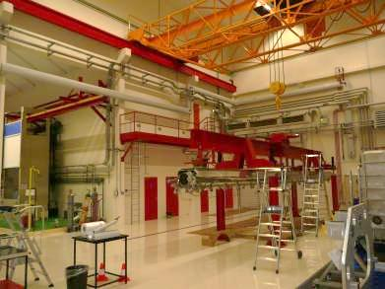
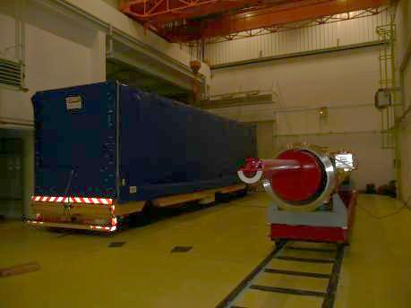
Cavity string in front of the CEA-Saclay CR
Assembly and alignment workstation
Wagon used for transport between workstations
Cantilever used for assembly

Slide 18
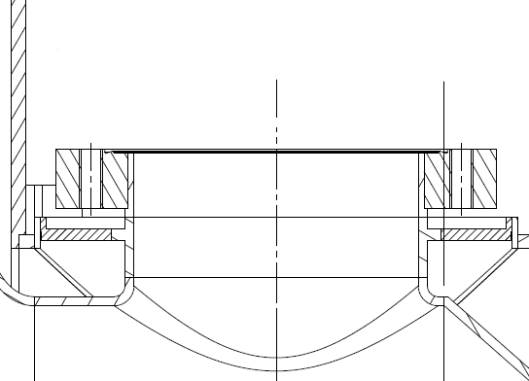
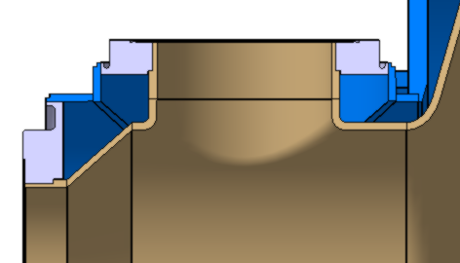
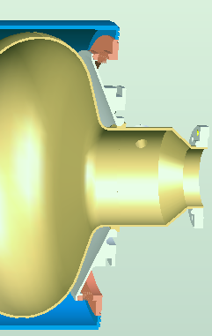

cavity/helium tank interfaces
Risk of leaks after cooldown of Nb/Ti CF flange and copper gasket
⇨ New design with a SS flange
Previous version
Current version
Ti tank
NbTi CF flange
welded
SS CF flange
brazed
Nb cavity port
Nb cavity port
Ti (or Nb/Ti) ring
Direct welding (Nb-Ti): connection piece redesigned
Ti
Nb

