Slide 1
5th SPL Meeting
Summary
Working Group 1
E. Ciapala

Slide 2
High Power Klystron and Solid State Amplifiers
E. Montesinos
SPL = 704 MHz
Courtesy Erk Jensen
Klystrons:
  One klystron per two cavities
  One klystron per cavity
IOTs:
  One IOT per cavity
  Multiple IOTs combined per cavity
Solid State Amplifiers (SSA)
Magnetron

Slide 3
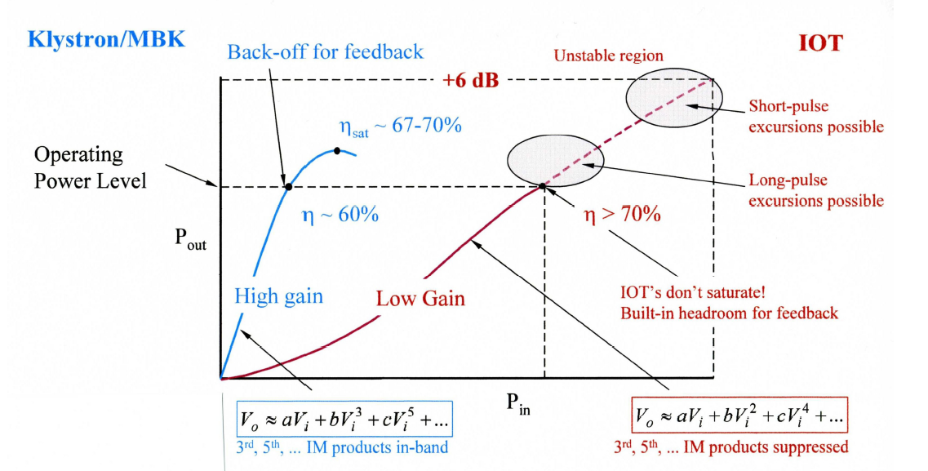
Alternative : IOTs
Courtesy Heinz Bohlen
IOTs do NOT saturate -> margin for LLRF already included !
No pulsed modulator needed -> pulses via RF drive
pulse excursions possible
Better efficiency than klystron at operating point
Less gain
Lower peak power

Slide 4
8 x single beam IOTs
Surface Building (30 m² per unit)
Quasi ‘off the shelf’ IOT products
Typical DC voltage range 40 kV
Pulses via RF drive
Easiest for control, individual LLRF per cavity
8 x 184 + 4 x 62 = 1720 IOTs
Production capability of such an item would be of ~ 150 per year per supplier
It would then required ~ 12 years production, even with three suppliers -> 4 years full production !
LLRF
15 kW driver
Splitter
40 kV HVPS
8 x IOTs
Comb.
Comb.
Comb.
Comb.
Comb.
Comb.
Total power from IOT, η_{RF dist.} = 91 % |  | 160 kW
Combiners | +8.7 dB | 155 kW
Circulator | - 0.1 dB | 1’125 kW
Power to Cavity Input |  | 1’100 kW
Combiner
Circ. Load
Circulator
SPL Tunnel
Total power from IOT, η_{RF dist.} = 93 % |  | 160 kW
Combiners | +5.8 dB | 160 kW
Circulator | -0.1 dB | 615 kW
Power to Cavity Input |  | 600 kW

Slide 5
Solid State Amplifier (SSA)
Surface Building (50 m² per unit)
Mandatory principle for reliability, module with:
  Individual circulator
  Individual DC/DC converter
  Long life DC capacitors
Foreseen reliable power unit = 1 kW
  (perhaps 2 kW within coming years ?)
1665 x 184 + 833 x 62 = 358’006 single modules
Lifetime > 20 years with less than 1% faulty module per year:
  ↗↘ turnover of ~ 3’500 modules per year
No HV needed (↘ but high current !)
Gain = 20 dB
Single low level per cavity
Total surface needed: ~ 11’000 m²
820-900 W module
400 V
LLRF
DC
DC
Splitter
64 x 820 W drivers
Splitter
Splitter
25 x 820 W
25 x 820 W
25 x Comb.
25 x Comb.
2 x Comb.
2 x Comb.
2 x Comb.
2 x Comb.
2 x Comb.
2 x Comb.
2 x Comb.
2 x Comb.
Total power from SSA (x 1600), η_{RF dist.} = 85 % |  | 820 W
Combiners | +31.3 dB | 815 W
Power to Cavity Input |  | 1’100 kW
2x Comb.
2x Comb.
2 x Comb.
SPL Tunnel
Total power from SSA (x 800), η_{RF dist.} = 87 % |  | 900 W
Combiners | +28.4 dB | 870 W
Power to Cavity Input |  | 600 kW

Slide 6
‘High Power amplifiers’ Costs over 20 years
Based on very tentative data
HP-SPL 40 mA : 0.78 ms / 50 Hz (cav #246 : 1.1 MW max) | ½ 3.4 MW Klystron | 1.6 MW klystron | 1.125 MW MB-IOT | 2 x 600 kW MB IOTs | 8 x 160 kW IOT | 1665 x 820 W SSA
Total | 546 | 499 | 459 | 550 | 803 | 1084
Risk to fail | Medium | Low | High | High | Low | Low

Slide 7

LLRF and Layout
Wolfgang Hofle
Outline
Motivation for LLRF simulation
RF layout
Update on the simulations (→ M. Hernandez Flano)
Recent results from tests with piezo compensation at CEA Saclay test stand
Proposal for full LLRF hardware for tests at CEA Saclay
Conclusions

Slide 8
Layout with 2 cavities per klystron
piezo tuner crucial to make vector modulator obsolete
X
X
Vector
modulator
Vector
modulator
Klystron
Feedback
Vector
SUM
Simulation program developed for LLRF simulations, user interface for 1, 2 and 4 cavities per klystron, for an update see presentation by M. Hernandez Flano

Slide 9
Optimization along Linac (Q_{ext}), filling time
to minimize (peak & installed) power ?
needs update

Slide 10
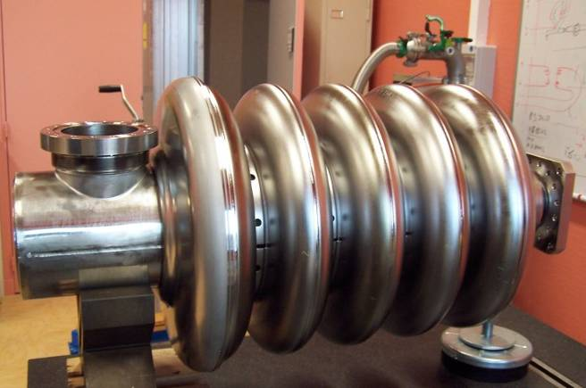
CEA cavity tested and characterized incl. piezo tuner
Frequency [MHz] | 704.4
Epk/Eacc | 3.36
Bpk/Eacc [mT/(MV/m)] | 5.59
r/Q [Ω] | 173
G [Ω] | 161
Q₀ @ 2K Rs=8 nΩ | 2 10¹⁰
Optimal β | 0.52
Geometrical β | 0.47
Total length [mm] | 832
Cavity stiffness [kN/mm] | 2.25
Tuning sensitivity Δf/Δl [kHz/mm] | 295
K_{L} @ k_{ext} = 30 kN/mm [Hz/(MV/m)²] | -3.9
Δf @ 12 MV/m, k_{ext} = 30kN/mm [Hz] | -560
K_{L} with fixed ends | -2.7
K_{L} with free ends | -20.3
Summary

Slide 11
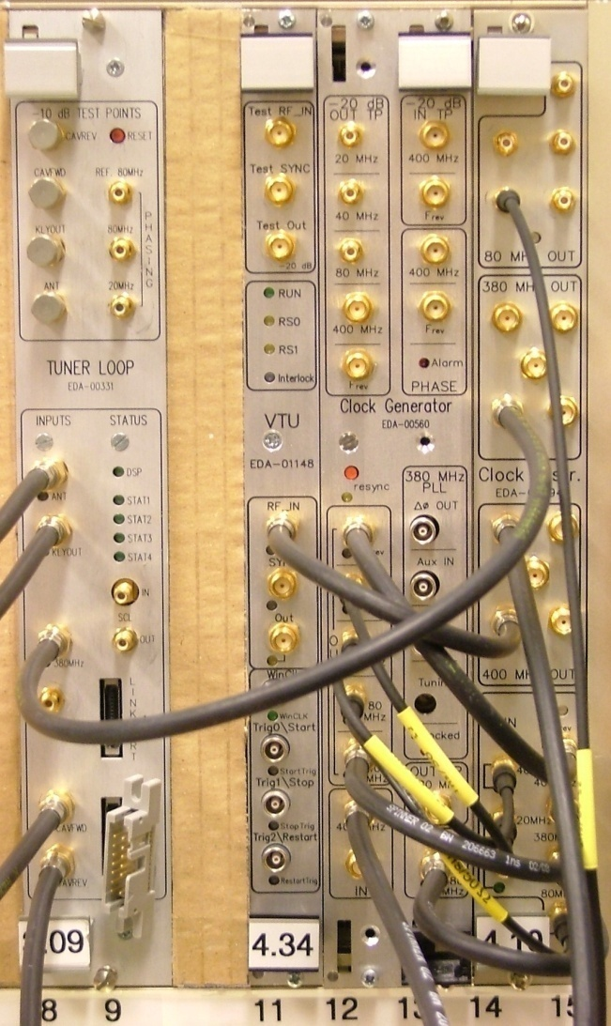
Measurement set-up
for cavity tuner characterization in pulsed mode
modified LHC hardware:
four channels analog down conversion to IF
f_{RF} = 704.4 MHz
f_{LO} = (39/40) f_{RF} = 686.79 MHz
f_{IF} = f_{RF} -f_{LO} = 17.61 MHz
digital IQ demodulation with
sampling at 4xf_{IF} = 70.44 MHz
rate of (I,Q) samples: 17.61 MS/s
actual bandwidth lower and
depending on desired precision
Next steps → evolution to full LLRF system with RF feedback

Slide 12
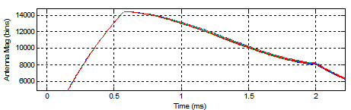
Field flatness with and without piezo compensation
(open loop → no RF feedback)
acquired with CERN system installed at CEA Saclay
no piezo
+/- 0.7 %
field flatness
In amplitude
achieved
by using
piezos !
piezo excited
use of piezo minimizes additional RF power needed to further improve the field flatness to the design target of +/- 0.5 %

Slide 13
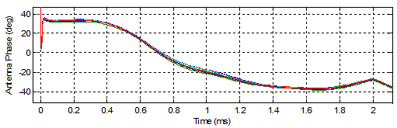
Field flatness for phase,
with and without piezo compensation
(open loop → no RF feedback)
no piezo
+/- 8 degrees flatness
In phase, achieved
by only using
piezo ! Needs
RF feedback
to achieve
design goal
of +/- 0.5 degrees
piezo excited

Slide 14
Conclusions
new parameters need to be taken into account (shorter pulses of low/high current SPL)
move towards considering the whole accelerator with the different beam β’s
parameter variations will have a large impact on required power overhead and performance
test stands indispensible for the development of the LLRF systems, plans exist
to build a test stand at CERN for 704 MHz, currently collaboration with CEA Saclay
results with piezo tuner demonstrate its capabilities to keep cavity on tune during the beam passage, essential to minimize the power requirements
having a test stand at CERN would be very important to build up momentum at
CERN in the area of LLRF developments

Slide 15
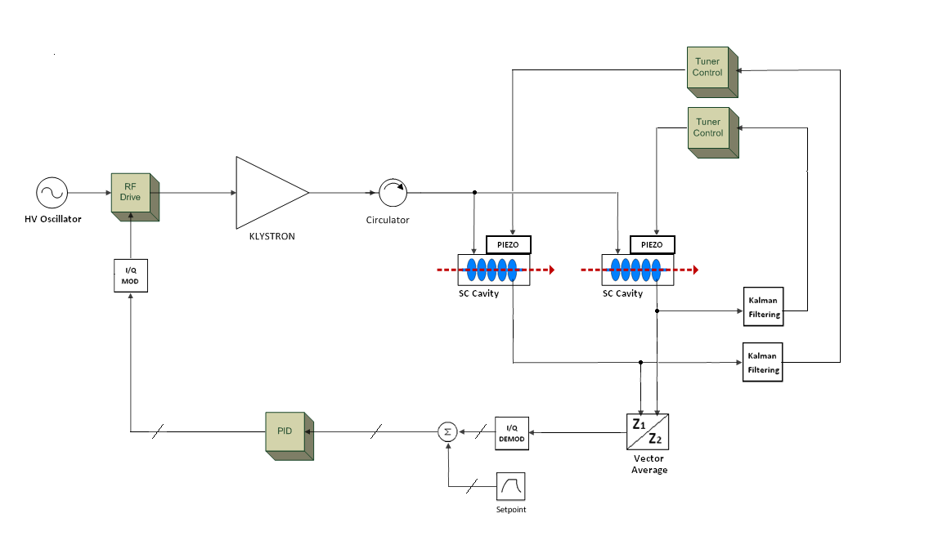
LLRF Simulations - Mathias Hernandez Flano
High Level Diagram for Dual Cavity + Control System

Slide 16
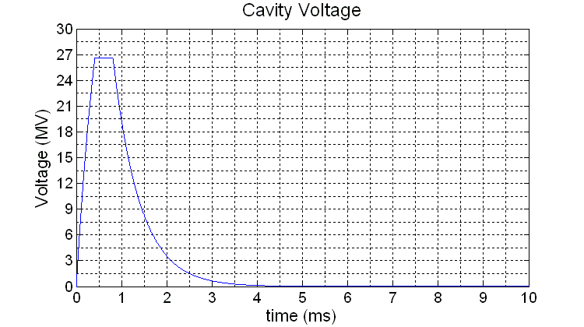
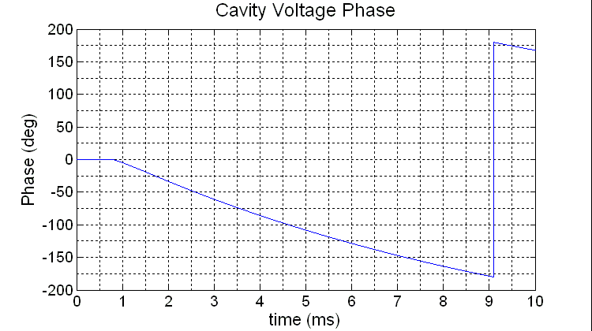
Vcav Magnitude and Phase for Dual Cavity Case
(K=-1 and -0.5)
Voltage magnitude and phase of vector average

Slide 17
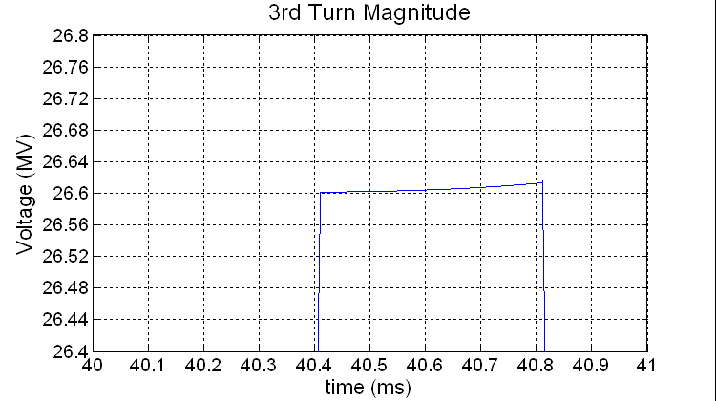
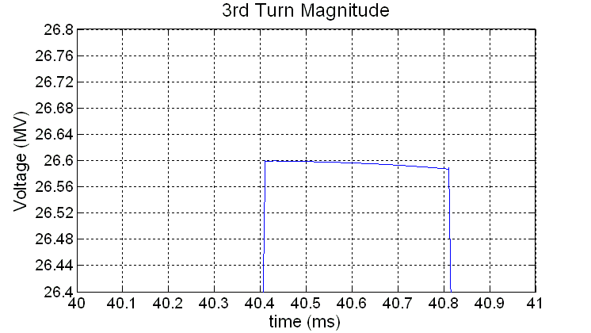
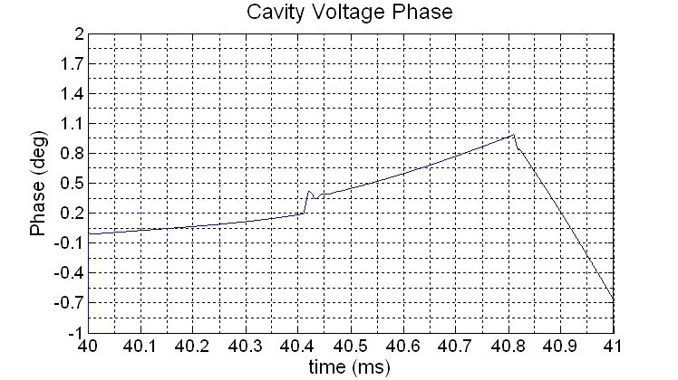
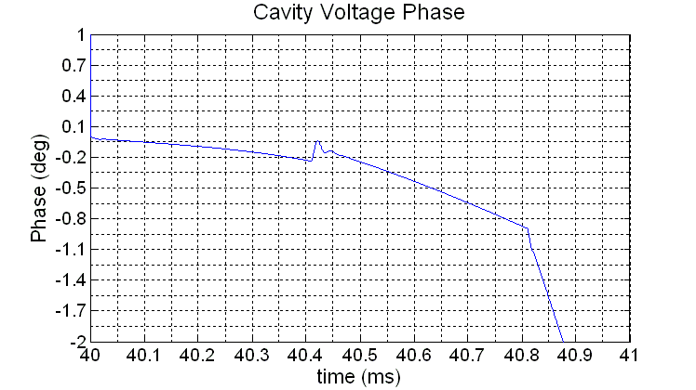
Vcav Magnitude and Phase for Dual Cavity Case
(Without Piezo Feed-Forward)
K=-0.5
K=-1

Slide 18
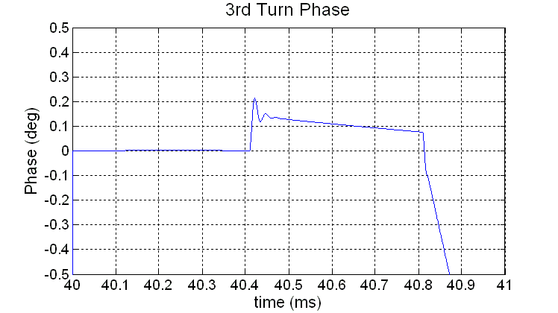
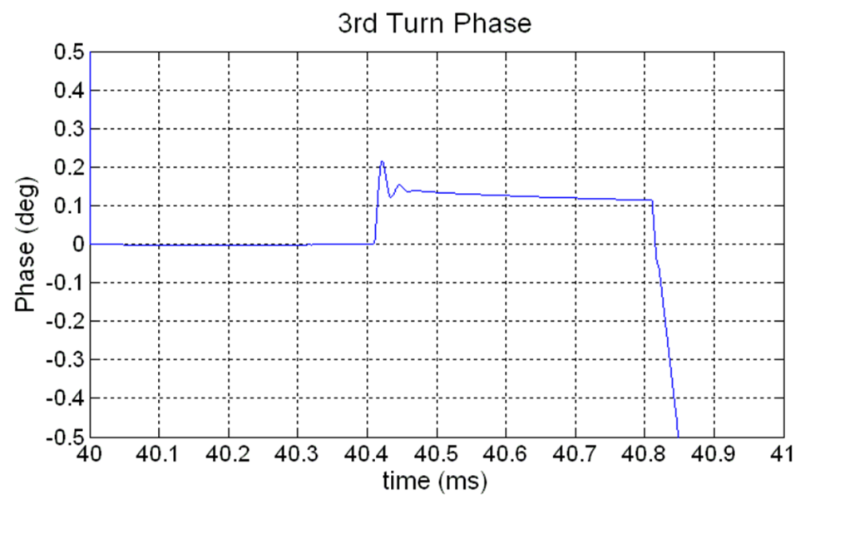
Vcav Magnitude and Phase for Dual Cavity Case
(With Piezo Feed-Forward)
Cavity 1 (K=-1 )
Cavity 2 (K=-0.5 )

Slide 19
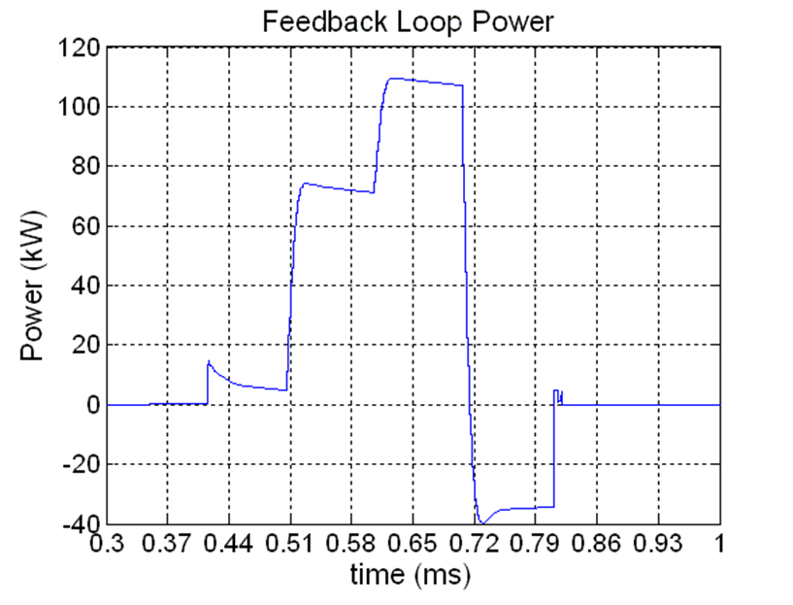
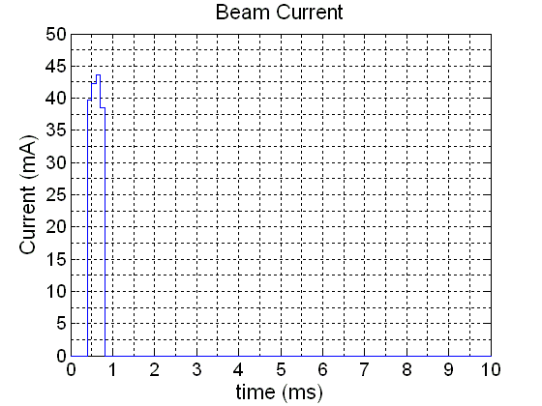
Effects of Source Beam Current Variation
5% variation in Ib for 40mA case requires approximately 60kW of additional power.

Slide 20
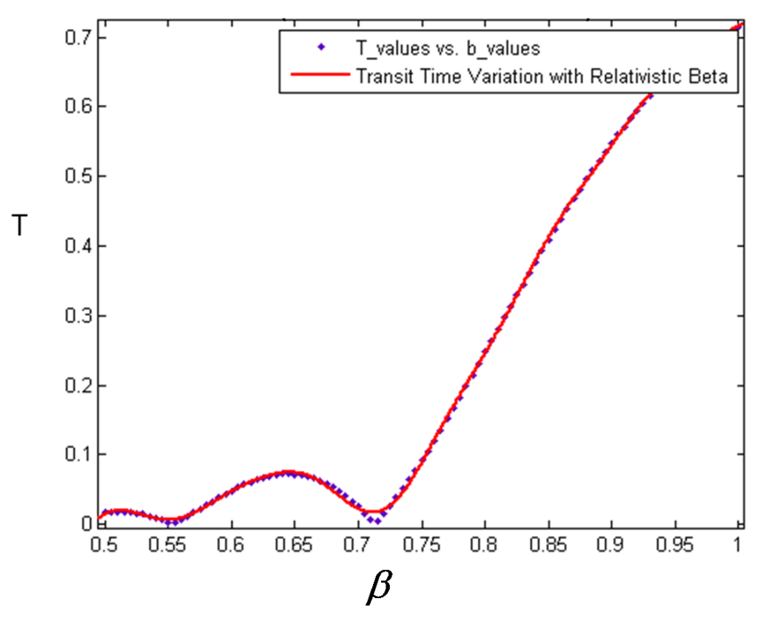
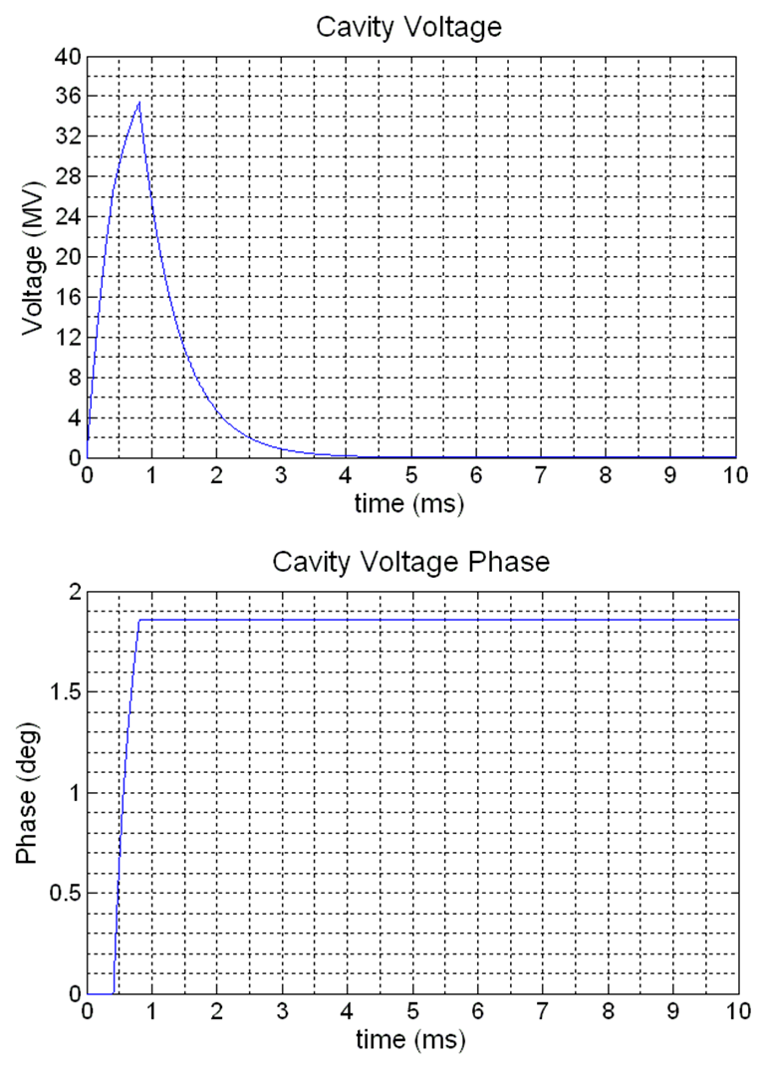
Transit Time Factor Variation with Relativistic Beta
(SPL β=1 cavities, open loop simulation)
Beamloading
Values obtained from SUPERFISH simulations by Marcel Schuh (CERN)
Beamloading
Weaker beam loading will result in a higher flattop equilibrium and less phase detuning of the cavity for the same generator power.
Beta value taken from beam energy at beginning of SPL β=1 section.

Slide 21
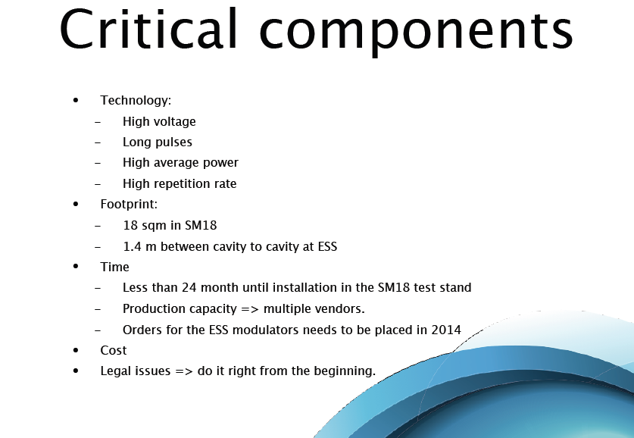
Status of Modulator Tendering K. Rathsman

Slide 22
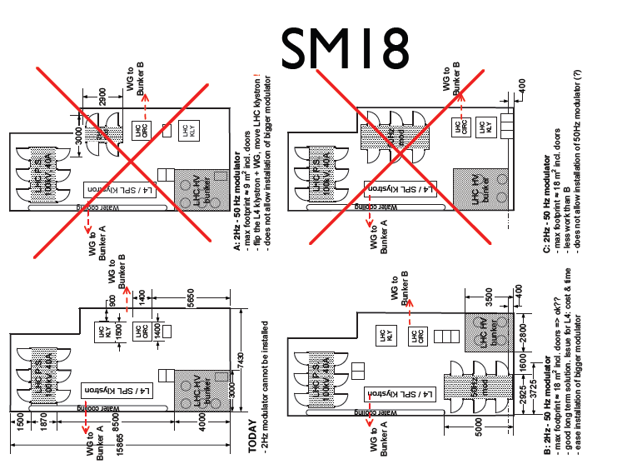
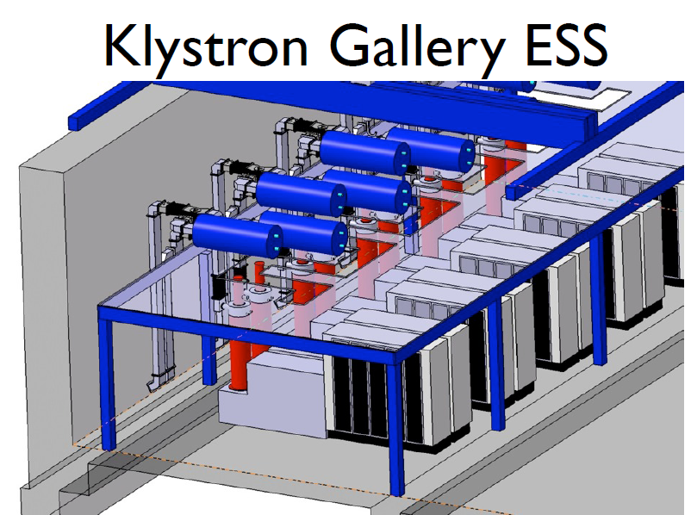
Space Constraints !
RF power system space as much, if not more, a constraint than cavity length !

Slide 23
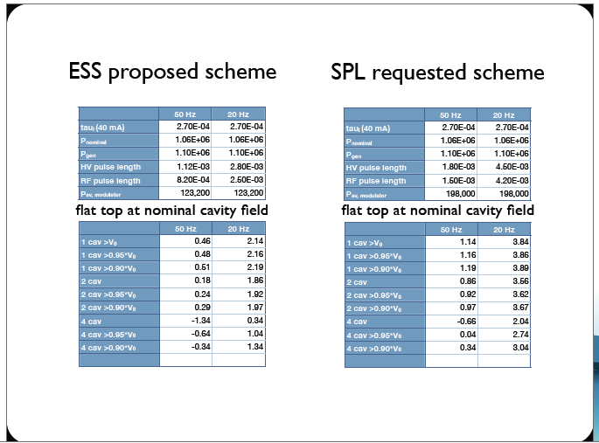
Klystron Modulators for for SM18 and ESS
ESS Modulator
Power to beam:
- Pulse repetition rate: 20 Hz
- Pulse length: 2 ms
- Peak Power: 0.9 MW
• Klystron:
- Pulse length: 2.5 ms
- Peak power: 1.5 MW
• Modulator
- Pulse length: 2.8 ms
- Peak power: 2.2 MW
- Average power: 123 kW
SM 18 Modulator
- Repetition rate: 20 Hz and 50 Hz
- Pulse length: 4.5 ms and 1.8 ms
- Average power: 200 kW

Slide 24
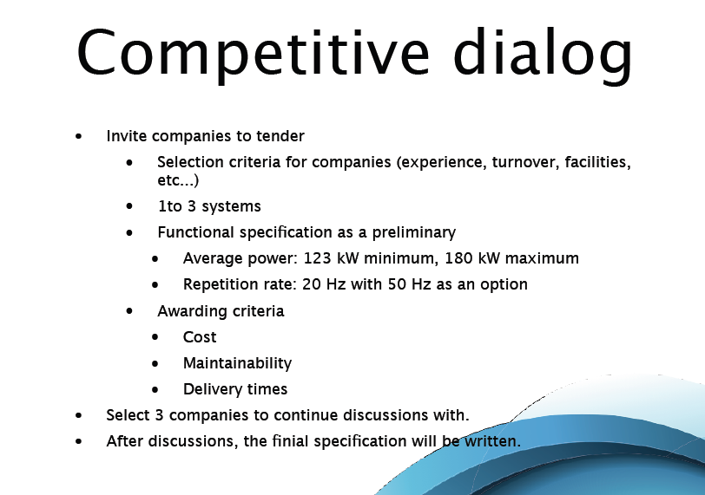
Modulator Tendering
Tender for 1-3 systems – 2 Suppliers ?
50 Hz as option for SPL
Specs in preparation – Aim to order in 2011, for delivery October 2012

Slide 25
Klystron Order and Test Stand in SM18 – O. Brunner
Scope of the Work Package / Prerequisites
Description of the work
  Interfaces with other activities (cryogenics, electricity, water distribution,..)
  Modulator
  Klystron
  RF power distribution system
  Interlocks & controls
  Auxiliaries
  Installation
Budget

Slide 26
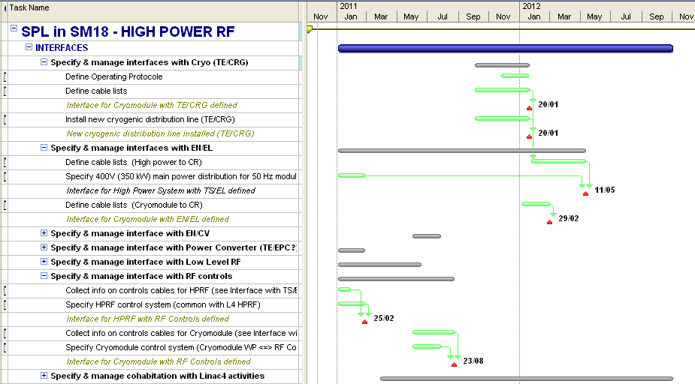
SM18 Equipment
A Linac4 test place is now being prepared in SM18 => compatible with SPL requirements
New helium (2K) distribution line will (might) be installed end 2011
Need 400 V distribution line for the 50Hz modulator
Must take into account the L4 planning in SM18 (in bunker A)

Slide 27
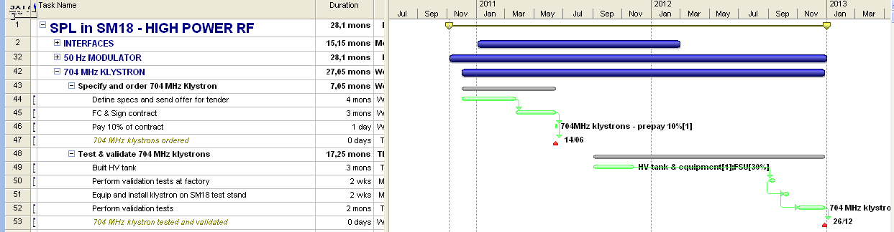
Klystrons
Option1:
1 MW 704 MHz tube based on CPI specs
•Specs ready (except HV interface to modulator)
•The tube exists. No development costs
•Specs do NOT include LLRF requirements
Option2:
3 MW 704 MHz tube including LLRF specifications
•Allows for full SPL (ESS?) RF power system distribution validation (incl. LLRF)
•More expensive! (≈ + 1.5 MCHF )
•Bigger modulator !? Feasible?
Option3:
1.5 MW 704 MHz tube – compat ible ESS – common order (off the shelf ??ESS

Slide 28
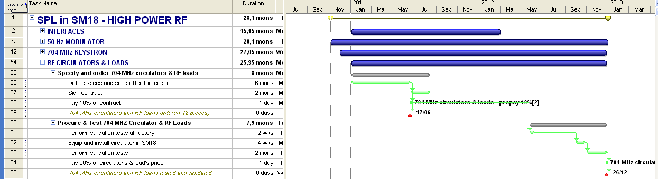
RF Power Distribution
Circulators and RF loads specs 80% ready
Cption1: 1 circulator and 2 RF loads
•Cheapest solution
•Impact on Qext& phase and power quality (crosstalk,…) will be studied (N. Schwerg)
Option 2: 2 circulators and 3 RF loads
•Allows for full SPL (ESS?) RF power system distribution validation
•More expensive (+ 1 circulator + 1 magic T + 2 RF loads + WG +..)

Slide 29
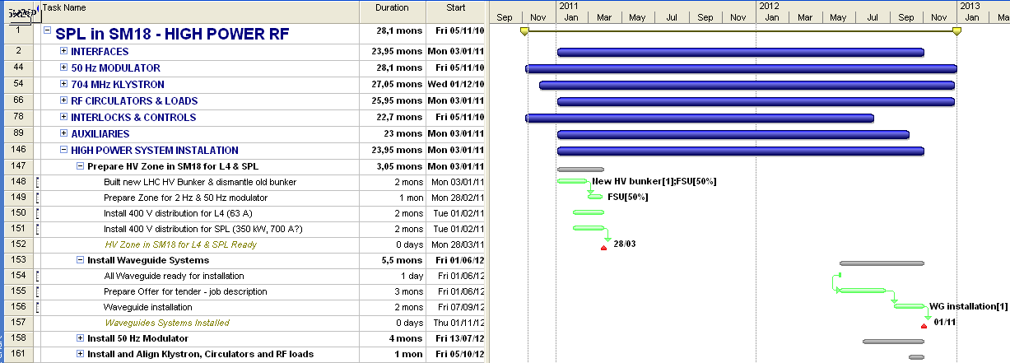
Overall Plan for SPL work
Key dates & constraints to be ready for cryomodule tests in January 2013:
Linac4 PIMS CW RF tests must be finished by end 2010 at the latest
Installation of L4 test place in SM18: January –March 2011
L4 tests: April 2011 –November 2012
installation: September -October 2012
704 MHz equipment tests: November –December 2012L4 tests in SM18
2 months overlap !!!Linac 4

Slide 30
WG1 Conclusions
RF Power
600 kW MB-IOT is a very interesting option to study:
Solid State options to be pursued. (easy configurability for different powers)
Studies on waveguide tuners not presented but under way
LLRF
Two cavity model now being used, extend results to low beta section
Saclay Piezo tuner gives good results, essential to minimize power and enable dual cavity operation
Source intensity stability is important, feedback will incur power loss
Tests on CEA cavity with all feedbacks is essential to validate the modelling
Optimization of Q ext along the linac ? (cavity batches ?)
SM18, Modulators, Klystron
Ordering of SM18 modulator on track for October 2012
Space constraints for modulators are a concern !
Common klystron order to arrange 1.5 MW ?
SM18 test place planning is tight, but feasible

Slide 31
Spare Slides

Slide 32
RF System Summary - points from 5th Meeting
Power splitting: from one klystron to 2 cavities, (use fixed 3-stub tuners instead of vector modulators),
IOTs or solid state (<350 kW) for low beta section (one per cavity)
Planning and preparation of RF test place in progress (consolidation with other projects at CERN is done, assembly procedure for cavities to be clarified,
Preparation of low-power tests in vertical cryostats started, diagnostics being prepared (T-mapping, second sound, etc),
JEMA is working on a ESS/SPL type 60 Hz modulator prototype, to be tested in 2011 at SNS,
CERN will do design effort on Modulators up to 2014/15,
Scandinova has done a pre-study with ESS specs, ESS is preparing tendering for test stand modulators
LLRF code with GUI for drive of 1 versus 2 (or more) cavities with one klystron and without vector modulators, models for cavities (w. Lorentz force detuning) taking beam current & Qex variations, test data from 704 MHz cavity tests at Saclay incorporated,
LLRF 2-cavity model w/o vector modulator seems feasible with feed-forward and piezo tuning, results now to be checked by beam dynamics,

