Slide 1


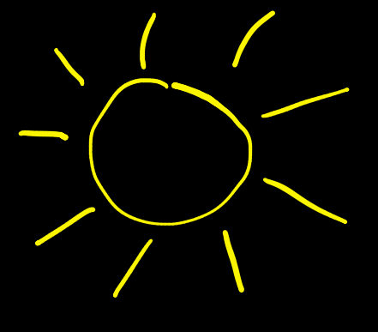
HOM coupler modelling for SPL
H.-W. Glock
Universität Rostock - Institut für Allgemeine Elektrotechnik
26.11.2010
5th SPL Collaboration Meeting, CERN, 25./26.11.2010
26.11.2010
© 2010 UNIVERSITÄT ROSTOCK | FAKULTÄT INFORMATIK UND ELEKTROTECHNIK

Slide 2

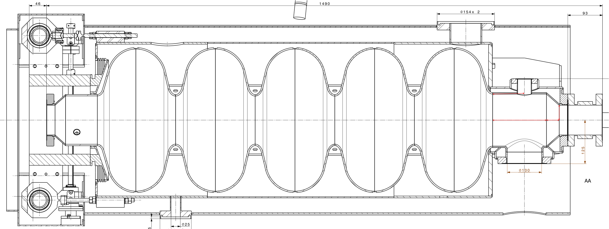
What we are talking about:
"left" side HOM coupler port
rotated by 60° towards you
(not drawn)
"right" side HOM coupler port
opposed to power c., D= 36mm
D_{le} = 130mm
704-MHz-SPL-beta-1-Cavity
D_{ri} = 140mm
D_{pipe} = 80mm
(drawing: Thierry Renaglia, CERN, 21.7.2010)
power coupler port
D=90mm
Q_{secure} ≤ 10⁵: HOM coupler not popular, but seem to be not to avoidable
26.11.2010
© 2010 UNIVERSITÄT ROSTOCK | FAKULTÄT INFORMATIK UND ELEKTROTECHNIK H.-W. Glock
2

Slide 3
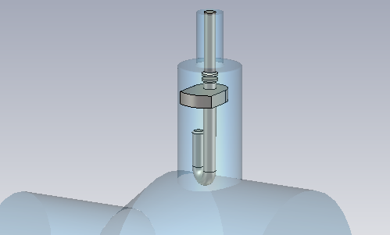
"Classical" LEP hook design as starting point (priv.com. WW)
reminder
coaxial 50-Ohm-port
(connector not modelled)
adjustable capacitive coupling
support carries liquid helium
combined E-/H-field coupling,
capacity couples to outer conductor
26.11.2010
© 2010 UNIVERSITÄT ROSTOCK | FAKULTÄT INFORMATIK UND ELEKTROTECHNIK H.-W. Glock
3

Slide 4
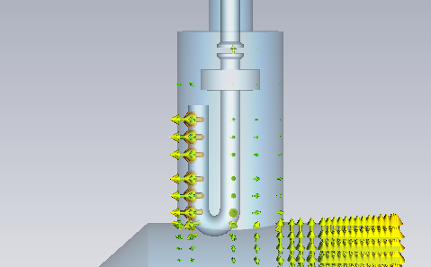
E-field geometry @ 704 MHz
reminder
capacitive coupling at hook determines notch resonance frequency
strong capacitive coupling between "hook" and outer conductor
26.11.2010
© 2010 UNIVERSITÄT ROSTOCK | FAKULTÄT INFORMATIK UND ELEKTROTECHNIK H.-W. Glock
4

Slide 5
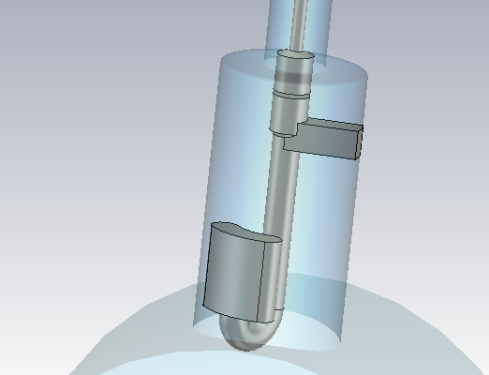
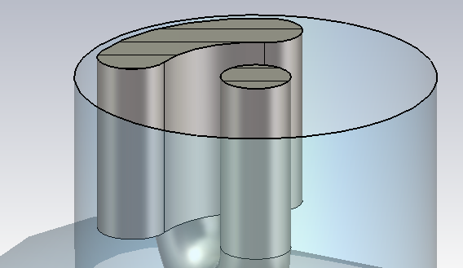
Pure hook not tunable for 704 MHz => Modification of hook end in order to adjust fundamental mode notch filter
reminder
enlarge capacitive coupling at hook with additional surface element
20.9.2010
© 2010 UNIVERSITÄT ROSTOCK | FAKULTÄT INFORMATIK UND ELEKTROTECHNIK H.-W. Glock
5

Slide 6
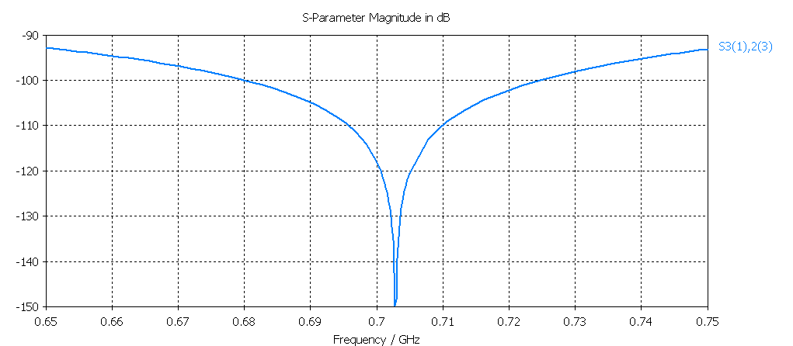
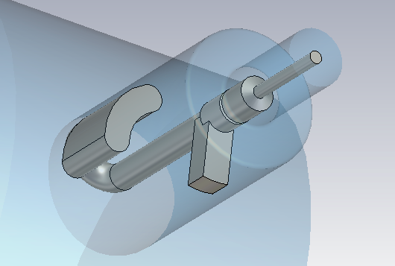
Waveguide(TM₀)–Coax–Transmission blocked
@ fundamental mode frequency => Tuning ok
reminder
26.11.2010
© 2010 UNIVERSITÄT ROSTOCK | FAKULTÄT INFORMATIK UND ELEKTROTECHNIK H.-W. Glock
6

Slide 7
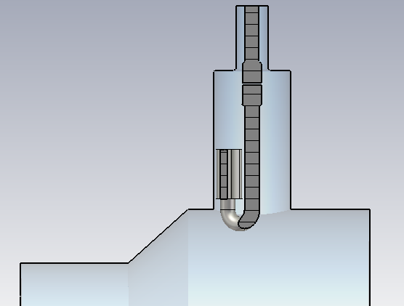
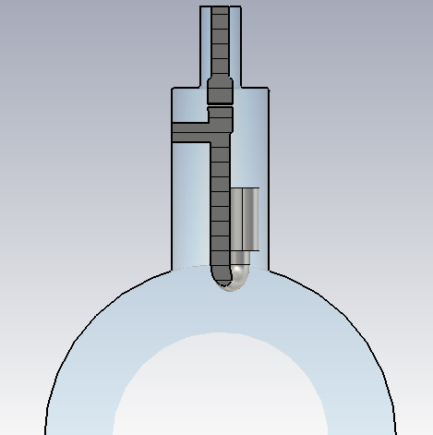
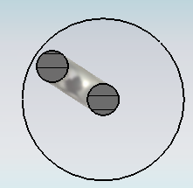
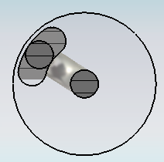
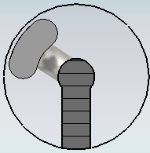
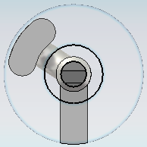
Some geometrical details
Penetration depth of the antenna/loop in the beam pipe could be increased, but:
risc of dark current heating,
impedance
Mechanical stability, esp. against oscillations, may be an issue.
But: LHC cavs. use similar concept (courtesy W.W.)
26.11.2010
© 2010 UNIVERSITÄT ROSTOCK | FAKULTÄT INFORMATIK UND ELEKTROTECHNIK H.-W. Glock
7

Slide 8
Remarks about fundamental mode notch filter:
1.) Tuning rather sensitive both against capacity surface AND rotation angle (~5 MHz/Degree⬄ 30 dB/Degree)
2.) => notch filter understood as combination of resonance AND "directional coupler"-effect: certain E-H-correlation causes cancelation
3.) This demands for external re-tuning capability after mounting (e.g. rotation)
26.11.2010
© 2010 UNIVERSITÄT ROSTOCK | FAKULTÄT INFORMATIK UND ELEKTROTECHNIK H.-W. Glock
8

Slide 9
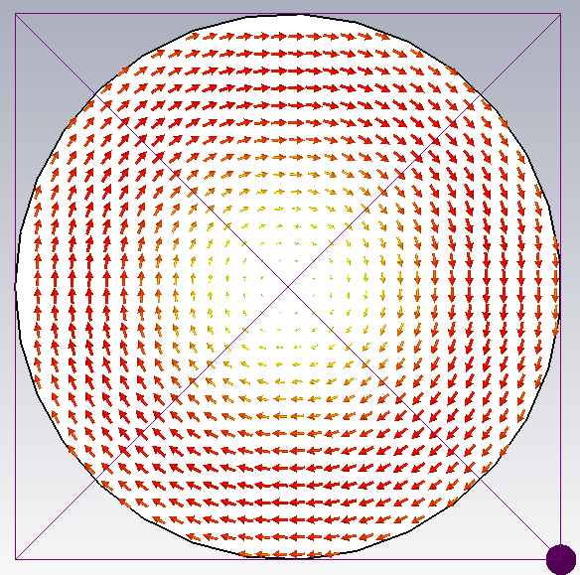
Why looking for a single S-parameter during tuning?:
Fundamental mode is of TM₀-type (no dependence on angle around axis).
Thus it directly couples only to TM₀₁, TM₀₂, ... waveguide modes, all below cut-off @ 704 MHz.
Neglecting all higher types than TM₀₁ causes very small error but significantly reduces numerical effort.
TM01-Mode H-field
26.11.2010
© 2010 UNIVERSITÄT ROSTOCK | FAKULTÄT INFORMATIK UND ELEKTROTECHNIK H.-W. Glock
9

Slide 10
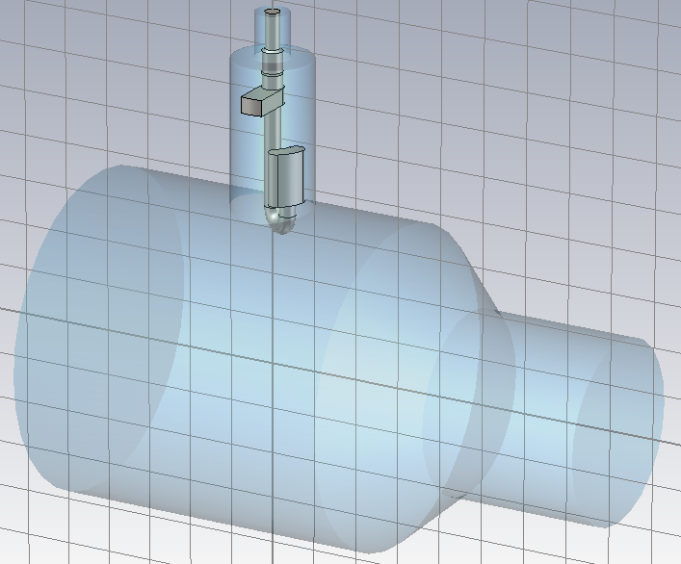
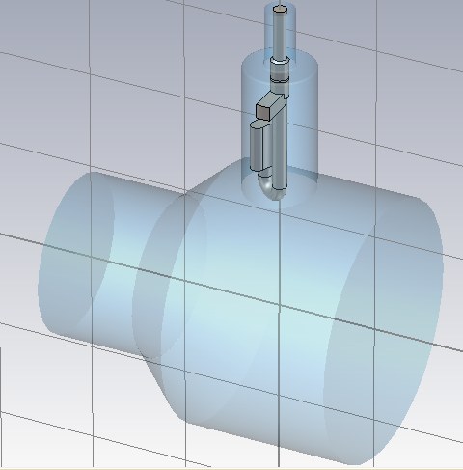
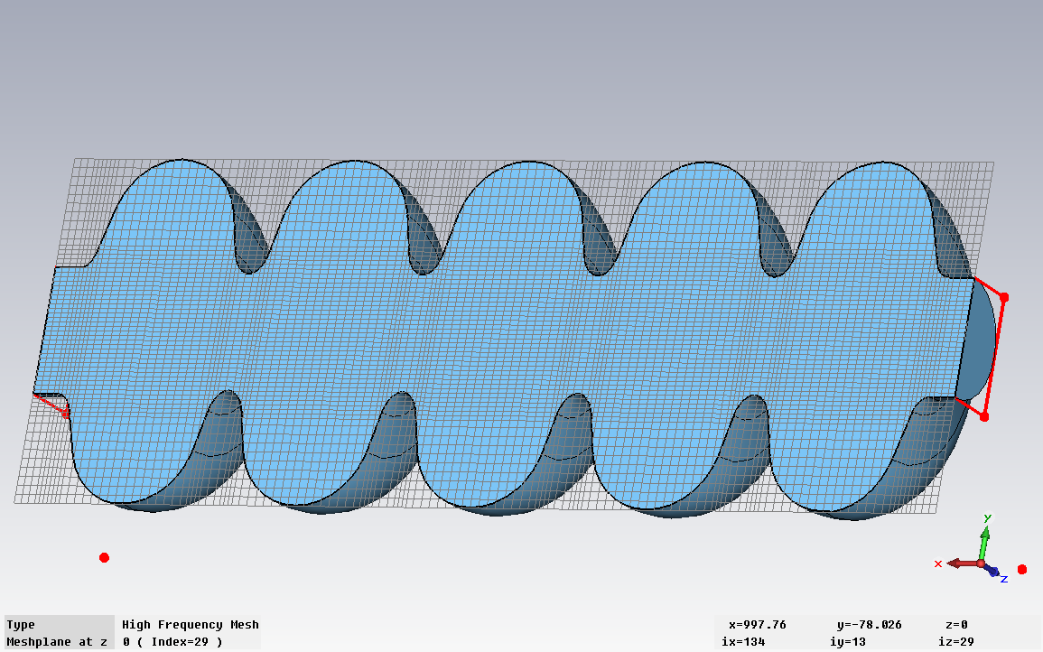
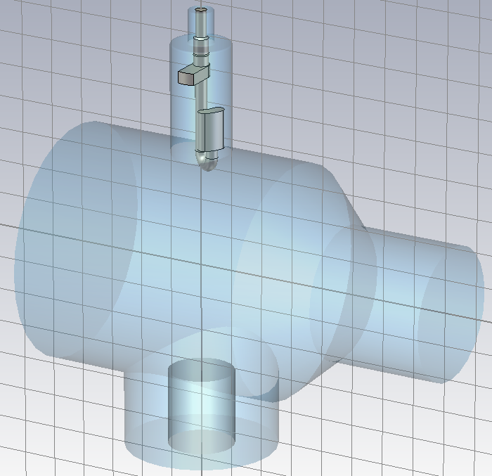
Q-ext computations based on:
CSC-coupling of 8 modes in D=130mm/140mm-coupler-cavity-connections (TE11,TM01, TE21,TM11,TE01)
right coupler both w/o power coupler (90mm coax, 50 Ohm, penetration depth freely chosen)
D=80mm beam pipes left open (but most below cut-off)
26.11.2010
© 2010 UNIVERSITÄT ROSTOCK | FAKULTÄT INFORMATIK UND ELEKTROTECHNIK H.-W. Glock
10

Slide 11
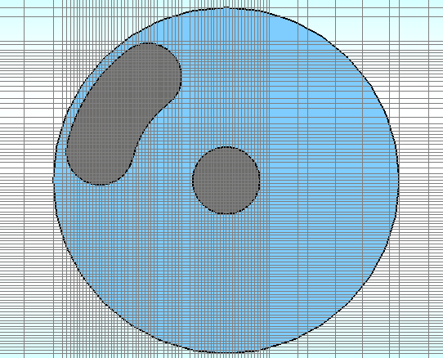
Scattering parameter computation:
Using "Fast-Resonant"-Solver of CST MicrowaveStudio© (ver. 2010-7)
taking S-parameter from multimodal Z-matrix using analytical waveguide impedance expressions (most secure way)
typical computation time: ~several hours; therefore during optimization use of tetrahedral grid, applied to few frequency points (=> ~fraction of hours/configuration)
26.11.2010
© 2010 UNIVERSITÄT ROSTOCK | FAKULTÄT INFORMATIK UND ELEKTROTECHNIK H.-W. Glock
11

Slide 12
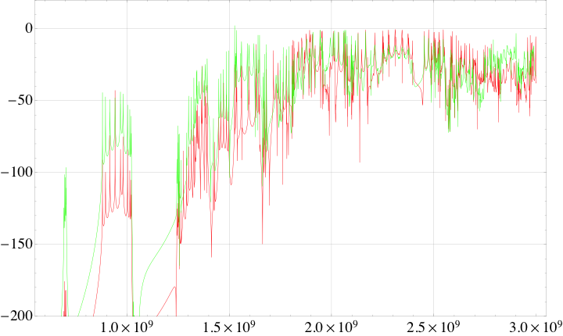
This (cst-computation, csc-concatenation) gives HOM1-HOM2 transmission:
S_{hom1-hom2} /dB
f/Hz
red: HOM coupler only, green with matched power coupler
presence of power coupler lifts transmission level and seem to decrease Qs
26.11.2010
© 2010 UNIVERSITÄT ROSTOCK | FAKULTÄT INFORMATIK UND ELEKTROTECHNIK H.-W. Glock
12

Slide 13
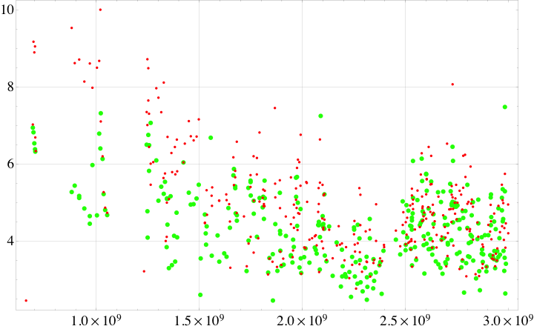
Put this in resonance-fit-algorithm in order to determine Qs:
Log₁₀(Q)
f/Hz
red: HOM coupler only, green with matched power coupler
main power coupler helps significantly below 2 GHz; still Qs > 10^6 found
26.11.2010
© 2010 UNIVERSITÄT ROSTOCK | FAKULTÄT INFORMATIK UND ELEKTROTECHNIK H.-W. Glock
13

Slide 14
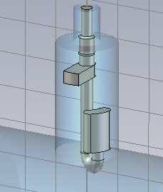
Conclusion
23/02/2010
tuning successful, but: sensitive setup, 180° rotation seem to hinder "directional coupler"- effect
Q values w/o main power coupler computed, closer to 10^5, but not reached
14
26.11.2010
© 2010 UNIVERSITÄT ROSTOCK | FAKULTÄT INFORMATIK UND ELEKTROTECHNIK H.-W. Glock
14

