Slide 1

State-of-the-art light source
M. Aiba, PSI
31.01.2022

Slide 2
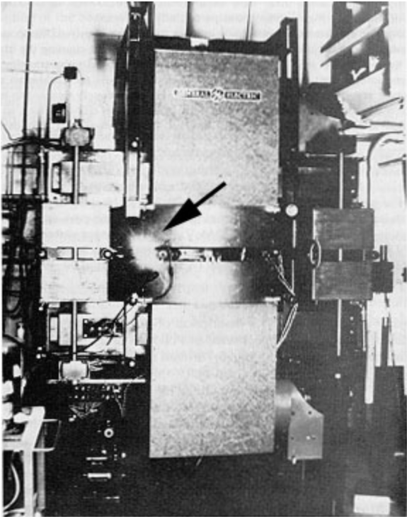
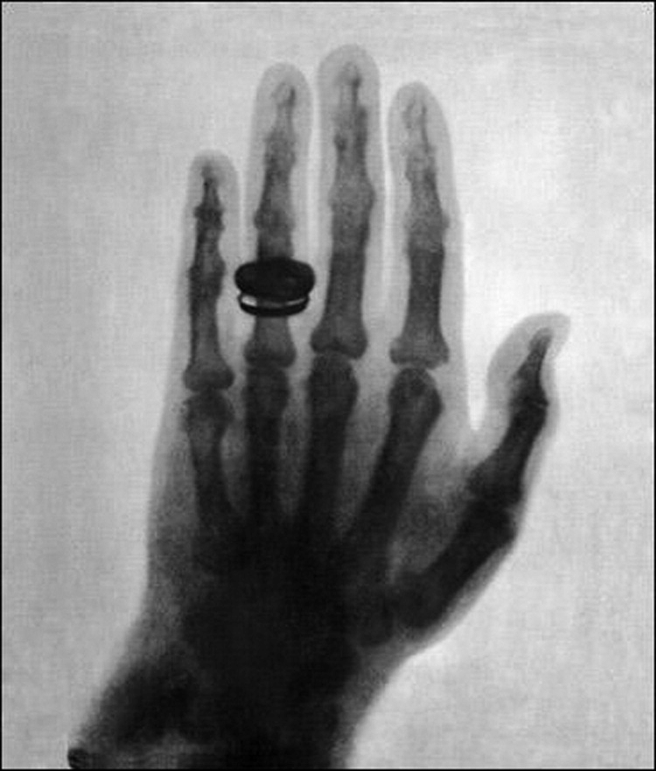
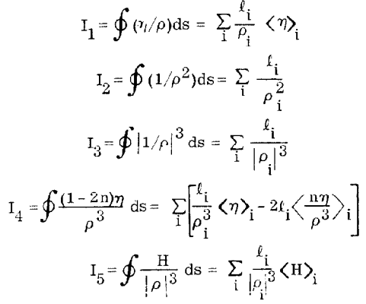
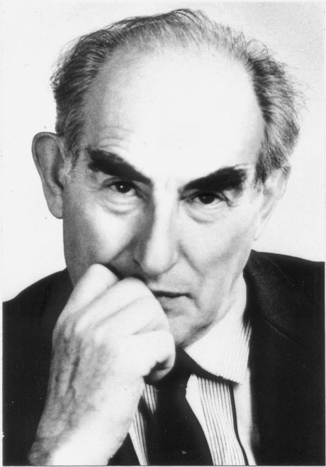
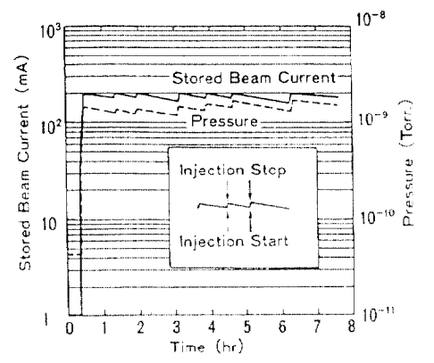

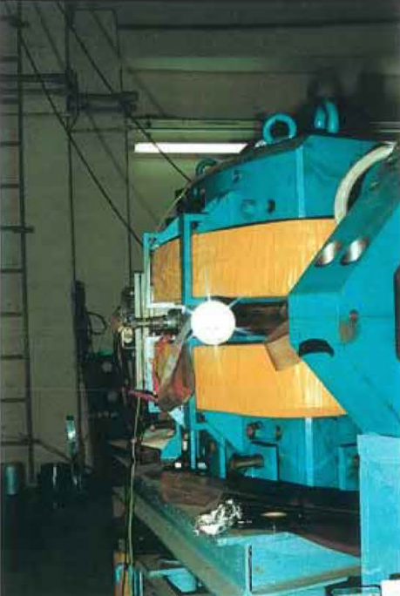

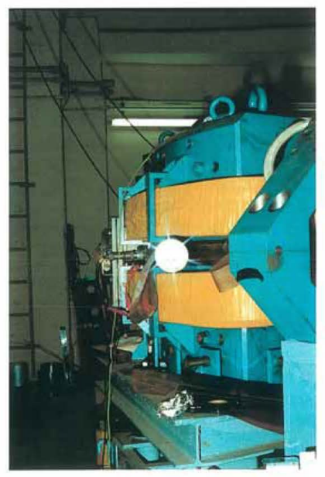
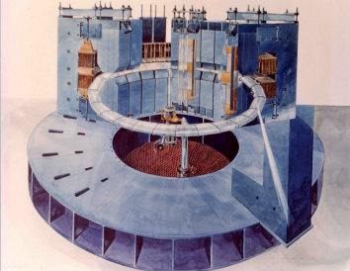
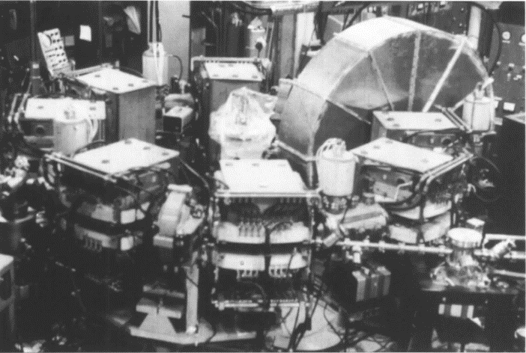

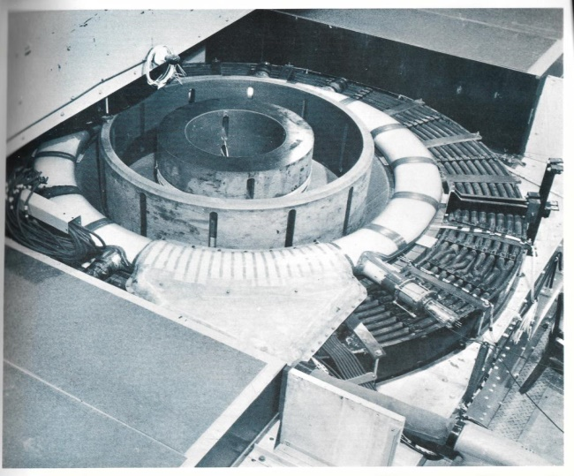
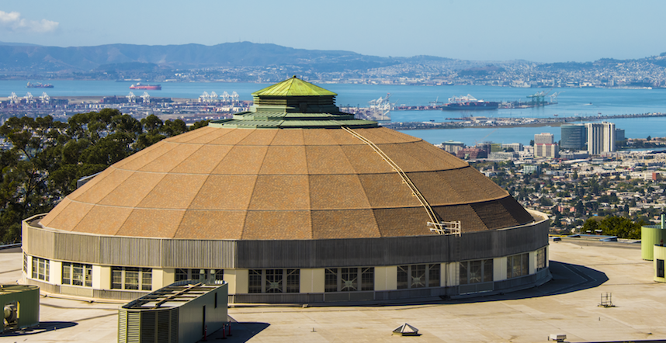
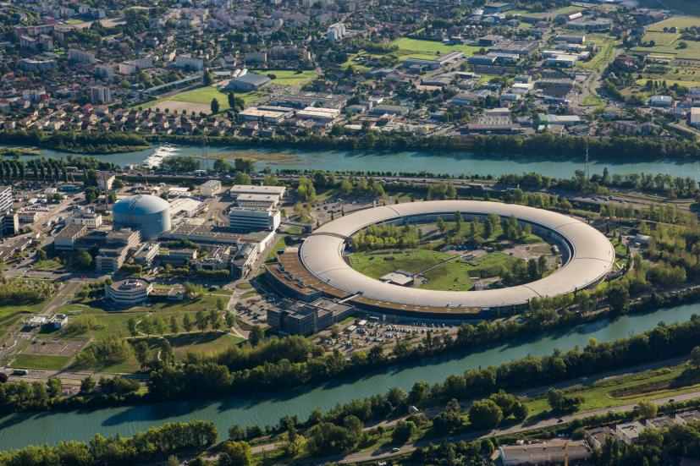
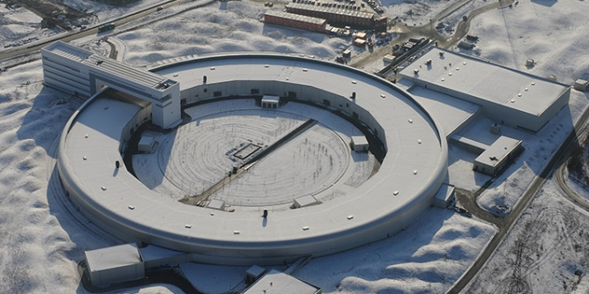
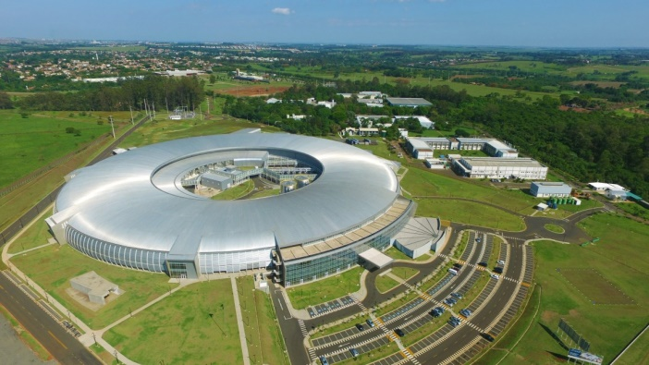
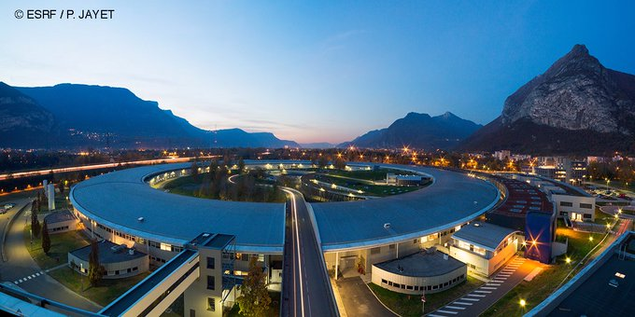
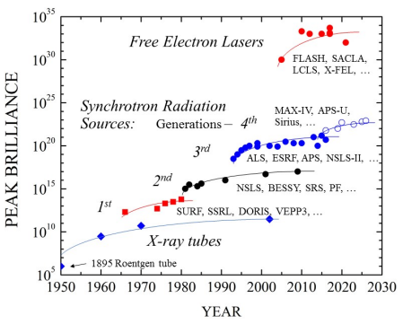
History of synchrotron light source
(in a nutshell)
First generation synchrotron light sources
1947~1950s: pioneering measurements
≥1960’s: SR measurements on a regular basis
SR classical
theory
Undulator
concept
SR quantum
theory
Radiation integrals
(Equi. emittance)
Top-up
operation
Top-up operation
(originally developed at the collider)
Second generation synchrotron light sources
at many places, ≥1961
Second generation light sources
1961-
Dedicated source
Third generation synchrotron light sources
at many places, ≥1993
Fourth generation synchrotron light sources
≥2016
1900
1950
2000
Dedicated light source
Parasitic use to the nuclear/high-energy physics machine
High brightness: Achromat lattice + Insertion devices in long straights
Ultra-low emittance with multi bend achromat lattice
First generation
Third generation
Synchrotron radiation
quantum theory, 1960’s-
A.A. Sokolov, I.M. Ternov, et al.
Fourth
generation
Second generation
Synchrotron radiation
classical theory, 1890’s
J. Larmor, A. Liénard, et al.
V. Ginzburg
First paper on undulator
in 1947
Portrait from Wikipedia
Higher
energy
Radiation integrals
M. Sands, SLAC-121, 1970
R. H. Helm, M. J. Lee, P. L. Morton, M. Sands,
PAC’73, p. 900
→ Equilibrium emittances
(together with quantum theory)
First synchrotron light observation
at 70-MeV synchrotron of General Electric
Laboratory, April, 1947
Picture from X-ray data booklet
Section 2.2 by A. L. Robinson
MAX IV, 2016-
Photograph from
lightsources.org
ALS, 1993-
Photograph from
lightsources.org
Sirius, 2018-
Photograph from
lightsources.org
First x-ray photograph (x-ray tube)
by W. C. Röntgen
Figure from, 1895,
“Über eine neue Art von Strahlen“
Spectral brightness
ESRF, 1994-2019
Photograph from
ESRF webpage
Tantalus, 1968-1987
First 2G LS from the start
Figure from, D. Lynch
Journal of SR, 4, p. 334, 1997
ESRF-EBS, 2019-
Photograph from
ESRF Twitter
First light from SOR-RING, 1974
“Machine built by the user and for the user”
Figure from T. Sasaki,
Journal of JSSRR, Vol. 11-2
NBS synchrotron
Photograph from NIST webpage
In 1961, upgraded to be SURF,
the first dedicated LS
(AVS symposium 2001)
Lower
energy
Cornell 300-MeV synchrotron
Figure from M. Tigner and D.G. Cassel,
Annu. Rev. Nucl. Part. Sci., 65:1–23, 2015
≤UV
First demonstration at SORTEC in 1990
Figure from S. Nakamura, EPAC’90, p. 472
Figure from V. Shiltsev
FERMILAB-PUB-105-AD-APC
Slide based on mainly X-Ray Data Booklet, Sec. 2.2 by A. L. Robinson

Slide 3
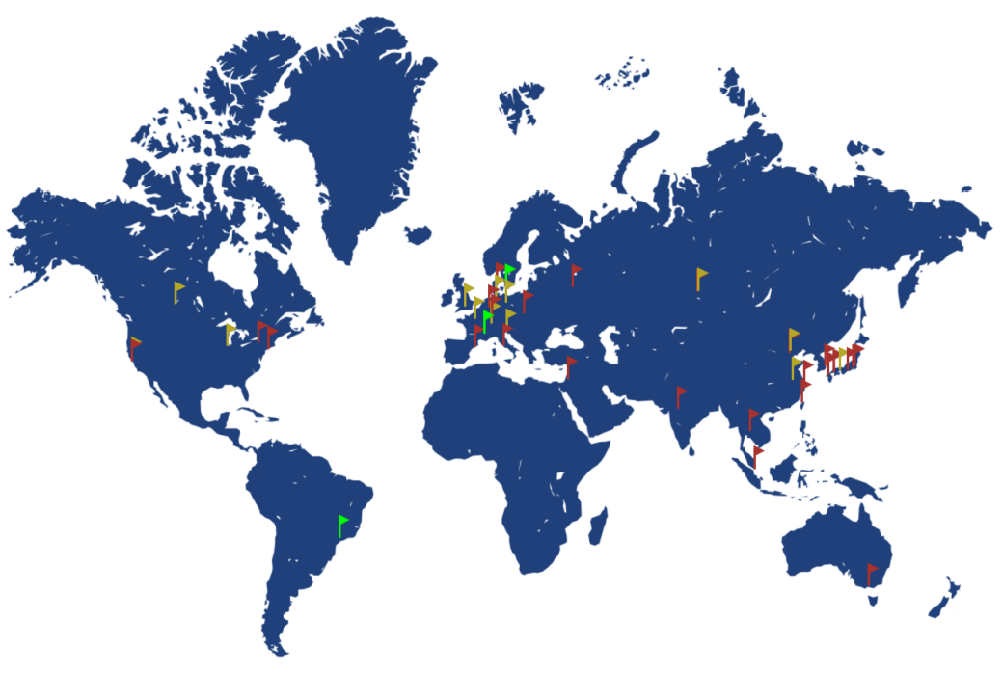
Synchrotron light sources all over the world
Red flags: Operating
Yellow flags: Planning
new 4G or upgrade to 4G
Green flags: 4G operating
Figure from J. Kallestrup, PhD thesis, ETHZ, 2021

Slide 4
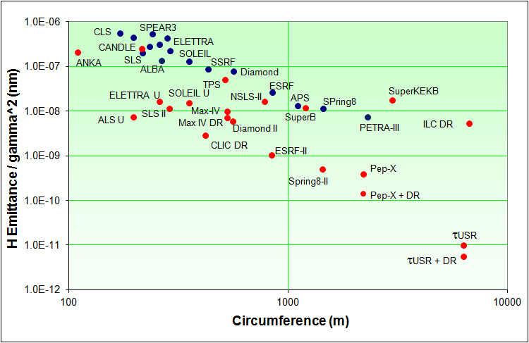
Jump in performance
3G
4G
Figure from R. Bartolini, LER workshop, 2014

Slide 5
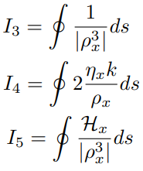
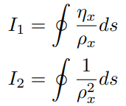




Equilibrium emittance
Radiation integrals
(Flat lattice, R bend)
Equilibrium emittance
and energy spread
→ Lowering emittance / Method / Drawbacks:
- I5 (H-function)↓/ Strong focusing / Chromaticity and lattice nonlinearity ↑
- I2 ↑/ Damping wiggler / RF voltage ↑
- Negative I4 / Combined function (Dipole+Quad) / Energy spread ↑
- ρ ↑ / More dipoles → MBA / A lot of problems…
Note: Making I4<0 corresponds to so-called damping partition shift

Slide 6
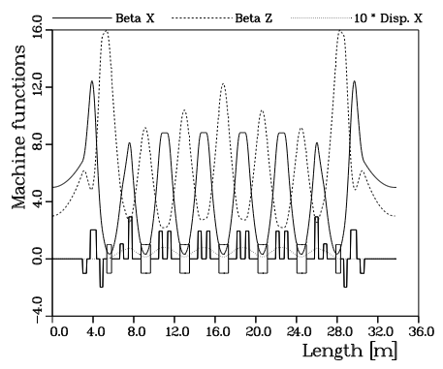
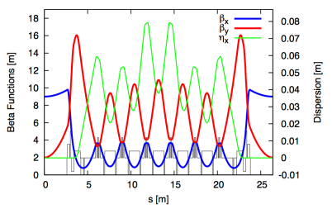
Multi Bend Achromat lattice
7BA lattice
Realized in
~20 years
later!
MAX IV lattice
Figure from S. Leemann,
ICFA BD Newsletter 71
Figure from D. Einfeld et al., PAC’95, p. 177
Gentle bend, tight focusing

Slide 7
MBA lattice evolution
1979: K. Steffan, The Wiggler Storage Ring: A Device With Strong Radiation Damping and Small Beam Emittance
1989: J.P. Delahaye, J.P. Potier, PAC’89
‘Reverse bending magnets in a combined-function lattice for the CLIC damping ring’
1992: A.F. Wrulich, Fourth Generation Light Sources workshop at SLAC
‘Overview of 3rd generation light sources’
Longitudinal Gradient Bend
90’s: D. Einfeld et. al.,
Multi-bend achromat
2017: SLS2 CDR
LGB-RB cell by A. Streun
2013: L. Farvacque et. al., IPAC’13
‘A low emittance lattice for ESRF’
Hybrid MBA (Originally developed
for Super-B, P. Raimondi et. al., ~2006)
~4 times lower emittance
Hybrid LGB-RB MBA is considered in some light source upgrade projects
Lattice nonlinearity mitigated

Slide 8
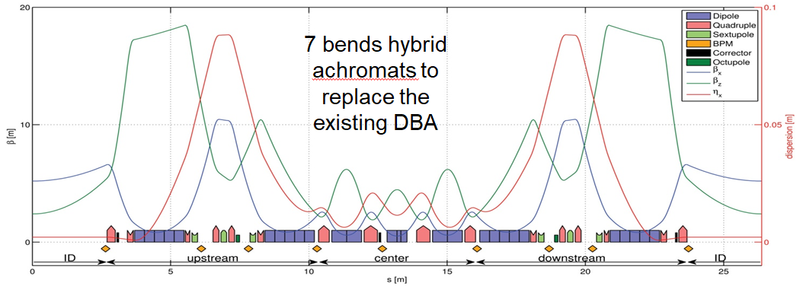
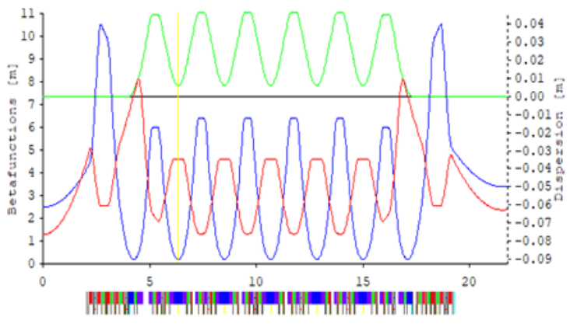
Advanced MBA lattices
-I transformation between dispersion bumps
Hybrid MBA, ESRF-EBS lattice:
Sextupoles with –I transformation
Large dynamic aperture, well-suited for the higher energy machine
Figure from LER 2014, J.-L. Revol
Periodic MBA, SLS2 lattice:
LGB-RB cells
Distributed sextupoles
Large momentum aperture, well-suited for the lower energy machine
(Touschek lifetime)
Figure from SLS2 TDR, 2021
Excellent lattice but highly compact and squeezed to the limit…

Slide 9
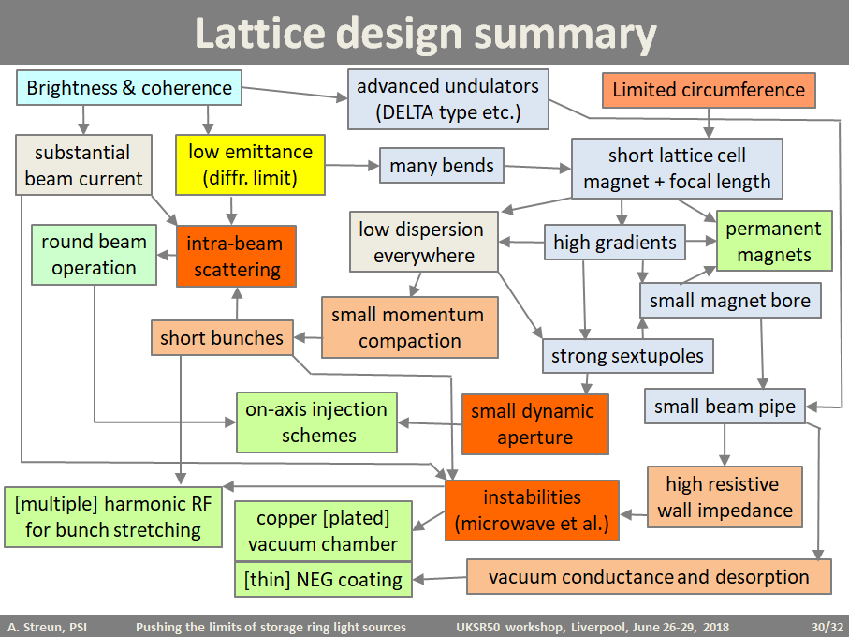
“Spaghetti a la MBA storage ring”

Slide 10
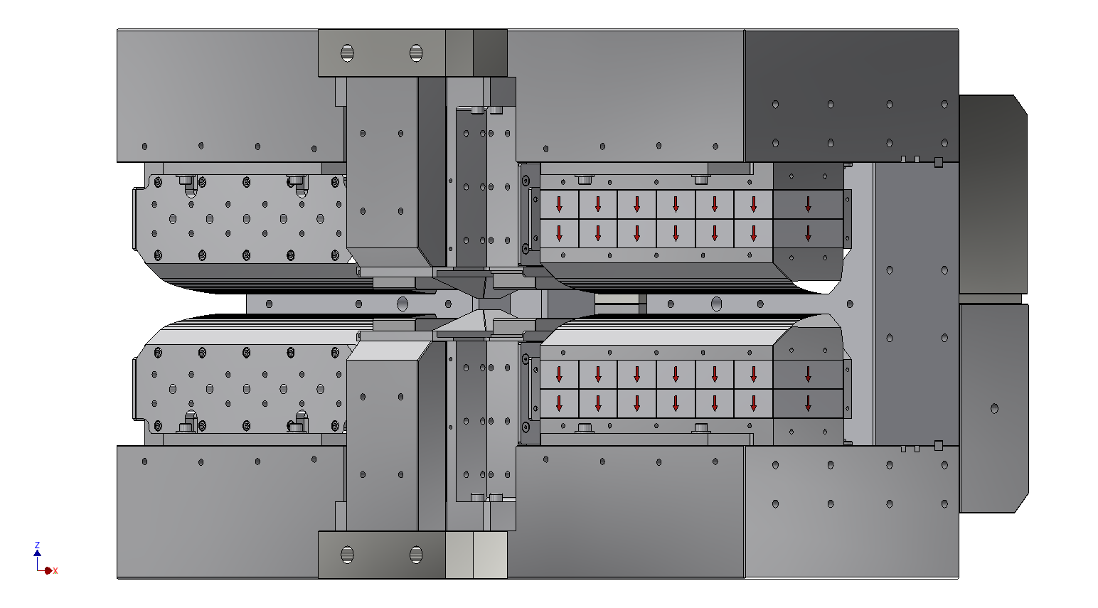
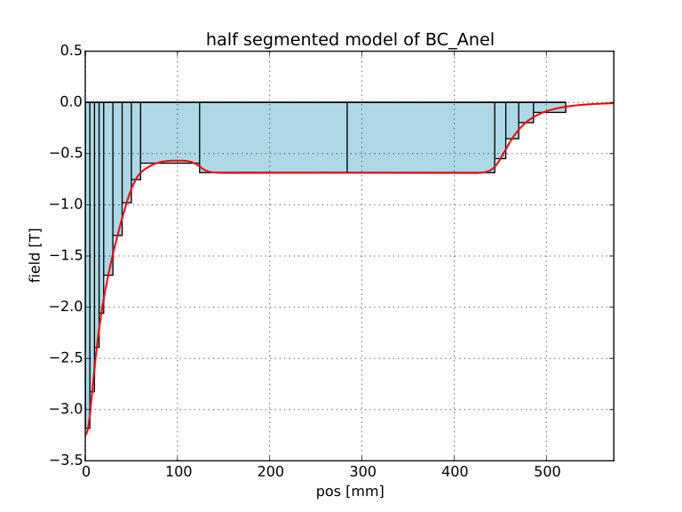
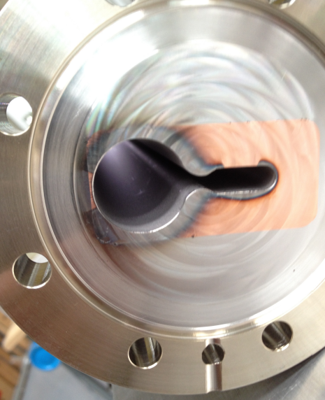
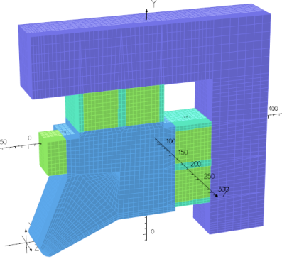
Supporting technologies
Non Evaporable Getter (NEG) coating
- Developed for LEP by C. Benvenuti et al.
- Thin layer of Ti-Zr-V works as “getter pump”
- Low radiation desorption
- Essential technology for MBA (small aperture)
Permanent magnet
- Matured enough for circular accelerator
magnets
- High field and space efficient magnets
(c.f. 5~6 cm coil space for ~15 cm iron core in EM)
22 mm Ø
Sirius 3.2 T permanent LGB
Figure from J. Citadini, ALERT 2016
Ante-
chamber
SLS2 reverse bend:
- Shifted quadrupole (3.4 mm)
→ Combined function
- 83 T/m, bore radius 13 mm
Opera model by V. Vrankovic (1/4 quad)
MAX IV NEG coated chamber
Figure from S. Dos Santos, LER 2014

Slide 11

Nonlinear optics
High gradient → High chromaticity → Strong sextupole → Nonlinearity
Requirements
  Dynamic aperture for injection (on-axis inj. minimizes this requirement)
  Momentum aperture for Touschek beam lifetime: 1~2% for higher energy machine, ~4% for lower energy machine
First step of optimization
  -I transformation in Hybrid MBA
  Unit cell phase advance to cancel major resonance driving terms in periodic MBA (distributed sexts)
    For 7BA, Qx=3/7 and Qy=1/7 is a good choice
  Other theoretical approaches, e.g., single resonance perturbation theory
Further optimization
  Harmonic sextupoles
  Octupoles to control tune footprint
  Numerical optimization by MOGA etc…
Vecteezy.com

Slide 12
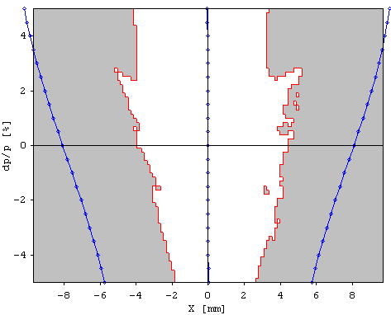
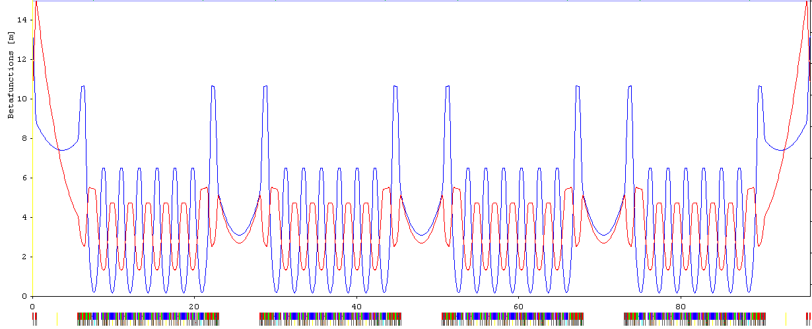
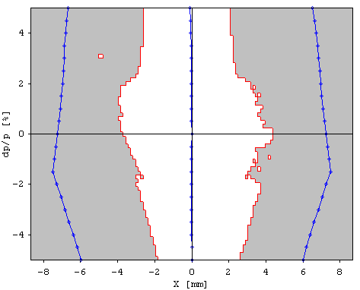
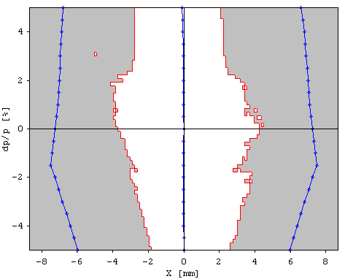
Pseudo Symmetry A. Streun
DA vs dp/p ±5%
@ βx=2.95 m
Trick to make Super Periodicity = Number of Arcs
Second half of
matching section
Second half of
matching section
S.P.=12
P.S.P.=12
2 x Second half of
matching section
2 x Second half of
matching section
2 x Second half of
matching section
S.P.=3
P.S.P.=12
Additional
quads
Additional
quads
Achromat +
2 x First half of
matching section
Achromat +
2 x First half of
matching section
Achromat +
2 x First half of
matching section
Achromat +
2 x First half of
matching section
S.P.=1
P.S.P.=12
Identical Achromat+ First half of matching section
Second half of matching section (sextupole free) can be different but with the identical phase advance in H and V

Slide 13

Round beam operation
Emittance is equalized in a full coupled lattice:
  Lowering horizontal emittance
  Touschek scattering mitigation
Round beam operation is planned at ALS-U, APS-U, Soleil-U and elsewhere
  Betatron tune working point close to linear coupling resonance
J. Bengtsson, PSI note,
SLS2-BJ84-001, 2017

Slide 14
More challenges…
Injection → Next talk by S. White
Beam instability →Talk tomorrow by A. Gamelin
4GSR design → Talk tomorrow by P. Raimondi
Beam diagnostics → Talks on Thursday by L. Torino and N. Hubert

Slide 15
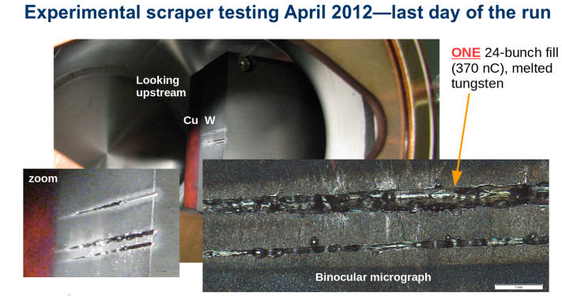
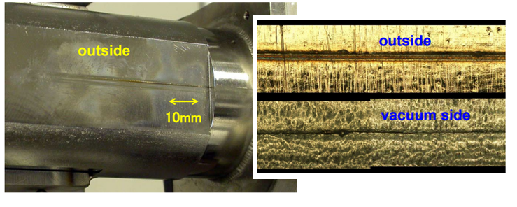
Beam dump
Thin vacuum chamber, 1 mm or less, to achieve the required field
Electron beam in the light source can be distractive:
Vacuum leak (!) at 0.7-mm thick chamber, SPring-8
H. Tanaka et al., EPAC06, p. 3359
‘Energy Deposition in APS-U Whole-Beam Dumps’, J. Dooling, M.Borland, B. Micklich, 7th high power target workshop

Slide 16
Is this an end of development?
3rd generation light source was regarded as the ultimate storage ring around 2000
What was said about MAX IV, S. Leemann
  “You’re crazy, that will never work” in 2010
  …Meantime, more challenging projects emerged…
  “You guys should have been much more aggressive” or “MAX IV lattice is relaxed” in 2015
4th generation light source may still not be the ultimate storage ring!

Slide 17
Next-next generation?
PETRA IV will be perhaps the first “true” diffraction limited light source, where ε~10 pm (Diffraction Limited up to ~10 keV photon)
However, not everybody can afford such a large machine…
  C=2.4 km @ 6 GeV (or ~1.5 km @ 3 GeV by scaling)
We have to get one step further to make DL light sources available at as many places as demanded

Slide 18
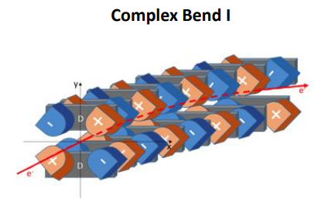
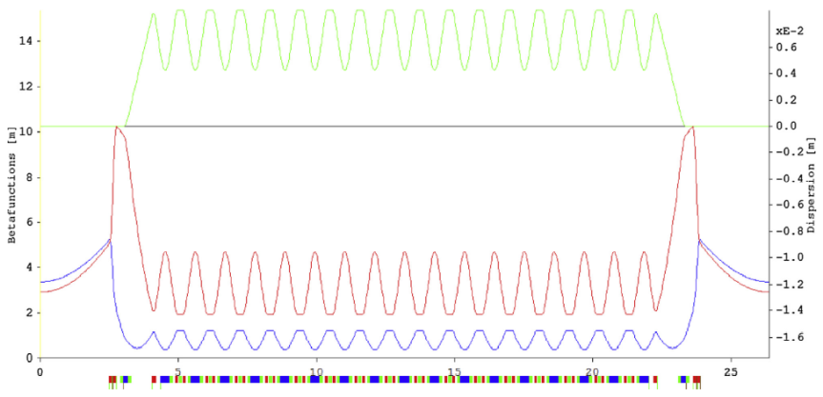
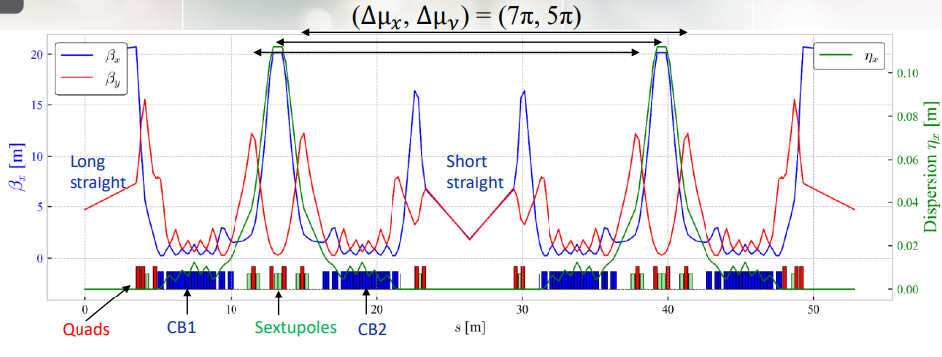
Pushing MBA to DL
MAX IV upgrade with 19BA lattice
NSLS II upgrade with
“Complex bend”
ε~16 pm @ 3 GeV, C=528 m
Gradient ~200 T/m (Permanent mag.)
ε~25 pm @ 3 GeV, C=792 m
Gradient ~100 T/m (Permanent mag.)
Figure from P. Fernandes Tavares, J. Bengtsson, Å. Andersson, Journal of Electron Spectroscopy and Related Phenomena, Vol. 224, p. 8, 2018
Figure from GM. Wang et al., LER 2020
New design philosophy:
No BPM/corrector within the linear channel

Slide 19
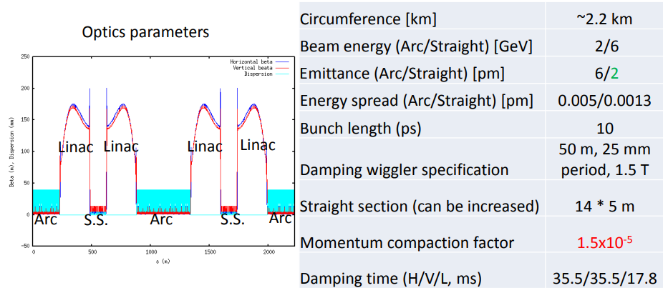
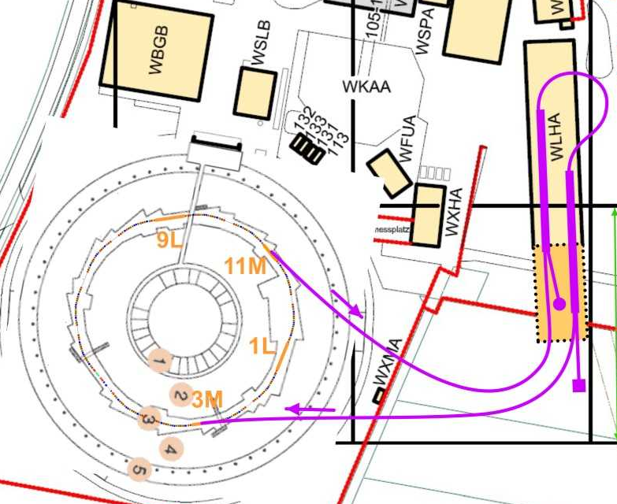
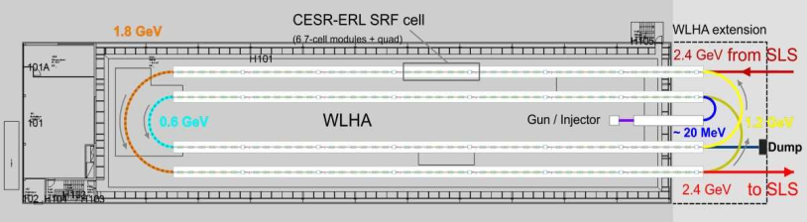
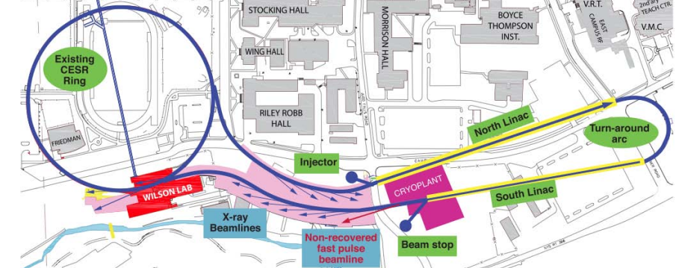
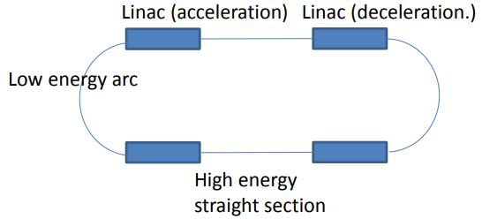
Light source based on ERL
Ultra low emittance beam (transverse and longitudinal) from linac is ideal for the light source
Energy
transfer
“Energy varying ring”
Feasibility not proven (yet)
Figure from M. Aiba, LER 2016
CESR+ERL at Cornell university
Figure from G. Hoffstatter, Future Light Source 2010
SLS upgrade in the parallel world…
Figure by courtesy of A. Streun

Slide 20
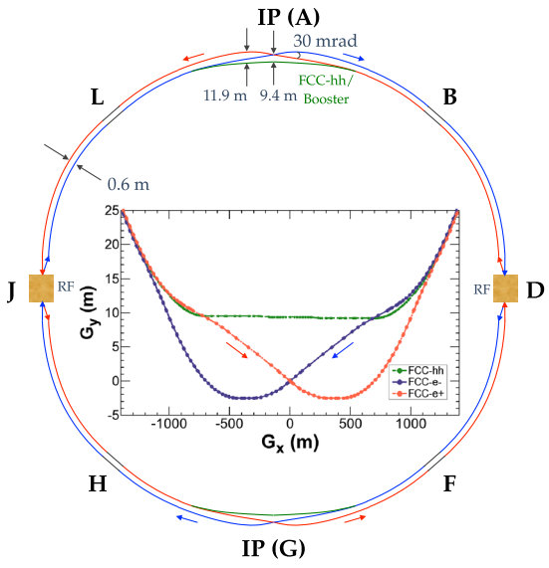

Gamma-ray source?
Coming back to 1GLS but
for totally different photon beams!
FCC-ee collider ring
Figure from K. Oide et al., PRAB, 19, 111005, 2016

Slide 21
Summary
Synchrotron radiation light source has a long history with great success
4th generation light sources have been operational, and more new/upgraded facilities are coming
Despite the established ‘state-of-the-art’ light source facilities, studies for the next step are on-going

