Slide 1
Oleksiy Dolinskyy
Extreme Storage Rings Workshop 2022.
February 1, 2022
Collector Ring at FAIR.
Status and Plans

Slide 2
Outline
CR Performances
RF debuncher
Stochastic Cooling system
Magnets
CR as a mass spectrometer
Civil construction

Slide 3
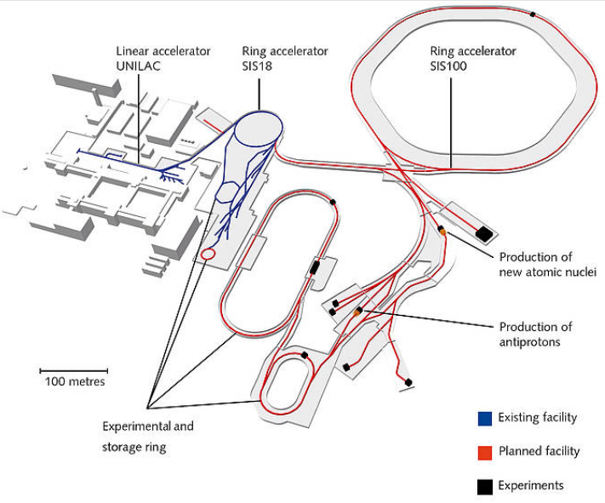
FAIR facility
Proton Linac
ESR
CBM
CRYRING
PANDA
HESR
Super-FRS
Antiproton accumulation at HESR up to 10¹⁰
CR
antiproton and rare isotope beam cooling at CR:
In-ring experiments. N=10⁸

Slide 4
CR features
Fast cooling of antiproton and heavy ion beams
Nuclear physics experiments with a high precision of measurements
Operation at magnetic rigidity of 13 Tm. B_{max}=+1.6 T,
B_{min}=-1.6 T (polarity change 60 s)
Flexible optics to meet requirements of Stochastic cooling and in-ring experiments
Large acceptance provides operation of beam with a momentum spread up to 6% and emittances up to 240 mm* mrad

Slide 5
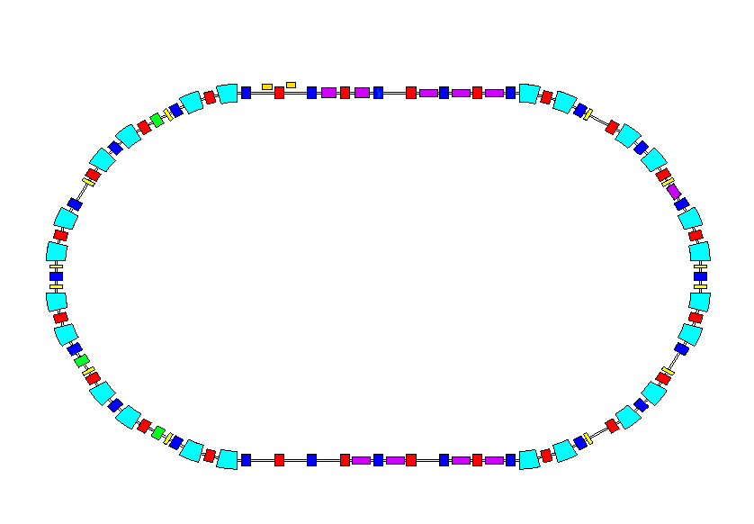
Tasks of the CR
Cooling of antiproton beams
.
From antiproton separator
CR
ε ⊥ = 240 mm mrad
Δp/p = 6 %
 10 sec
ε ⊥ ≤ 5 mm mrad
Δp/p ≤ 0.1 %
to the HESR
.
Cooling of secondary beams of radioactive ions
From Super-FRS
CR
ε ⊥ = 200 mm mrad
Δp/p = 3 %
 2 sec
ε ⊥ ≤ 0.5 mm mrad
Δp/p ≤ 0.05 %
to the HESR (RESR)
Mass spectrometry of radioactive ions
.
From Super-FRS
CR
ε ⊥ = 100 mm mrad
Δp/p = 1 %
 up to few turns

Slide 6
Basic CR parameters
Circumference | m | 221.45
Max. magnetic rigidity | Tm | 13
 |  | Anti-protons | Rare isotopes | Isochronous mode
Max. number of particles |  | 10⁸ | 10⁸ | 1-10⁸
Kinetic energy | MeV/u | 3000 | 740 | 790
Velocity, β | v/c | 0.971 | 0.83 | 0.84
Lorentz, γ |  | 4.2 | 1.79 | 1.84
Transition energy, γ_{tr} |  | 3.85 | 2.82 | 1.43-1.84
Frequency slip factor , η |  | -0.011, 0.014 | 0.176 | 0
Betatron tunes , Q_{h} / Q_{v} |  | 4.39 / 3.42 | 4.28 / 3.44 | 3.4 / 4.44
Revolution frequency | MHz | 1.315 | 1.124 | 1.137
Bunch length at injection | ns | 50 | 50 | 50
Bunch length at extraction | ns | 300-500 | 200-700 | no extraction
Beam injection |  | fast single turn, full aperture
Beam extraction |  | fast single turn |  | no extraction
Average vacuum | mbar | 3 x 10⁻⁹

Slide 7
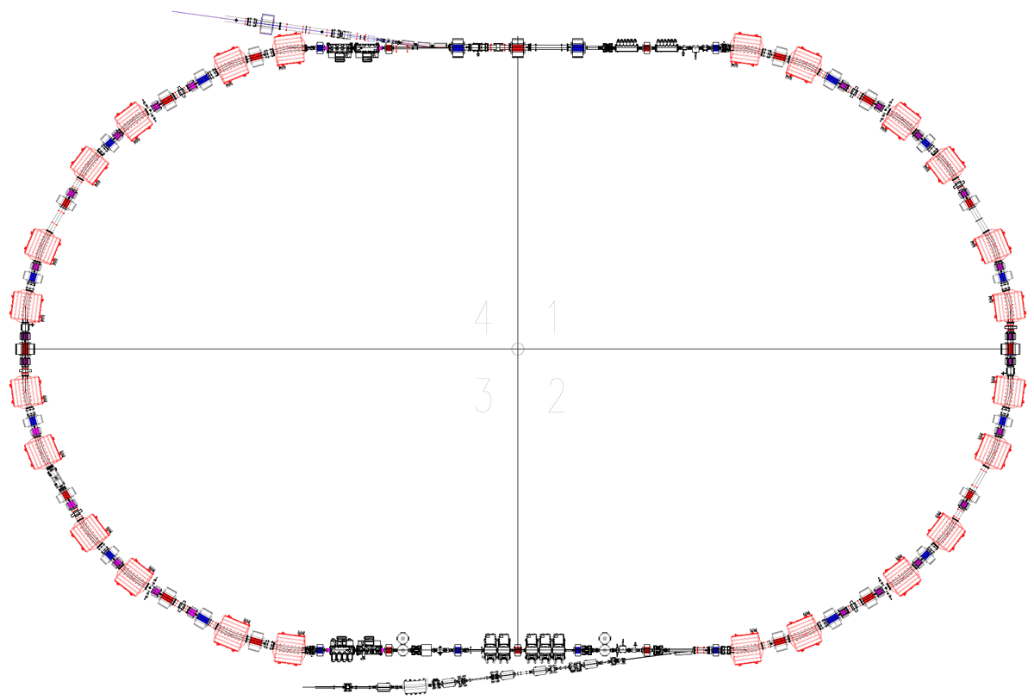
Key components for beam cooling
Injection
Stochastic cooling
Kickers
Stochastic cooling
Pick-ups
RF – debuncher system
(5 cavities)
Extraction to HESR

Slide 8
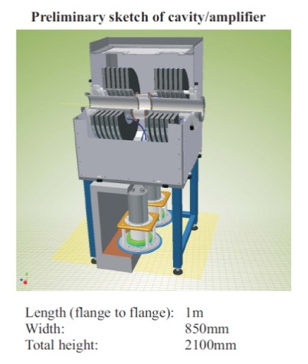
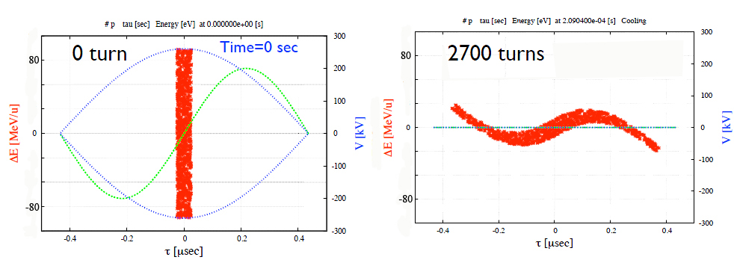
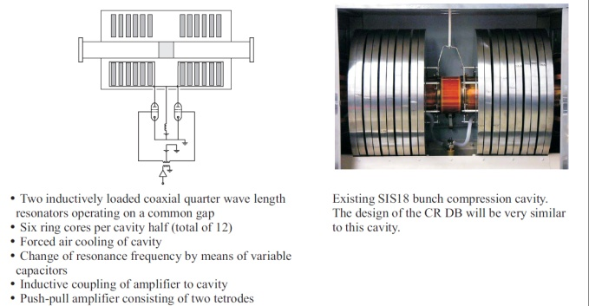

RF debuncher system
By bunch rotation the momentum spread is reduced by factor 3
P-bars (from 6% to less than 2%)
RIBs (from 3% to less then 1 %)
Δp/p=6%
Δp/p=2%
$γ_{tr}=γ_{tr}$(δp/p)
Total voltage (5 cavities) | 200 kV
Peak voltage per cavity | 40 kV
Peak dissipation per valve | 393 kW
Peak dissipation per valve into ring cores | 648 kW
Peak power per valve | 1040 kW

Slide 9
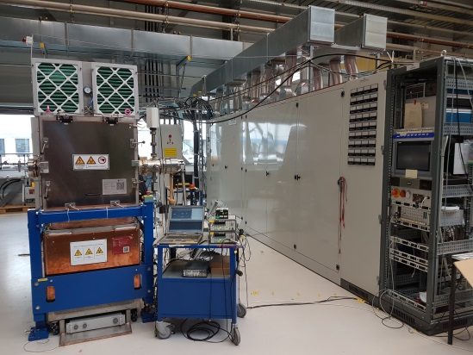
RF debuncher system
  Series production of 5 RF-debuncher systems completed
  They have been delivered to GSI in 2019
  SAT of all system takes place at GSI
- EMC/EMI effects have to be carefully studied
- Some technical corrections are needed to improve reliability
- A long term of collaboration with companies is ongoing
RF cavity and its Power Supply at GSI test hall

Slide 10
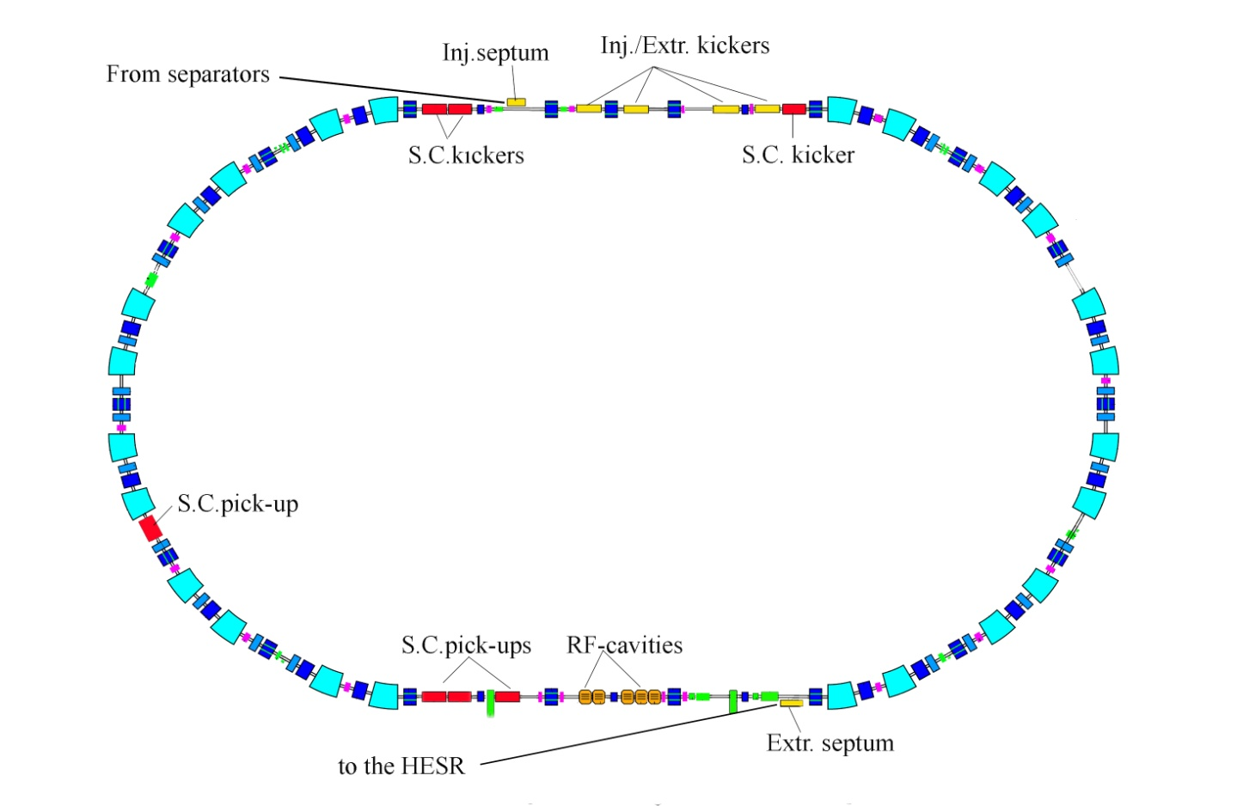

Stochastic cooling
The ring is designed to have a required η parameter both for antiproton and RI beams. Optics and positions of PU and KI are optimized to have required phase advances between all pairs of PU-KI.
η=-0.011 for pbar
η=+0.014 for pbar
η=+0.177 for RIB
Cooling methods:
- Notch filter
- Palmer
- TOF
Good mixing
Pickup tanks (1-2 GHz)
Kicker tanks (1-2 GHz)
Palmer Pickup tanks
Bad mixing
Palmer cooling PU
Phase advance PU-KI
$${Δμ}_{ x or y}=\left(2n+1\right)\frac{π}{2}$$

Slide 11
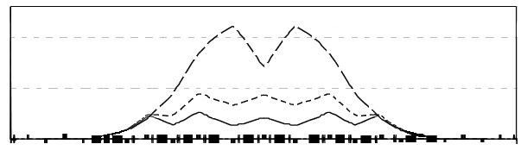
CR Optics Dispersion function
The ring lattice should be adjustable to different slip factors (gamma-tr).
dispersion function over a half of the ring
Antiproton mode (η=−0.011)
RIB mode (η=0.186)
Isochronous mode (η=0)
γ_{tr}=1.84, 1.67, 1.43
0 10 20 25
D_{x} (m)
pick-up
kicker
0
path length s (m)
111
* Phase advance between pick-ups and kickers for stochastic cooling is
* There are 13 independent power supplies for quadrupole magnets

Slide 12
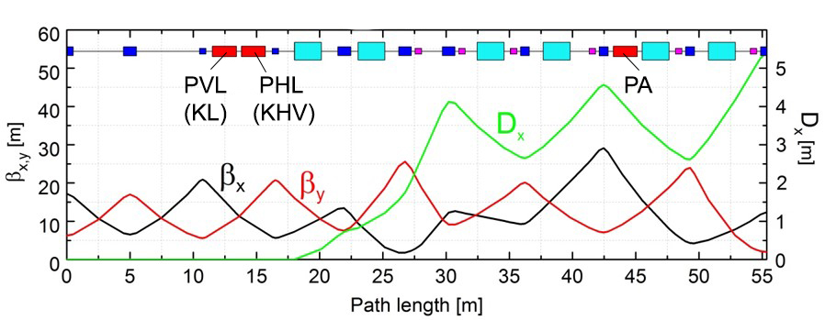
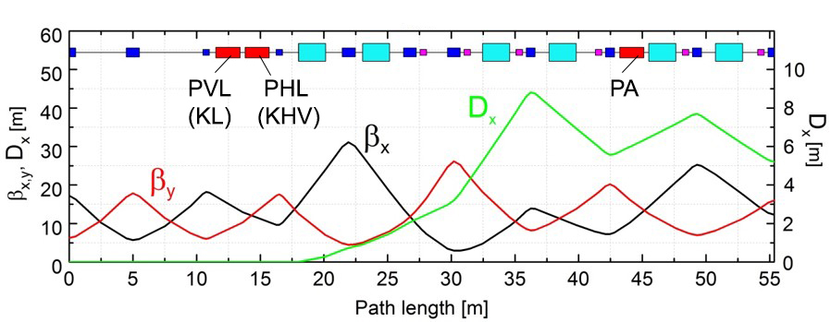
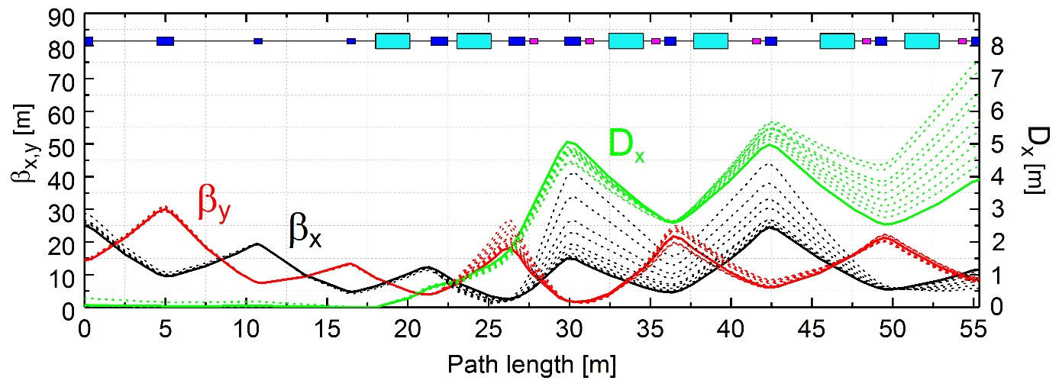

CR optics
Antiproton mode
Heavy ion mode
RF, SC Pick-Up and SC Kicker at D=0
Palmer Pick - Up
Dynamic variation of the momentum slip factor during cooling process to increace SC efficiency
η= from -0.011 to -0.03
13 families of
Quadrupole PC
Ramp rate 5.1 T/m
One has to keep phase advances
$${Δμ}_{ x or y}=\left(2n+1\right)\frac{π}{2}$$

Slide 13
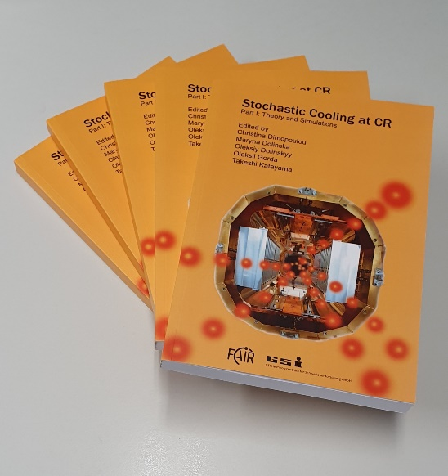
Stochastic cooling
After bunch rotation Stochastic cooling is applied to reduce both the beam emittance and momentum spread, which is required by HESR for further accumulation
Fritz Nolden is the father of SC system at CR
Antiproton beam
Momentum spread: 2% → 0.1%
Emittance: 240 → 5 mm*mrad
Cooling time: 10 s
Heavy ions
Momentum spread: 1 % → 0.05 %
Emittance from: 200 → 0.5 mm*mrad
Cooling time: 2 s
Stochastic cooling theory and simulations for CR were developed over many years by: F.Nolden (GSI), D.Möhl (CERN), L.Thorndahl (CERN), T.Katayama (Japan), C.Dimopoulou (GSI), C.Peschke (GSI), M.Steck (GSI), M.Dolinska (GSI) and many other colleagues.
The SC system is under construction at GSI
by C.Dimopoulou’s team
Hand Book „Stochastic Cooling at CR“

Slide 14
Stochastic Cooling system
Injection
SC kicker
(slot ring electrodes)
W=1-2 GHz
SC Palmer Pick-Up
(Faltin electrodes)
SC Cryogenic Pick-Ups
(slot line electrodes)
Extraction to HESR

Slide 15
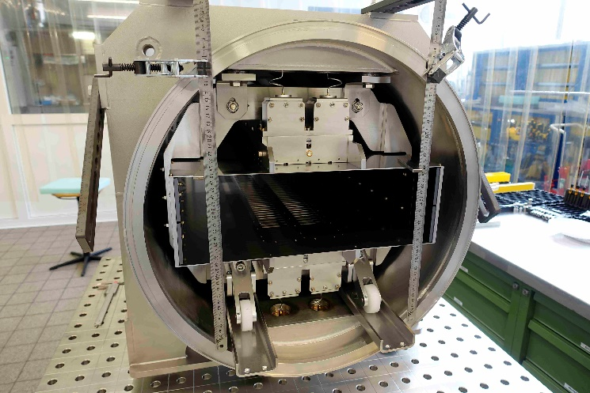
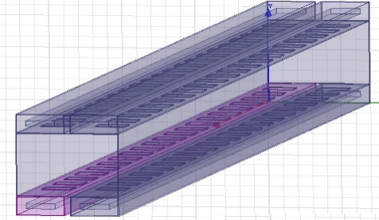
Palmer Pick-Up for Stochastic pre-cooling of heavy ions
Engineering at GSI
Manufacturing has been done at GSI + external company in 2020.
Faltin electrodes

Slide 16
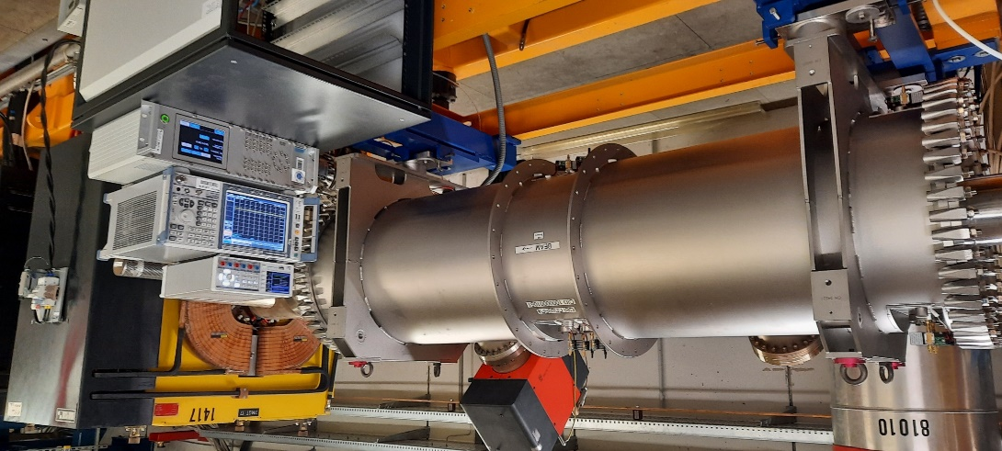
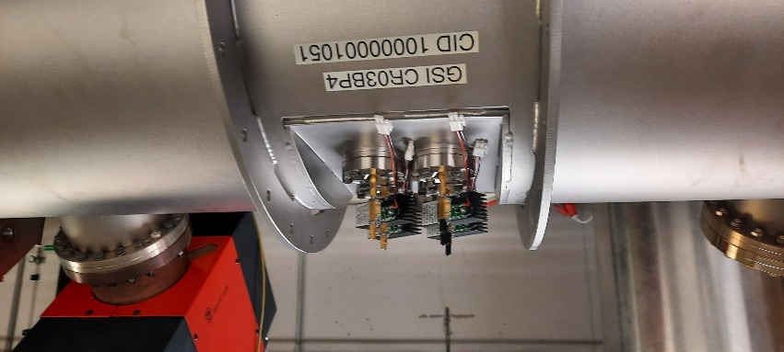
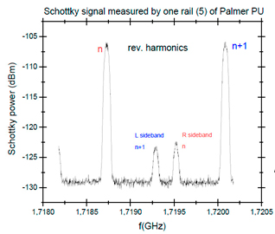
Palmer Pick-Up for Stochastic pre-cooling of heavy ions
Test with proton beam at COSY (FZJ) in 2021
all Faltin electrodes deliver good signals at characteristic beam frequencies (rev. harmonics + vertical betatron)
coasting beam, v=0.83 c
Proton beam N=1.8 x 10¹⁰

Slide 17
Cryogenic Pick-Up for Stochastic cooling of all ions
- Engineering done at GSI
- 2 vacuum tanks has been manufactured in 2021.
- Delivery Q1/2022

Slide 18
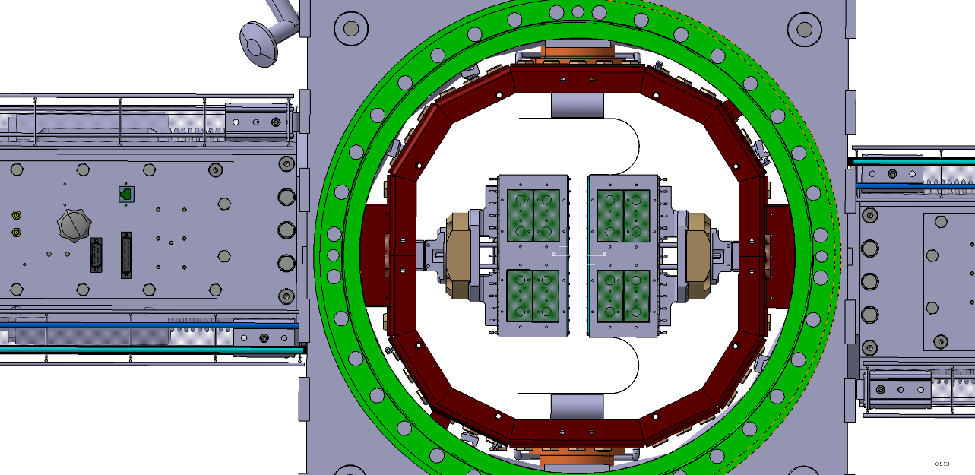
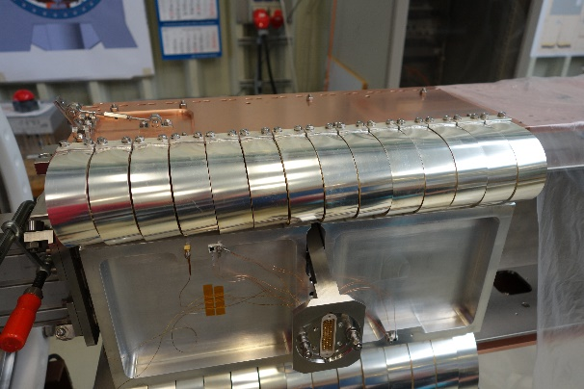
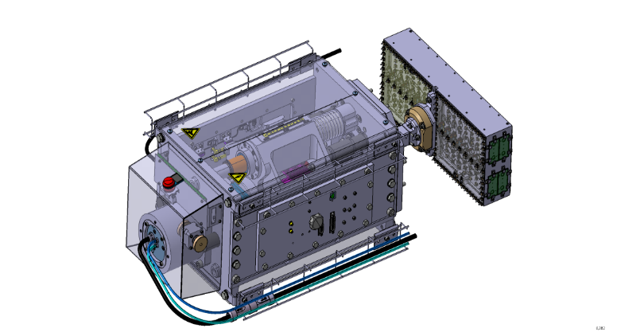
Cryogenic Pick-Up for Stochastic cooling
Motor drive unit
~3500 CuBe plunging foils and their Ag/Cu holders (incl. spares)
design of motor drive unit with electrode module
16 Motor Drive Units: ready, pre-assembled in house; stored

Slide 19
Cryogenic Pick-Up for Stochastic cooling of all ions
- Engineering at GSI
- Manufacturing at GSI + external
- Delivery to GSI Q3/2023
Slotline Electrode Module

Slide 20
Stochastic Cooling Kicker
- electrodes= slot-rings 1-2 GHz;
- 140 mm aperture
- one tank transverse (Hor/Ver);
- one tank longitudinal cooling
- Decision to adapt the well-proven FZJ kicker concept
- Engineering at FZJ
- 2 vacuum tanks will be manufactured at FZJ
- Delivery to GSI Q4/2024
HESR Kicker module
CR Kicker design done at FZJ

Slide 21
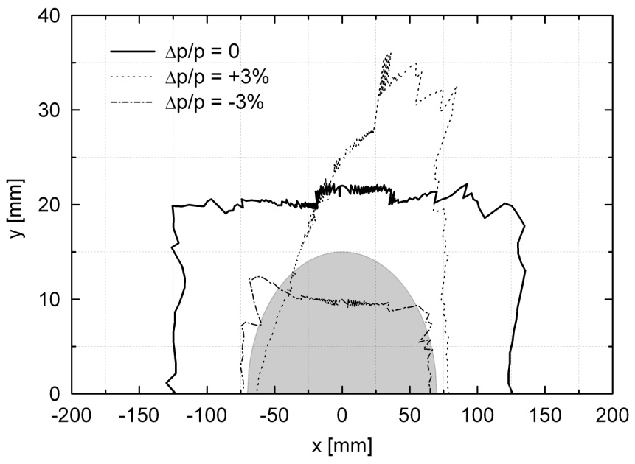
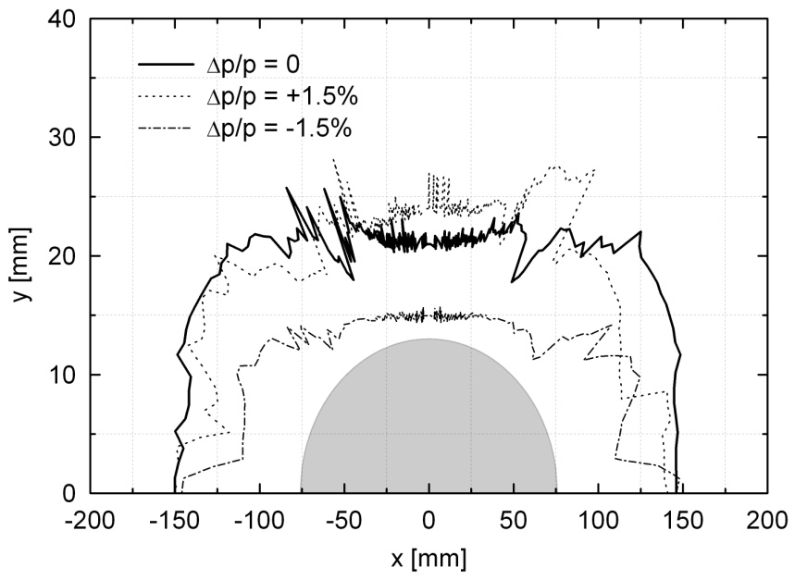
CR Beam dynamic study
Dynamic aperture
Field quality
dipole magnet dB/B =±1*10⁻⁴
quadrupole magnet dQ/Q=±5*10⁻⁴
Dynamic aperture with field imperfection up 9th order
Fringe field effect of quadrupole magnets is included
antiproton optics
heavy ion optics

Slide 22
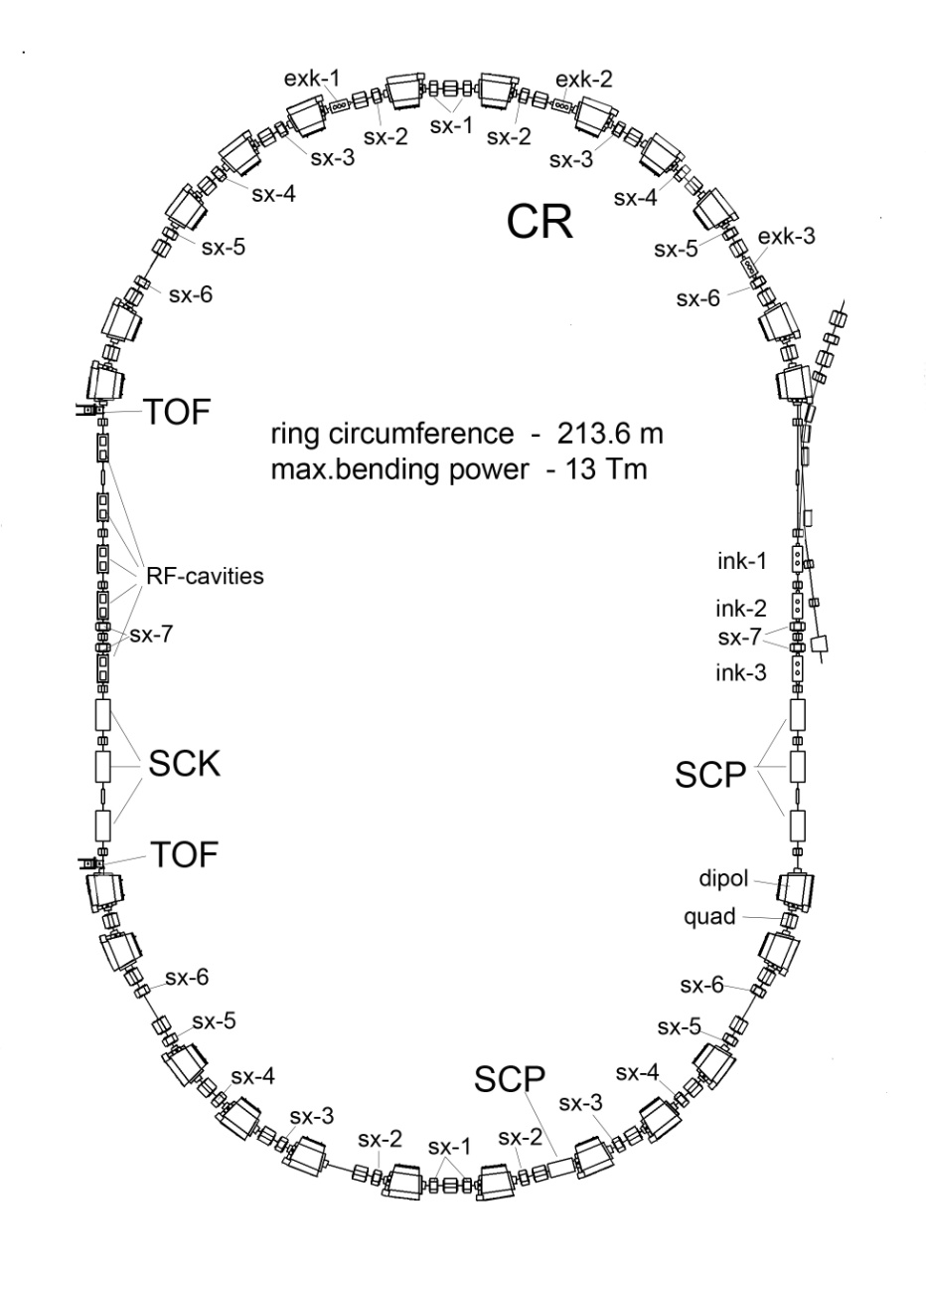
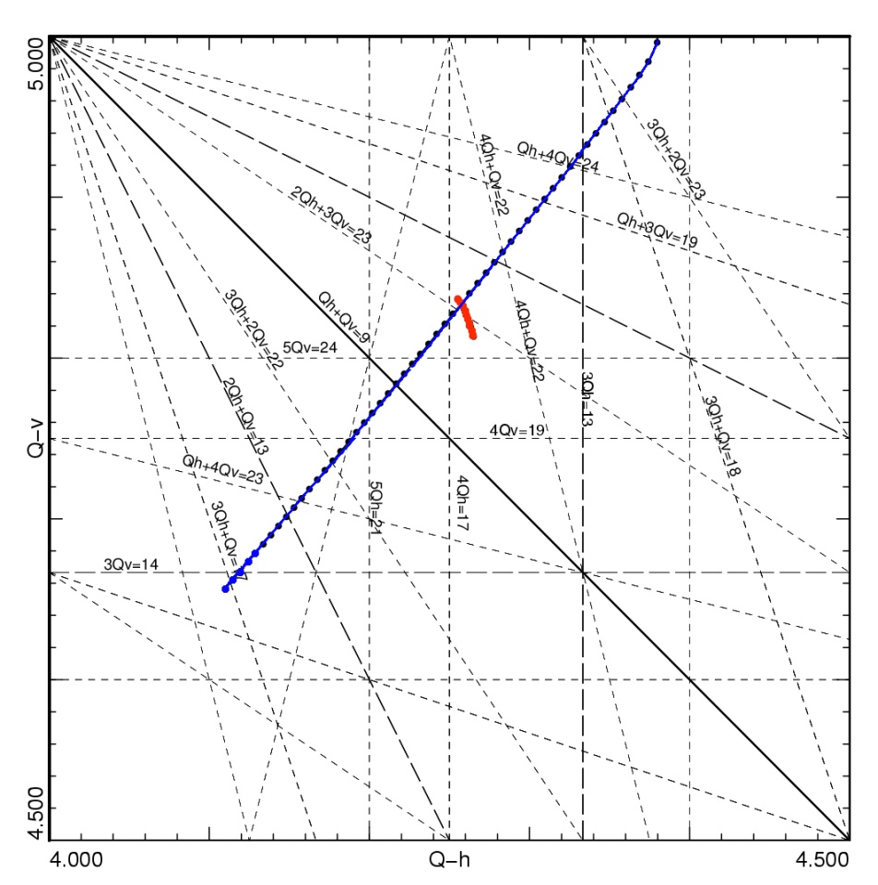
Beam dynamic study
Nonlinear correction
24 sextupole magnets (6 families) are needed for :
* Chromaticity correction
* Control of the dispersion function
* Avoiding synchrobetatron coupling
12 octupole correctors (3 families )
for minimizing of the fringe field effect of quadrupoles in the isochronous mode operation
24 sextupole magnets
(6 families)
without correction
after correction
ΔQ_{h,v}≈ 0.02 in Pbar mode
ΔQ_{h,v} ≈ 0.02 in RIB mode

Slide 23
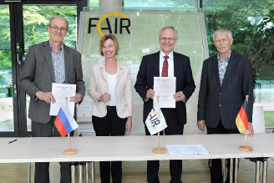
CR ring systems
BINP (Novosibirsk, Russia): design, engineering, manufacturing,
testing, installation, commissioning without beam
Dipole magnets
Quadrupole magnets
Sextupole magnets
Steerers and correction coils
Vacuum system
Power converters
Diagnostic elements
Inj./ext. kicker
Inj./ext. septa
  Contract with BINP for production of major part of CR components has been signed in 2018

Slide 24
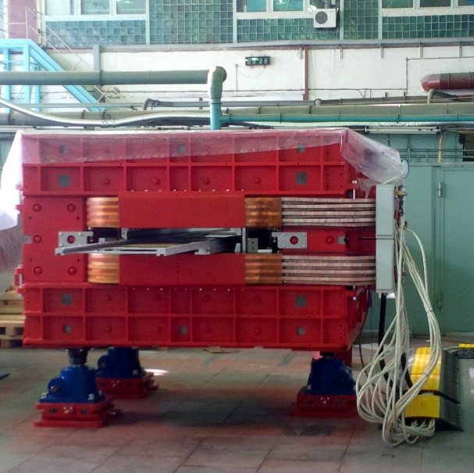
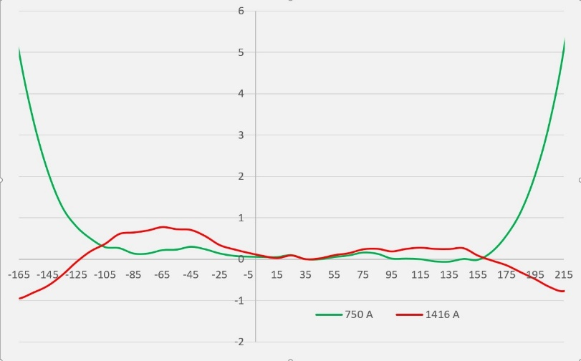
CR Dipole magnet
- Engineering and Manufacturing at BINP (Russia)
- First of Series delivered to GSI in 2021
- SAT is planned in Q2/2022
Main Parameters
Good field region | 380 x 140 mm²
Required field quality at B_{max}=1.6 T | ± 1 x 10⁻⁴
Required field quality at B = 0.8 T | ± 2.5 x 10⁻⁴
bending angle | 15°
pole gap | 170 mm
bending radius: | 8.125 m
max. current | 1400 A
Weight | 60 t
Embedded coils for horizontal steering | ± 3 mrad
ΔB/B x 10⁻⁴
measured field inhomogeneity

Slide 25
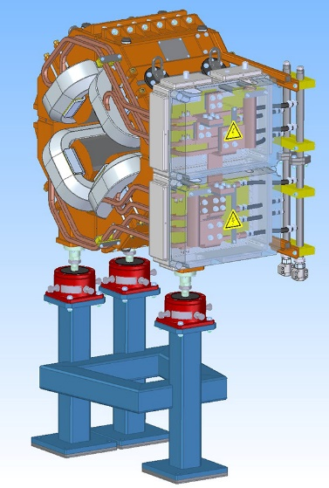
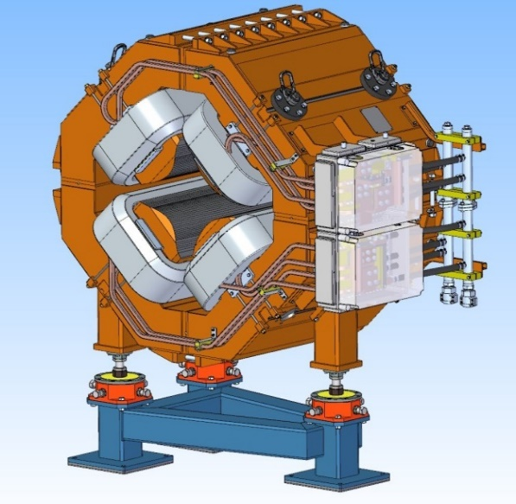
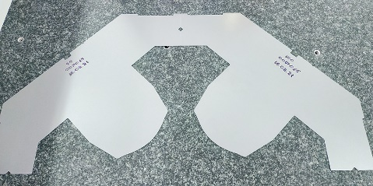
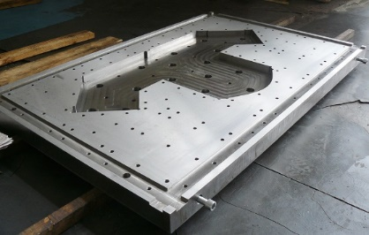
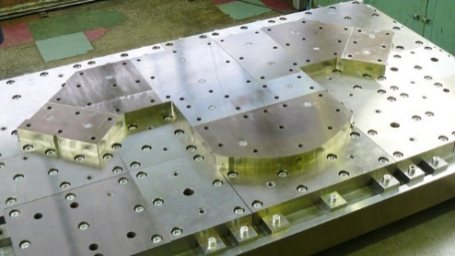
Quadrupole Magnets
Wide and narrow quadrupole magnets:
Design done by BINP
Materials procurement ongoing
Production workshop at BINP is preparing tools for manufacturing
narrow quadrupole
wide quadrupole
Narrow quadrupole test laminas stamped
Wide quadrupole stamping tooling assembly

Slide 26
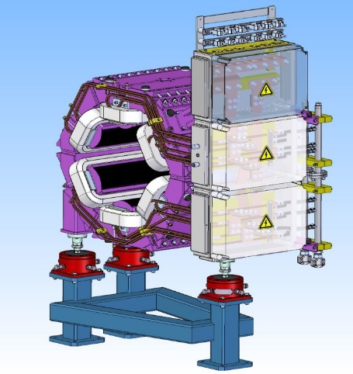
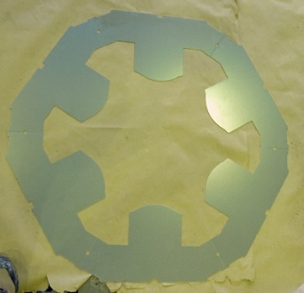
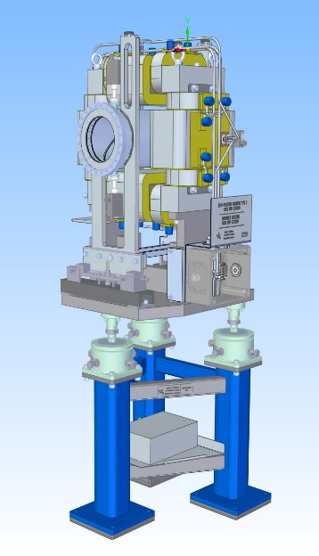
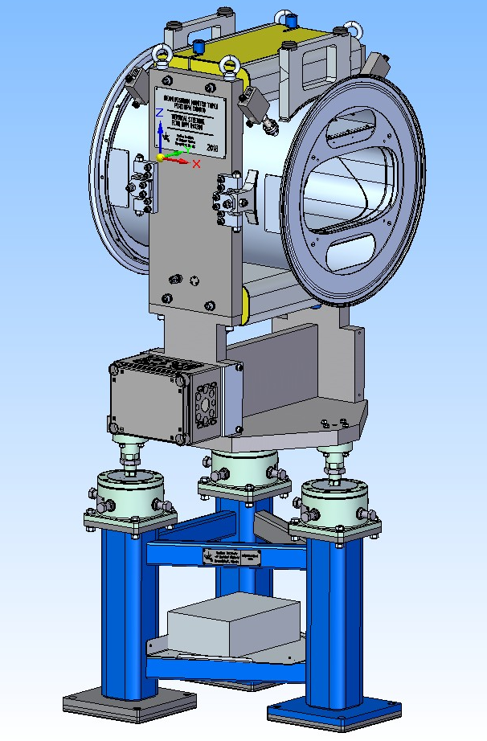
CR Magnets
Sextupole magnte:
- Design done,
- Tooling are ready;
- FoS sextupole magnet is expected in Q1/2022
test laminas of sextupole
sextupole design
Steerer with BMP:
Design done
- Prototype of BPM and Steerer is under test.
Vertical steerer with BPM
Narrow aperture steerer

Slide 27
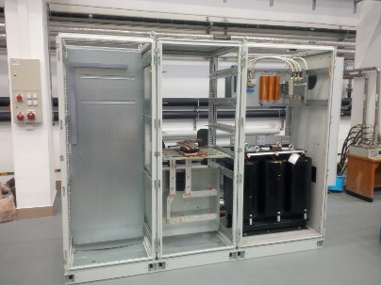
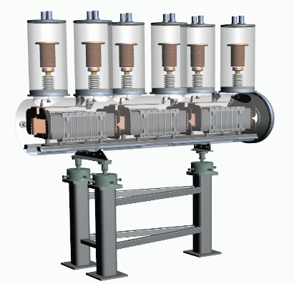
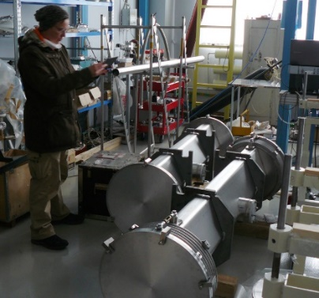
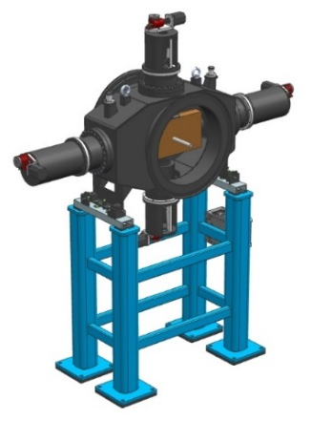
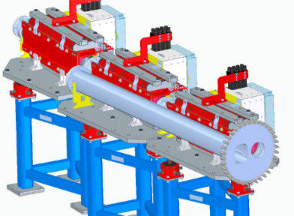
CR components
Engineering design , procurement of materials, prototypes, test,
series manufacturing at BINP are ongoing
- Power converters for all magnets
- Kicker magnet
- Injection extraction magnets
Diagnostic: BPM, Scrapers, Stoppers, RGM, Scintilator screen
Vacuum system
power converter
kicker
Vacuum chamber
RGM
BPM
screaper
septa
scintilator screen

Slide 28
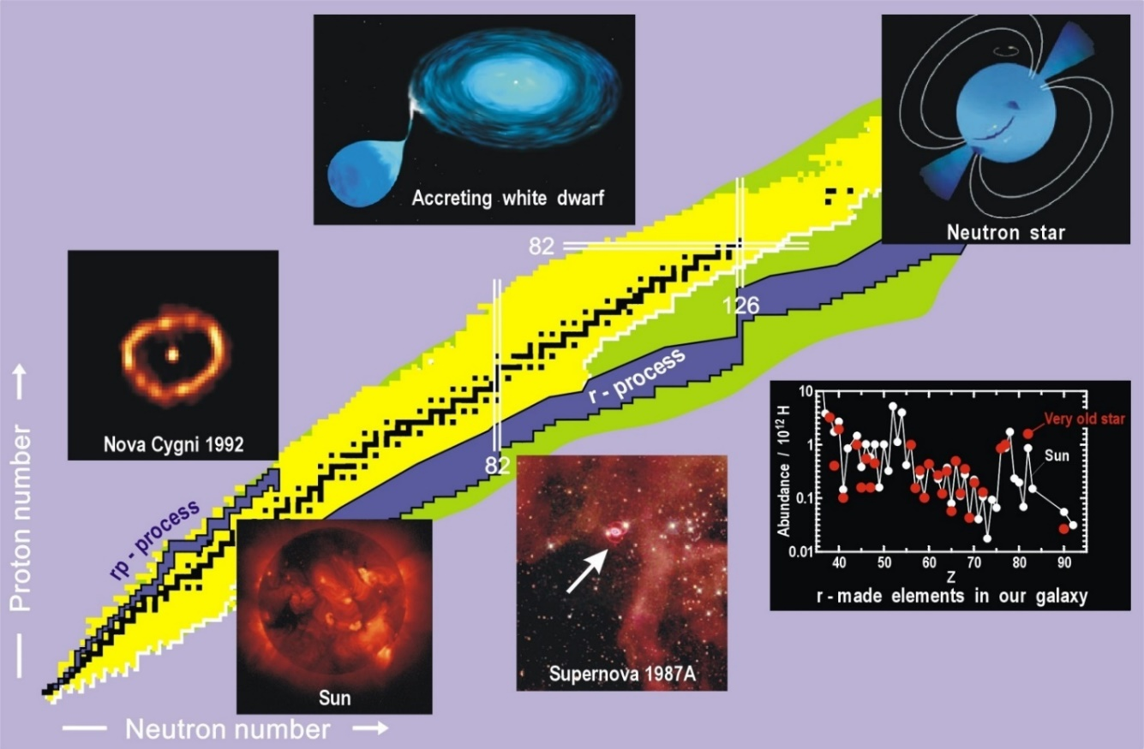
ILIMA experiments at FAIR
ILIMA =Isomeres, LIfetimes and MAsses
- Total binding energies
- Nuclear decay modes
- Separation energies
- Driplines
- Pairing correlations
- Deformations
- Shell closures
- Reaction Q-values
- Testing and improving nuclear theories
Path ways of nucleosynthesis
Mass measurements of rare isotopes
For experiments at CR many detectors are planned to be istalled:
Pocker detectors; Schotky resonators; Time of Flight detectors

Slide 29
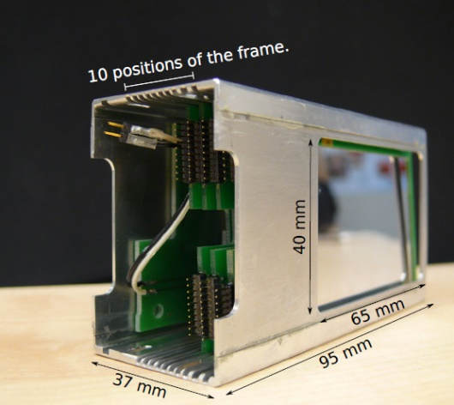
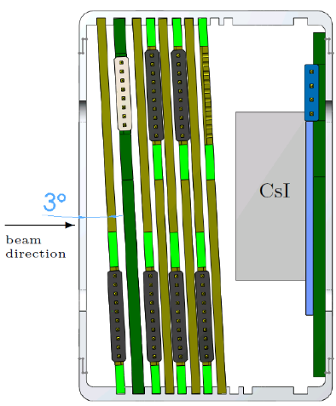
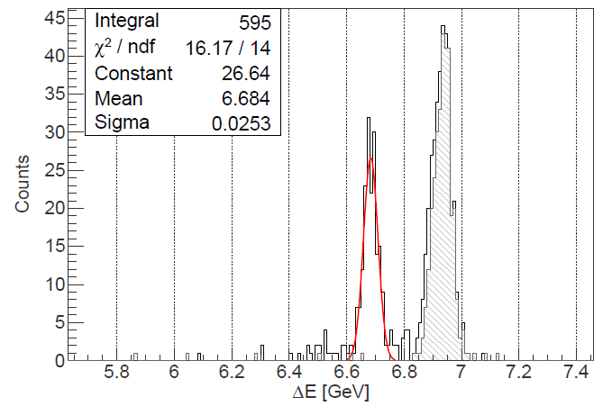
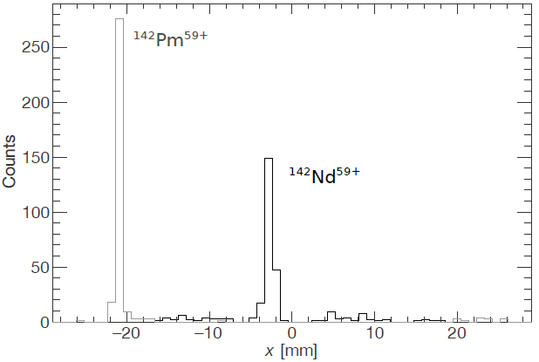
Silicon Heavy Ion Detector
Measurements of β-decay half-lives for determination of the pathways of nucleosynthesis processes
-Silicon pad detectors (x6)
-Double sided silicon strip detector (x1)
-Passive absorber (x1)
-CsI scintillator coupled to silicon photodiode
β⁺ decay: ¹⁴²Pm⁶⁰⁺ → ¹⁴²Nd⁵⁹⁺, electron capture ¹⁴²Pm⁵⁹⁺
Ali Najafi et al.
NIM A836 (2016) 1.
position
S/DSSD stack for ΔE, x
active area 40mm x 60mm
with CsI calorimeter +
Si photo diode to identity
Z and A by ΔE, E.
ΔE

Slide 30
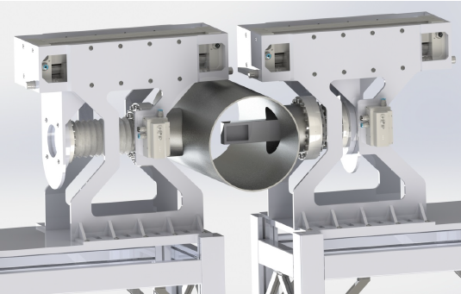
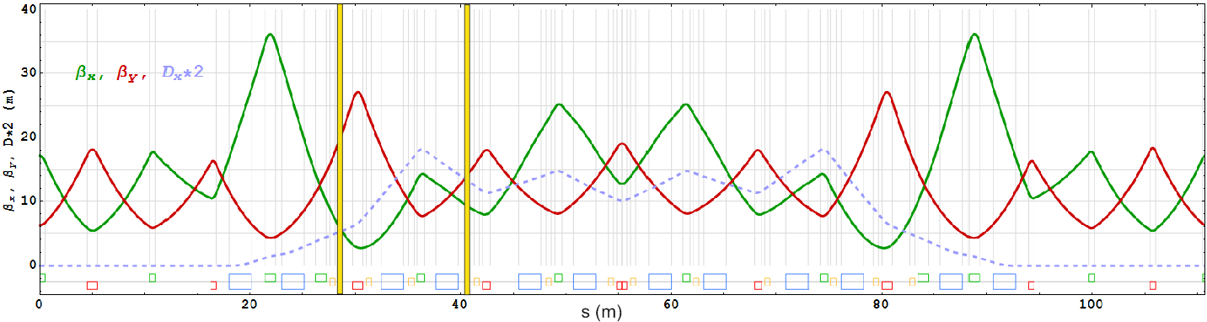
Detector Pockets
e.g. for β delayed neutron emission
CR TDR, Annex 1, 2016
pocket out during injection
→ fast drive with servo motor
Δx = -72 mm
for Z=50, m=132
Δx = -130 mm
for Z=82, m=126
cooled beam (ε_{x} = 1 mm mrad)
➔ x-width = 2.2 – 3.2 mm

Slide 31
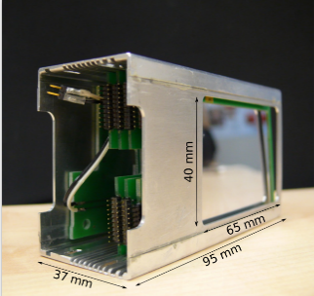



Position of detectors at CR
pocket detector
4 special vacuum chambers will be constructed with possibility for installation of detectors
Schottky resonator
Extraction to HESR

Slide 32

CR as a mass spectrometer
To determine the r-process, rapid neutron capture process, that occurs in core-collapse supernovae one have to measure masses of neutron-rich exotic nuclei.
Isochronous mode ( γ_{tr} = γ ) for fast mass measurements.
γ_{t} = γ = 1.84 (E = 782.5 MeV/u)
γ_{t} = γ = 1.67 (E = 624.1 MeV/u)
γ_{t} = γ = 1.43 (E = 400.5 MeV/u)
Isochronous Mass Spectrometry (IMS)
is one and only quick and sensitive enough technique for mass measurements of large
number of extremely short exotic nuclei with high accuracy (Δm/m~10⁻⁶)
TOF mass measurements
Isochronous Mode of the CR

Slide 33





TOF detectors
Chamber + Bellow
Installation in ring
$γ_{tr}=γ_{tr}$(δp/p)
$γ_{tr}$(δp/p) ≠ $γ$
Isochronous conditions are no ideal for full momentum spread area.
2 TOF detectors are used for velocity measurement as a function of m/q
Extraction to HESR

Slide 34

Isochronous optics for TOF measurements
γt = 1.43
ε_{x}= ε_{y}=100 mm mrad
Δp/p ±0.2%
ΔL (TOF) = 18 m
x/y (TOF1) = 56/42 mm
x/y (TOF2) = 59/42 mm
D_{max}=47 m,
=0 at the straight sections.
Notes:
Super-FRS + CR
CR is coupled to the Super-FRS facility and will among other tasks operate as an isochronous storage ring. As I mentioned before my task was to investigate and design the isochronous mode of the CR

Slide 35


TOF Detector System for CR
d =80 mm
MCP and carbon foil
Isochronous electron transport
by crossed E, B fields.
ion
yoke diameter 900mm
magnet hom. dB/B = 10⁻³
Electron transport efficiency ≈ 98%
Timing accuracy ≈ 35 ps
Active area d=80mm wanted, accepted emittance (x * y) scales with d^4 !
Simulations + Tests for detector show even better timing than ESR detector
          M. Diwisch thesis, University Giessen 2014, N. Kuzminchuk et al., NIM B 821, 160

Slide 36





Schottky resonators
Schottky resonators are planned for measurements of radioactive decay, electron capture decay, for mass measurements in both in normal and isochronous mode operation.
There will be 13 resonators in the CR ring.
4 types of resonators for measurement of longitudinal and transverse Schottky signals
It will also be useful for diagnostics of antiprotons with high sensitivity, stochastic cooling process.

Slide 37



Schottky resonators
One type of resonator:
A prototype has been designed and manufactured at GSI.
Test at ESR/ GSI has been done.

Slide 38




Precision of mass measurements
Sextupoles, octupoles are foreseen, but
also a 4th order corrector is needed.
$$\frac{∆f}{f}=−\frac{1}{γ_{tr}^{2}}\frac{∆m}{m}+{\frac{∆f}{f}}_{error}$$
With full correction
ΔB/B [10⁻⁴]
from CR TDR
(δf/f)_{error} [10⁻⁶ ]
in GICOSY
simulation
(δf/f)_{error} [10⁻⁵ ]
Decapole Corrector B⁽⁴⁾L = 80 Tm/m⁴
Current ripple δI/I of power converter for dipole magnets should be not larger as 10⁻⁶

Slide 39

CR magnets
The Octupole coils are embedded in wide aperture quadrupole magnets
Sextupole magnet
Decapole magnets are installed in the middle of each arc.

Slide 40
non linear correction
Decapole
magntet
12 Octupole correctors (3 families)
Decapole
magntet
Octupole coils embedded
into quadrupole magnets

Slide 41

FAIR CIVIL CONSTRUCTION

Slide 42

FAIR CIVIL CONSTRUCTION
HESR
CR

Slide 43

Building for CR and RESR

Slide 44

Building for CR and RESR
Present status:
Design of building done
Planning of technical
infrastructure
and cable takes place.
Start of construction
is planned in 2023

Slide 45
Conclusion
CR will provide cooling of secondary beams with a high efficiency
In-ring experiments can be done with a high precision
Technical design of all CR systems has been finished.
The RF debuncher system has been completed by 100 %
The SC Palmer Pick-Up has been constructed and tested
Many accelerator components are under serial production
It is planned to finish production of all accelerate systems by 2025
Ring assembling is planned in 2025-2026
Commissioning in 2026 -2027
Start operation 2027

Slide 46

FAIR – Facility for Antiproton and Ion Research
GSI Helmholtzzentrum für Schwerionenforschung
Thank you!

