Slide 1
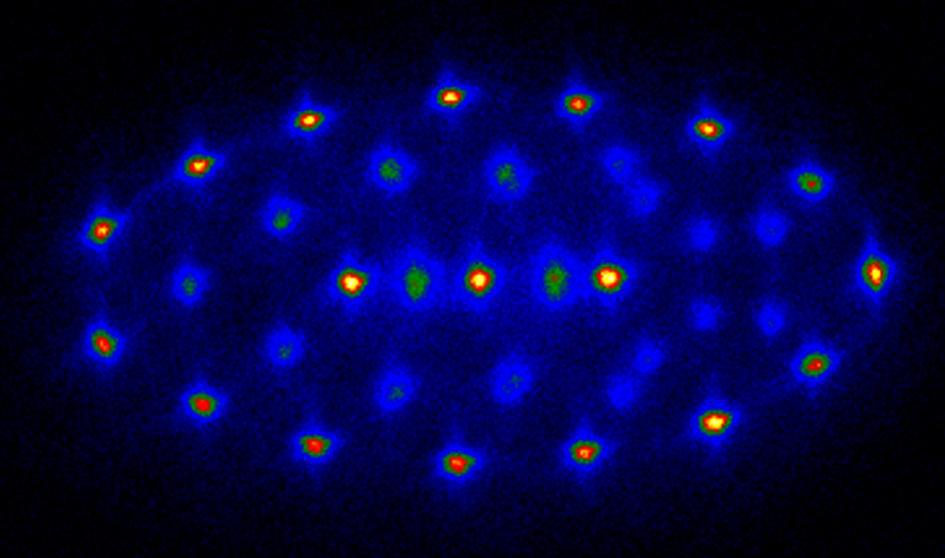
CRYSTALLINE BEAM
Lessons from
PALLAS
10µm
Extreme Storage Rings 2022 – Tobias Schaetz LMU...Freiburg

Slide 2
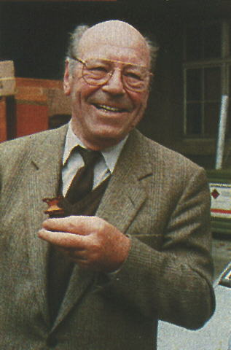
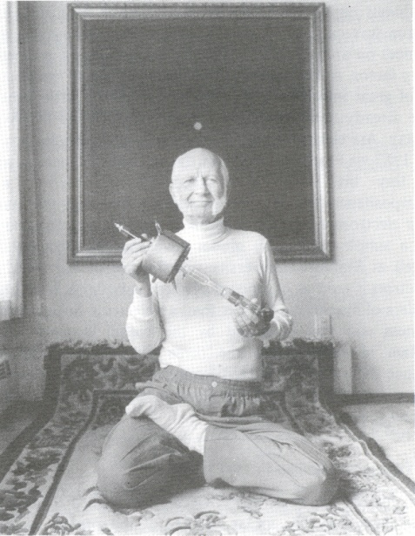

PALLAS
Brilliant!
… but …
static & local

Slide 3
CRYSTALLINE BEAMS
PALLAS
Outline:
storage ring [rf versus magnetic lattice]
- classify PALLAS
- crystallization “challenges”
PALLAS
- setup
- operation modi
Crystalline beams [!eV!]
- continuous
- bunched
towards “lessons on stability”
Extreme Storage Rings 2022 – Tobias Schaetz LMU...Freiburg

Slide 4
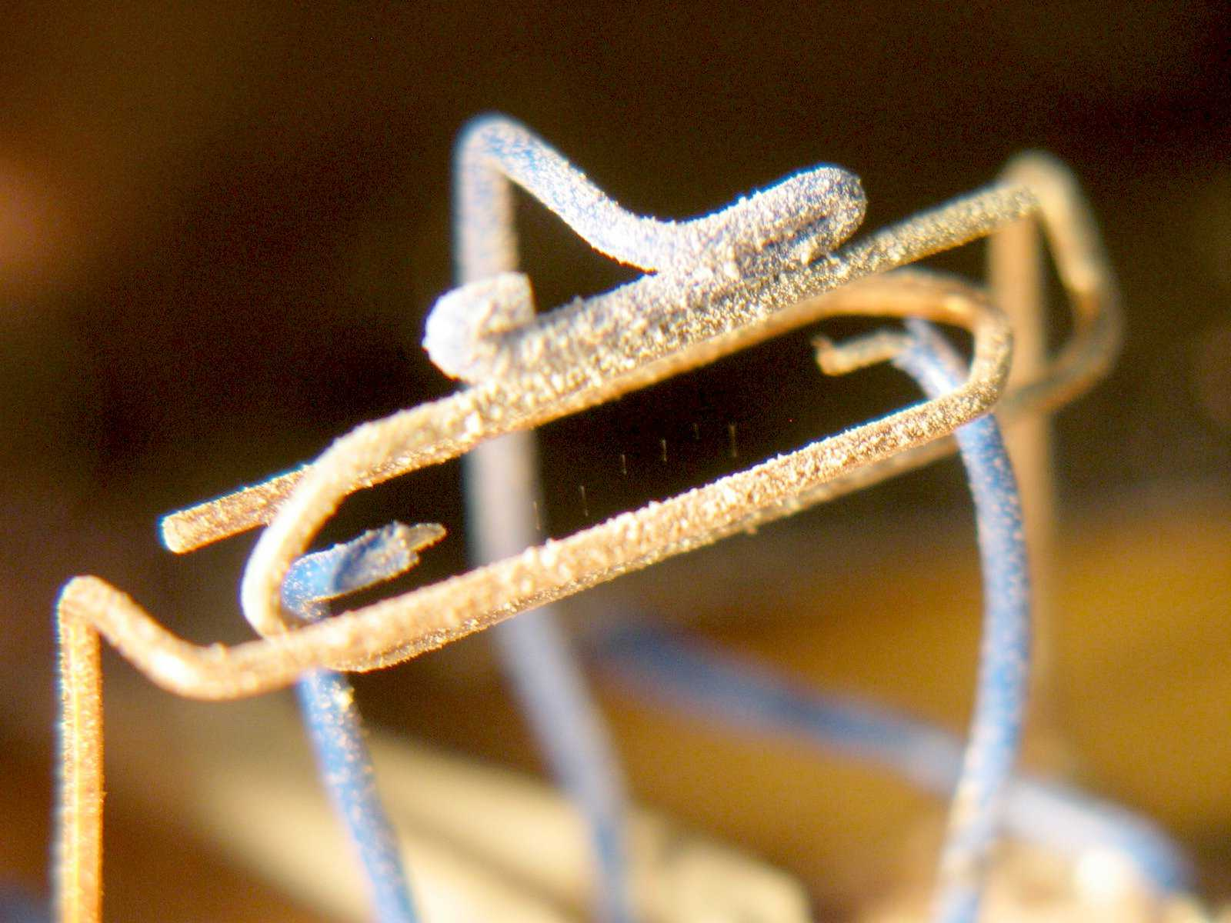
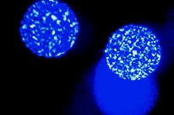
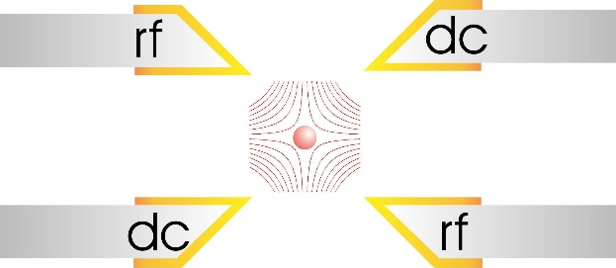
must have: a Paul trap - flight simulator
+
~ rf

Slide 5
Lattice
magnetic “vs” rf - confinement
Manfred
Grieser

Slide 6
classify PALLAS
plasma/crystal
legend:
tunable
identify/study
crystal (1d-3d) stability criteria

Slide 7
crystal beam “challenges”
*
Challenges:
IBS
- strong 3d cooling (coupling)
- P>: ... laser overlap…
(2) eigenmodes (and sidebands at Ω)
crystal “in statu nascendi”
(3) stop bands [Q no integer]
during crystallization (scanning Q to 0)
- fast crossing
- P> (min. disturbances)
(4) shear forces (>1d)
*

Slide 8
CRYSTALLINE BEAMS
PALLAS
Outline:
storage ring [rf versus magnetic lattice]
- classify PALLAS
- crystallization “challenges”
PALLAS
- setup
- operation modi
Crystalline beams [!eV!]
- continuous
- bunched
towards “lessons on stability”
Extreme Storage Rings 2022 – Tobias Schaetz LMU...Freiburg

Slide 9
PALLAS - setup

Slide 10
PALLAS - modi
PALLAS – continuous mode:
PALLAS – synchrotron mode:

Slide 11
CRYSTALLINE BEAMS
PALLAS
Outline:
storage ring [rf versus magnetic lattice]
- classify PALLAS
- crystallization “challenges”
PALLAS
- setup
- operation modi
Crystalline beams [!eV!]
- continuous
- bunched
towards “lessons on stability”
Extreme Storage Rings 2022 – Tobias Schaetz LMU...Freiburg

Slide 12
crystal beam
T|| < 3mK
Γ|| > 180
v = 2800 m/s

Slide 13
2d beam crystals

Slide 14
3d beam crystals

Slide 15
CRYSTALLINE BEAMS
PALLAS
Outline:
storage ring [rf versus magnetic lattice]
- classify PALLAS
- crystallization “challenges”
PALLAS
- setup
- operation modi
Crystalline beams [!eV!]
- continuous
- bunched
towards “lessons on stability”
Extreme Storage Rings 2022 – Tobias Schaetz LMU...Freiburg

Slide 16
PALLAS

Slide 17
PALLAS - synchrotron

Slide 18
CRYSTALLINE BEAMS
PALLAS
Outline:
storage ring [rf versus magnetic lattice]
- classify PALLAS
- crystallization “challenges”
PALLAS
- setup
- operation modi
Crystalline beams [!eV!]
- continuous
- bunched
towards “lessons on stability”
Extreme Storage Rings 2022 – Tobias Schaetz LMU...Freiburg

Slide 19
crystal beams - stability

Slide 20
PALLAS

Slide 21
PALLAS – “lessons”
start crystalline in bucket
- post accelerate
(separate control: timing & confinement)
reduce heating
(lifetime without cooling > - Schottky diagnosis)
2d vertical
(“no” shear)
3d cooling
- coupling: Q>
- transverse/dispersive cooling (TSR)
    + straight sections (P?)
    - wiggler (helical trajectory - ?com. with 3d helix?)
low energy options (see also SNL talk)
- periodic boundary conditions
- read and write head on qubit disk

Slide 22


Slide 23
PALLAS

Slide 24
PALLAS

Slide 25
PALLAS

Slide 26
PALLAS

Slide 27
PALLAS

Slide 28
PALLAS

Slide 29
PALLAS

Slide 30
PALLAS

Slide 31
PALLAS

Slide 32
PALLAS

Slide 33
experimental quantum simulations
- (each) Quantum Matter(s) -
+ discrete [lattice sites]
+ isolated
+ phonons
+ long range interaction
+ magnified lattice (dilute)
- [controlled] interaction
+ unique fidelities (gates)
+ identical quanta (clocks)
10µm
QUSTEC 2020 – Tobias Schaetz/Freiburg

Slide 34
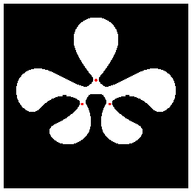
the piano of states (12)
our ion - ²⁵Mg⁺ (I=5/2)
Mg²⁵: I=5/2
(m_{f}=-4,….,+4)
m_{f}=-4
P_{3/2} (S=1/2, L=1)
[F=4,3,2]
(m_{f}=-3,….,+3)
P_{1/2} (S=1/2, L=0)
[F=3,2]
|↑⟩
m_{f}=-2
m_{f}=-1
F=2
m_{f}=0
m_{f}=1
m_{f}=2
S_{1/2} (s=1/2, L=0)
m_{f}=3
m_{f}=2
m_{f}=1
m_{f}=0
F=3
|↓⟩
m_{f}=-1
m_{f}=-2
m_{f}=-3

Slide 35
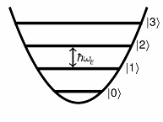
²⁵Mg⁺ (I=5/2)- transitions
tools: our ion species of choice – ^{24,25,26}Mg⁺
~ 200 GHz
²P_{3/2}
|↓⟩ ≡ |F = 3, m_{F} = -3⟩
|↑⟩ ≡ |F = 2, m_{F} = -2⟩
~ 2750 GHz
²P_{1/2}
quantum state
of motion
(harmonic oscillator)
cooling +
Detection (σ⁻)
280 nm
Raman
repump
|↑⟩
|⟩|1⟩
|⟩|0⟩
²S_{1/2}
1.79 GHz
|↓⟩
|↓⟩|1⟩
|↓⟩|0⟩

Slide 36
PALLAS

