Slide 1
EA YETS Planning
135th EATM 16th of November 2021
Bastien Rae

Slide 2
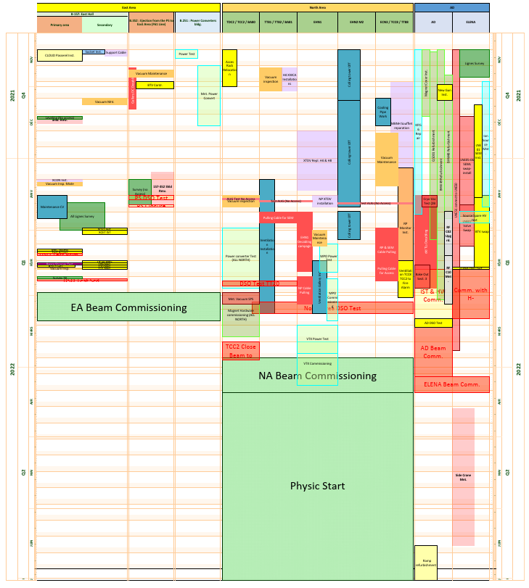
Planning
Draft of Linear planning on the indico.
  To be review by super intendants.
  Don’t hesitate to make comments
AD → Really dense planning
East Area → No critical point foreseen
North Area → Perturbation foreseen
  AUG Tests
  Access Rack Relocation
  Gas Consolidation
  EHN1 De-cabling (see M. Jeckel talk)

Slide 3
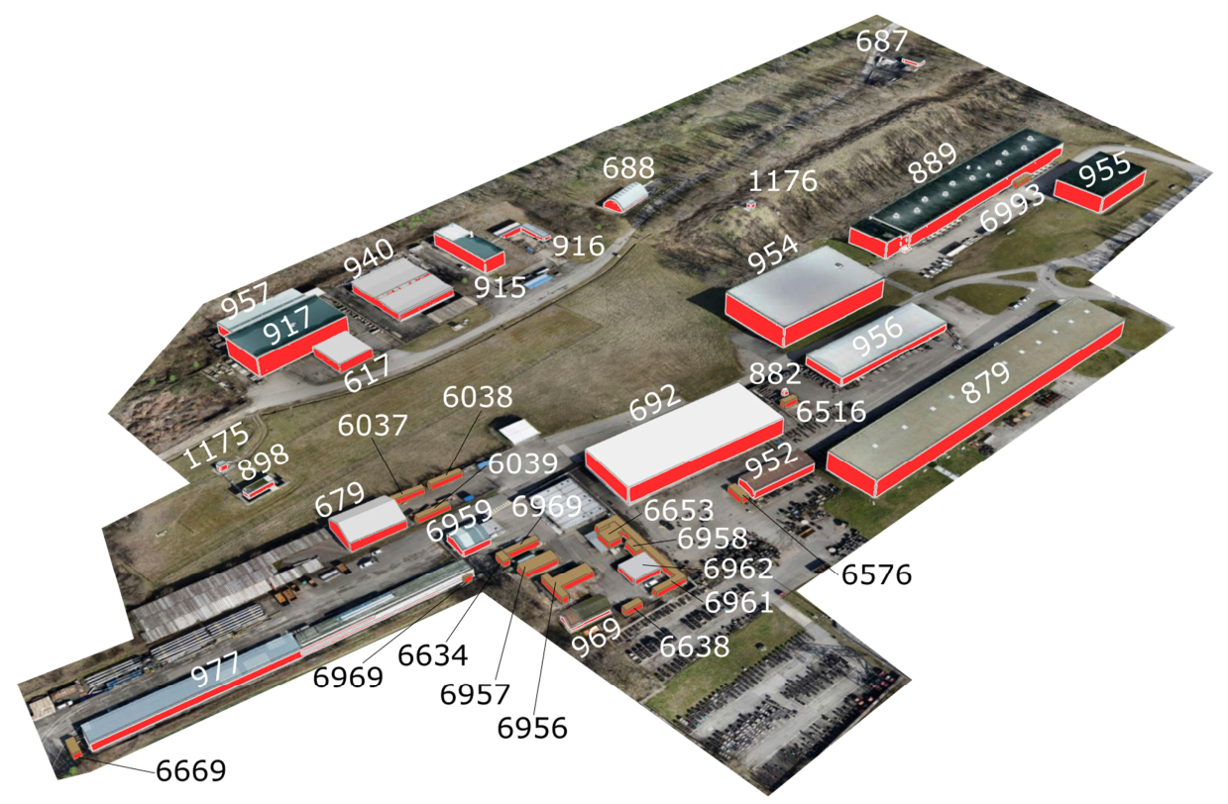
North Area AUG Test
BA80 18.01.22 (No access)
Courtesy : B. Saint Sulpice

Slide 4
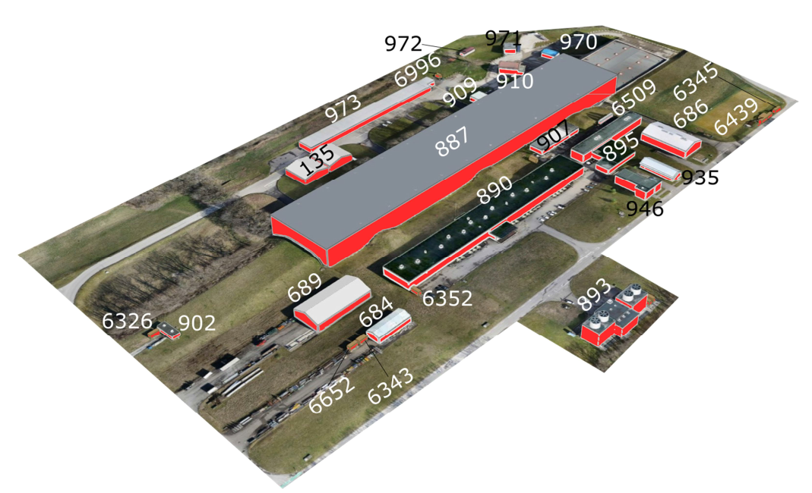
North Area AUG Test
BA81 19.01.22 (No Access)
Courtesy : B. Saint Sulpice

Slide 5
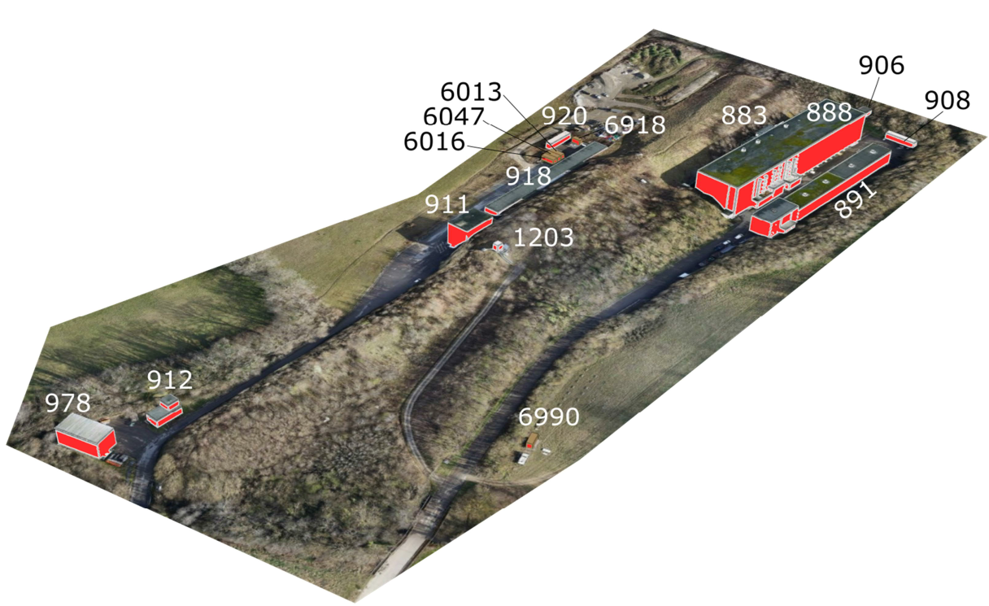
North Area AUG Test
BA82 20.01.22 (No Access)
Courtesy : B. Saint Sulpice

Slide 6
North Area Important Dates
Access Relocation Test (No access)
Access Point | Zone Concerned | Date
BA80 | TCC2-TDC2 | 14.01.22
BA81 | TT81-TT82-TT83-TT84 | 23.02.22
TCC8 | TCC8 | 24.02.22
ECN3 | ECN3 | 25.02.22
Gas consolidation work (No Gas):
Building | Zone Concerned | Date
909 | EHN1 Jura Side, NA61, & GIF++ | 05.01.22 → 11.03.22

Slide 7
Coordination
Experimental Area Planning Officers → S. Schuh & B.Raë
  Please put us in copy of any email concerning email
Area Coordinators
Accelerator Planning Contact (EN-ACE)
  SPS → D. Mcfarlane.
  PS → F. Baltasar Dos Santos Pedrosa (collaboration for B.352 zone)
Areas | Contact
East Area | A. Ebn. Rahmoun
North Area (starting at BA80) | S. Girod
AD | F. Butin
HiRadMat | A. Ebn. Rahmoun

Slide 8
Experiments Coordination
We can help for coordinate work organize by fixed experiment.
  Add some Important work to the linear planning
Improve communication between EA and Experiment
  Update on planning from both side.
  Better visions of the work of each and avoiding co-activity problem in advance.
  Better vision of experiment milestone (Could help when discuss with services availability)
Open to all suggestions to improve the process.

Slide 9
Experimental Areas Planning Gantt view
In case of missing or wrong information please contact us ASAP

