Slide 1

ECR for Approval
Silvia Schuh and Giulia Romagnoli for BE-EA, 2021-11-16

Slide 2
LIST OF DOCUMENTS
For APPROVAL by EATM |  |  |  | EDMS Status
Installation of the Water Cerenkov Test Experiment in the T09 beamline | 2618347 | PSZ-J-EC-0001 v.0.2 | Dipanwita Banerjee | Under approval #1

Slide 3
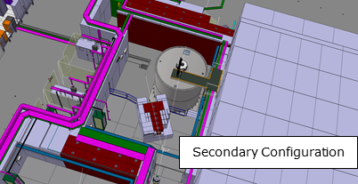
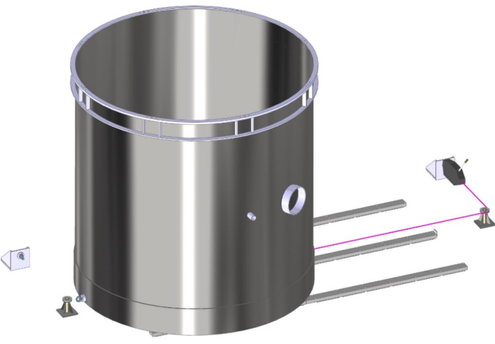
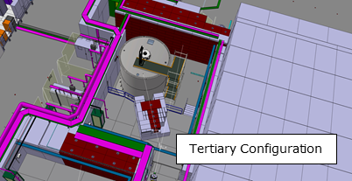
Water Cerenkov Test Experiment in the T09 beamline
DIPANWITA BANERJEE
2618347 v.0.2 | PSZ-J-EC-0001 v.0.2
The Water Cherenkov Test Experiment (WCTE) is a proposed 50-ton water cherenkov experiment to be operated in the T09 beamline in the East Area at CERN, starting from 2023. The experiment requires some infrastructure changes in the T09 beamline to install the 4 m diameter and 4 m high tank which will need to be moved by about 3 m between their secondary and tertiary beam configurations.
WCTE will use 2 beam configurations :
1) Secondary mode using the secondary beam of T09;
2) Tertiary mode where the secondary beam of T09 will be incident on a secondary target to produce low momentum hadrons in the 0.2 (ideally 0.1) to 1.2 GeV/c range.
The 50-ton water tank will need to be moved between these two configurations via a low impact pulling mechanism to avoid any damage to the detectors in the tank due to vibrations and movement of the water inside. This requires installation of a rail system in the experimental zone, in addition to some changes required in the user area to accommodate and install the tank.
Estimated cost: 220kCHF
Born by experiment: 90kCHF
Seeking Approval from EATM
EATM Meeting, 2021-11-16

Slide 4
Thank you!
EATM Meeting, 2021-11-16

