Slide 1
Request for Goliath Magnet
CMS-GEM
M. Bianco, GEM-TC

Slide 2
Test of GE1/1 chamber in Magnet field
Three main scope for tests in magnet field:
  Reproduce the effects observed in CMS (trips/discharges in GEM chamber during magnet ramp)
  Define HV settings such that we can keep in safe status the GE1/1 in CMS during Magnet ramp
  Define a procedure to burn shorts in GEM

Slide 3
Magnet available at CERN
M1: in H2 Beam Line (North Area), up to 4T, superconductive magnet actually at room temperature, not available for tests before spring 2022
Goliath: in H4 Beam Line (North Area), up to 1.2 T, quite big volume
  Same beam area where we are running the R&D51 TB
  Gas mixture available (gas line to be extended of few meter)
  HV Mainframe and cables available (actually in place for TB, we can keep in the beam area)
  Up to three weeks of test, possibly starting from Monday 22nd Nov

Slide 4
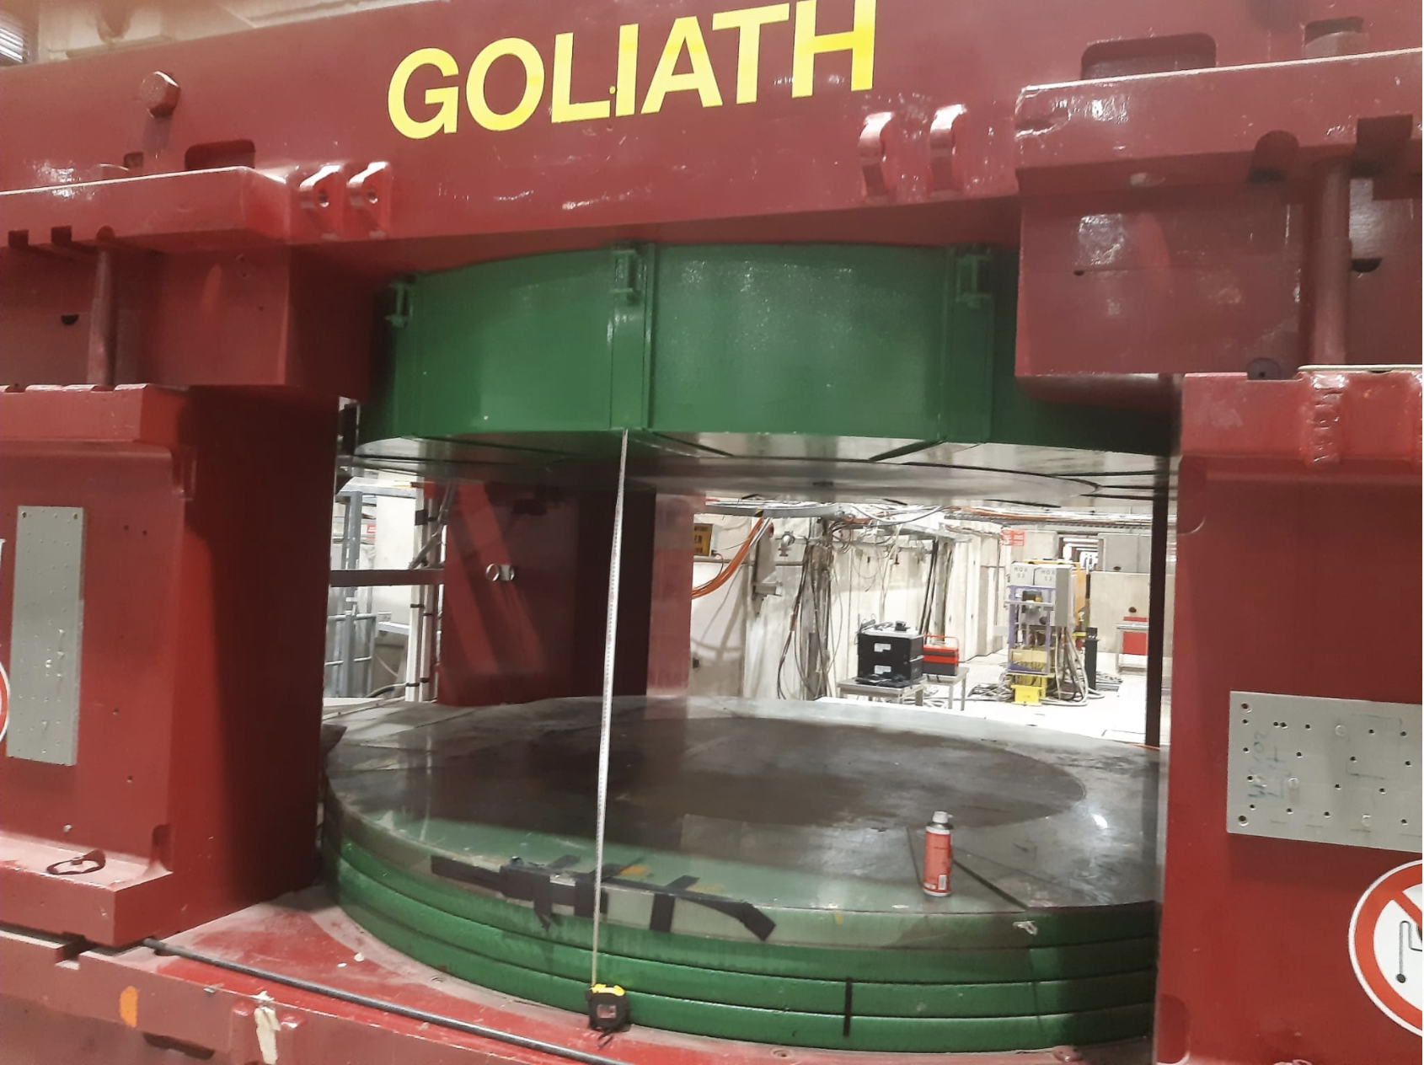
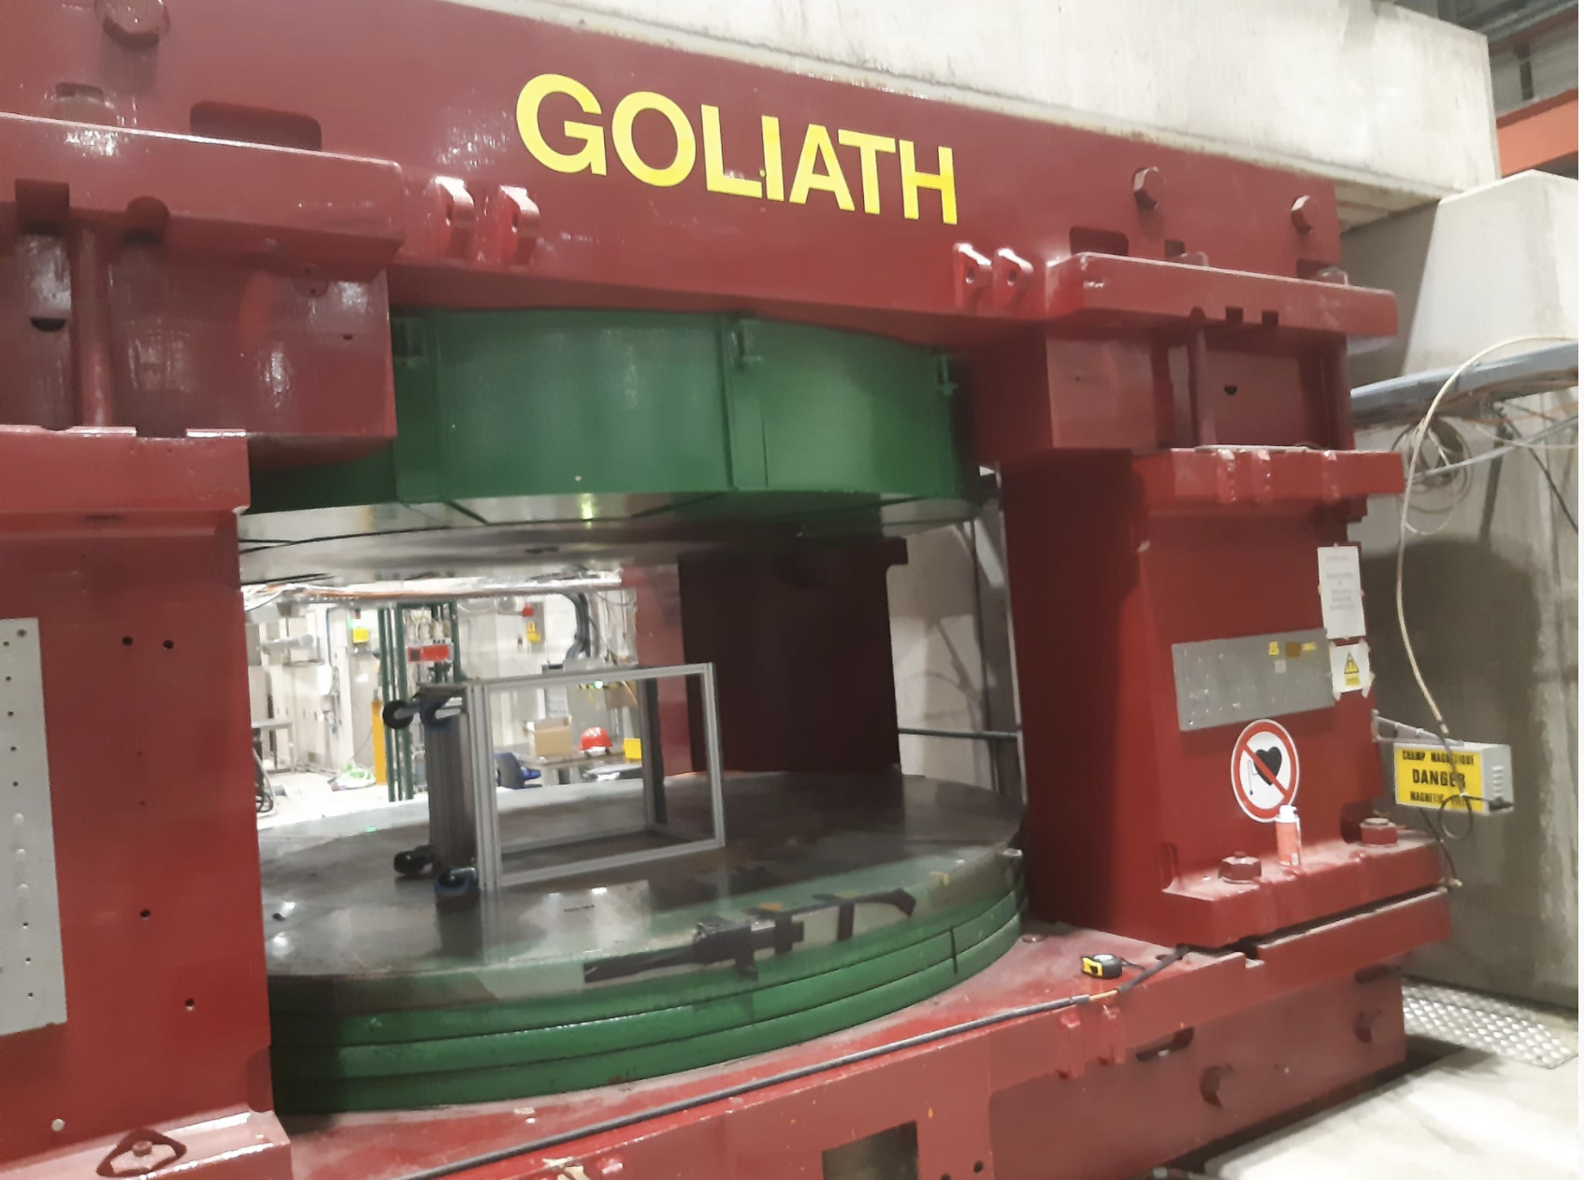
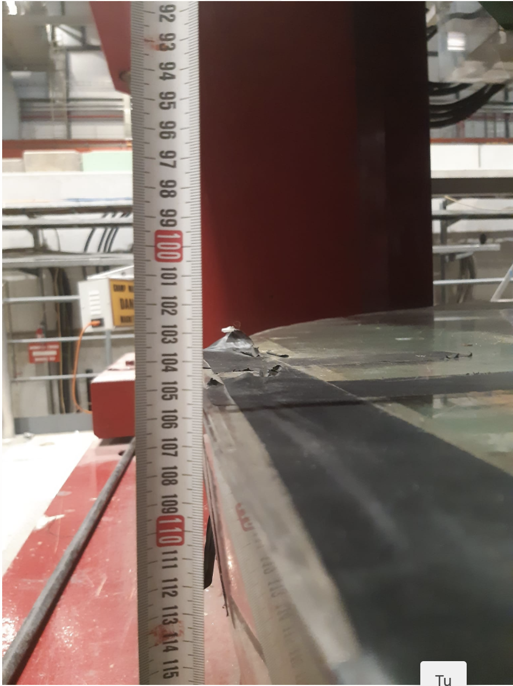
The Goliath Magnet
H max 106 cm
GEM trolley, we can hot up to 4 GE1/1 chambers (wheel to be removed)
https://cds.cern.ch/record/2310483/files/CERN-ACC-NOTE-2018-0028.pdf

Slide 5
Simplified plan
Accelerated GEM foils training like what we are running in P5, GEM1 and GEM3 trained in parallel, then GEM1/GEM3 with Drift/Induction gap and finally the GEM2 with the transfer gap, at least one day of HV ON without magnet
Tests with magnet
  Ramping up (or down) with HV (standard settings), to reproduce what observed in P5 (trips?)
  Ramping up (or down) without HV, to reproduce the effect observed in P5 (shorts?)
  Ramping up (or down) with modified settings like ALICE
  Ramping up (or down) with only GEM1 and GEM3 ON at very high HV value (430 / 440 V)
  Burning ”shorts” procedure with Megger in Ar/CO2
Aim to run the test with the magnet only during regular working time (8:30 a.m. / 5:30 p.m. , Monday to Friday) and keep the GEM detector ON during the rest of the time, detector monitored remotely
Effective test time will depend on the possibility to replicate the effects observed in CMS experiment

Slide 6
Request of support
Access to the Goliath for three weeks
Training for Magnet operation
Contact person/team in case of issue with Magnet or with the access to the area
GEM Contact persons
F. Fallavollita
D. Fiorina
M. Bianco

Slide 7
Backup

Slide 8
Outline
Feedback from GEM wide community
  As a consequence of the Discharges events and shorts in GE1/1 chamber in P5 we look for feedback from colleagues operating GEM detectors in other experiments, mainly ALICE and R&D51
Interventions on GAS System
Tests with Magnet Field

Slide 9
Feedback from GEM wide community (ALICE)
Contact person, Chilo Garabatos (ALICE):
  Similar observations with ALICE TPC chambers, multiple trips during the magnet ramps
  Frequency of discharge/trips seems reducing with the time
  HV across the kept ON during magnet ramp, gap field OFF during planned ramp (New status in the DCS linked to the Magnet to trigger the Magnet Ramp Status and the modification of the voltages)
  Unexpected Magnet Trip occurred once -> No activation of Magnet Ramp Status -> Trips on foils reverted in one Short
  Inspection of the TPC reveled not negligible amount of dust in the TPC volume, trips events associated to the movement of the dust
  No metallurgy analysis on the dust performed so far
  Developing fast HV switch, trying to implement procedure for cleaning of foils “on short”

Slide 10
Feedback from GEM wide community
(R&D51)
Contact person Eraldo Oliveri (R&D51):
TOTEM
Quite large movements of the support structure during the CMS Magnet Ramp
  Mechanical deformation?
Problems during the first 6 months of operation, 4 shorts on 40x3x4 (480)sectors, (we have 144x3x40 (17280) sectors) at the time the 4 shorts were assumed as weak points in the QA/QC.
Support for use of Goliath Magnet for dedicated tests in Magnet field

Slide 11
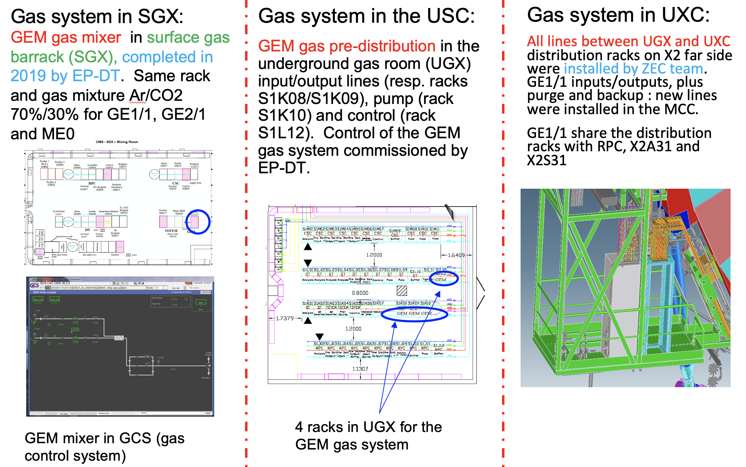
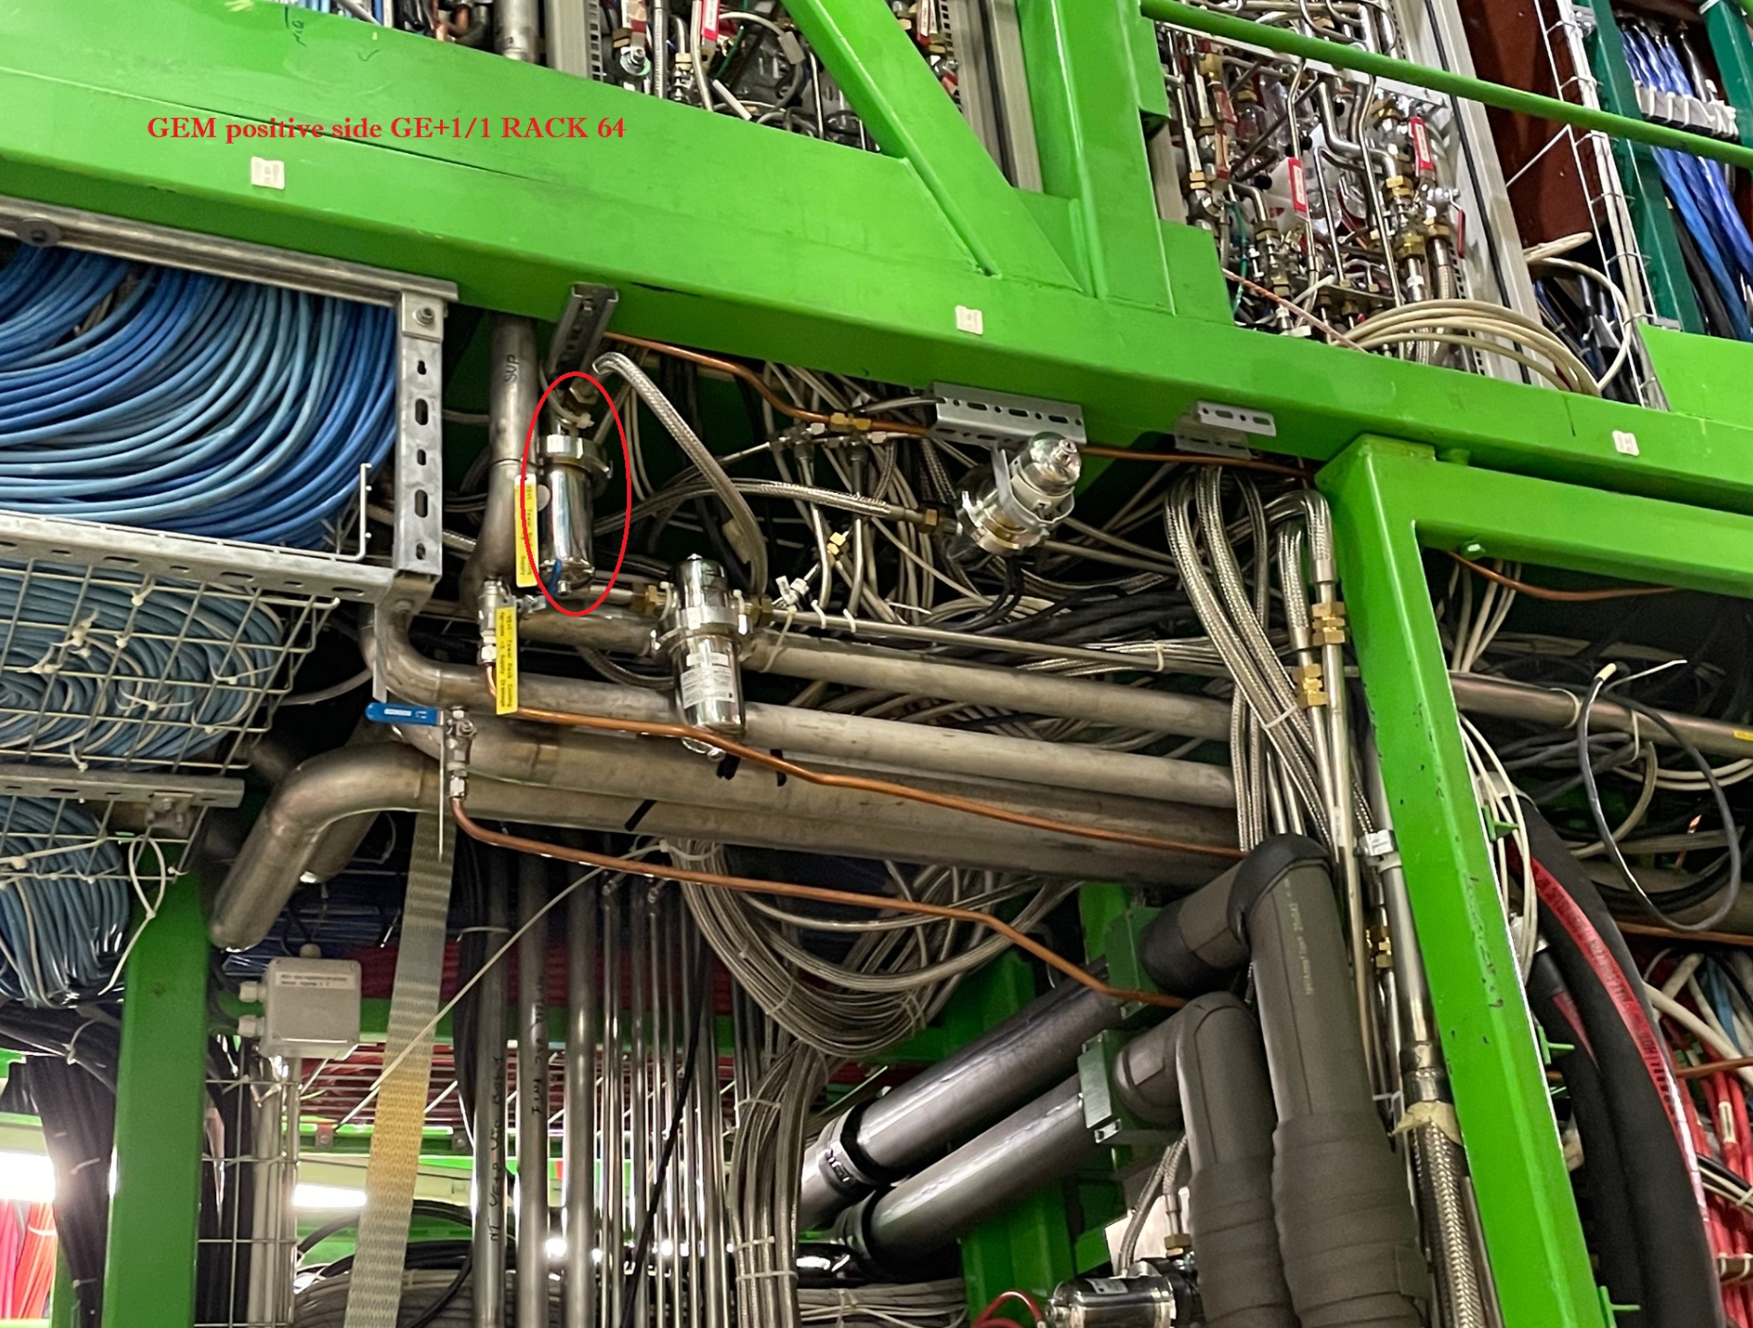
Intervention on Gas System
As the gas contamination is our primary suspected, to reduce the probability of contamination from the gas mixture additional gas filters (filtering 1 um dust) have been required to the CMS Gas System group to be added as close as possible to the GEM Chamber (Tuesday 9th Nov)
Prompt reaction of the CMS Gas group, material prepared on Wednesday 10th (actual filters cartridge 5 um, other ordered), installed on Thursday 11th

Slide 12
Intervention on Gas System
Filters installed at the entrance of the GE1/1 GAS Distribution Racks in UXC
Scope of these filter is to trap contaminations inside the gas system as residual of the assembly process
  Gas filtered on surface at the entrance of the mixer
  Gas system components cleaned in the surface treatment lab at CERN (bd. 107) before the installation
Plan for inspection of the filters before the end of the year, replacement of the cartridge with 1 um filter filtering power
Analysis of the current 5 um cartridge through the metallurgy analysis lab at CERN to identify the nature or the components (Silicon, Metal, ..)

