Slide 1
Proposal for Intensity Ramp-Up 2022
C. Wiesner, M. Solfaroli Camillocci, J. Uythoven, J. Wenninger, D. Wollmann
217th MPP, November 19th, 2021

Slide 2
Outline
Motivation and general strategy
Intensity ramp-ups in Run 2
  Re-cap of ramp-up 2018
  Duration of ramp-ups
  Issues discovered during ramp-ups
Proposal for intensity ramp-up 2022
Reminder: ramp-up scenarios after stops of nominal operation
Conclusions and outlook

Slide 3
Intensity ramp-up: motivation and strategy
Step-wise increase of injected and stored beam energy after YETS and long shutdowns to…
    establish operational cycle
    identify and mitigate issues in machine-protection-relevant systems that are remaining after individual system tests and hardware commissioning
    identify issues related to stored beam intensity and other beam related parameters and establish mitigation measures
Per intensity step: 3 fills, >20h stable beams
Verify correct functioning of MP systems via checklists
  To be filled by system experts and checked by rMPP before advancing to the next intensity step
  Systems covered: magnet powering, interlocks, RF, beam instrumentation, operation, orbit, feedbacks, injection, beam dumping system, heating of equipment

Slide 4
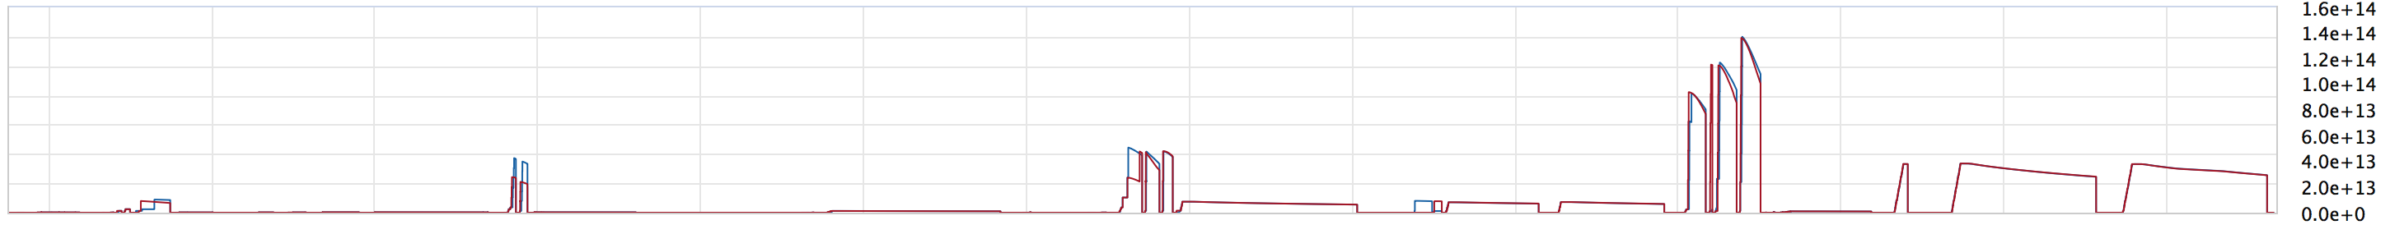
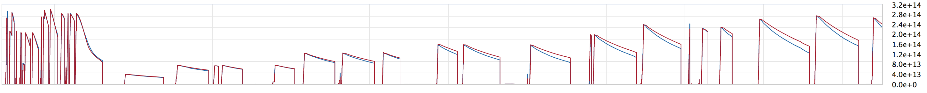
Re-cap of intensity ramp-up 2018
Intensity steps (~number of bunches):
All high-energy beam dumps carefully checked and documented in 8 checklists on EDMS
Establish cycle
MP dominated
Intensity dominated
3/12 - 75 - 300 - 600 - 900 - 1200 - 1800 - 2400 – 2550
17.04.
19.04.
75 b
21.04.
315 b / 339 b
3/12 b
scrubbing
2175 / 2319 / 2460 b
27.04.
28.04.
1227 b
30.04.
1887 b
02.05.
04.05.
25.04.
603 b
987 b

Slide 5
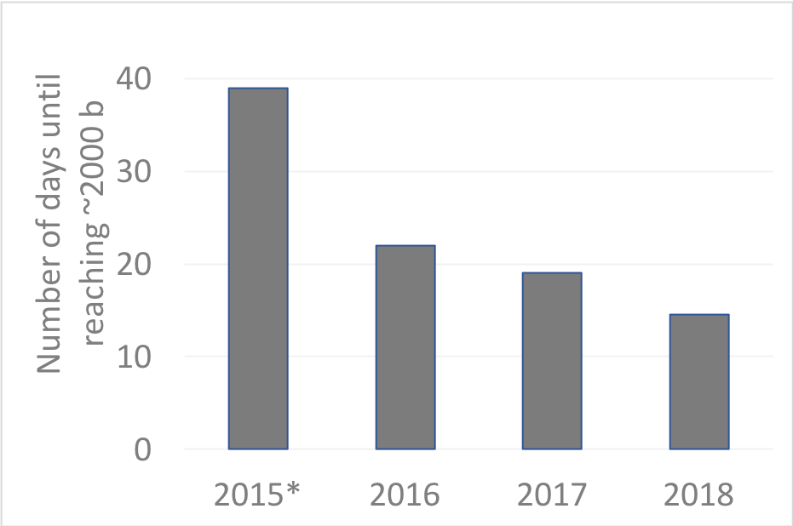
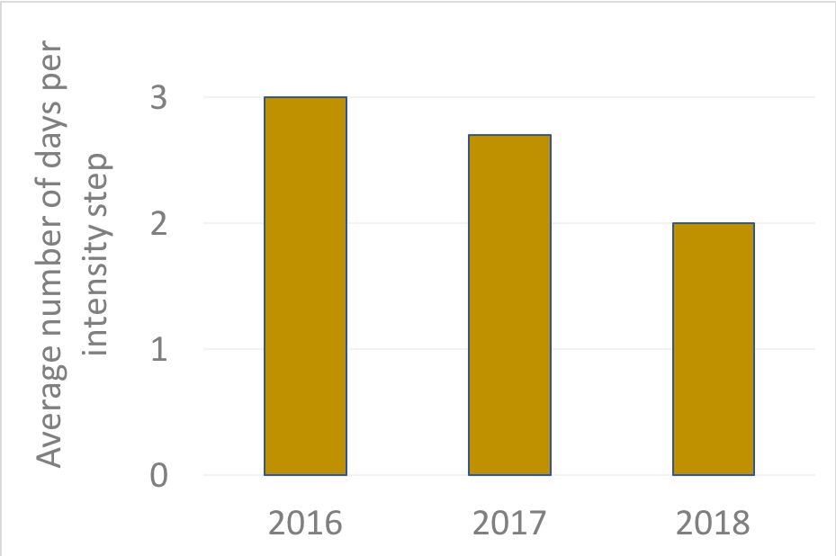
Durations of intensity ramp-ups in Run 2
2015: commissioning year
    Two ramp-ups (50 ns & 25 ns operation); intensity increase until end of proton run
2016/17/18: 7 steps to reach 2000+ bunches
    2016 → 2018: reduction of ramp-up duration by 35%
    The 14.5 days achieved in 2018 are close to the theoretical minimum
44 intensity-ramp-up and scrubbing checklists issued during Run 2
*2015: up to 1825 b (25 ns)
See D. Wollmann, Evian’19

Slide 6
Issues discovered during intensity ramp-ups
Establish cycle/beam commissioning:
  PM/XPOC: data missing or misaligned
  BIS timing mis-aligned
  Direct dump BLMs (IR6) – connected to LBDS of wrong beam
MP dominated:
  Orbit feedback: offsets due to BPM calibrations
  UFO – 16L2 events causing beam dumps & quenches
  Abort Gap cleaning not properly functioning
  Screen unintentionally left in dumpline
Intensity dominated:
  TDI – vacuum issues and heating
  Insufficient cooling of a collimator
  Instabilities
Random occurrence:
  QPS_OK flickering
  MKD and MKB erratics
  Un-physical BLM readings in PM
For full list: see D. Wollmann, Evian’19 and checklists for intensity ramp-up

Slide 7
Proposal for intensity ramp-up 2022
Continue successful strategy applied during Run 2
Stepwise increase of stored energy and number of injected bunches:
Use 3/12 - 75 - 300 - 600 - 900 - 1200 - 1800 - 2400 – 2700 bunches*
For each intensity step: monitor behavior during at least 3 fills and 20h stable beams, and validate via checklist
Insertion of TOTEM/CT-PPS, AFP, ALFA roman pots to agreed settings after >2h in second fill and full third fill at each intensity step
Keep bunch intensity to ~1.15e11 ppb during intensity ramp-up. Then, gently increase bunch intensity (e.g., in steps of 0.05e11) up to 1.4e11 ppb, depending on machine behaviour and available bunch intensity
Use of beta* levelling already during the intensity ramp-up
Scrubbing: Verify heating of critical elements before going to next intensity step. Intermediate scrubbing checklist after ~300 bunches (RF power, heating, … ), final checklist at the end of scrubbing
During the Run: issue Cruise Checklist every ~8 weeks (e.g., between TS) to check behaviour of MP systems
Establish cycle
MP dominated
Intensity dominated
*exact number of bunches will depend on agreed filling schemes and beams

Slide 8
Ramp-up scenarios after stops of nominal operation
Stop >48 h with massive HW + SW interventions | Stop >48 h without massive HW + SW interventions | Triplet events with non-reversible position changes**
One fill with either pilot bunches or max. 2-3 nominal bunches into SB (cycle revalidation, etc.) | One fill with 2-3 nominal bunches into SB (cycle revalidation, etc.) | One fill with 2-3 nominal bunches into SB (re-adjust orbit in IP)
One fill with ~50 bunches and about 1-2 hours of stable beams
One fill with 600 bunches and min. 2 hours of stable beams* | One fill with 600 bunches and min. 2 hours of stable beams*
If > 2000 bunches have been reached, one fill with about half max. number of bunches and about 5 hours of stable beams
Back to pre-stop intensities | Back to pre-stop intensities | Back to pre-stop intensity
In total, 3-4 fills for ramp-up | In total, 2 fills for ramp-up | In total, 1 fill for ramp-up
*known intensity step to disentangle wrong settings, de-conditioning, etc. from intensity dominated effects at full intensity
**E.g. triplet quench, warm up of triplet region, cryo stop in triplet region, … Note: Fixed displays are available for WPS, pressure and thermal shield T covering ~1 week history, which should be used as indicators.
As approved in the LMC, 2018-03-28. No modifications proposed.

Slide 9
Conclusions and outlook
Intensity ramp-ups have been essential to identify and mitigate issues before physics production
  Ramp-up duration reduced by 35% from 2016 to 2018, indicating reduced number of issues
  Checklists during intensity ramp-up and scrubbing have proven to be an important and useful tool to analyze and document the correct functionality and performance of the machine protection systems
Proposal for 2022 intensity ramp-up
  Based on successful strategy applied in Run 2
  For each of the 8 intensity steps: 3 fills, >20h in stable beams, to be concluded by checklist
  Keep bunch intensity at ~1.15e11 during ramp-up. Then, gradual increase of bunch intensity (e.g. steps of ~0.05e11) to 1.4e11
Checklist tasks to be reviewed for Run 3 (before FEB 2022)
  System experts will be contacted for their input
  New web tool under preparation to replace the currently used shared spreadsheets

Slide 10
Thank you very much for your attention!

Slide 11
Issues discovered during intensity ramp-ups
Post Mortem / XPOC - missing data, data mis-aligned, missing files & synchronization, issues PM event builder stuck
BIS timing mis-alignment
Unbalanced rupture of the QPS internal quench loop
Setup Beam Flag – glitches
Beam Loss Monitors – communication issues BLM-SIS, un-physical readings in post-mortem data
Direct BLMs (IP6) – connected to LBDS of wrong beam
Collimators & Roman Pots – LVDT position drifts, LVDT/resolver faults
Orbit Feedback – orbit jumps at optics changes, zeroing of reference, offsets due to BPM calibrations
Dump Line – screen remaining in dump line, BTVDD images missing
MKD and MKB erratics
MKI – flashovers, MKI kicking last bunch of circulating beam
Abort Gap Cleaning – in-sufficient cleaning, not functioning due to software issues / wrong parameters
Radio Frequency – wrong low-level settings
QPS_OK flickering
Beam current change monitor – false dumps
BIS – too much attenuation of signal in fibre (3 dumps)
Earth fault in circuits (RB, RCS)
QPS – single event upsets → dumps & communication issues
UFO – 16L2 events causing beam dumps & quenches
Collimators – un-physical temperature readings
Injection – high losses and satellites leading to beam dumps
TDI – vacuum issues and heating (2016)
Insufficient cooling of a collimator
Decrease of bunch length < 1ns in cycle
Instabilities
Establish cycle/beam commissioning
MP dominated
Intensity dominated
Random
See checklists and D. Wollmann, Evian’19

