Slide 1
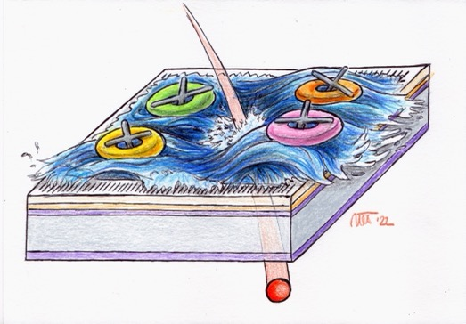
Spatial and temporal resolution of FBK RSD2 sensors
N. Cartiglia
UFSD group
Image courtesy of M. Tornago

Slide 2
TREDI and resistive silicon detectors
Resistive silicon detectors (aka AC-LGAD) were presented at TREDI 2015
At TREDI 2020, we presented the first results on the properties of silicon sensors with resistive read-out
Now, at TREDI 2022, we present the results obtained with the second FBK RSD production, RSD2.
AC-RSD building blocks:
Electrodes
Physicist
AC coupling dielectric
Resistive n++ electrode (sheet resistance)
gain implant
p++ electrode

Slide 3
Digress: nomenclature
metal
oxide
Gain implant
p bulk
p++
LGAD (also UFSD)
RSD (also AC-LGAD),
==> AC-RSD
FBK RSD1, RSD2 are AC-RSDs
New design: DC – RSD
(see L. Menzio, Thursday afternoon)

Slide 4




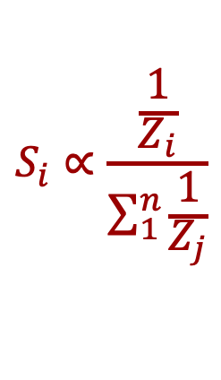




Aide memoire: RSD principle of operation
The signal sees several impedances Z_{i} in parallel, and it is split according to Ohm’s law.
$$S_{i}∝\frac{\frac{1}{Z_{i}}}{\sum_{1}^{n}{\frac{1}{Z_{j}}}}$$
Each pad gets a share S_{i} of the total signal, exactly as in a current divider
1
2
$$Z_{1}$$
$$Z_{3}$$
$$Z_{4}$$
$$Z_{1}$$
$$Z_{2}$$
$$Z_{2}$$
3
$$Z_{3}$$
$$Z_{4}$$
4

Slide 5
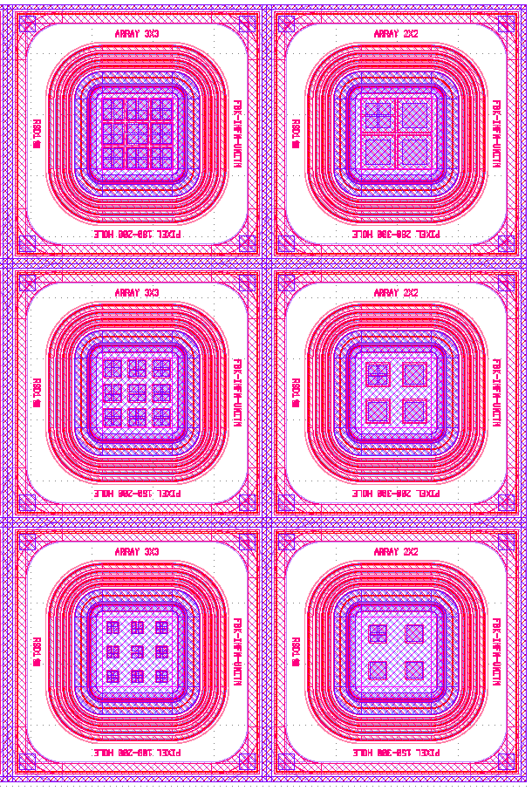
FBK RSD1 lessons learnt
Signal sharing
  allows reaching excellent spatial resolutions,
  does not spoil the temporal resolution proper of the LGAD technology.
Hits on the metal generate (mostly) a signal only in that pad
  ==> no signal sharing if the metal pad is large, the resolution is spoiled
Sharing to many pads leads to signals so small that are not considered in the reconstruction
  ==> reconstruction is biased
Sharing should involve a “fixed” number of pads
  ==> otherwise non-uniform response and performance
Floating pads do not contribute,
==> be aware during testing, you can get to the wrong conclusions
Example of RSD1 structures

Slide 6
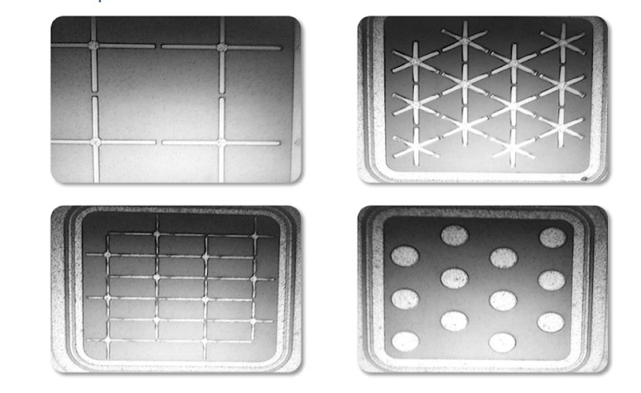
The FBK RSD2 production
Focus of this talk
Goals for RSD2:
Uniform and controlled signal sharing
Optimize the fabrication parameters (resistivity, oxide, gain layer)
Reduce as much as possible the metal area of the pads
Design the electrodes to contain the signal
Split the signal into a well defined set of pads
3 electrodes,
snowflakes
4 electrodes, crosses
2 electrodes
pois
Details on RSD2:
M. Mandurrino, “RSD2, the new production of AC-LGADs at FBK”, 39th RD50,
F. Siviero, “First experimental results of the spatial resolution of RSD pad arrays …” VCI2022

Slide 7
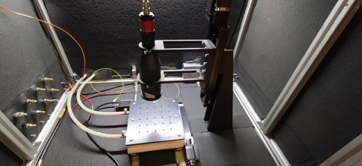
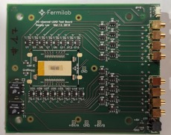
Experimental set-up
The Particulars TCT laser setup has been used:
  IR laser generates a signal in the RSD,
  simulating the passage of a MIP
  laser spot size ~ 8 μm
  Laser temporal precision: ~ 8 ps
  movable x-y stage provides reference positions of the laser shots, precision: σ _{Laser}~ 2 μm
All pads are read out with an oscilloscope
We used a 16-ch fast analog board, developed at FNAL, with an RMS noise ~ 2 mV.
Minimum signal level ~ 8 mV

Slide 8
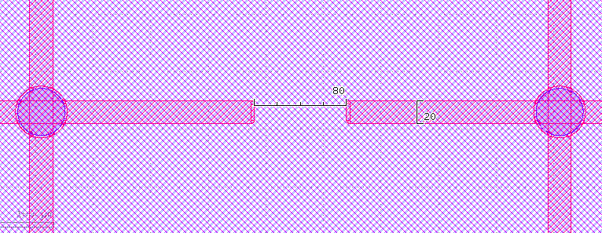
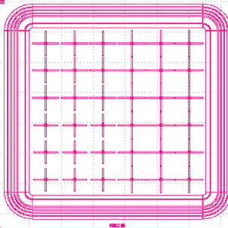
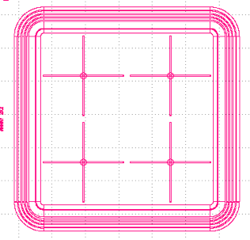
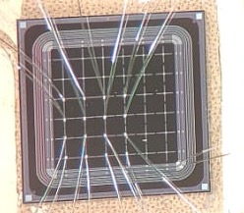
RSD2 sensors with 4 electrodes
In this study, the perfomances of sensors with electrodes shaped as crosses are presented.
Two different pitches: 450 μm and 1300 μm
Electrode width: 20 μm
Gap: 80 μm (pitch = 450 μm) and 100 μm (pitch = 1300 μm)
20
80, 100
Pitch = 0.45 mm
1
3
1
3
2
4
2
4
Pitch = 0.45 mm
Pitch = 1.3 mm

Slide 9
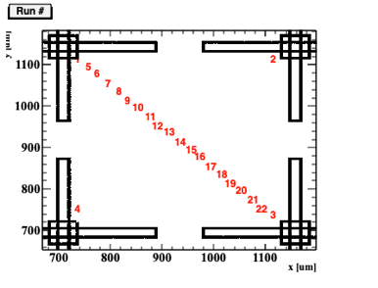
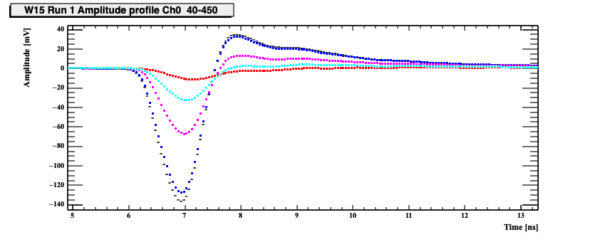
Signal shape and propagation – 450 μm pitch
Read-out pad
The effects of propagation on the signal shape have been studied by shooting laser signals along the diagonal, and measuring the signals seen in a given read-out pad
The signal is very similar to that of a standard LGAD when the hit is near the pad.
The signal decreases in amplitude and it is shifted in time as the hit position is moved away

Slide 10
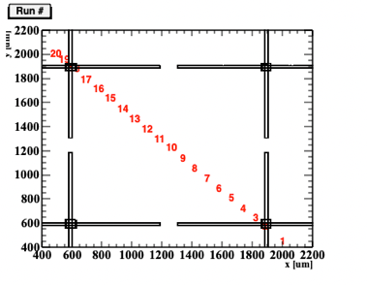
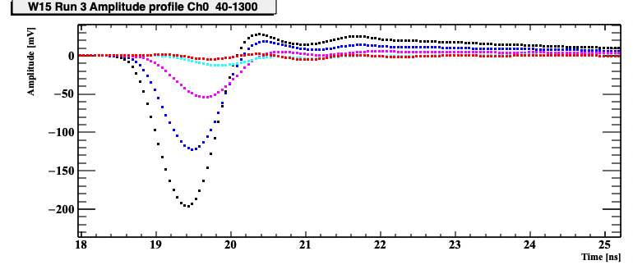
Signal shape and propagation – 1300 μm pitch
The overshoot is smaller in the 1300 μm pitch, as the RC is longer (the capacitance is larger)
When the hit is at the opposite corner of the square, the signal is barely visible ==> distortion in the reconstruction
Read-out pad
The signals measured in sensors with pitch either 450 μm or 1300 μm are very similar
The major difference is in the overshoot

Slide 11
Signal attenuation in 1300 μm pitch: 2 different sheet resistances
How does the sheet resistance influence signal attenuation & sharing?
Signal area vs distance for two RSDs with different sheet resistance:
Signal amplitude vs distance for two RSDs with different sheet resistance:
Red = Nomina sheet resistance
Blue = 25% of nominal sheet resistance
Red = Nomina sheet resistance
Blue = 25% of nominal sheet resistance
No significant difference in signal attenuation.
As expected, the sheet resistance does not influence signal sharing
On the more resistive sheet, the signal becomes smaller and wider with distance, so the amplitude decreases more rapidly.

Slide 12
Signal amplitude vs distance for 450 μm and 1300 μm pitch
How signal sharing is affected by the size of the pixel?
Read-out pad
For the two geometries, compare the signal attenuation seen while shooting along the diagonal.
1300 μm
Read-out pad
450 μm
The two pixel sketches are to scale.

Slide 13
Signal attenuation vs distance for 450 μm and 1300 μm pitch
For equal electrode design, sharing is identical, regardless of the pitch size
The absolute distance (450 μm vs 1300 μm) does not matter in the attenuation
Red = 1300 micron pitch
Blue = 450 micron pitch
Red = 1300 micron pitch
Blue = 450 micron pitch
Example: a pad sees 10% of the signal when the hit is about 1 pitch away along the diagonal
The curves “amplitude vs distance” for the two pitches are almost identical if the distance is expressed in unit of pitch
Note: the signal is almost contained within a pixel, even if they have very different sizes ==> the cross geometry behaves as envisioned.

Slide 14
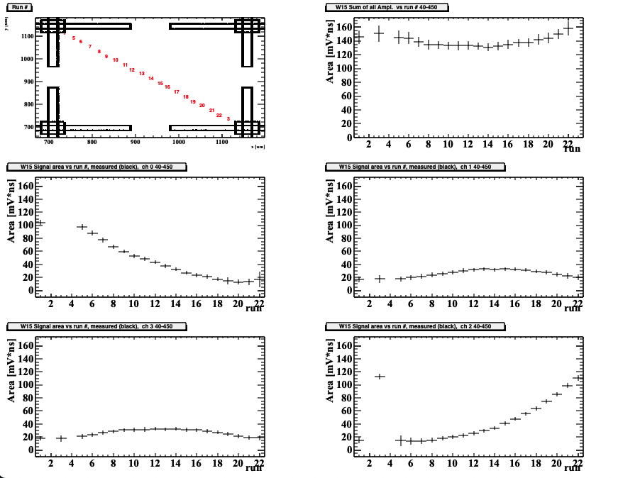
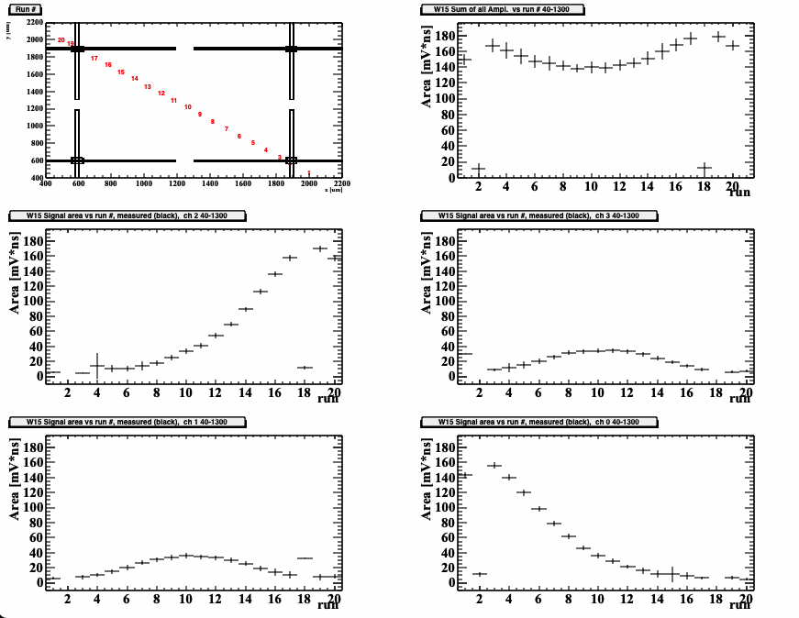
Signal sharing among the 4 pads vs run #
450 μm pitch
1300 μm pitch
0
1
0
1
2
3
3
2
0
1
0
1
2
3
2
3
This is the complete signal splits for signals shot along the diagonals

Slide 15
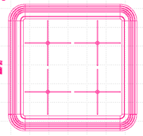
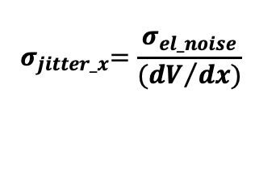
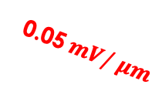
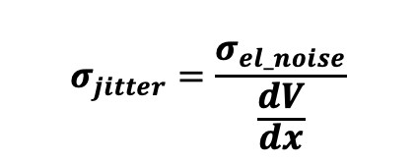
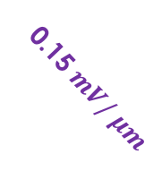


Position resolution
The main component of the position resolution
is the position jitter, defined as:
$$σ_{jitter}=\frac{σ_{el_noise}}{\frac{dV}{dx}}$$
Imagine a system with a single read-out pad where a hit generates:
A signal of 100 mV when shot near a pad
A signal of 0 mV when shot at the opposite corner
Noise – 2 mV (as in our lab)
Read-out pad
100 mV
0 mV
In this simplified system, the signal decreases by:
Pitch 1300 μm: 0.05 mV/μm
Pitch 450 μm: 0.15 mV/μm
100
$$σ_{el_noise}$$
Amplitude [mV]
0.05$mV/ μm$
$$σ_{jitter_x}$$
50
0.15 $mV/ μm$
$${ σ}_{jitter_x}=\frac{σ_{el_noise}}{{(dV}/{dx)}}$$
So, the jitter is:
Pitch 1300 μm: 2 mV/(0.05 mV/μm) = 40 μm
Pitch 450 μm: 2 mV/(0.15 mV/μm) = 14 μm
pitch: 450 μm
inter-pad: 1300 μm
0
0
500 1000 1500
distance [μm]
Obviously the real reconstruction is more complex, 4 pads are contributing

Slide 16
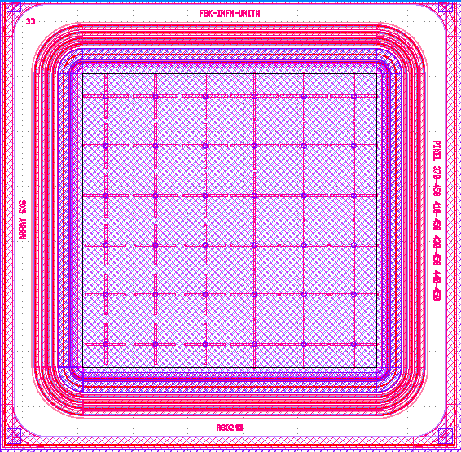
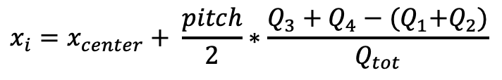
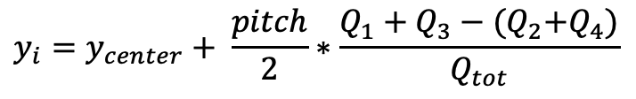
Position reconstruction
4 pads are readout, all others connected to gnd
Reconstruction method via charge imbalance (aka charge-weighted position centroid):
$$x_{i}=x_{center}+ \frac{pitch}{2}∗\frac{Q_{3}+Q_{4}−{(Q}_{1}+Q_{2})}{Q_{tot}}$$
1
3
$$y_{i}=y_{center}+ \frac{pitch}{2}∗\frac{Q_{1}+Q_{3}−{(Q}_{2}+Q_{4})}{Q_{tot}}$$
2
4
This is the simplest alghoritms for position reconstruction.

Slide 17
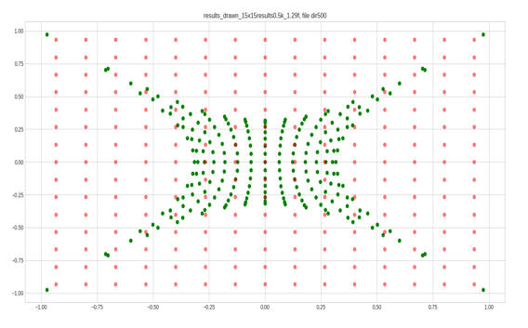
Simulation results
Shoot in a grid of points, and see where the position is reconstructed:
Red: points where the signals are injected
Green: reconstructed points
The reconstructed points (in green) show a distortion effect called “pincuschion”
(very common in other resistive surfaces)

Slide 18
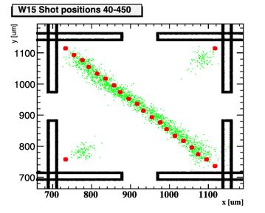
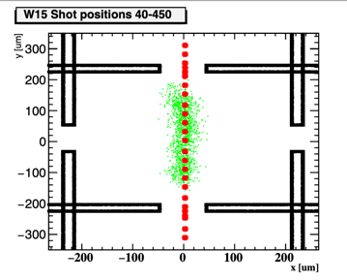
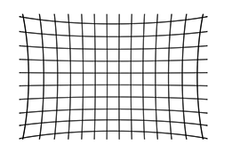
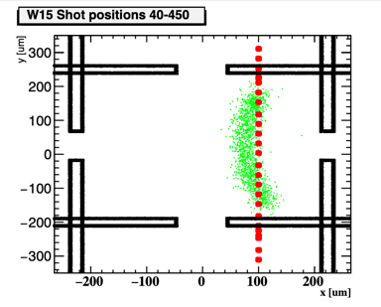
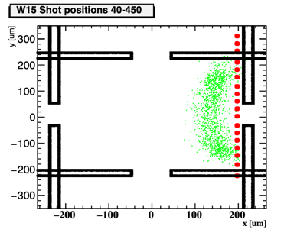
Reconstruction results: 450 μm pitch
Laser position red, reconstructed position green
In the geometry with crosses the “pincuschion” distortion is present, but not very pronounced
The points are “compressed” towards the center.
It is possible to correct this distortion, either with an analytic law or a map.

Slide 19
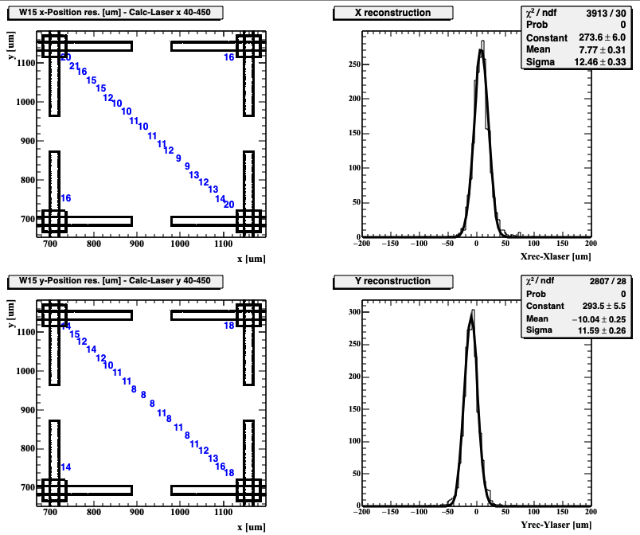
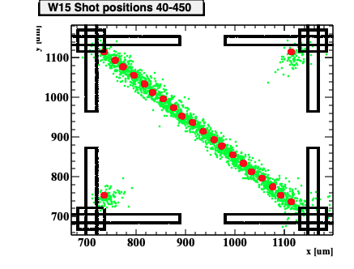
Position resolution for 450 μm pitch, gain = 10
Resolution at various positions
Resolution at all positions
After correcting for the distortion, the position resolution is about 13 μm
(gain ~10)
σ_{x} ~ 13 μm
σ_{y} ~ 12 μm
Laser position red, reconstructed position green

Slide 20
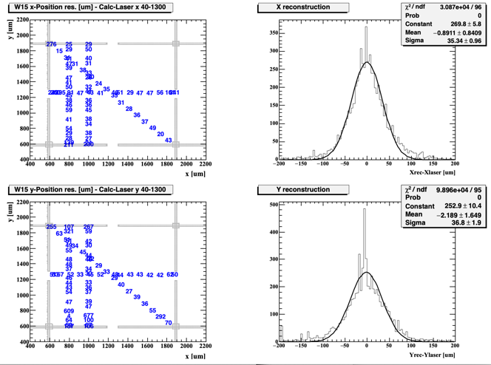
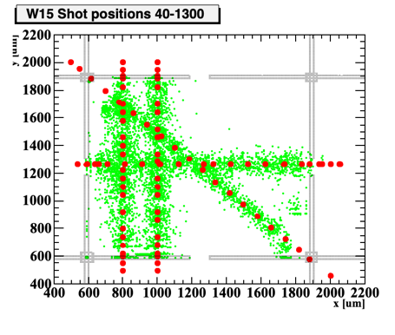
Position resolution for 1300 μm pitch, gain = 10
Resolution at various positions
Resolution at all positions
After correcting for the distortion, the position resolution is about 40 μm
(gain ~10)
σ_{x} ~ 36 μm
σ_{y} ~ 37 μm
Laser position red, reconstructed position green

Slide 21
Position resolution vs gain or pitch
The position resolution is a strong function of the signal amplitude, reaching about σ_{x} ~ 20 μm for a gain ~14
For equal gain, the position resolution improves as 1/pitch
Note:
σ_{x} follows quite well the behaviour 1/(dV/dx) (equivalent to 1/gain or 1/pitch)
as predicted by the jitter formula

Slide 22
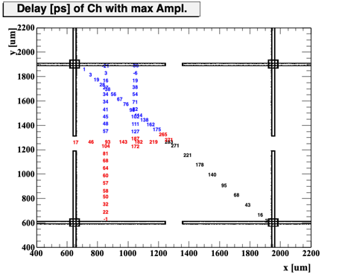

Signal delay
The signal delay increases with distance, however, given the shape of the electrodes, the determination of ”distance” it is not straightforward: the vertex? the closest metal?
Along the diagonal, the delay for this specific structure is about 0.3 ps/ μm
  ==> the delay is the same for 450 μm and 1300 μm pitch
  ==> the delay increases in wafer with a higher sheet resistance
0.3 ps/μm
The time of each pad i is defined as:
$$t_{i}^{True}= t_{i}^{Meas}−delay$$
Using the laser, a delay map has been created
Signal delay of the channel with the maximum amplitude for different hit positions

Slide 23

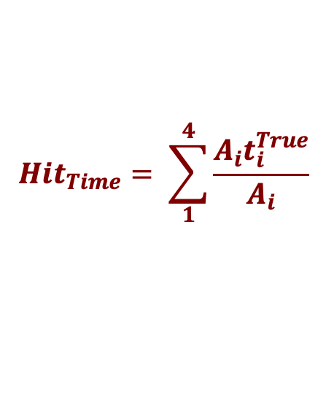
Hit time
The time of the hit can be defined in several ways. For examples:
Amplitude-weighted
(leads to uniform precision on the pixel surface):
$${Hit}_{Time}= \sum_{1}^{4}{\frac{{A_{i}t}_{i}^{True}}{A_{i}}}$$
2) Time of the channel with the maximum amplitude:
(works best when one amplitude is much larger than the other 3, not uniform on the pixel surface)
Amplitude weighted temporal resolution (jitter component) vs gain
(laser contribution not subtracted)
$${Hit}_{Time}=t_{ChMax}^{True}$$
The jitter is quite good, similar to that of an LGAD with equivalent gain

Slide 24
Conclusions
The FBK – AC-RSD2 production has been designed to:
Have uniform signal sharing on the pixel surface
Limit sharing to a well defined set of electrodes
Electrodes shaped as crosses are very effective in reaching both goals
Sharing happens on the whole pixel surface
The signal is mostly contained within 4 electrodes
In our studies, we reached a spatial resolution about 3% of the pitch at gain = 10
Pitch = 450 μm ==> σ_{x} ~ 13 μm; σ_{x}/pitch ~ 3%
Pitch = 1300 μm ==> σ_{x} ~ 37 μm; σ_{x}/pitch ~ 3%
Spatial resolution depends upon ~ 1/gain, ~ 1/pitch, and ~noise
Temporal resolution similar to LGAD with equivalent gain

Slide 25
Acknowledgement
We kindly acknowledge the following funding agencies, collaborations:
RD50 collaboration
INFN - Gruppo V, RSD projects
INFN – FBK agreement on sensor production (convenzione INFN-FBK)
Dipartimenti di Eccellenza, Univ. of Torino (ex L. 232/2016, art. 1, cc. 314, 337)
Ministero della Ricerca, Italia , PRIN 2017, progetto 2017L2XKTJ – 4DinSiDe
Ministero della Ricerca, Italia, FARE, R165xr8frt_fare

