Slide 1
Task 2.1 Optics and layout – 2021-2022
R. De Maria

Slide 2
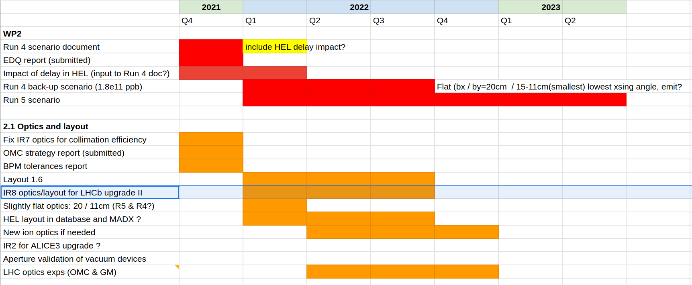
From Rogelio
ramp &squeeze for Run 4 scenario.
Additional topic. To keep in mind for the future, potential limitation of 4.5K MQML (S. La Naour)

Slide 3
Other topics:
Study ramp and squeeze for Run 4 scenario. Isolated optics exists.
Next steps:
Complete and validate feasibility of ramp and squeeze that pass through the proposed point
Useful for Run 5 scenario as well
[4 weeks]

Slide 4
IR7
It is possible to approach HLLHCV1.3 optics but there is no clear specifications on IR7 optics requirements.
Next steps:
1) Either redo new 1.3-like optics for 1.5 [2021-Q4] but need collimation to check anyway [wait WP5].
2) Or wait for a more thorough analysis of IR7 constraints and redo the exercise. [wait WP5 + 1 week]

Slide 5
BPM tolerance report
Document basically ready, thanks to D. Gamba.
Last comments from M. Krupa to be addressed.
I know that our specification is already getting quite voluminous, but I would like to discuss the possibility of extending the specification by two more parameters:
“blind time” in closed orbit mode – some self-calibration techniques might require the BPM acquisition electronics to be “blind” (i.e. no measurements possible) for a given time window (e.g. for the existing DOROS system this is between 40 – 200 ms per each averaged 1-second-long acquisition). For the HL-LHC era, is there any limit on the maximum “blind time” provided that all other requirements can be satisfied?
Bunch-to-bunch leakage – some small part of signal from one bunch could “leak” to the next 25 ns bucket which would of course introduce an error term for bunch-by-bunch measurements with 25 ns spacing. I think it could be good idea to specify how accurate the BPM system should be in 25 ns bunch-by-bunch mode (injection + physics) and 10+ us bunch-by-bunch mode (optics measurements). I naively assume that the 25 ns mode can be less precise than what you need for optics measurements, but please correct me if I’m wrong!
Next step. Update and send to engineering check probably for [2021-Q4].

Slide 6
Layout 1.6
Few modifications in the pipeline such as crab positions are clear.
1) Decision pending on the update of magnetic length and centre of MQXF. I strongly requested to put in version 1.6 to avoid duplicating work later. ECR and TCC requested by P. Fessia. Similar adjustments are probably needed for D1 and D2 as well, but it possible we data is not available.
2) Work in progress for APWL/BTPX (next update beginning in December)
Next steps:
Validate new drawings and Layout DB data [2022-Q2, 2 weeks]
Rematch all relevant optics [2022-Q3, 2 weeks]
Check geometries and apertures (using new tolerances reference) [2022-Q3, 2 weeks]

Slide 7
Optics for IR8 LS4-Run5 upgrade
Activity not yet started.
Next steps:
Needs assessment on additional masks and collimator [wait WP5, WP8]
Rematch/optimize the end points
Connect to the start of levelling
[4 weeks]

Slide 8
Flat optics for Run 5 20/11
Starting point: existing 18/9cm and 18/7.5 optics.
Next steps:
Optimize end point optics
Connect to start of levelling cycle
[4 weeks]

Slide 9
Hel in layout and MAD-X
Markers already exist in the present layout.
Next steps:
Introduce orbit correctors and solenoids
MAD-X beambeam, BBSHAPE=2 (trapezoidal) should be sufficient. Probably some tests will be needed
[3 weeks]

Slide 10
New ion optics
Few low beta* optics are available for old layouts version (IP2: 0.5 cm , IP8:0.5m , 1 m, IP1-5: 0.5)
Next steps:
Rematch/optimize the end points
Connect to the start of levelling
[4 weeks]

Slide 11
Alice 3 upgrade
Very little information. Probably synergies studies with LHCb Run5 upgrade.
Next steps: wait for more mature ideas…

Slide 12
Conclusion
ramp &squeeze for Run 4 scenario.
2022 Q2-Q3 looks very challenging considering how other commitments are taking shape.
Shifting and spreading the activities on a longer time scale will help…

