Slide 1
CAD to GEANT4 conversion
FCC study group, 17-11-2021, Marton Ady

Slide 2
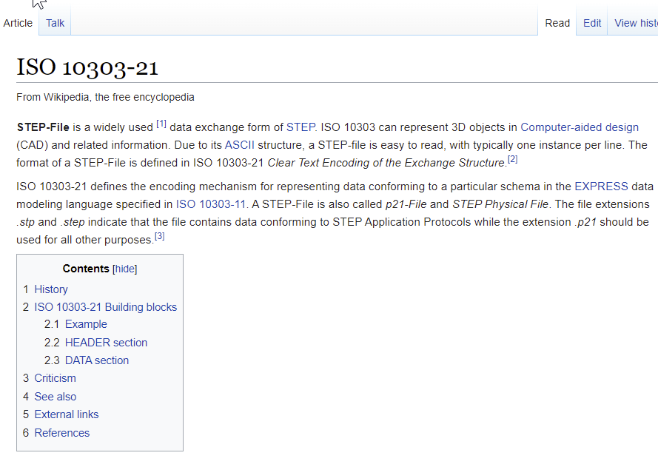
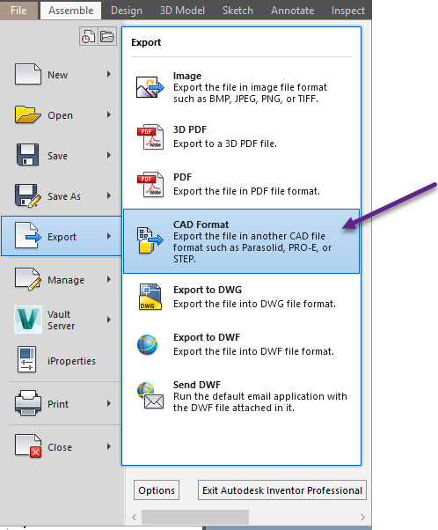
Format overview - STEP
Iso standard
Can be read/written by almost all CAD editors

Slide 3
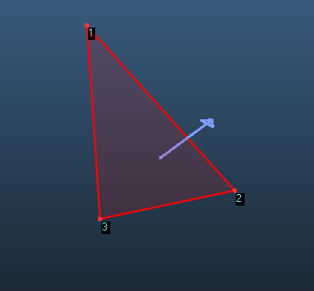
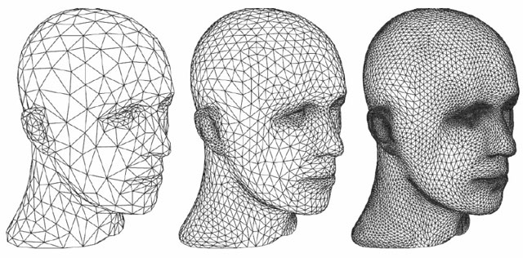
Format overview - STL
Tessellated (triangulated) surface description
Each triangle had 3 vertices, normal is auto-deduced
Can be binary and ASCII
solid name
…
facet normal ni nj nk
outer loop
vertex v1x v1y v1z
vertex v2x v2y v2z
vertex v3x v3y v3z
endloop
endfacet
…
endsolid name

Slide 4
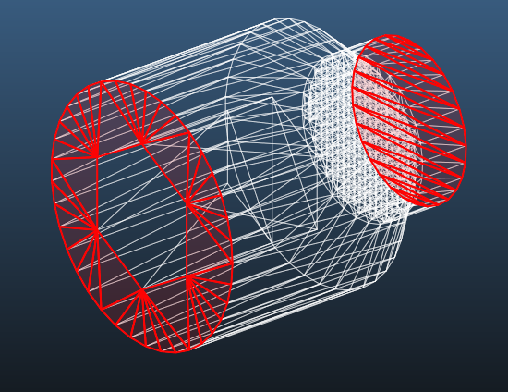
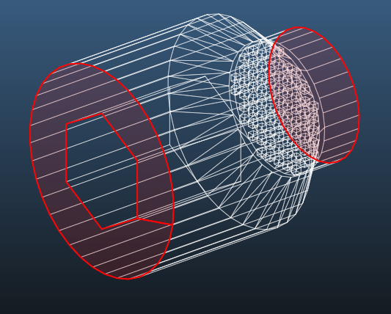
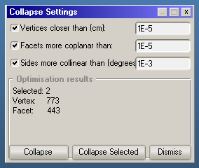
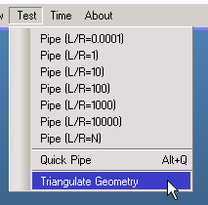
Format overview – MolFlow+ XML
Facets: polygons (N=3 or more)
Adjacent triangles in same plane can be merged
Can triangulate geometry and save as STL again

Slide 5
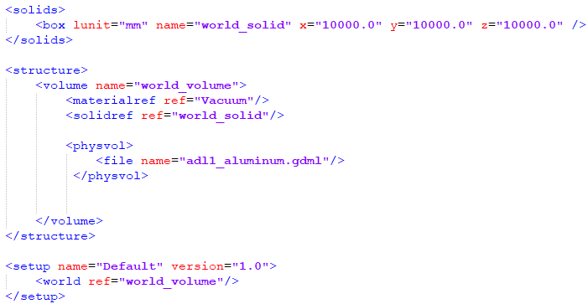
Format overview - GDML
XML-based geometry descriptor language
Nested volumes (Virtual / physical)
Supports Tessellated Solids
top level GDML file referring to physical volume

Slide 6
Format overview – GDML physical volume
<?xml version="1.0" encoding="UTF-8" standalone="no" ?>
<gdml xmlns:xsi="http://www.w3.org/2001/XMLSchema-instance" xsi:noNamespaceSchemaLocation="http://service-spi.web.cern.ch/service-spi/app/releases/GDML/schema/gdml.xsd">
<define>
<position name="adl1_aluminum_v0" unit="mm" x="-18" y="-0.0940756169409" z="-0.895069705831"/>
<position name="adl1_aluminum_v1" unit="mm" x="-18" y="-0.209056926535" z="-1.98904379074"/>
<position name="adl1_aluminum_v2" unit="mm" x="-18" y="0" z="-0.9"/>
<position name="adl1_aluminum_v3" unit="mm" x="-18" y="0" z="-2"/>
<position name="adl1_aluminum_v4" unit="mm" x="-18" y="0.0940756169409" z="-0.895069705831"/>
[...]
</define>
<solids>
<tessellated aunit="deg" lunit="mm" name="adl1_aluminum-SOL">
<triangular vertex1="adl1_aluminum_v0" vertex2="adl1_aluminum_v1" vertex3="adl1_aluminum_v2"/>
<triangular vertex1="adl1_aluminum_v2" vertex2="adl1_aluminum_v1" vertex3="adl1_aluminum_v3"/>
<triangular vertex1="adl1_aluminum_v2" vertex2="adl1_aluminum_v3" vertex3="adl1_aluminum_v4"/>
<triangular vertex1="adl1_aluminum_v4" vertex2="adl1_aluminum_v3" vertex3="adl1_aluminum_v5"/>
<triangular vertex1="adl1_aluminum_v4" vertex2="adl1_aluminum_v5" vertex3="adl1_aluminum_v6"/>
[...]
</tessellated>
</solids>
<structure>
<volume name="adl1_aluminum">
<materialref ref="Aluminum"/>
<solidref ref="adl1_aluminum-SOL"/>
</volume>
</structure>
<setup name="Default" version="1.0">
<world ref="adl1_aluminum"/>
</setup>
</gdml>
Vertices
Triangles

Slide 7
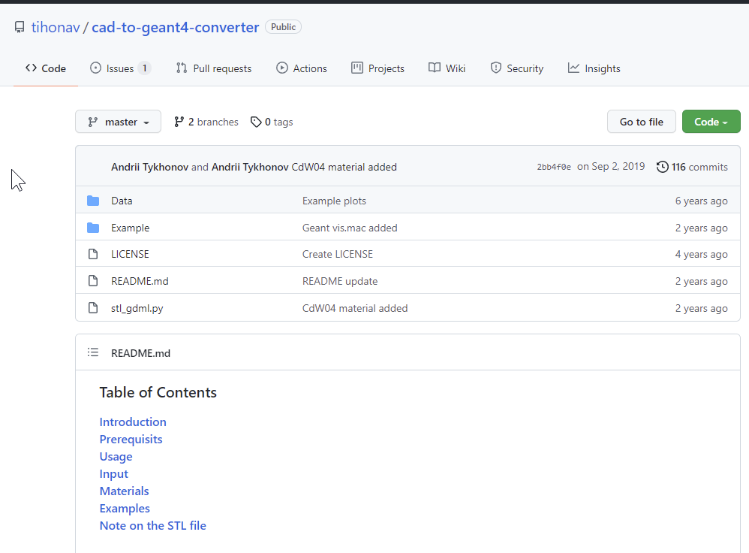
Conversions
STEP to STL: CAD program, for example FreeCAD
MolFlow to STL: MolFlow
STL to GDML: Cad to Geant4 converter by Andrii Tikhonov
https://github.com/tihonav/cad-to-geant4-converter

Slide 8
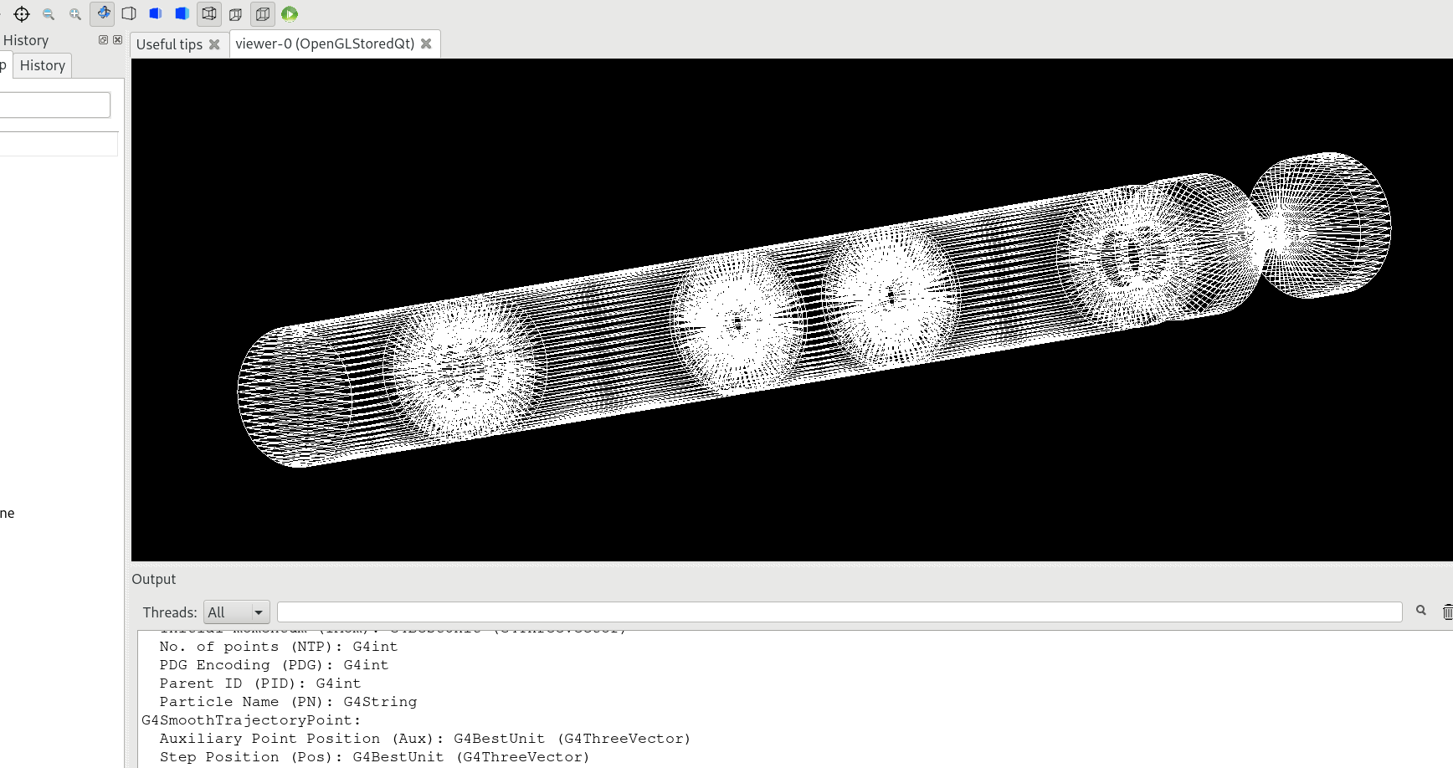
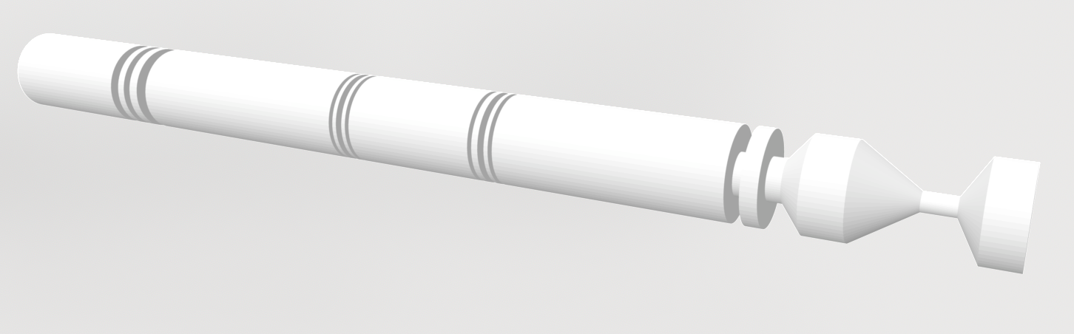
Using CAD to Geant4 converter
python stl_gdml.py result input_geom_1_material.stl ... input_geom_N_material.stl
input_geom_1_material.gdml
result.gdml
…
input_geom_N_material.gdml
Acoustic_delay_line.gdml in GEANT4
Image: Marian Luckhof
Acoustic_delay_line.stl

Slide 9
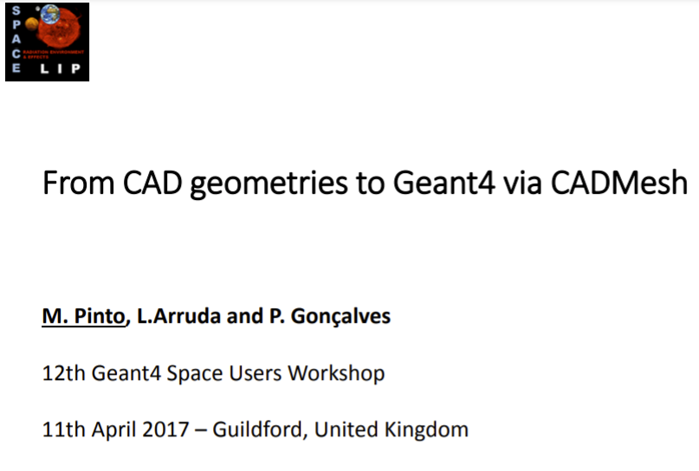
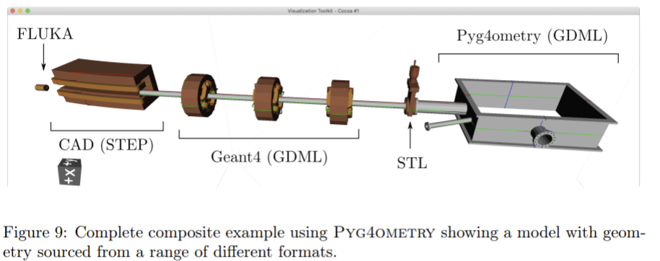
This has been done before
https://indico.esa.int/event/160/contributions/1162/attachments/1096/1298/Geant4_Space_Users_Workshop_MP_final.pdf
https://arxiv.org/pdf/2010.01109.pdf

Slide 10
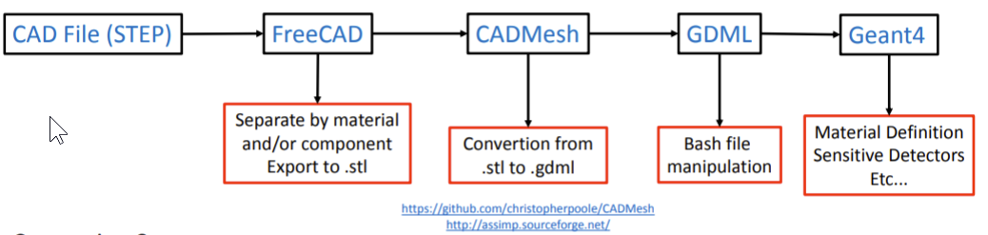
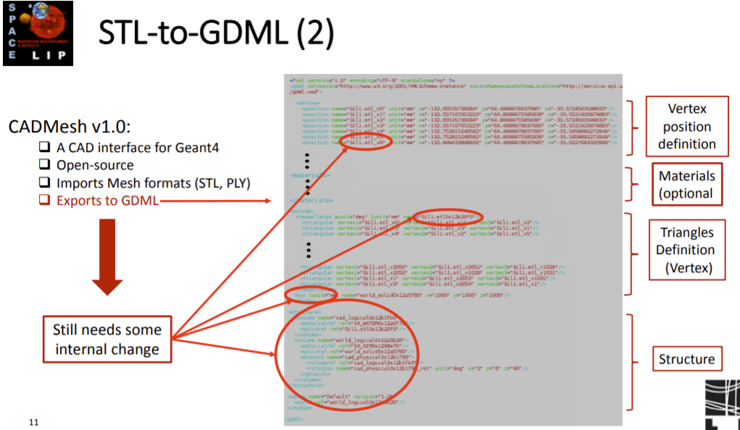
This has been done before

Slide 11
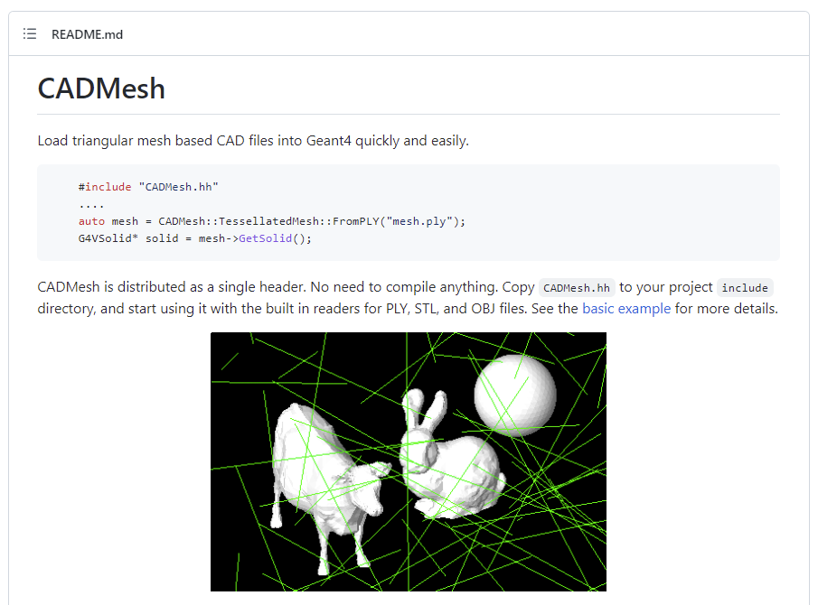
This has been done before
https://github.com/christopherpoole/CADMesh
#include "CADMesh.hh"
....
auto mesh = CADMesh::TessellatedMesh::FromSTL("mesh.stl");
G4VSolid* solid = mesh->GetSolid();

