Slide 1
FCCee options and layout for RF sources
(with new beam parameters)
16th of Nov. 2021
F. Peauger
Acknowledgments: O. Brunner, R. Calaga, S. Gorgi Zadeh, I. Karpov,
K. Watanabe (KEK), M. Diop (SOLEIL), L. Delpech (CEA),
K.Smith, A. Zaltsman (BNL)

Slide 2
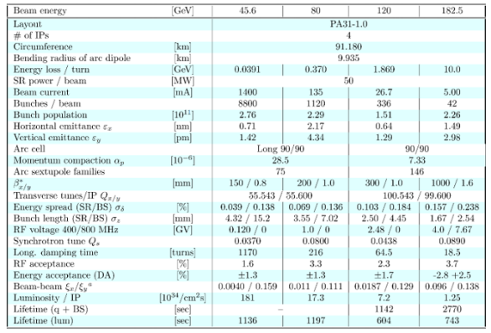
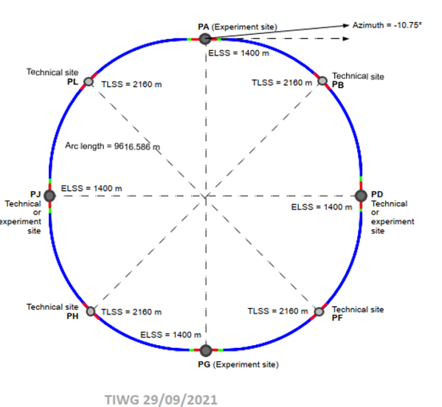
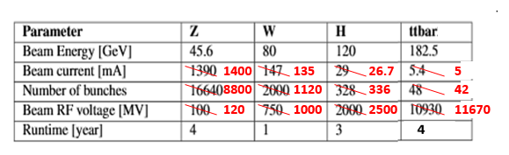

New beam parameters
CDR baseline update:
Point H: Z, W and ZH
  2 x 2.5 GV @ 400 MHz, 4.5 K
  1 x 2.5 GV @ 400 MHz, 4.5 K (booster)
Point L: ttbar
  + 6.7 GV @ 800 MHz, 2 K
  + 9.2 GV @ 800 MHz, 2K (booster)
Beam currents ~ CDR
Increased charge per bunch
Increased voltages for Z, W, ZH (~ + 20%)

Slide 3
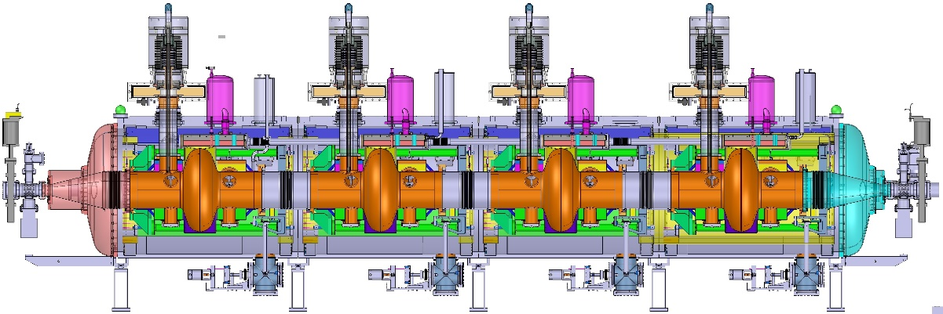
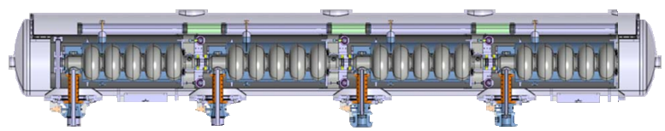
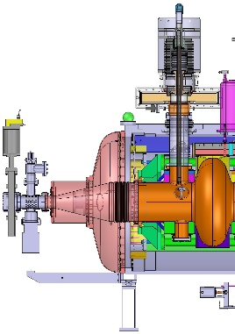
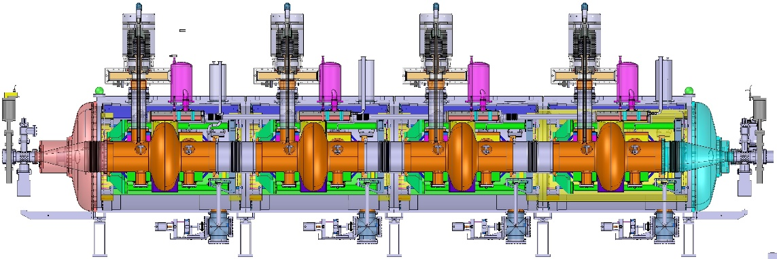
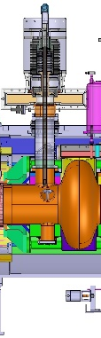

FCC cryomodules (baseline) – Artistic view
Electron (Z energy) and hadron
400 MHz 1-cell acceleration cavity
L = 7.5 m
Electron (ttb energies)
800 MHz 5-cell acceleration cavity
Electron (W & H energies)
400 MHz 4-cell acceleration cavity
L = 11.4 m

Slide 4


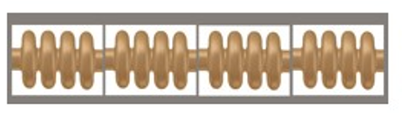
Updated 400 / 800 MHz scenario
26
time (operation years)
Machine
26
78
90
93
68
Booster
40
122
4
31
120
Z machine:
  Eacc: 5.2 → 6 MV/m
  Beam – cavity interaction → to be studied (HOM, instabilities,..)
W machine:
  ~ 5 additional CM + 5 CM (booster)
  Beam – cavity interaction → to be studied (HOM, instabilities,..)
ZH machine:
  ~ 10 additional CM + 10 CM (booster)
  LSS ~ 1.6 km
ttbar:
  ~ identical
  LSS ~ 1.9 km
 | CDR | new baseline (nov. 2021)
bunch pop | 1.70E+11 | 2.76E+11
bunch charge Qb (pC) | 27200 | 44160
bunch length (mm) | 12.1 | 15.2
K (V/pC) | 0.116 | 0.103
I0 (A) | 1.39 | 1.4
P HOM = K . Qb . I0 (W) | 4386 | 6399 (~ +50%)

Slide 5
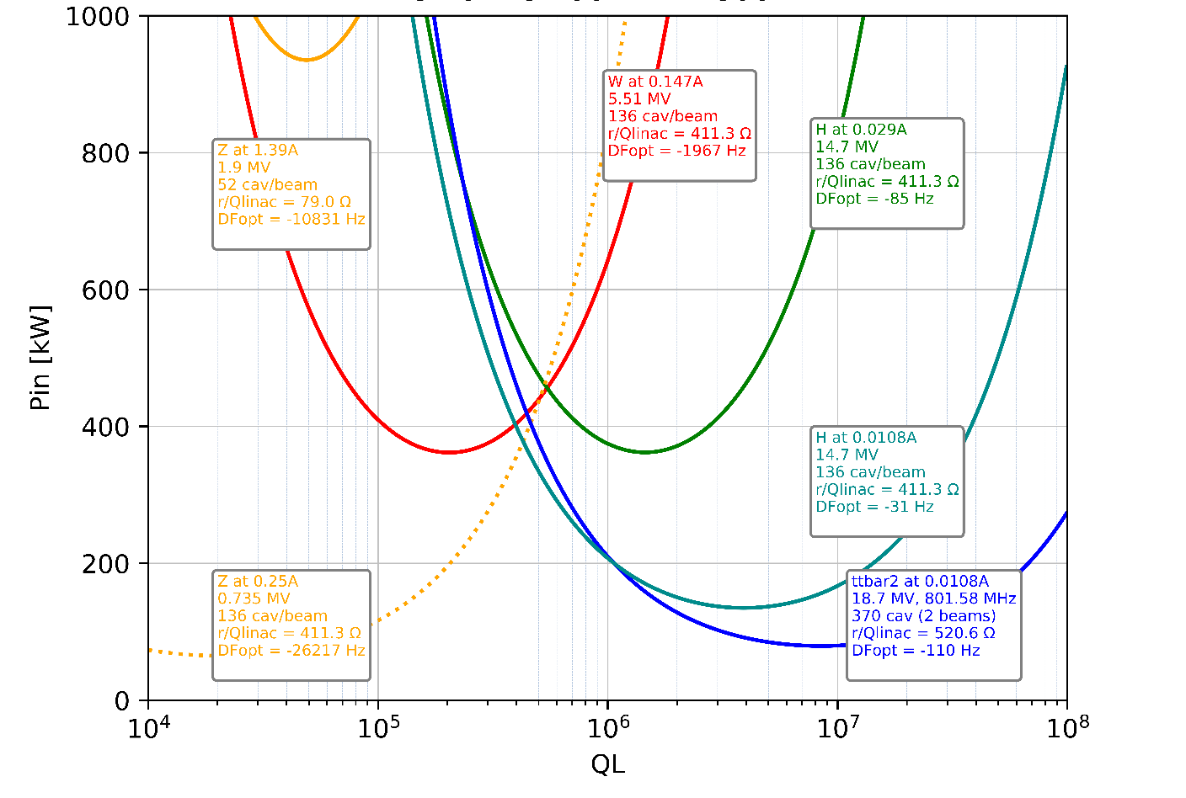
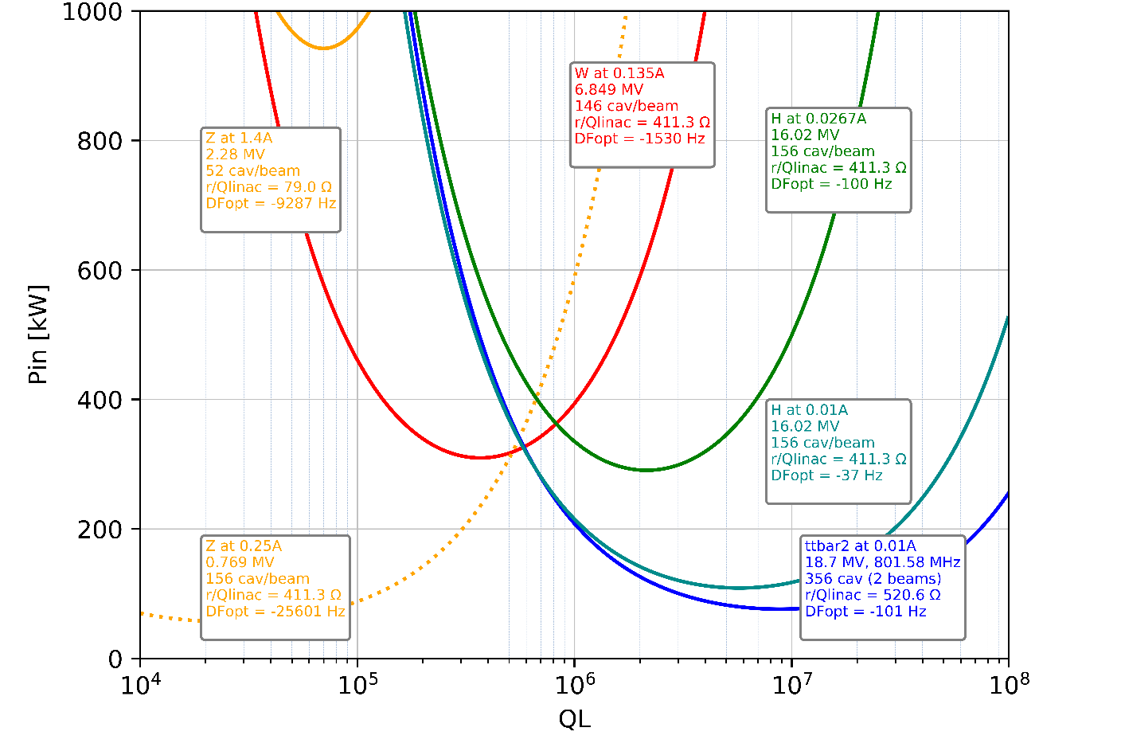
RF power and FPC coupling requirements
400 / 800 MHz CDR option
Energy lost due to SR and synchronous phase kept identical
New beam parameters moves the optimal coupling to higher QL and slightly lower power
Variable coupling needed to minimize RF power consumption

Slide 6
Other considerations (rough estimates)
Point H: (Z, W and ZH)
  RF power: 110 MW → Plug power: ~ 180 MVA
  Air cooling: ~ 5 MW
  Water cooling: ~ 55 MW
  Cryogenic power (@ 4.5 K) (incl. booster)
    Static losses (~ 60 W/CM) → 7 kW @ 4.5 K → 1.55 MW wall plug power
    Dynamic losses (~ 920 W / CM) → 75.4 kW @ 4.5 K → 16.5 MW wall plug power
Point L: ttbar
  + 6.7 GV @ 800 MHz, 2 K (i.e. 60% of total voltage)
  RF power: ~ 66 MW →Plug power: ~ 106 MVA
  Air cooling: ~ 3 MW
  Water cooling: ~ 33 MW
  Cryogenic power (@ 2 K) (incl. booster)
    Static losses (~ 37.5 W/CM) → 8 kW @ 2 K → 5.9 MW wall plug power
    Dynamic losses (~ 260 W / CM) → 26.5 kW @ 2 K → 19.8 MW wall plug power
Very Preliminary
(includes + 10 % for booster)

Slide 7
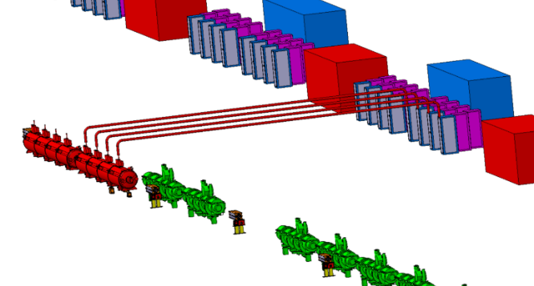
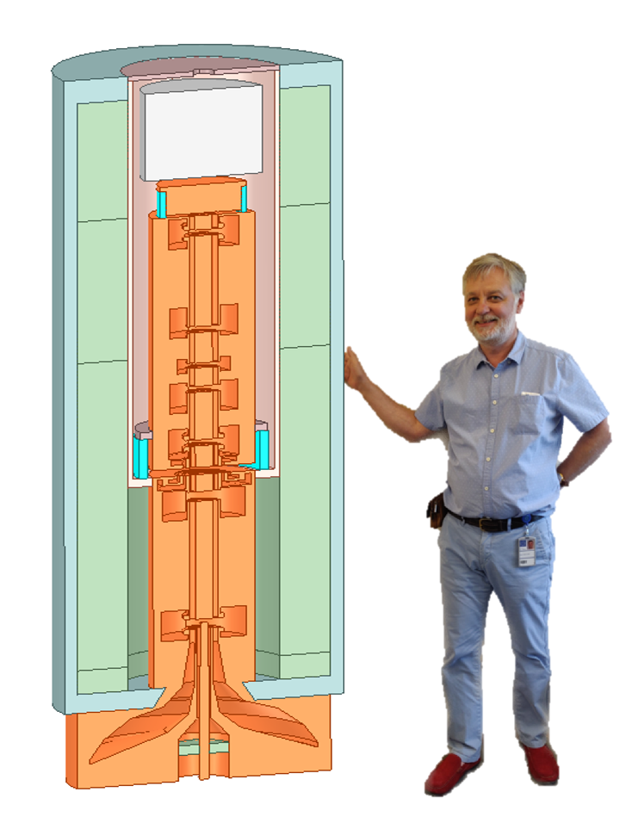
400 MHz RF system 3 D integration for Z
O. Brunner, Fani Valchkova-Georgiev (CERN)
→ based on a “1 klystron per cavity” scheme for the Z
→ RF split by two for W and H
FCC high efficiency TS klystron development at CERN
400MHz, 1.2 MW, η≈80%
(scalable to 600 MHz, 650 kW, η≈80% )

Slide 8
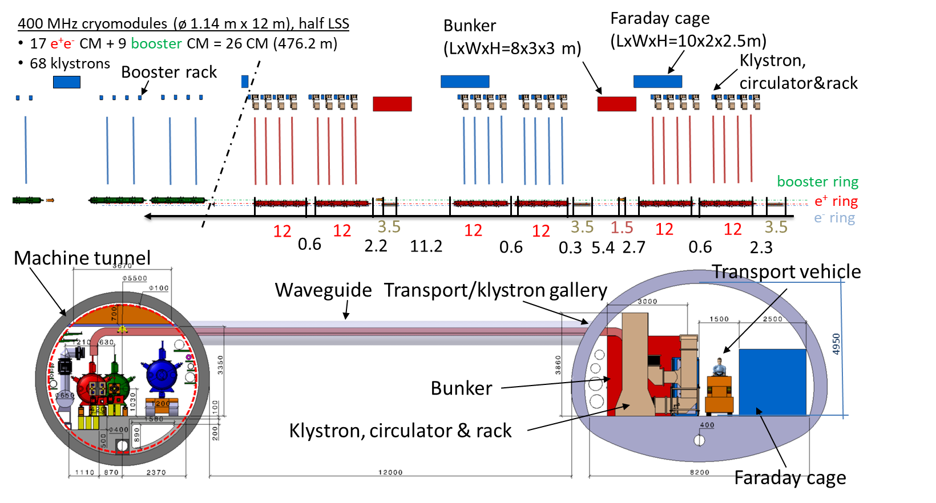
RF Power density (400 MHz)
Surface = 35.5 x 5.6 = 200 m²
RF power = 8 x 1 MW
Power density ~ 40 kW_{RF}/m²
From Fani Valchkova-Georgieva

Slide 9
RF power density
Comparison with other machines

Slide 10
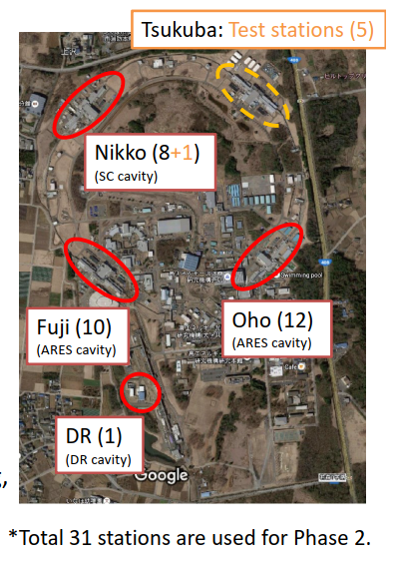
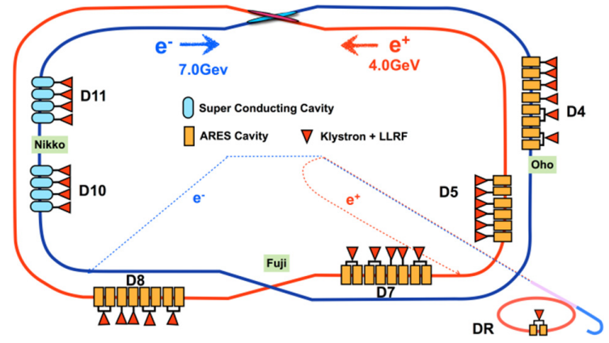
SuperKEKB RF system
508.9 MHz – 700 kW max
K. Watanabe (KEK)

Slide 11
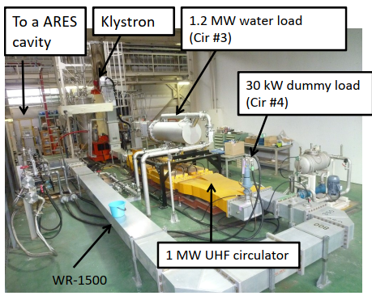
SuperKEKB RF system
508.9 MHz – 700 kW max
K. Watanabe (KEK)
For 1 klystron + HV power supply + RF network:
Surface = 144 m²
RF power = 700 kW
Power density ~ 5 kW_{RF}/m²

Slide 12
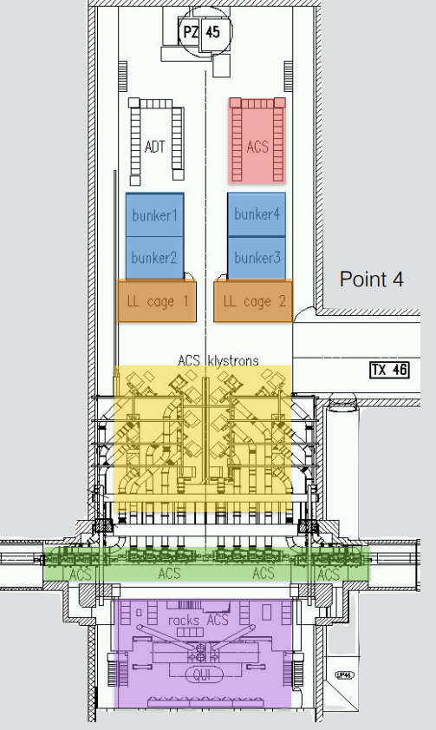
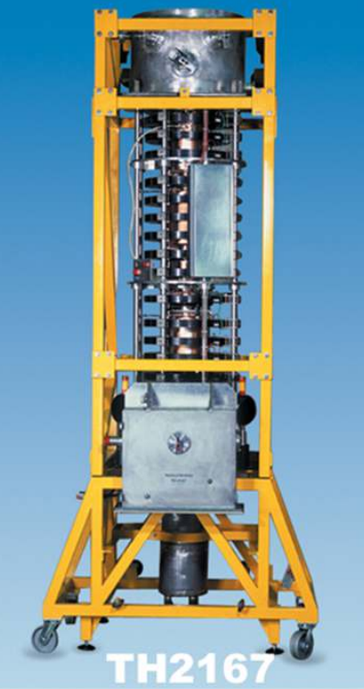
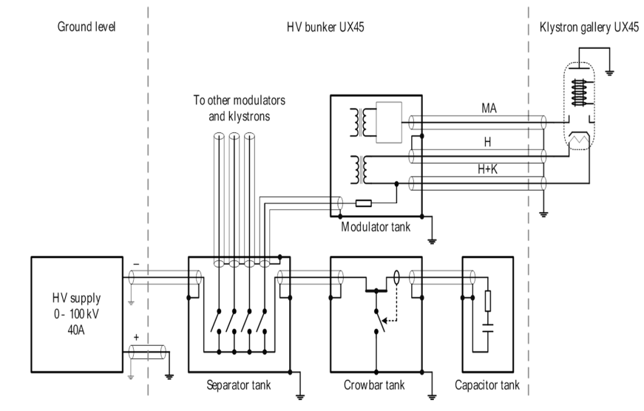
LHC RF system
16 klystrons 300 kW - 400 MHz and 4 bunkers:
Surface = 270 m²
RF power = 16 x 300 (350) kW = 4.8 (5.6) MW
Power density ~ 17.8 (20) kW_{RF}/m²

Slide 13
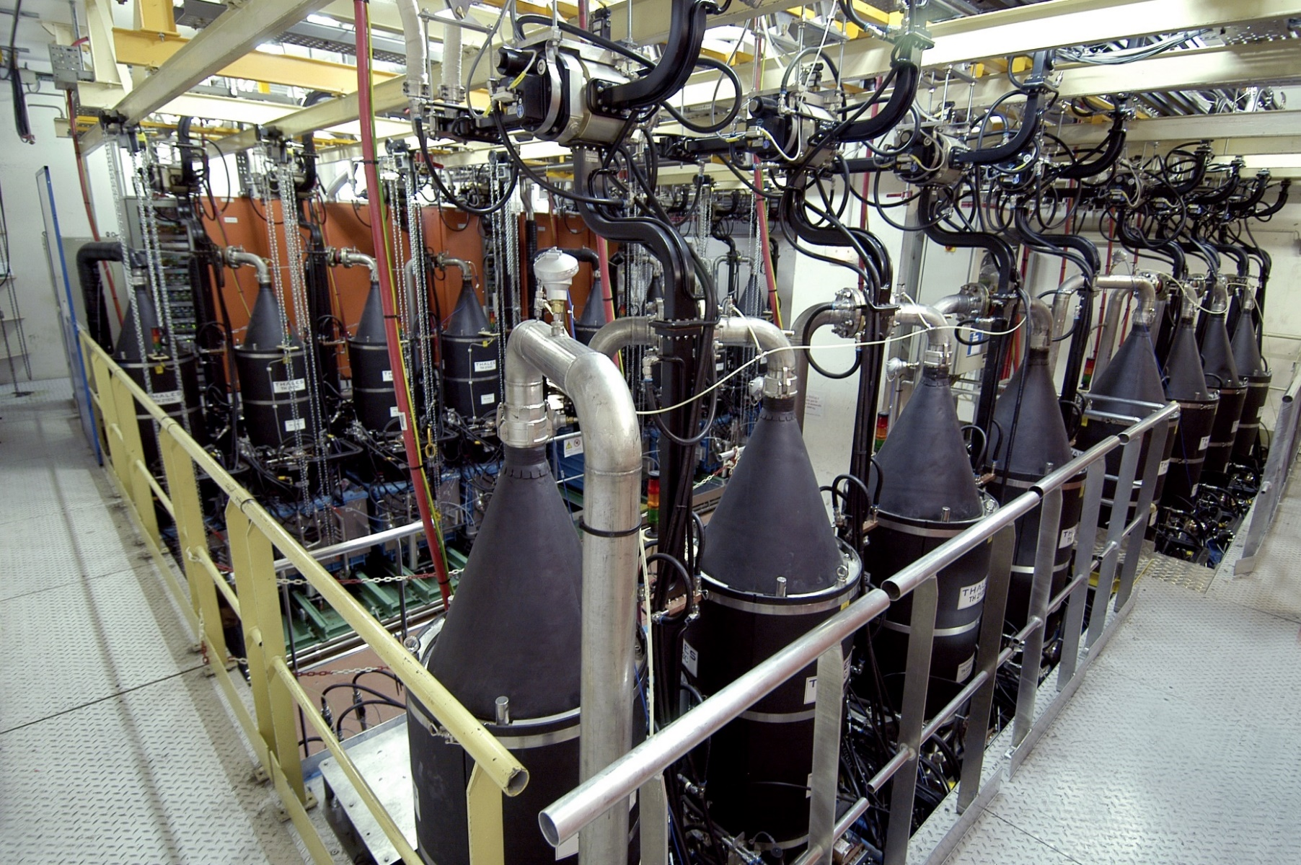
TOKAMAC WEST (France)
Lena Delpech (CEA)
16 klystrons* 3.7 GHz – 500 kW - CW:
Surface = 150 m²
RF power = 16 x 500 kW = 8 MW
Power density ~ 53 kW_{RF}/m²
*diode gun (no modulating anode)
+ crowbar switches integrated inside the klystron oil tank

Slide 14
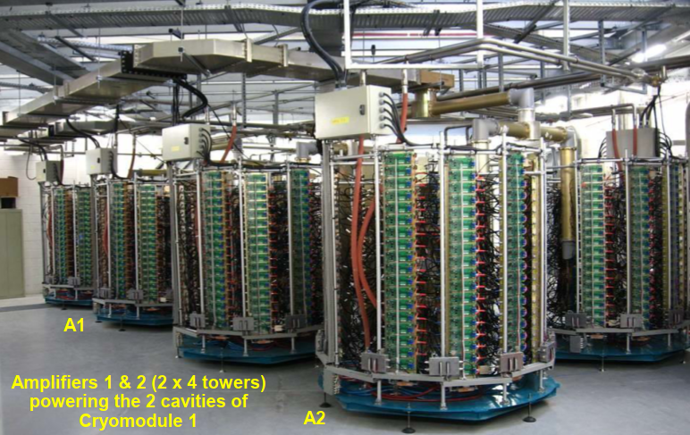
RF system of SOLEIL synchrotron
Massamba Diop
Frequency: 352 MHz
1 solid state tower delivers 50 kW in CW
With 2 x 4 SSPA towers :
Surface = 2 x 22 m²
RF power = 2 x 4 x 50 kW = 0.4 MW
Power density ~ 18 kW_{RF}/m²

Slide 15
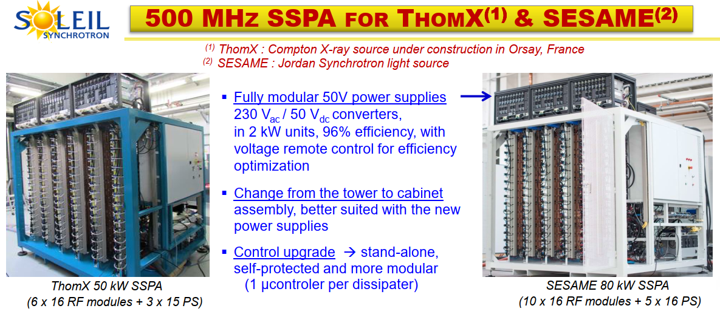
New developments at SOLEIL synchrotron
Massamba Diop

Slide 16
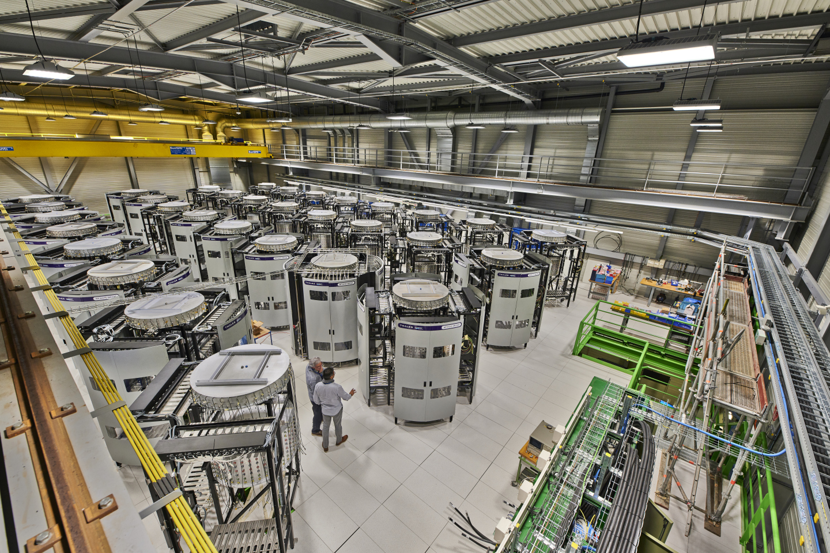
200 MHz Thales solid state modules for SPS
Eric Montesinos
Industrial solution
How this system can be extrapolated for FCC ?

Slide 17
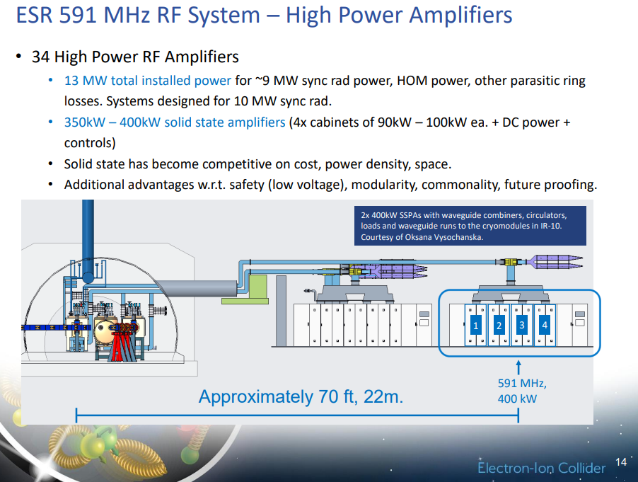
RF system foreseen for EIC
Kevin Smith, Alexander Zaltsman (BNL)
8 racks of SSPA:
Surface = 8 x 1.2* x 15 = 144 m²
RF power = 8 x 2 x 400 kW = 6.4 MW
Power density ~ 44 kW_{RF}/m²
~15 m
* assuming the cabinet is 1.2 m depth

Slide 18
RF system alternative options under study

Slide 19
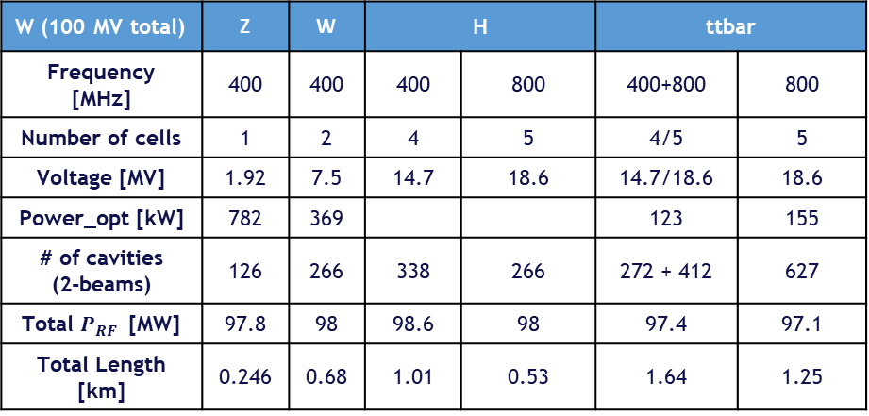
Alternative scenario with 2-cell 400 MHz for W and 5-cell 800 MHz for H
R. Calaga and Univ. of Rostock
2-cell 400 MHz has some advantages compared to 4-cell cavity
  Better in terms of impedances
  Easier to fabricate
Studies on-going with the new beam parameters
RF layout to be established
W (100 MV total) | Z | W | H | H | ttbar | ttbar 800 MHz
Frequency [MHz] | 400 | 400 | 400 | 800 | 400+800 | 800
Number of cells | 1 | 2 | 4 | 5 | 4/5 | 5
Voltage [MV] | 1.92 | 7.5 | 14.7 | 18.6 | 14.7/18.6 | 18.6
Power_opt [kW] | 782 | 369 |  |  | 123 | 155
# of cavities (2-beams) | 126 | 266 | 338 | 266 | 272 + 412 | 627
Total $P_{RF}$ [MW] | 97.8 | 98 | 98.6 | 98 | 97.4 | 97.1
Total Length [km] | 0.246 | 0.68 | 1.01 | 0.53 | 1.64 | 1.25
FCC-ee HYBRID RF SCHEME, S. Gorgi Zadeh et al., IPAC2018
https://cds.cern.ch/record/2646064/files/mopmf036.pdf?version=1

Slide 20

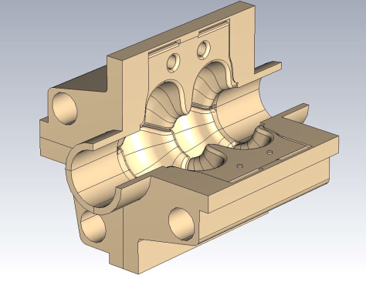
Alternative scenario with 2-cell 600 MHz SWELL
A great candidate to have a single cavity type for (almost) all the FCCee beam energies
  Can operate at high current and high gradient at the same time
Studies to be started with the new beam parameters
Optimized RF layout – see next slide
Slotted waveguide (x4)
HOM extractors (x8)
Cooling circuits

Slide 21

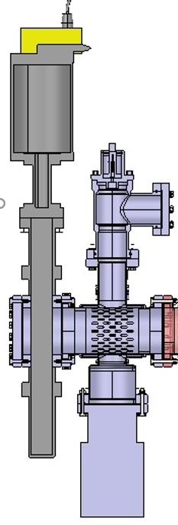
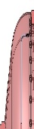
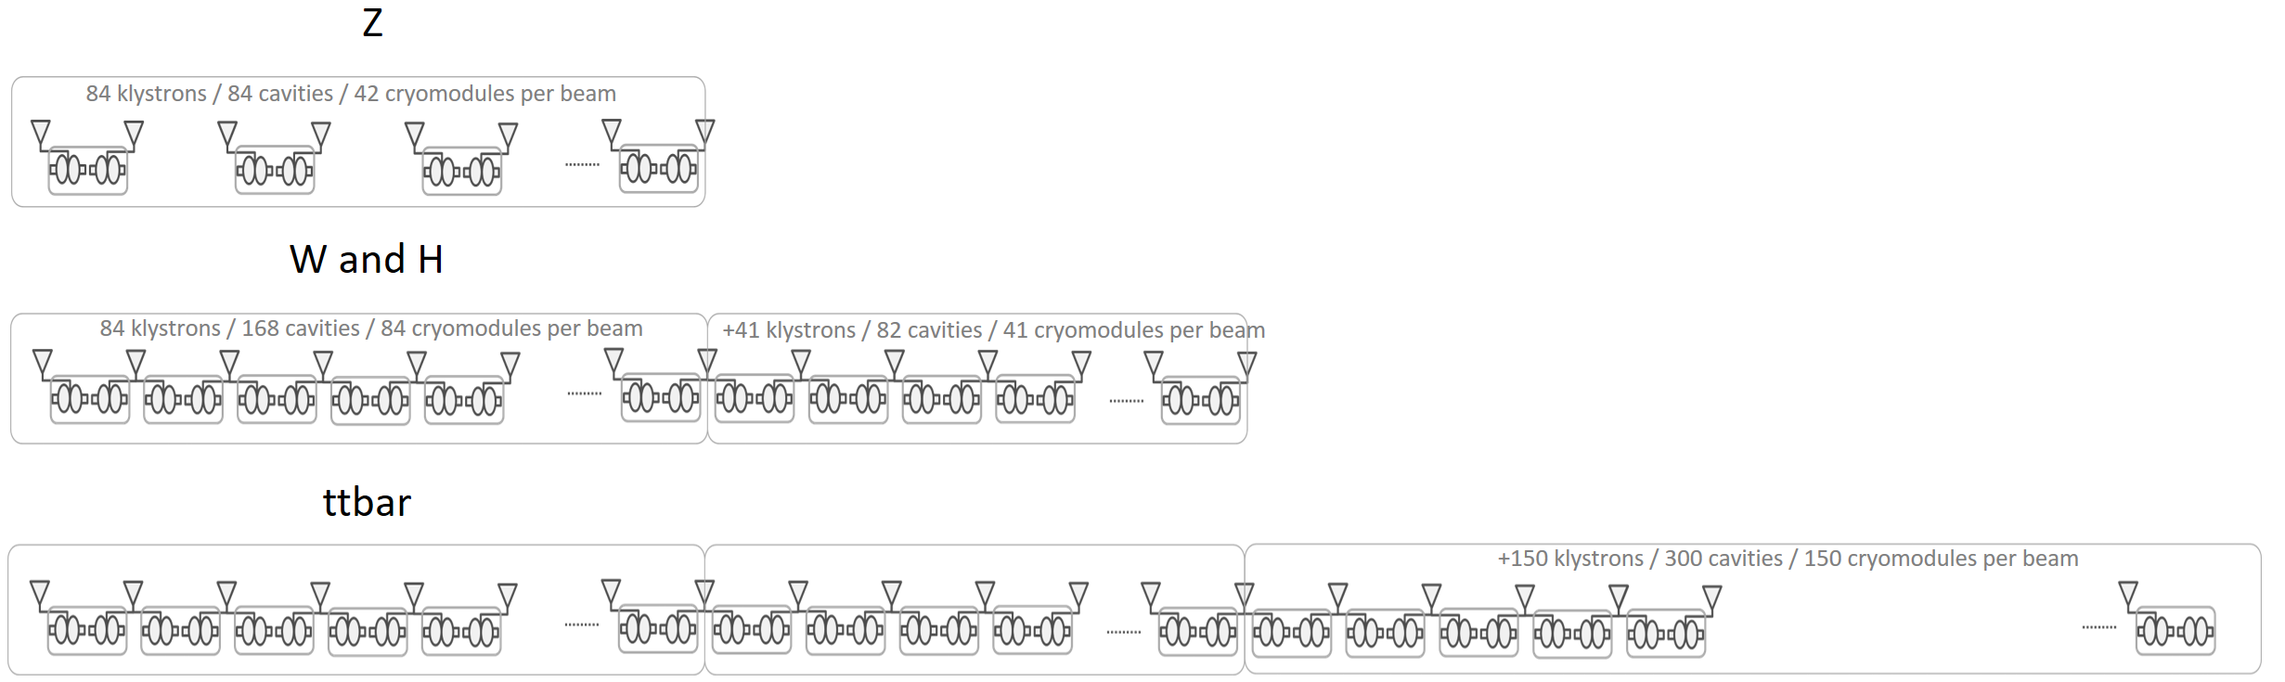

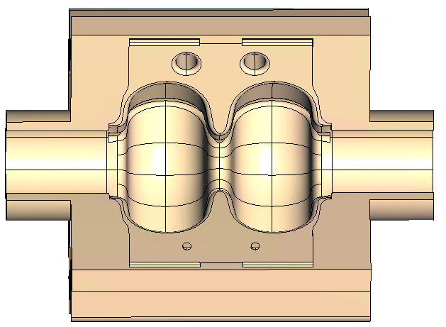
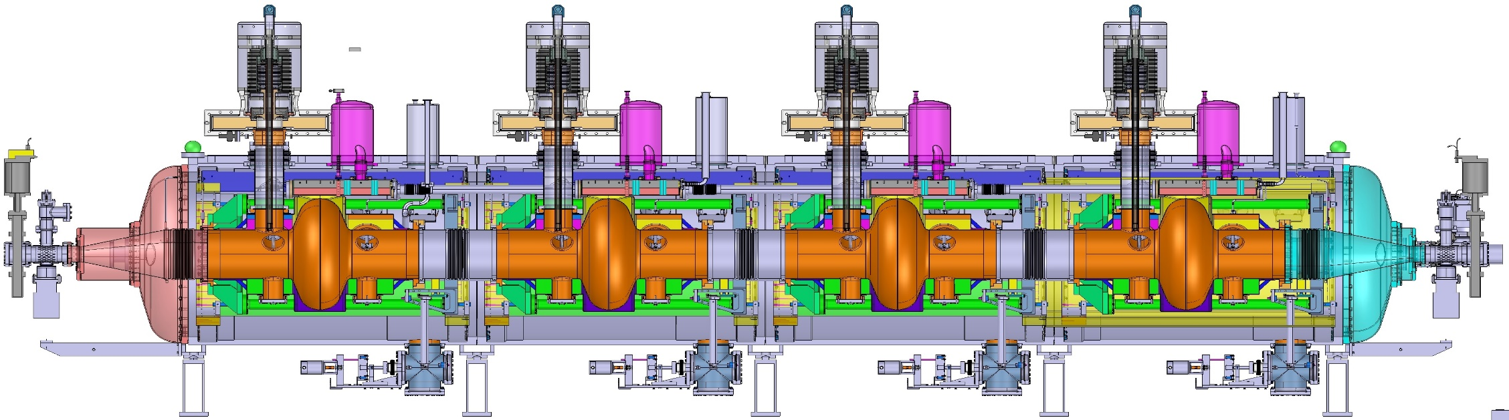
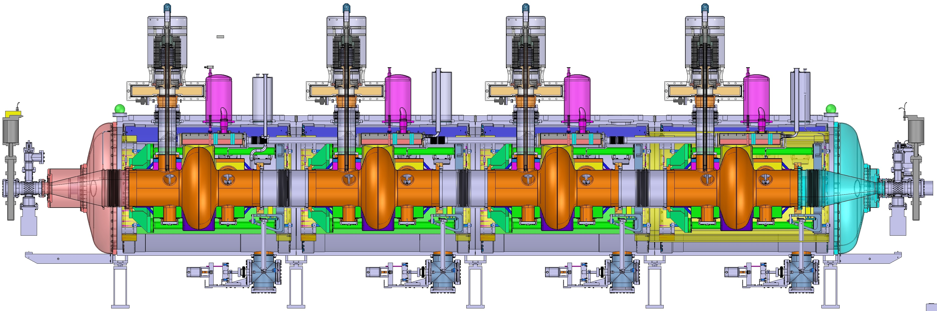


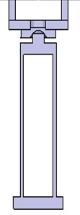
SWELL cavities, cryomodules
and klystrons integration
SWELL cryomodule (artistic view)
Working hypothesis of 2 cavities per cryomodules
Free space between cryomodules at Z stage
high power RF splitter to divide the power by two for the W and H operation so that klystrons operate at constant power of 600 kW
Other options are posssible:
4 or 5 cells 600 MHz, without slotted waveguides
4 or 5 cells 800 MHz

Slide 22
Summary
The new set of beam parameters proposed seems to be suitable for the RF system
  The higher required beam RF voltage is achieved by increasing slightly the number of cavities (not the gradient (except for Z))
  Quite favourable for the FPC design
  Less favourable for HOM power → beam pipe absorbers to be considered seriously
  Overall power consumption roughly evaluated: Pt H: 260 MW , Pt L: 170 MW
The RF power density is challenging for FCC, especially for the Z machine
  Twice higher compared to LHC
  Confirm the needs for compact high efficiency klystron
  In general, going higher in frequency will help
  Circulator and RF loads developement shall not be forgotten
Alternative studies will take into account the new beam parameters proposal

