Slide 1
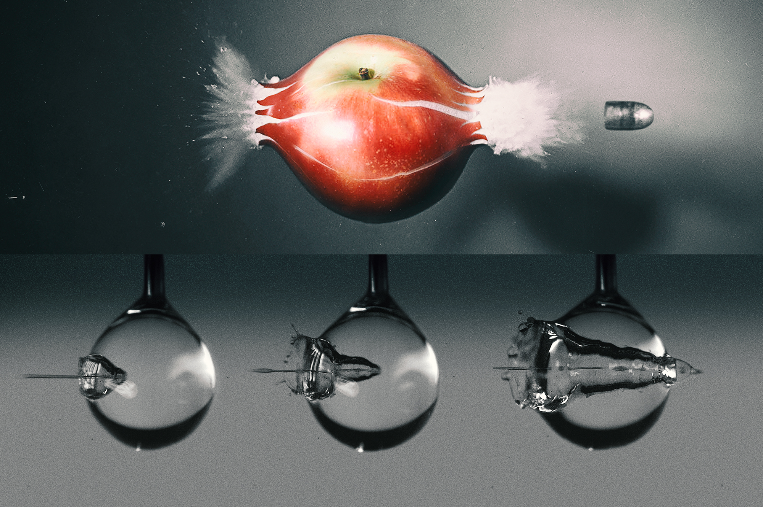
What have we really
learned about QGP droplets?
21st ZIMÁNYI SCHOOL
WINTER WORKSHOP
ON HEAVY ION PHYSICS
Jamie Nagle
University of Colorado Boulder
December 09, 2021

Slide 2
RHIC Heavy Ion Program will be ending in the next 5 years or so to make way for the Electron Ion Collider…
sPHENIX and STAR (with forward upgrades) still ahead and
longer term LHC Heavy Ion program into 2030s
Good to take stock of what we have learned and
what we have not learned…

Slide 3
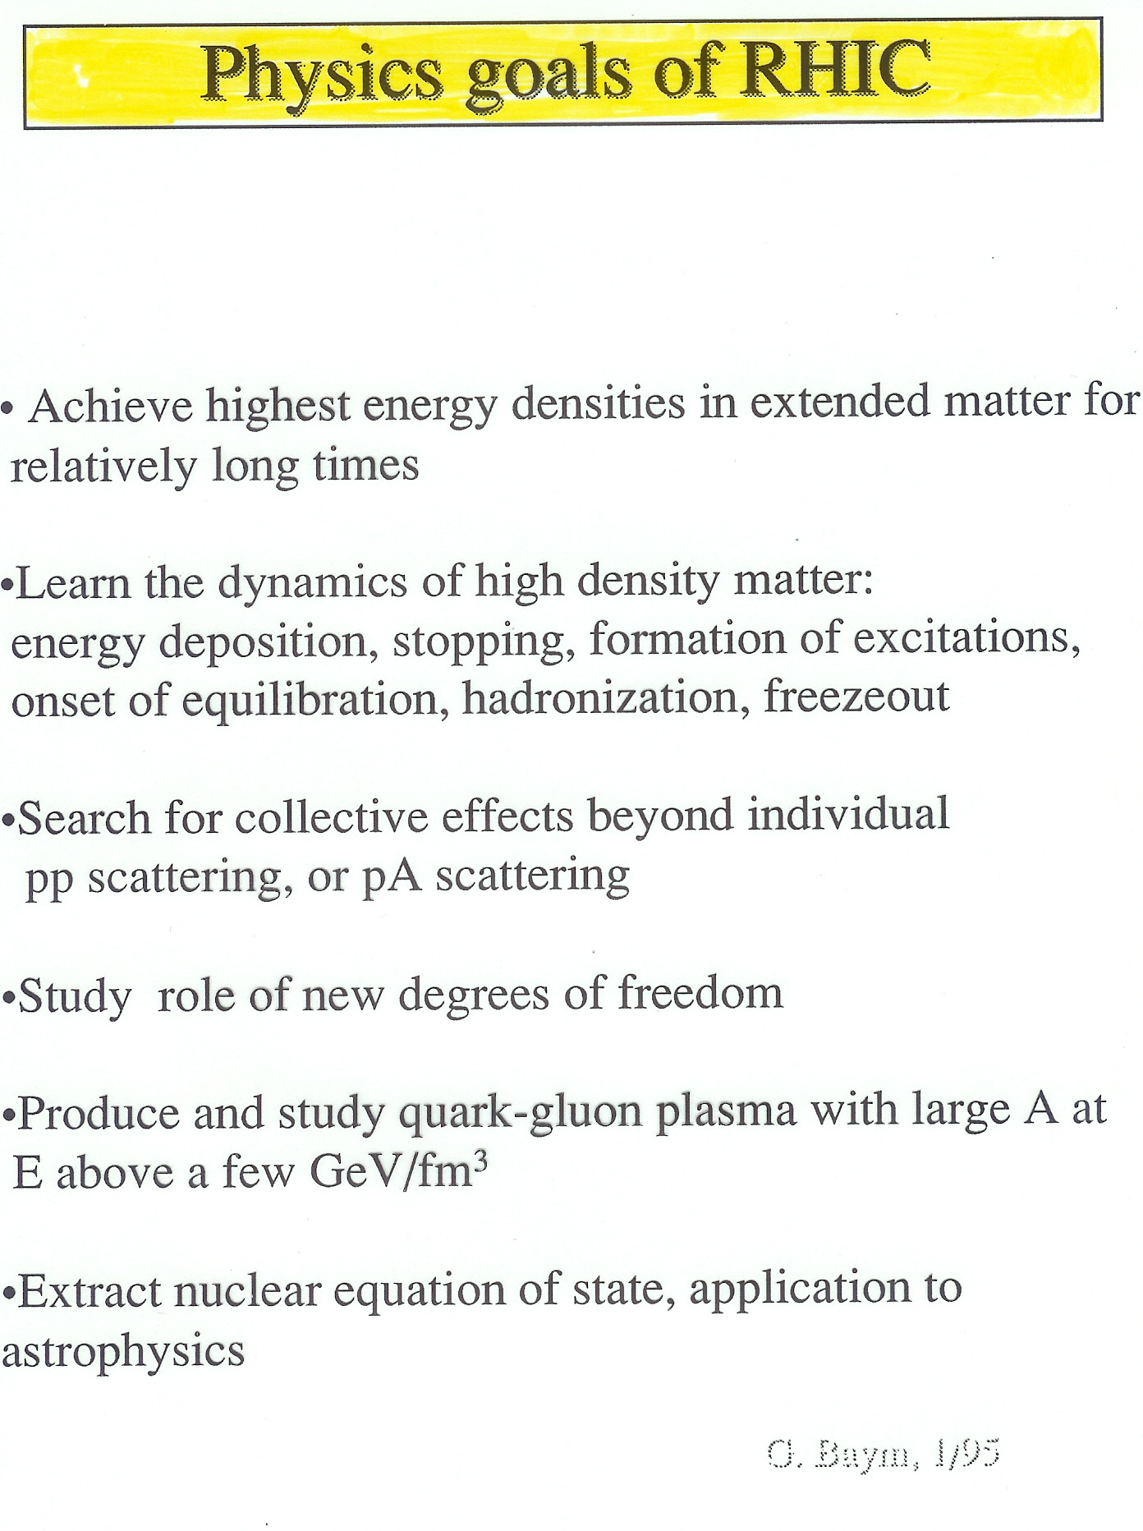
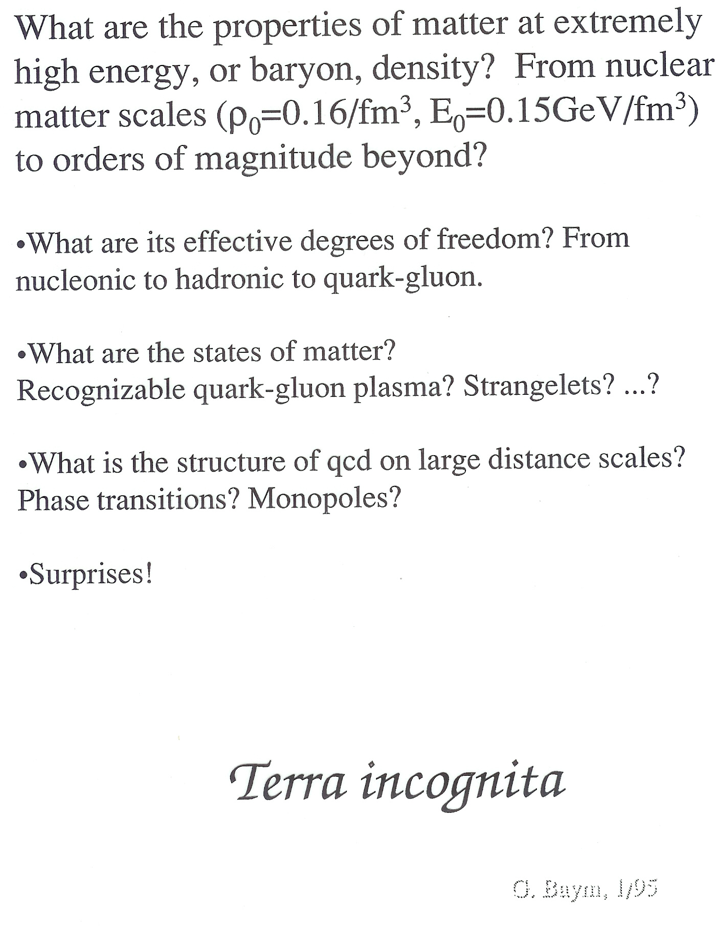

Slide 4
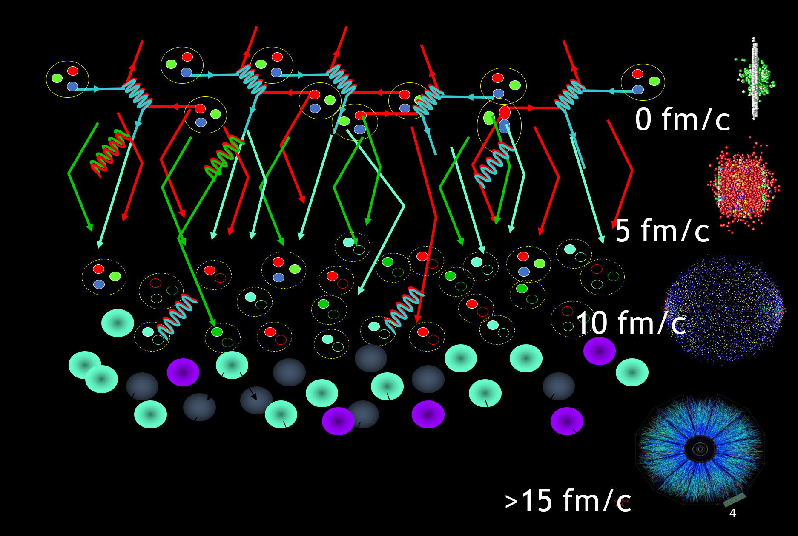
Standard Time Evolution Model of Heavy Ion Collisions
Initial State – nPDF, saturation physics, color domains?
QGP State – hydrodynamics, parton scattering
Hadron State – hadronization, hadron scattering
Free Streaming State – measured by experiment
4

Slide 5
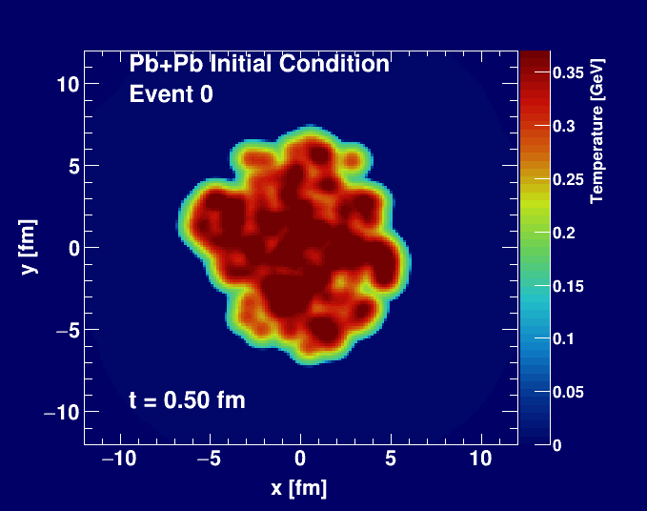
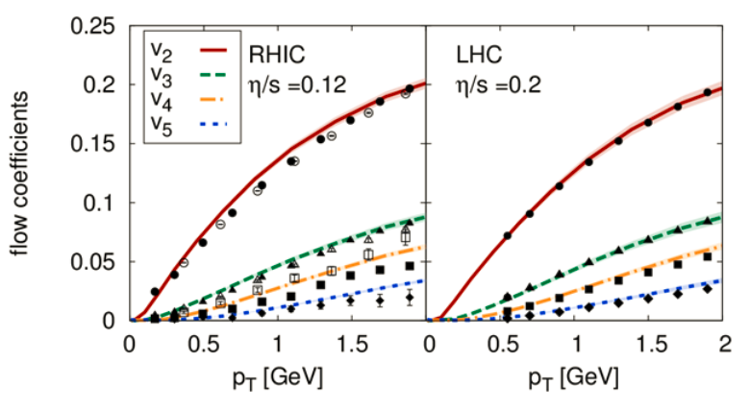
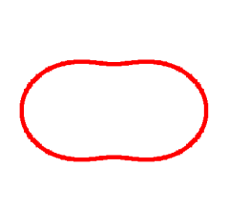
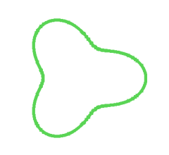
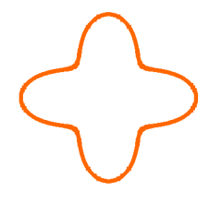
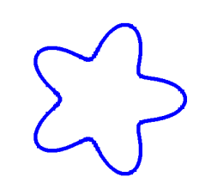
Standard Time Evolution Model of Heavy Ion Collisions
Bjoern Schenke
Hydrodynamic simulation (SONIC from Paul Romatschke) run with
η/s = 0.08 ~ 1/4π and ζ/s = 0.01

Slide 6
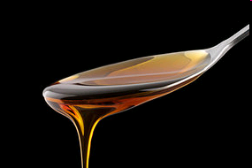
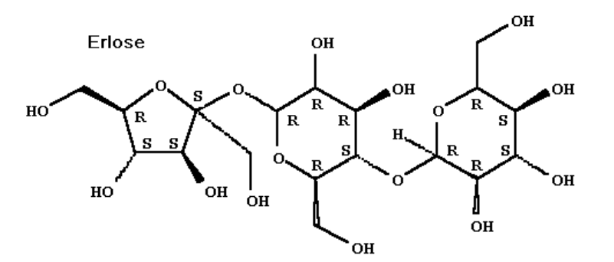
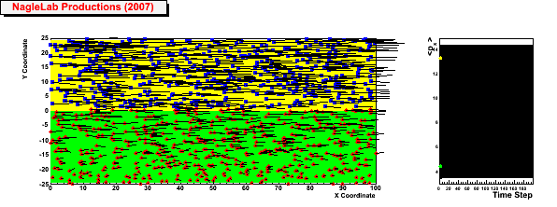
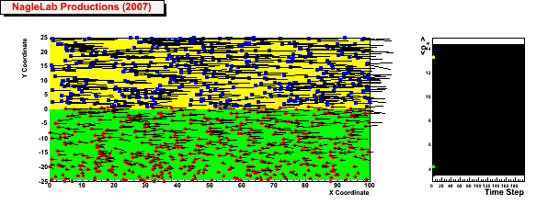
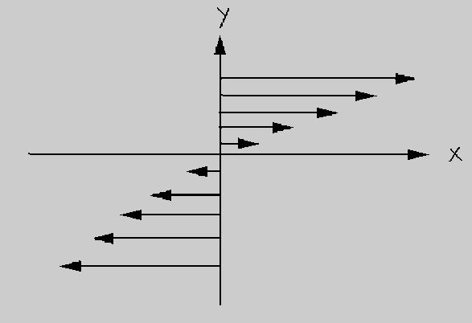
Shear Viscosity and Strong Coupling
Honey – viscosity decreases at higher temperatures
viscosity increases with stronger coupling
Weak coupling (σ=0)
Inhibited
diffusion
↓
Small
viscosity
↓
Perfect fluid
<p_{x}> top region
<p_{x}> bottom region
Strong coupling (σ ↑)
6

Slide 7
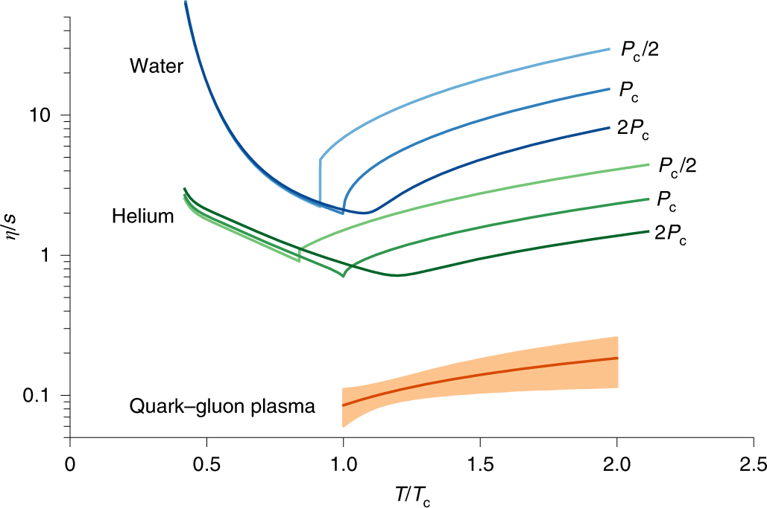
Quantitative Assessment of Most Perfect Fluid
https://www.nature.com/articles/s41567-019-0611-8?proof=t

Slide 8
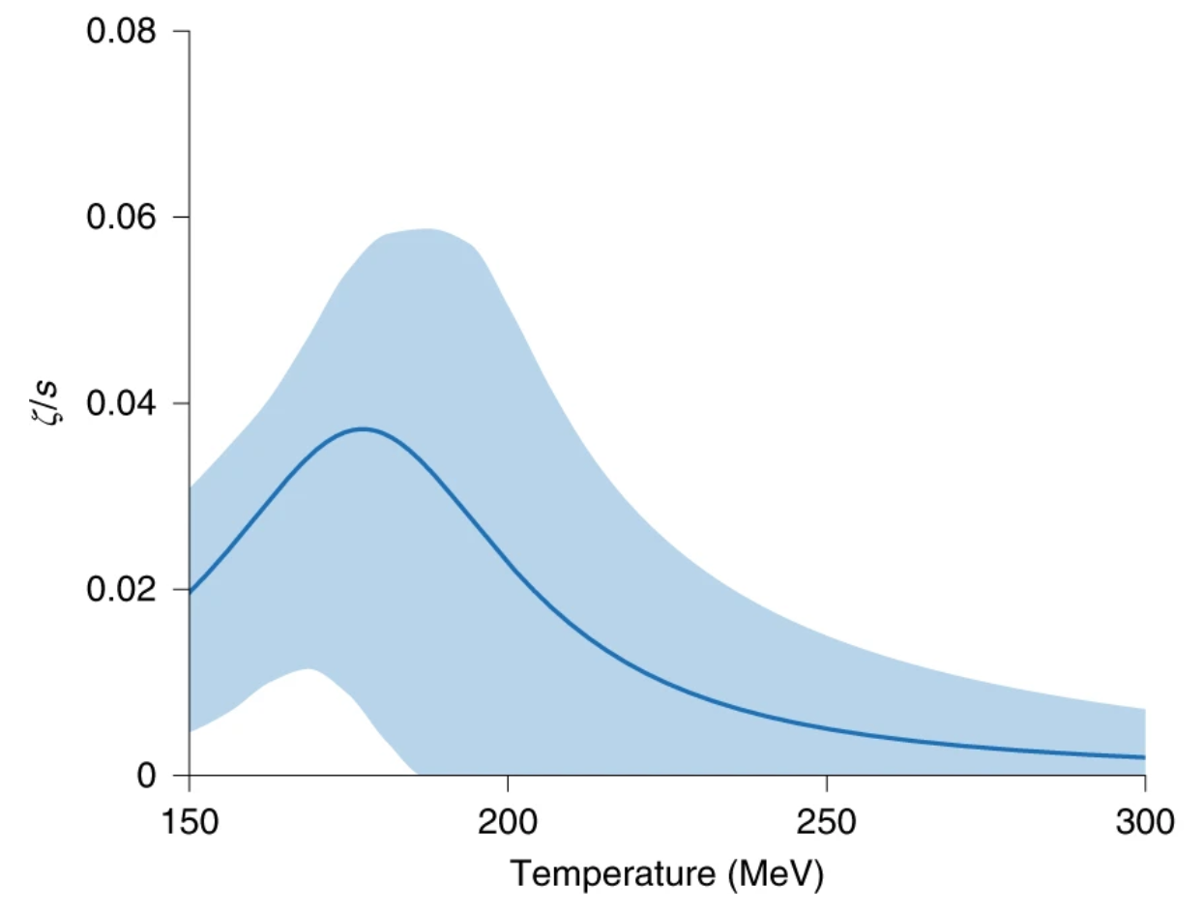
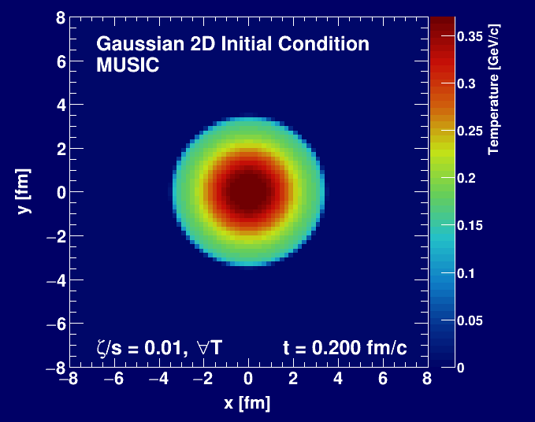
Quantitative Assessment of Bulk Viscosity?
Early pre-hydrodynamic expansion is critical here
Bayesian analyses only consider free streaming case
and not weak versus strong coupling case, and thus the constraint is misleading…
https://www.nature.com/articles/s41567-019-0611-8?proof=t
M. Byres, https://arxiv.org/abs/1910.12930

Slide 9
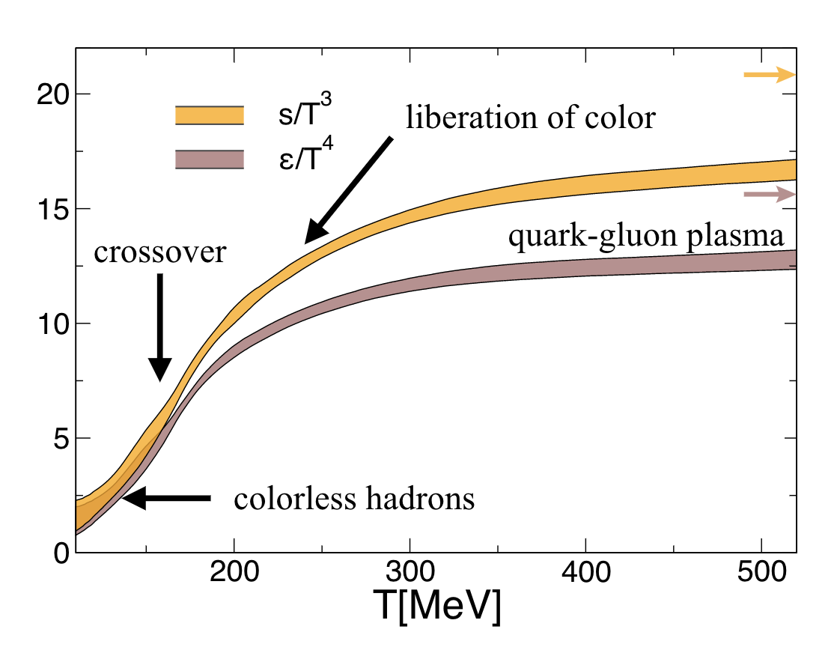
Nearly perfect fluid – yes!
Most perfect fluid measured to date – yes!
Quark-gluon plasma?
Hydrodynamic calculations typically start with
T = 340 (420) MeV at RHIC (LHC), which is well above T = 155 MeV transition temperature.
Temperature alone does not tell you directly the
degrees of freedom.

Slide 10
Equation of State Constrained by Data
With beam energy scan data, can we constrain equation of state to see μ_{B} dependence?
See comment soon regarding lack of full equilibration…

Slide 11
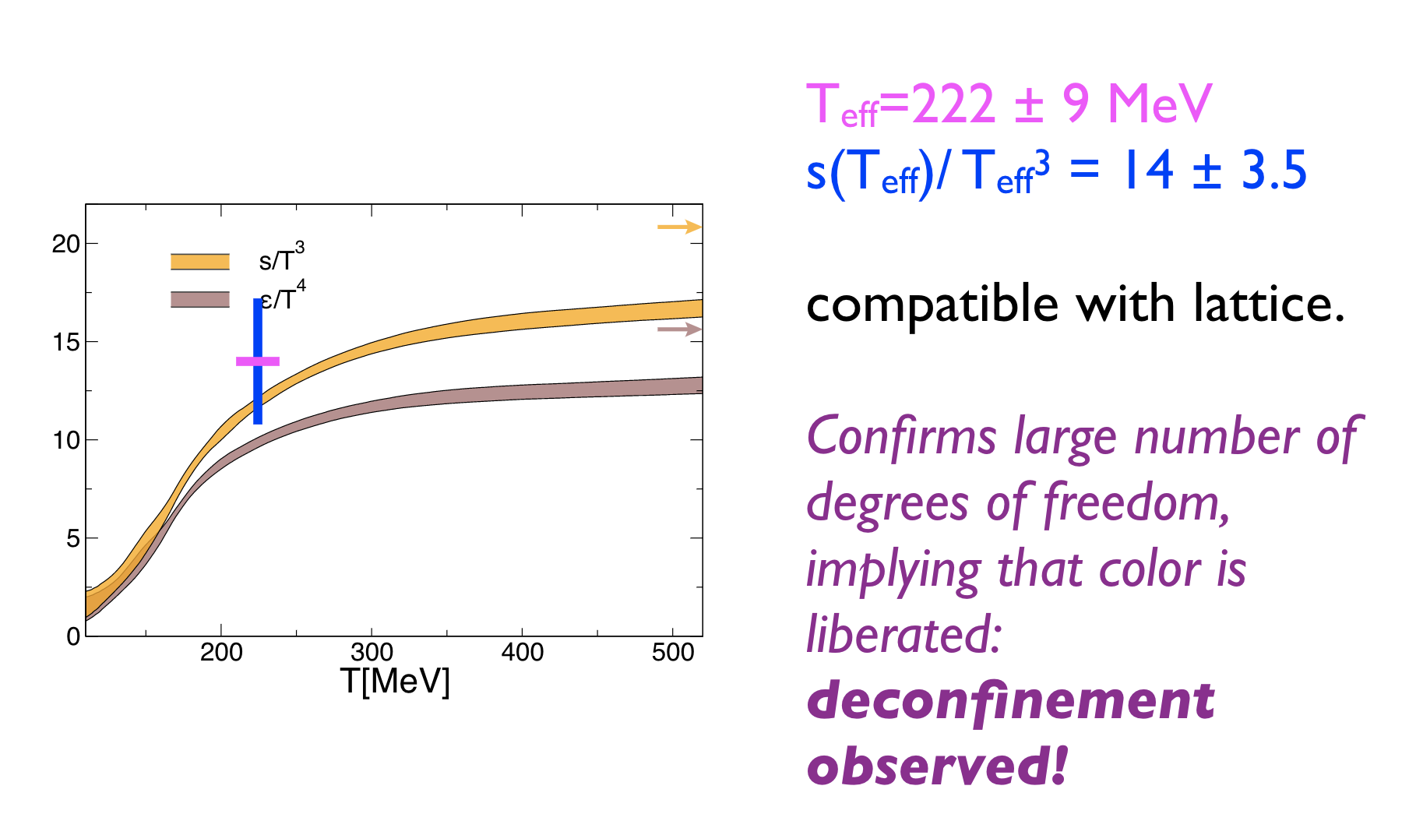
Energy density for “g” massless degrees of freedom
Slide from J.Y. Ollitrault
Hadronic Matter:
3 π with spin=0
Quark Gluon Plasma:
8 gluons;
2 quark flavors, antiquarks, 2 spins, 3 colors
Nature Phys. 16 (2020) 6, 615-619

Slide 12
What about smaller droplets?
Pb+Pb
p+Pb
p+p
Weller and Romatschke, https://arxiv.org/abs/1701.07145

Slide 13
One, Two, Three Droplets of QGP
PHENIX, Nature Phys. 15 (2019) no.3, 214-220

Slide 14
What does it all mean?
I thought hydrodynamics only applies if
system is near equilibrium
system has a size scale L >> mean free path
How can these be true in p+p, p+Au, d+Au, ³He+Au, etc.?
Maybe they are NOT!
String Theory Dual (completely solvable at strong coupling)
Systems very far from equilibrium still described by hydrodynamics as long as non-hydrodynamic modes are damped → hydrodynamic attractor.
Major re-thinking well beyond field of heavy ion physics

Slide 15
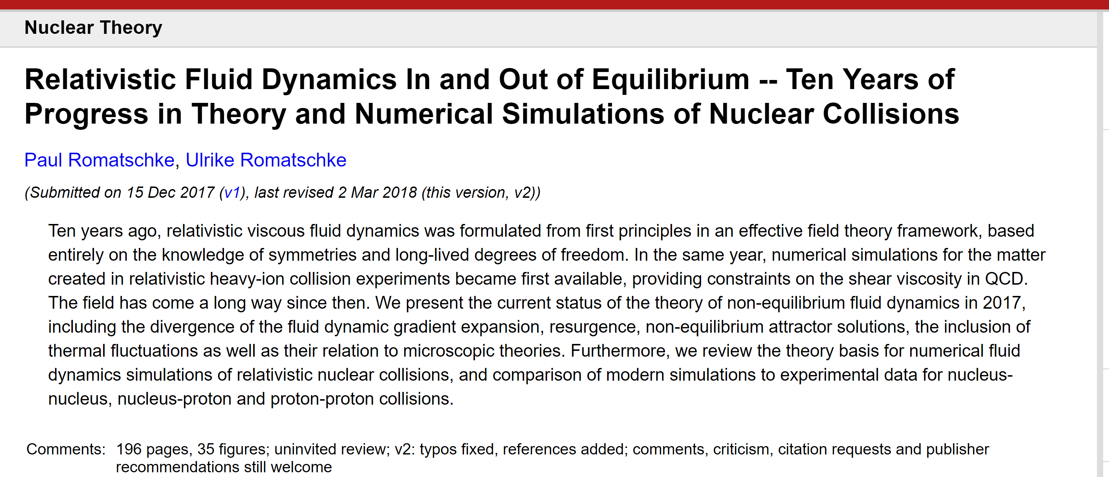
https://arxiv.org/abs/1712.05815

Slide 16
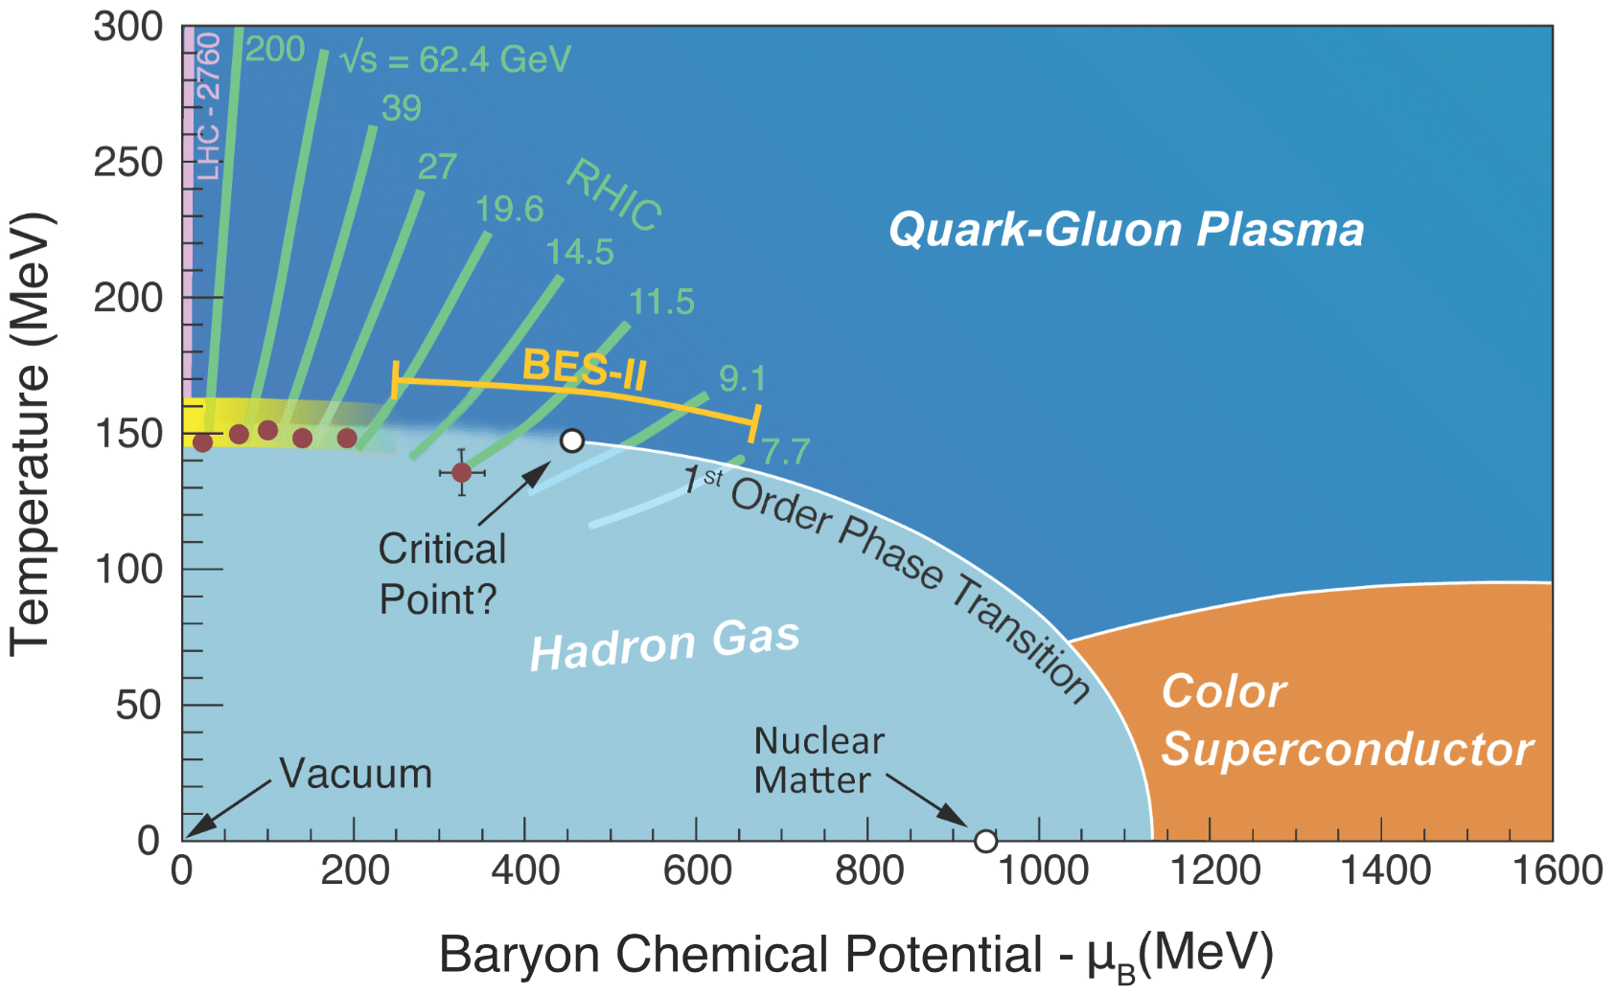
Not equilibrated …
What does that mean?
Not really on this QGP phase diagram
Extracted parameters like η/s and susceptibilities might not be the equilibrium values

Slide 17
What else did we want to learn?

Slide 18
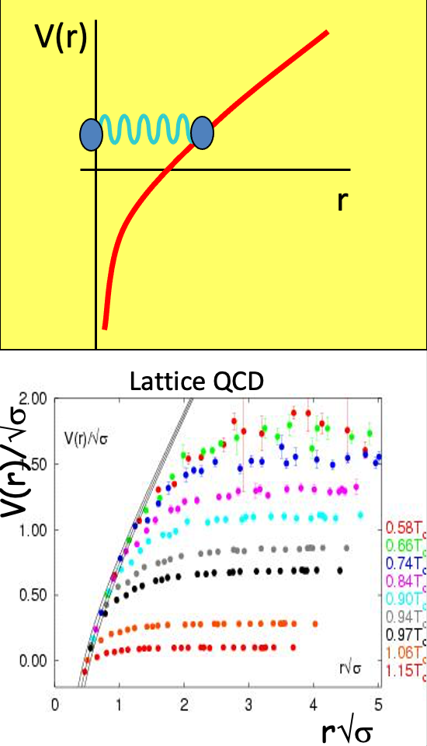
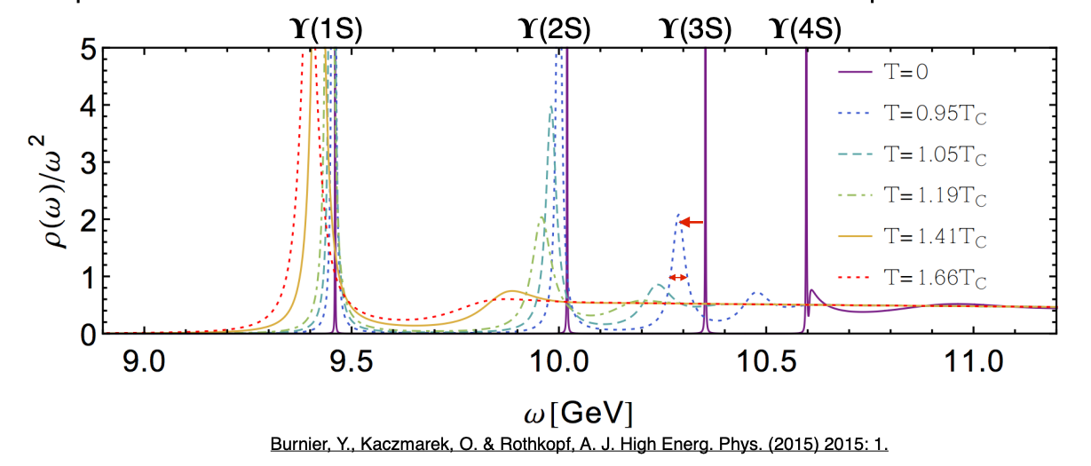
QGP Properties: What about deconfinement?
Quarkonia probe a specific length scale of the medium.
The Debye screening length is a fundamental parameter for plasmas

Slide 19
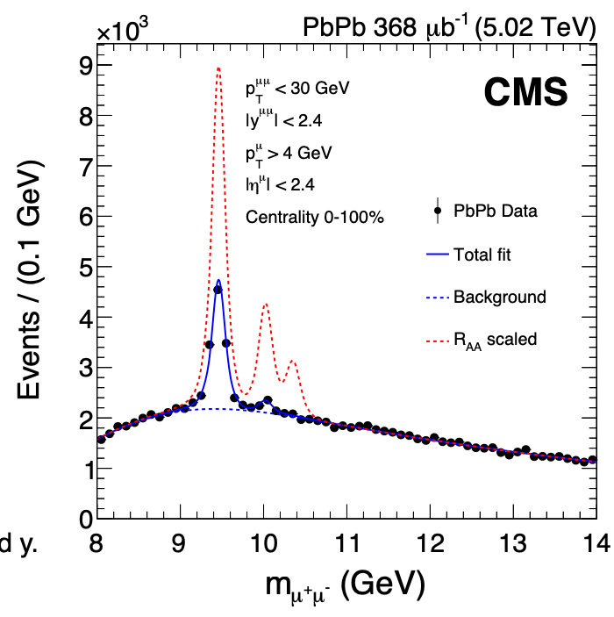
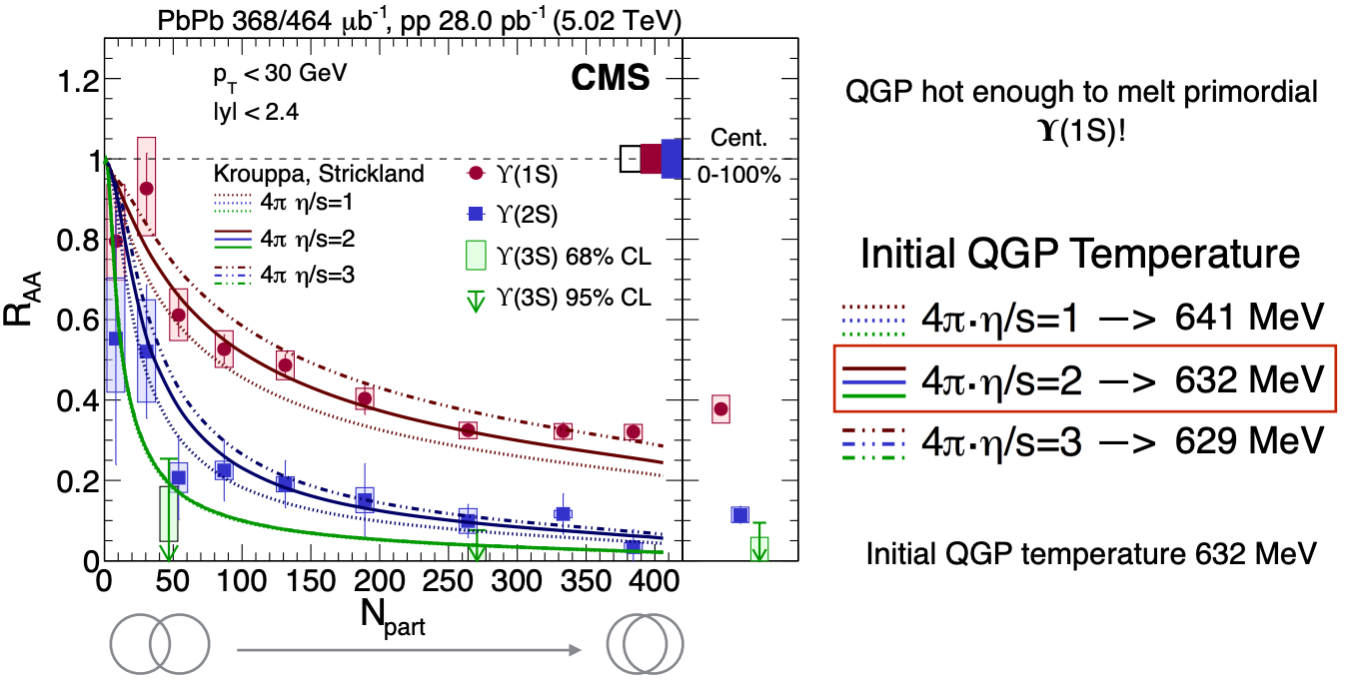
Is Upsilon suppression a definitive observation of deconfinement?
“Because the more excited states melt at lower temperatures, the sequential suppression is an excellent indicator of the temperature of the nuclear medium produced in PbPb collisions.”
I am less interested in the temperature.
Indirect assessment: T > 2.5 T_{c} and thus must be QGP
Direct assessment: Melting tells us something fundamental about color screening in QGP

Slide 20

Jet Quenching Signature of QGP

Slide 21
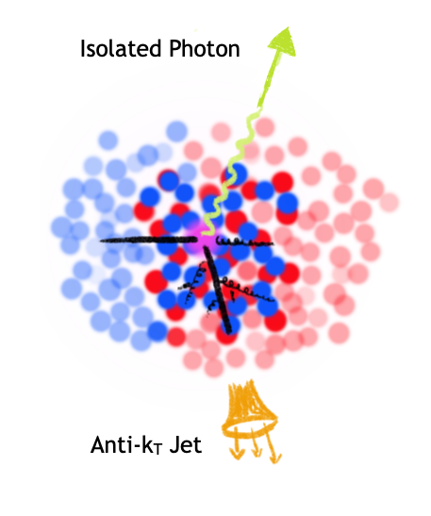
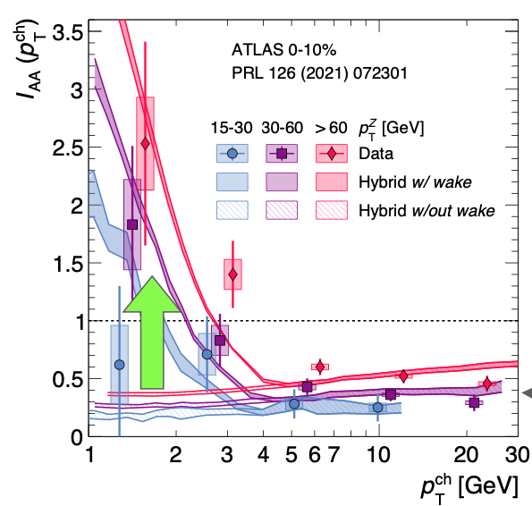
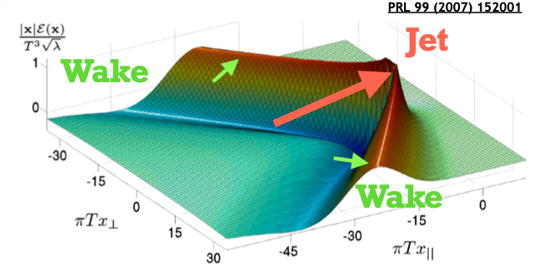
Scales and quasiparticles probed by jets
Jet yield suppressed at high p_{T} (quenching) and
enhanced at
low p_{T} (medium response)
Does not necessarily mean color charges are deconfined and rather the coupling strength as a function of scale
or Z Boson

Slide 22

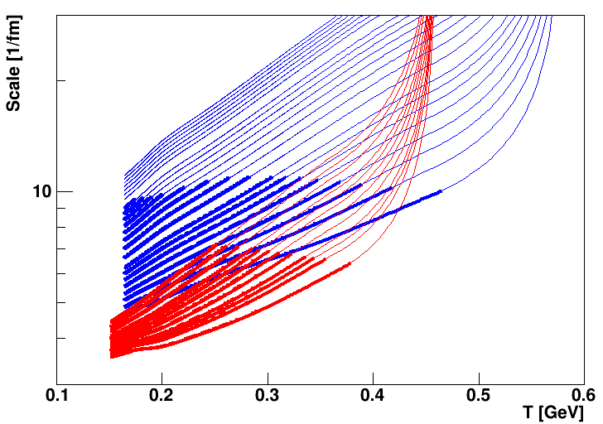
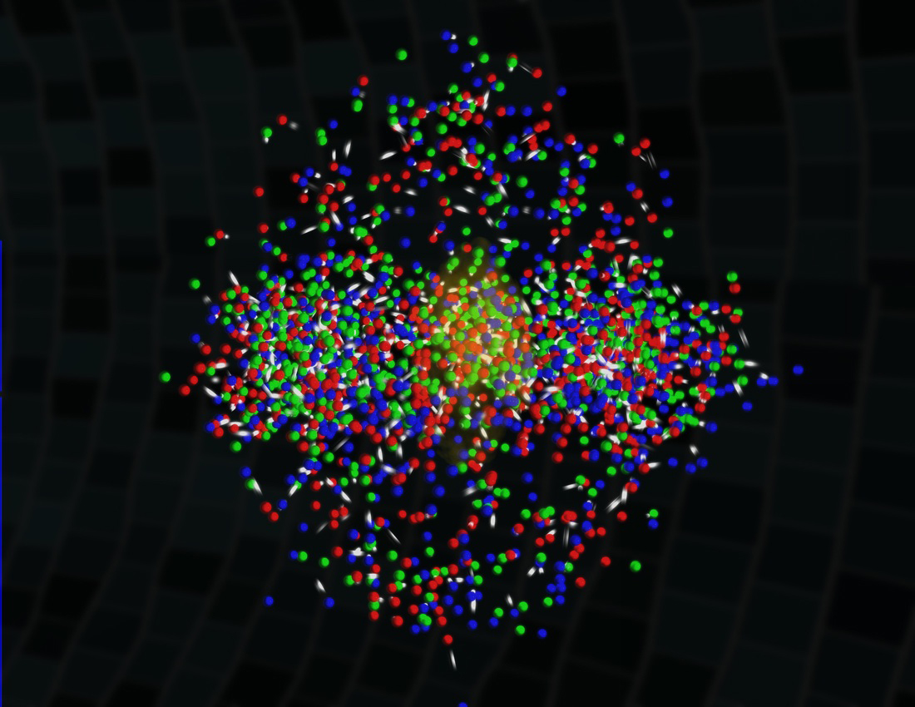
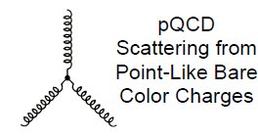
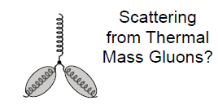
sPHENIX will measure jets and heavy quark probes with precision complementing LHC measurements
Initial hard scatterings act as a microscope on the QGP with varying resolution scale
RHIC Jet Probes
LHC Jet Probes
QGP Influence
Bare Color Charges
Thermal Mass Gluons
Perfect Fluid Only

Slide 23
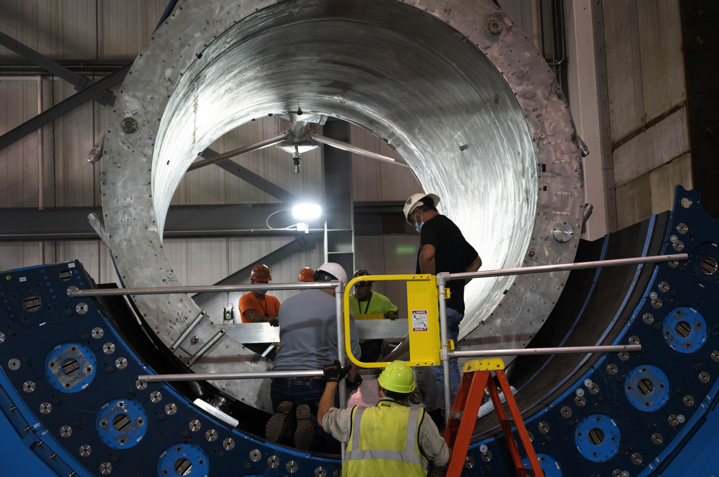
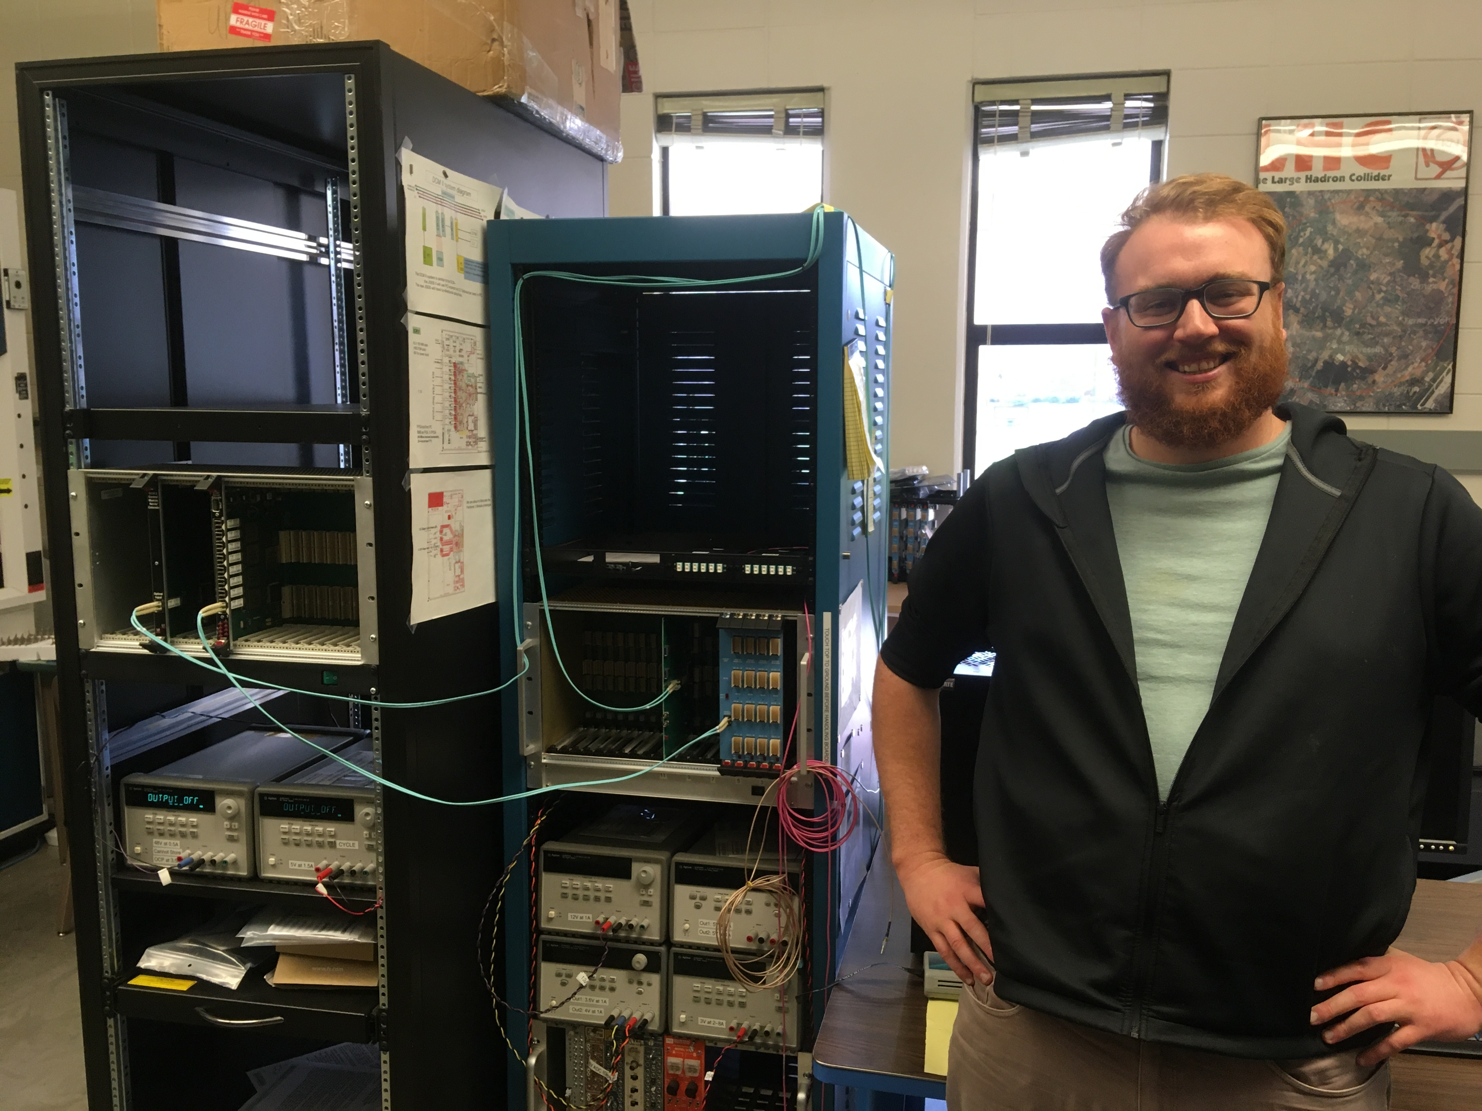
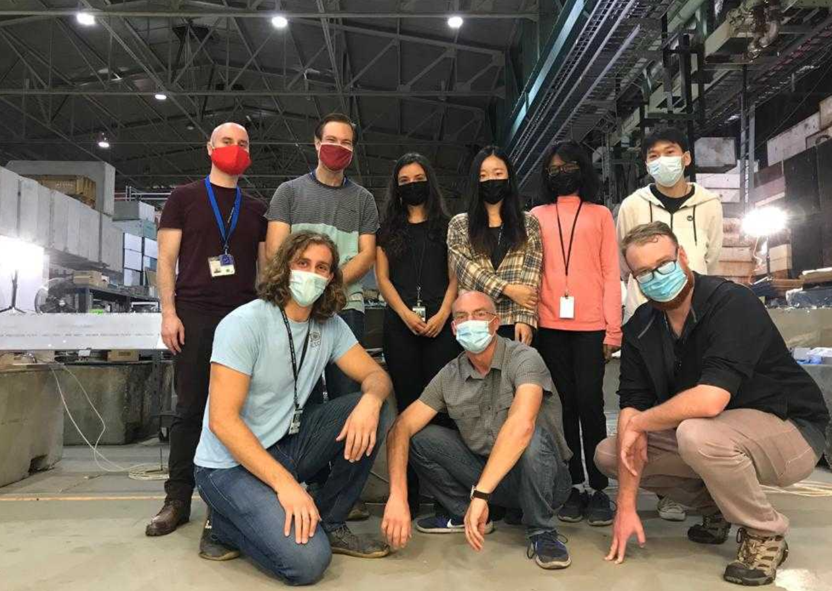
sPHENIX being assembled
sPHENIX first data taking in 2023!

Slide 24
What else did we want to learn?

Slide 25
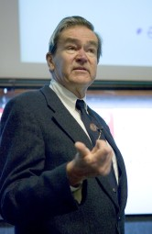
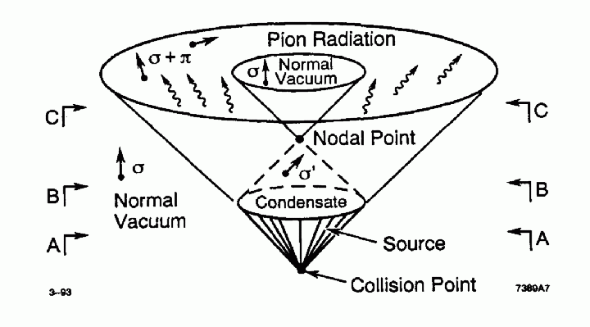
Domains within Droplets
Bjorken speculated that in the
“interiors of large fireballs produced in very high-energy pp collisions; vacuum states of the strong interactions are produced with anomalous chiral order parameters.”
“Disoriented Chiral Condensate” Domains

Slide 26
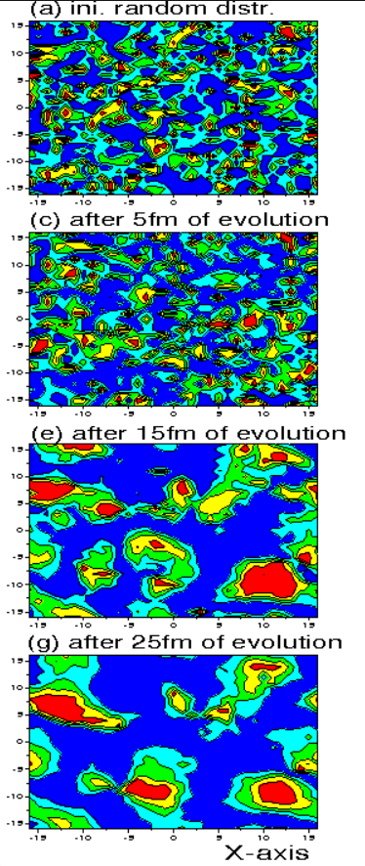
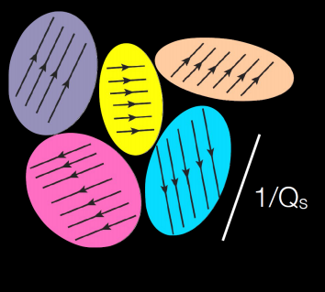
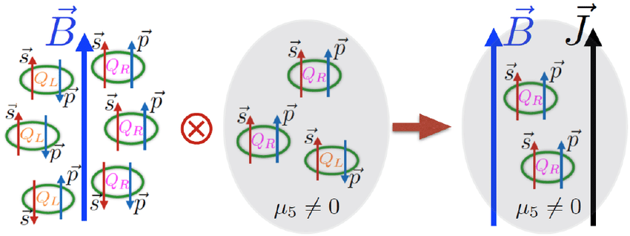
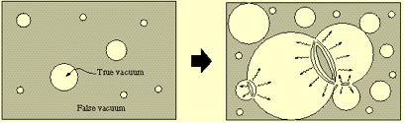
Other types of “domains”

Slide 27
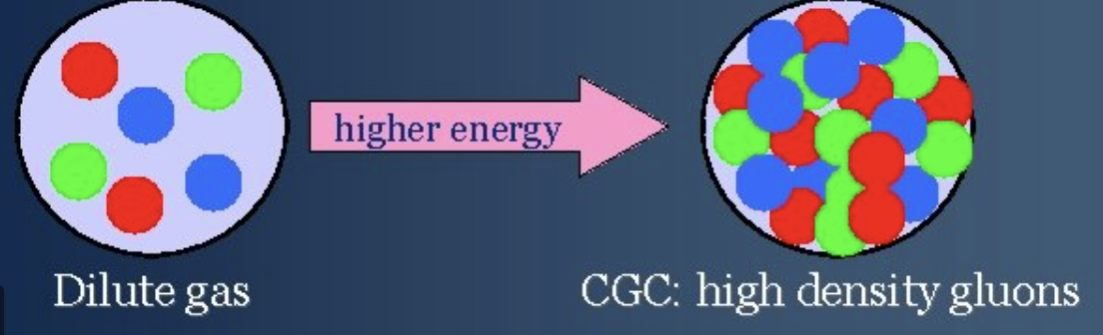
Color Domains - a post-modern view of CGC
Saturation physics sets a scale Q_{s}
corresponding to gluon occupation number exceeding unity.
Beautiful weak-coupled theory with
phenomenology that has been used to explain literally everything at RHIC
(read the 20+ year literature).
Now it is clear there is no evidence that saturation regime extends to physics of RHIC or LHC.
What are the EIC detector design implications?

Slide 28
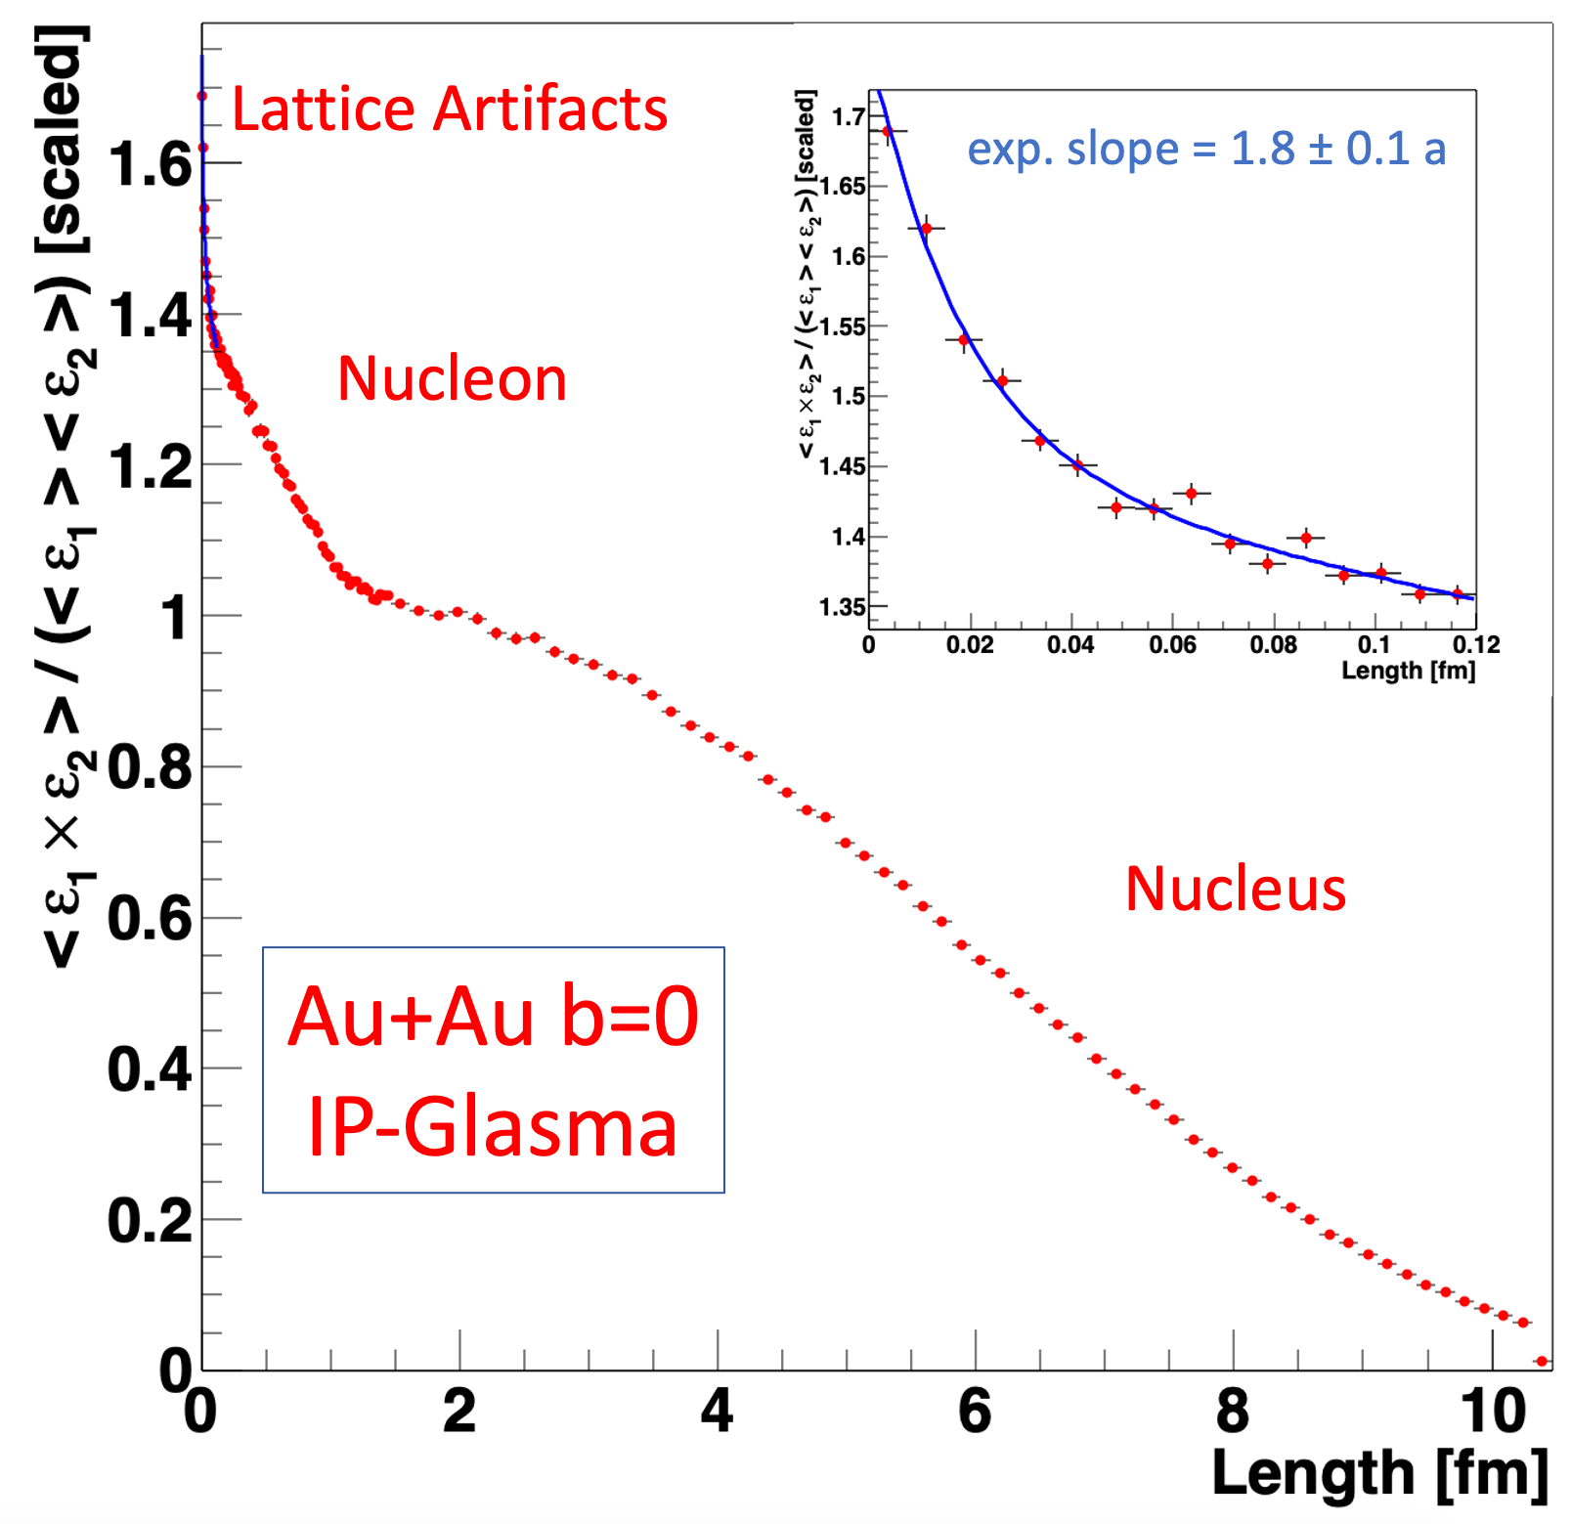
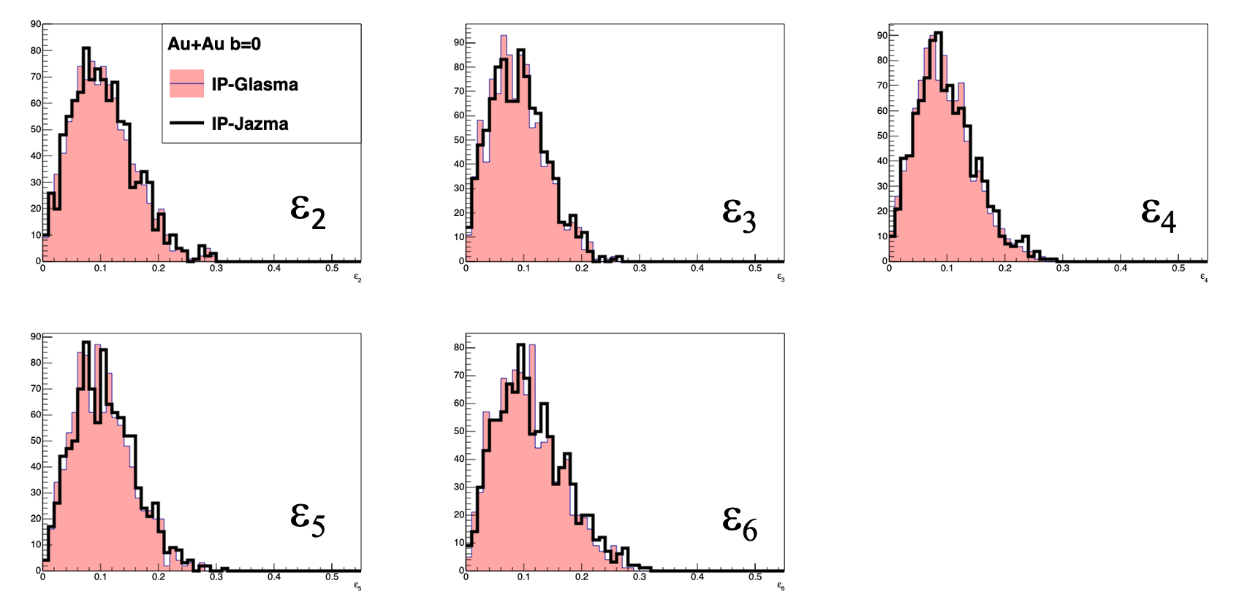
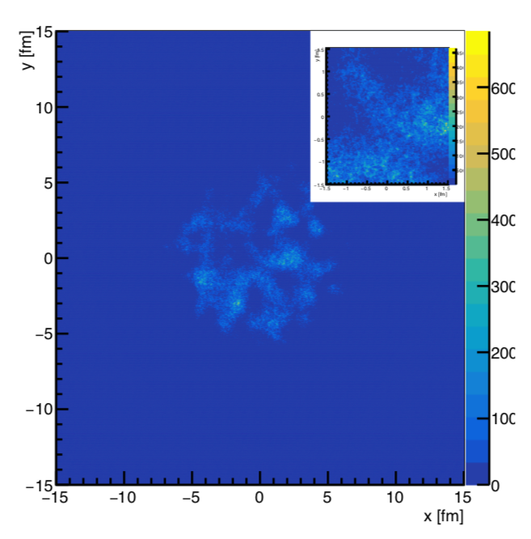
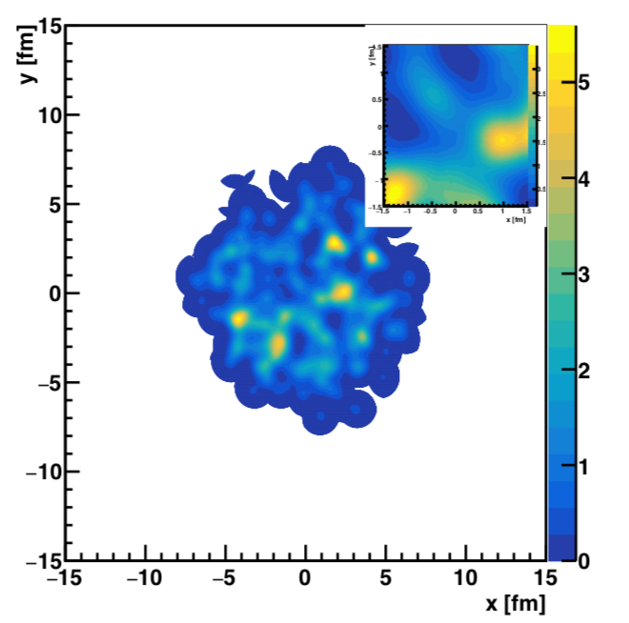
IP-Glasma “color domains”
Apples to Apples Comparison at τ=0.000015 fm/c
IP-Glasma AuAu b=0
IP-Jazma AuAu b=0
None of the features tested by
IP-Glasma + hydrodynamics give any evidence of saturation physics or color domains.
Only feature not seen in IP-Jazma is the lattice artifact component in the correlator.

Slide 29
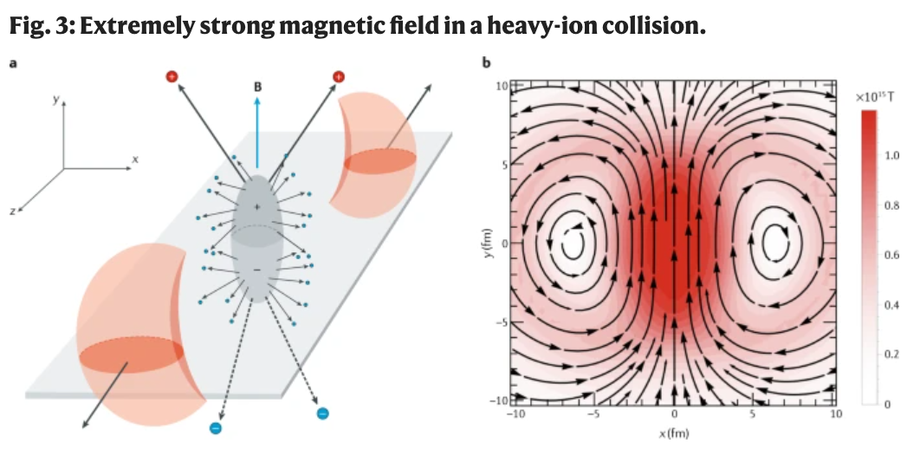
Other types of “domains”
https://www.nature.com/articles/s42254-020-00254-6
https://journals.aps.org/prc/abstract/10.1103/PhysRevC.96.024901
Simplified pictures, even as schematic,
often mislead the field in its critical thinking.
Much harder to imagine observing a
CME effect here.

Slide 30
Deep dive…
Is there any experimental evidence for CGC effects at RHIC (or LHC)?
Is there any experimental evidence for weak-coupled initial stage between strongly coupled incoming nuclei and strongly coupled QGP?
3) Is there any experimental (or theoretical) evidence for equilibration?
The answers have important implications for what we have (and also can) learn about QCD from heavy ion collisions.

Slide 31

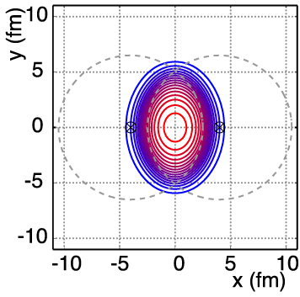
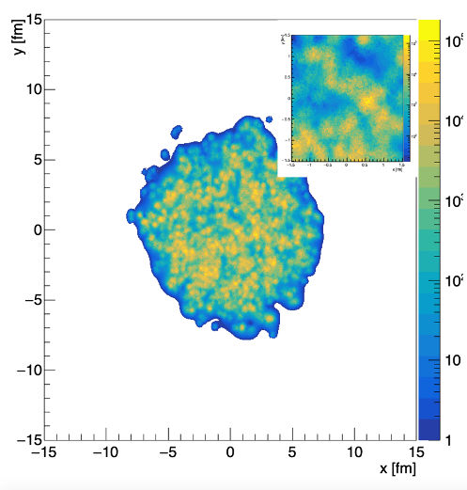
So, what have we learned?
Three valance quarks are the important DOF?
Color Glass Condensate Domains are important?
Chiral Magnetic Domains are important?
Nuclei are not smooth.
Nucleon fluctuations are important.
Sub-nucleonic geometry is important.

Slide 32

Are we unlearning things: “hot spots”
G. Giacalone
State-of-the-Art
JETSCAPE Bayesian analysis
https://journals.aps.org/prc/pdf/10.1103/PhysRevC.103.05490
New parameters:
w = 1.12 fm - really big proton
d_{min} = 1.44 fm - nice and even spacing
- cannot be hard core repulsion
Important progress with Bayesian analyses,
but losing sight of the goals of the field.
Treating too many parameters like nuisance parameters

Slide 34
vége
Jamie Nagle
University of Colorado Boulder
December 09, 2021

Slide 35
Extras

Slide 36




University of Colorado Boulder Group
College Scholar Award
Emilie du Chatelet grant from P2IO at CEA / Saclay
Key additional contributors
Professor Ron Belmont (UNCG) and Professor Sanghoon Lim (PNU),
both former postdocs in Boulder

Slide 37

35+10

