Slide 1
Run 3 Live and Higgs@10
Scenario discussion
25.11.2021

Slide 2
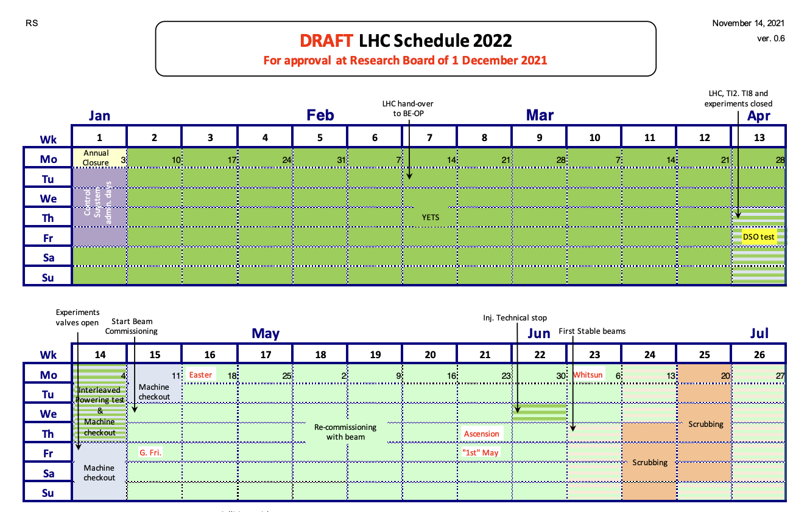
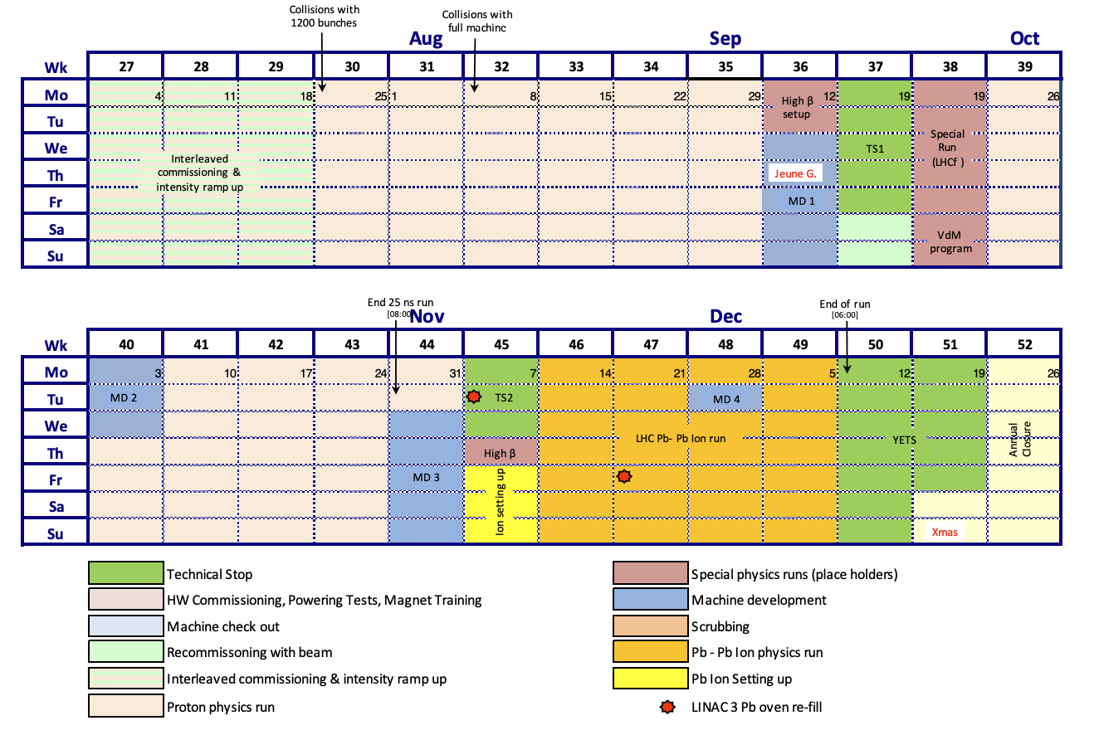
First stable beams – 9 June (LIVE)
Proton physics run starts – 25 July (LIVE)
Full machine collisions – 8 August

Slide 3
Scenarios:
1) Run3 live and Higgs@10 conference on same day*
2) Run3 live and Higgs@10 conference on 2 consecutive days*
3) Run3 live 2-3 weeks before Higgs@10 conference
4) Run3 live weeks after Higgs@10 conference**
* Implies staged Live or delaying first physics
** Implies considering “proton physics run” as first physics

Slide 4
First stable beams – 9 June (LIVE)

Slide 5
LHC planning points to Scenario 3 as the most likely – Run3 live 2-3 weeks before Higgs@10 conference
Run 3 live around 9 June + Higgs@10 symposium on 4 July (+/- 4 weeks spacing)
Messaging: Run 3 for a new physics run, at highest energy ever, in the year of Higgs@10
  Focus is on re-start of LHC
  Could be used to preview symposium of 4 July
  Part of “Higgs@10” brand?
? Which journalists would be interested? Same as for Higgs@10? Different?
Determines scope of the Live
Pros:
Two separate events w/ two separate messages
Easier to deal with the uncertainty of the LHC restart date
Could still attract TV media to the LIVE even without journalists on site (via the LIVE feed with EBU)
Will help filtrate journalists: those interested in the restart and those only interested in Higgs@10
Longer coverage of CERN in the news
Only one event to handle at a time (PO and AV)
No need to have additional help to handle the media
Cons:
Live will scoop messaging around Higgs@10 for symposium
More difficult to present a coherent message and maximise impact
Outlets may not wish to send journalists twice to cover CERN news (budget, other)
Will require to ask the experiments' help two times (interviewees, etc.) for two very different events
Hard to start again working on a 2nd big event once the first one is done

Slide 6
Scenario 1 - Run3 live and Higgs@10 conference on same day
Assuming a staged live if Run 3 does not “naturally” fall on 4 July
Pros:
Impactful messaging on importance of studying the Higgs: clearer link between anniversary and future.
No risk of scoop
Guest stars would be available for both events
1 VNR including both events more efficient and impactful
7 months to organise a single event
Target audiences would be boosted (increase likelihood of staying for both events)
Very attractive to journalists
Cons:
Run3 message will be diluted by Higgs@10 message
Doubtful that will fly with DG
Uncertain with how much notice of confirmation Run 3 can be staged on same day
Live production on a Monday morning implies preparations during weekend
Same day streaming of both events on CERN platforms would be stressful for IT support
Photo documenting of 2 events (one of which in 5 locations)
Challenging in terms of logistics (moving people, production) especially in case of delays to either of the events.
May be flooded by journalists

Slide 7
Scenario 2 - Run3 live and Higgs@10 conference on 2 consecutive days
Assuming a “scripted” live if Run 3 does not “naturally” fall on 3 July*
Pros:
Impactful messaging on importance of studying the Higgs: clearer link between anniversary and future (as per Scen1)
Risk of scoop between Scenario 1 and 3
Live on a Tuesday - none of the tech cons of scenario 1
Option of staging the Live in the afternoon - maximise international audiences and facilitate organisation
Guest stars could be convinced to stay over 2 days and take part in the Live
More breathing space for teams
Avoid having to double the production resources
Less stress to welcome journalists as event split in 2 days.
7 months to organise one single event over two days
Could be attractive for journalists travelling from abroad.
Cons:
Uncertain with how much notice we would be sure Run 3 can be staged on same day
Which message to prioritise?
2 days of intense work and probably also during the week-end
May increase for the food/drinks budget
Requires the journalists to stay 1-2 nights in the area.
We could loose some journalists who will come to only one of the two days
* ECO-ECP strongly recommend Symposium on 4 July at 4pm and LIVE on 5 July 5, ideally at 2 pm. Will we loose journalists?

Slide 8
Scenario 4 - Run3 live weeks after Higgs@10 conference**
? Which journalists would be interested? Same as for Higgs@10? Different?
Determines scope of the Live
Pros:
2 messages, decoupled but linked and sequential : Higgs discovery opened the door to a journey of discovery -> Run 3 marks the re-start of that journey (at highest energy yet)
Easier to deal with the uncertainty of the LHC restart date
Could still attract TV media to the LIVE of Run 3 even without journalists on site (via the LIVE feed with EBU)
Will help filtrating journalists: those interested in the restart and those only interested in Higgs@10
Longer coverage of CERN in the news
Only one event to handle at a time (press office and AV production)
No need to have additional help to handle the media
Cons:
More difficult to maximise impact.
Difficulty in coherent message.
Outlets may not wish to send journalists twice to cover CERN news (budget, other)
Will require to ask the experiments' help two times (interviewees, etc.) for two very different events
Run 3 during summer holiday period
If <3 weeks apart(?) - hard to start again working on a 2nd big event once the first one is done
** Implies considering “proton physics run” as first physics

Slide 9
Next steps:
Prepare a one-page proposal for the Directorate, for approval (30 Nov)
Present at next LOG meeting (16 Dec)
One-pager:
Why (messaging)
When (?)
Where (X locations)
Who (target audience, invitees, teams)
How (X-hour live,…)
Cost (required budget)

