Slide 1
Run 3 Live and Higgs@10
Scenario discussion
25.11.2021

Slide 2
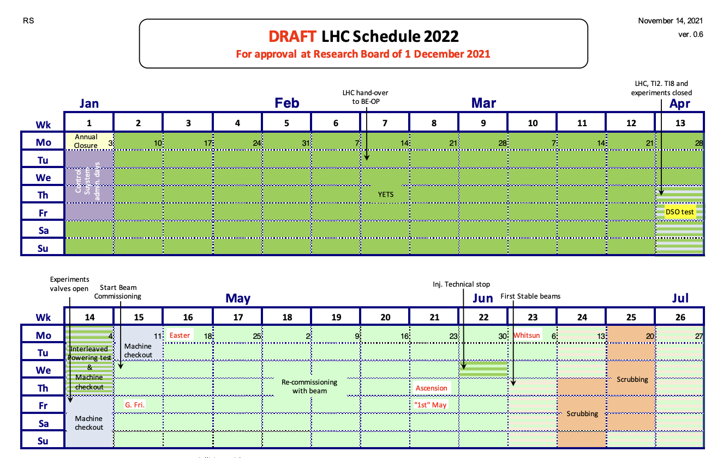
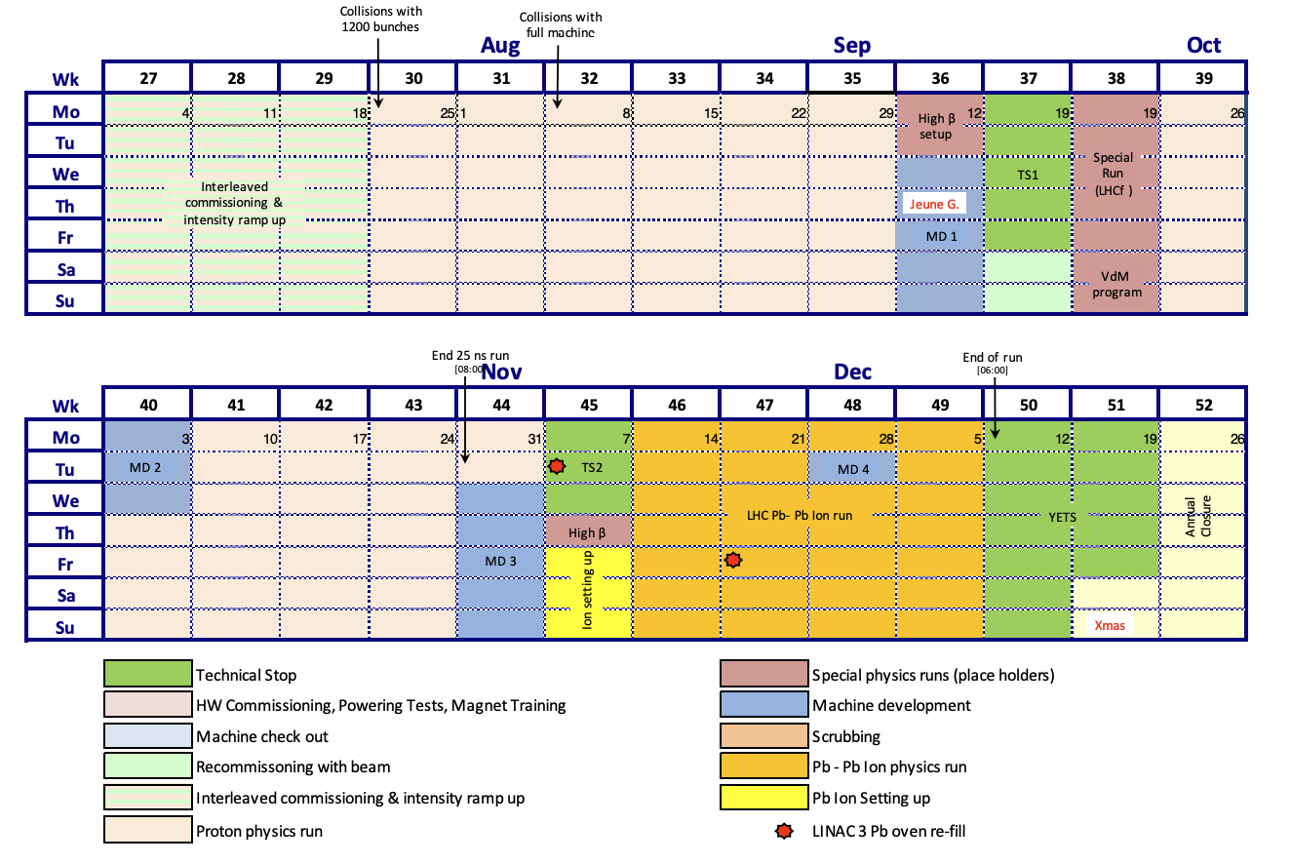
First stable beams – 9 June (LIVE)
Proton physics run starts – 25 July
Full machine collisions – 8 August

Slide 3
Scenarios:
1) Run3 live and Higgs@10 conference on same day*
2) Run3 live and Higgs@10 conference on 2 consecutive days*
3) Run3 live 2-3 weeks before Higgs@10 conference
* Implies staged Live or delaying first physics

Slide 4
First stable beams – 9 June (LIVE)

Slide 5
LHC planning points to Scenario 3 as the most likely – Run3 live 2-3 weeks before Higgs@10 conference
Run 3 live around 9 June + Higgs@10 symposium on 4 July (+/- 4 weeks spacing)
Messaging: Run 3 for a new physics run, at highest energy ever, in the year of Higgs@10
  Focus is on re-start of LHC
  Could be used to preview symposium of 4 July
  Part of “Higgs@10” brand?
? Which journalists would be interested? Same as for Higgs@10? Different?
Determines scope of the Live
Pros:
Two separate events w/ two separate messages
Easier to deal with the uncertainty of the LHC restart date
Could still attract TV media to the LIVE even without journalists on site (via the LIVE feed with EBU)
Will help filtrate journalists: those interested in the restart and those only interested in Higgs@10
Longer coverage of CERN in the news
Only one event to handle at a time (PO and AV)
No need to have additional help to handle the media
Cons:
Live will scoop messaging around Higgs@10 for symposium
More difficult to present a coherent message and maximise impact
Outlets may not wish to send journalists twice to cover CERN news (budget, other)
Will require to ask the experiments' help two times (interviewees, etc.) for two very different events
Hard to start again working on a 2nd big event once the first one is done

Slide 6
Next steps:
Prepare a one-page proposal for the Directorate, for approval (30 Nov)
Present at next LOG meeting (16 Dec)
One-pager:
Why (messaging)
When (?)
Where (X locations)
Who (target audience, invitees, teams)
How (X-hour live,…)
Cost (required budget)

