Slide 1


Introduction to G4SEE: a toolkit for simulating radiation effects in electronics
Dávid Lucsányi, CERN

Slide 2
Agenda
Introduction to G4SEE toolkit:
  An open-source toolkit
  Capabilities
  User support & community
Hands-on tutorial #1:
  The simulation case: Proton induced SEUs in ISSI SRAM
  1.1) General, Input/Output
  1.2) Geometry
  1.3) Primary particles, Scoring
  1.4) Scoring, SEE cross-section
To be continued tomorrow...

Slide 3
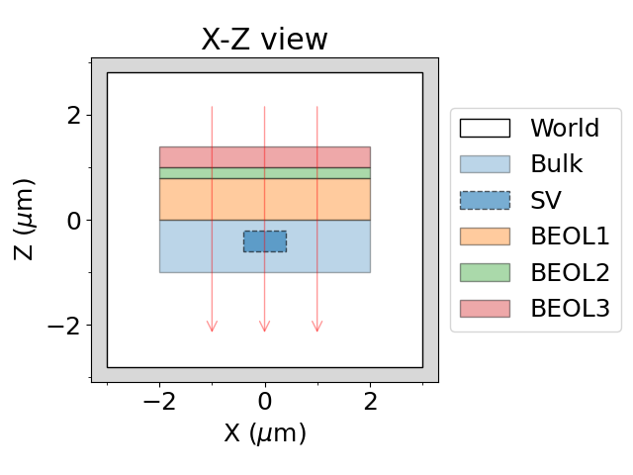


Introduction – An open-source toolkit
G4SEE is a Geant4-based Monte Carlo
Single Event Effect (SEE) simulation toolkit
Free and open-source, available for the whole radiation effects community for a wide variety of use cases
It is being developed in CERN Radiation To Electronics (R2E) project, but developers, contributors and beta testers outside CERN are also welcome!
Multi-layer, micro-metric geometry used in a G4SEE simulation to obtain energy deposition in Sensitive Volume (SV)

Slide 4

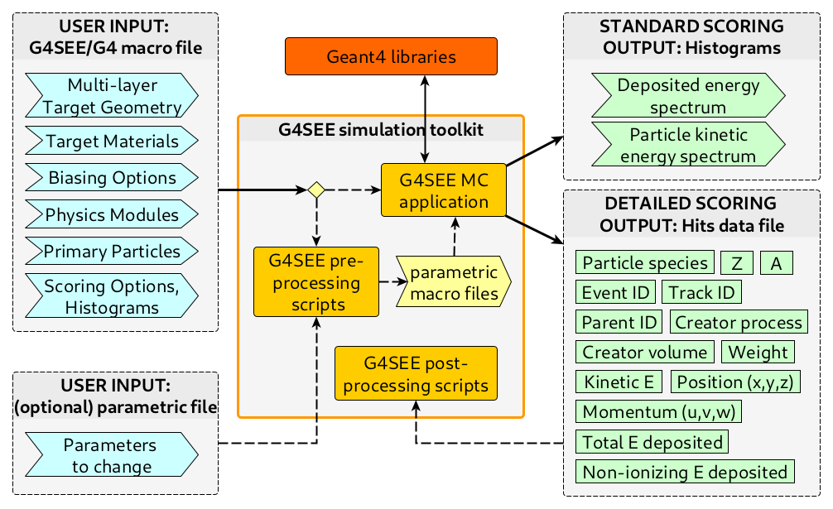
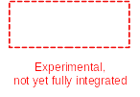
Introduction – Capabilities
Extracting low-level information relevant for SEEs, event-by-event and particle-by-particle, based on the needs of users
Direct and indirect energy deposition scoring in a micro-metric, user-defined sensitive volume ⇒ SEE cross-section (or rate) estimation
Primary motivation and use cases so far were neutron and proton induced SEEs (relevant at CERN environments)
High-level architecture of the G4SSE toolkit with user inputs and outputs (ASCII files)

Slide 5
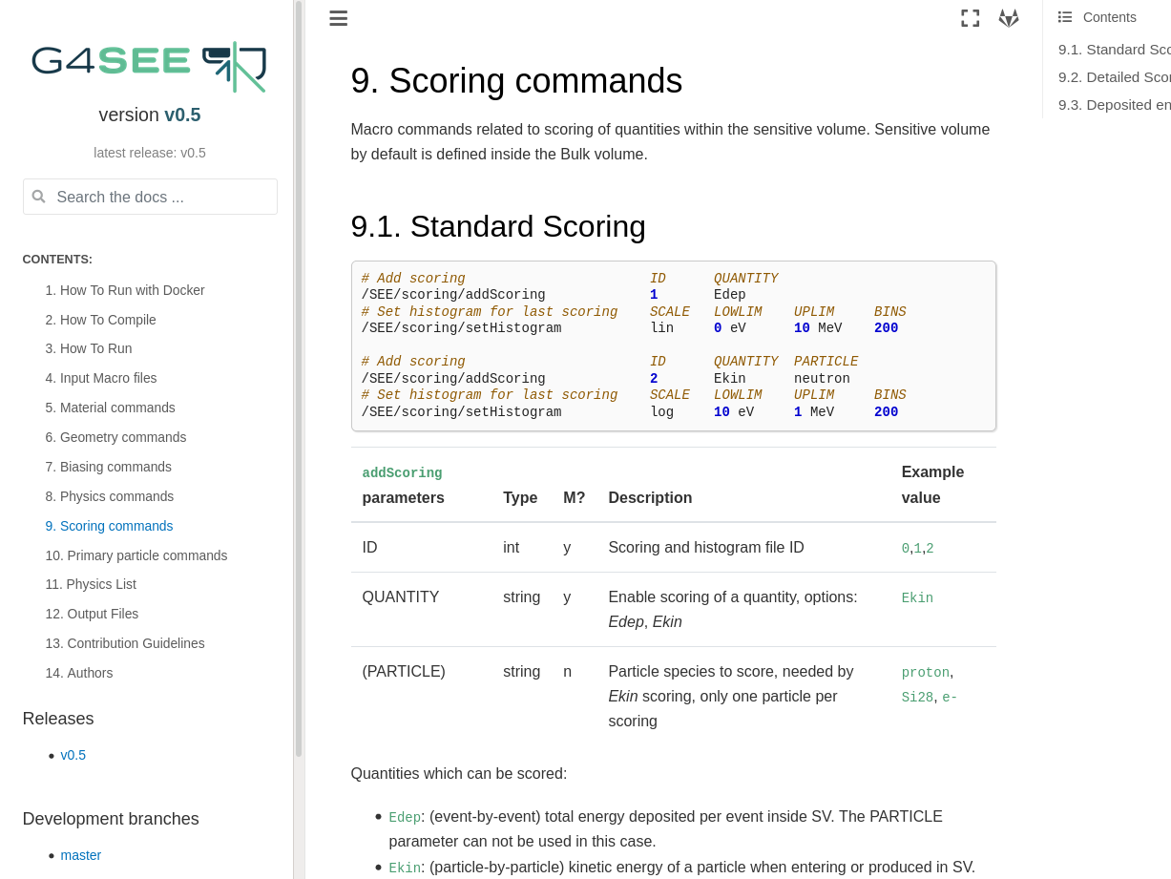
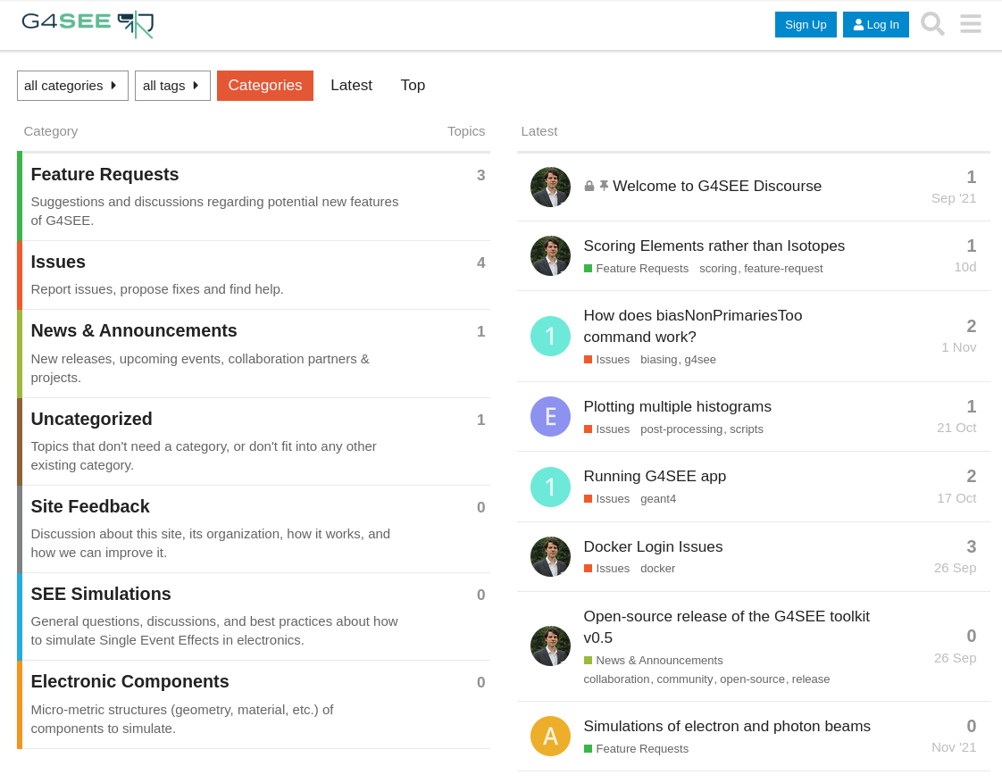
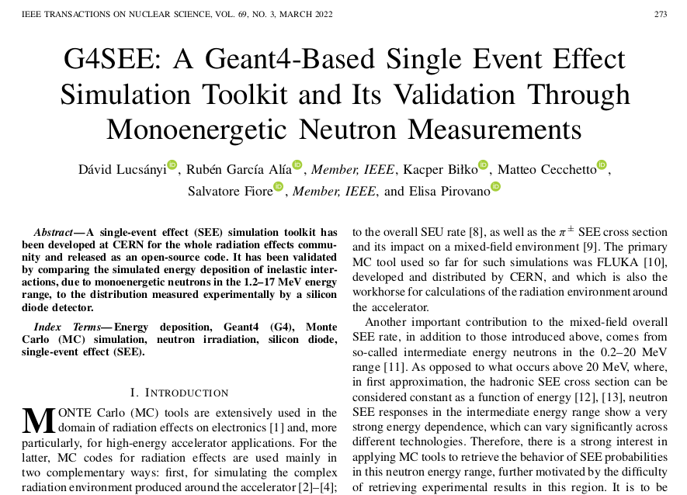
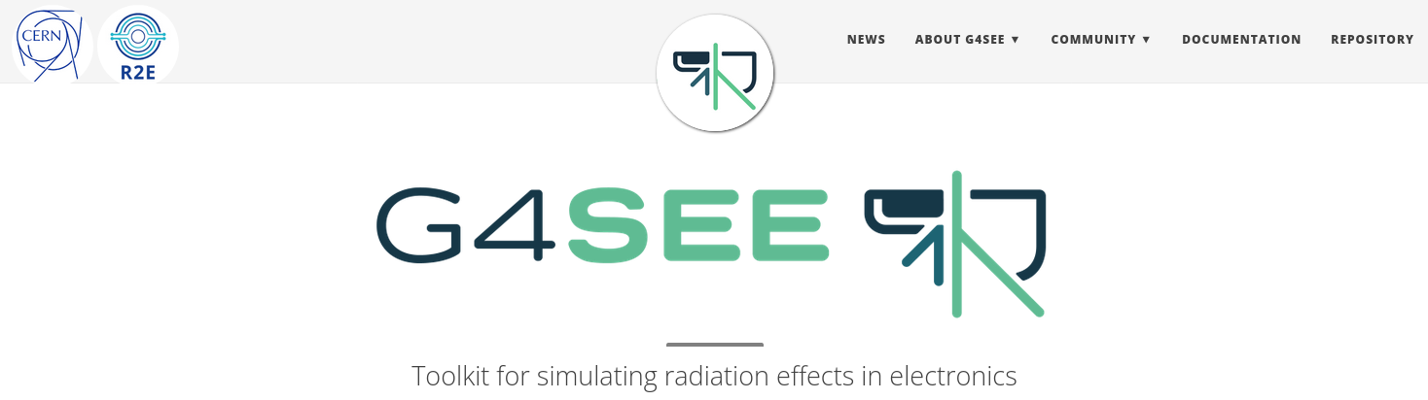
Introduction – User support & community
​G4SEE documentation:​
g4see-docs.web.cern.ch​
​G4SEE community forum:​
g4see-forum.web.cern.ch
​G4SEE paper in IEEE TNS:
doi.org/10.1109/TNS.2022.3149989
​G4SEE website:​ g4see.web.cern.ch
Contact: g4see.toolkit@cern.ch

Slide 6


Introduction – Get the toolkit!
See lecture preparation slides on SERESSA Indico page
Options to run G4SEE toolkit on your computer:
  A) Cloning CERN GitLab repos & building from source (not recommended now)
  –– OR ––
  B) Using Docker (recommended, see lecture preparation slides)
    After Docker installation, pull the latest, G4SEE v0.5.1 Docker image
    Run a Docker container based on G4SEE v0.5.1 image (with shared folder)
CLI commands to run on host computer to start G4SEE Docker container
$ docker pull gitlab-registry.cern.ch/g4see/g4see:v0.5.1_G4-11.0.3
$ export DISPLAY=:0.0
$ xhost +local:docker
$ docker run -it -h g4see -e DISPLAY=$DISPLAY -v /tmp/.X11-unix:/tmp/.X11-unix \
-v /host/path/to/shared_folder:/home \
gitlab-registry.cern.ch/g4see/g4see:v0.5.1_G4-11.0.3
root@g4see:/home# cp –r $G4SEE_BUILD/examples/tutorial_1 /home
Once inside Docker container,
copy tutorials to /home folder!

Slide 7
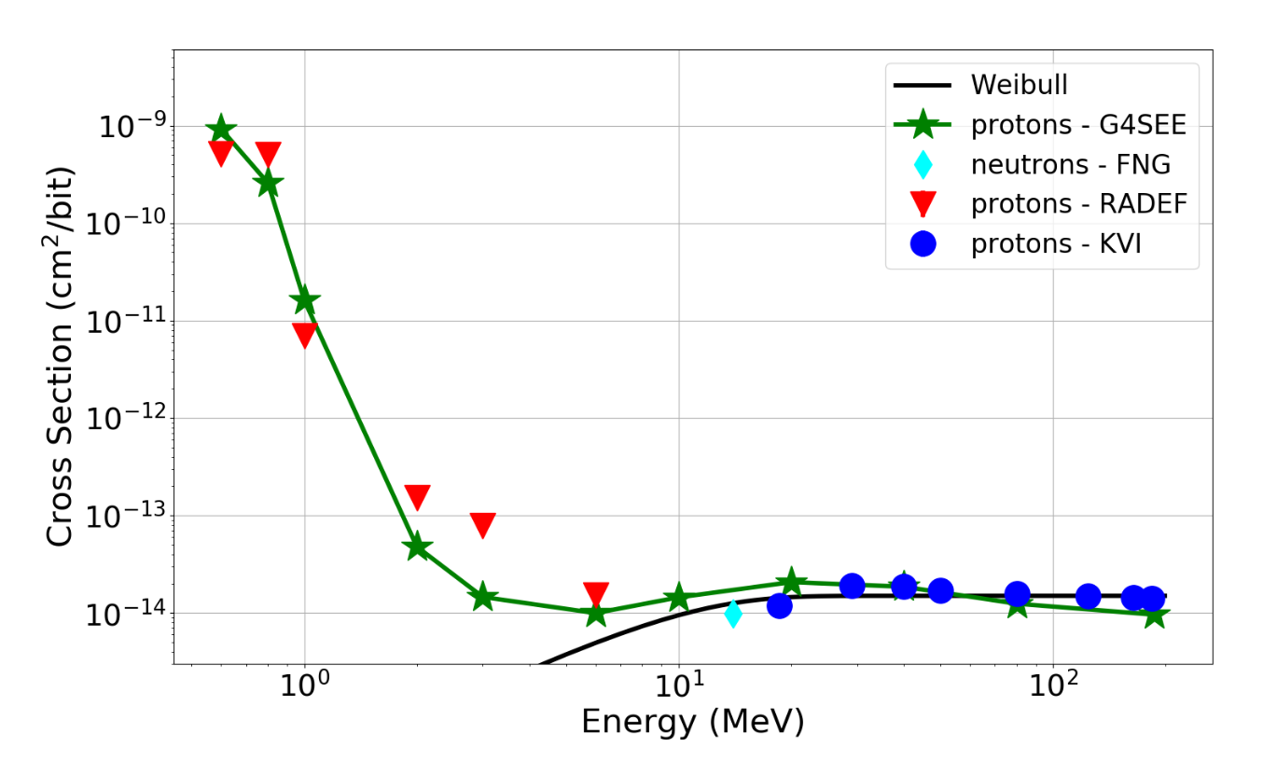
Tutorial #1 – ISSI SRAM & protons [1]
DUT: 65-nm ISSI SRAM memory
Effects: Single Event Upsets
Q_{critical} = 0.96 fC (≈ 21.6 keV)
Facilities: RADEF, PARTREC
Primaries: beam of protons
Physics: direct ionization
Scoring: standard (E_{kinetic} and E_{deposited})
Tutorial files in GitLab
Cross-section of proton induced SEUs in 65nm ISSI SRAM as function of proton beam energy [1]
Reference (open-access)
[1] Andrea Coronetti et al., "Proton direct ionization upsets at tens of MeV", in IEEE TNS, 2022, (link)

Slide 8
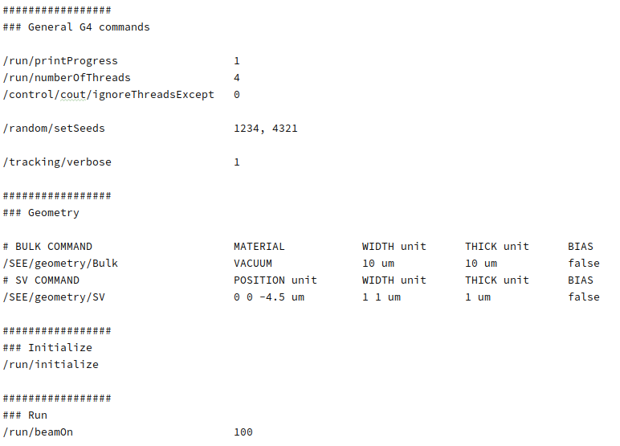
Tutorial 1.1 – General, Input/Output
To run G4SEE, a G4-style macro (UI) file is needed as input, with general G4 and G4SEE-specific UI commands
Open the tutorial_1-1.mac input macro file:
General Geant4 (G4) macro commands can be also used
Multi-threading related commands
Optional commands
Seeds for random number generator
(if you want to reproduce exact same results multiple times)
Increasing verbosity (from 0 to 1), use only for few events when testing your macro!
G4SEE-specific commands ('/SEE/...') to define geometry (see Tutorial 1.2)
These are macro (UI) commands
with multiple parameters in a single line
One command = one line
Comments start with # character
Mandatory commands
Initialization of a G4 simulation
Last command: start N=100 primary particles
(default: "geantino" virtual particles)
Tutorial files
in GitLab

Slide 9
Tutorial 1.1 – General, Input/Output
Run a simulation with this macro file, then check the output files of G4SEE:
Commands in G4SEE Docker container (CLI)
:/home# cd tutorial_1/ && mkdir output_1 && cd output_1/
:/home/tutorial_1/output_1# g4see ../tutorial_1-1.mac > stdout.log
:/home/tutorial_1/output_1# ls
* Optional redirection to file
G4/G4SEE stdout (redirected to stdout.log):
  Material information
  List of all particles and their processes
  List of all physics models enabled
  Production thresholds (a.k.a. Range cuts)
  [optional] Steps of each particle track (a.k.a. G4Track info)
g4see.out – useful info about simulation run, like G4 and G4SEE versions, running time, random seeds, number of primary particles, macro file
n_event_t<j>.out – number of events run by a specific thread/job
No scoring was added yet, so no actual data has been scored and written to file (see Tutorial 1.3)
Tutorial files
in GitLab

Slide 10
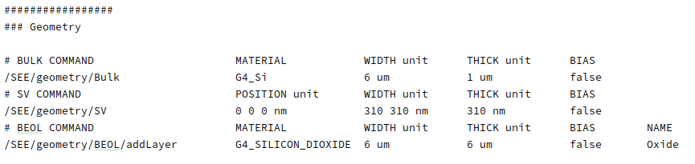
Tutorial 1.2 – Geometry
Let's define a simplified geometry for a target SRAM cell (Bulk, SV and BEOL volumes)!
Open the tutorial_1-2.mac input macro file:
Silicon is defined as the material of Bulk vol.
Dimensions (width and thickness) of a volume
Enable/Disable biasing for a given volume
Name of given Back End Of Line (BEOL) layer
(X,Y,Z) position of a SV (scoring) volume inside the Bulk (relative to Bulk cube's top center point)
SV can by asymmetric in size along X and Y axes
One can add arbitrary number of BEOL layers on top of each other, but only a single Bulk and SV for now
(NEW FEATURE SOON: arbitrary number of SVs, and nested SVs!)
Any predefined material from G4 material database can be used here
Users can also define custom materials, like elements, compounds and mixtures

Slide 11
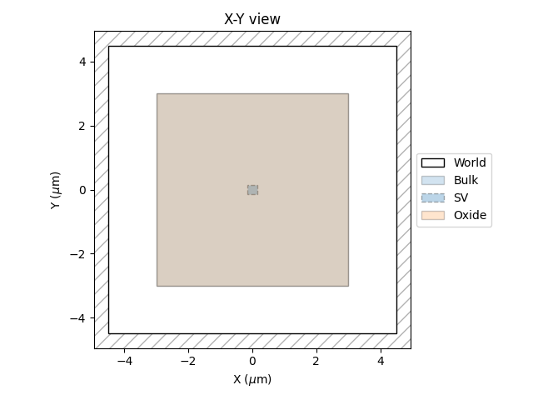
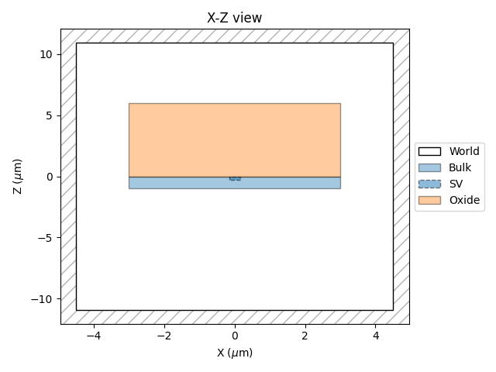
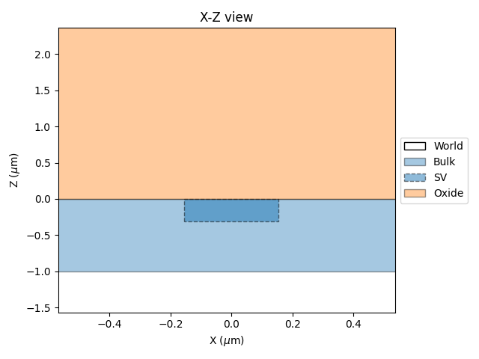
Tutorial 1.2 – Geometry
Run a simulation with this macro file, and check changes in stdout (materials and particle tracks)!
Commands in G4SEE Docker container (CLI)
:/home# cd tutorial_1/ && mkdir output_2 && cd output_2/
:/home/tutorial_1/output_2# g4see ../tutorial_1-2.mac > stdout.log
:/home/tutorial_1/output_2# less stdout.log
:/home/tutorial_1/output_2# python $G4SEE_BUILD/scripts/g4see.py view ../tutorial_1-2.mac
* press q to exit 'less'
Visualize geometry using G4SEE 'view' script:
Top (X-Y), side (X-Z) and zoomed-in (X-Z) view of simulated ISSI SRAM memory cell, proton beam will have –Z direction

Slide 12
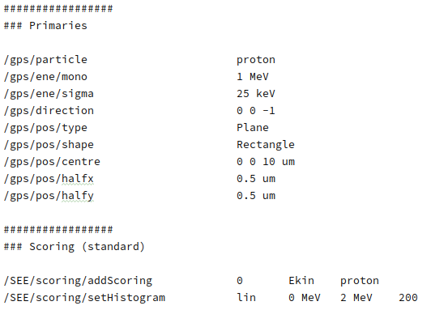
Tutorial 1.3 – Primary particles, Scoring
We can also define a simple monoenergetic proton beam (or any arbitrary particle source distribution)
Add scoring commands to record and write to file binned kinetic energy values of protons
Open the tutorial_1-3.mac input macro file:
Any G4 General Particle Source (GPS) command can be used in a G4SEE macro file, there is no limit in source definition
Particle species
Energy and angular distributions can be user-defined functions or read directly from ascii file
Mean and std. deviation of energy
Particle direction (monodirectional, -Z direction)
Shape and type of source (point/surface/volume)
Two types of scoring mechanisms implemented:
- Standard: Ekin or Edep; ​
- Detailed (see later)​
Position of source's center
Half dimensions of source plane
(now it's only 1×1 μm² plane to save time)
Scoring definitions
Kinetic energy scoring for protons (particle-by-particle scoring)
file name id: 0 --> 'Ekin_0_hist_tN.out'
Binning of histogram for previously defined scoring
(linear binning from 0 to 2 MeV in 200 bins, other option is log binning)

Slide 13
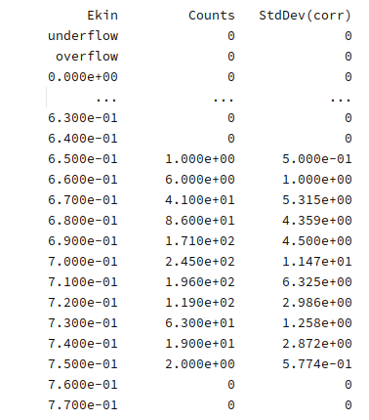
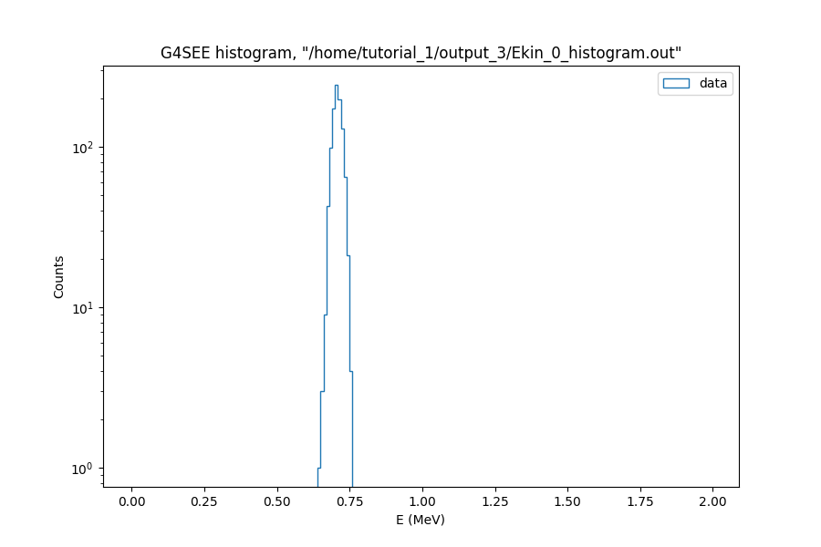
Tutorial 1.3 – Primary particles, Scoring
Run a simulation with a proton beam, while scoring energy of each proton:
Commands in G4SEE Docker container (CLI)
:/home# cd tutorial_1/ && mkdir output_3 && cd output_3/
:/home/tutorial_1/output_3# g4see ../tutorial_1-3.mac > stdout.log
:/home/tutorial_1/output_3# mergeHistograms .
:/home/tutorial_1/output_3# ls
:/home/tutorial_1/output_3# python $G4SEE_BUILD/scripts/g4see.py plot Ekin_0_histogram.out
Merge histogram files of the multiple threads into a single histogram!
Only the kinetic energy of protons entering (or produced) in the SV is scored
Plot histogram using G4SEE 'plot' script!
The proton kinetic energy spectrum reaching the SV, the 1 MeV mean energy of p beam degrades to 700 keV due to ionization
Merged histogram of scored proton kinetic energy values, during merging std. deviation of each bin is also calculated

Slide 14
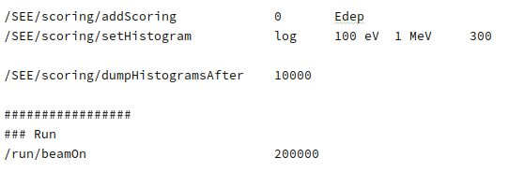
Tutorial 1.4 – Scoring, SEE cross-section
Let's add energy deposition scoring as well, similarly to kinetic energy scoring!
Open the tutorial_1-4.mac input macro file:
Deposited energy scoring per event for all particles
(event-by-event scoring)
file name id: 0 --> 'Edep_0_hist_tN.out'
Logarithmic binning with 300 bins
After how many simulated events we want to dump histograms to file
By increasing the primary particle number, we can get better statistics
Run the bit longer simulation (1-2 min), then merge histograms and create Edep histogram plot:
Commands in G4SEE Docker container (CLI)
:/home# cd tutorial_1/ && mkdir output_4 && cd output_4/
:/home/tutorial_1/output_4# g4see ../tutorial_1-4.mac > stdout.log
:/home/tutorial_1/output_4# mergeHistograms .
:/home/tutorial_1/output_4# python $G4SEE_BUILD/scripts/g4see.py plot Edep_0_histogram.out
:/home/tutorial_1/output_4# python $G4SEE_BUILD/scripts/g4see.py see-xs ../config_1-4.yaml

Slide 15
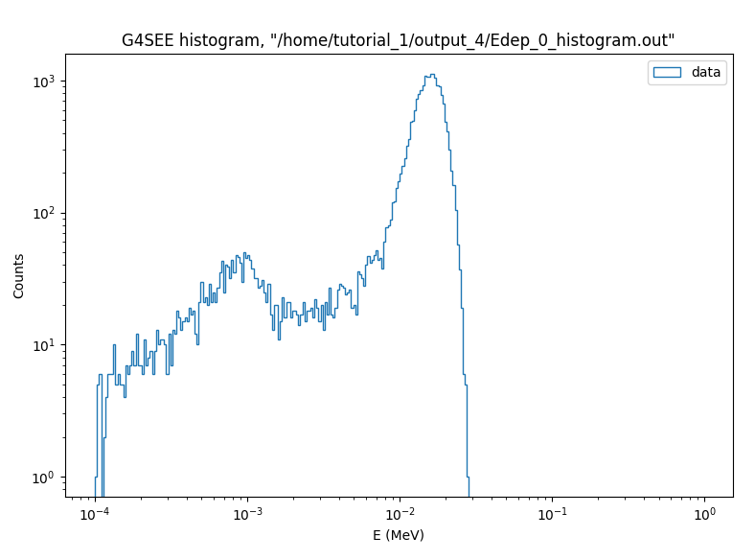
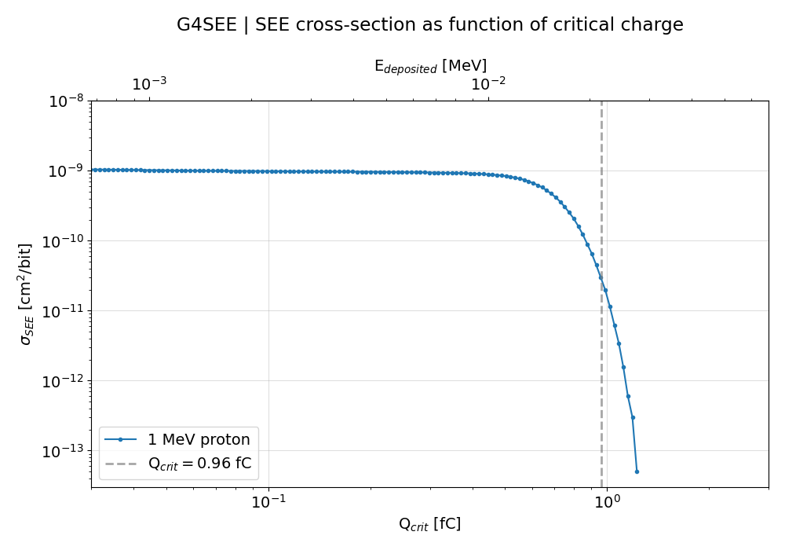
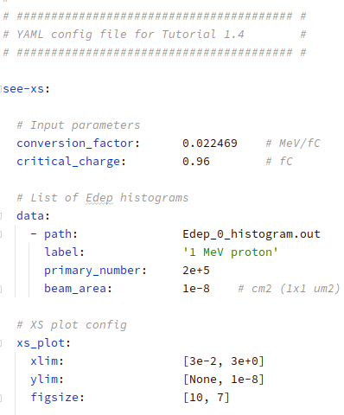
Tutorial 1.4 – Scoring, SEE cross-section
(new feature) By running the 'see-xs' script, one can obtain the SEE cross-sections in function of critical charge based on the inverse cumulative sum of energy deposition distribution --> SEE cross-section (and rate) estimation if we know Q_{critical}
(new feature) The script 'see-xs' needs a YAML config file with input parameters and plotting options
σ_{SEE} = 2.985e-11 cm²/bit
Event-by-event energy deposition distribution, contribution of δ-electrons produced outside SV at lower E_{dep} values
SEE cross-section estimation at 1 MeV proton beam energy (assuming Q_{crit} = 0.96 fC) based on MC simulated E_{dep} histogram
YAML config file

Slide 16
To be continued tomorrow...
Thank you for your attention!
Questions?
If you have further questions, need more help, or you are interested in contributing to the G4SEE toolkit, please let us know!
g4see.toolkit@cern.ch

