Slide 1


Introduction to G4SEE: a toolkit for simulating radiation effects in electronics
Part 2
Dávid Lucsányi, CERN

Slide 2
Agenda (part 2)
Hands-on tutorial #2:
  The simulation case: Neutron interactions in Silicon (ISSI SRAM)
  2.1) Geometry, Primaries, Scoring and Physics
  2.2) Biasing (non-analog MC)
  2.3) Detailed Scoring
Validation of the G4SEE toolkit with monoenergetic neutrons

Slide 3


Get the latest G4SEE release!
See lecture preparation slides on SERESSA Indico page
Options to run G4SEE toolkit on your computer:
  A) Cloning CERN GitLab repos & building from source (not recommended now)
  –– OR ––
  B) Using Docker (recommended, see lecture preparation slides)
    After Docker installation, pull the latest, G4SEE v0.5.1 Docker image
    Run a Docker container based on G4SEE v0.5.1 image (with shared folder)
    Download 'tutorial_2' folder from CERNbox
CLI commands to run on host computer to start a G4SEE Docker container
$ cp -r tutorial_2 /host/path/to/shared_folder
$ docker pull gitlab-registry.cern.ch/g4see/g4see:v0.5.1_G4-11.0.3
$
$ docker run -it -h g4see -v /host/path/to/shared_folder:/home \
gitlab-registry.cern.ch/g4see/g4see:v0.5.1_G4-11.0.3
root@g4see:/home#
Download or copy 'tutorial_2' folder to the shared folder of your host computer, so you can access it in Docker container!
Share a folder between host and Docker container!

Slide 4
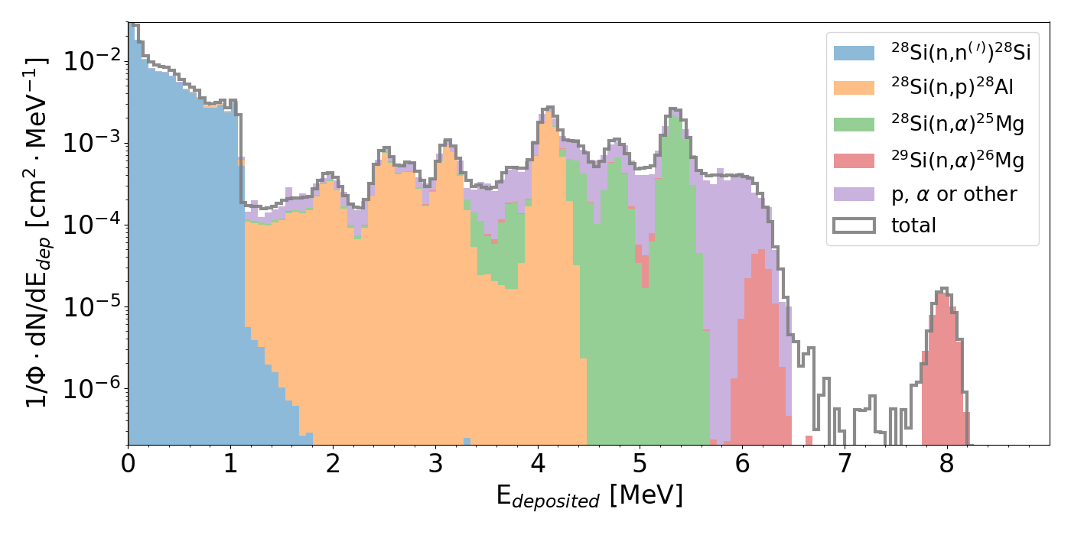
Tutorial #2 – Neutrons in Silicon [1,2]
DUT: Si diode det., 40-nm ISSI SRAM
Facilities: PTB (PIAF)
Primaries: 8 MeV neutrons
Physics: nuclear reactions
Scoring: standard, detailed
For SEU calc.: Q_{crit}=0.72 fC (≈16.2 keV)
Tutorial files can be viewed in GitLab
Contribution of different nuclear reactions to energy deposition distribution of 8 MeV neutrons in natural Silicon [1]
References (open-access)
[1] Dávid Lucsányi et al., "G4SEE: A Geant4-Based Single Event Effect Simulation Toolkit and Its Validation Through Monoenergetic Neutron Measurements," in IEEE TNS, vol. 69, no. 3, March 2022, (link)
[2] Matteo Cecchetto et al., "0.1–10 MeV Neutron Soft Error Rate in Accelerator and Atmospheric Environments", in IEEE TNS, vol. 68, no. 5, May 2021, (link)
See lecture by Matteo Cecchetto (Thursday, 10h10)!

Slide 5
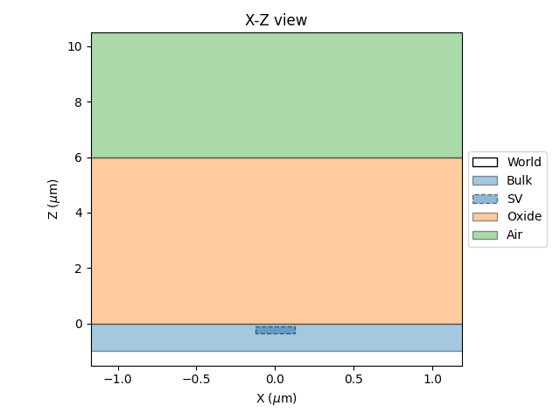
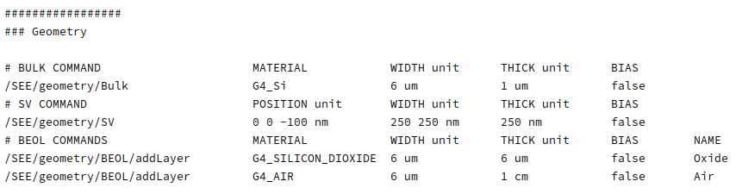
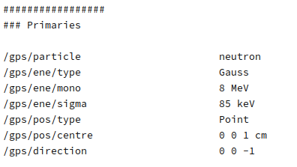
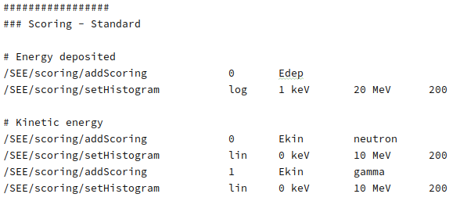
Tutorial 2.1 – Geometry, Primaries, Scoring
Open the tutorial_2-1.mac input macro file:
Tutorial files in GitLab
Tutorial files in CERNbox

Slide 6
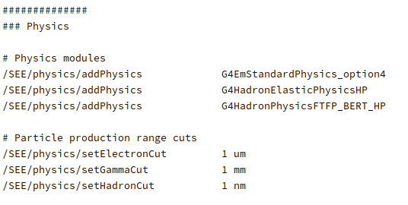
Tutorial 2.1 – Physics
Add elastic and inelastic hadronic physics to the simulation, since so far we had EM physics models only
Adding G4 physics modules to put together a full G4 physics list:
Default physics, highest accuracy general EM physics in G4 (no need to add here explicitly)
Hadron elastic physics with High Precision (HP) neutrons models
Hadron inelastic physics with HP neutron models
HP models are strongly recommended for <20 MeV neutrons!
See full list of physics options in G4SEE docs!
Running the simulation with 300k neutron primaries, we get an empty Edep histogram (only a single event!)
Simulation running time increases proportionally with primary particle number and particle interactions
Secondary particles with expected range below the defined range cuts are not produced, its E is deposited on the spot instead, it can save computational time!
Commands in G4SEE Docker container (CLI)
:/home/tutorial_2# mkdir output_2 && cd output_2/
:/home/tutorial_2/output_1# g4see ../tutorial_2-1.mac > stdout.log
:/home/tutorial_2/output_1# mergeHistograms . --delete
:/home/tutorial_2/output_1# less Edep_0_histogram.out
Tutorial files in GitLab
Tutorial files in CERNbox

Slide 7
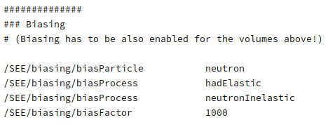
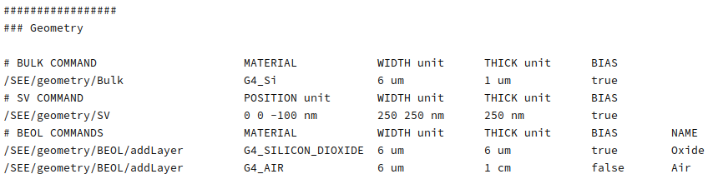
Tutorial 2.2 – Biasing
Let's increase statistics, by running a non-analog Monte Carlo simulation using a biasing (variance reduction) technique!
G4SEE has microscopic XS biasing implemented to artificially increase probabilities of certain particle interactions
Open the tutorial_2-2.mac input macro file:
Particle species to be biased (by default biasing only applies to primary particles)
Physics process(es) to be biased
The σ(E) function is multiplied by this factor, increasing interaction probability with 3 orders of magnitude
Use biasing cautiously, since it is
very easy to over-bias a simulation,
producing non-valid results!
To avoid this, run at least once without any biasing (with high pp number) for validation
Don't forget to enable biasing for the volumes here!
Tutorial files in GitLab
Tutorial files in CERNbox

Slide 8
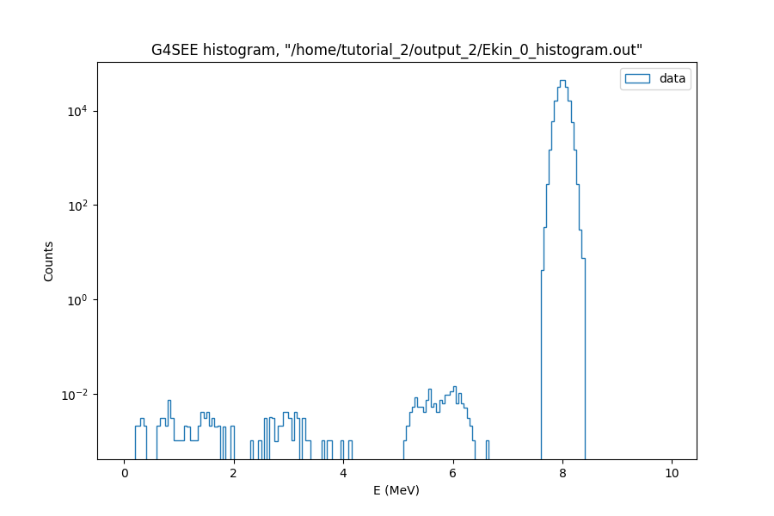
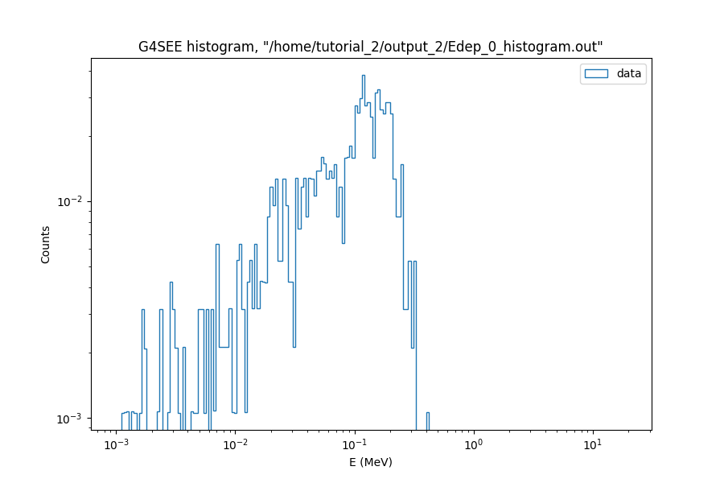
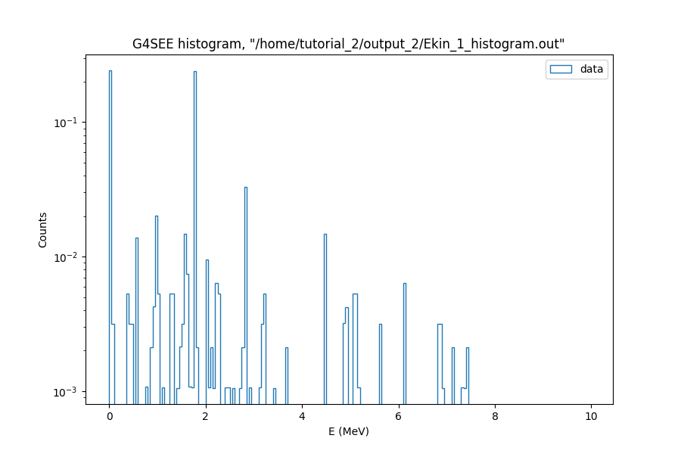
Tutorial 2.2 – Biasing
Primary neutron spectrum
Running similarly as before (300k pp), but now we get counts in histograms thanks to the applied XS biasing
Histogram counts are weighted to correct for artificial increase in interaction probabilities, so results should be in agreement with an analog Monte Carlo simulation (no biasing)
counts
Direct neutrons
Scattered neutrons
Energy deposited per event
E_{kinetic} (MeV)
Secondary gamma spectrum
counts
counts
Tutorial files in GitLab
Tutorial files in CERNbox
E_{deposited} (MeV)
E_{kinetic} (MeV)

Slide 9
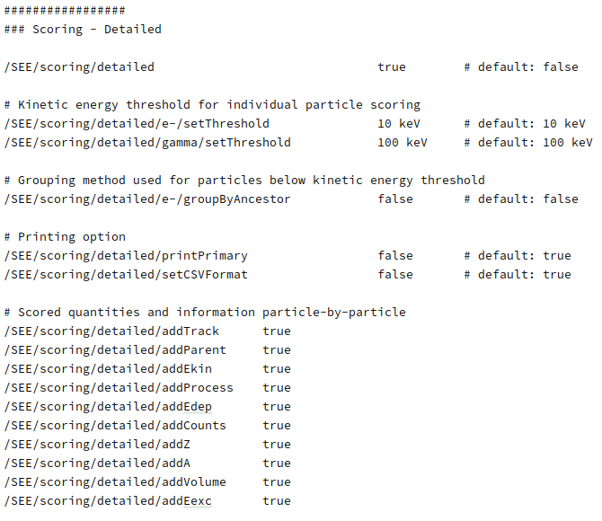
Tutorial 2.3 – Detailed Scoring
Open the tutorial_2-3.mac input macro file:
Tutorial files in GitLab
Tutorial files in CERNbox
Commands in G4SEE Docker container (CLI)
:/home/tutorial_2# mkdir output_3 && cd output_3/
:/home/tutorial_2/output_3# g4see ../tutorial_2-3.mac > stdout.log
:/home/tutorial_2/output_3# ls
:/home/tutorial_2/output_3# less Hits_t0.out

Slide 10
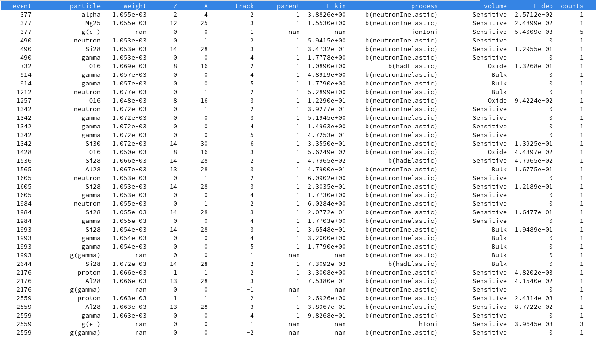
Tutorial 2.3 – Detailed Scoring
'Hits_tN.out' detailed scoring output file containing information of individual particles (or particle groups if grouped, in case of e⁻, e⁺ and γ)
Further processing and analysis needed (such a post-processing python script to be added to a future G4SEE release)
Tutorial files in GitLab
Tutorial files in CERNbox

Slide 11
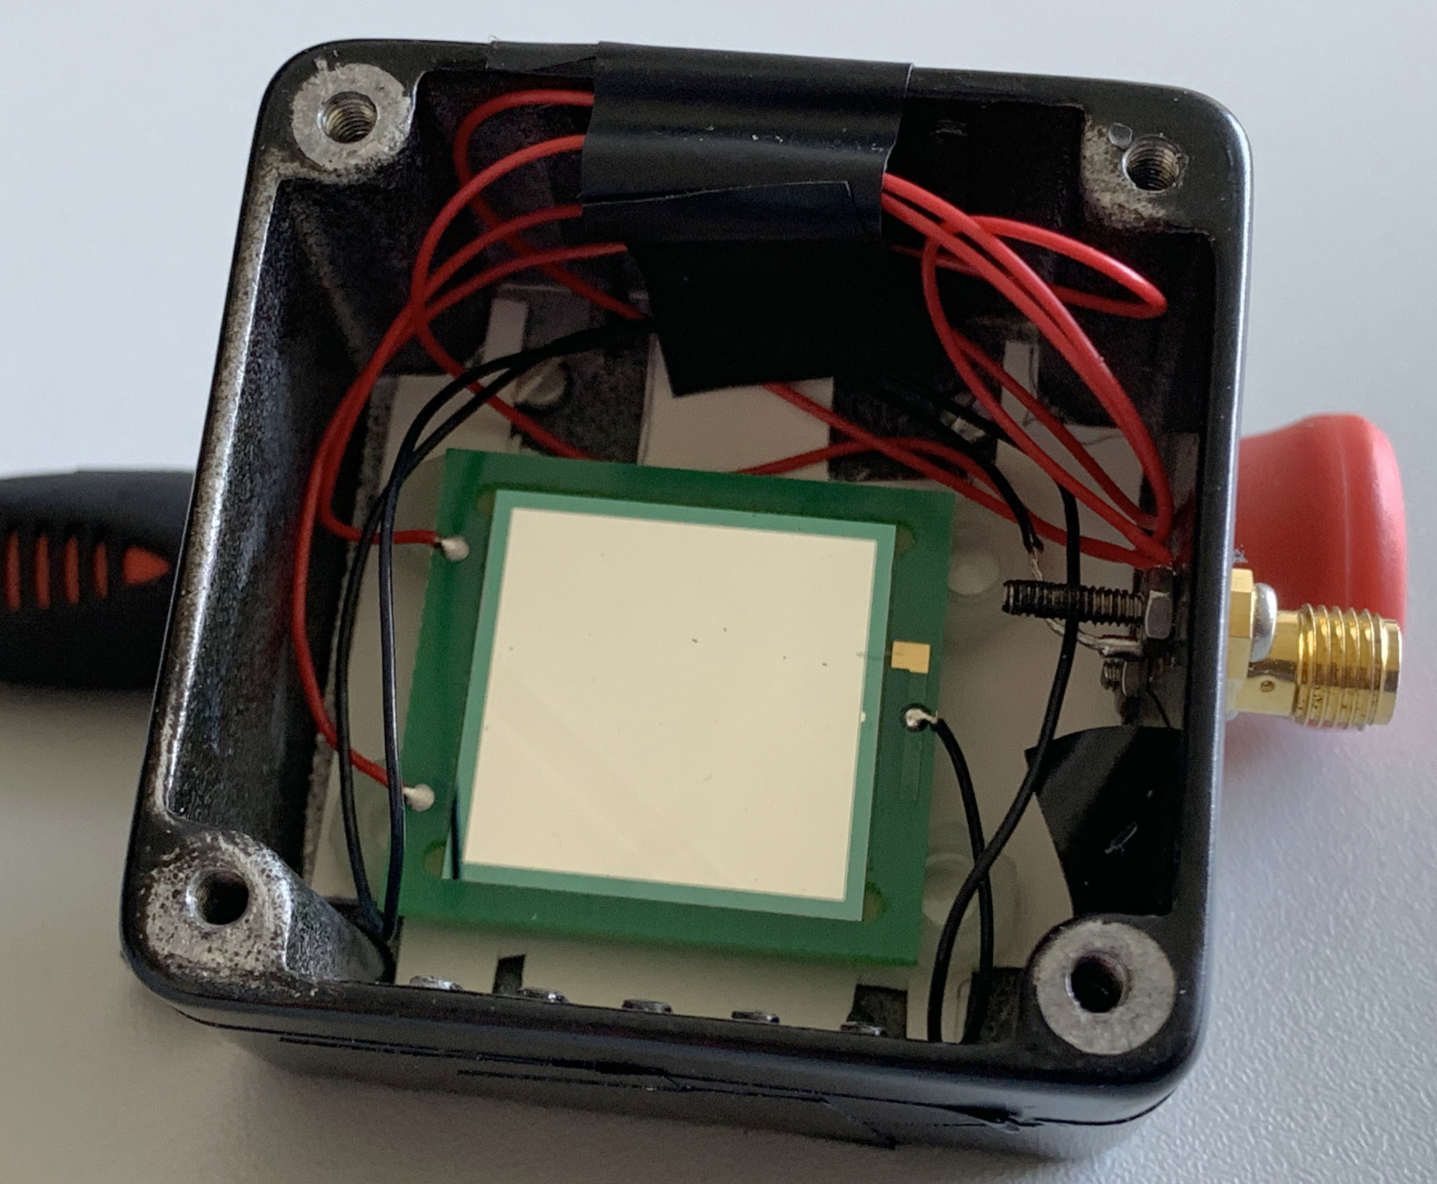
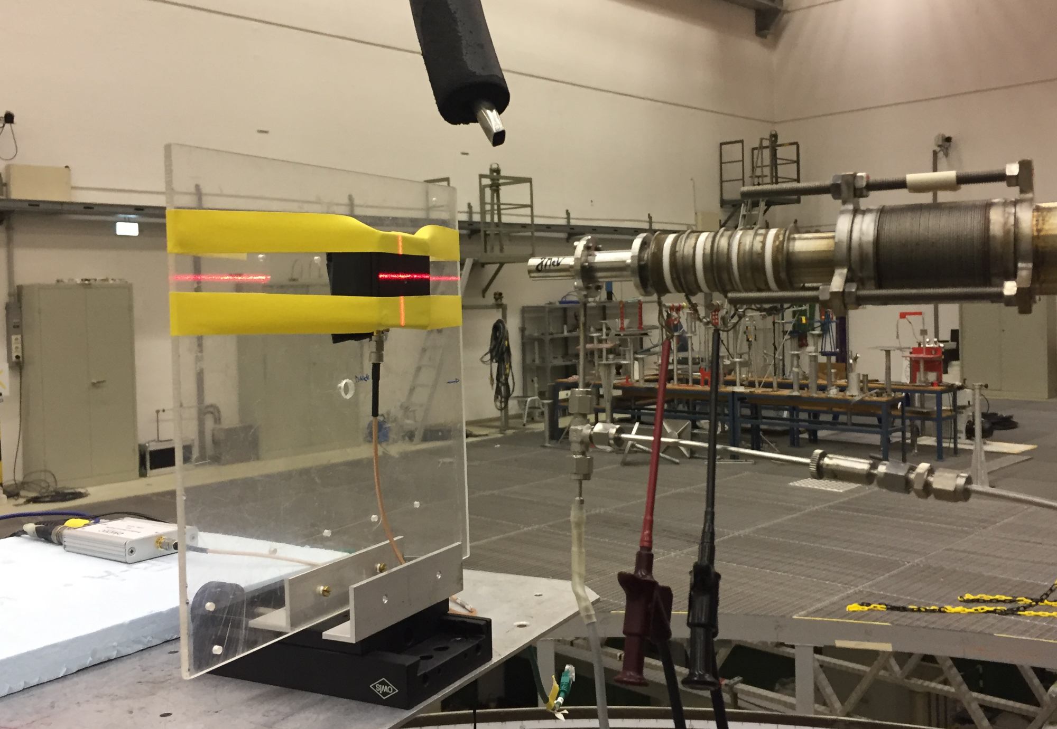
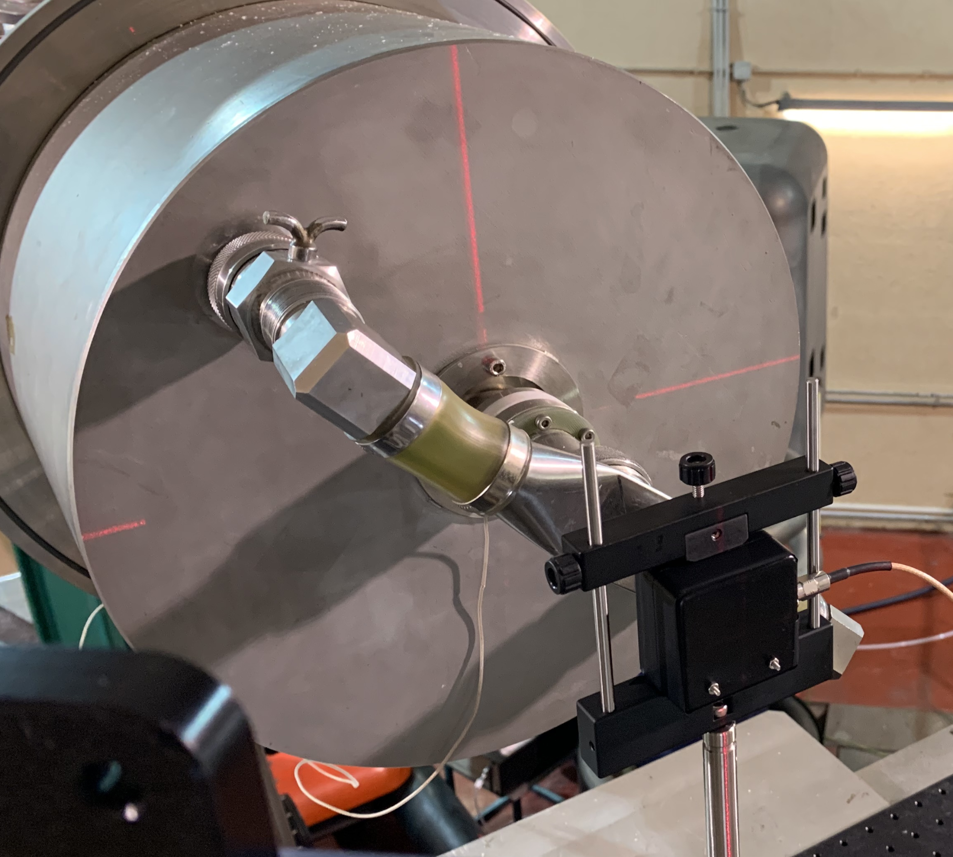
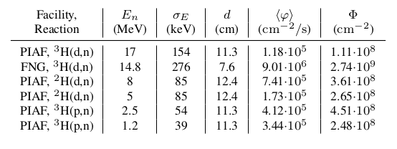
Validation of G4SEE with neutrons [1]
Silicon diode detector
(2cm × 2cm × 300 μm)
Diode setup irradiated at
PTB Ion Accelerator Facility (PIAF)
Diode setup irradiated at
Frascati Neutron Generator (FNG)

Slide 12
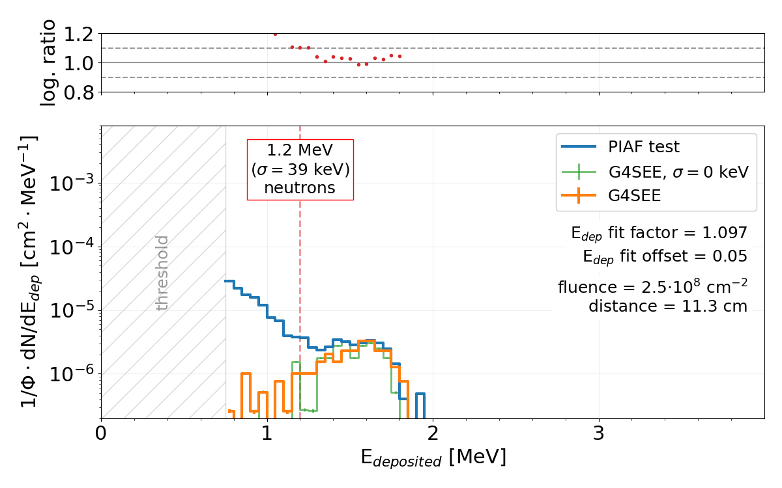
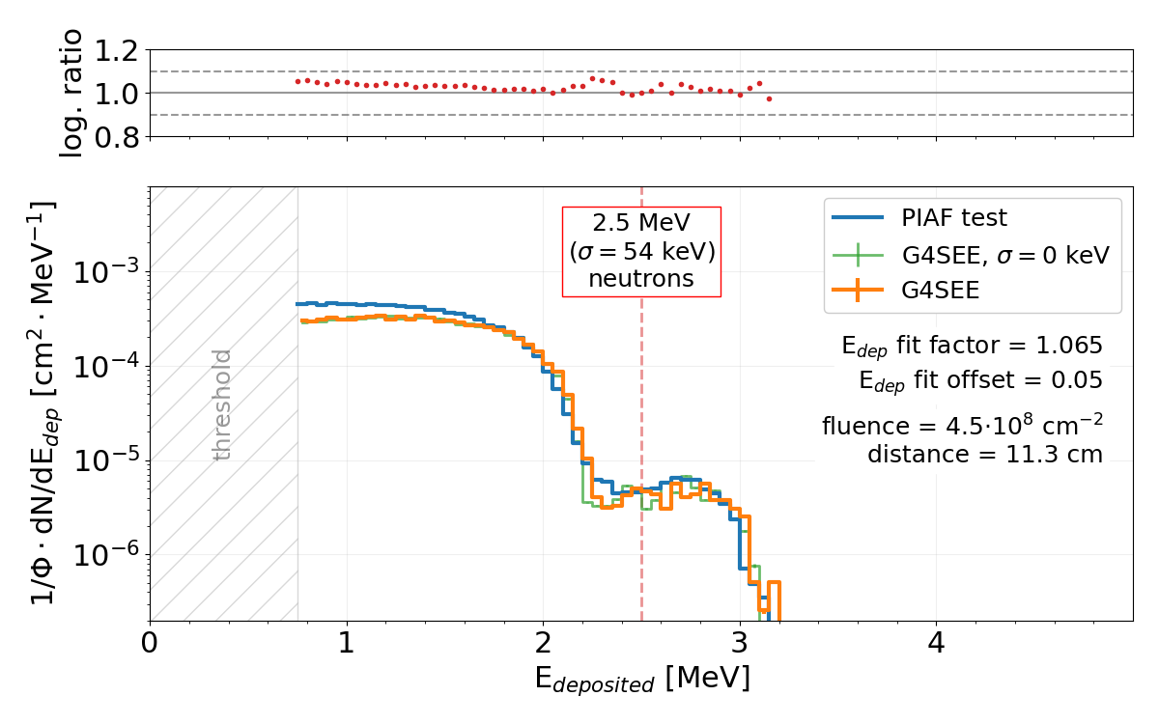
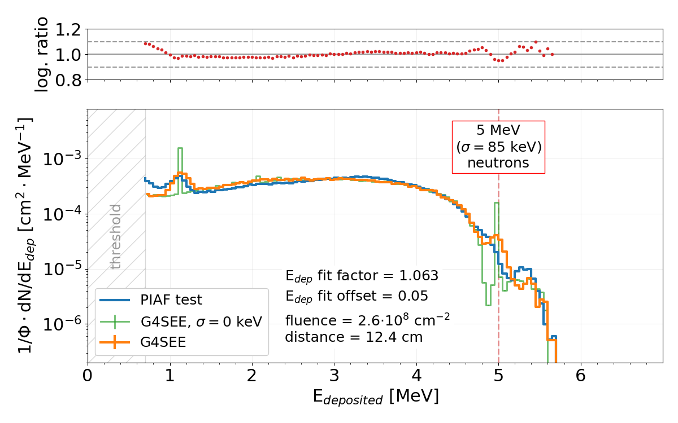
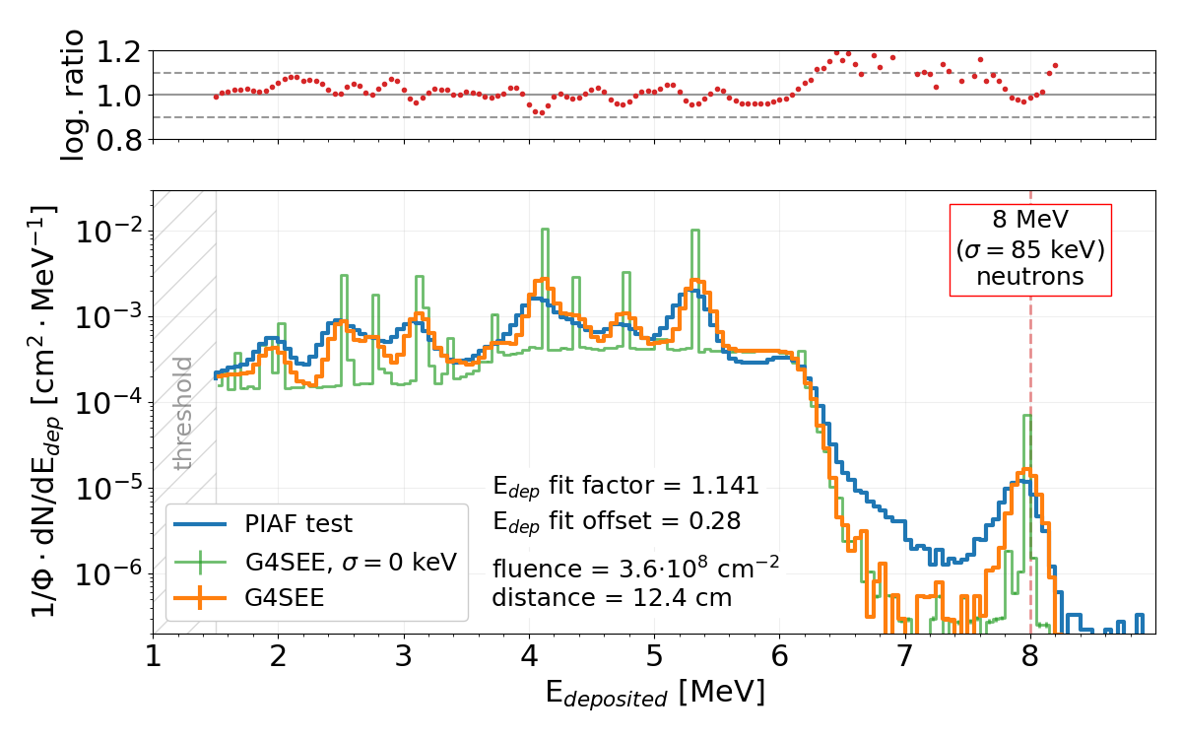
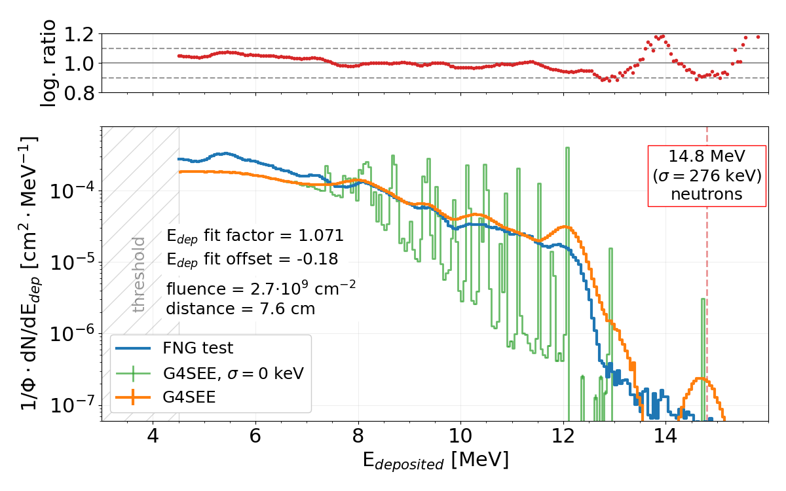
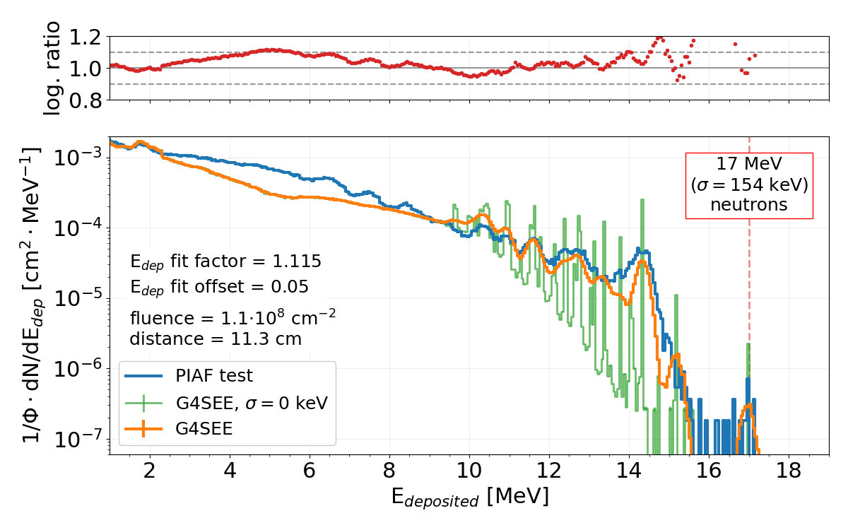
Validation of G4SEE with neutrons [1]
1.2 MeV
2.5 MeV
5 MeV
8 MeV
14.8 MeV
17 MeV

Slide 13
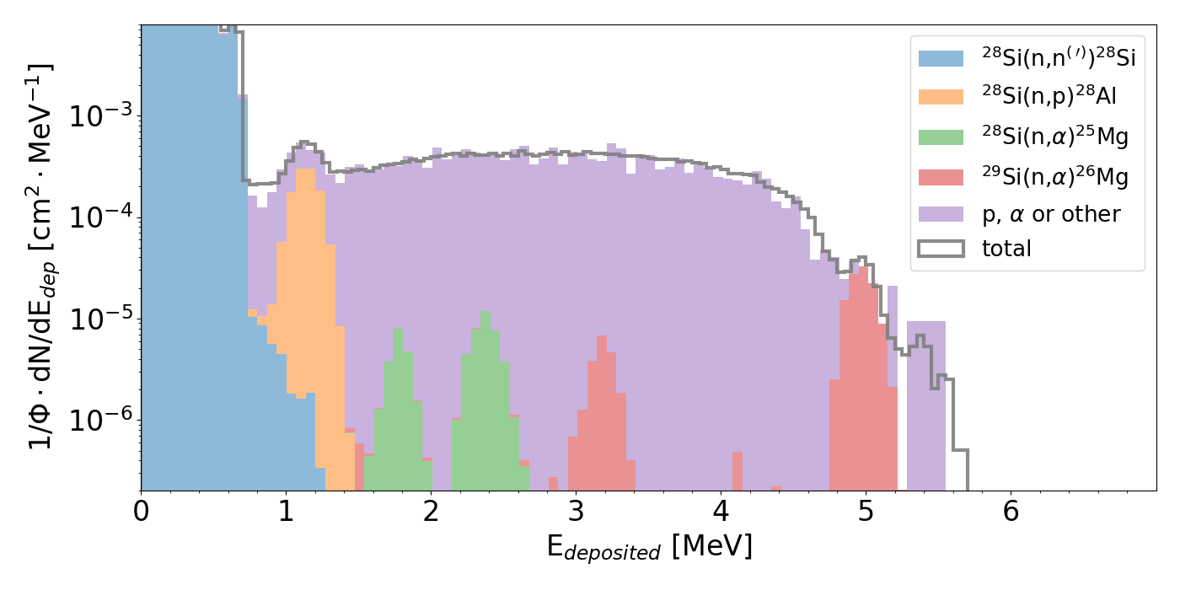
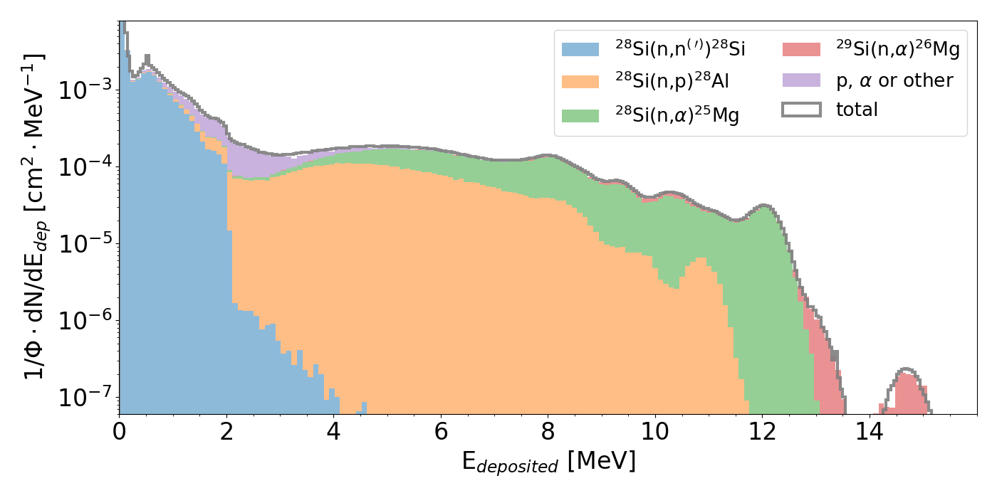
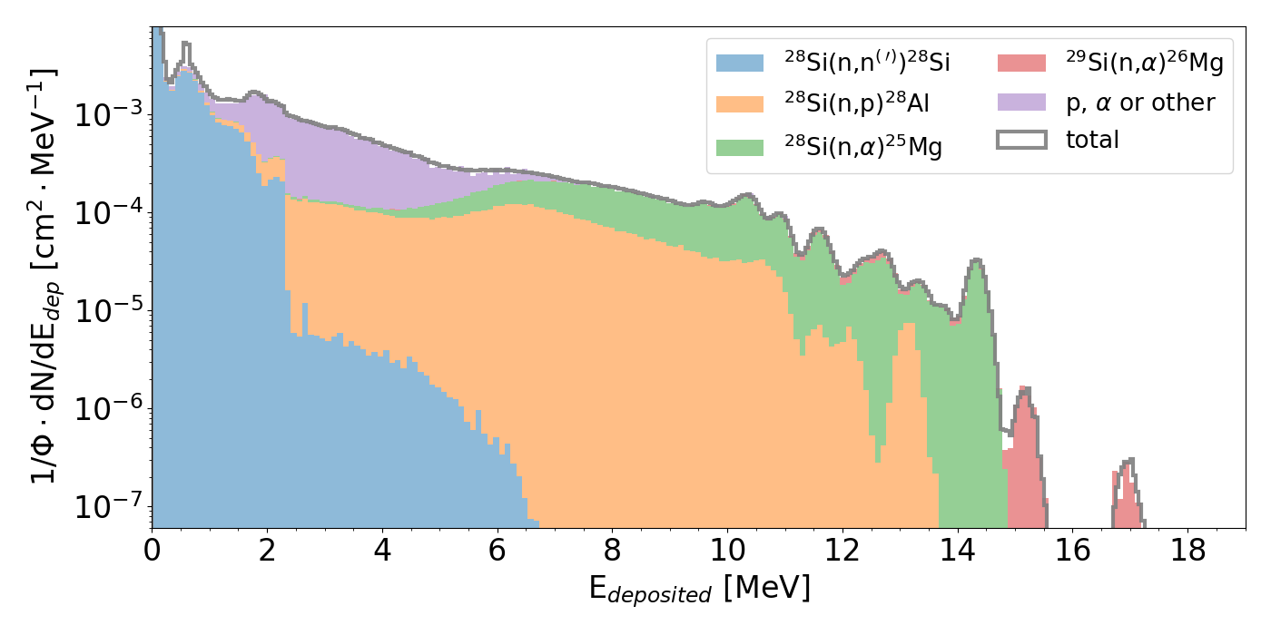
Validation of G4SEE with neutrons [1]
5 MeV
8 MeV
14.8 MeV
17 MeV
Contribution of the most frequent nuclear reactions to energy deposition distributions of monoenergetic neutrons in Silicon diode detector

Slide 14
Summary

Slide 15
Thank you for your attention!
Questions?
If you have further questions, need more help, or you are interested in contributing to the G4SEE toolkit, please let us know!
g4see.toolkit@cern.ch

