Slide 1

HL-LHC WP3
MCBRP-04 (CCT) Project
Kick-off meeting
Arnaud Foussat, Veronica Ilardi – CERN MSC-SMT
On behalf of Collaboration for HL-LHC MCBRD WP3
SMT MCBRD kick off Meeting, CERN, Nov.18, 2021

Slide 2
Outline
Introduction
Responsibility matrix
Organization, team
WBS, Main MIPs ( winding, impregnation, matrix assembly)
Provisional Schedule
Procurement status, Open documentation items, actions
AOB

Slide 3
Introduction
To construct a 4th MCBRD prototype at CERN qualified per the MCBRD HL-WP03 series.
The prototype construction shall rely on SMT resources, and shall gather all best practise experience accumulated from past.
Changes will be minimised, unless directly justified by better performance or reliability.
This construction opportunity allows to consolidate electrical design features, fabrication procedures, tests on the CCT cutting edge technology.

Slide 4
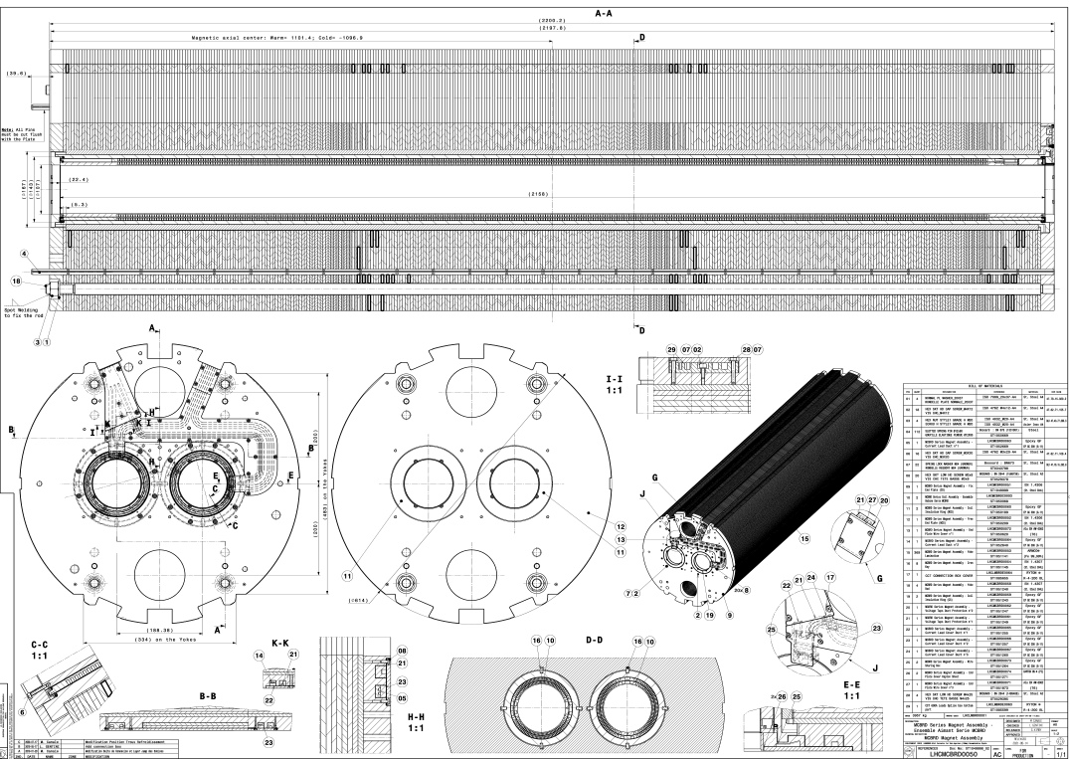
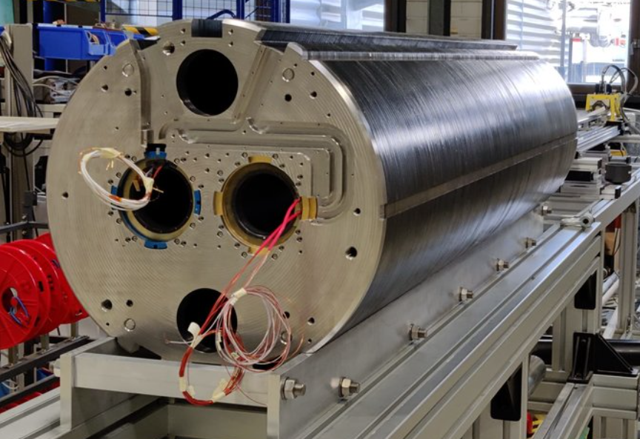
Assembly drawing LHCMCBRD0050
MCBRDP3

Slide 5
WBS
MCBRD-P4 WBS includes the common magnet manufacture packages breakdown structure
Magnet Design
Magnet components procurement
Electrical test
Winding
Impregnation VPI
Magnet assembly
QA inspection
Magnetic measurements
Magnet cold test interface
Analysis
Wires preparation, test, spooling
Assembly processes electrical test
  Assembly steps validation
  Impregnation support
Handling tooling preparation, wire spooling
Vacuum vessel preparation , sealing , pumping
Preparation of assembly tooling
Documentation, templates, MTF QC work flow
Warm MM on aperture
Power systems, protection
Mechanical
  Aluminium formers fabrication, metrology, cleaning
Components inspection, material certificates
Impregnation process
Instrumentation, DAQ
Design office
Double aperture yoke assembly
Cold MCBRDP4 magnet MM measurement
Acceptance electrical tests
Winding, inner, outer layers
MIP, Manufacture processes validation
Composite parts
Monitoring (T, P, electrical meas.)
Test plan, approval
PI sheets, Fiber glass, wires (VTs)
Acceptance tests
Instrumentation
T sensors

Slide 6
WBS provisional resource
WBS ID | WP Responsibilities | Res. name | Team | Comments
01 | Project coordination | A. Foussat | H. Felice
02 | Design support | G. Kirby | Foussat D. Tommasini | Support on test conditions, diagnostics, limits, improved electrical features
03 | Magnet fabrication follow up | V. Ilardi | A. Foussat
04 | CAD support | M. Canale | L. Gentini
05 | Procurement follow up, Parts preparation. | V. Ilardi, | D. Cote, B. Fornes | 90 % of components launched J. Mazet as support until end dec 2021
06 | Logistics coord. | G. Maury | V. Ilardi, D. Cote
07 | Winding | C. Fernandez | F Garnier, | J. Mazet as support
08 | Impregnation | C. Urscheler, V.Ilardi | A. Benfkih, S. Clement, | D. Tommasini as support
09 | Electrical testing & instrumentation | F.O. Pincot | P. A Contat
10 | Magnet assembly | V. Ilardi, | H. Dupont, N. Eyraud | J.C Perez as support
11 | QA doc. & inspection | V. Ilardi, | S. Menu
12 | Work shop resources | J.C. Perez | H. Felice
13 | Magnetic measurement | C. Petrone | L. Fiscarelli
14 | Cold SM18 test interface | F. Mangiarotti |  | A Foussat follow up
15 | Mechanical workshop production & metrology support | V. Ilardi | P. Moyret (EN MME), S. Becle ( LMF). A. Cherif (EN MME), P. Rizzo (SMT)

Slide 7
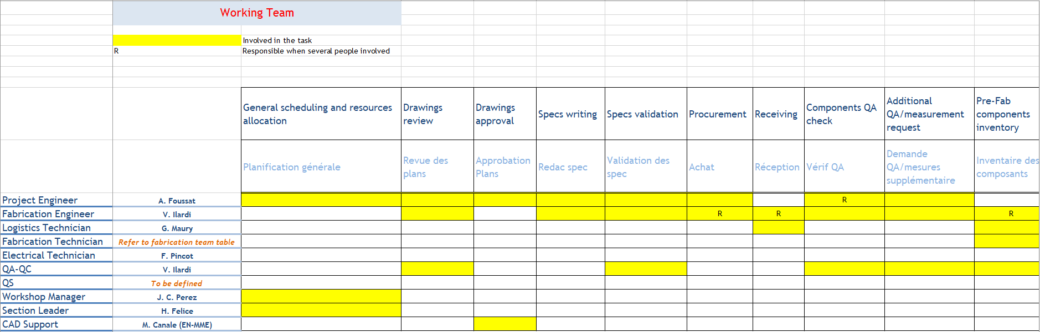
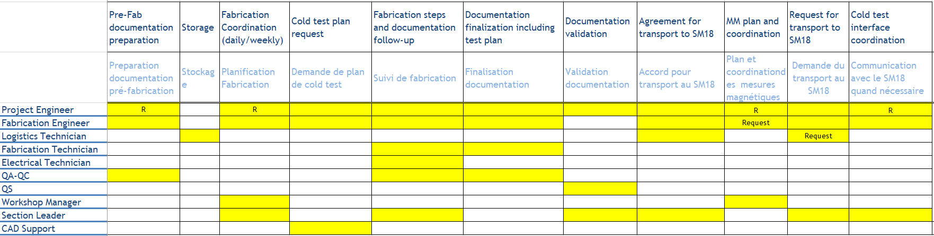
Responsibility matrix
See Paper copy by Veronica

Slide 8
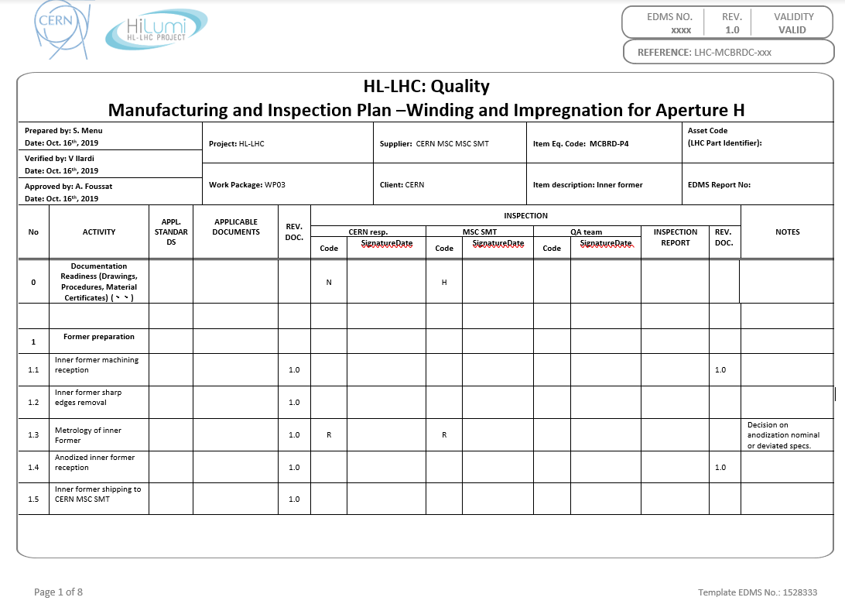
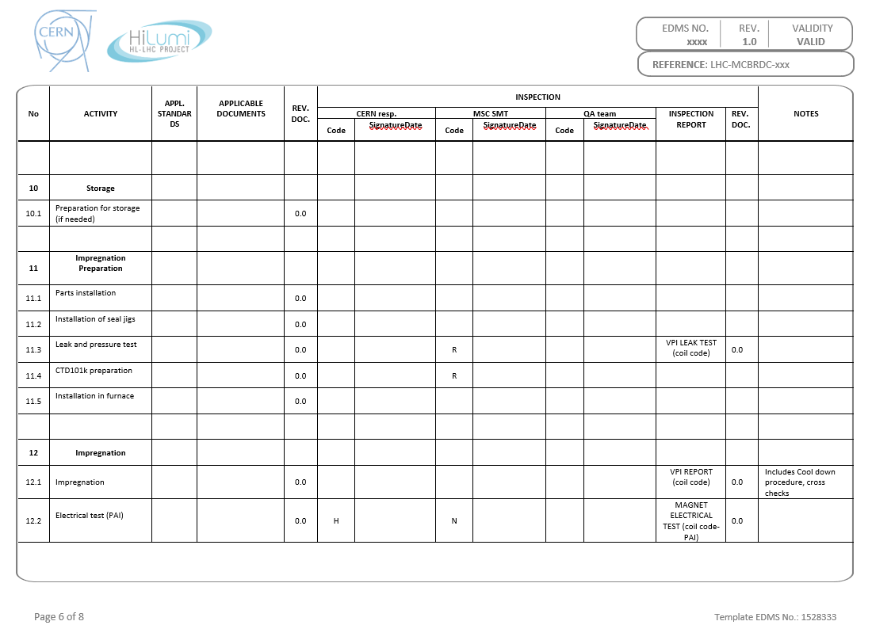
Manufacture Inspection Plan (MIPs)
Set of MIPs under progress for MCBRDP4 relying also on best practise manufacture steps included, links to updated procedures
Facilitate the controls points and interfaces management

Slide 9
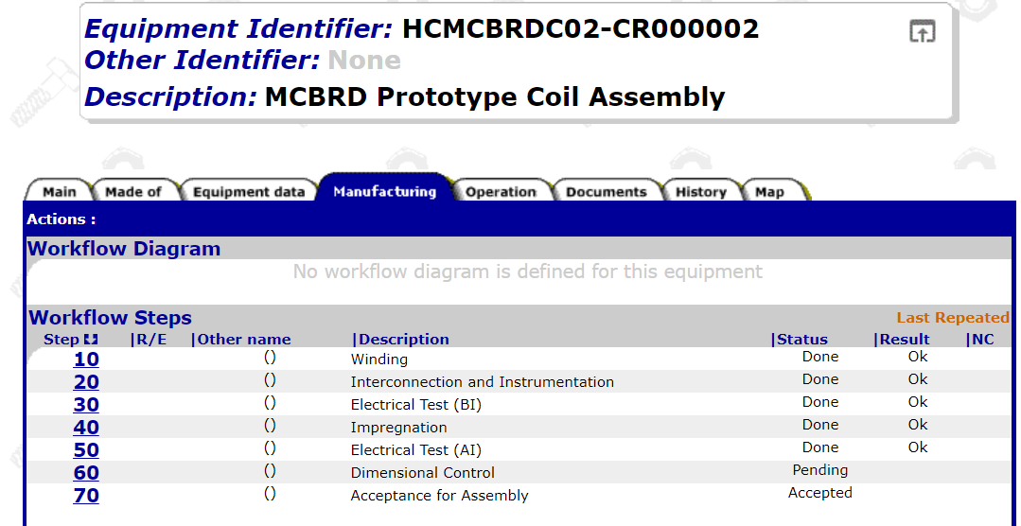
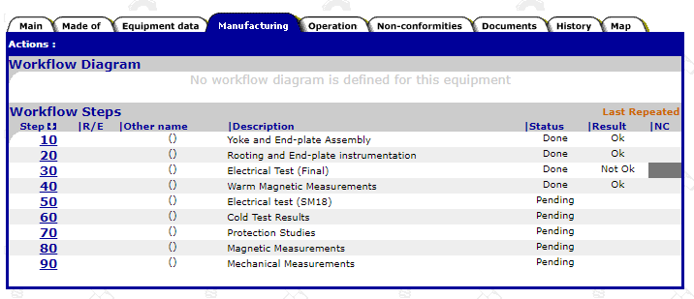
Manufacture Traveller Folder
Structure of MTF steps for Proto MCBRDP4 shall follow the previous prototype P3 model (below).

Slide 10
MCBRDP4 BOM
Updated prototype 4 BOM by M. Canale last 09/2021

Slide 11
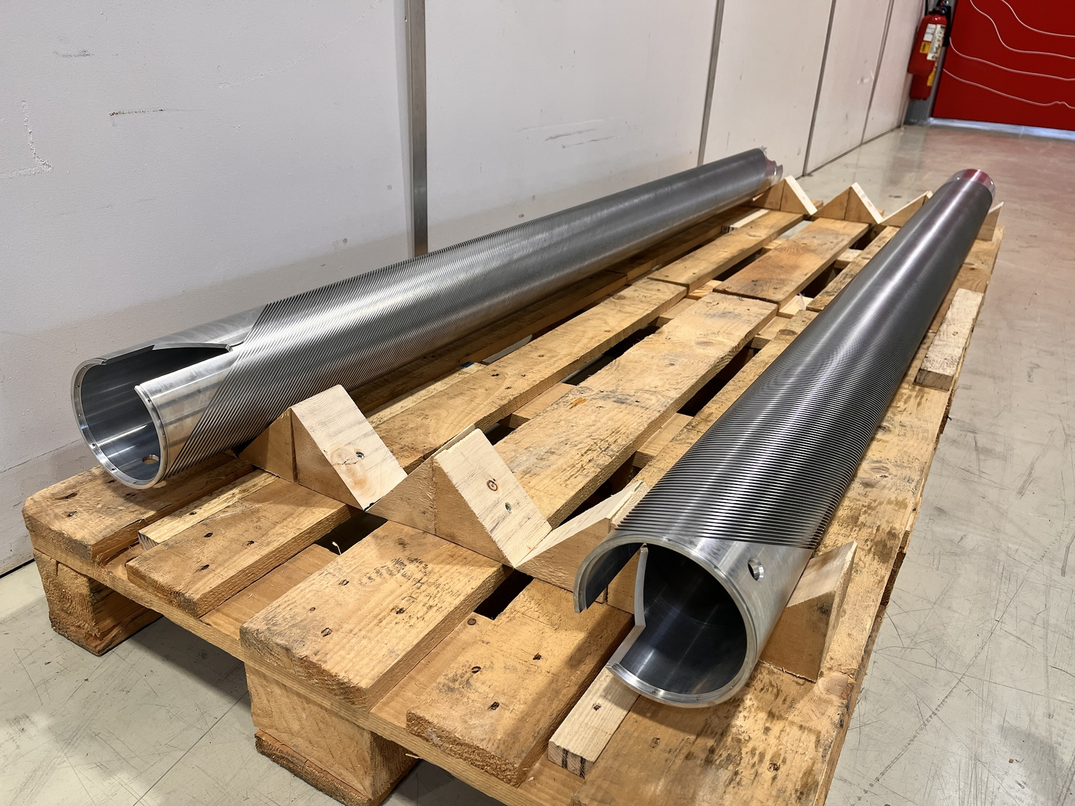
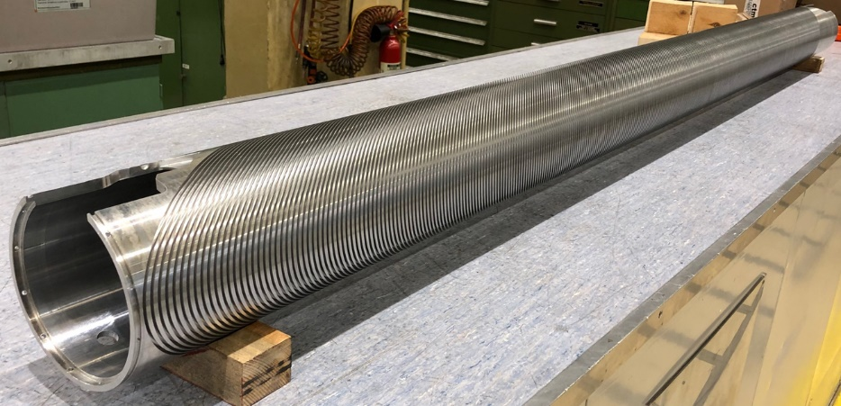
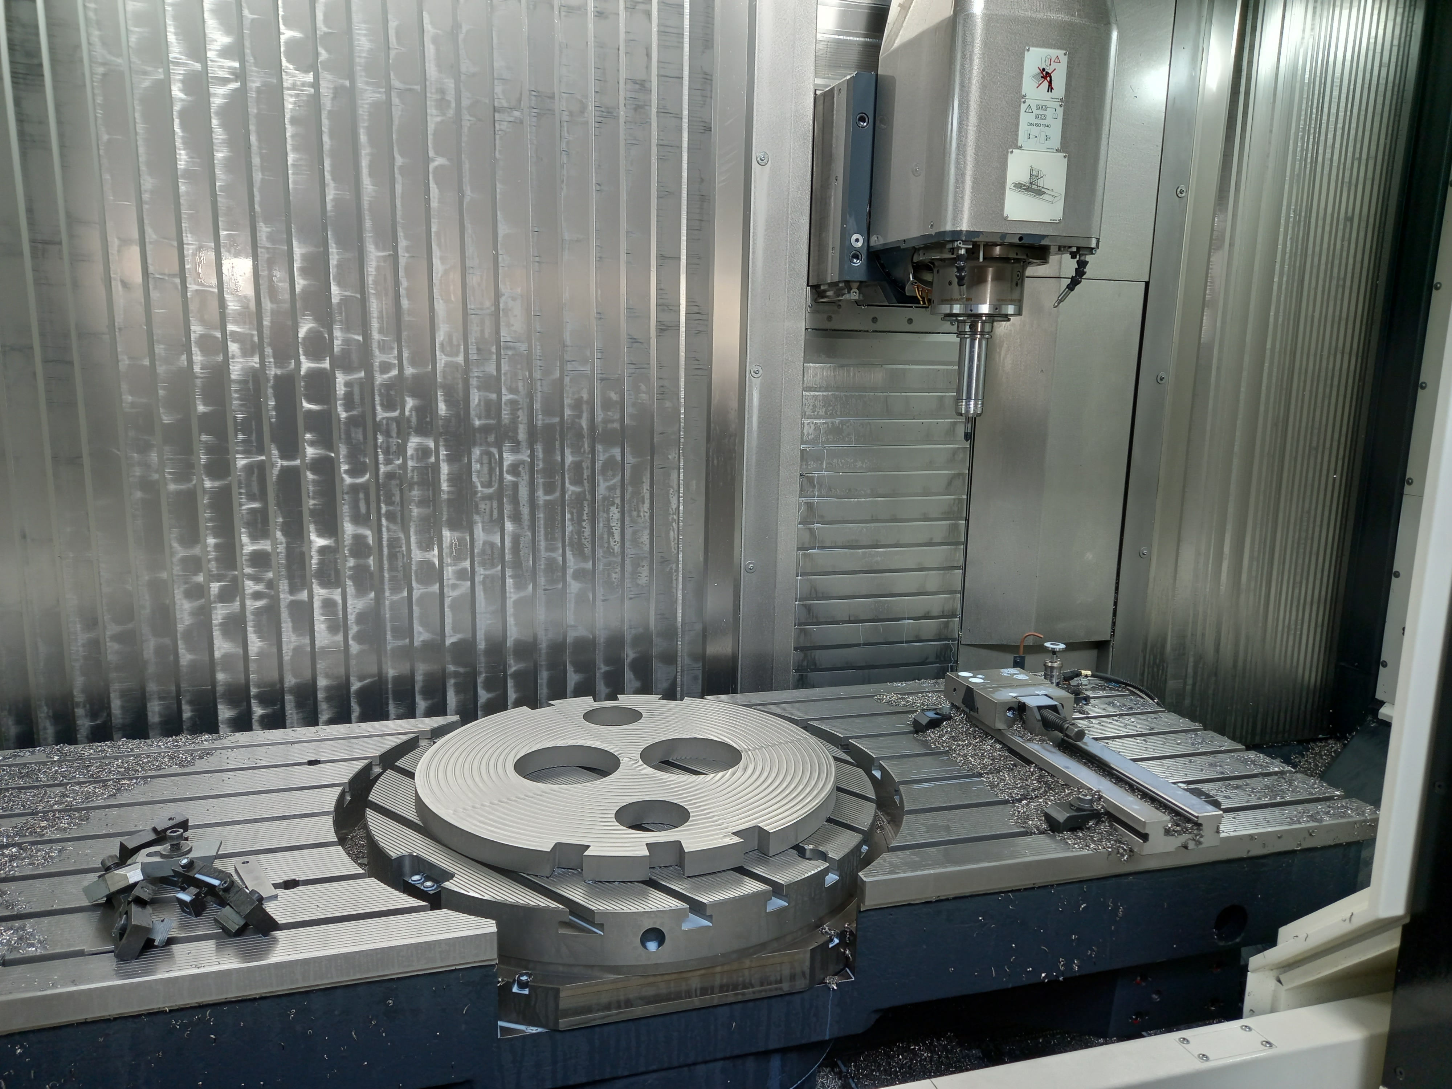
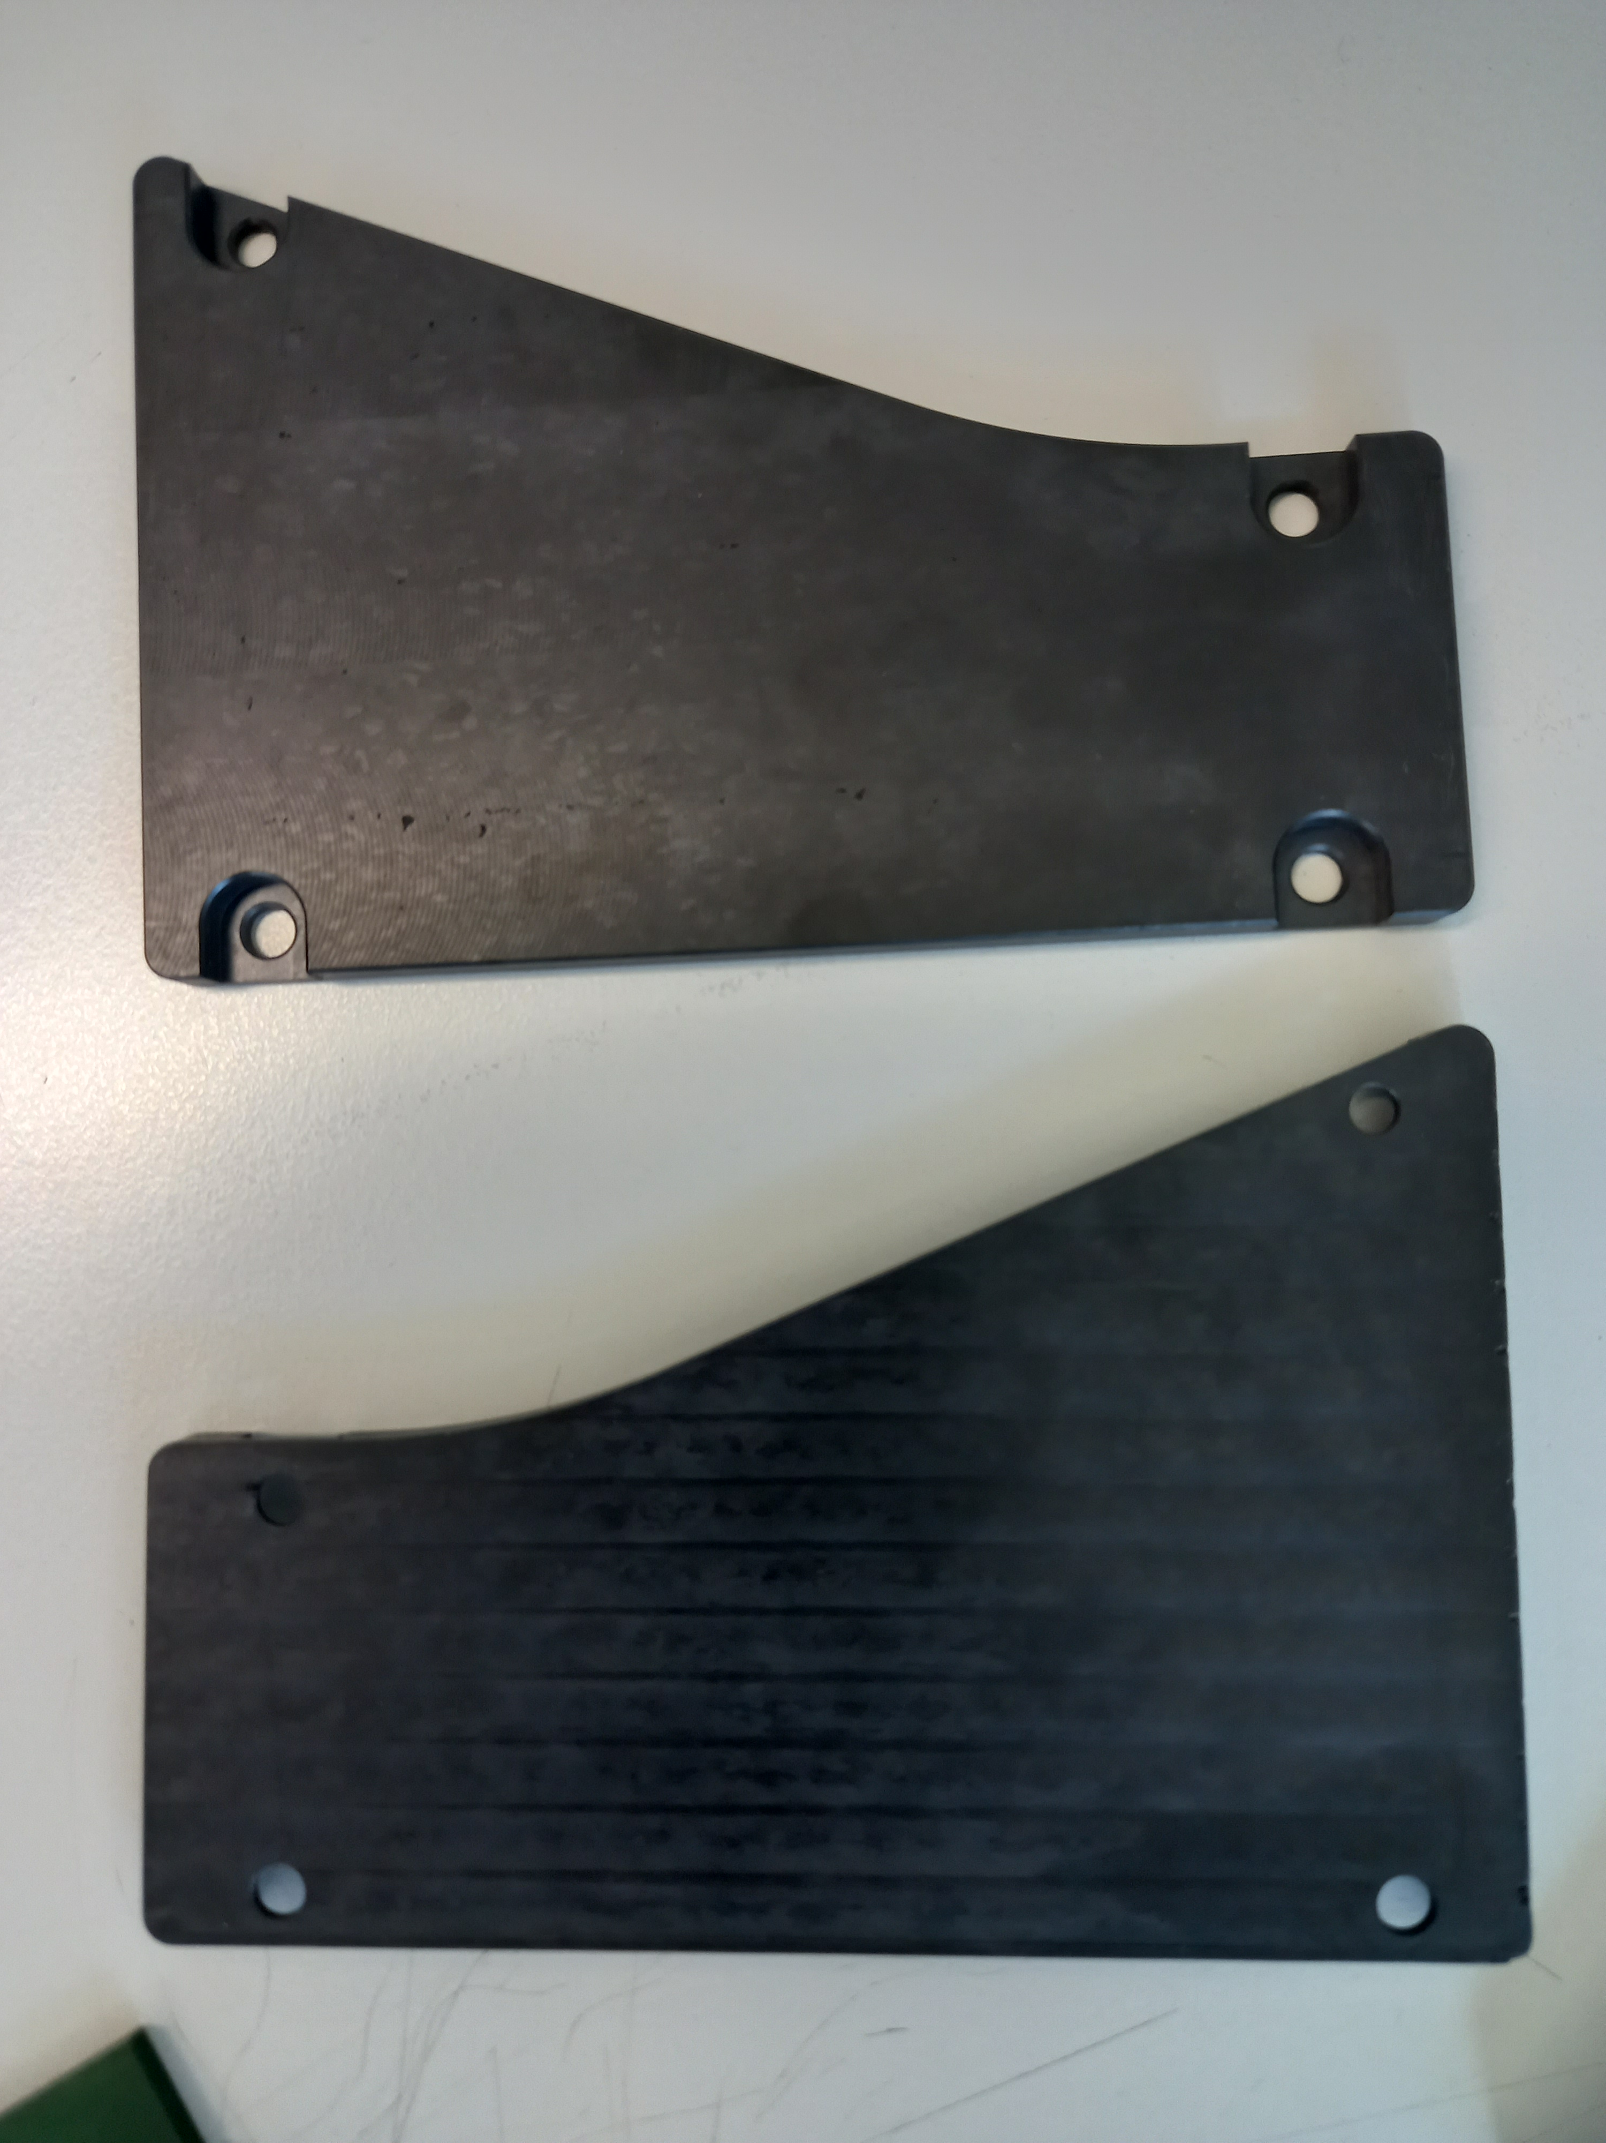
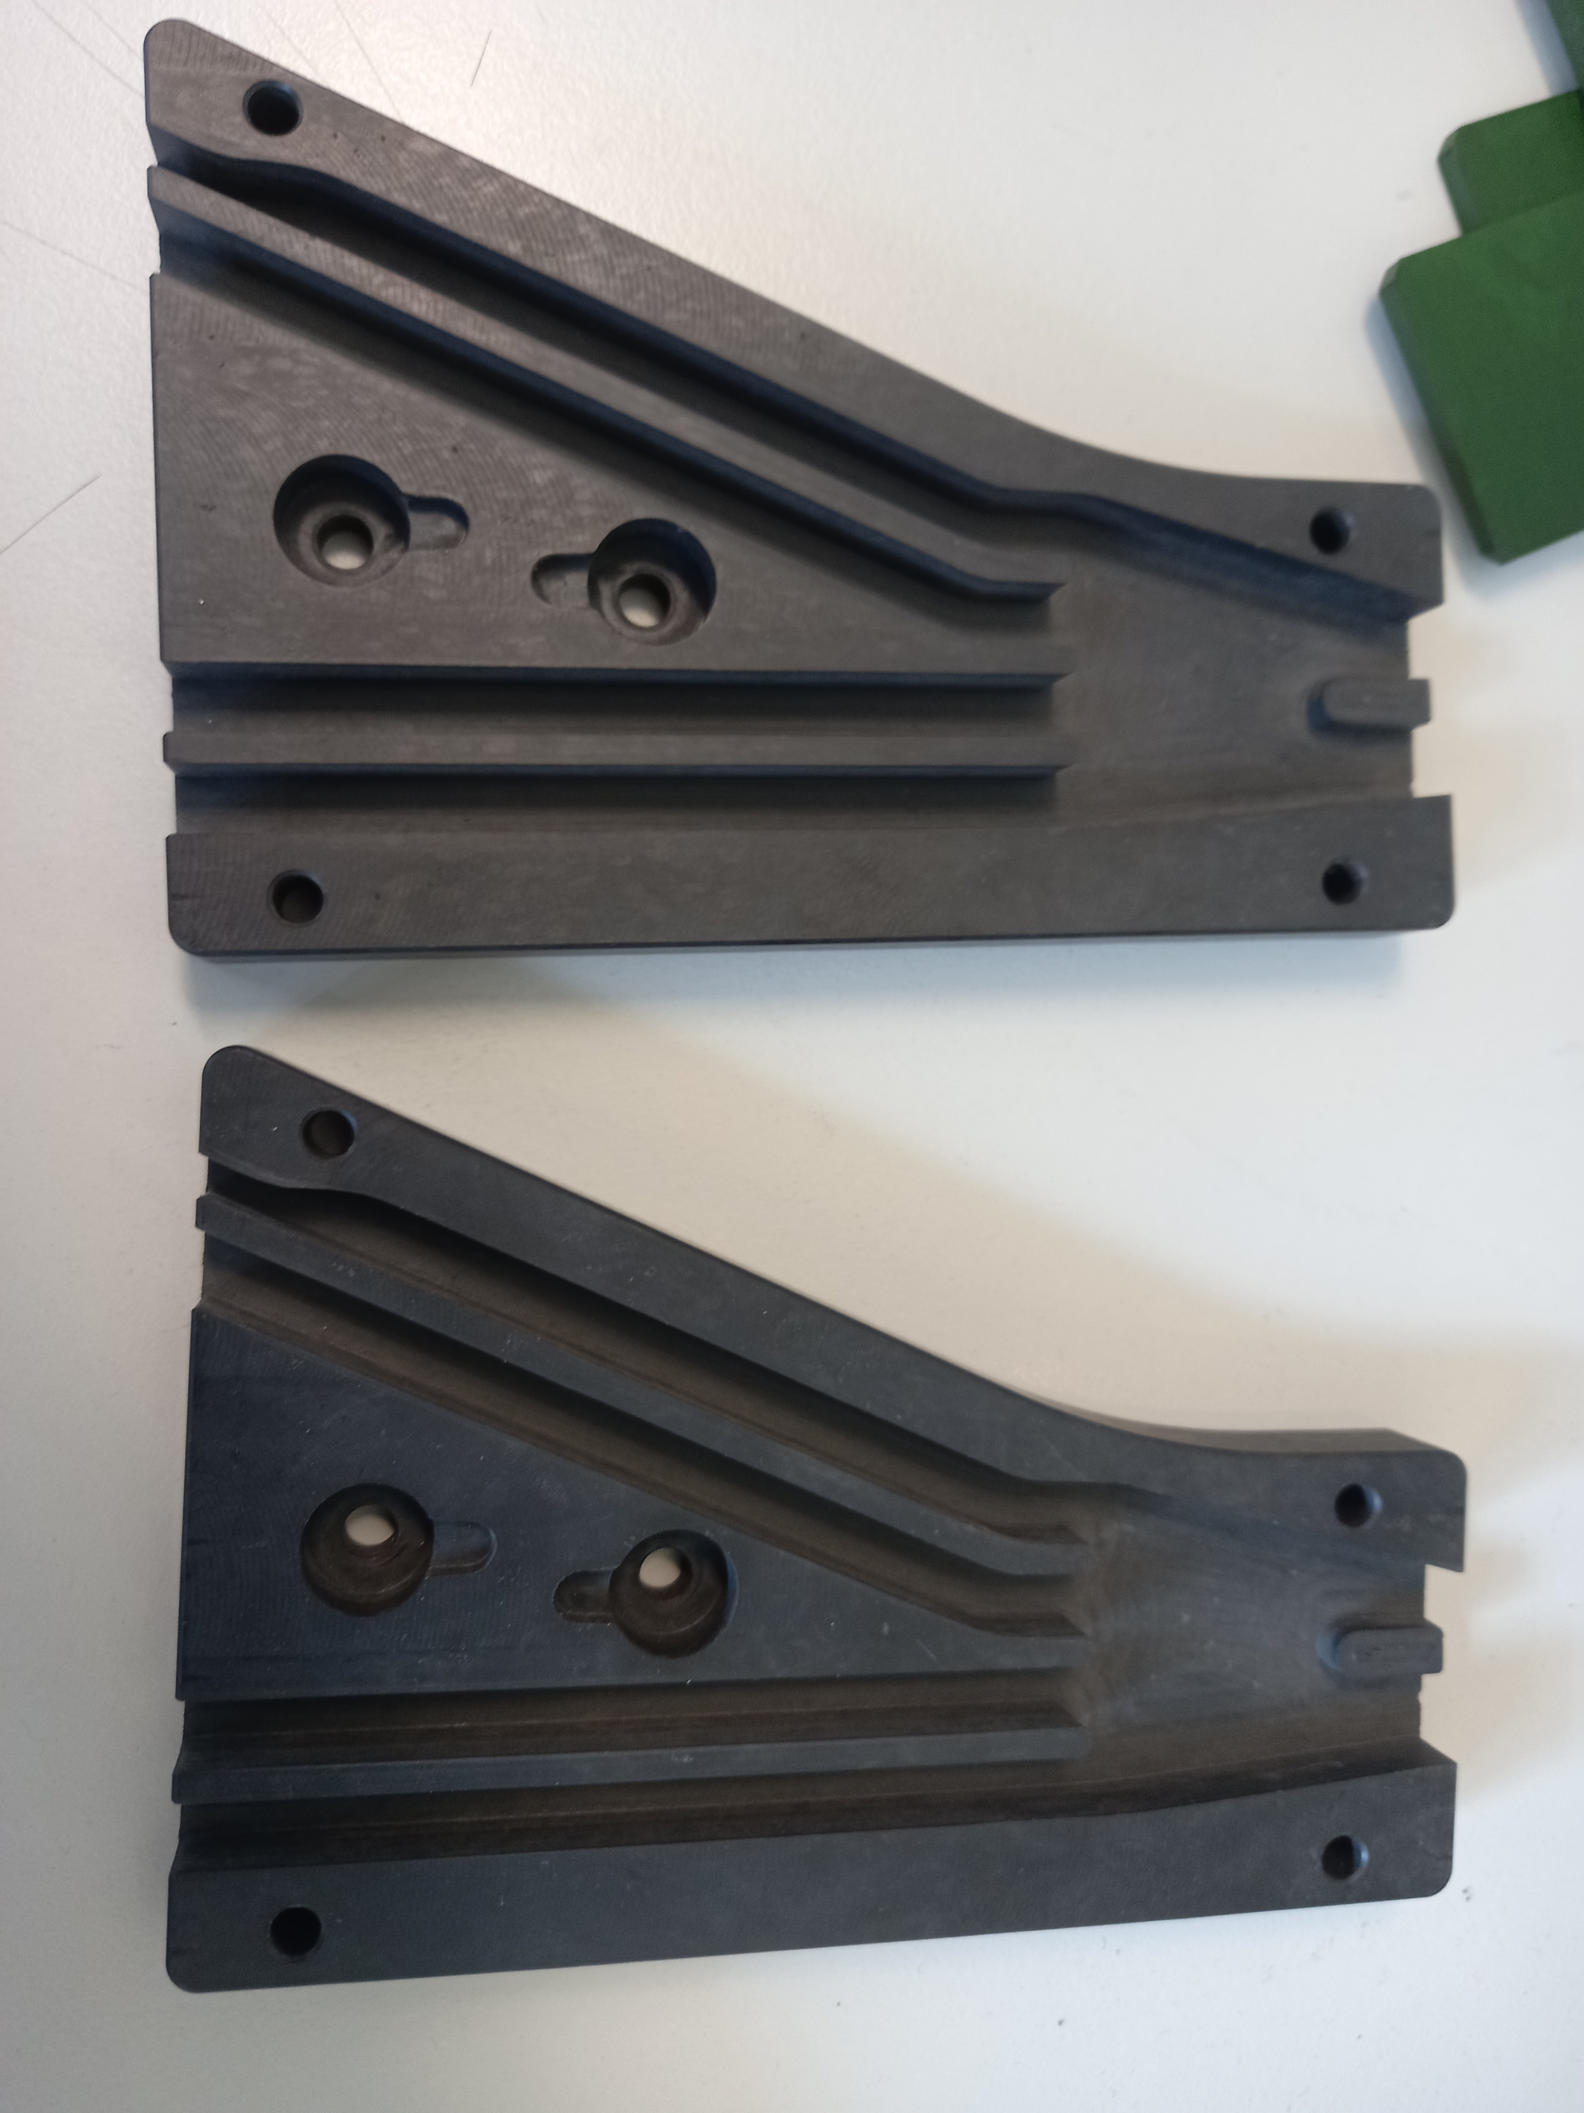
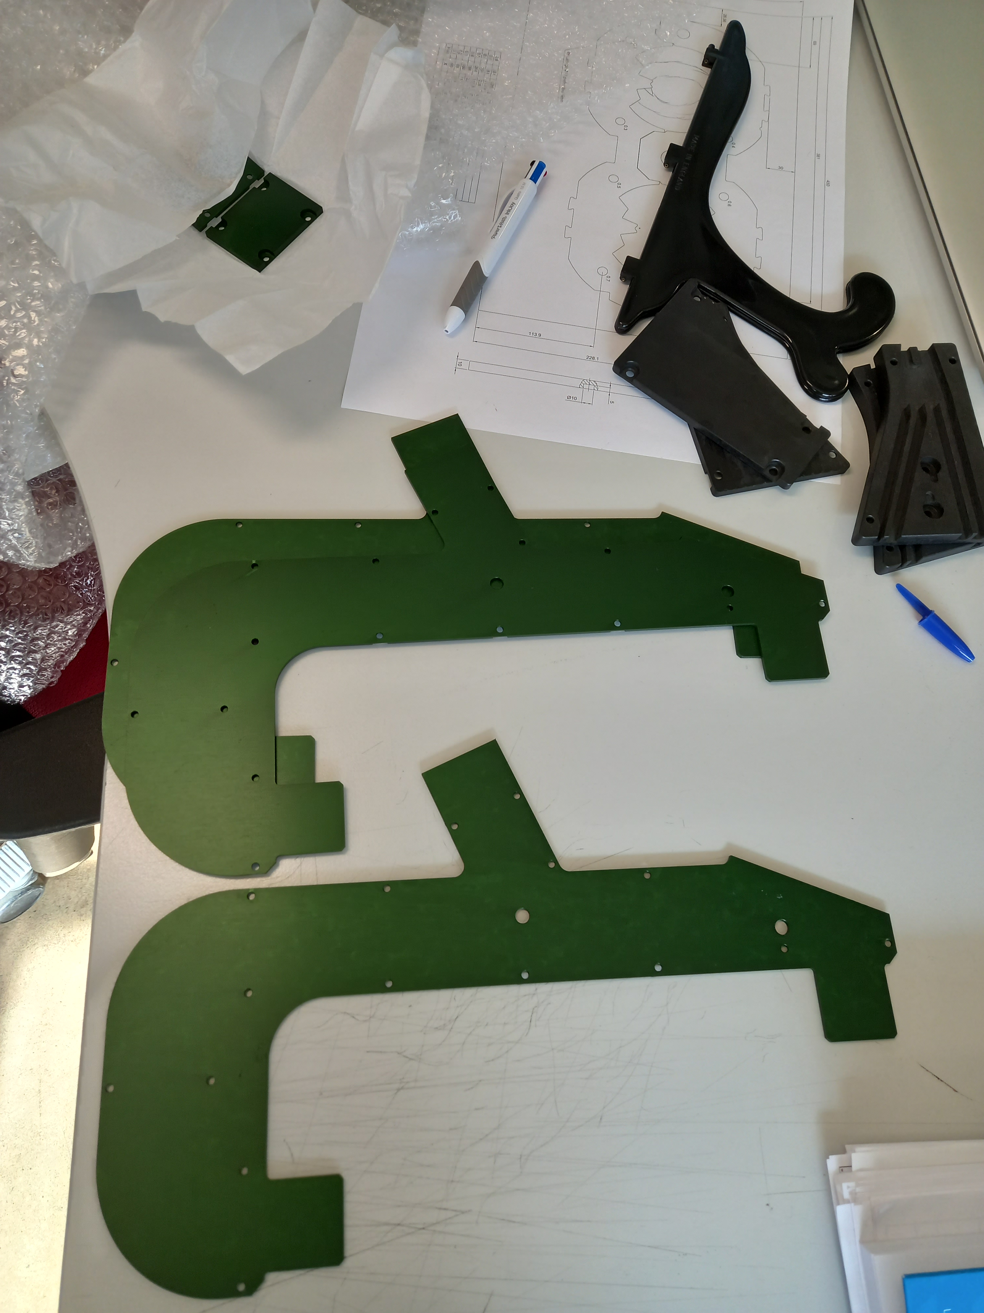
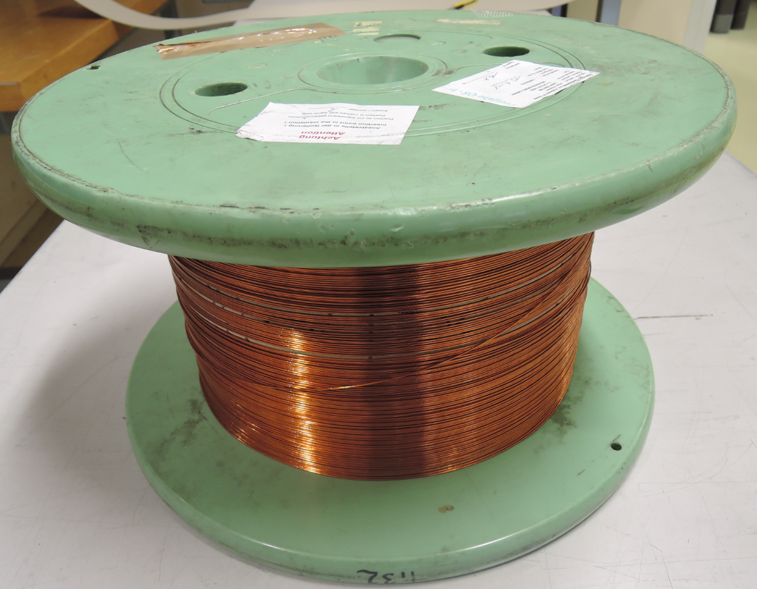
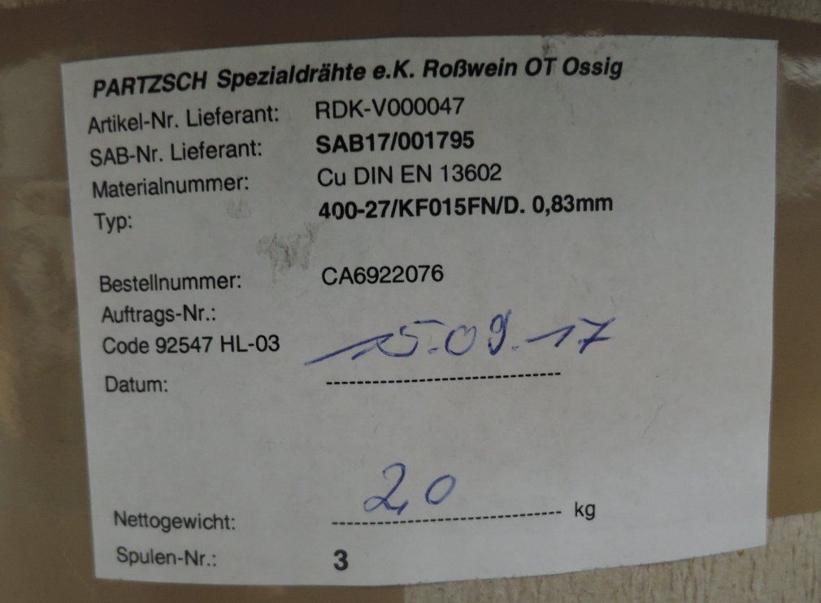
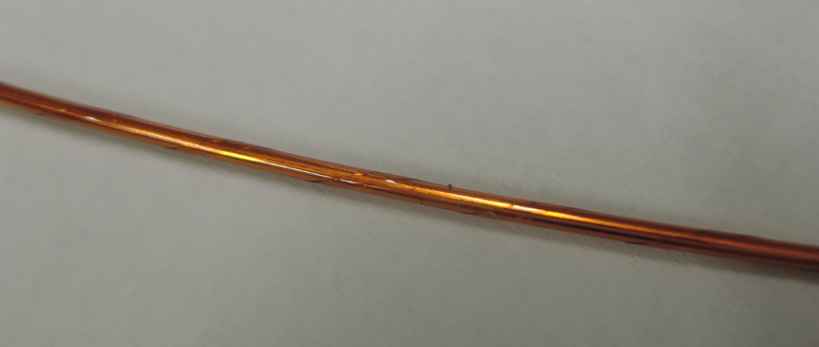
Components procurement, status
All Al formers, tubes, laminations and metallic components and composite parts (G11-CR) procurements launched at Main CERN workshop.
All pieces delivery by beg Jan 2022
First three formers received for cleaning and deburring before metrology by beg Dec 21, then anodization for beg Jan 2022 .
All insulating covers, steel end plates produced at B180 workshop
Selection of NbTi SC wires spools, insulated Ø 0.992
  Use of insulated wires spools by Partzch, 20 ULs of 476 m (minimum length to be confirmed)
  Some of wires have identified insulation defects, repair and Hi-pot re-test needed

Slide 12
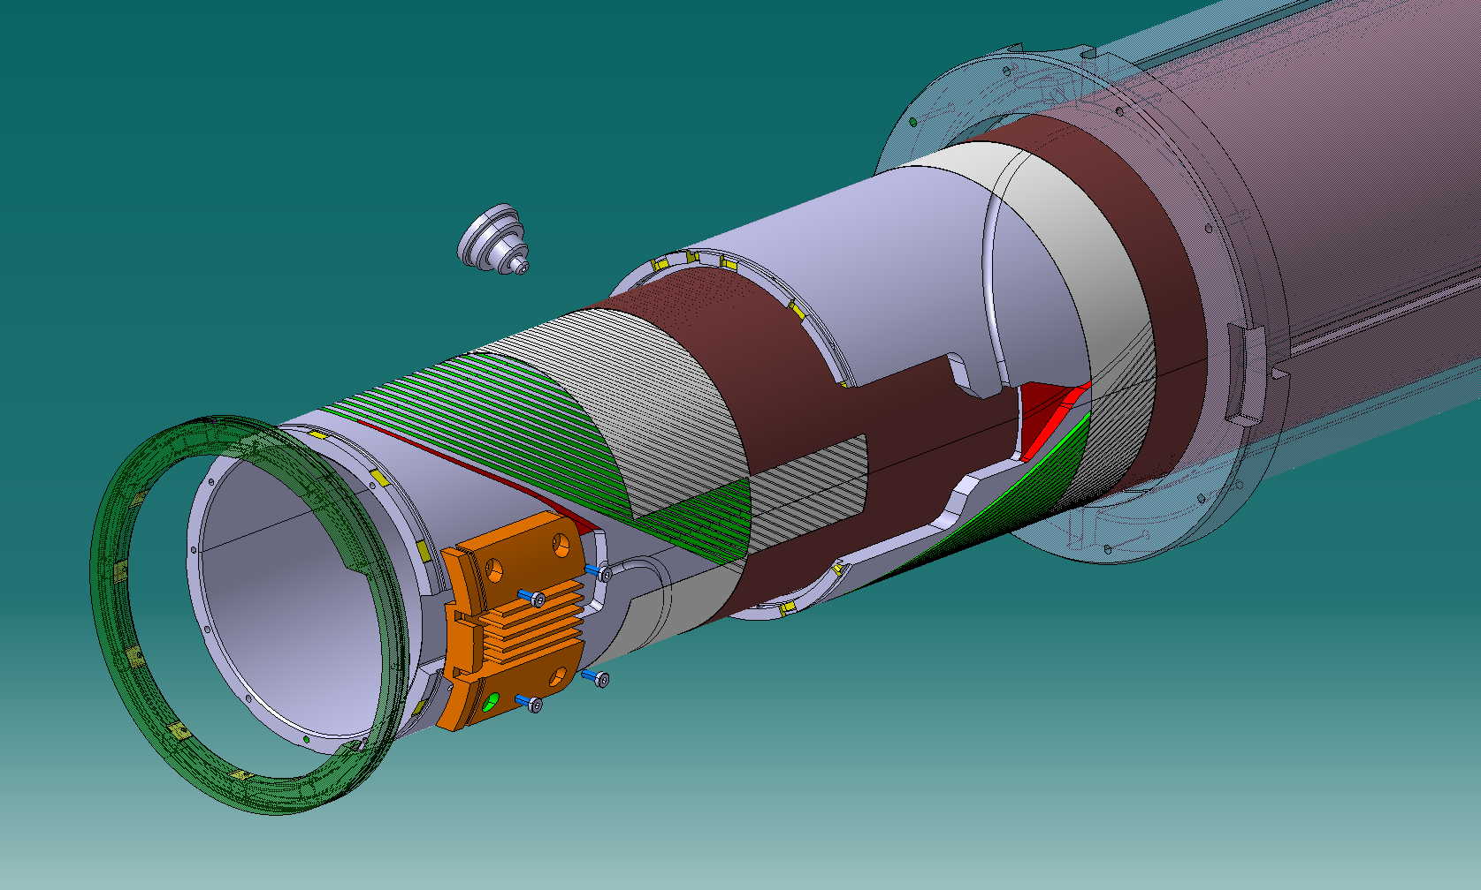
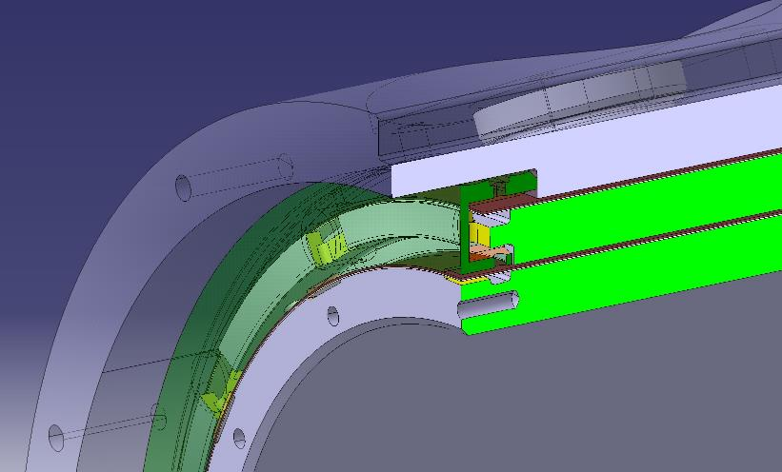
Functional design improvement
Some improvements implemented in end cap rings and outer tube, former to facilitate resin passage and enhance withstand voltage to GND ( > 3 kV)
  This avoids holes in GI sheet for resin passage ( procedure EDMS 2002853)
  In case of low insulation level coil to formers, the insulation formers to GND is still enhanced

Slide 13
Open documentation items
Next review, update of procedures, approval
  MOP-MCBRD_Winding and former assembly,, EDMS 2002853 v.0.2
  MOP-MCBRD COIL IMPREGNATION UNDER PRESSURE, EDMS 2493897 v0.1
  Pending approval of all last QA manufacturing procedures CERN 0000162331
Test definition, Inspection sheet:
    Test templates update per latest approved Electrical test criteria, EDMS 2363906
    MOP-MCBRD Prototype electrical guideline EDMS 2007651
    Electrical wire identification on MCBRDP4, EDMS 2520450
Next creation of MCBRDP4 QA MTF structure ( asset IDs, manufacture steps)

Slide 14
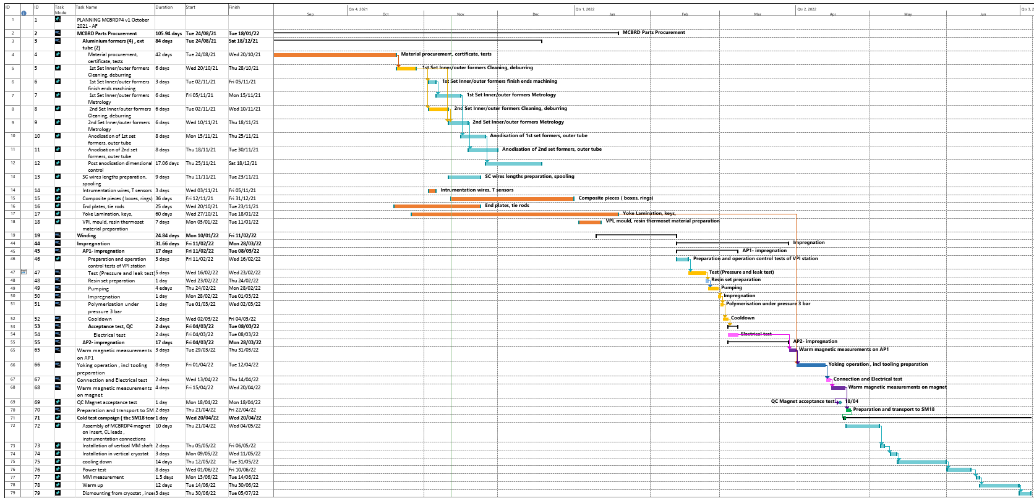
Provisional schedule
Winding from mid Jan 22, apertures impregnation mide feb 22, yoking beg April
6 months project till RT warm measurement
AFT-V0.2

Slide 15
Summary
The 2.2 m long MCBRD prototype P4 magnet (MCBRDP4) components are under procurement through CERN main and B180 workshops. All deliveries by beg Jan 2022
Small parts and insulation sheets procured at B927, to be discussed for preparation
Main WBS packages on MCBRD production shown, responsibility matrix and resource table proposal
The help of MIPs to manage interfaces, inspection points and sign offs.
Key manufacture procedures, inspection sheets, test criteria being updated. Last improvement comments planned form first aperture.
Last selection of SC wires is based on the Partzch (D) insulated SC conductor
  20 ULs of 476 m (margins tbc) have been identified, Hi-pot test history to be confirmed, evaluate repair with J Mazet, F. O Pincot. Spools list to be confirmed by Veronica Ilardi.
Provisional schedule v0.2 with latest procurement inputs.
  Start of winding from mid Jan 2022
  Start of impregnation from mid Feb 2022
  Magnet assembly from Beg. April 2022, readiness for cold test from May 2022
  Responsible persons to cross check main steps

Slide 16
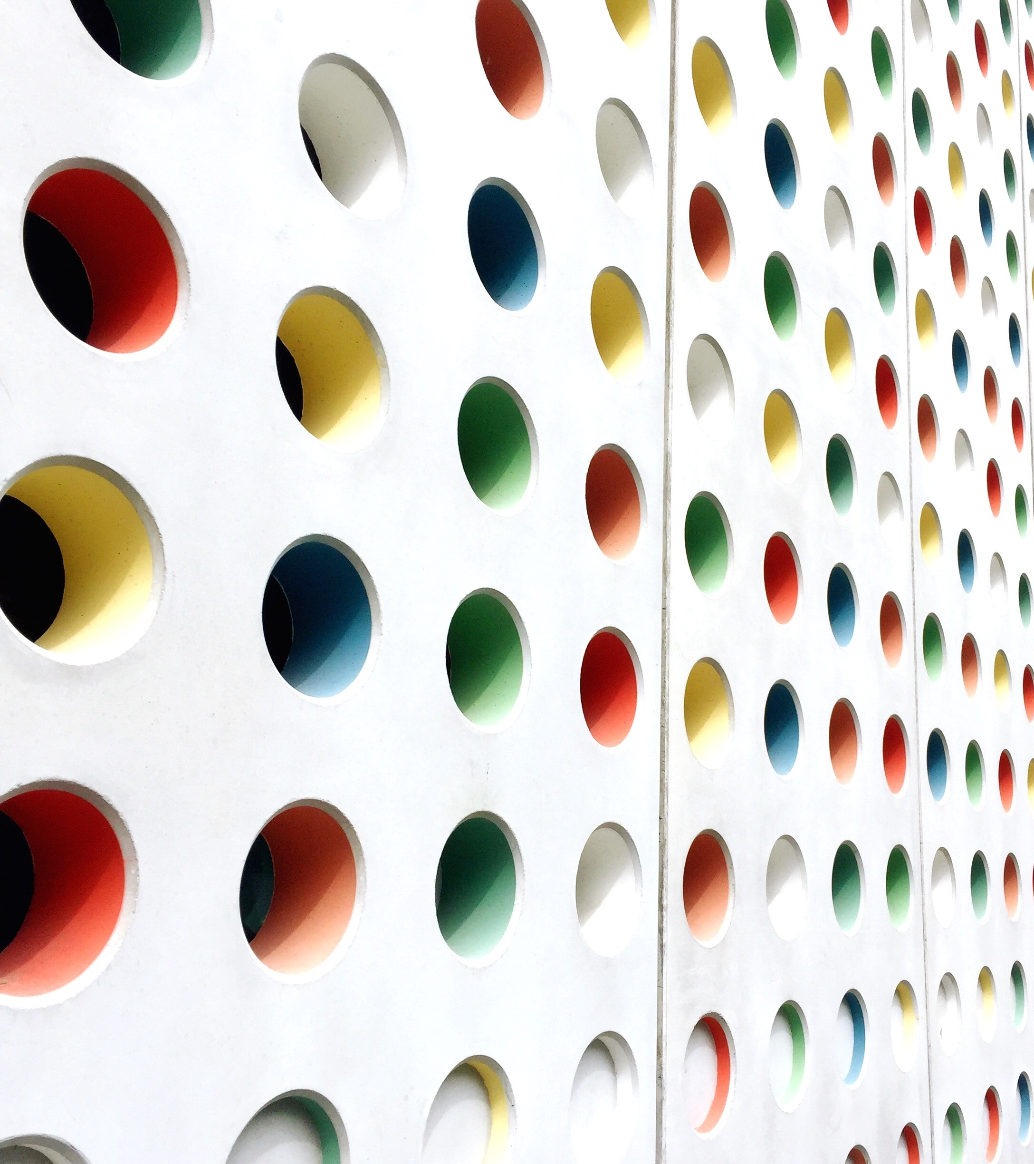
Thank you for your attention for the steady support from SMT and WP3L

Slide 17
Extra slides

Slide 18
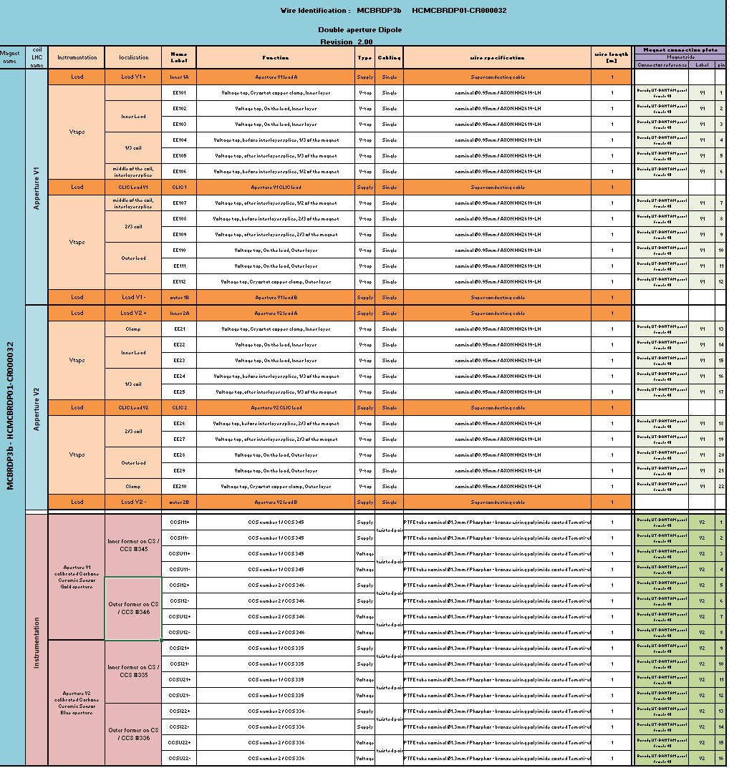
Wires Identifications

