Slide 1
IRON SULPHIDE FUNCTIONALIZED POLYANILINE NANOCOMPOSITE FOR THE REMOVAL OF EOSIN Y FROM WATER: EQUILIBRIUM AND KINETIC STUDIES
By
Bernice Yram Danu, Ph.D

Slide 2
OUTLINE
INTRODUCTION
  Background and Motivation
  Problem Statement
  Justification
  Aims and Objectives
  Novelty Statement
METHODOLOGY
RESULTS AND DISCUSSION
CONCLUSION AND RECOMMENDATION
REFRENCES
ACKNOWLEDGEMENT

Slide 3
INTRODUCTION:
WATER POLLUTION AS AN ENVIRONMENTAL HAZARD (BACKGROUND AND MOTIVATION)
CAUSES OF WATER POLLUTION
Chemicals for mining
Improper disposal of liquid waste
Effluents from textile dyeing industries
Fishing and Agriculture
Among these various causes of water pollution, textile industries form one of the major contributors of pollutant release into clean water, after agriculture and mining
Constituents of these effluents , collectively make it highly toxic, carcinogenic and damaging to fauna, flora and humankind.

Slide 4
PROBLEM STATEMENT
CONVENTIONAL TREATMENT TECHNOLOGIES
Physical methods (Adsorption, etc)
Biological methods (Aerobic and anaerobic degradation)
Chemical methods (electrocoagulation, etc)
SETBACKS
Sludge generation
High maintenance cost
Toxicity of dyes to microorganism
Clogging of surface membranes, frequent formation of scales, etc.
ADSORPTION
flexible and simple in design
low cost and ease of operation
does not result in the formation of harmful substances.

Slide 5
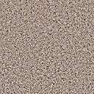
PROBLEM STATEMENT CONT’D
Adsorption: adhesion of molecules, ions or atoms from, liquids and gas onto a surface.
Adsorbent types
Agricultural byproducts
Nanoparticles
Polymeric adsorbents
Composite
Weak Van derWaal forces
Chemical bonds
Adsorbate
Adsorbent
Adsorbent
Physical adsorption
Chemical adsorption

Slide 6
JUSTIFICATION
  Nanoparticles: nanometer range(1 nm-100 nm)
  Unique properties due to high surface to volume ratio: high chemical reactivity, manipulation of optical and electrical properties
  Advent of nanotechnology can provide a solution in water remediation
Surface modification by incorporating into polymers
Lack of total recovery
Do we have the proposed material?
UV-Vis Spectroscopy: Adsorption removal experiments
  Adsorption isotherms
  Adsorption kinetics
  Thermodynamic properties
Characterize
  FTIR: Confirm the formation of the nanocomposite
  XRD: crystal structure and crystalline size
  SEM and TEM: Morphology
  SAED: nature of material
  BET: Surface area and bioavailability
Efficacy of material for dye removal

Slide 7
AIM AND OBJECTIVES OF THE STUDY
AIM
The overarching aim of this research was to synthesise and disperse iron sulphide nanoparticles into polyaniline for the removal of eosin Y in water.
OBJECTIVE
To synthesise FeS nanoparticles and FeS functionalized polyaniline nanocomposites by co-precipitation method and in-situ polymerization technique, respectively.
Characterize the materials using advanced analytical techniques such as FTIR, XRD, TEM, SEM, BET and UV/Visible spectroscopy.
Perform adsorption and kinetics studies on the adsorbents using eosin yellow (EY) dye.

Slide 8
NOVELTY OF RESEARCH
To the best of my knowledge, there is no work on FeS functionalized PANI for the removal of dyes in water.

Slide 9
METHODOLOGY
Preparation of FeS nanoparticles and FeS/PANI nanocomposite
0.5 M FeSO_{4 (aq)} (100 ml) + Glycerol (2 ml) + 0.5 M Na₂S _{(aq)} (100ml)
N₂ gas source
FeS/PANI mixture
N₂ gas outlet
FeS precipitate
Magnetic hotplate stirrer
Magnetic hotplate stirrer
Figure 1b. Schematic of the synthesis of FeS/PANI
Figure 1a. Schematic of the synthesis of FeS nanoparticles
FeS (0.9 g) + D.W (20 ml)
Aniline (2 ml) + methanol (5 ml)
Aniline ( 5 ml) + methanol (25 ml)
CuSO₄ _{(aq)} (16 ml) dropwise
Stirred 30 min
Filtered by D.W addition
Oven dried at 60 °C and pulverized
Stirred 30 min
Washed with D.W and ethanol copiously.
Oven dried at 60 °C and pulverized

Slide 10
RESULTS AND DISCUSSION
FTIR Analysis
3342 cm⁻¹: O-H vibrations
1632 cm⁻¹ and
1133 cm⁻¹ : S-S and S-O stretch
621 cm⁻¹ and 456 cm⁻¹ : Fe-S stretching
3259 cm⁻¹ :N-H stretch
3143 cm⁻¹ and 1493 cm⁻¹ : C-H and C-C aromatic stretch
585 cm⁻¹ : Fe-S stretch
Figure 2. FTIR spectra of FeS (A) nanoparticles and FeS/PANI (B) composite

Slide 11
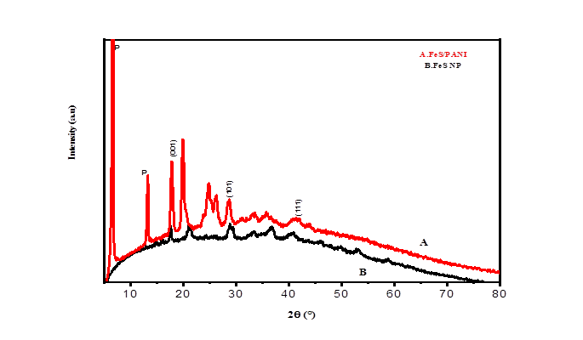
RESULTS AND DISCUSSION CONT’D
XRD Analysis
Peak positions at 17.56⁰, 28.83⁰ and 40.75⁰ correspond to (001), (101) and (111) planes : tetragonal mackinawite phase
Peak positions at 6.48°, 19°-20°:Interplanar spacing in PANI particles
Figure 3. XRD spectra of FeS/PANI (A) nanocomposite and FeS nanoparticles (B)

Slide 12
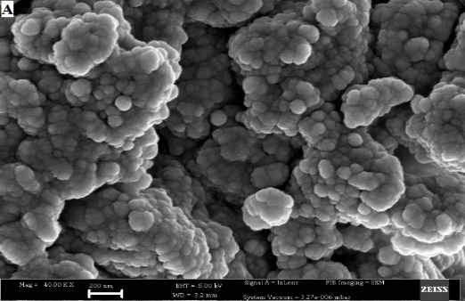
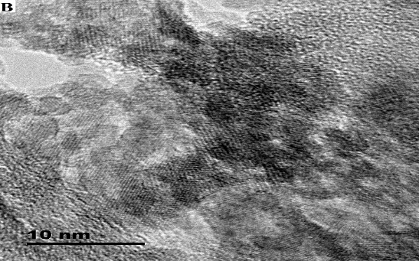
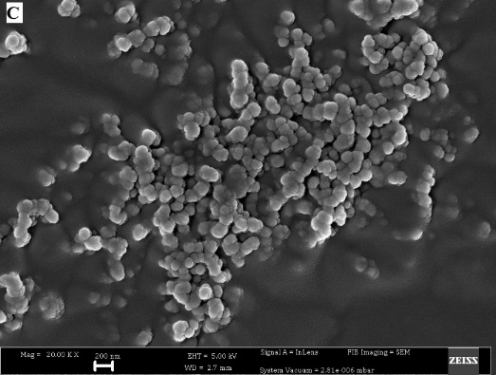
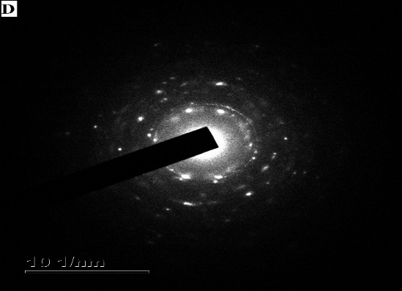
RESULTS AND DISCUSSION CONT’D
SEM, TEM AND SAED Analyses
Figure 4. SEM image of FeS NP (A), TEM image of FeS NP (B), SEM image of FeS/PANI nanocomposite (C) and SAED pattern of FeS NP (D)

Slide 13
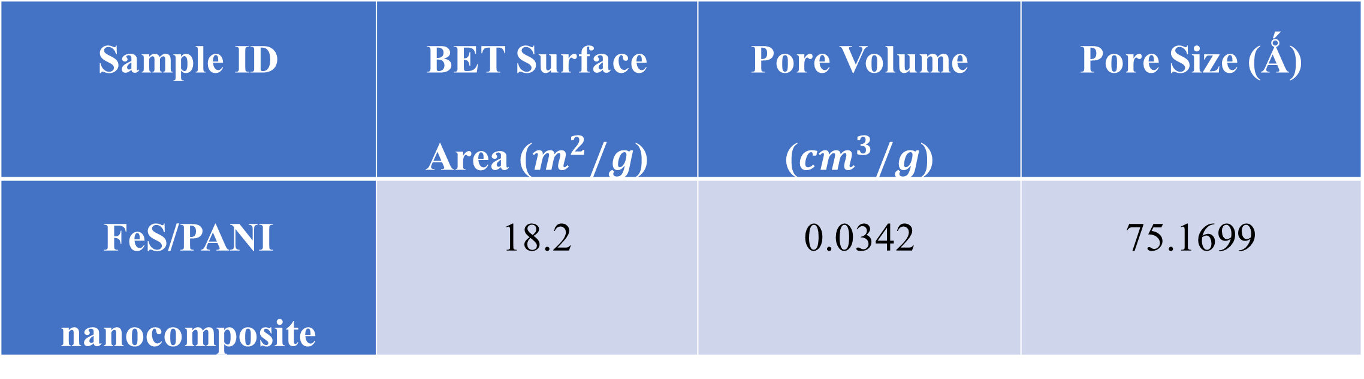
RESULTS AND DISCUSSION CONT’D
BET Analysis
Table 1. BET surface area, pore volume and pore size value of FeS/PANI nanocomposite
Sample ID | BET Surface Area ($m^{2}/g$) | Pore Volume (${cm}^{3}/g$) | Pore Size (Ǻ)
FeS/PANI nanocomposite | 18.2 | 0.0342 | 75.1699

Slide 14
RESULTS AND DISCUSSION CONT’D
Adsorption Removal Experiments
Effect of EY concentration and FeS/PANI dosage
Figure 5. Effect of initial concentration (A) and adsorbent dosage (B) on EY adsorption onto FeS/PANI nanocomposite

Slide 15
RESULTS AND DISCUSSION CONT’D
Effect of pH and contact time
Figure 6. Effect of pH (A) and contact time (B) on EY adsorption onto FeS/PANI nanocomposite

Slide 16
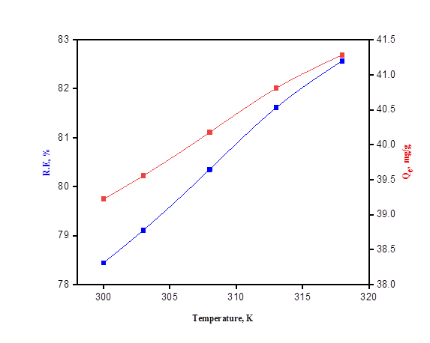
RESULTS AND DISCUSSION CONT’D
Effect of temperature
Figure 7. Effect of temperature on EY adsorption onto FeS/PANI nanocomposite

Slide 17
RESULTS AND DISCUSSION CONT’D
Adsorption Isotherms
Figure 8. Langmuir (A), Freundlich (B) and Dubinin-Radushkevich (C) plots of EY adsorption onto FeS/PANI nanocomposite

Slide 18
RESULTS AND DISCUSSION CONT’D
Adsorption Kinetics
Figure 9. A pseudo first order (A) and pseudo- second-order (B) kinetic plot of EY adsorption onto FeS/PANI nanocomposite

Slide 19
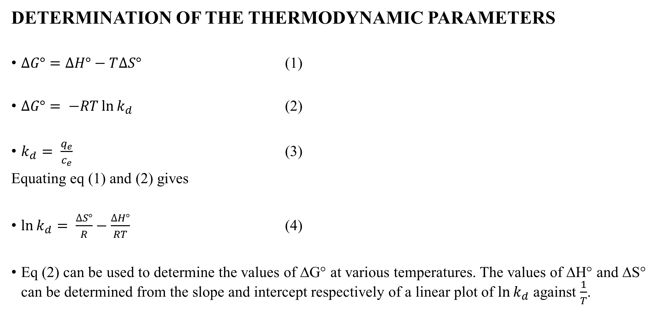
RESULTS AND DISCUSSION CONT’D
DETERMINATION OF THE THERMODYNAMIC PARAMETERS
$∆G°=∆H°−T∆S°$ (1)
$∆G°= −RT\ln{k_{d}}$ (2)
$k_{d}= \frac{q_{e}}{c_{e}}$ (3)
Equating eq (1) and (2) gives
$\ln{k_{d}}= \frac{∆S°}{R}−\frac{∆H°}{RT}$ (4)
Eq (2) can be used to determine the values of ∆G° at various temperatures. The values of ∆H° and ∆S° can be determined from the slope and intercept respectively of a linear plot of $\ln{k_{d}}$ against $\frac{1}{T}$.

Slide 20
RESULTS AND DISCUSSION CONT’D
Adsorption Thermodynamics
Table 2. Thermodynamic parameters for EY adsorption onto FeS/PANI nanocomposite
ΔH° (kJ/mol) | ΔS° (kJ/mol) | ΔG° (kJ/mol.K)
 |  | 300 K | 303 K | 308 K | 313 K | 318 K
11.84 | 0.044 | -1.49 | -1.60 | -1.83 | -2.07 | -2.28

Slide 21
CONCLUSION
FeS nanoparticles were successfully prepared using the co-precipitation method.
FTIR and XRD analyses revealed the incorporation of the nanoparticles in the polymer matrix.
The nanocomposites produced, showed high adsorption activity towards organic dye (eosin yellow) in aqueous solutions during the batch adsorption experiments (i.e. R.E > 70% in all adsorption experiments).
The optimum dosage for eosin removal for FeS/PANI was found to 0.15 g, lower adsorbate concentrations were most favourable for adsorption and acidic pH(FeS/PANI) was favourable.
The pseudo second kinetic model was favourable during the adsorption process. This was also reported in literature for the adsorption of eosin yellow dye by various adsorbents.

Slide 22
RECOMMENDATION
An investigation may be conducted to determine the extent of reusability of the nanomaterials.
  This will help determine the number of cycles that the adsorbents can be used for in water treatment.
These nanomaterials can be explored in the fabrication of filters for water purification.
FeS/PANI can be employed for the treatment of effluents from the textile industries in the country.
Perform zeta potential analysis to determine the overall charge on the surface of the nanocomposites.
FeS/PANI nanocomposites can be explored for antimicrobial, antifungal and pharmaceutical study.

Slide 23
REFERENCES
Malek, T. J., Chaki, S. H., & Deshpande, M. P. (2018). Structural, morphological, optical, thermal and magnetic study of mackinawite FeS nanoparticles synthesized by wet chemical reduction technique. Physica B: Condensed Matter, 546, 59–66. https://doi.org/10.1016/j.physb.2018.07.024
Kyzas, G. Z., & Matis, K. A. (2015). Nanoadsorbents for pollutant’s removal: A review. Journal of Molecular Liquids, 2014, 1–10. https://doi.org/10.1016/j.molliq.2015.01.004
Sionkowska, A. (2011). Current research on the blends of natural and synthetic polymers as new biomaterials: Review. Progress in Polymer Science (Oxford), 36(9), 1254–1276. https://doi.org/10.1016/j.progpolymsci.2011.05.003
Wang, W., Zhao, Y., Bai, H., Zhang, T., Ibarra-Galvan, V., & Song, S. (2018). Methylene blue removal from water using the hydrogel beads of poly(vinyl alcohol)-sodium alginate-chitosan-montmorillonite. Carbohydrate Polymers, 198, 518–528. https://doi.org/10.1016/j.carbpol.2018.06.124
Watson, J. H. P., Cressey, B. A., Roberts, A. P., Ellwood, D. C., Charnock, J. M., & Soper, A. K. (2000). Structural and magnetic studies on heavy-metal-adsorbing iron sulphide nanoparticles produced by sulphate-reducing bacteria. Journal of magnetism and magnetic materials, 214(1-2), 13-30.
Lei, J., Zhu, Y., Chen, Z. et al. Improving the electrochemical performance of Nano-PANI by adding manganese. J Mater Sci: Mater Electron 29, 12366–12372 (2018). https://doi.org/10.1007/s10854-018-9350-3

Slide 24
ACKNOWLEDGEMENT
Royal Society- Department for International Development (DFID) Africa Capacity Building Initiative (ACBI), UK.
Prof Ampong, Prof Awudza and Dr. Agorku (Supervisors) and the late Paul O’Brien for granting me the opportunity to be part of the DFID initiative.
DST-CSIR National Center for Nanostructured Materials, CSIR, South Africa, for providing technical support in characterizing the materials.
Staff and technicians of the Physics, Chemistry, Chemical engineering, Theoretical and Applied Biology and Pharmacy departments, KNUST

Slide 25
THANK YOU
Danu, B. Y., et al. "Iron Sulfide Functionalized Polyaniline Nanocomposite for the Removal of Eosin Y from Water: Equilibrium and Kinetic Studies." Polymer Science, Series B 63.3 (2021): 304-313.
DOI: https://doi.org/10.1134/S1560090421030040

