Slide 1




TIARA: shall we proceed with an application for call Horizon-infra-2022-Dev-01-01 ?
Roberto Losito
CERN
3rd Community meeting of the International Muon Collider Design Study - 6 Oct. 2021

Slide 2
HORIZON-INFRA-2022-DEV-01-01
Research Infrastructure concept development
  This topic aims at supporting the development of new concepts for the next generation of research infrastructures of European interest^{[1]}, single/multi sited, distributed or virtual, that none or few countries might individually be able to afford. All fields of research can be considered.
The Commission estimates that an EU contribution of between EUR 1.00 and 3.00 million would allow these outcomes to be addressed appropriately.

Slide 3
Expected Outcome
Projects are expected to contribute to all the following expected outcomes:
  sound science cases for new research infrastructures, including expected scientific breakthrough, gap analysis and feasibility/design studies to support planning and decision making at the national level (e.g. funding bodies, governments) and at European level (e.g. ESFRI);
  a better alignment of the development of the research infrastructure landscape with the advancement of excellent science and frontier research;
  new services and access opportunities available to the research community, allowing to better tackle scientific and societal challenges.

Slide 4
Scope
This topic aims at supporting the development of new concepts for the next generation of research infrastructures of European interest^{[1]}, single/multi sited, distributed or virtual, that none or few countries might individually be able to afford. All fields of research can be considered.
Major upgrades of existing infrastructures may also be considered if the end result is significantly transformative and equivalent to a new infrastructure concept.
Proposals for RI concept development will tackle all key questions concerning the technical and conceptual feasibility of new or upgraded fully fledged user facilities.

Slide 5
Proposals
In this respect, proposals should address all following aspects:
  demonstrate relevance in relation to ERA, including to the existing landscape, and the advancement with respect to the state-of-art of the new infrastructure;
  highlight the research challenges the new research infrastructures will make possible to address, including at global level;
  indicate the gaps in the research infrastructure landscape the new infrastructure will cover and the synergies with existing infrastructures at European and global level, including those co-financed from other EU instruments (e.g.: Cohesion policy);
  Indicate, when relevant, the potential impact of the new research infrastructure at regional level.

Slide 6
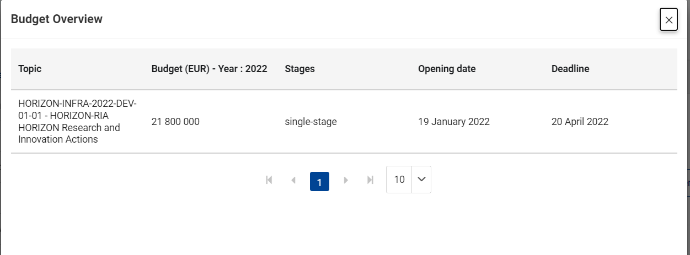
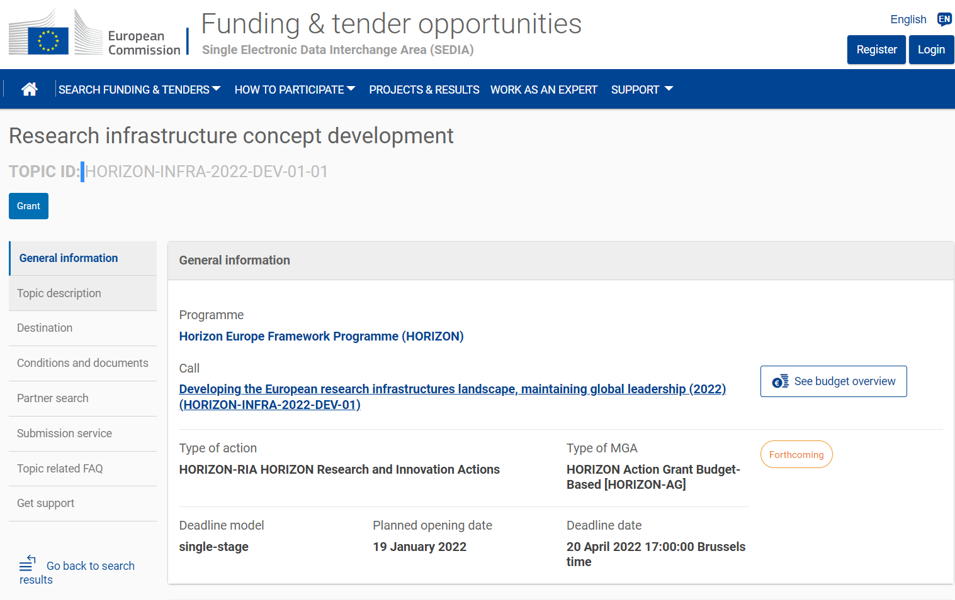
HORIZON-INFRA-2022-DEV-01-01
Research infrastructure concept development

Slide 7
HORIZON-INFRA-2022-TECH-01-01
R&D for the next generation of scientific instrumentation, tools and methods
Call aimed at developing “innovative scientific instrumentation, tools and methods, which advance the state-of-art of European RIs, and show transformative potential in RIs operation. “
Cutting-edge technologies will also enhance the potential of RIs to contribute addressing EU policy objectives and socio-economic challenges.
The Commission estimates that an EU contribution of between EUR 5.00 and 10.00 million would allow these outcomes to be addressed appropriately.

Slide 8
Expected Outcome:
Project results are expected to contribute to several of the following expected outcomes:
  enhanced scientific competitiveness of European research infrastructures
  Foundations for the development of innovative companies;
  increase of the technological level of industries through the co-development of advanced technologies for research infrastructures and creation of potential new markets;
  integration of research infrastructures into local, regional and global innovation systems.

Slide 9
Proposals
Proposals should address all following aspects:
  Research and development of new scientific instrumentation, tools and methods for research infrastructures taking into due account resource efficiency (e.g. energy consumption) and environmental (including climate-related) impacts;
  their technology validation and prototyping;
  training of RI staff for the operation and use of these new solutions;
  the innovative potential for industrial exploitation of the solutions and/or for the benefits of the society.
Consortia must be built around a leading core of at least 3 world-class research infrastructures, being ESFRI infrastructures, European Research Infrastructures Consortia (ERICs) and/or other world-class research infrastructures of European interest¹⁰² and can include a wider set of RIs. Other technological partners, including industry and SMEs, should also be involved, thus promoting innovation and knowledge sharing through co-development of new technical solutions for research infrastructures.

Slide 10
Additional considerations
The TIARA consortium initially pushed us to submit a proposal to the first call (DEV)
We asked for opinion in case we submit a TECH proposal
  Scepticism about the possibility to build a coherent programme with 3 ESFRI class of facilities.
  In the TECH proposal we also have difficulties to involve Industry (not required in the DEV).
Both calls have very little chance of success (10% or less).

Slide 11
What do we need
Possible topics for the project:
  Studies and tests to reduce the breakdown rate in RF cavities (in High Magnetic field): test stand to be built (CEA& STFC?)
  Design and development of high-field Solenoids (20T – 50 T). At the highest fields (50T) we need to develop a concept that makes it resilient to high levels of radiation (interested: KIT, CEA)
  Improve efficiency of RF sources and power converters (CERN, Industry).
    Need to design Klystrons at the frequencies of interest (around 700 MHz) with peak power in excess of 24 MW.
    Need to design Power converters for rapid cycling synchrotrons with highest efficiency
  Improve capacity of simulation of muon beams, neutrino radiation and detail better the layout of the different machines in the accelerator chain (CERN, STFC, CEA, INFN)
  Confirm and refine the necessary beam power on target necessary to have a reasonable peak luminosity, studies on target materials to assess feasibility of few MW target (CERN, STFC, ESS)
  Define and address strategies to cope with Neutrino Radiation (for the 10+ TeV collider) (CERN, …)

Slide 12
Conclusions
Any program needs a strong support from several labs/institutions
It will also require a substantial level of matching funds (ideally full match of EU requested funds).
Needs 3 Research infrastructures (CERN, ISIS?, ESS?, Myrrha? Eupraxia?...)
What option would the community support ?

Slide 13
Thank you
for your attention

