Slide 1
TURKISH ENERGY, NUCLEAR AND MINERAL RESEARCH AGENCY
2021

Slide 2

CONTENT
Establishment and Purpose
Duties
Organisation Scheme
R&D Vision
Research and Development (R&D) Support Departments
Institutes
Other Departments

Slide 3
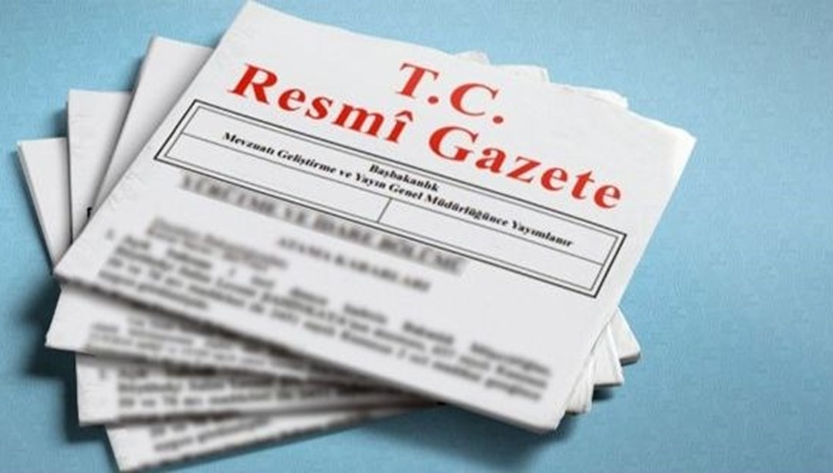
ESTABLISHMENT AND PURPOSE
TURKISH ENERGY, NUCLEAR AND MINERAL RESEARCH AGENCY
(TENMAK)
In the field of energy, mining, ionizing radiation, particle accelerators and nuclear technology to increase the competitiveness of Turkey and to perpetuate, to meet the needs of innovation, and in order to support R&D activities in order to serve our country and humanity, With the Presidential Decree Law numbered 57 published in the Official Gazette edition 31082 and dated 28/3/2020 TENMAK was established related to the Ministry of Energy and Natural Resources with special budget.

Slide 4

ESTABLISHMENT AND PURPOSE
TENMAK will operate in related fields, including the duties and work carried out by our institutions, which were restructured after their closure and transformed into institutes.
With the establishment of TENMAK, it is aimed to jointly use the technological and expertise infrastructures, experiences, existing laboratories and facilities of our restructured institutions regarding R&D studies and thus to carry out R&D studies more effectively and efficiently.

Slide 5
DUTIES OF TENMAK
To carry out cooperation and coordination with the public and private sector, to have encourage and support R&D activities, developing programs and projects done for this purpose.
To make or have all kinds of research, development, innovation, design, technology acquisition, production, testing, localization studies done in order to ensure the wide use of the products developed as a result of R&D activities.
To promote the transformation of the outputs obtained as a result of R&D activities into commercial value and to support intellectual property rights.

Slide 6
DUTIES OF TENMAK
To carry out all kinds of activities related to radioactive waste management and to establish radioactive waste facilities.
To provide measurement, analysis, dosimetry, calibration, metrology, irradiation, intervention, technical support, inspection, evaluation and consultancy services and other services related to its field of duty.
To prepare training programs and provide training.

Slide 7
DUTIES OF TENMAK
To collect and disseminate information, to carry out periodic and non-periodic publication activities, to support such publications, to provide scientific support services such as data banks, libraries, archives.
To organize and support scientific meetings such as national and international congresses, seminars, and to contribute and participate in them.

Slide 8
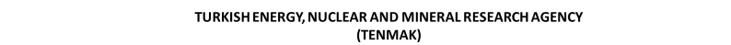
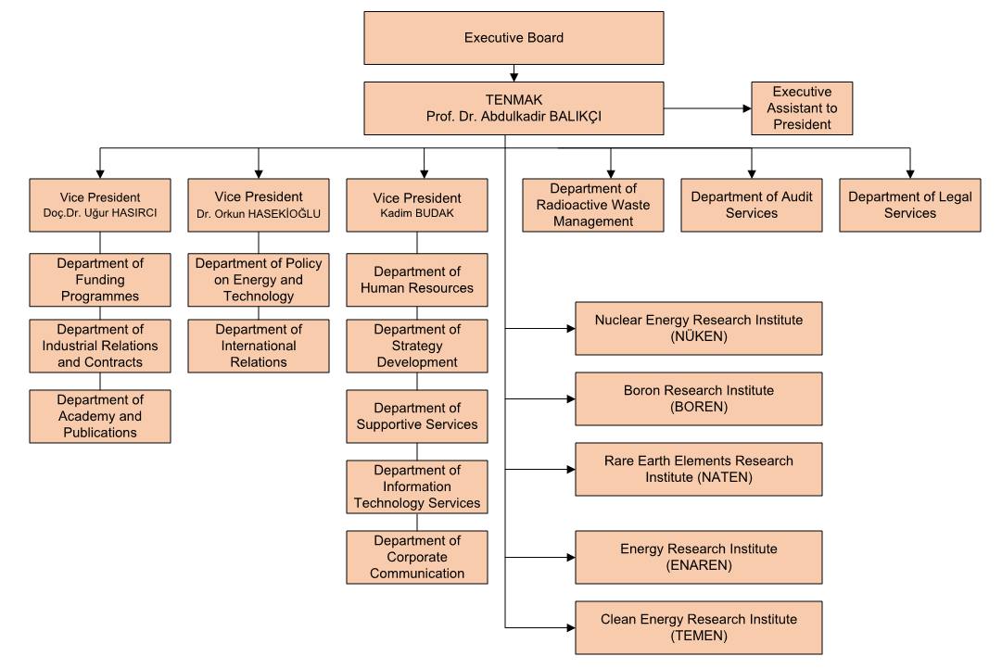
ORGANISATION SCHEME

Slide 9

RESEARCH & DEVELOPMENT VISION
Human Resource Development Studies
Nationalization of R&D Studies
Product and Technology Development Studies
Studies for Conversion Into Production
International Cooperation Studies

Slide 10

R&D SUPPORT DEPARTMENTS
Department of Funding Programmes
Department of Industrial Relations and Contracts
Department of International Relations
Department of Policy on Energy and Technology
Department of Academy and Publications

Slide 11

DEPARTMENT OF FUNDING PROGRAMMES
It was established to create, execute and monitor the results of R&D incentive and support programs by ensuring the necessary coordination in line with the needs of R&D units.

Slide 12

DEPARTMENT OF INDUSTRIAL RELATIONS AND CONTRACTS
TENMAK was established to create collaborations and support projects and other activities in order to ensure the wide use of R&D products by ensuring the necessary coordination in line with the needs of R&D units.

Slide 13

DEPARTMENT OF INTERNATIONAL RELATIONS
It was established;
To carry out, develop and cooperate relations with institutions and organizations abroad, foreign countries and international organizations related to the fields of activity of the institution
To coordinate the participation in the works of international institutions and organizations, to ensure participation, contribution and all kinds of payments related to them.
To search, procure and distribute funds and resources that can be obtained from international organizations and abroad for the development of the activities of the Institution.
To carry out transactions related to international bilateral and multilateral agreements and contracts.
To carry out the works and procedures for the temporary assignment of the personnel of the institution abroad.

Slide 14

DEPARTMENT OF POLICY ON ENERGY AND TECHNOLOGY
It was established ;
To monitor and report national and international energy policies and policies regarding technologies related to the Authority's field of duty.
To contribute to the formation of policies that will increase the competitiveness of our country in this field.

Slide 15
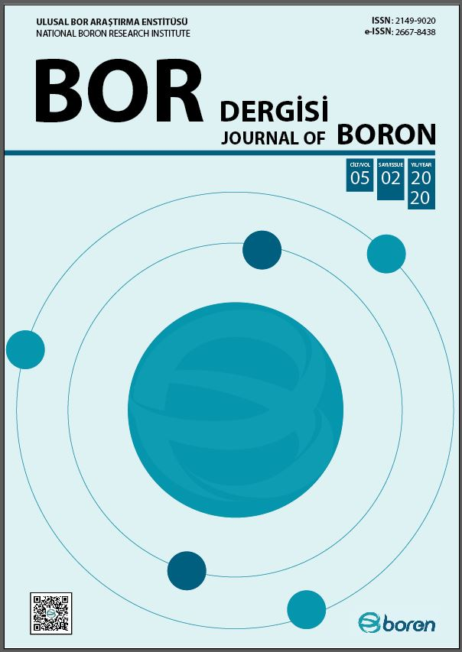
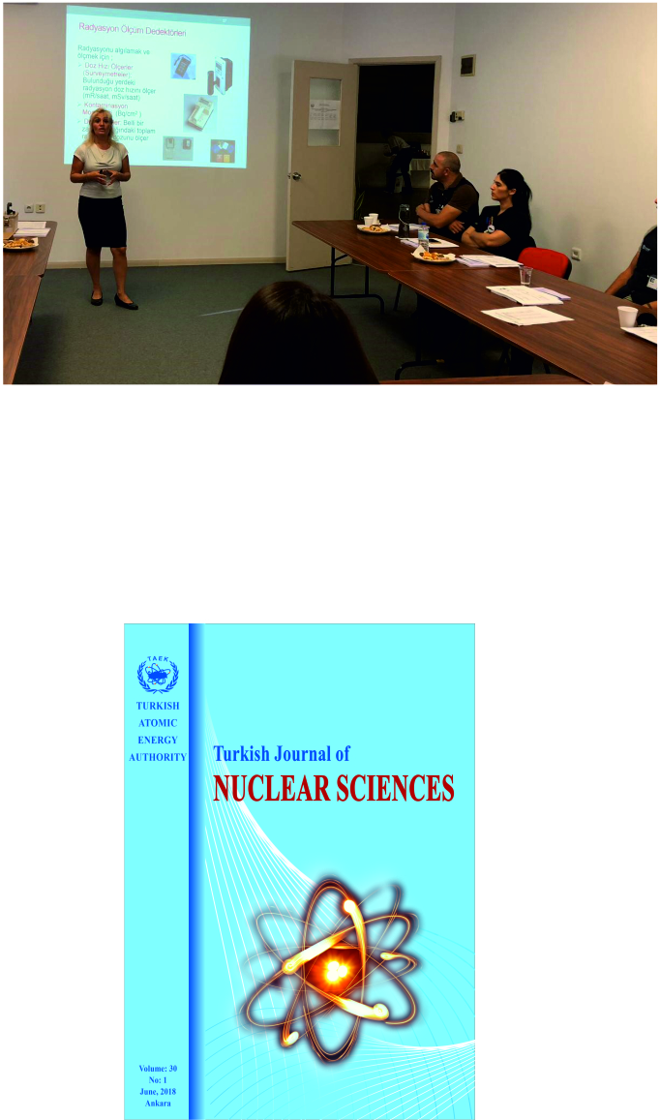
DEPARTMENT OF ACADEMY AND PUBLICATIONS
It was established to carry out training and publication activities on the subjects related to the scope of the institution's duty.

Slide 16
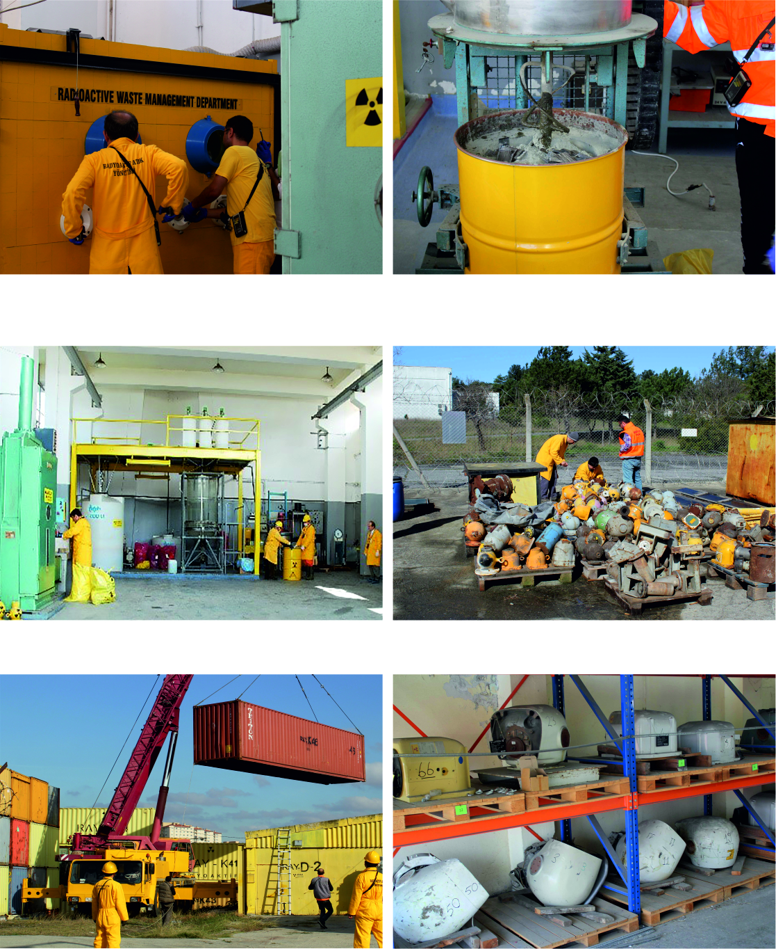
DEPARTMENT OF RADIOACTIVE WASTE MANAGEMENT
It was established to carry out and coordinate all kinds of operations related to the management of radioactive wastes in Turkey.

Slide 17

INSTITUTES
Boron Research Institute (BOREN)
Energy Research Institute (ENAREN)
Nuclear Energy Research Institute (NÜKEN)
Rare Earth Elements Research Institute
(NATEN)
Clean Energy Reseach Institute (TEMEN)

Slide 18
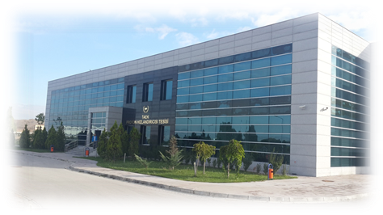
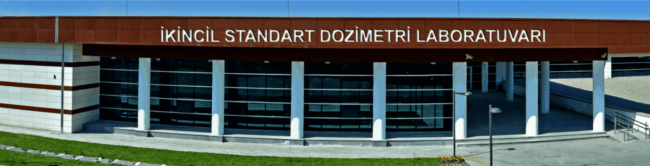
NUCLEAR ENERGY RESEARCH INSTITUTE (NÜKEN)
NÜKEN carries out in the fields of ionizing radiation, particle accelerators and nuclear energy and technology.
This institute conducts research, development and innovation activities. In addition, it provides services such as measurement, testing, inspection, analysis, inspection, consultancy and training.

Slide 19
UNITS OF NÜKEN
Nuclear Sciences and Materials Research Coordination
Accelerator and Irradiation Technologies Coordination
Radiation Metrology and Measurement Services Coordination
Technology Development and Nuclear Research Coordination

Slide 20
INFRASTRUCTURE OF NÜKEN
Ankara Sarayköy Campus
İstanbul Çekmece Campus
Proton Accelerator Facility (PHT)
Second Standard Dosimetry Laboratory (İSDL)
Gamma Irradiation Facility (GIT)
Electron Accelerator Facility (EHT)
Research Reactor Facility (5MW)
Radioactive Waste Treatment Facility
Nuclear Fuel Pilot Facility
Low Energy Ion Accelerator Facility

Slide 21
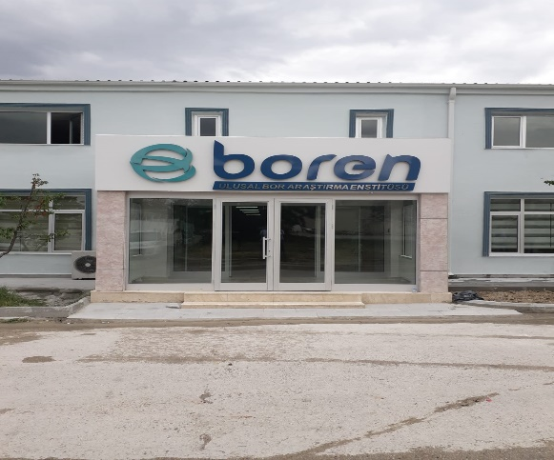
BORON RESEARCH INSTITUTE (BOREN)
BOREN provides analysis and testing services along with R&D and innovation activities in order to develop and spread boron products, usage and technologies with high added value.

Slide 22
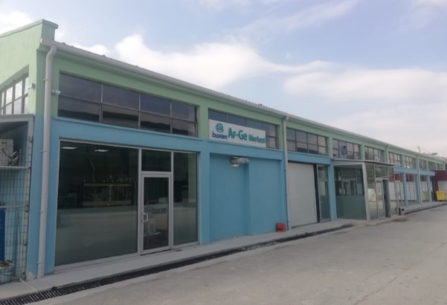
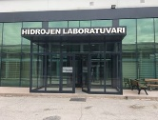
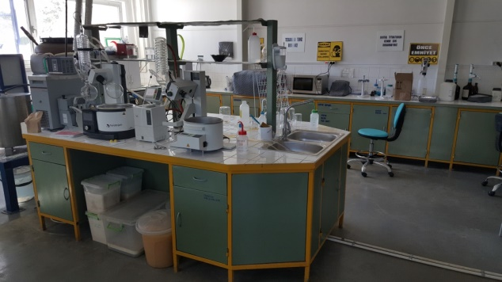
INFRASTRUCTURE OF BOREN
Ankara Central Campus
BOREN R&D Center Laboratory
BOREN Hydrogen Technologies Laboratory
Boron Materials Research Laboratory
Boron Composite Materials Laboratory
Boron Coating Technologies Laboratory
Organoboron ve Polymer Laboratory
BOREN Biotechnology Laboratory

Slide 23
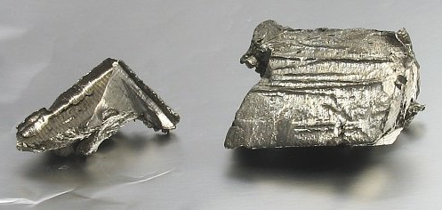
RARE EARTH ELEMENTS RESEARCH INSTITUTE (NATEN)
R&D and innovation activities are carried out in order to obtain Rare Earth Elements (REE) and other valuable elements from our domestic resources, which are needed to reduce the external dependency of our country's developing energy sector and industry, and to develop technologies for this purpose.

Slide 24
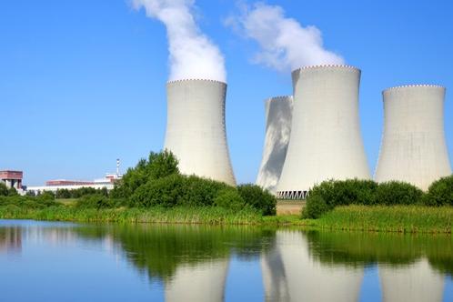
ENERGY RESEARCH INSTITUTE (ENAREN)
ENAREN aims to meet the R&D needs in the product and technology areas in the production, transmission, distribution and consumption processes of our country's energy resources and to develop domestic products and technologies.

Slide 25

CLEAN ENERGY RESEARCH INSTITUTE (TEMEN)
TEMEN aims to meet the R&D needs of our country in the fields of energy efficiency with products and technologies in processes for clean energy generation from all energy sources, especially renewable energy sources, and to develop domestic products and technologies in this field.

Slide 26

OTHER DEPARTMENTS
Department of Audit Services
Department of Legal Services
Department of Corporate Communication
Executive Assistant to President

Slide 27
OTHER DEPARTMENTS
ADMINISTRATIVE, TECHNICAL AND FINANCIAL AFFAIRS
Department of Human Resource
Department of Strategy Development
Department of Support Services
Department of Information Technology Services

