Slide 1
CERN Teacher and Student Programmes Joint CERN-Turkey Liaison Committee 10.12.2021
Dr. Sascha Schmeling
Head of Teacher and Student Programmes

Slide 2






















Education @ CERN – Today
CERN Education Programme for Teachers and Students
1 staff
1 admin
1 tech
Teacher Programmes
S’Cool LAB
Competitions
Internships
Publications
1 staff
1 doct
1 fellow
1 doct
1 technician
½ fellow
½ fellow
1 staff
1 fellow
Collaboration
1 user
Science Gateway
Physics Education Research
3 doct

Slide 3
Our Programmes

Slide 4
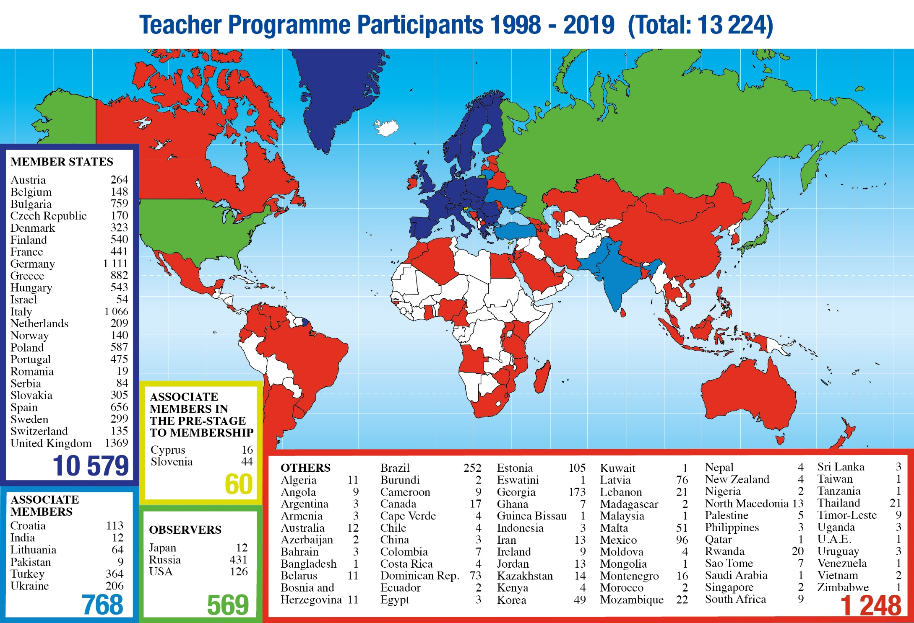
Teacher Programmes
National (Language) Teacher Programmes | 4-6 days
focus on visits and lectures
International Teacher Programme “HST” in English | 2 weeks
International Teacher Weeks in English | 2 weeks
focus on visits, lectures, and collaboration

Slide 5
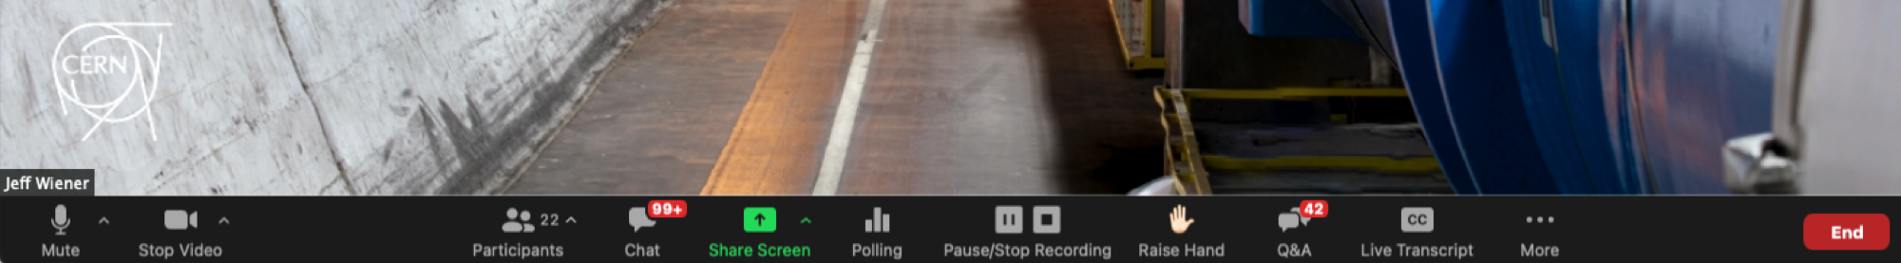
ONLINE Teacher Programmes
More than a dozen programmes, different formats, more than 2000 teachers,
~40 countries
Italian Programmes
Spanish Language Programme
UK Programme
Slovenian Programme
Romanian Programme
Upcoming Programmes in German, Spanish, and French Language
Slide courtesy of Sarah Zöchling

Slide 6
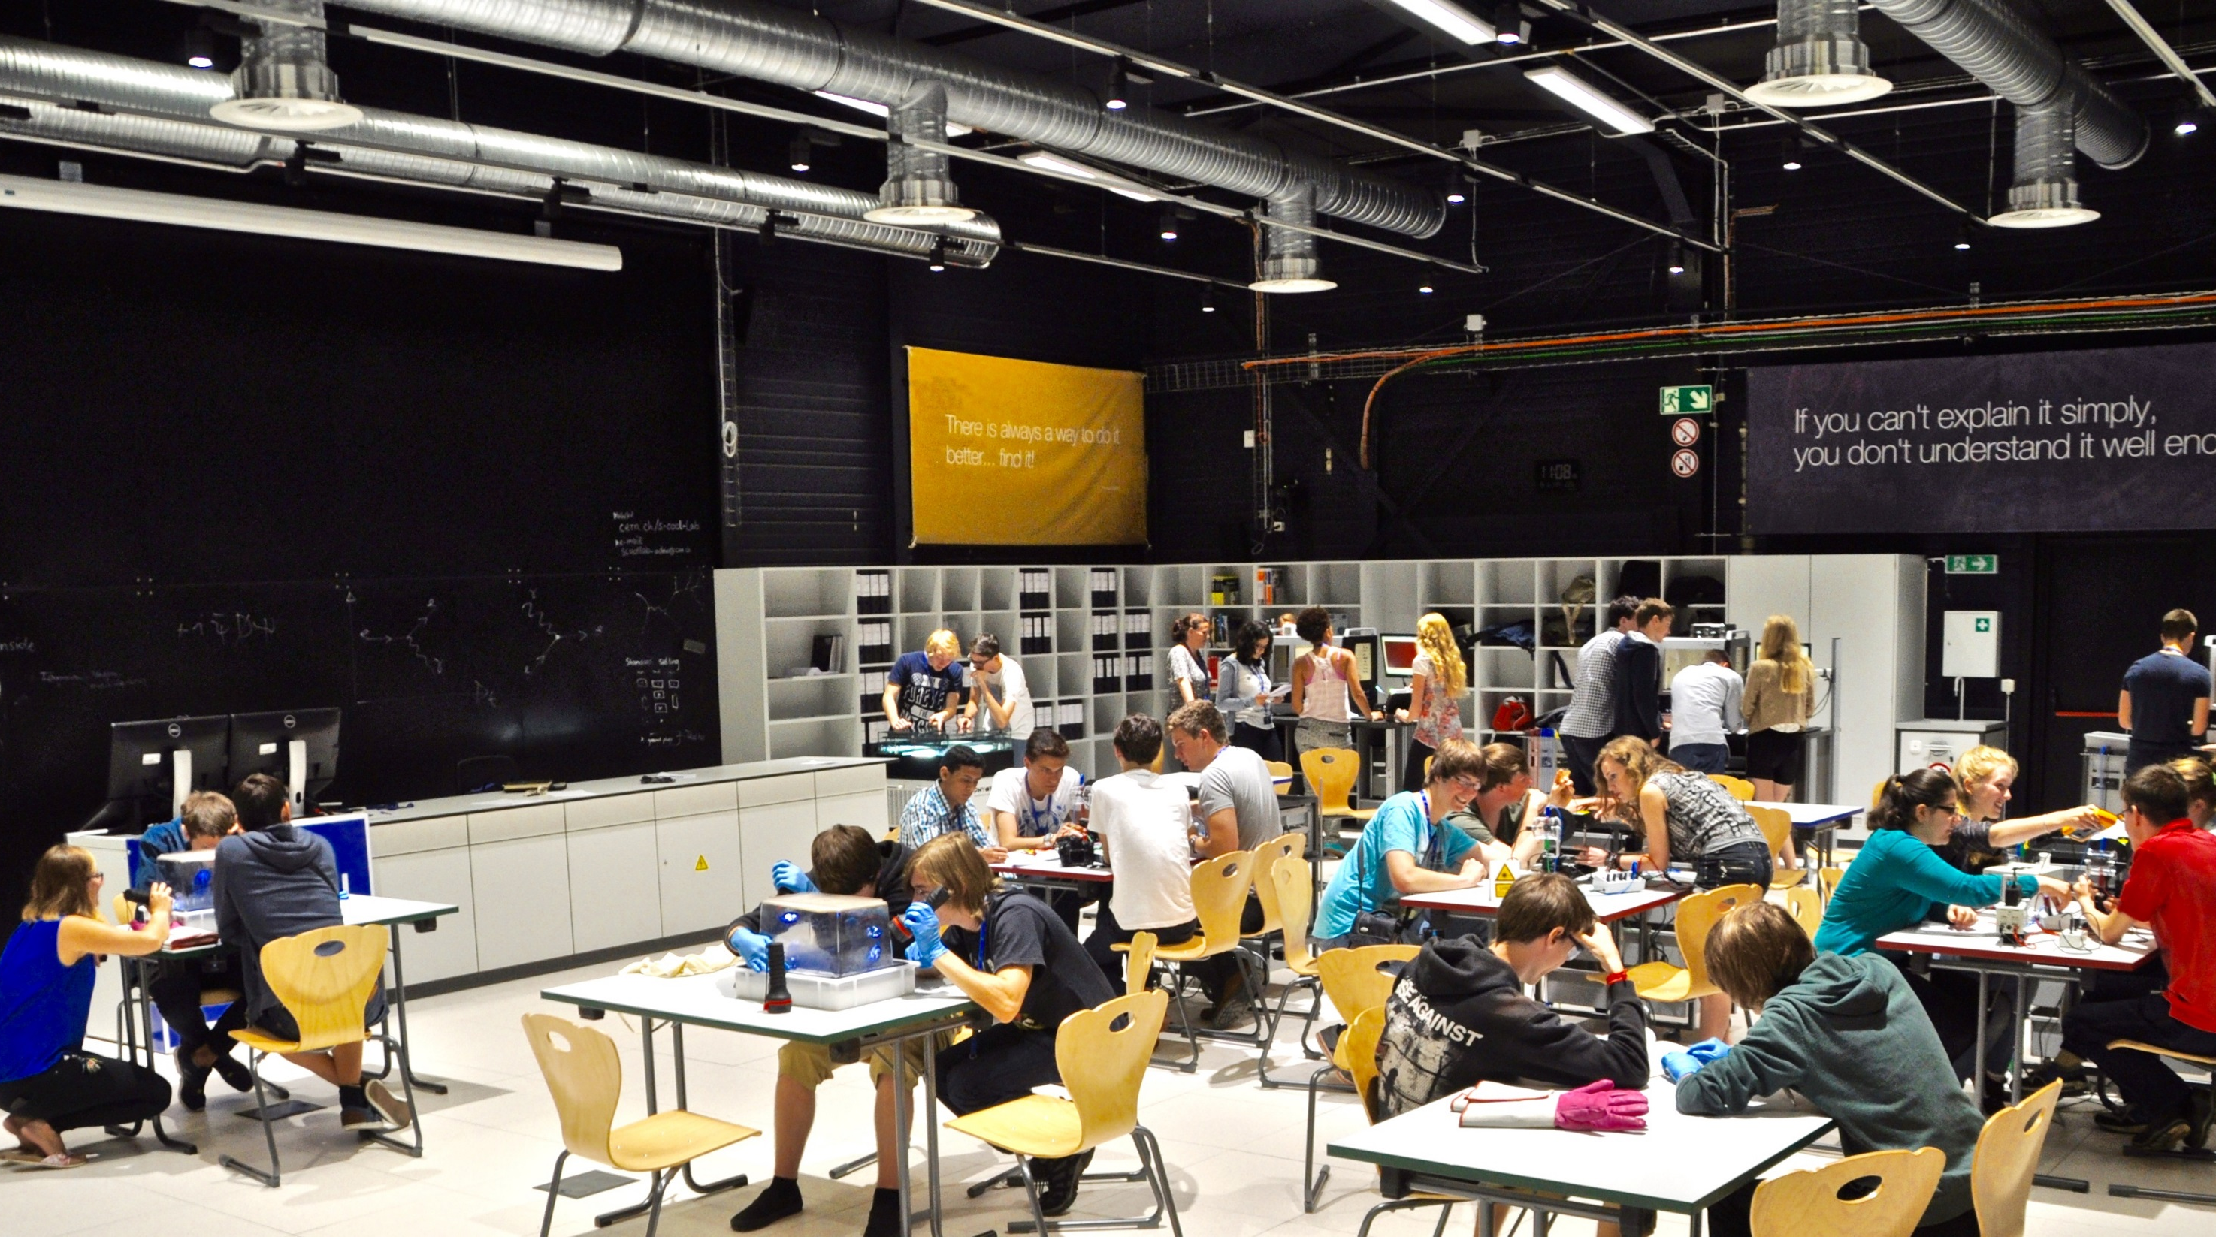
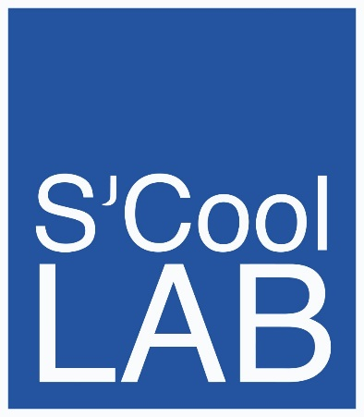
Welcome

Slide 7
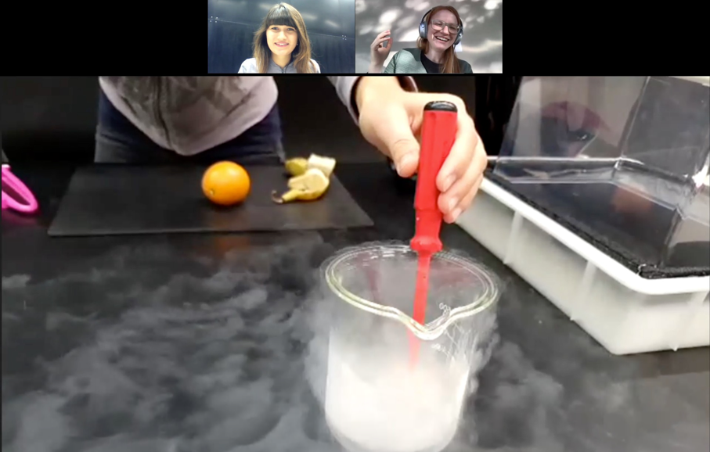
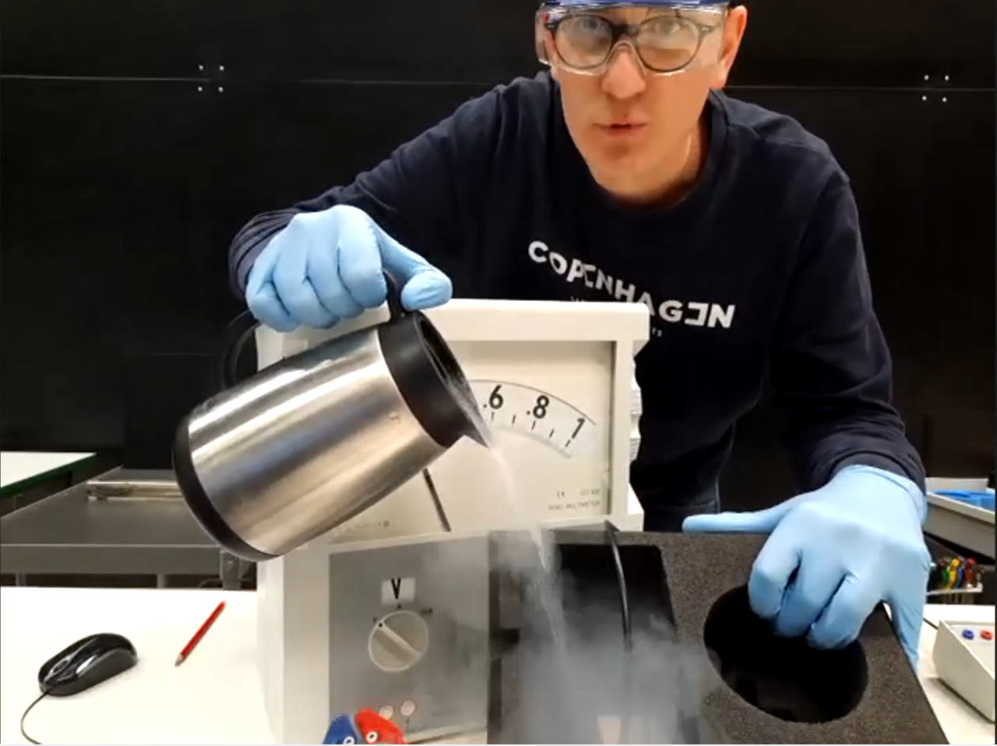
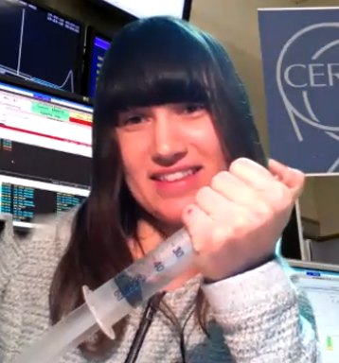
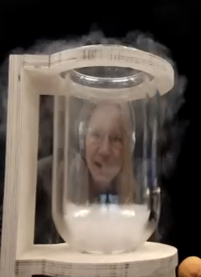
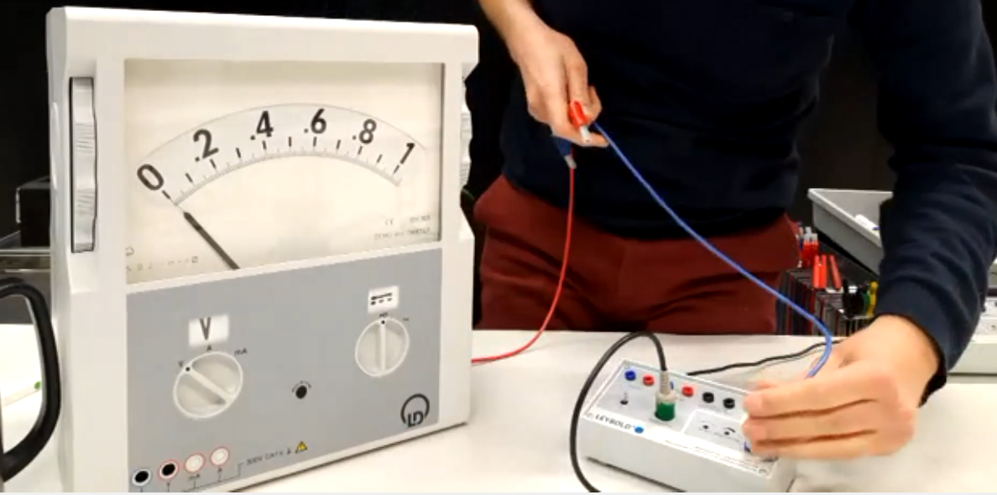
Virtual Science Shows The pandemic as great opportunity
Live interactive demonstrations of scientific phenomena
Links to CERN research
Questions and answers
Various languages
It’s Just a Phase!
Superconductors Take Off!
Slide courtesy of Sarah Zöchling

Slide 8
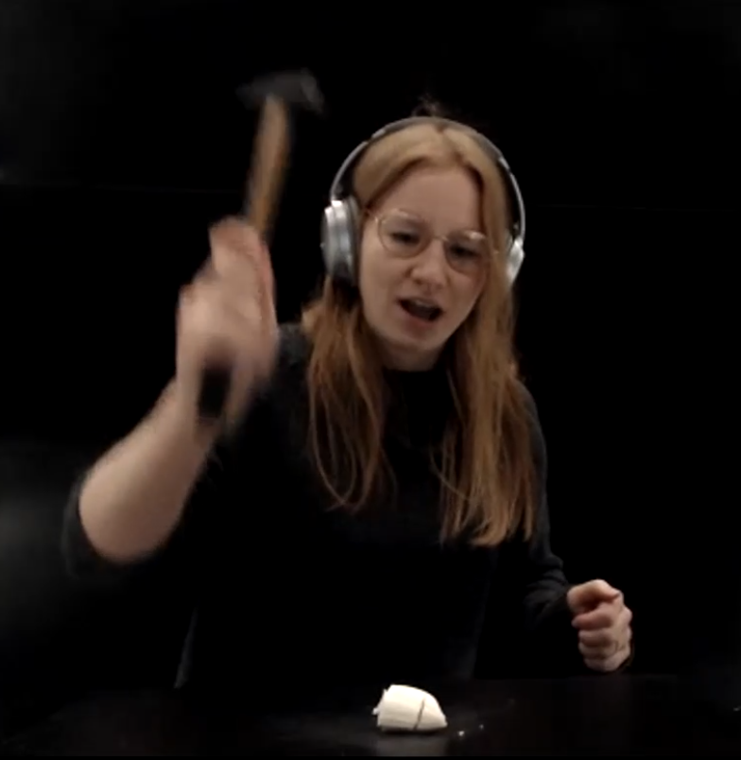
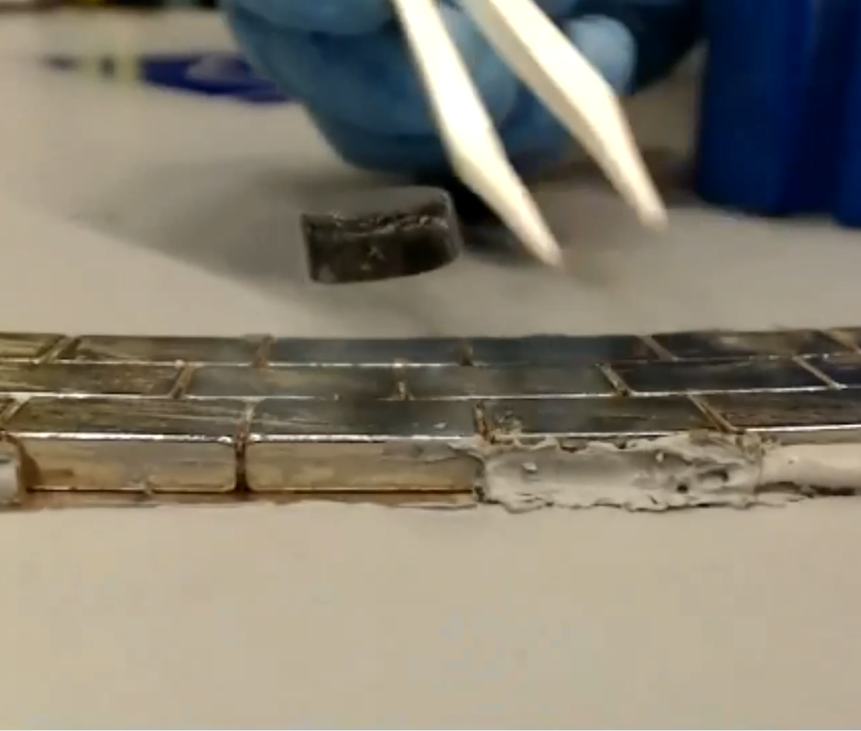
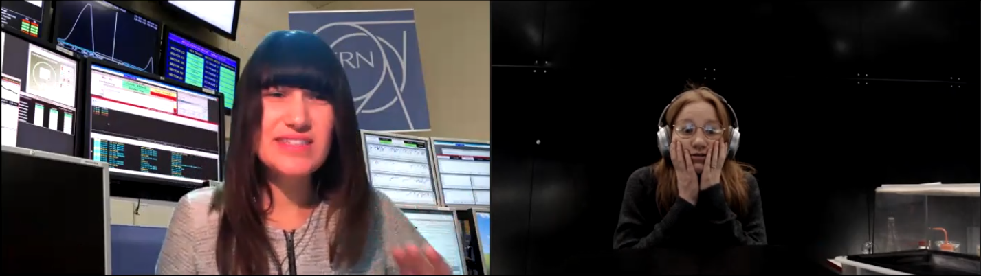
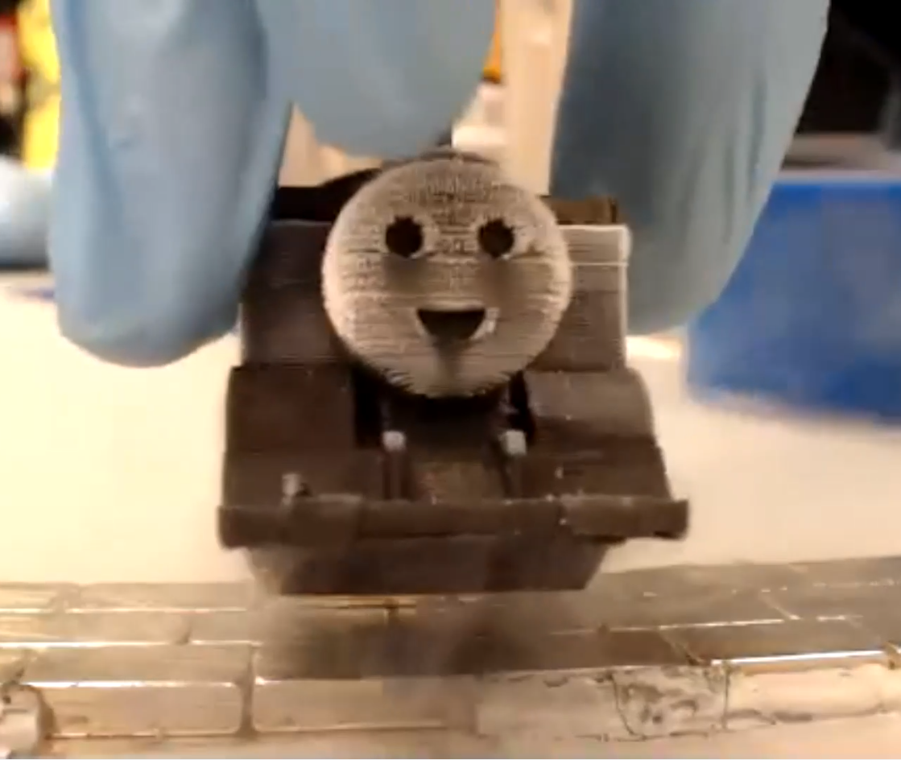
Virtual Science Shows Participation overview
Since October 2020 we performed >>50 shows.
Our shows “travelled” to >20 different countries.
We reached more than 2500 students between ages 12 and 19!
Slide courtesy of Sarah Zöchling

Slide 9
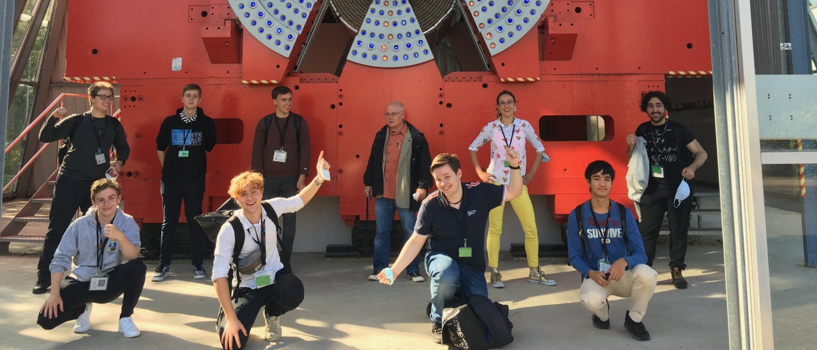
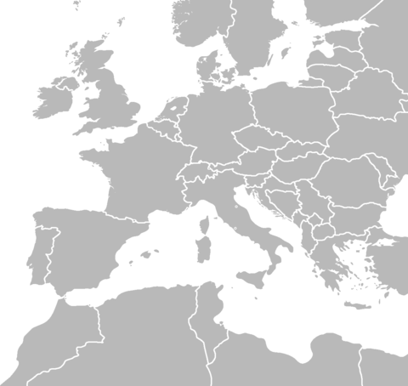
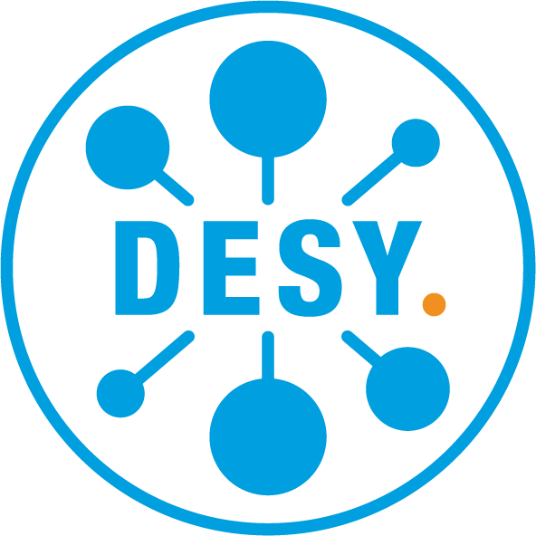

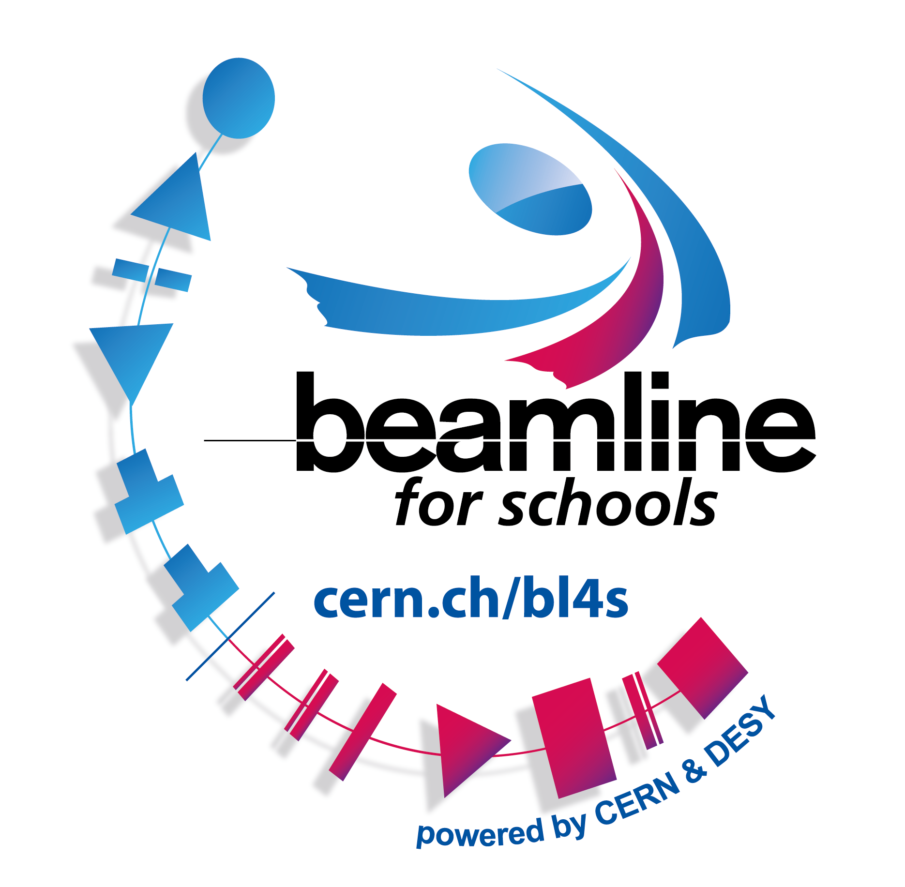
Beamline for Schools
Competition for High-School Student Teams
Normally at CERN’s PS, 2019-21 at DESY
Participation 2021
298 proposals
2022
back at CERN for the finals of the competition
Team @ DESY
DESY
Edition
CERN
Number of Proposals/Countries

Slide 10






















High-School Students Internship Programme
2017
2018
2019
2021
2022

Slide 11
Participation from Turkey
Teacher Programmes
Turkish Teacher Programmes 2014-2020 389 teachers
SESAME Teacher Programme 2015 2 teachers
International Teacher Programmes 2010-2019 13 teachers
S’Cool LAB
S’Cool LAB Days/Workshops 686 high-school students
S’Cool LAB Summer Camps 2017, 2018 2 high-school students
Online Science Shows 120 high-school students
Beamline for Schools
Turkish Teams participated in all years (2014-2021) 194 teams and is one of the most active countries with 1468 students

Slide 12
Teacher and Student Forum
This is one of several CERN Member State Thematic Forums. Their goal is to bring together CERN and Member State representatives who are experts in the relevant field to exchange information, share ideas and discuss the development of coherent strategies. Associate Member States may also participate.
The Teacher and Student Forum focusses on pre-university activities, both for teachers and for students, as well as on the research on these activities.
regular meetings in the March and September CERN Council Weeks
CERN Member and Associated Member States are invited to send a representative

Slide 13
European Strategy for Particle Physics Update 2020
Chapter
Environmental and Societal Impact
Particle physics, with its fundamental questions and technological innovations, attracts bright young minds.
Their education and training are crucial for the needs of the field and of society at large.
Public engagement, education and communication in particle physics should continue to be recognised as important components of the scientific activity and receive adequate support.
The particle physics community should work with educators and relevant authorities to explore the adoption of basic knowledge of elementary particles and their interactions in the regular school curriculum.
Deliberations
CERN has thriving teachers and students programmes, which are also capable of generating valuable data that should be made available to the education research community.
Vocational education in the fields relevant for CERN should also be encouraged. It is important to be inclusive for all students, and initiatives to address under-represented groups should be supported.
The Science Gateway, under construction at CERN, will offer a golden opportunity to reinforce particle physics public engagement and education, which should be made to radiate across the whole of Europe.
Chapter
Environmental and Societal Impact
Particle physics, with its fundamental questions and technological innovations, attracts bright young minds.
Their education and training are crucial for the needs of the field and of society at large.
Public engagement, education and communication in particle physics should continue to be recognised as important components of the scientific activity and receive adequate support.
The particle physics community should work with educators and relevant authorities to explore the adoption of basic knowledge of elementary particles and their interactions in the regular school curriculum.
Deliberations
CERN has thriving teachers and students programmes, which are also capable of generating valuable data that should be made available to the education research community.
Vocational education in the fields relevant for CERN should also be encouraged. It is important to be inclusive for all students, and initiatives to address under-represented groups should be supported.
The Science Gateway, under construction at CERN, will offer a golden opportunity to reinforce particle physics public engagement and education, which should be made to radiate across the whole of Europe.

Slide 14
Physics Education Research
The basis of all our programmes

Slide 15
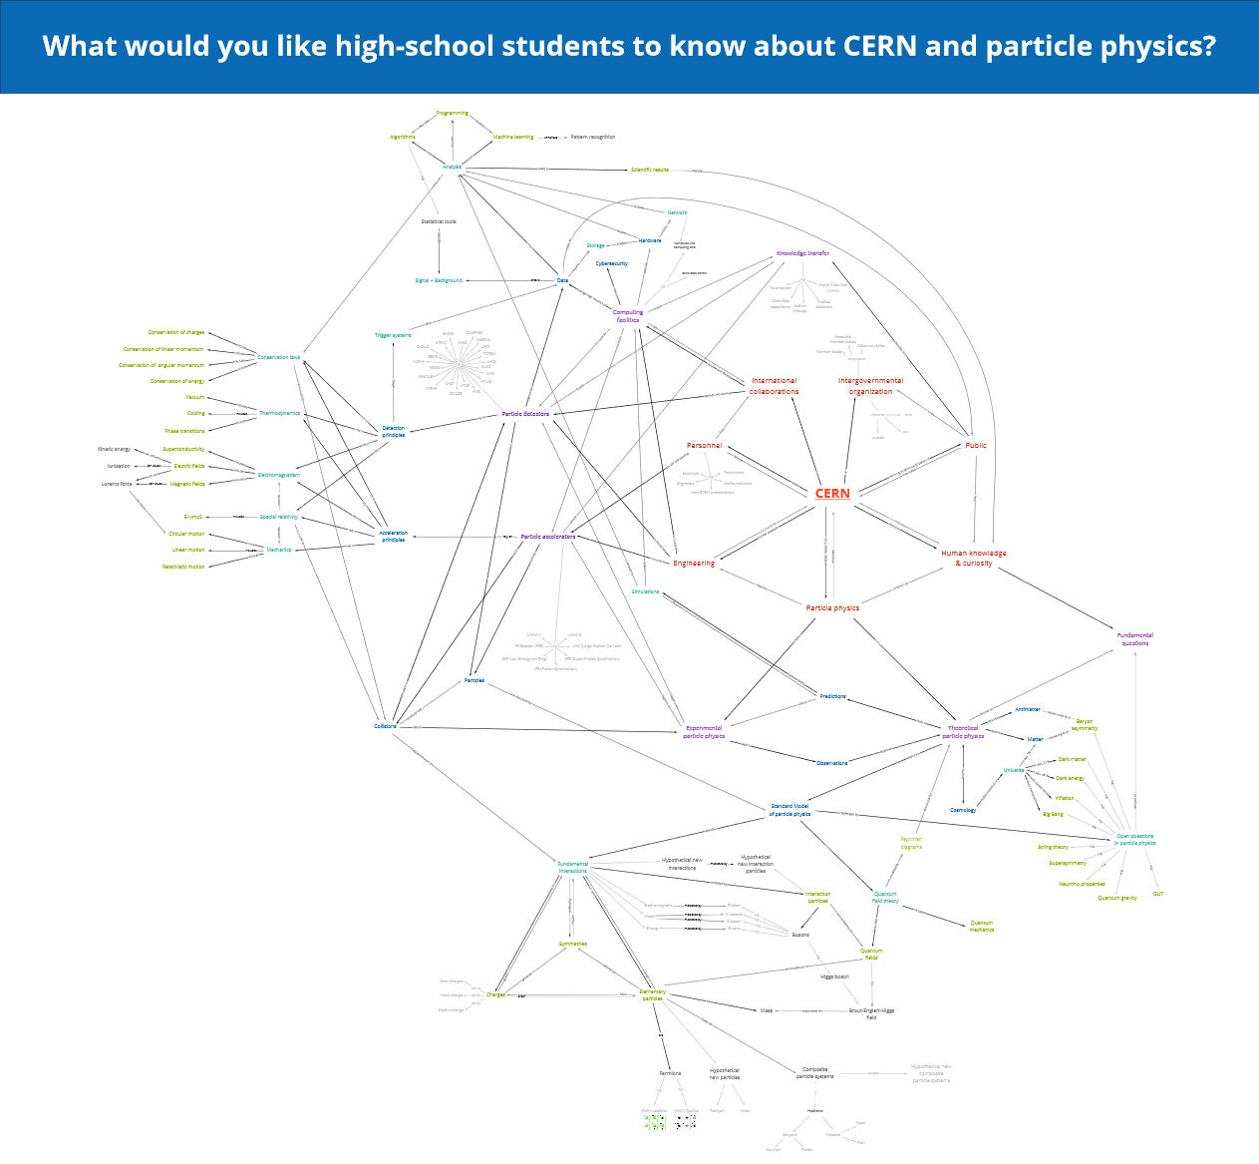
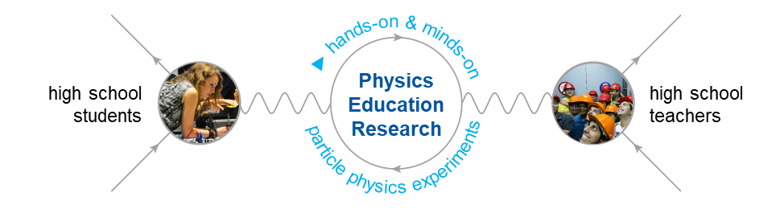
Evaluation of CERN’s Teacher Programmes Anja Kranjc Horvat
Link to CERN
Evaluation of CERN’s Teacher Programmes and overview of concepts in the field “CERN and particle physics” to ...
inform and improve CERN’s Teacher Programmes
create a valuable teaching resource
Paper: Kranjc Horvat, A., Wiener, J., Schmeling, S. & Borowski, A. (Accepted). Learning goals of professional development programs at science research institutions: A Delphi study with different stakeholder groups. Journal of Science Teacher Education.
Slide courtesy of Sarah Zöchling

Slide 16
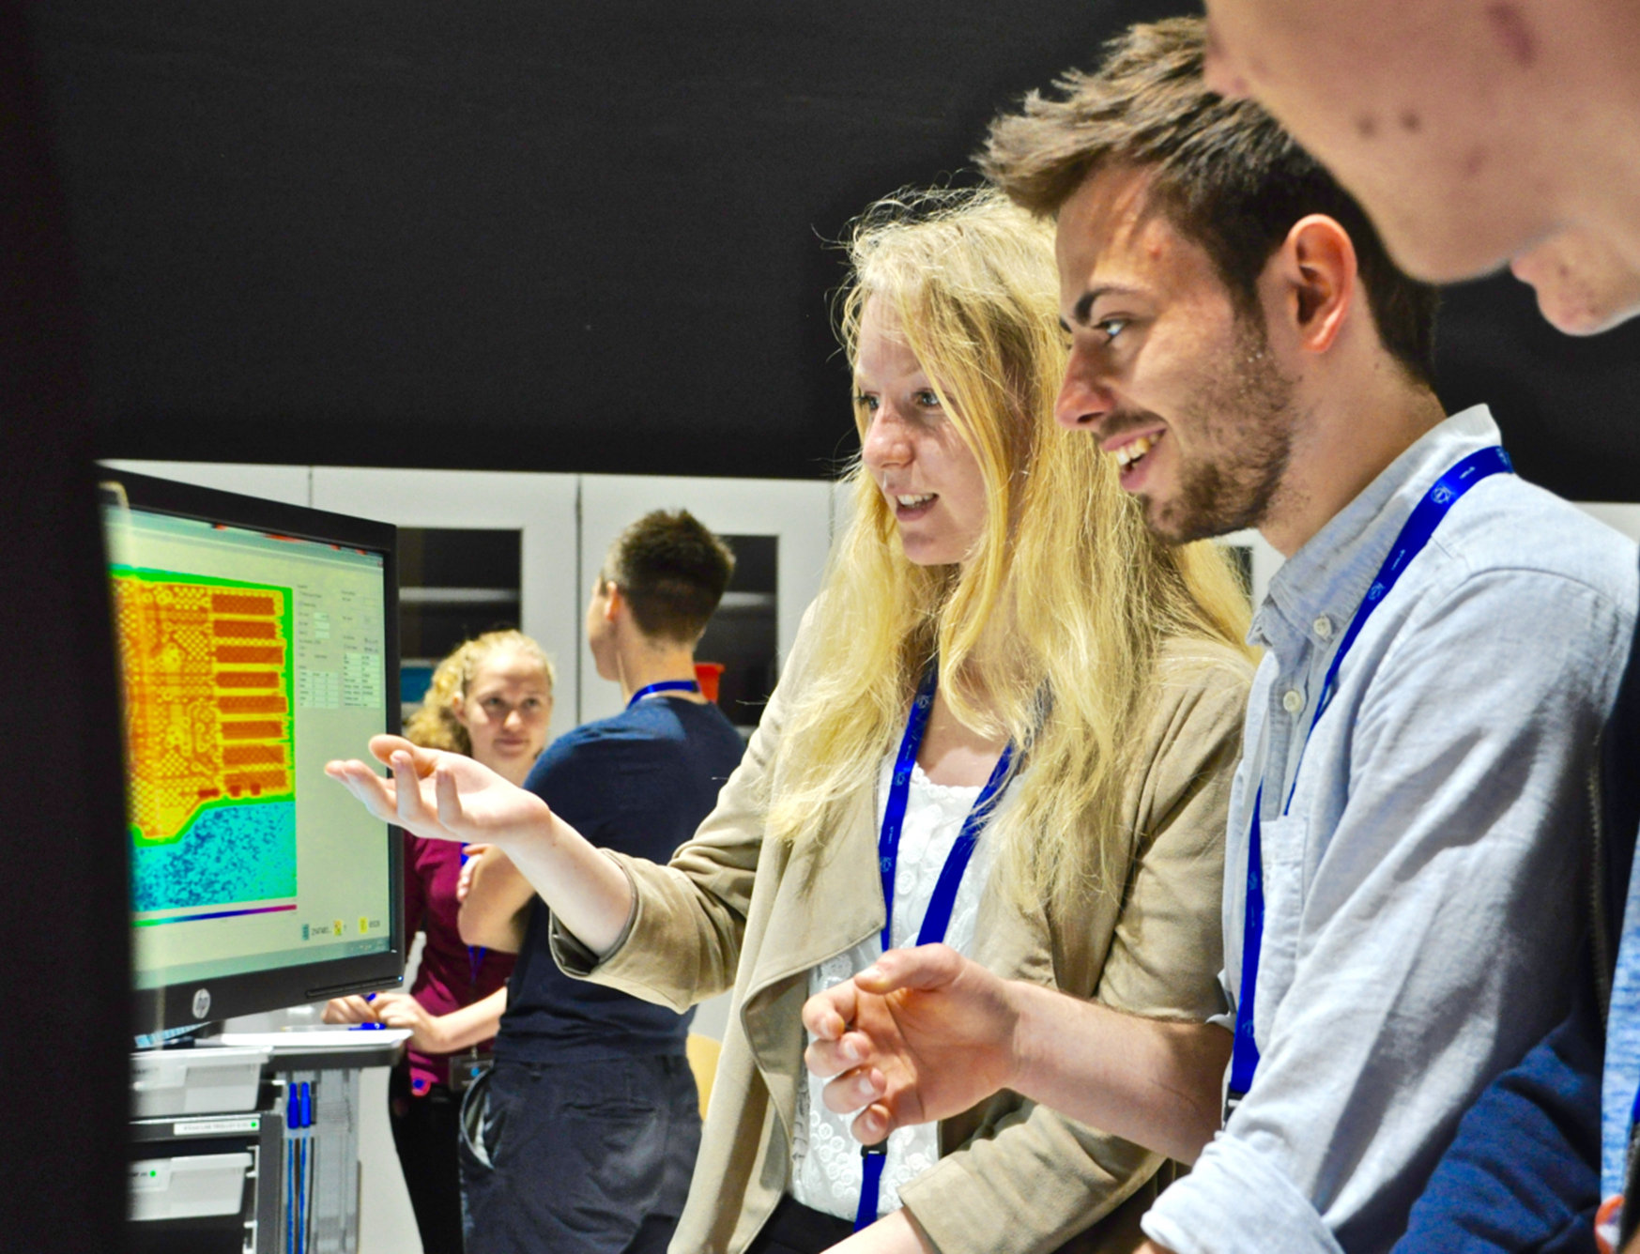
Fostering interest in particle physics Sarah Zöchling
Link to CERN
Development of a measurement instrument about interest in particle physics and study about students’ interest in different contents and contexts to …
define interest types
give recommendations for interesting learning material
Slide courtesy of Sarah Zöchling

Slide 17
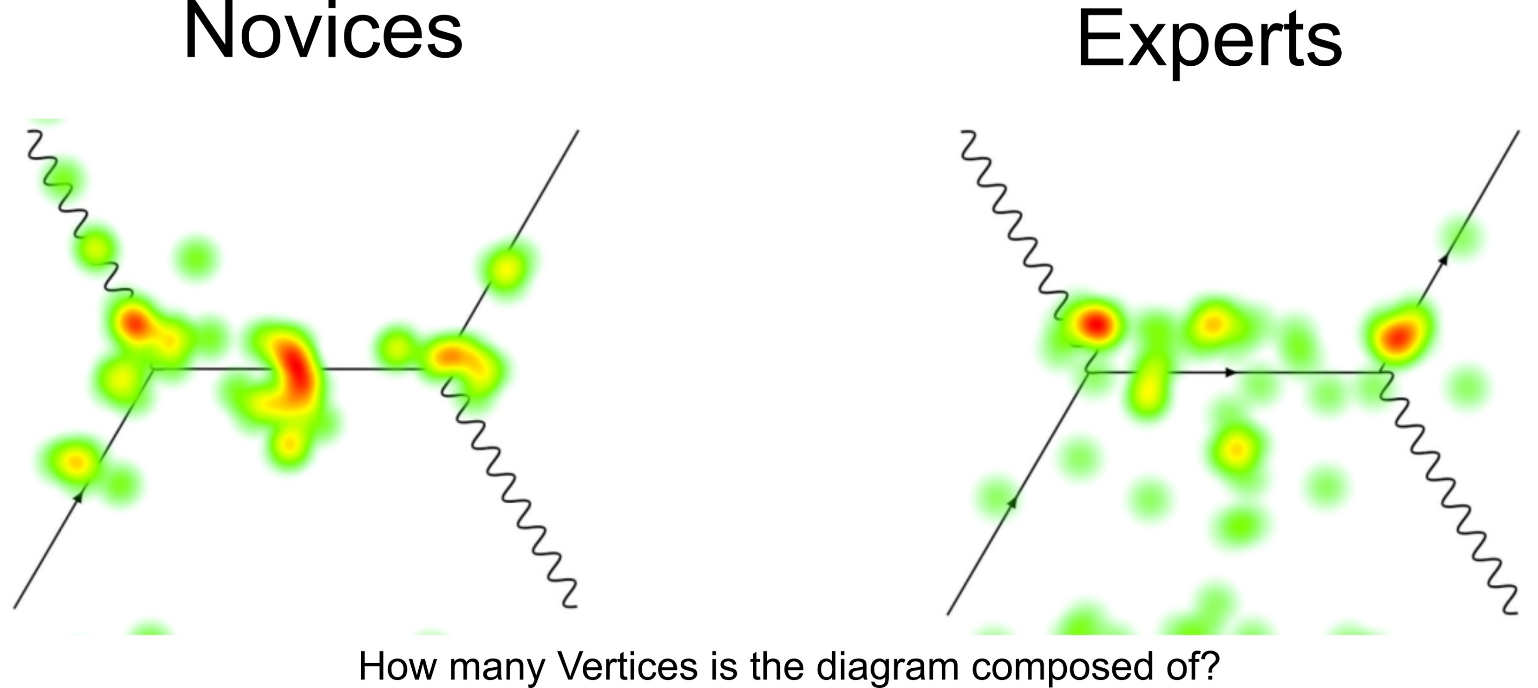
Eye Tracking in PER Merten Dahlkemper
Link to CERN
Introduce eye tracking as a PER method at CERN to ...
better understand how students perceive visualisations in particle physics (e.g. Feynman diagrams or event displays)
develop learning material for particle physics
Slide courtesy of Sarah Zöchling

Slide 18
Science Gateway
A future outlet for Science Education and Outreach

Slide 19
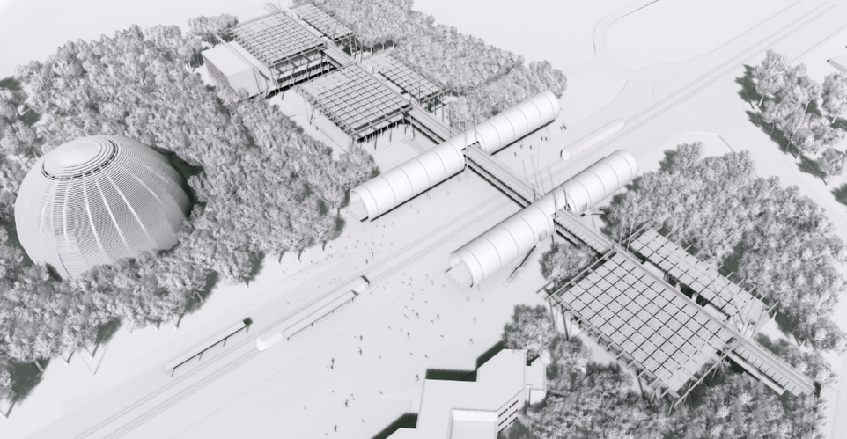
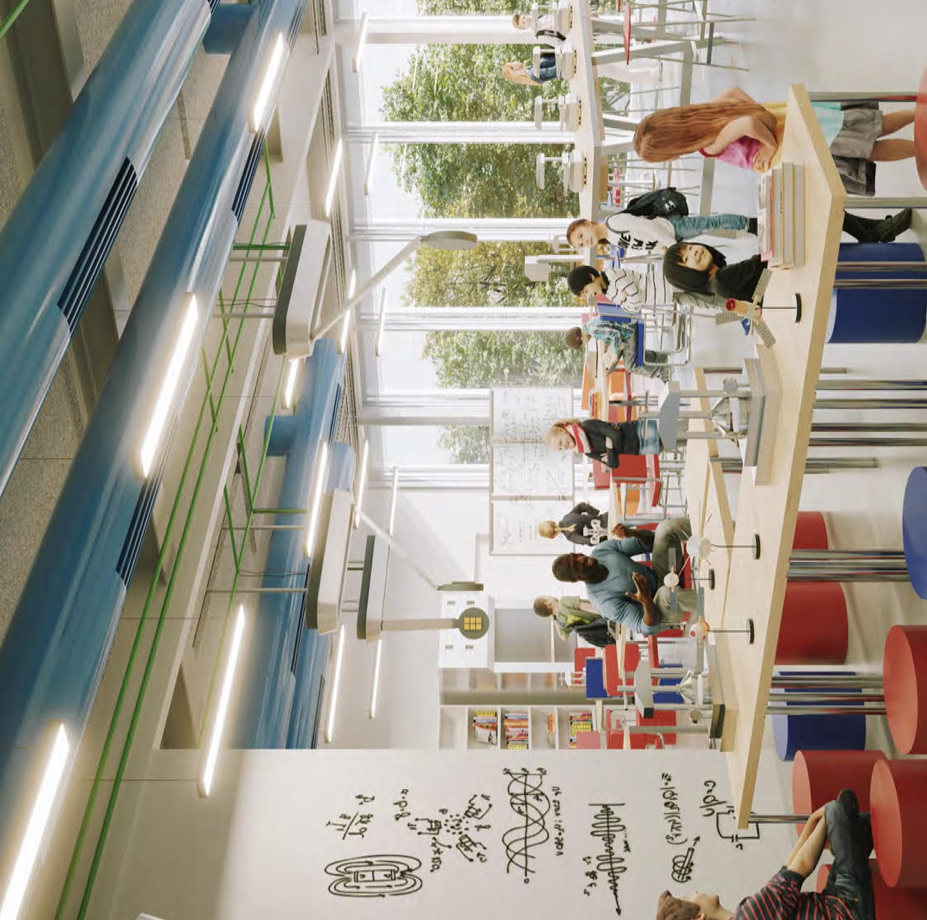
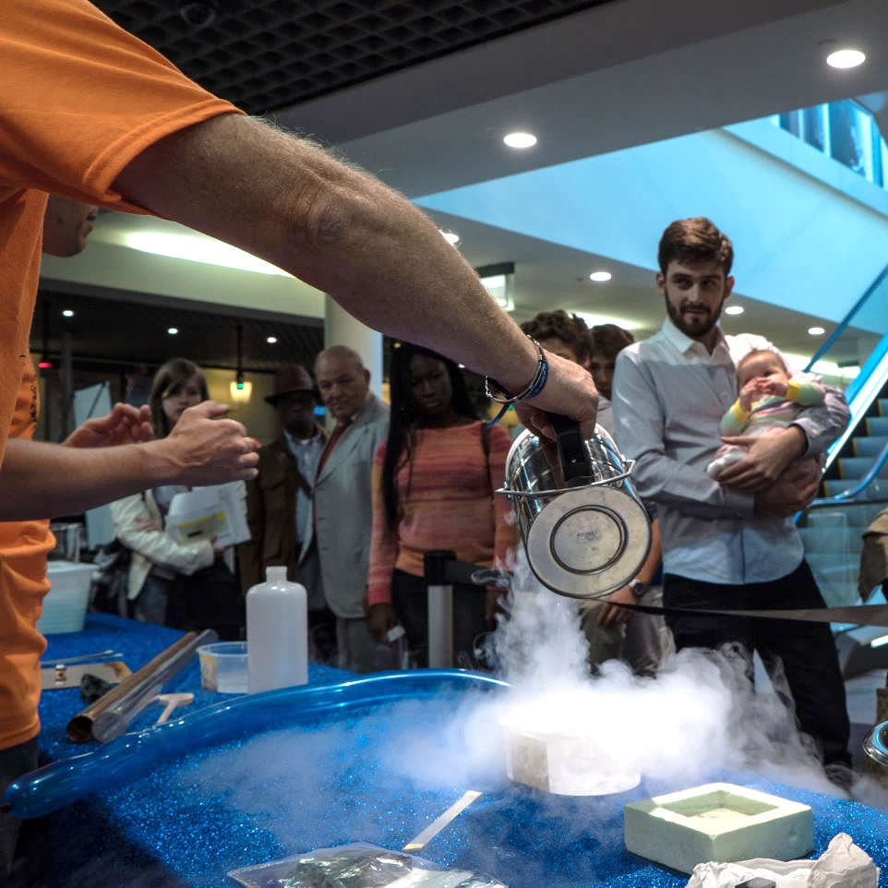
Slide courtesy of Sarah Zöchling
Notes:
Als Hintergrund Artwork (blick von oben auf SG- CERN Townhall meeting) und inspirationen für text (shows, labs, online offer), als Text folien 7, 8 (goals, potential) Stichwort: Katalysator (school project with Italy, summer camps) als auslöser

Slide 20
Participation from Turkey
Teacher Programmes
Turkish Teacher Programmes 2014-2020 389 teachers
SESAME Teacher Programme 2015 2 teachers
International Teacher Programmes 2010-2019 13 teachers
S’Cool LAB
S’Cool LAB Days/Workshops 686 high-school students
S’Cool LAB Summer Camps 2017, 2018 2 high-school students
Online Science Shows 120 high-school students
Beamline for Schools
Turkish Teams participated in all years (2014-2021) 194 teams and is one of the most active countries with 1468 students

