Slide 1
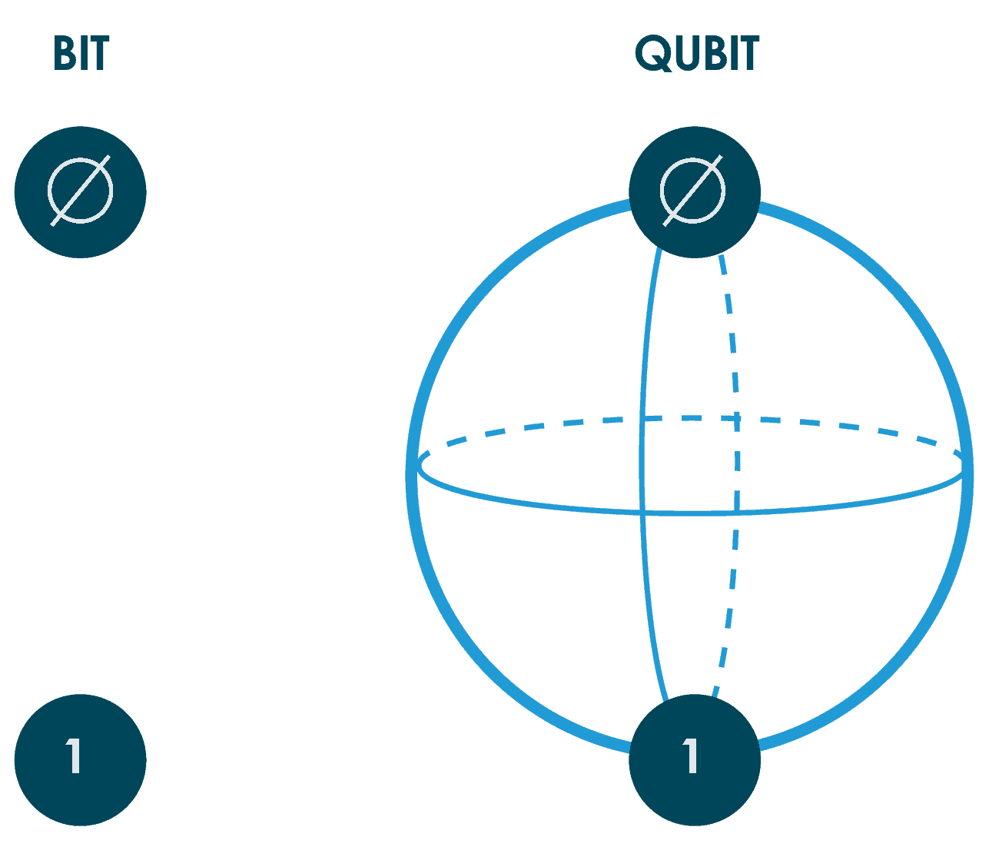

Introduction to
Quantum Computing
Workshop Overview
Maria Alandes Pradillo

Slide 2
What?
Introduction to Quantum Computing
Target Group: Highschool Students
Ages: 15 to 19 years old
Duration: 1h30
Bits and Logical Gates
Moore’s Law and Intractable problems
Unplugged workshop
A bit of theory & explanations
Work in pairs/groups
Discussion and Interaction
Superposition, Entanglement and Qubits
Groover’s algorithm
Learning objectives and pedagogical scenario: https://cernbox.cern.ch/index.php/s/X3AD9q8yLs5xPrD

Slide 3




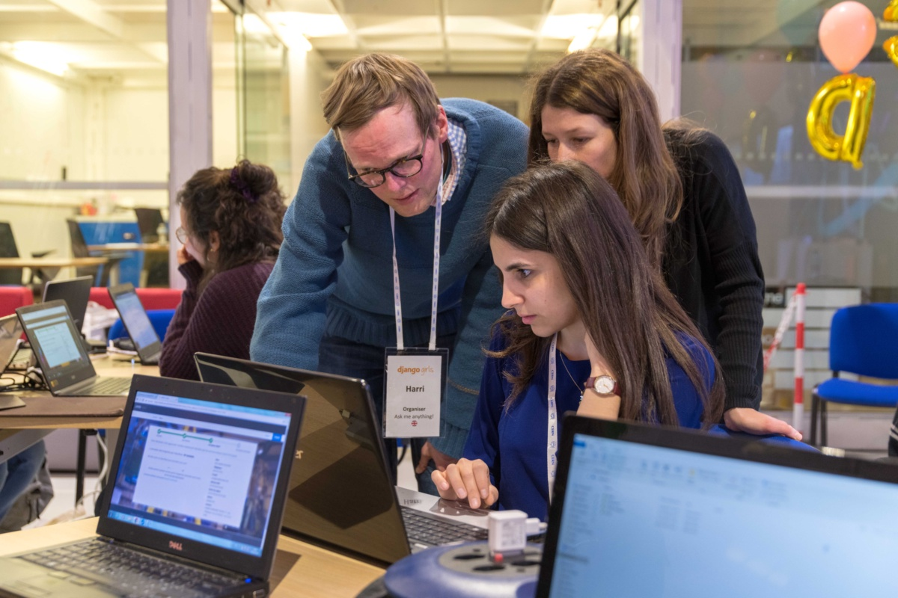
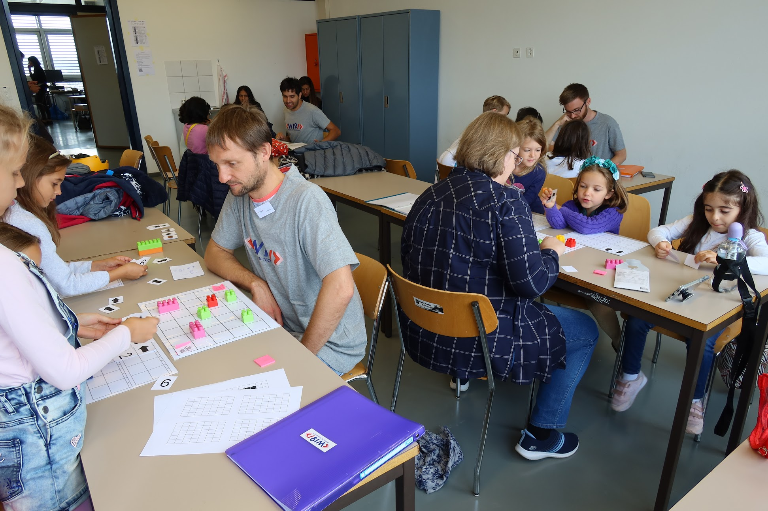
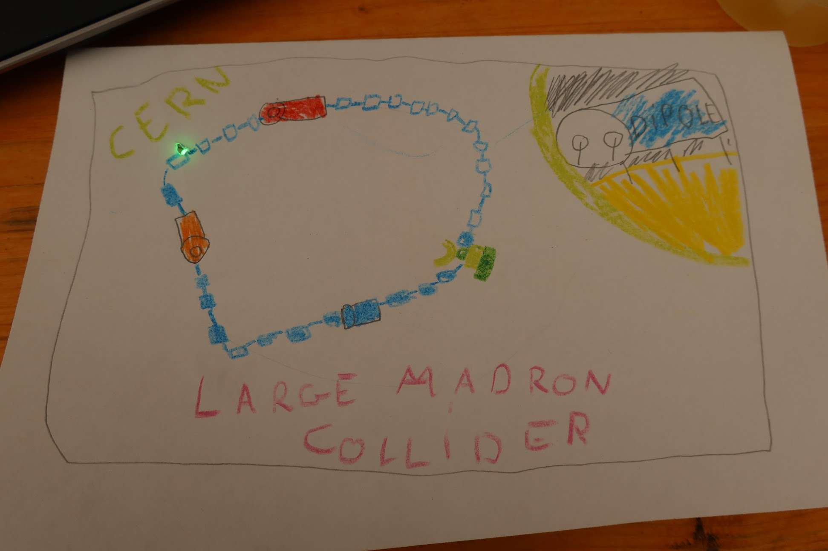
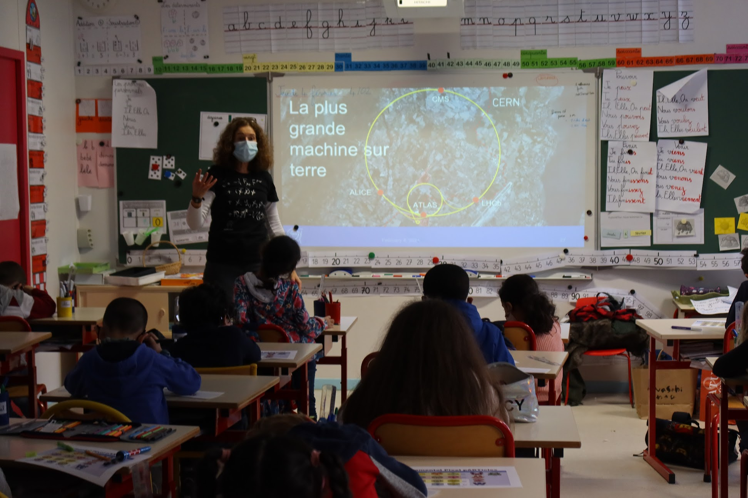
Who?
WIT Outreach
More about WIT: https://wit-hub.web.cern.ch

Slide 4
When?
TecDay – 17th March 2022
Organised by Swiss Academy of Engineering Sciences
National event across Switzerland
College Sismondi in Geneva
Participants from Industry and Academia
Two workshops organised by CERN
Superconductors by School Lab
Quantum Computing by WIT
Groups of 12 students
Students enrol to 3 sessions of 1h30 throughout the day
Highschool students from 15 to 19 years old
More about TecDay: https://www.satw.ch/fr/tecday

Slide 5
How?
Finish
Content
Prepare Material
Expert
Input
Workshop
Creation
Foster Collaboration
Find Volunteers
Get Feedback
Contact: wit-outreach@cern.ch

