Slide 1
Towards Tokens for WLCG
March. Identified technical solution (Indigo IAM)
November. Identified Pilot Software Options
July. Identified Certificate Authority (RCAuth.eu)
WLCG IAM instances deployed for CMS and ATLAS to allow testing
Sep. WLCG Token Schema v1.0 Published​
X.509
Tokens
2017
2018
2019
2020
July. WLCG AuthZ WG Formed
February. Privacy Statement agreed and approved by CERN HR
April. Schema presented to OpenID Foundation
Hackathons demonstrated full token workflow
&
X.509 + VOMS (ad interim)
Infrastructure
  Token issuers per VO (Indigo IAM) - ATLAS and CMS in progress
    Operational support and maintenance (CERN IT)
  Command line solution (Hashicorp Vault) - Pilot set up
  Token support throughout WLCG stack - Timeline TBC
Documentation
  Token schema v1.0
  Token discoverability specification v1.0
Notes:
The aim is to migrate authz ecosystem from X509 Certificates to JWT, Json Web Tokens, using the OpenIDConnect protocol.
Good progress in that direction has been made so far, but not finished yet – it is expected that certain users, particularly admin users, wull still need to be using end user and entity certs for some time yet
Real motivation is that typical researchers will not need to manager user certificates themselves, rather more user friendly options will be open to them to be authorized for physics workflows
Key timeline notes:
Sept 2019 – Token Schema published, allowed dev work to get off the ground as there was a common schema for work to centre around
Several hackathons since then have helped progress and demonstrated full token workflows, and now have several token issuer instances deployed for testing
Infrastructure is based on AARC to take into account best practices from Research communities in order to create a system which works for WLCG whilst benefiting from work done.
For WLCG there will be a certain amount of integration with Cern infrastructure for the 4 main Vos, for example using the CERN SSO as a single point of entry and integration with CERN HRDB for user association validity and end dates.
Plan is for one token issuer per VO utilising the INDIGO IAM, at this stage ATLAS and CMS instances deployed at CERN for testing, with plans for these to be supported operationally by CERN IT as production instances down the line.
Needs a command line solution which is both user friendly and secure. This means that the solution must have a protected way to handle refresh tokens – allowing processes to obtain new access tokens. This will be implemented using Hashicorp vault – I will leave further technical details on this to be covered by Dave in the following talk.
Further token integration is underway, with a timeline for full support TBC.
Cover the documentation areas – token schema and discoverability – over the next few slides

Slide 2
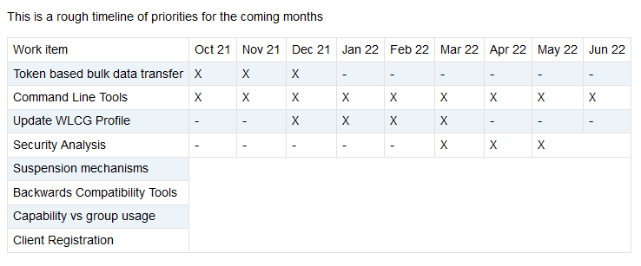
Towards Tokens for WLCG
Notes:
The aim is to migrate authz ecosystem from X509 Certificates to JWT, Json Web Tokens, using the OpenIDConnect protocol.
Good progress in that direction has been made so far, but not finished yet – it is expected that certain users, particularly admin users, wull still need to be using end user and entity certs for some time yet
Real motivation is that typical researchers will not need to manager user certificates themselves, rather more user friendly options will be open to them to be authorized for physics workflows
Key timeline notes:
Sept 2019 – Token Schema published, allowed dev work to get off the ground as there was a common schema for work to centre around
Several hackathons since then have helped progress and demonstrated full token workflows, and now have several token issuer instances deployed for testing
Infrastructure is based on AARC to take into account best practices from Research communities in order to create a system which works for WLCG whilst benefiting from work done.
For WLCG there will be a certain amount of integration with Cern infrastructure for the 4 main Vos, for example using the CERN SSO as a single point of entry and integration with CERN HRDB for user association validity and end dates.
Plan is for one token issuer per VO utilising the INDIGO IAM, at this stage ATLAS and CMS instances deployed at CERN for testing, with plans for these to be supported operationally by CERN IT as production instances down the line.
Needs a command line solution which is both user friendly and secure. This means that the solution must have a protected way to handle refresh tokens – allowing processes to obtain new access tokens. This will be implemented using Hashicorp vault – I will leave further technical details on this to be covered by Dave in the following talk.
Further token integration is underway, with a timeline for full support TBC.
Cover the documentation areas – token schema and discoverability – over the next few slides

Slide 3
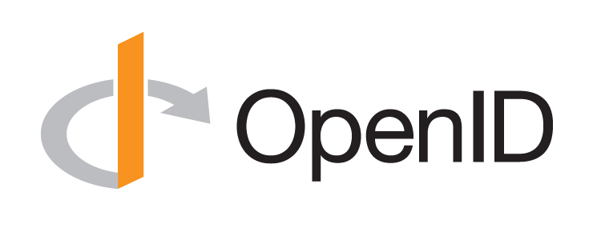
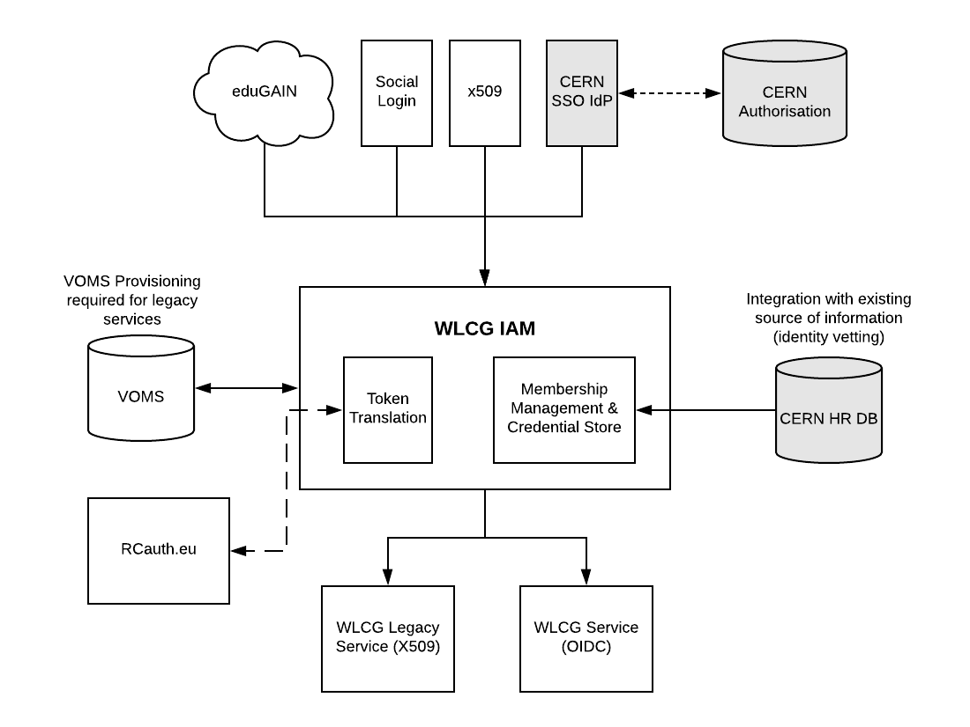

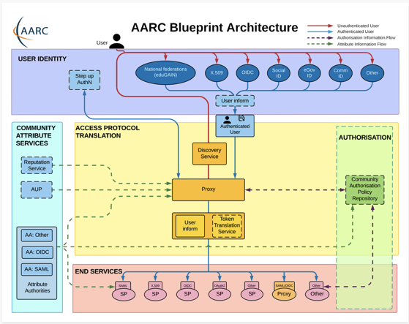

Infrastructure Design
CERN SSO configured as sole Identity Provider, enables identity verification via HR DB (match CERN PersonID)
Follows the AARC Blueprint
https://aarc-community.org/architecture/
Note: one WLCG AAI per VO
WLCG AuthZ WG

Slide 4
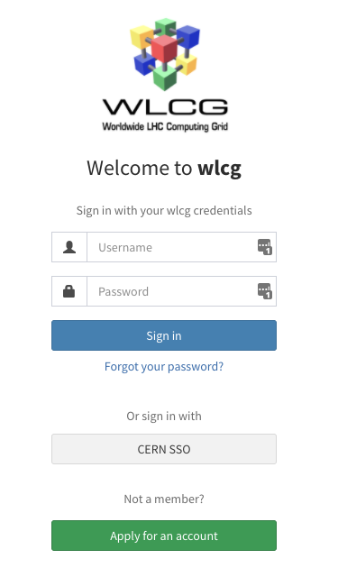
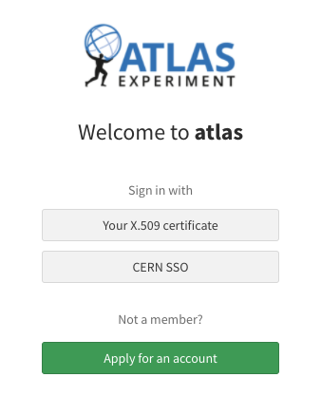
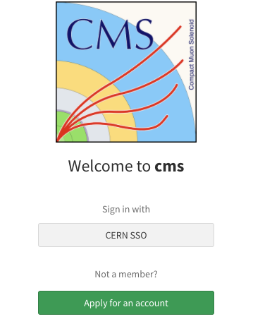
Deployments
The following token issuers have been deployed. The ATLAS and CMS instances are available for testing and integration, with the expectation that they will become the future production token issuers.
https://wlcg.cloud.cnaf.infn.it
https://atlas-auth.web.cern.ch
https://cms-auth.web.cern.ch

Slide 5
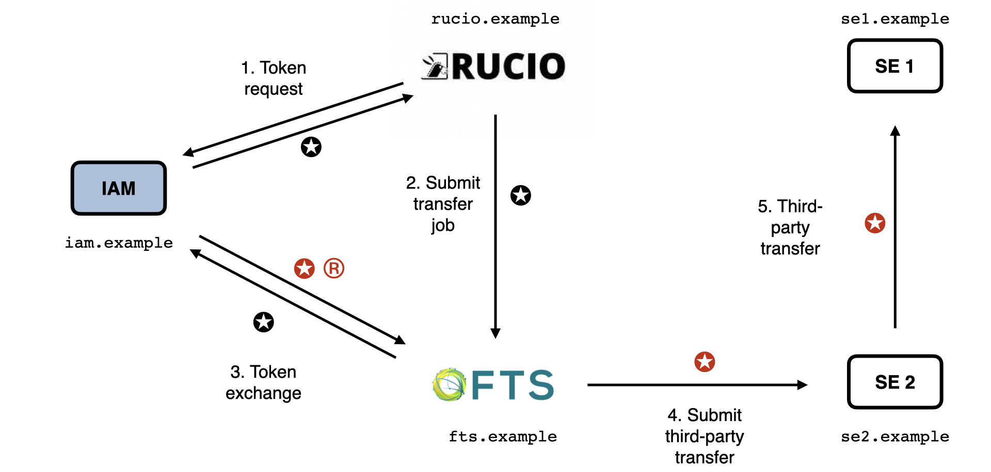
Rucio-FTS-SEs flow
Rucio and FTS are registered IAM Clients
Rucio requests token for FTS from IAM
Rucio submits job to FTS and includes token
FTS exchanges token for one for target third-party
Third-party transfer submitted along with new token
Token can be reused among instances of third-party
Storage Elements are unregistered Resource Servers that trust IAM
Notes:
In order to test the previously discussed concepts and support DOMA activities, the first scenario focussed on was the RUCIO managed data transfer, which is common to many LHC experiments and depicted here.
In this scenario, the identity RUCIO obtains from IAM will be delegated to FTS in order to manage a third-party transfer between two storage elements.
The flow begins with RUCIO submitting a token request to the IAM via the client credentials floq, specifically requesting that the audience claim in the token be restricted to the FTS service. Once RUCIO obtains the token from IAM, it will then submit a transfer job to FTS whilst including the token in the request.
When FTS creates the transfer job, it must then in turn start a new token exchange with the IAM, as the FTS audience from the token from RUCIO may not grant the permissions required for read and write at the storage elements. FTS therefore exchanges the received token at the IAM for an access token and a refresh token, which it will use then to manage the transfer. In this step, FTS requests the scopes required to access the data and restricts the audience to of the issued tokens to the target storage elements. The obtained access token is used to submit the thurd-party transfer to one storage element and throughout the process for the data transfer amongst the elements. The refresh token can be used by FTS throughout the process to obtain a fresh access token from the IAM should it be needed, for example if the process takes longer than the lifetime of the original access token.
The successful testing of this flow and publication of the discoverability schema demonstrate the significant progress made towards the goal of submitting jobs authorised with WLCG tokens within 2021. Whilst much work remains to align the community on a realistic timeline for a full transition, this will be the focus of work over the coming months whilst in parallel the development and testing of these token based workflows will continue.

Slide 6
Token Discovery
Many tools will rely on tokens being stored in the local environment
Token discoverability specification v1.0 published https://zenodo.org/record/3937438
If a tool needs to authenticate with a token and does not have out-of-band WLCG Bearer Token Discovery knowledge on which token to use, the following steps to discover a token MUST be taken in sequence, where $ID below denotes the process’s effective user ID:
1. If the BEARER_TOKEN environment variable is set, then its value is taken to be the token contents.
2. If the BEARER_TOKEN_FILE environment variable is set, then its value is interpreted as a filename. The contents of the specified file are taken to be the token contents.
3. If the XDG_RUNTIME_DIR environment variable is set1, then take the token from the contents of $XDG_RUNTIME_DIR/bt_u$ID2.
4. Otherwise, take the token from /tmp/bt_u$ID
Logic of where to search for (or place) tokens locally
Notes:
Recent conversations have focussed on the problem of token discovery within the command line environment. Whilst browsers internally manage tokens, terminal based tools will rely on finding tokens stored in local environment, and so it was important to define where tokens should be stored within those environments, as well as whether they should be as environment variables, files, or otherwise. Version 1 of the token discovery specification has been recently published, and defines logical steps of where a tool should look for a token – if it is not found in the first place, it should move to the second and so on. This allows tools to know where to expect a token and allows clients know where they should be stored. Full details on the defined logic flow can be found in the paper for this talk.

Slide 7
Supplementary Slides

Slide 8
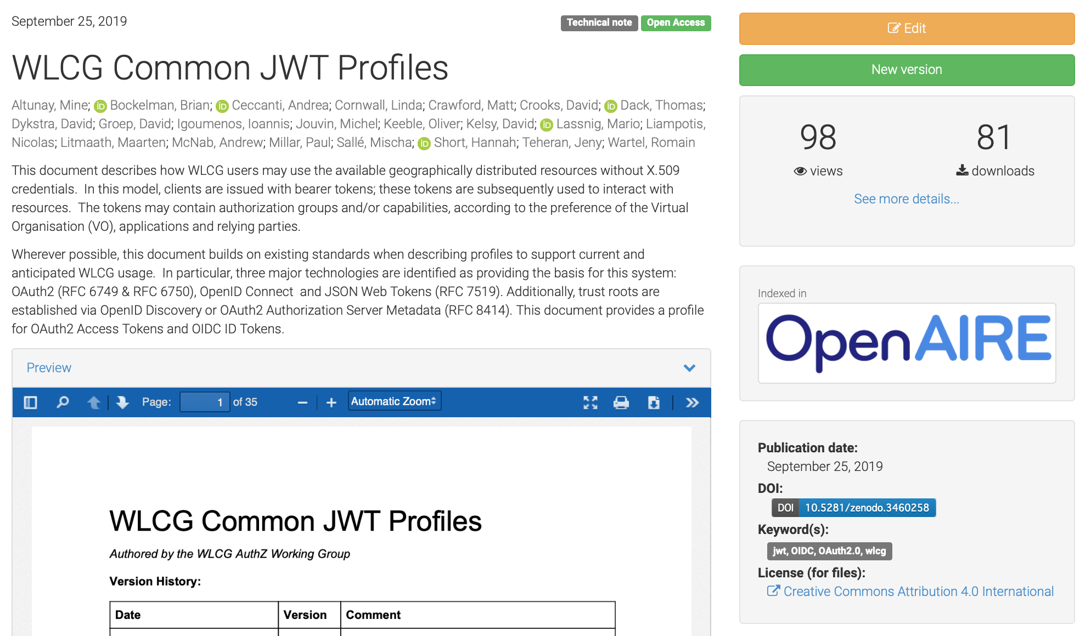
WLCG Schema V1.0
Published on Zenodo, September 25th 2019
Allows middleware developers to enable token based authorization to an agreed schema
Working document at https://github.com/WLCG-AuthZ-WG/common-jwt-profile
https://zenodo.org/record/3460258

Slide 9
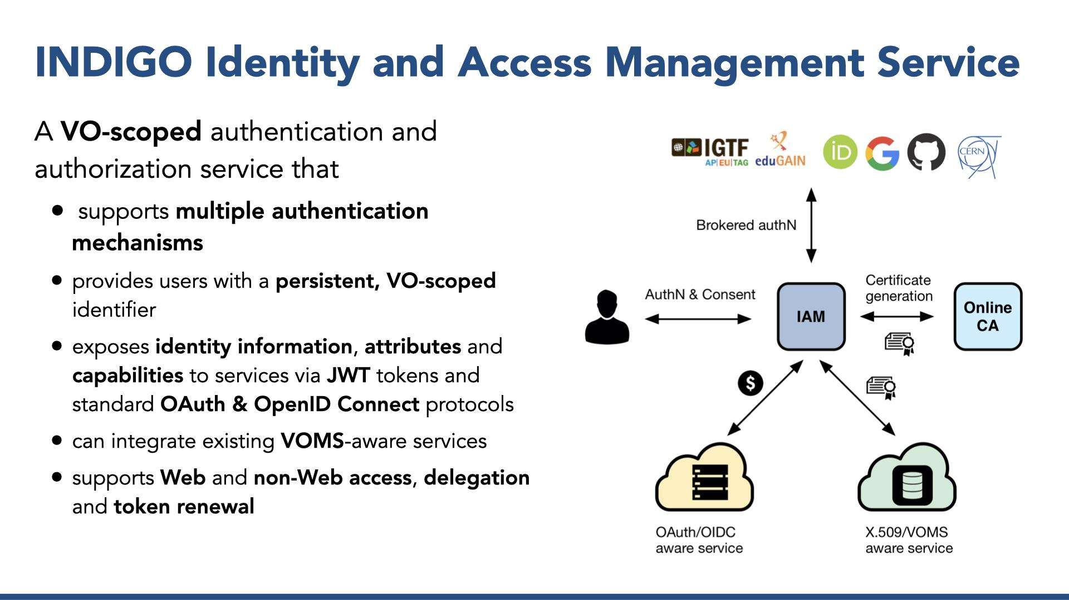
Identity and Access Management = IAM

Slide 10
X.509 Backwards Compatibility
IAM can act as a backwards compatible VOMS server supporting voms-proxy-init etc.
For users without an end user certificate, RCauth.eu can be used to generate X.509 certificates which are stored in IAM and returned on demand
Users can be imported from a VOMS server
RCauth.eu online CA can be used to generate X.509 certificates for users

Slide 11
Command Line Tools
Since many workflows are performed on the command line, we need users to be able to get Tokens in their local environment
  Must be user friendly
  Must be secure (i.e. refresh tokens protected)
Solution identified: use Hashicorp Vault as the registered client and manager of refresh tokens
Vault
WLCG IAM
Request access to Vault
Login Request
Refresh token returned
Vault token returned
Access token requested using Vault Token
Access token generated
Access token returned
See https://github.com/fermitools/htvault-config

Slide 12
WLCG Token Schema
12/07/17
WLCG AuthZ WG

Slide 13
Token Claims
Common Claims
ID Tokens
Access Tokens
iss+sub used to uniquely identify a user, e.g. for blocking
  sub
  exp
  iss
  acr
  aud
  iat
  nbf
  jti
  eduperson_assurance (REFEDS)
  wlcg.ver (WLCG)
  wlcg.groups (WLCG)
  auth_time
  general OIDC Claims
  scope (RFC8693)
Access tokens should include at least scope (capabilities) or group for authorization
wlcg prefix added to avoid collisions with other schemas
Note: Where unspecified, the origin is RFC7519 or OpenID Connect core

Slide 14
Lifetimes
Token Type | Recommended Lifetime | Minimum Lifetime | Maximum Lifetime | Justification
Access Token & ID Token | 20 minutes | 5 minutes | 6 hours | Access token lifetime should be short as there is no revocation mechanism. The granted lifetime has implications for the maximum allowable downtime of the Access Token server.
Refresh Token | 10 days | 1 day | 30 days | Refresh token lifetimes should be kept bounded, but can be longer-lived as they are revocable. Meant to be long-lived enough to be on a “human timescale”.
Issuer Public Key Cache | 6 hours | 1 hour | 1 day | The public key cache lifetime defines the minimum revocation time of the public key. The actual lifetime is the maximum allowable downtime of the public key server
Issuer Public Key | 6 months | 2 days | 12 months | JWT has built-in mechanisms for key rotation; these do not need to live as long as CAs. This may evolve following operational experience, provision should be made for flexible lifetimes.

Slide 15
Authorization
12/07/17
WLCG AuthZ WG

Slide 16
Authorization
Two models
  Groups e.g. /atlas/production
  Capabilities e.g. storage.read/atlas
"Access tokens may convey authorization information as both groups and capabilities. If both group membership and capabilities are asserted, then the resource server should grant the union of all authorizations for the groups and capabilities that it understands." From the WLCG Token Schema

Slide 17
Groups (in wlcg.groups claim)
Authorization may be based on the wlcg.groups claim.
wlcg.groups semantics are equivalent to existing VOMS groups. VOMS roles should be considered as optional (i.e. returned only if requested) wlcg.groups
Requesting the wlcg.groups scope returns all default groups

Slide 18
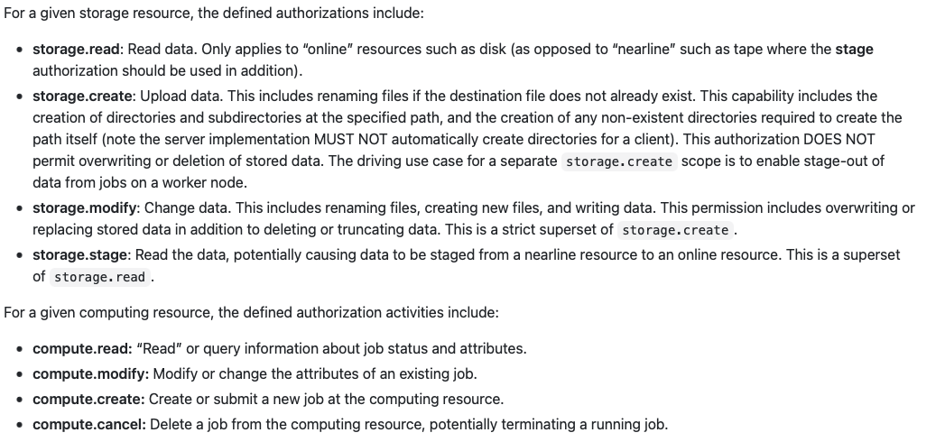
Capabilities (in scope claim)
Authorization may be based on the scope claim.
Format $AUTHZ:$PATH where $PATHis mandatory (may be ‘/’ for *)
Scopes proposed for storage and compute

Slide 19
Scope Based Attribute Selection
We propose to use scopes to implement an attribute selection mechanism for both groups and capabilities following the approach outlined in the OpenID Connect standard:
  https://openid.net/specs/openid-connect-core-1_0.html#ScopeClaims
Authorizations are requested using scopes and returned by the token issuer if the client and user are entitled

Slide 20
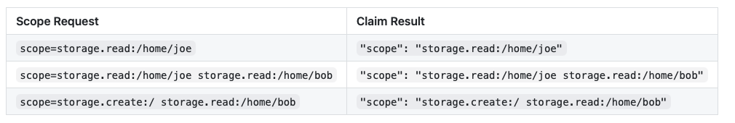
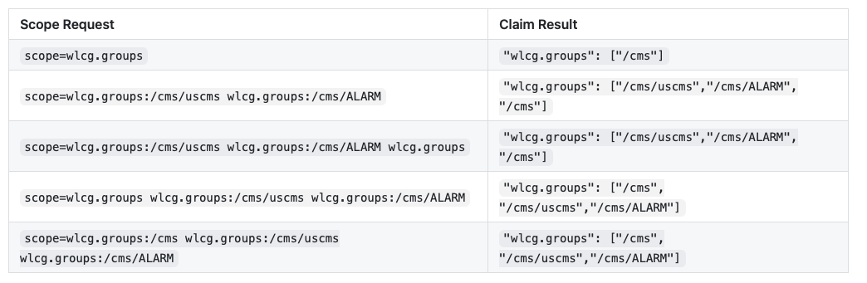
Scope Based Attribute Selection
Capability requests are matched exactly
/cms is a default group and always returned

Slide 21
Capability Sets
In some use cases (e.g. Vault) a client may not know exactly which capabilities will be required by downstream services
A capability set can be requested; if granted, multiple capabilities will be returned in the token
Work ongoing at https://github.com/WLCG-AuthZ-WG/common-jwt-profile/pull/10

Slide 22
Next Steps
12/07/17
WLCG AuthZ WG

Slide 23
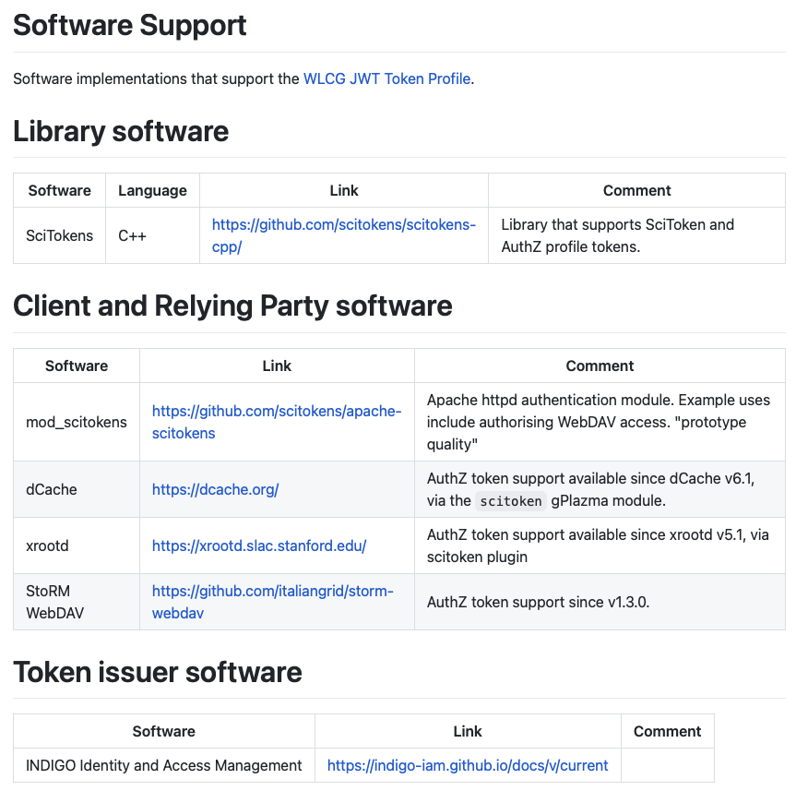
Schema Adoption
A catalogue of software that supports the WLCG JWT Schema is being compiled at https://github.com/WLCG-AuthZ-WG/software-support
Aware that storage components are progressing faster than compute

Slide 24
Interoperability
Participating in AEGIS community to facilitate interoperability between infrastructures e.g. EOSC https://aarc-project.eu/about/aegis/

Slide 25
Timeline
Timeline under discussion https://twiki.cern.ch/twiki/bin/view/LCG/WLCGTokensGlobusWG
Summary at https://indico.cern.ch/event/876787/#6-globus-retirement-timeline
Key points (TBC)
  Q2 2021 production IAMs available for VOs
  Q3 2021 pilot jobs may be performed with tokens
  Q4 2021 VOMS-Admin retired

Slide 26
Questions?
12/07/17
WLCG AuthZ WG

