Slide 1


Knowledge & Technology Transfer at CERN
Nick Ziogas
Knowledge Transfer Group
CERN
ANDRA Visit 25 Nov 2021

Slide 2
Overview
CERN in a nutshell
Innovation drivers – context - briefly
Knowledge Transfer mission
Knowledge Transfer examples
Support for start-ups & spin-offs
Knowledge Transfer in practice
Conclusions

Slide 3

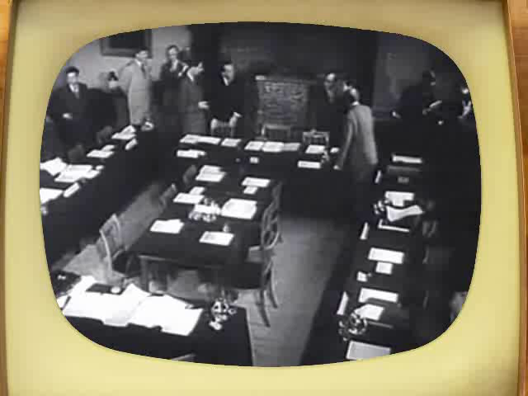
Council meeting when the CERN convention was signed (1953).
The convention establishing the organization was signed the 6th session of the CERN Council, in Paris from 29 June – 1 July 1953. The convention was ratified on 29 September 1954 by 12 in Europe.

Slide 4
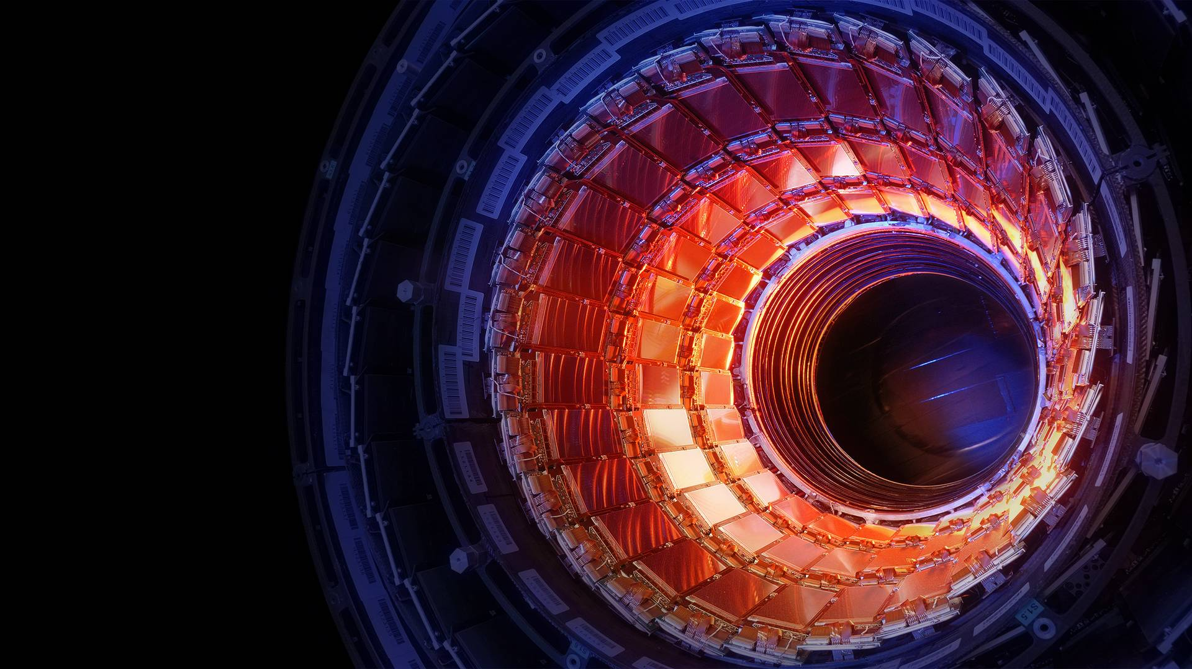
PUSH BACK
the frontiers of knowledge
develop
NEW TECHNOLOGIES
TRAIN
scientists and engineers of tomorrow
UNITE
people from different countries & cultures
Photo: CERN

Slide 5
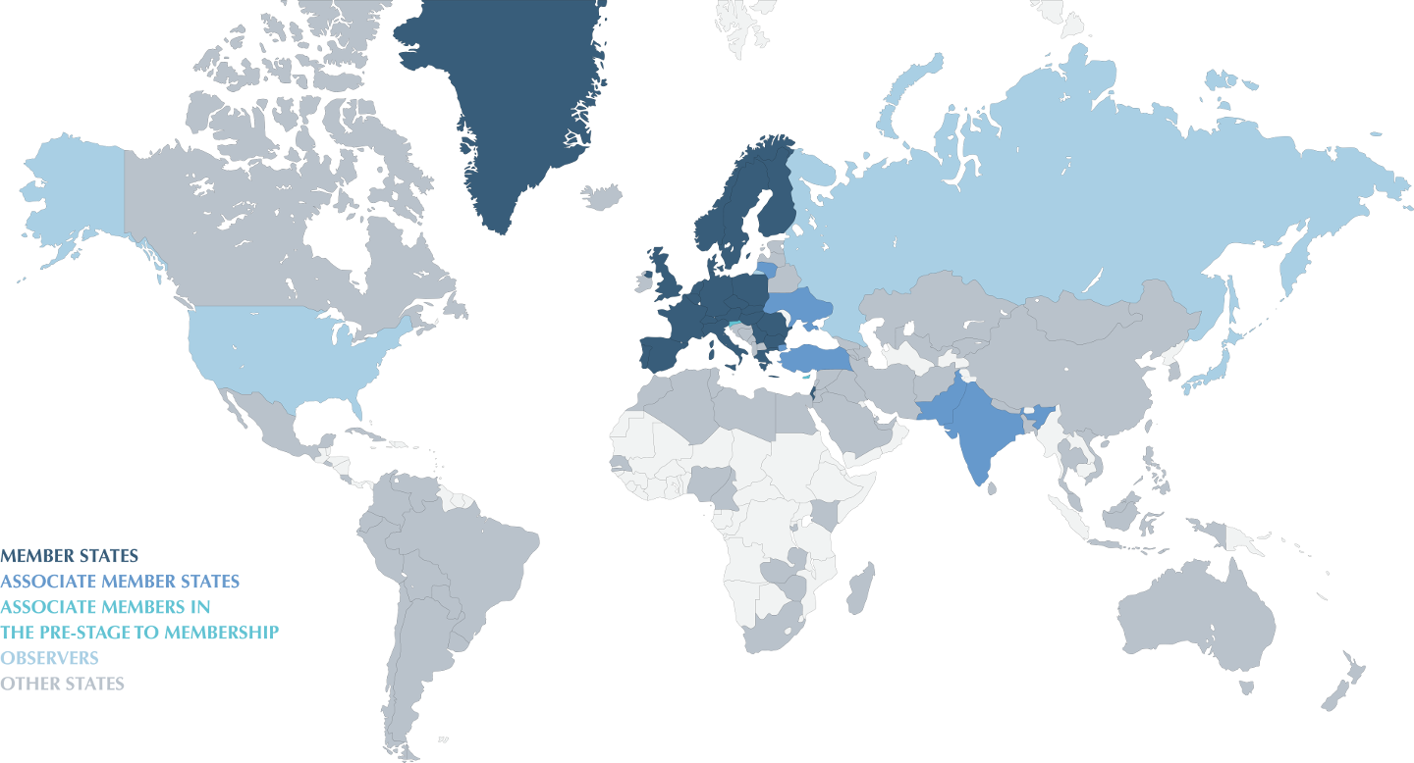
Conseil Européen pour la Recherche Nucléaire
World’s largest Particle Physics Laboratory (1954)
Personnel
2500 Staff
730 Fellows & Associates
200 Students
11000 Users from
500 Universities
2000 External
companies
Yearly Budget
~1100 MCHF
(~ 1000 MEUR)
Experiments
financed
externally
23 Member States
Austria, Belgium, Bulgaria, Check Republic, Denmark, Finland, France, Germany, Greece, Italia, Israel, Hungary, Holland, Norway, Poland, Portugal, Romania, Serbia, Slovakia, Spain, Sweden, Switzerland, UK.
6 Observers
EU, Japan, JINR, Russia, UNESCO, USA
8 Associate Member States
Croatia, Cyprus, India, Lithuania, Pakistan, Slovenia
Turkey, Ukraine

Slide 6
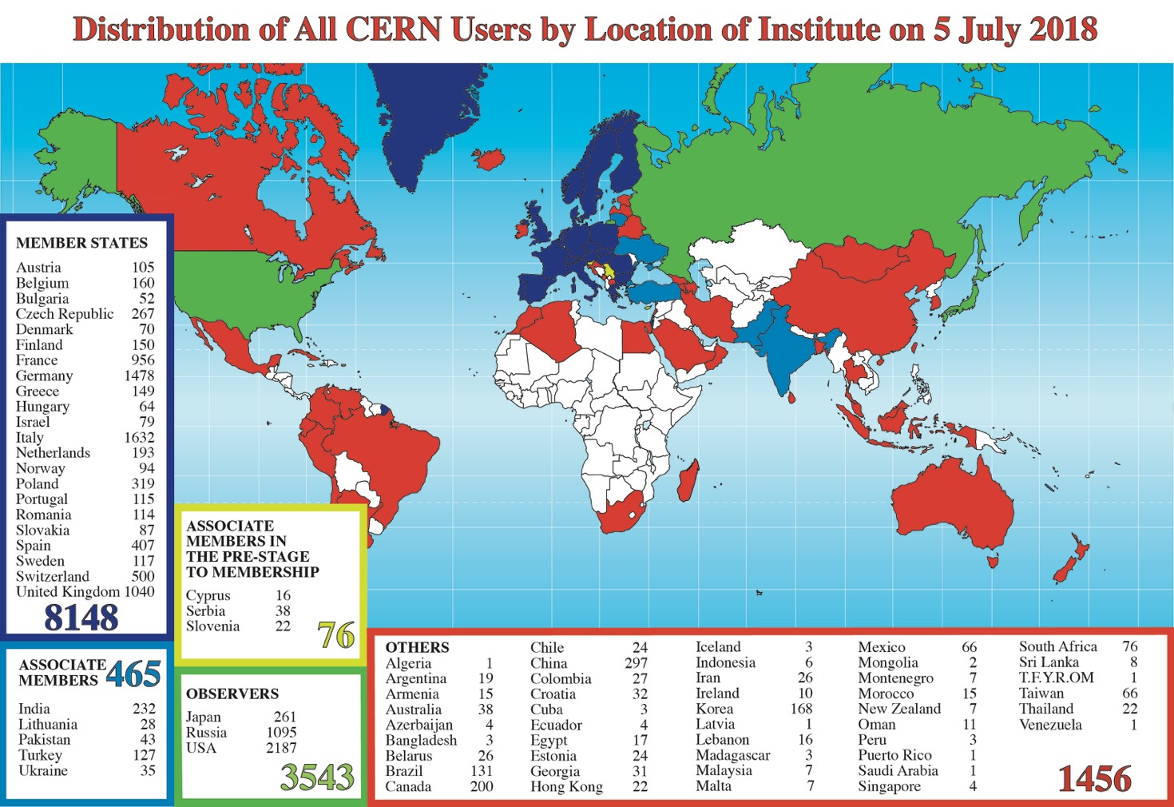


Slide 7
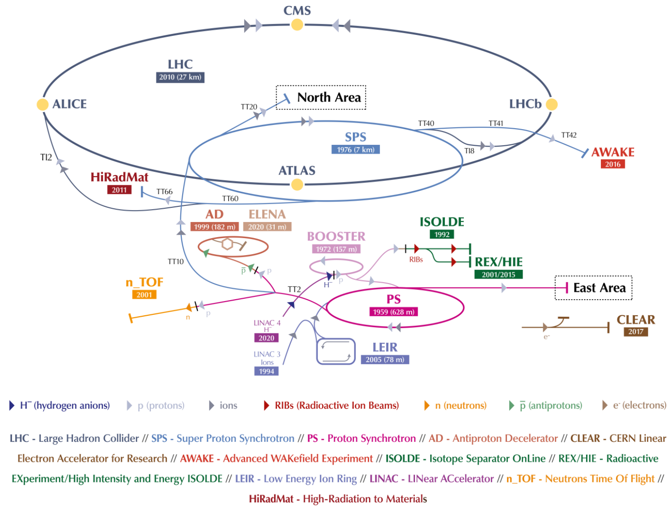
The CERN accelerator complex 2019

Slide 8
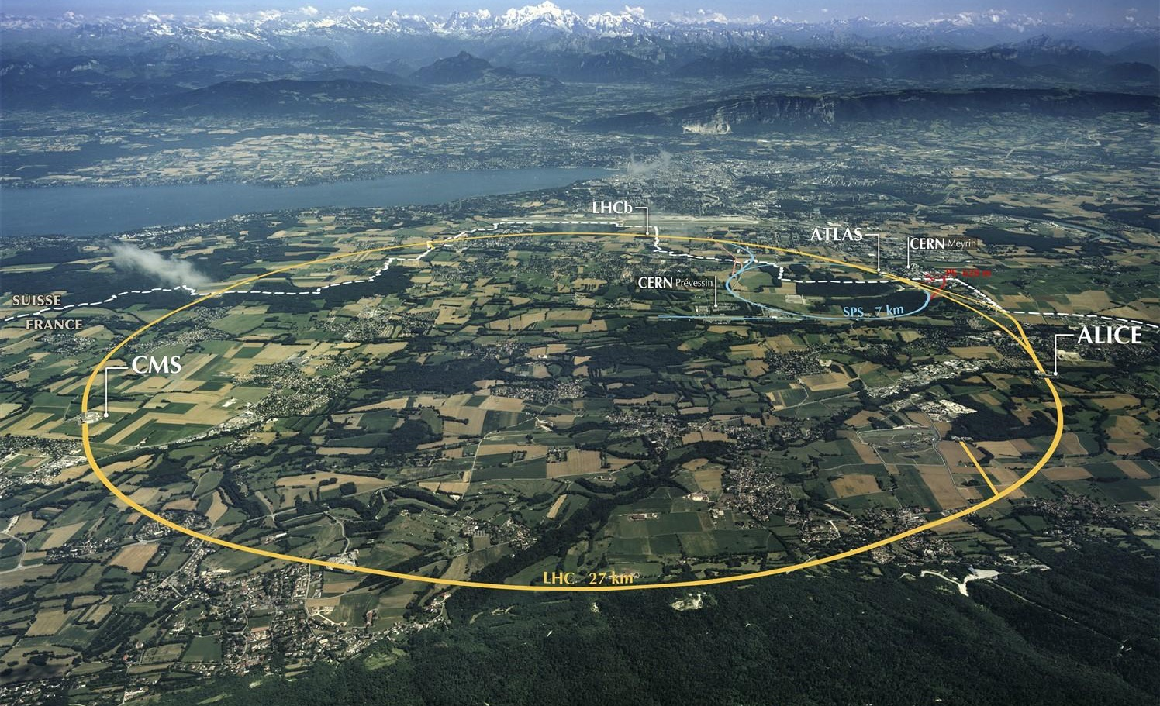

https://www.kathimerini.gr/1068264/article/epikairothta/ellada/iera-synodos-o-korwnoios-den-metadidetai-me-th-8eia-koinwnia
Accelerating Science and Innovation
Notes:
8

Slide 9
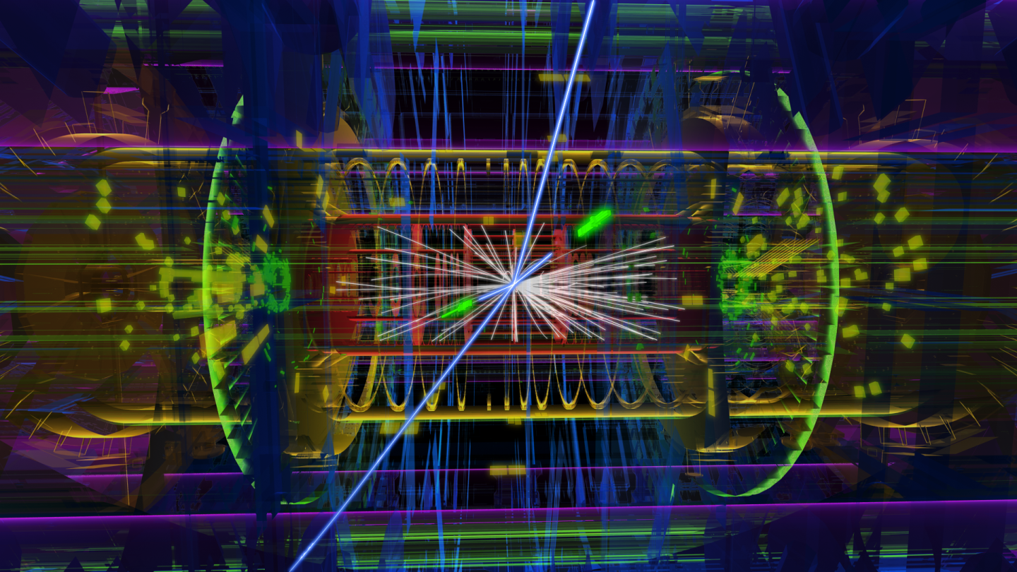
DETECTORS
Photos: CERN
Our electronic eyes

Slide 10
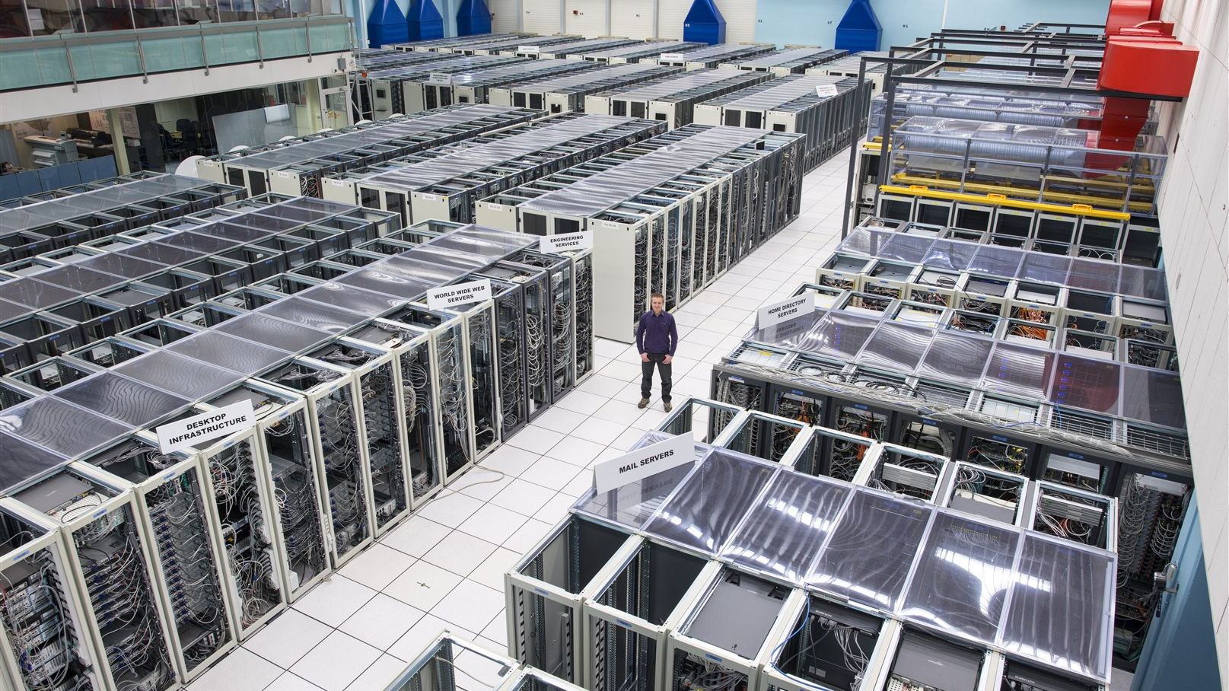
Photo: CERN
Computing

Slide 11
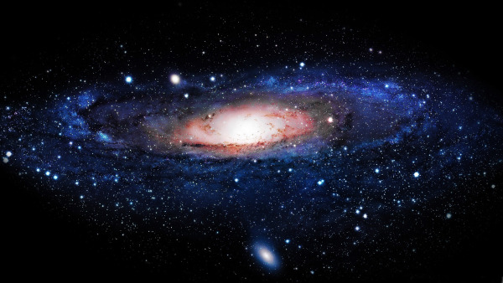
The Higgs Boson completes the Standard Model,
but the Model explains only what concerns ordinary atoms i.e, ~ 5% of our Universe
Dark matter (~24%) and dark energy (~71%) make up the rest. What are they really?
How does gravity really works?
Why there is no antimatter in nature?

Slide 12
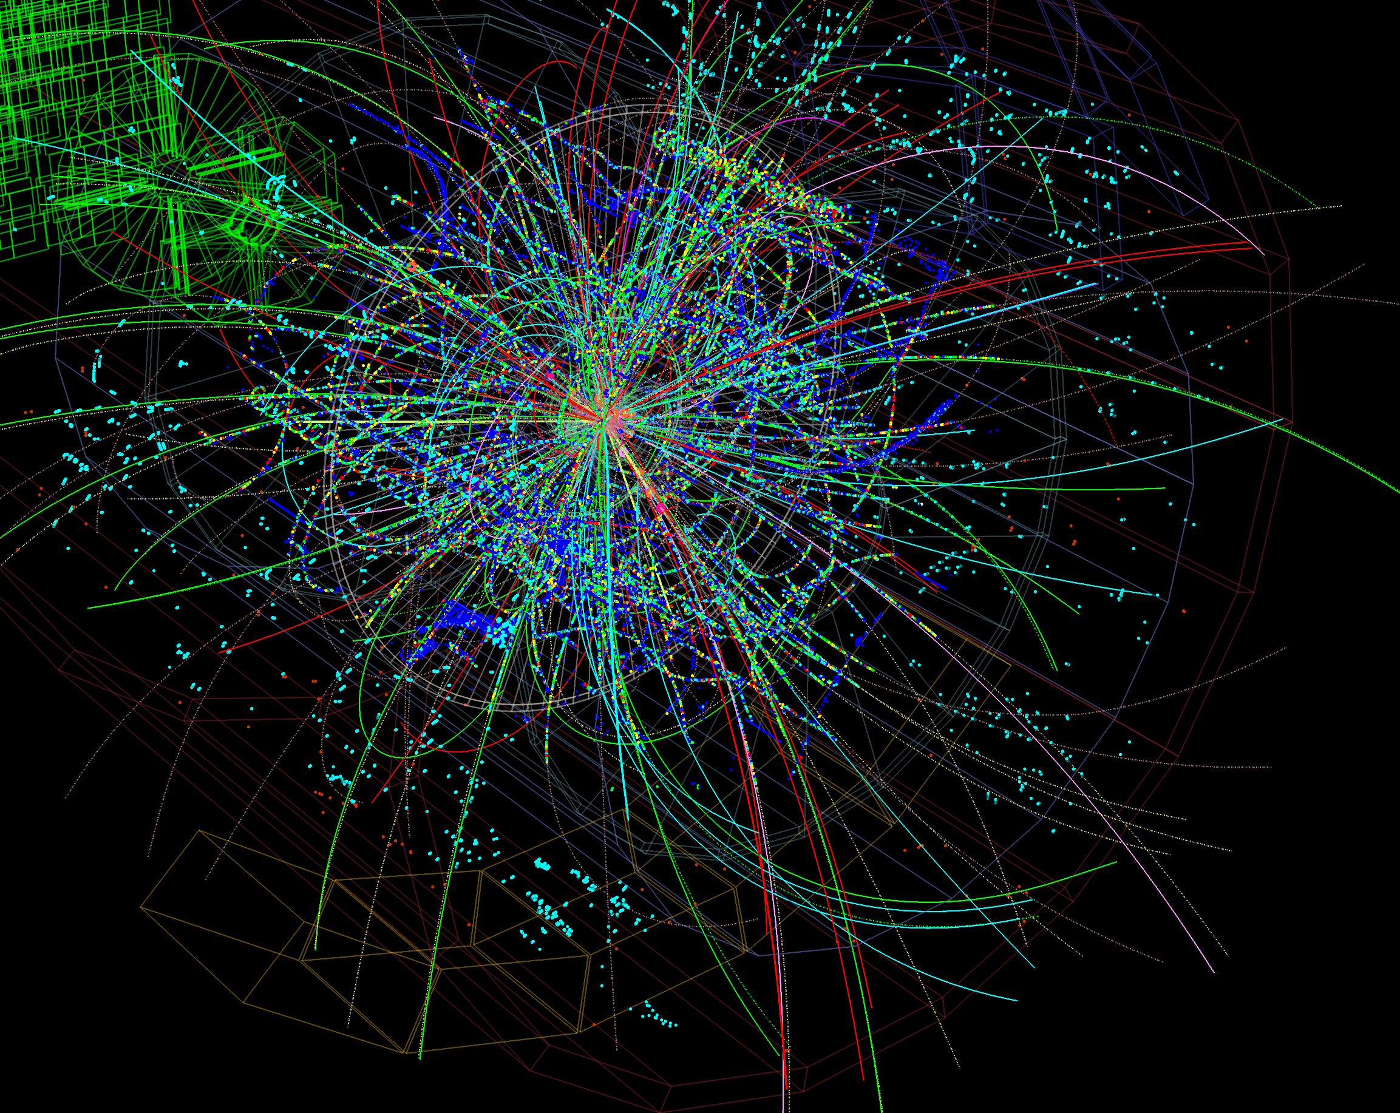
FACTS
The LHC collides protons at unprecedented energy, equivalent to 13,000 times their mass
40 Million collisions/sec, one every 25 ns. About 40 collisions per event.
Thousands of particles emerge from each collision
1 MB of data recorded by the detectors at each collision. Too much to be stored
Only 5% of those are stored after filtering. About 80 Pb of derived data per run.

Slide 13
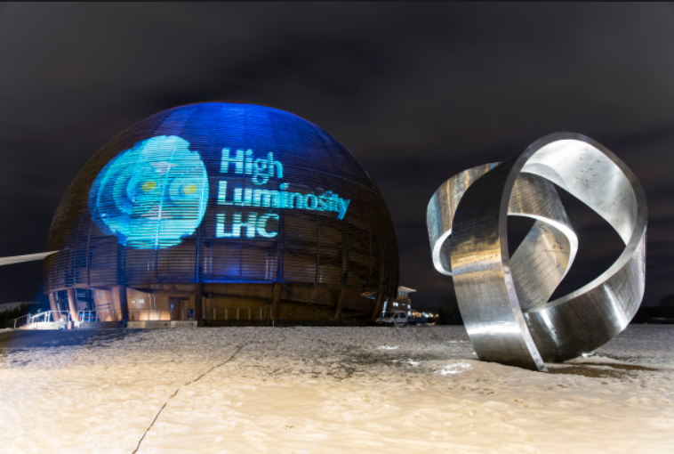
The NEXT Challenge
Upgrade of the LHC the CERN flagship accelerator which led to the discovery of the Higgs boson.
Increase of instantaneous luminosities by a factor of five larger than the LHC nominal value
Enlarge experiment data sample by one order of magnitude compared with the LHC baseline programme.
Operational around (2026)-2027

Slide 14
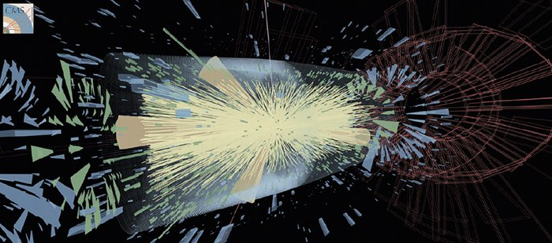
The LHC Big Data Challenge – HL LHC
High Luminosity LHC
200 collisions per event vs 40 today. Need to disentangle 200 collisions happening at once.
Event complexity grows non linearly
A HL-LHC run would need to store about 900 Pb of derived data. A data deluge!
Even taking into account HW progress (storage & processing), we are off by a factor of 10, projecting to 2027

Slide 15
Physics always drives CERN Innovation but we need
  Accelerators, Detectors & Computing to underpin the Physics exploration
R&D is happening now, in many domains
In Computing
    Data Analytics
    Machine/Deep Learning at detector output & many other areas
    Quantum Computing
Some of the promising areas to address our challenge

Slide 16
The mission of CERN’s Knowledge Transfer Group is to maximise the impact of CERN technology and know-how in society, in particular through industry in the member states.
Key words:
Dissemination and Impact!

Slide 17
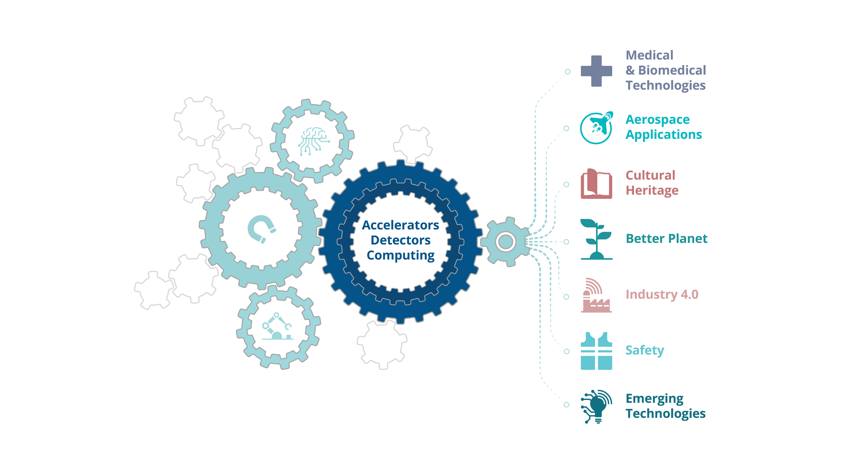
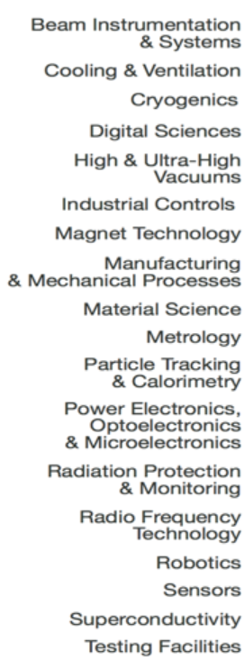

Slide 18
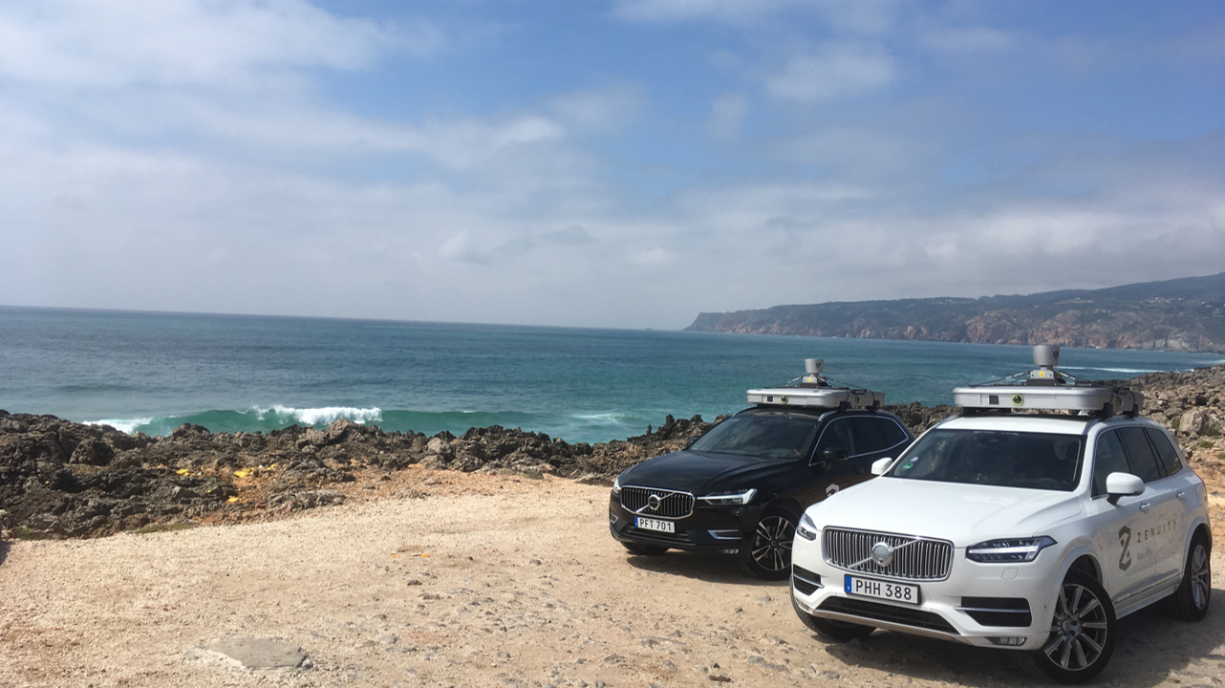
Zenseacat (Volvo Cars) teams up with CERN on fast machine learning using FPGAs

Slide 19
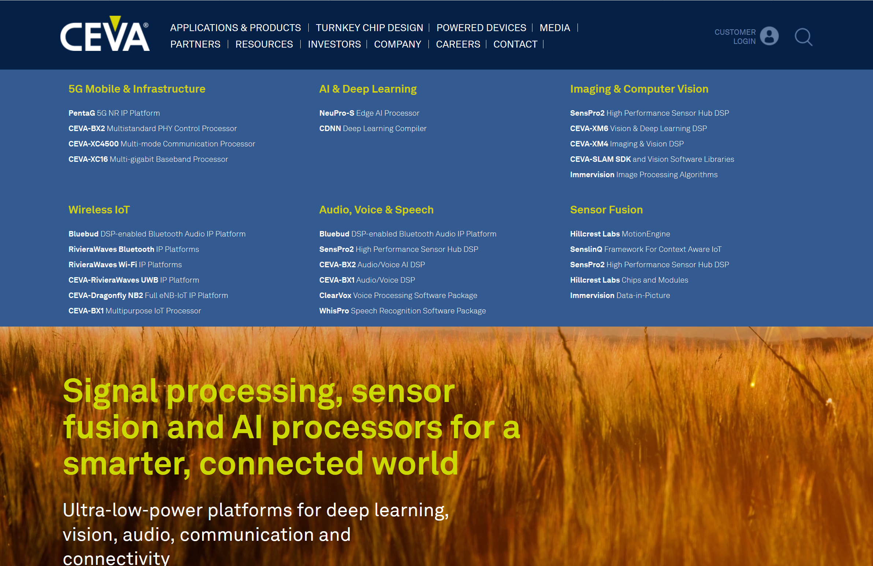
R&D on weight and activation compression algorithms for NNs. Wireless communications and computer vision applications

Slide 20

Collaboration with WUR to support national banks and regulators to detect trading anomalies in financial markets

Slide 21

ROCHE is using CernVM-FS for application and library distribution worldwide. Strong interest in the financial services sector.
Trading companies have strong interest in this tech for fast reliable worldwide file distribution

Slide 22
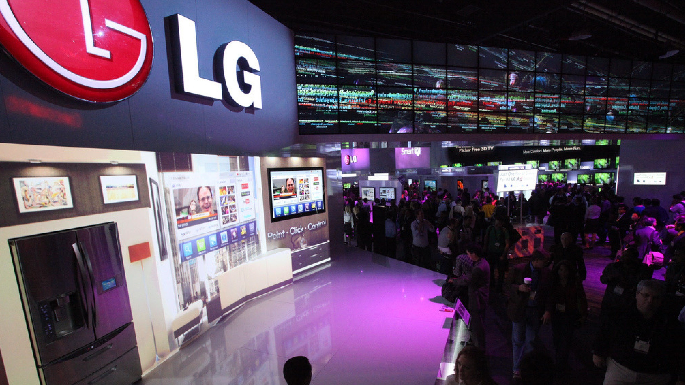
CERN CMW (controls middleware) for Industrial Manufacturing Execution System

Slide 23

Bundesdruckerei (Berlin) works with CERN on next generation ideas for identity management and cryptography and data handling

Slide 24
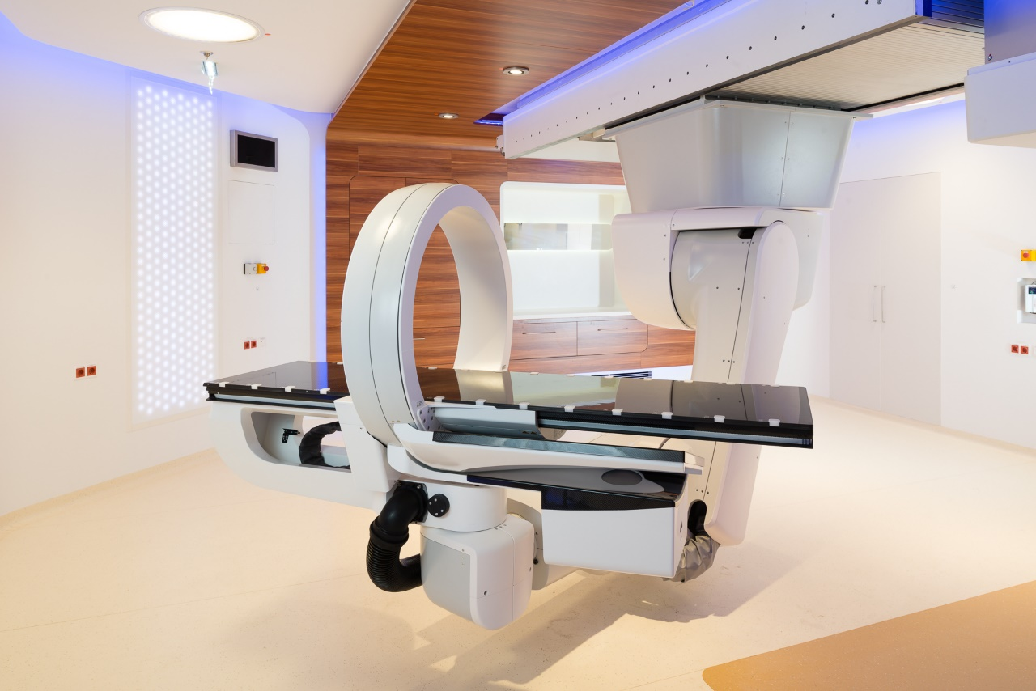
MedAustron started patient treatments in December 2016...

Slide 25
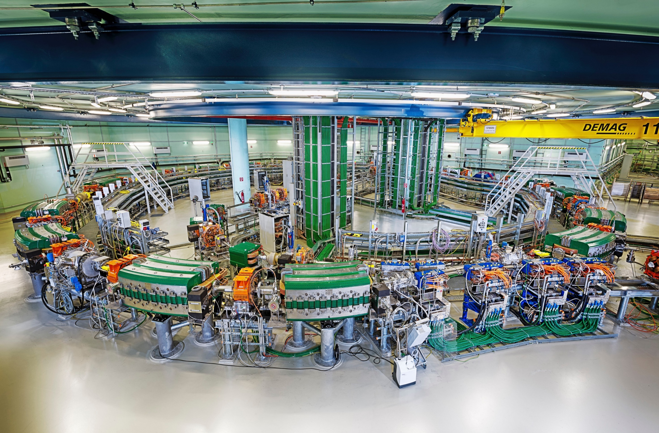
...and is using a lot of CERN technology for its proton acceleration

Slide 26
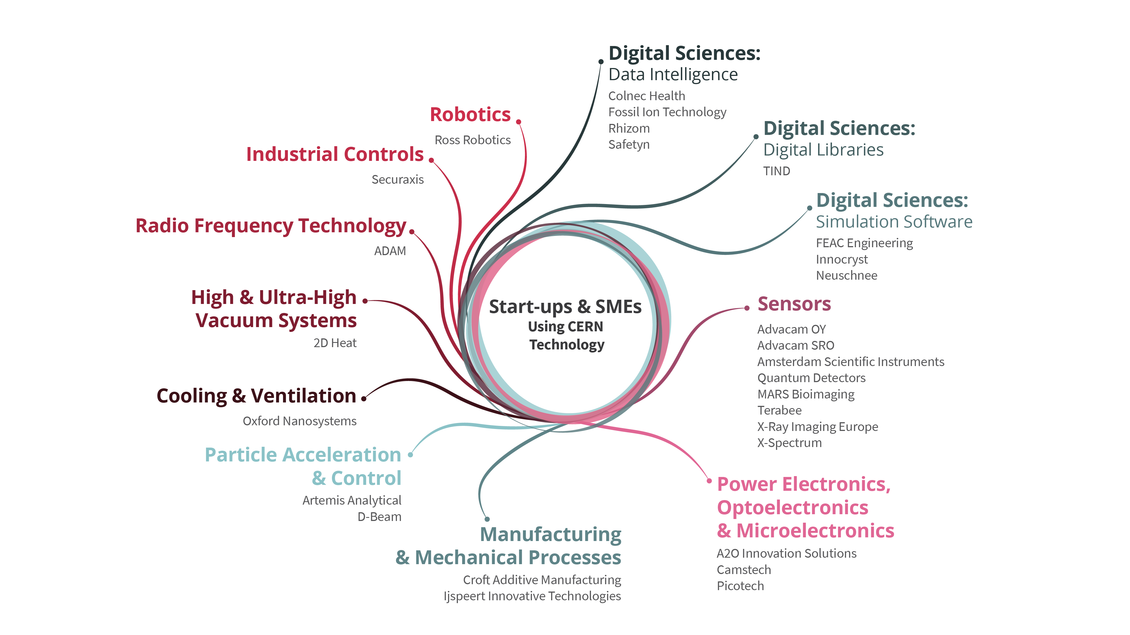

Slide 27
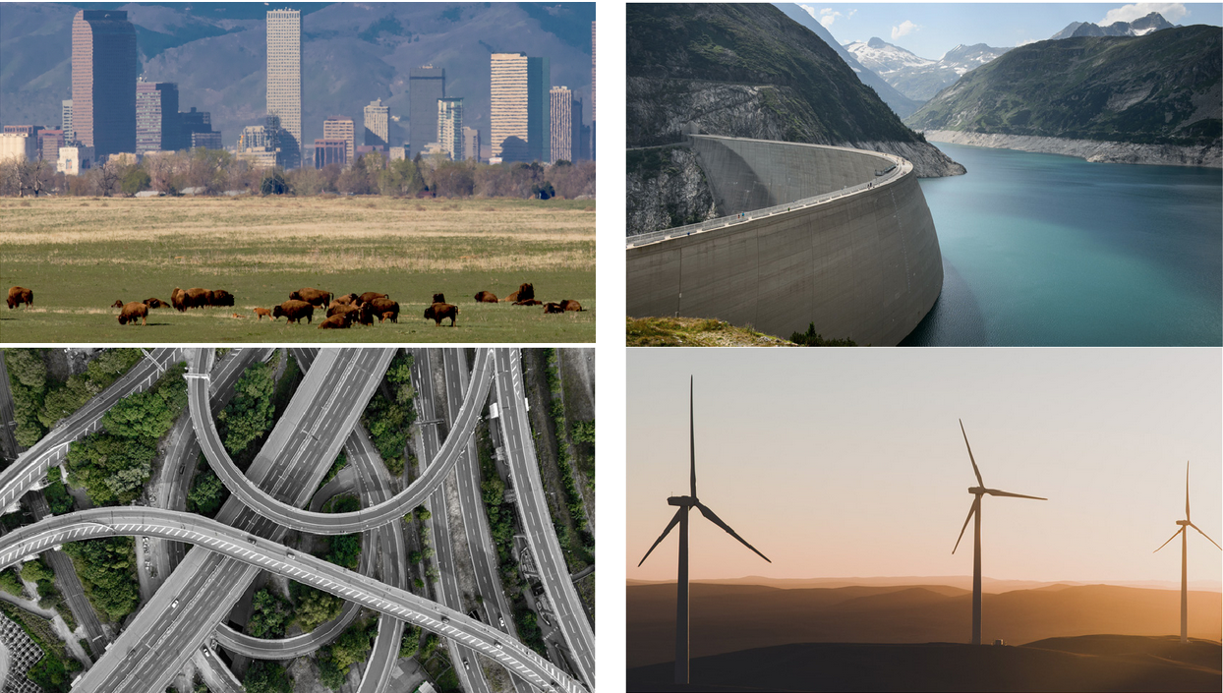
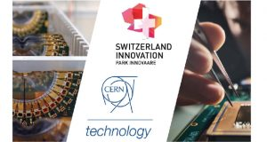
SecurAxis: Real Time Analysis, Reporting and Localization with Smart Acoustic Sensors
C2MON monitoring software

Slide 28
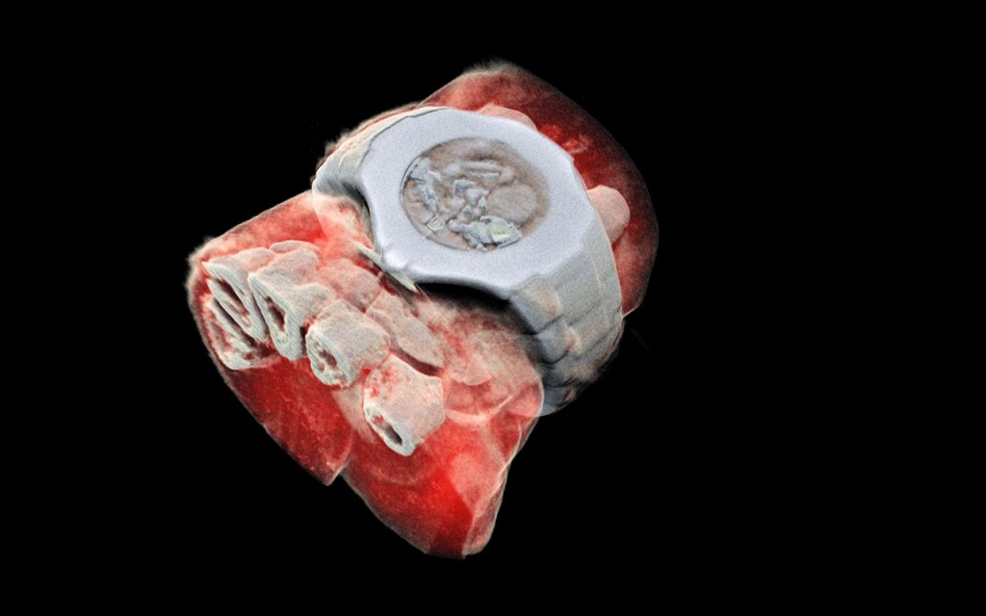
Next generation X ray finally in color (MARS Bio Imaging).

Slide 29
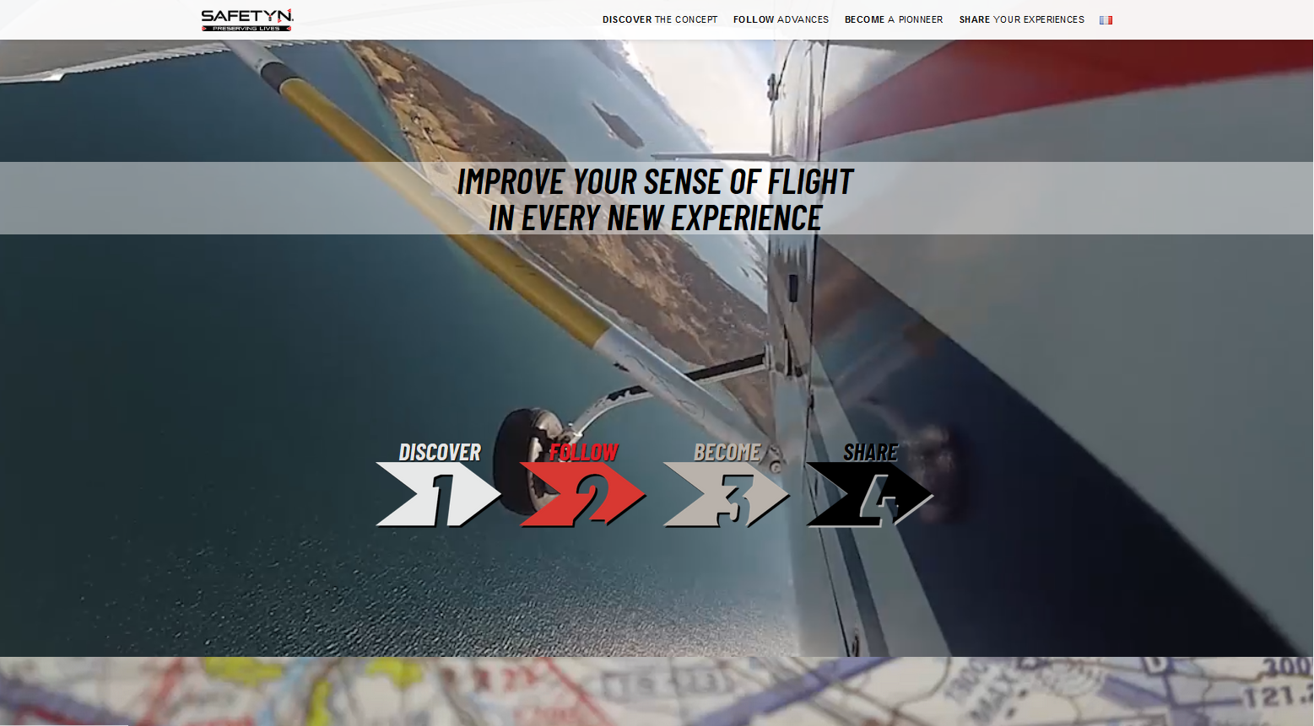
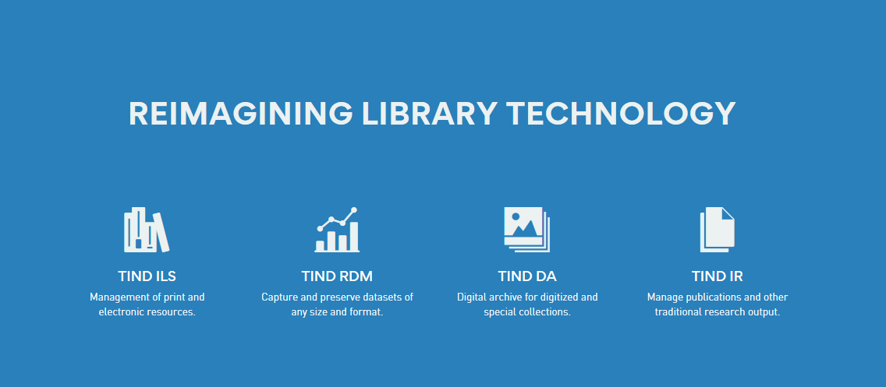
Library management and preservation (TIND).

Slide 30
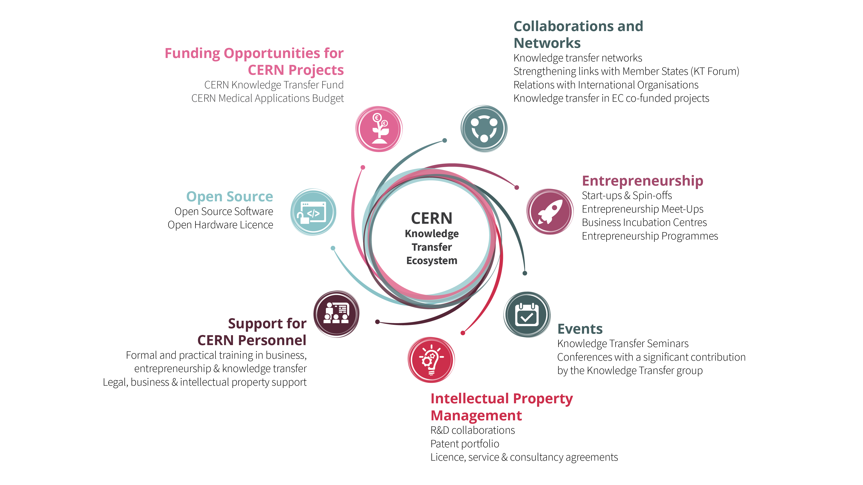

Slide 31


Advise / 2ND Opinion / Tech Challenge from CERN Expert team
Collaborative R&D / Co-development agreements on specific topic of mutual interest
Support of start-ups and CERN spin offs through the Business Incubator of CERN technologies network.

Slide 32
Using CERN labs / openlab for prototyping, benchmarking and testing of equipment
Licensing of CERN technology for commercial use / Support or training on using Open Source Hardware / Software
Facilitation of Knowledge Exchange by sponsoring PhD / Allocation of company resource at CERN / Use of Alumni Network

Slide 33
Conclusions
CERN innovation culture is inherent to its mission.
Knowledge Transfer at CERN objective is to move the innovations and expertise from the lab to society.
We have many ways and a lot of flexibility but we need an equally motivated partner to accomplish this mission.
Some techs and expertise are more readily transferable while others require adaptation via partnerships and funding.

Slide 34
Objectives of the day
Improve CERN’s understanding of ANDRA’s need concerning the Cigeo project.
Improve ANDRA’s understanding of what CERN can offer in terms of technology and expertise.
Identify synergies and precise areas of interest to work together.
Clarify how we can work together.
Agree on follow up actions and timelines.

Slide 35
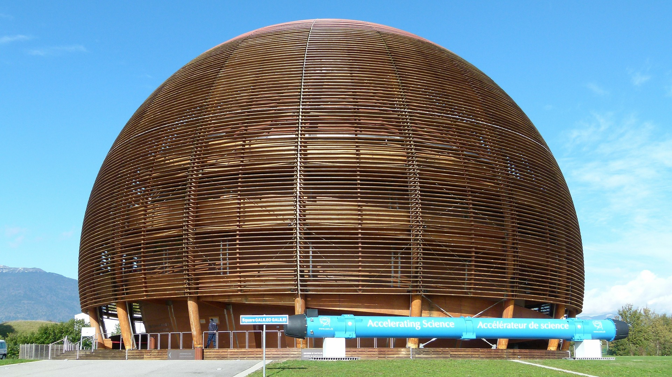
Thank you!
Nick Ziogas@cern.ch
cern.ch/kt

