Slide 1
Beam parameters and longitudinal stability requirements at 450 GeV
Ivan Karpov
Acknowledgements:
Theodoros Argyropoulos, Rama Calaga, James A. Mitchell,
Nicolas Mounet, Sigurd Nese, Elena Shaposhnikova, and Helga Timko
Special Joint HiLumi WP2/WP4 Meeting, 30 Nov. 2021

Slide 2
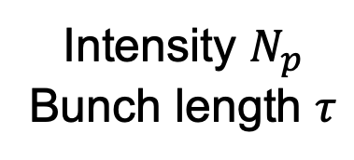
Introduction
Many aspects define beam parameters at 450 GeV in the LHC
Constrains in SPS:
Stability at SPS flattop and
during ramp
Beam loading limitations
Shot-to-shot reproducibility
…
Constrains in LHC:
Stability at LHC flatbottom
Beam loading limitations
Losses
…
Intensity $N_{p}$
Bunch length $τ$
$→$ Acceptable parameter space could be very limited

Slide 3
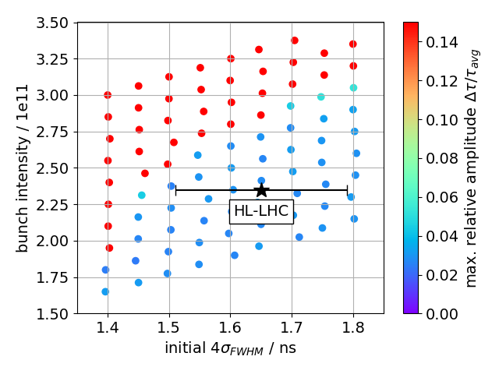


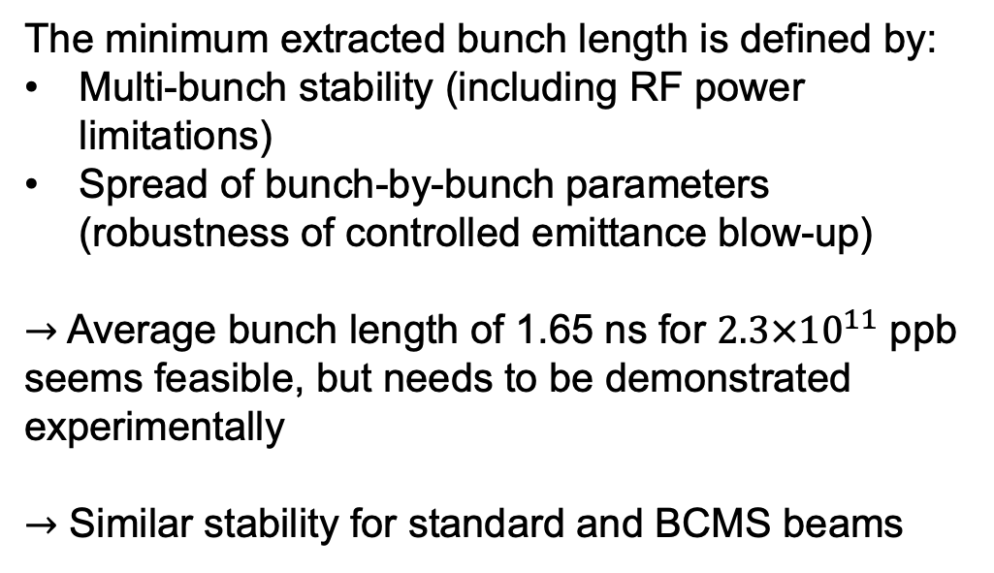
Constrains in SPS
Stability map at flat top (BLonD) after LS2
for LHC standard beam 4x72 bunches
$V_{200}=10$ MV, $V_{800}/V_{200} =0.16$
The minimum extracted bunch length is defined by:
Multi-bunch stability (including RF power limitations)
Spread of bunch-by-bunch parameters (robustness of controlled emittance blow-up)
$→$ Average bunch length of 1.65 ns for $2.3×{10}^{11}$ ppb seems feasible, but needs to be demonstrated experimentally
$→$ Similar stability for standard and BCMS beams
$±8.5\%$ spread

Slide 4
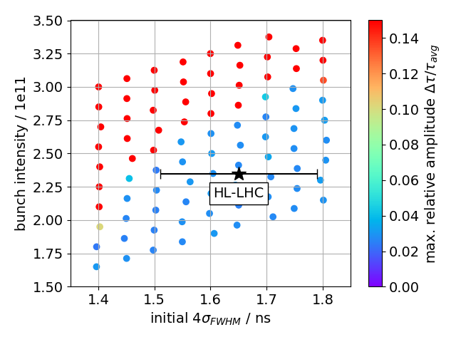
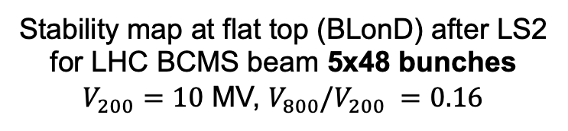
Constrains in SPS
Stability map at flat top (BLonD) after LS2
for LHC BCMS beam 5x48 bunches
$V_{200}=10$ MV, $V_{800}/V_{200} =0.16$
The minimum extracted bunch length is defined by:
Multi-bunch stability (including RF power limitations)
Spread of bunch-by-bunch parameters (robustness of controlled emittance blow-up)
$→$ Average bunch length of 1.65 ns for $2.3×{10}^{11}$ ppb seems feasible, but needs to be demonstrated experimentally
$→$ Similar stability for standard and BCMS beams
$±8.5\%$ spread

Slide 5
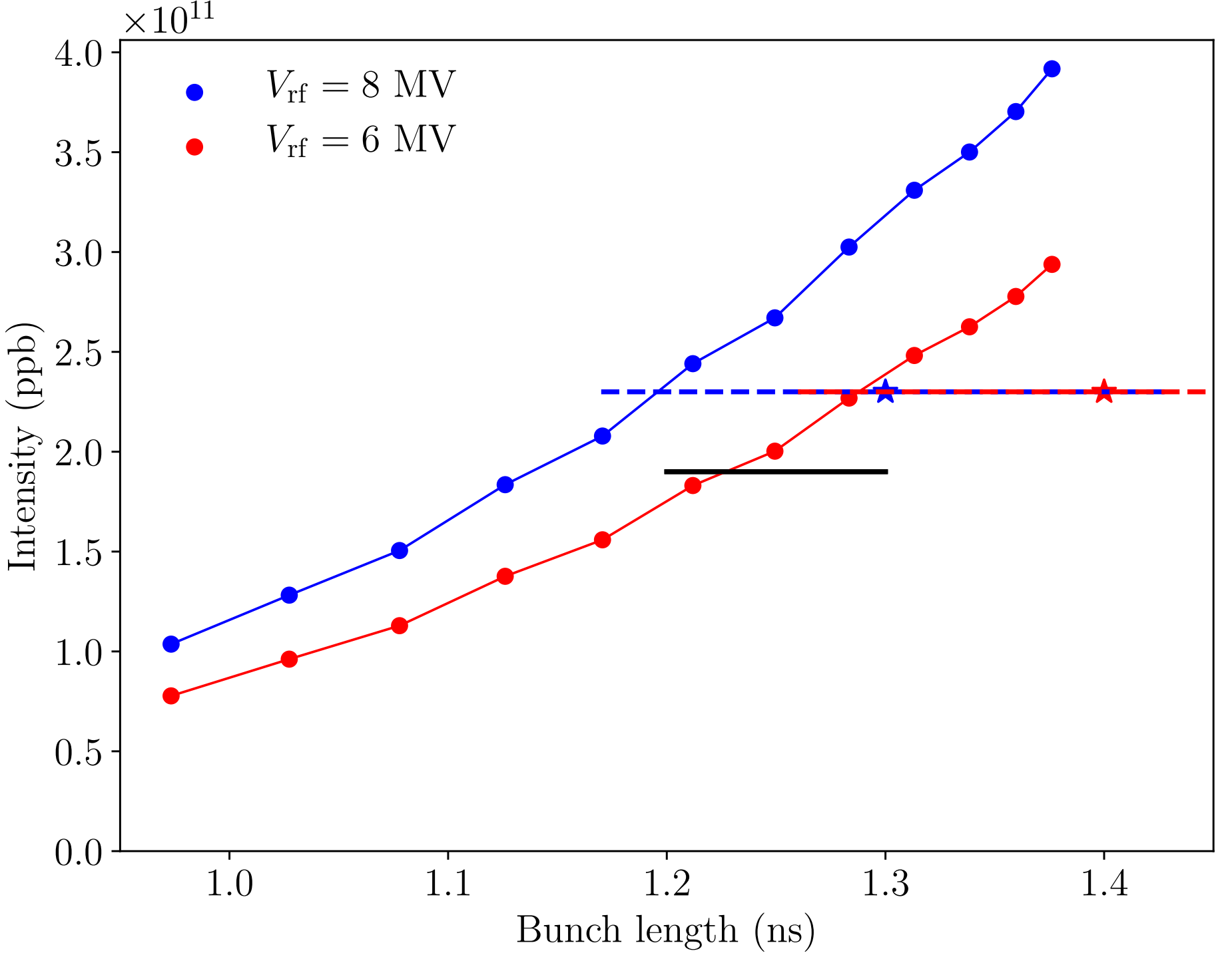
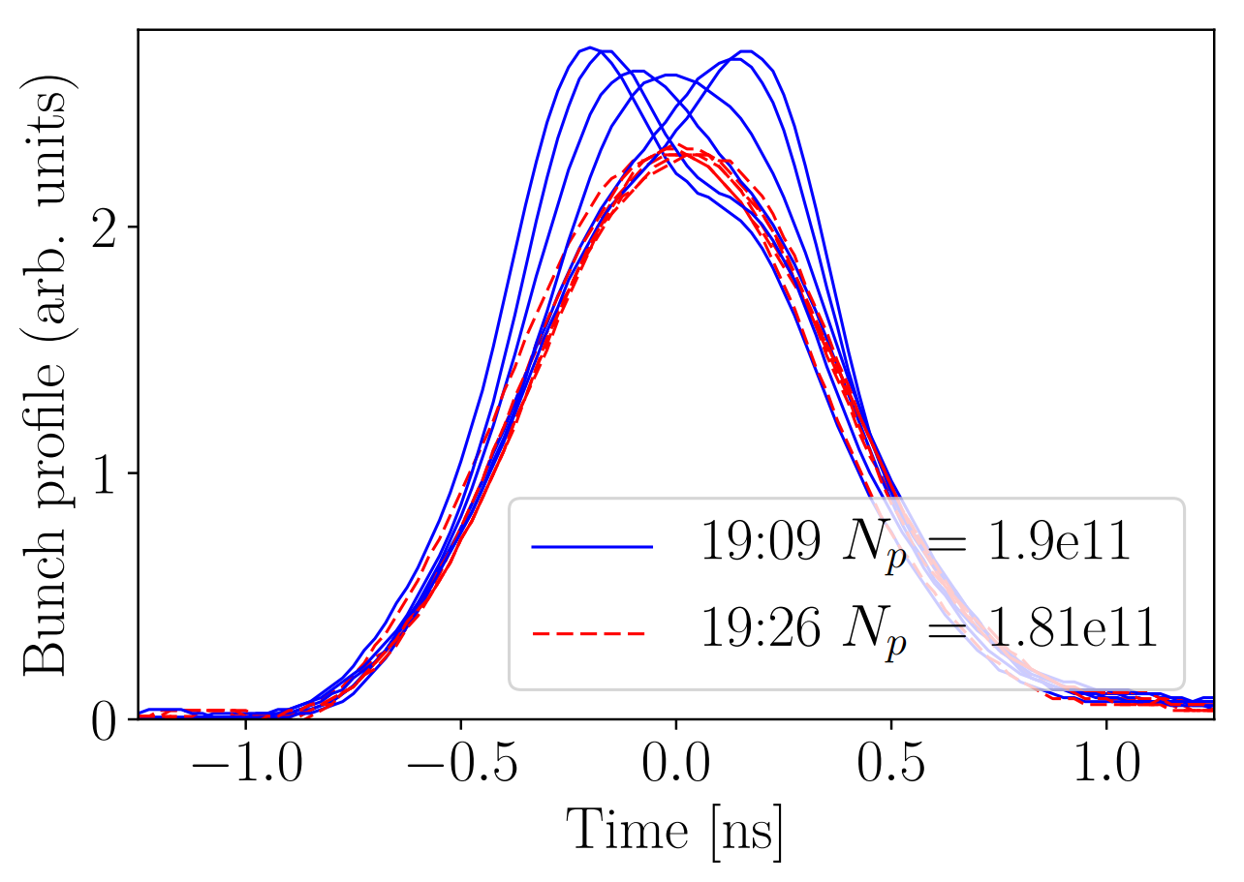
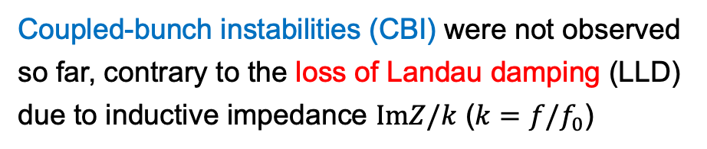

Longitudinal stability in LHC
Coupled-bunch instabilities (CBI) were not observed so far, contrary to the loss of Landau damping (LLD) due to inductive impedance $ImZ/k$ ($k=f/f_{0}$)
LLD threshold (MELODY) at 450 GeV for smoothed imp. (resistive wall + broad-band model at 5 GHz)
Persistent oscillations after injection
LHC MD
2017
$V_{rf}=6$ MV
MD data
(IK, HL-LHC collaboration meeting, 2019)
(H. Timko et al., HB2018)
$→$ During 20 min oscillations lead to ~10 % bunch lengthening and ~5% particle loss
$→$ New approach to compute the LLD threshold was developed (IK, TA, ES, PRAB 2021)

Slide 6
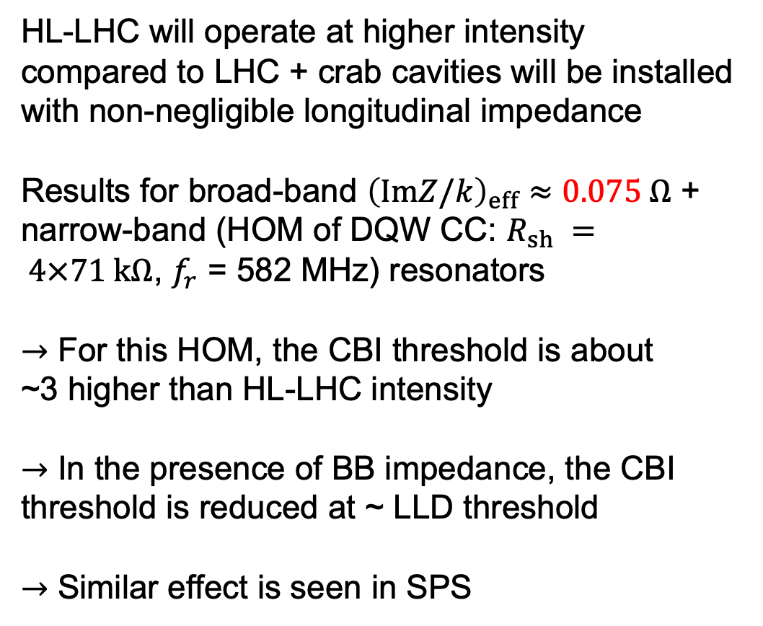
Reduction of CBI threshold due to ImZ/k
HL-LHC will operate at higher intensity compared to LHC + crab cavities will be installed with non-negligible longitudinal impedance
Results for broad-band ${\left(ImZ/k\right)}_{eff}≈0.075 Ω$ + narrow-band (HOM of DQW CC: $R_{sh} = 4×71 kΩ$, $f_{r}$ = 582 MHz) resonators
$→$ For this HOM, the CBI threshold is about
~3 higher than HL-LHC intensity
$→$ In the presence of BB impedance, the CBI threshold is reduced at ~ LLD threshold
$→$ Similar effect is seen in SPS
Coupled-bunch instability in HL-LHC (MELODY)
CBI threshold
LLD threshold at ~2.9e11
$E = 450$ GeV, $V_{rf} = 8$ MV, $μ=2, τ_{4σ}≈1.3$ ns

Slide 7
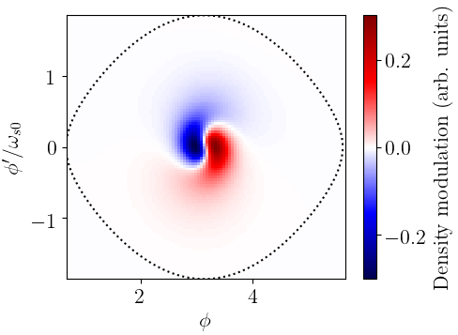
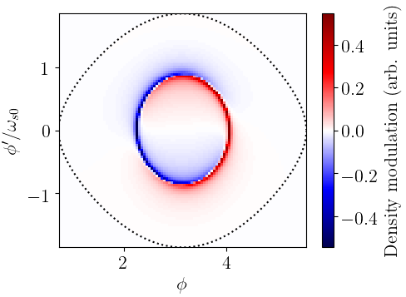
Types of coupled-bunch instability
It was expected that multi-turn or CB wake can make LLD mode unstable
Mode structure BB + HOM, growth rate ~0.13 1/s
Mode structure HOM only, growth rate ~0.13 1/s
$→$ In presence of broad-band impedance and small growth rate, unstable mode is localized in bunch center (LLD type), which is different from the case of HOM alone

Slide 8
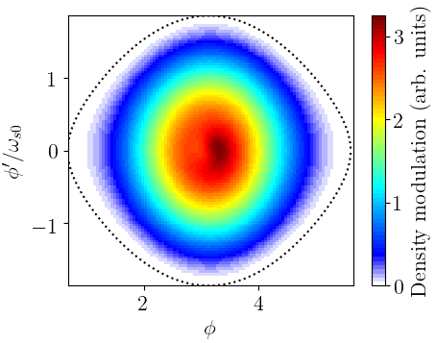
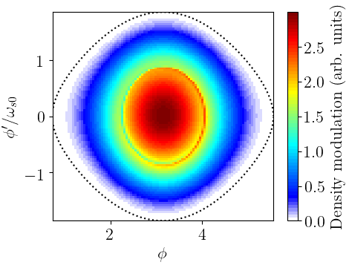
Types of coupled-bunch instability
It was expected that multi-turn or CB wake can make LLD mode unstable
Mode structure BB + HOM, growth rate ~0.13 1/s
Mode structure HOM only, growth rate ~0.13 1/s
$→$ In presence of broad-band impedance and small growth rate, unstable mode is localized in bunch center (LLD type), which is different from the case of HOM alone

Slide 9


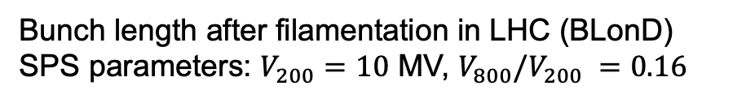


CBI threshold at 450 GeV
Bunch length after filamentation in LHC (BLonD)
SPS parameters: $V_{200}=10$ MV, $V_{800}/V_{200} =0.16$
Results for broad-band and narrow-band resonators (MELODY), $V_{rf}$ = 8 MV
$τ=1.65$ ns, $μ=1.5$
$R_{sh} = 4×71 kΩ$, $f_{r}$ = 582 MHz
${\left(ImZ/k\right)}_{eff}≈0.075 Ω$, $f_{r}$ = 5 GHz
$→$ Simulations for ideal case (no phase/energy errors) show that bunch length can be smaller than 1.3 ns
$→$ No margin for operational parameters

Slide 10
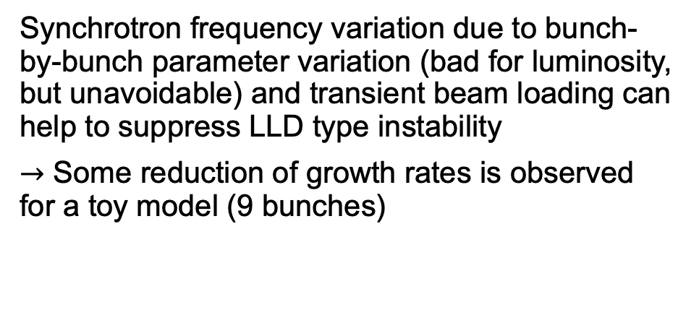
Possible cures (1/3)
Example for short bunches of ~0.8 ns
Synchrotron frequency variation due to bunch-by-bunch parameter variation (bad for luminosity, but unavoidable) and transient beam loading can help to suppress LLD type instability
$→$ Some reduction of growth rates is observed for a toy model (9 bunches)

Slide 11
Possible cures (1/3)
Example for short bunches of ~0.8 ns
Synchrotron frequency variation due to bunch-by-bunch parameter variation (bad for luminosity, but unavoidable) and transient beam loading can help to suppress LLD type instability
$→$ Some reduction of growth rates is observed for a toy model (9 bunches)

Slide 12
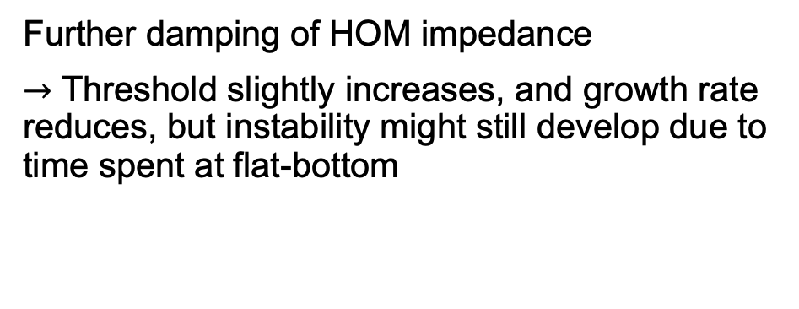
Possible cures (2/3)
Further damping of HOM impedance
$→$ Threshold slightly increases, and growth rate reduces, but instability might still develop due to time spent at flat-bottom
)
$E = 450$ GeV, $V_{rf} = 8$ MV, $μ=2, τ_{4σ}≈1.2$ ns

Slide 13
Possible cures (3/3)
Increase of LLD threshold and CBI threshold by
Increase of RF voltage in LHC and SPS (more power or additional cavities) to increase emittance
Adding 800 MHz RF system (smaller than 4 MV might be sufficient to compromise losses)
Increase bunch length/emittance in SPS and capture in 200 MHz + 400 MHz RF systems
(J., Esteban-Müller, PhD thesis, 2016), but rather high RF voltages are needed

Slide 14
Summary
Loss of Landau damping was observed for short bunches injected into the LHC indicating that we are close to the threshold
The coupled-bunch instability threshold due to HOMs of CCs is decreased in the presence of broad-band inductive impedance and another type of instability is observed
Possible cure of this instability is a natural spread of bunch-by-bunch parameters, further damping of HOM impedance, and increase of the LLD threshold by using 2nd harmonic RF system

Slide 15
Thank you for your attention!

Slide 16
Spare slides

Slide 17

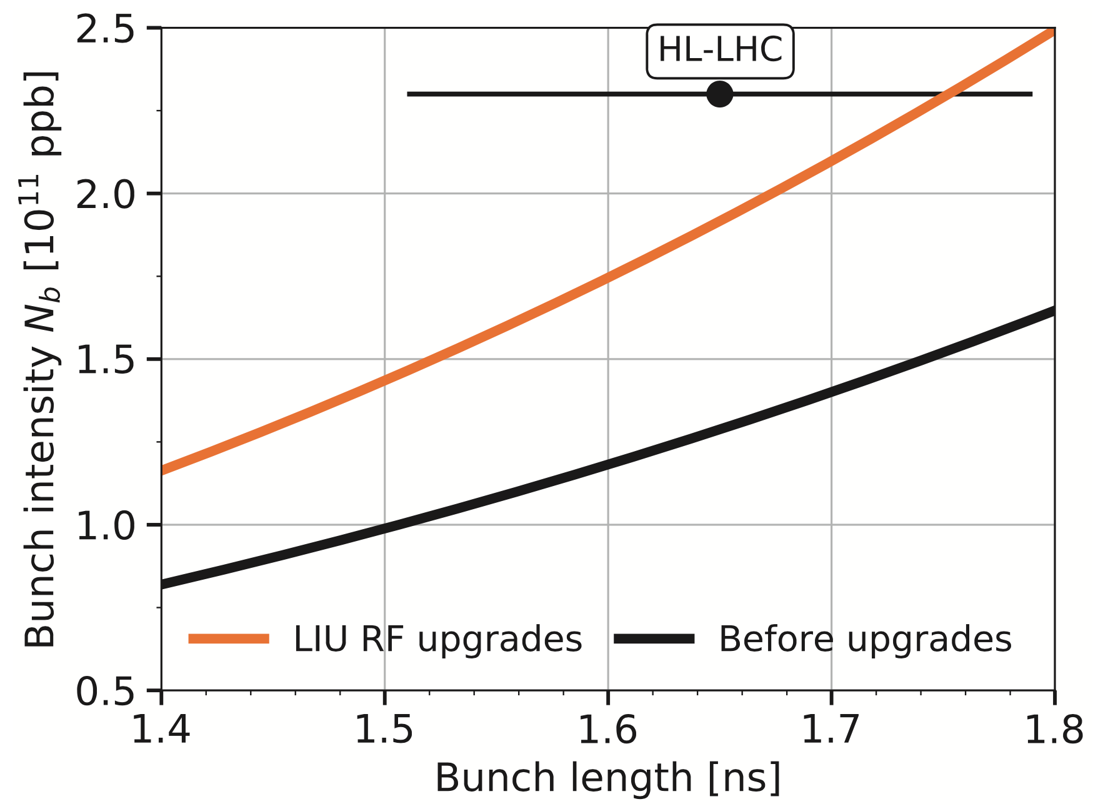
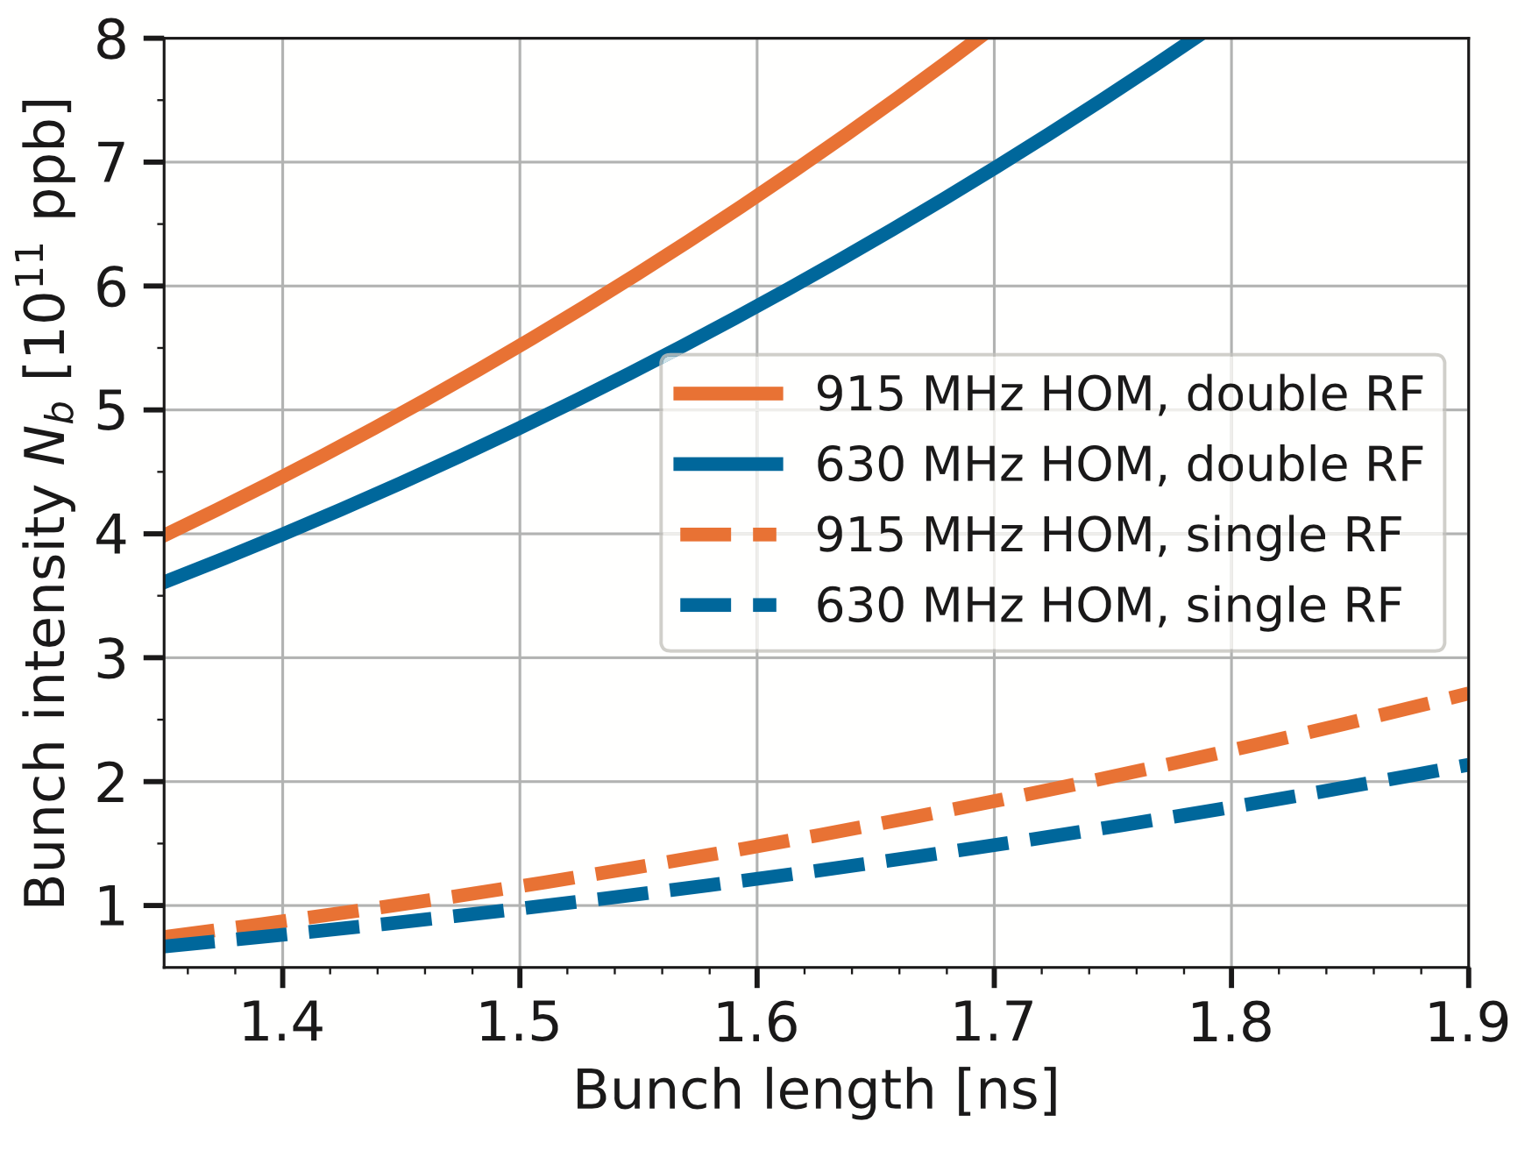






Simulations at SPS flattop: 72 bunches
2018 SPS impedance model, $V_{200}/V_{800}$ = 0.1
HOM only, $V_{200}$ = 10 MV
$$V_{800}/V_{200} =0.1$$
$V_{200}=$ 10 MV
$V_{200}=$ 7 MV
$$V_{800}/V_{200} =0$$
J. Repond, PhD thesis, 2019
$→$ Multi-bunch instability threshold in the presence of HOM only is significantly higher than the one with full impedance model

Slide 18
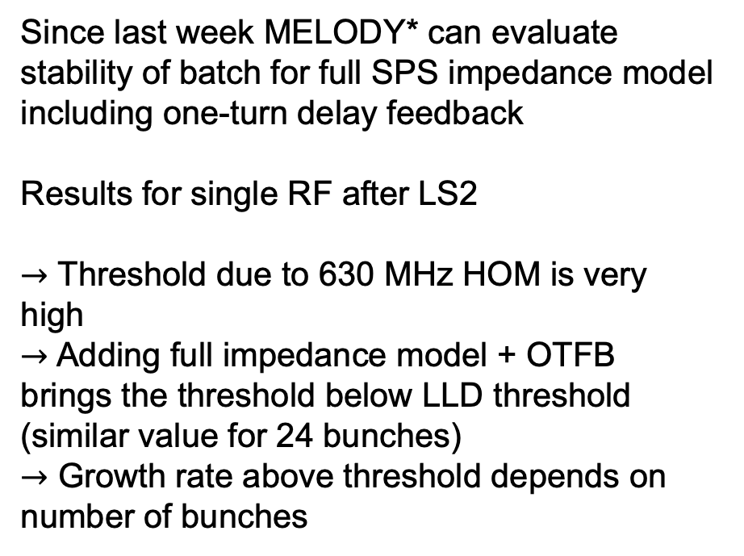
Multi-bunch stability
Since last week MELODY* can evaluate stability of batch for full SPS impedance model including one-turn delay feedback
Results for single RF after LS2
$→$ Threshold due to 630 MHz HOM is very high
$→$ Adding full impedance model + OTFB brings the threshold below LLD threshold (similar value for 24 bunches)
$→$ Growth rate above threshold depends on number of bunches
*Matrix Equations for LOngitudinal beam DYnamics

Slide 19
Multi-bunch stability
Since last week MELODY* can evaluate stability of batch for full SPS impedance model including one-turn delay feedback
Results for single RF after LS2
$→$ Threshold due to 630 MHz HOM is very high
$→$ Adding full impedance model + OTFB brings the threshold below LLD threshold (similar value for 24 bunches)
$→$ Growth rate above threshold depends on number of bunches
*Matrix Equations for LOngitudinal beam DYnamics

Slide 20
Multi-bunch stability
Since last week MELODY* can evaluate stability of batch for full SPS impedance model including one-turn delay feedback
Results for single RF after LS2
$→$ Threshold due to 630 MHz HOM is very high
$→$ Adding full impedance model + OTFB brings the threshold below LLD threshold (similar value for 24 bunches)
$→$ Growth rate above threshold depends on number of bunches
*Matrix Equations for LOngitudinal beam DYnamics

Slide 21
Multi-bunch stability
Since last week MELODY* can evaluate stability of batch for full SPS impedance model including one-turn delay feedback
Results for single RF after LS2
$→$ Threshold due to 630 MHz HOM is very high
$→$ Adding full impedance model + OTFB brings the threshold below LLD threshold (similar value for 24 bunches)
$→$ Growth rate above threshold depends on number of bunches
LLD threshold
*Matrix Equations for LOngitudinal beam DYnamics

