Slide 1
Lessons learnt from the wideband feedback R&D in the SPS for the head tail I/Q sampling
Wolfgang Hofle

Slide 2
Reminder: Noise in crab cavities
noise in crab cavity system leads to emittance blow-up → mitigation needed
phase noise in RF crab cavities → amplitude kicks, mitigation by ADT possible
amplitude noise in crab cavity → head tail kicks, mitigation by a head tail feedback
  can use crab cavities as kickers
  similarities of processing with wideband feedback study conducted in SPS

Slide 3
SPS Wideband Feedback system
intra-bunch damping of transverse instabilities
  demonstrator built and tested successfully in the SPS in the vertical plane as part of a multi-lab collaborative effort
  proposals made for SPS and LHC to build a full fletched system, simulations for FCChh
  SPS kicker design report explored several options (kickers and multi-band versus broadband)

Slide 4
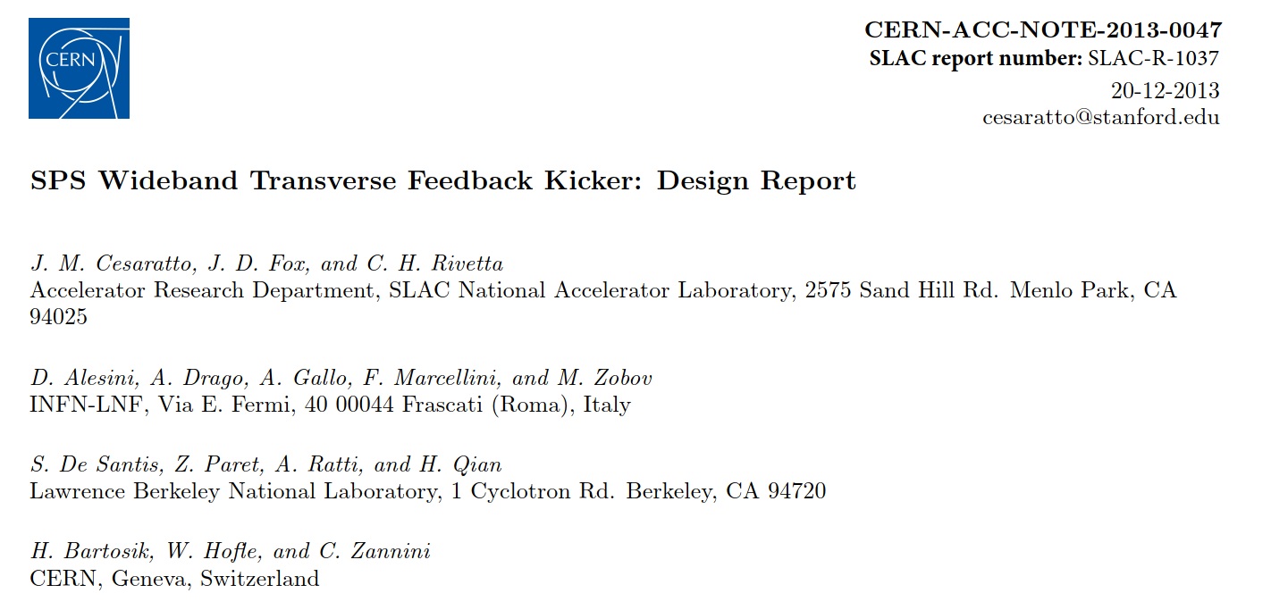
SPS kicker design report

Slide 5
SPS kicker design report
kicker types explored
  strip-lines, including using existing exponential SPS BPWs built originally as pick-up
  short strip-lines → 700 MHz
  Faltin kicker: strip-line shielded from beam pipe by slots → multi GHz bandwidth possible, scalable to FCChh
    interesting features when used as pick-up
  cavities with transverse modes, heavily damped
  kickers realized and installed in the SPS in LSS2:
    two short strip-lines (~15 cm length) → 700 MHz
    Faltin kicker (→ 1.2 GHz)

Slide 6
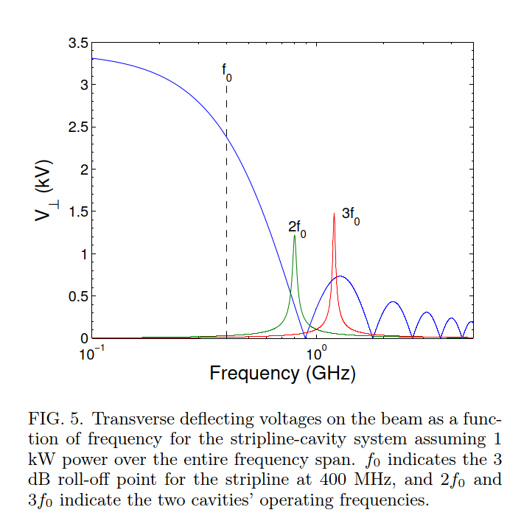
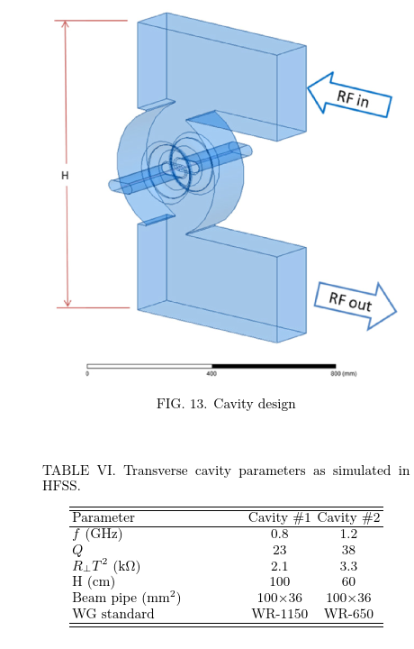
Multi-band approach
intra-bunch motion can be decomposed in a series of internal modes similar to a Fourier series
for 2.5 ns bunch length → kickers at n x 400 MHz
bandwidth > +/- 20 MHz to treat 25 ns spaced bunches individually
individual digital signal processing chains for each band (I/Q)

Slide 7


I/Q sampling
Relevance for crab cavity and instability studies !
Longitudinal profile
$$λ(t)$$
symmetric
asymmetric
Transverse oscillation
pattern
Movement of centre-of-charge
Normalized transverse
position $\text{x}[n]$
even symmetric
odd symmetric

Slide 8
Analog processing of PU signals
equalization of phase and amplitude of PU signal within the bandwidth of interest
  must have linear delay
  needs to include compensation for cable
  exponential strip-line made this more tricky compared to a linear strip-line (SPS WB study)
  button pick-up response would require attention with respect to the type of compensation

Slide 9
FC BA3, measurement setup
Pickup: BPWB.32101
VME modules
VME module
BPF e.g. 200 MHz
digitization
compensation
amplification
from SPS
damper
to wide band feedback
A means of compensating the offset before digitization critical to make best use of the available range of the ADC

Slide 10
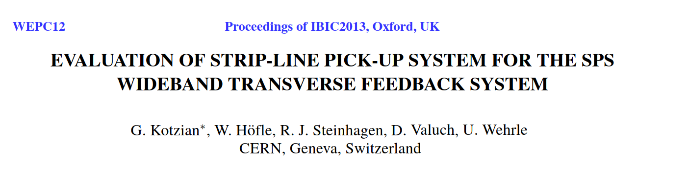
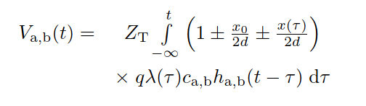

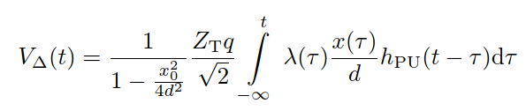
Closed orbit suppression
variable attenuator before hybrid
controlled by a slow feedback loop
resulting Δ signal varies with offset only in second order

Slide 11
MD results*
Investigated beam behaviour on MD2-cycle in SPS at 2016-12-07.
Single bunch, 25 ns LHC-beam, nominal intensity.
No acceleration
Q26 optics, to increase amount of head-tail motion.
Approx. 2 mm orbit by using steering bump.
Measured behaviour using three different tools
  DamperLoops observation memory. Installed in BA3 faraday cage.
  Pickup signals connected to Tektronix DPO7254 in BA3 faraday cage.
  Pickup delta and sigma signals connected to BQMt in CCR.
*) Endre Bjørsvik et al., some slides from Endre

Slide 12
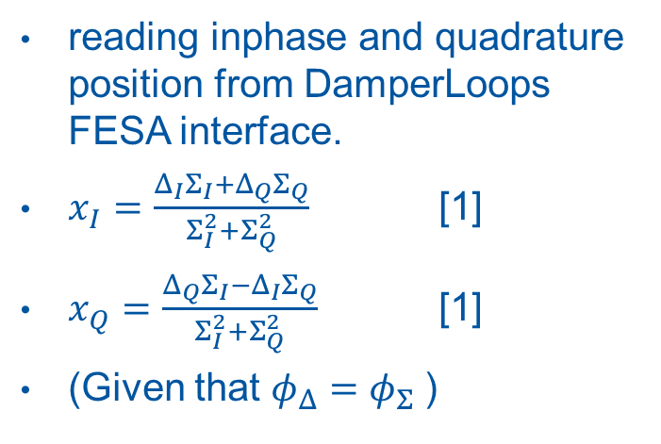
FC BA3, DamperLoops acquisition
reading inphase and quadrature position from DamperLoops FESA interface.
$x_{I}=\frac{Δ_{I}Σ_{I}+Δ_{Q}Σ_{Q}}{Σ_{I}^{2}+Σ_{Q}^{2}}$ [1]
$x_{Q}=\frac{Δ_{Q}Σ_{I}−Δ_{I}Σ_{Q}}{Σ_{I}^{2}+Σ_{Q}^{2}}$ [1]
(Given that $φ_{Δ}=φ_{Σ}$)
changed chromaticity and used Q-kicker to make beam unstable
[1] W. Hofle, G. Kotzian, D. Valuch, Transverse rigid dipole and intra-bunch oscillation detection using the transverse feedback beam position detection scheme in SPS and LHC, IBIC’2015, Melbourne, Australia, TUPB056, (2015);
G. Kotzian, W. Hofle, D. Valuch, Sensitivity of the LHC Transverse Feedback System to Intra-Bunch Motion,
IPAC 2017, Copenhagen, Denmark TUPIK093, (2017)

Slide 13


Normalized beam position
LHC ADT case (f scales 1/bunch length)
normalized
transverse position
as computed
center of gravity
oscillation amplitude
Phase rotation in digital part to align
Sum and Delta in I, Q; required
angle measured during set-up
The normalization scheme sees the symmetric (even) oscillation patterns (needed for the closed loop feedback)
Damper sensitivity to symmetric intra-bunch motion is a function of the longitudinal beam spectra
LHC vs SPS feedback: 400 MHz → 200 MHz, bunchlength
G. Kotzian, EDMS 1404633

Slide 14
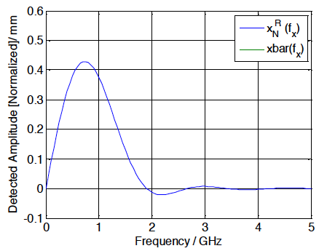

Headtail oscillation detection
LHC ADT case (f scales 1/bunch length)
different combination
of Sum and Delta I,Q components
indicates headtail motion
This algorithm can detect odd-mode oscillations
Algorithms cannot resolve the original oscillation frequency, and absolute oscillation amplitude accurately
However, can detect activity and distinguish between symmetric (even) and asymmetric (odd) modes of every bunch → valuable diagnostics !
LHC vs SPS feedback: 400 MHz → 200 MHz due to bunchlength

Slide 15
Visualization of bunch motion (1)
TAIL
LINE OF CHARGES
HEAD
pure movement of the
CENTRE-OF-CHARGES
transverse
MEAN
TRANSVERSE
OFFSET
Q-Component
I-Component
MEAN
TRANSVERSE
OFFSET
longitudinal
MEAN
TRANSVERSE
OFFSET
only HEAD-TAIL activity,
constant transverse offset
transverse
Q-Component
I-Component
longitudinal

Slide 16
Visualization of bunch motion (2)
mixed HEAD-TAIL activity with
coherent CENTRE-OF-CHARGES
movement
TAIL
HEAD-TAIL activity is in-phase
with CENTRE-OF-CHARGES
movement
HEAD
MEAN
TRANSVERSE
OFFSET
transverse
Q-Component
I-Component
MEAN
TRANSVERSE
OFFSET
longitudinal
HEAD-TAIL activity has some phase-advance w.r.t. the
CENTRE-OF-CHARGES movement
MEAN
TRANSVERSE
OFFSET
transverse
Q-Component
I-Component
longitudinal

Slide 17
Visualization of bunch motion (3)
Rapid identification of
quiet bunches
bunches with transverse center of mass motion
bunches with head tail motion
bunches with combination of center of mass and headtail motion with correlation
example
from LHC
scrubbing run
< 2014
“Q”
“I”

Slide 18
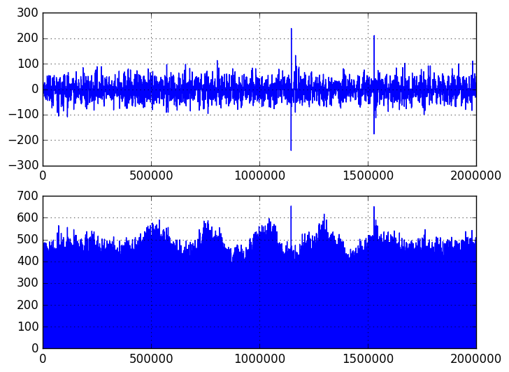
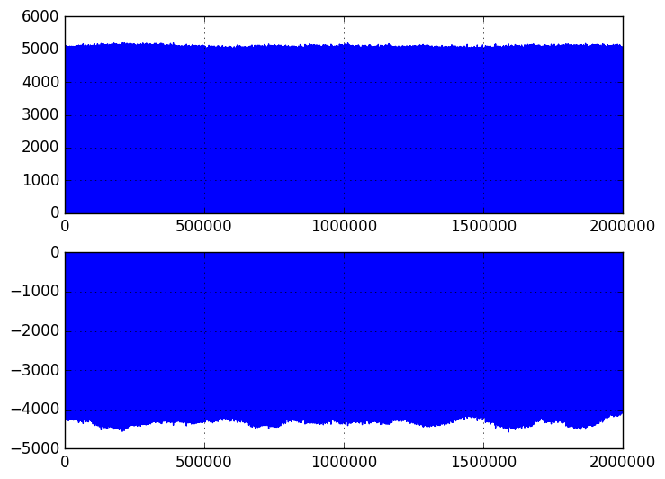
FC BA3, DamperLoops acquisition*
Without orbit suppression
With orbit suppression
Inphase [int]
Inphase [int]
Quadrature [int]
Quadrature [int]
*) Endre Bjørsvik, all this is for illustration;
verification of calibrations and signs if re-launched

Slide 19
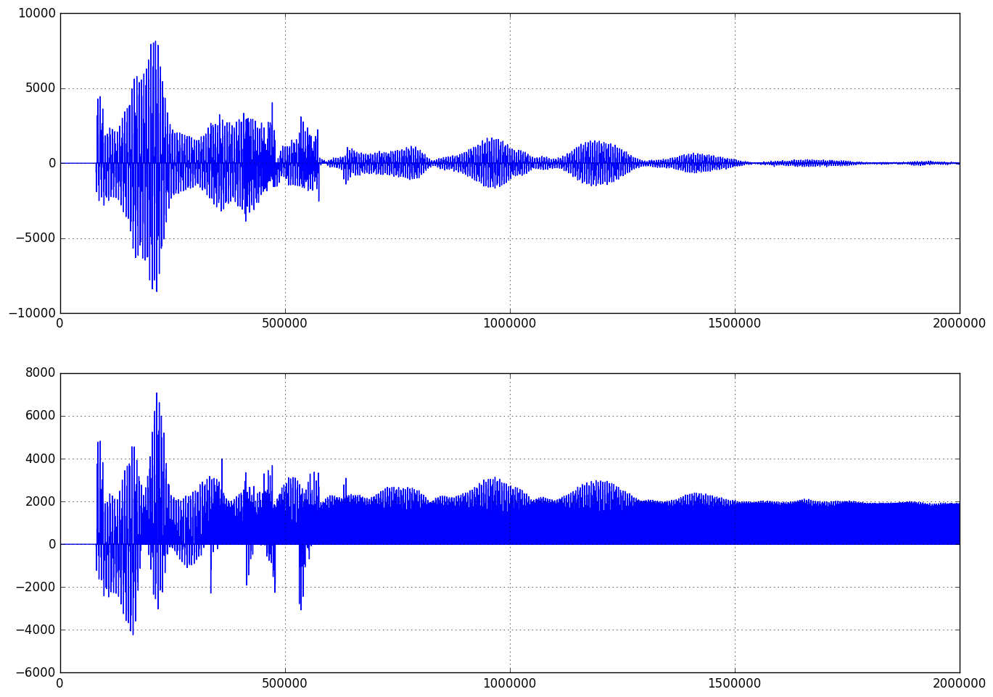
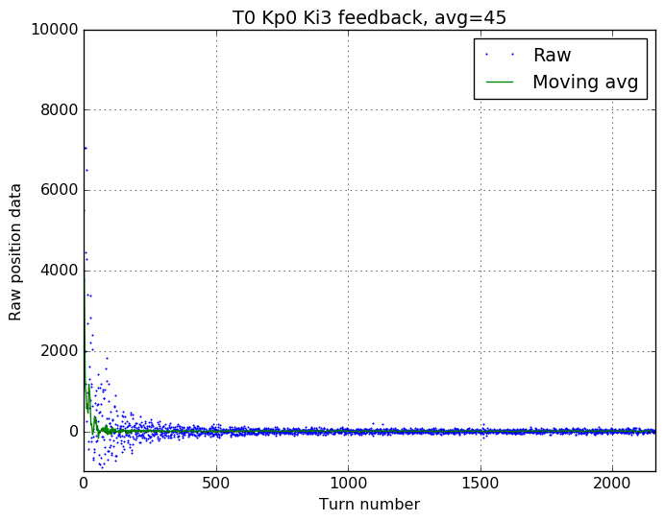
FC BA3, DamperLoops acquisition, injection
Before feed forward
Inphase [int]
Quadrature [int]

Slide 20
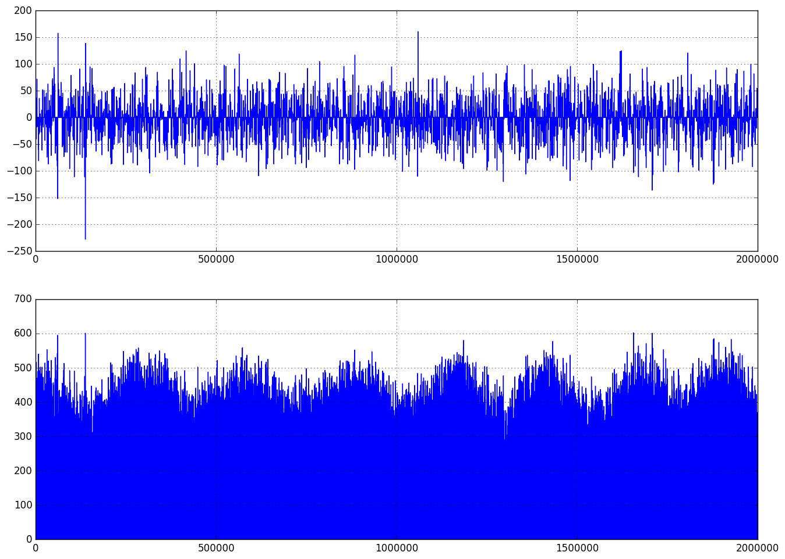
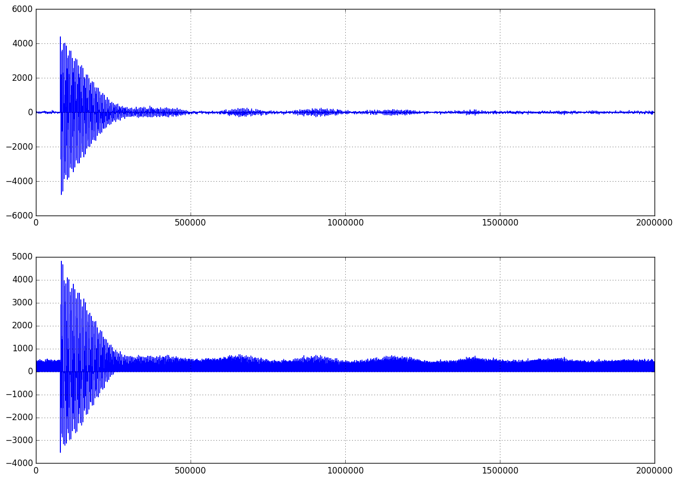
FC BA3, DamperLoops acquisition
At 100 ms, no kick
At 100 ms, 1 kV kick
Inphase [int]
Inphase [int]
Quadrature [int]
Quadrature [int]

Slide 21
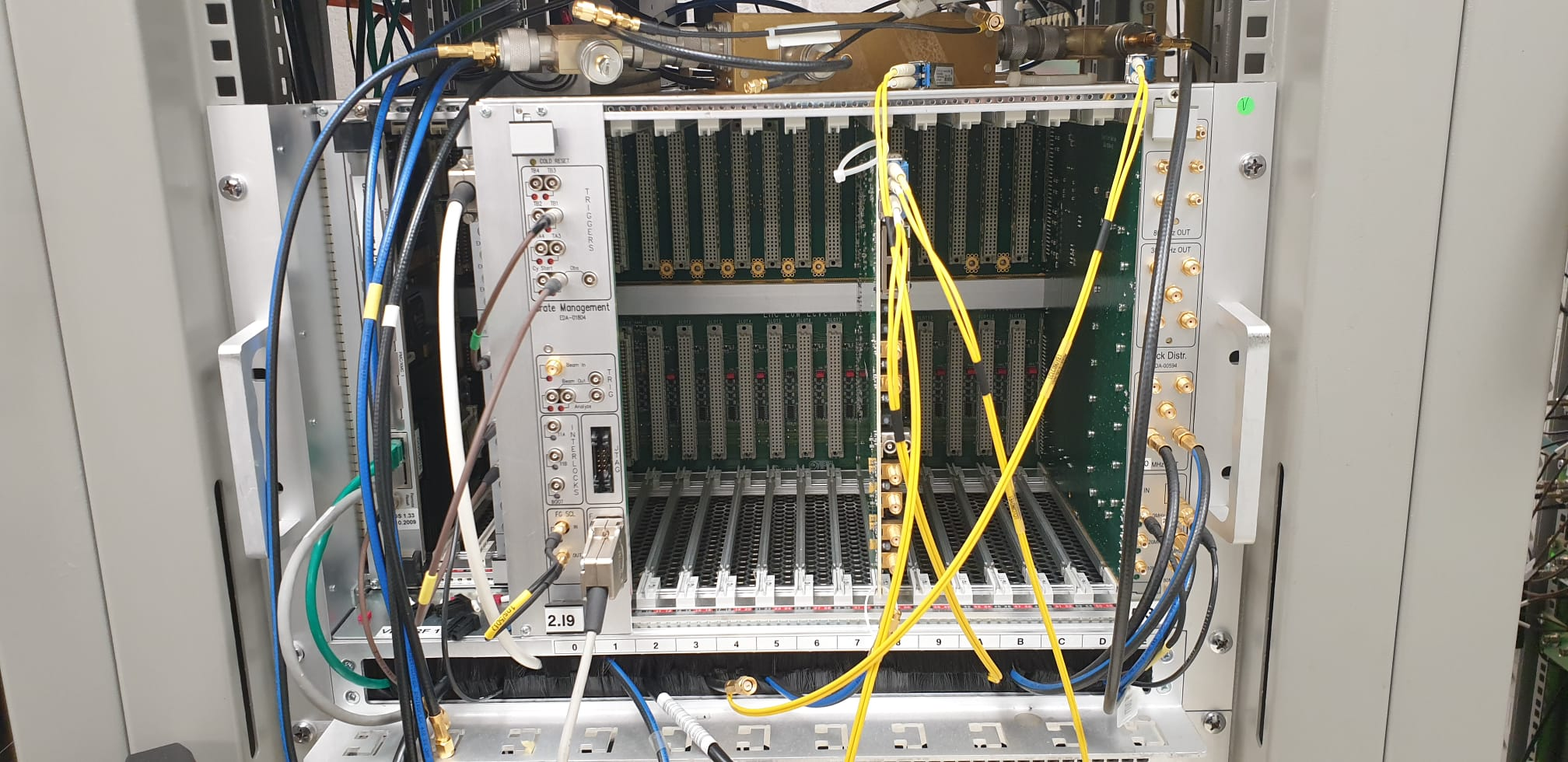
VME crate in SPS FC
some modules removed
for phase monitoring
SPS/AWAKE

Slide 22
Revival of VME hardware?
moderate effort to revive VME hardware for head tail diagnostics previously used in SPS FC
  SPS damper loops module
  band pass filters
  closed orbit suppression with feedback
  use on head tail monitor from BI possible
  crab cavity FB could be implemented in this hardware and tested in the SPS
  Basically looks like MIM monitor with I,Q detection

Slide 23
Some lessons and recommendations
closed orbit suppression essential for noise performance, use of feedback and variable attenuators possible
equalization of phase (and gain where needed) across the band important for FB
symmetry with respect RF harmonic chosen probably essential
do not use a too high harmonic of the RF
explore other harmonics of the 40 MHz bunch frequency and do not exclude it from the start

