Slide 1
Summary of Quadrupole CBFB Beam Tests
Jan Paszkiewicz
26/11/2021

Slide 2
Modifications to CBFB for Quadrupole Filtering
Sideband swap enable
1st order IIR HPF
CIC
↓64
Complex gain & bit shift
CIC
↑64
IQ conv.
IQ conv.
In
Out
Complex gain & bit shift
Σ
Filter freq. function
DSP Core
NCO
50 MHz clock domain
Excitation DDS
PS Acq Core
CIC
↓50
sample rates: 30 MHz 468 kHz 10 kHz

Slide 3
DSP Core
Simple DSP core for quadrupole mode filtering.
36x36 bit multiply-accumulate unit
Fixed program length: 128 instructions
  Runs once every start strobe.
Coefficients and program:
  Hard-coded defaults, or read from mem-map
No pipelining
  Simplifies both programming and firmware
  High latency: runs at half RF clock
M0
0
M1
M2
Acc
…
Reg write sel.
Reg read sel.
C0
C1
C2
C3
…
Coeff sel.

Slide 4
IIR Filter Implementation
Currently programmed on DSP core:
  2-stage cascaded biquad IIR filter, Direct-Form II implementation for minimum resource usage
  47 instructions per IQ channel.
  Maximum of 4 zeros and 4 poles, in addition to zero from f_{rev} notch
  Possibility of complex coefficients to create filters asymmetric about the f_{rev} harmonic
  Design filter for f_{s} = 800 Hz, slow down sample rate to match actual f_{s}: less sensitive to rounding errors
+
b_{0,0}
+
+
b_{1,0}
+
b_{2,0}
+
+
+
+
z⁻¹
z⁻¹
-
a_{0,1}
b_{0,1}
+
-
a_{1,1}
b_{1,1}
+
-
+
-
+
z⁻¹
z⁻¹
a_{0,2}
b_{0,2}
a_{1,2}
b_{1,2}

Slide 5
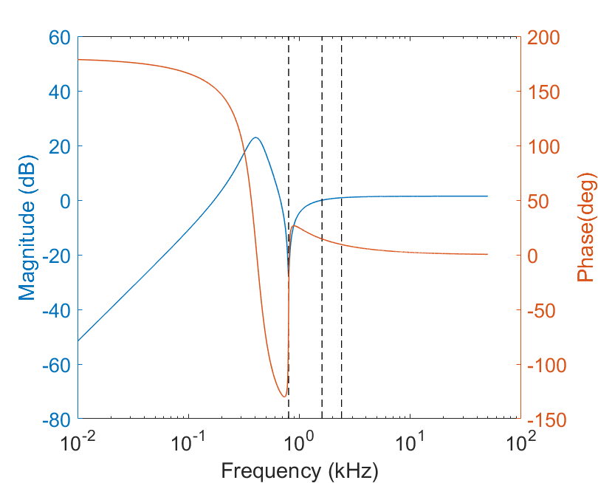
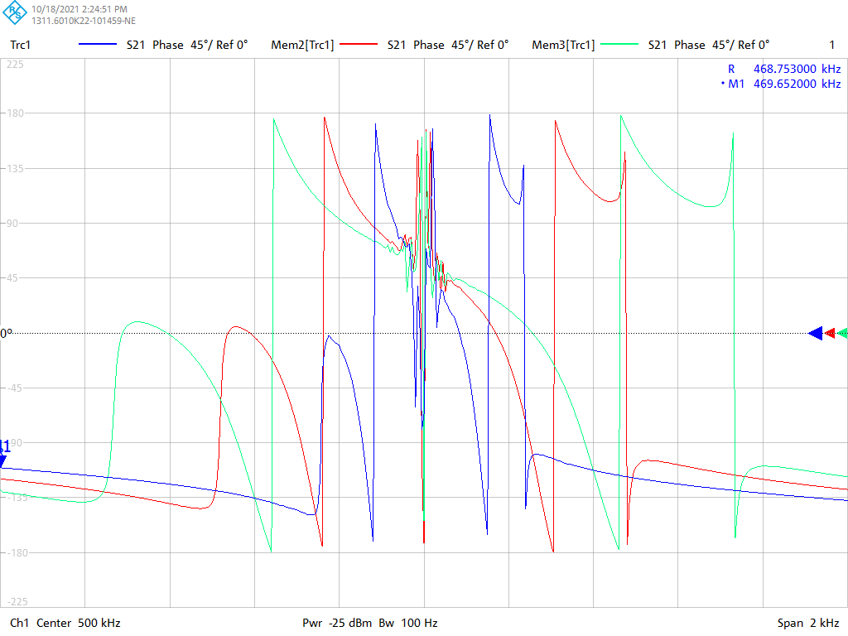
Initial Filter Configuration
Notch at dipole frequency
  -26 dB relative to quadrupole frequency
2nd – order notch at zero frequency for better f_{rev} harmonic rejection.
  -51 dB at 10 Hz relative to quadrupole frequency
  Removed later as this removed the central 180° step
4 poles at 0.5*f_{s} to cancel out the amplitude slope (80 dB/decade)
  Tradeoff between peak amplitude and group delay
  In this case: group delay = 0.04 * quadrupole period

Slide 6
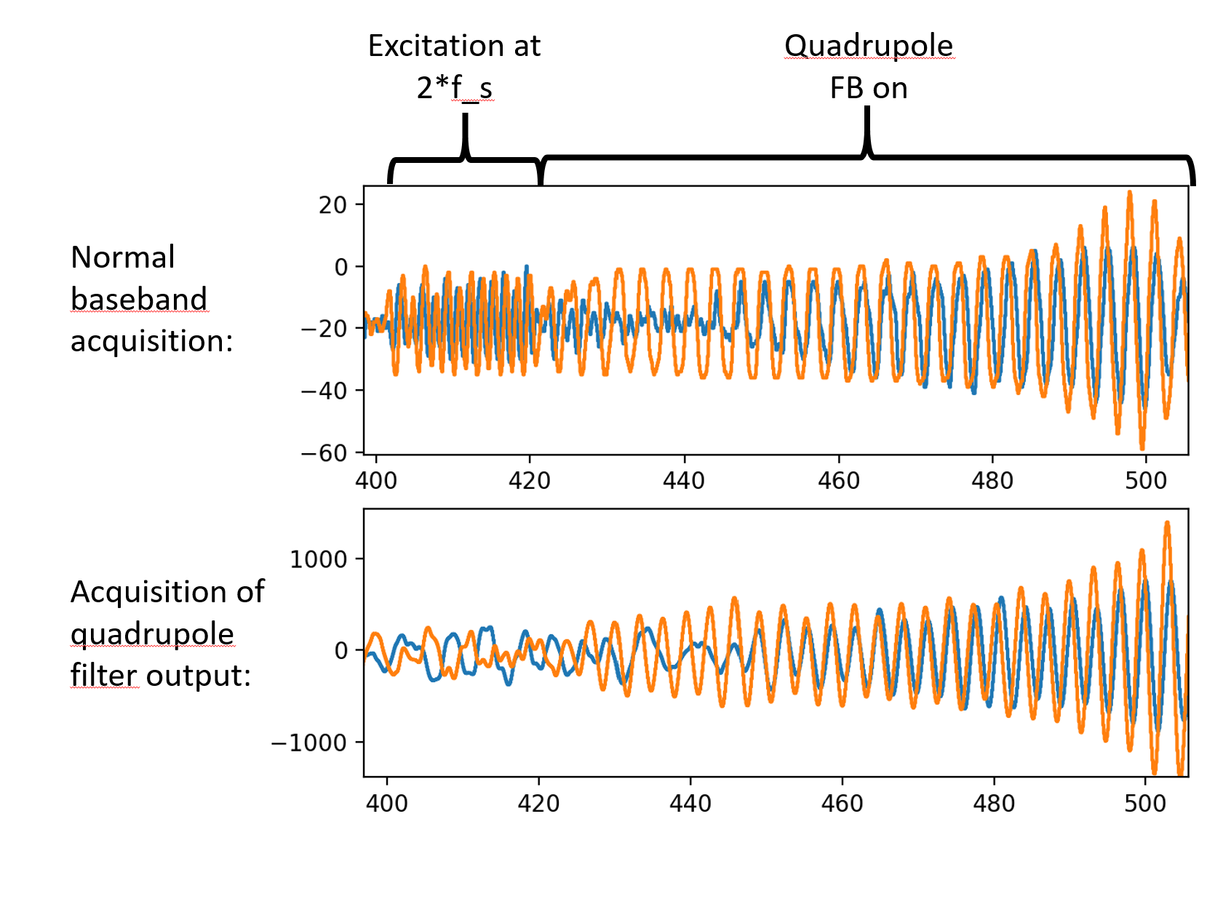
Initial Filter Configuration: Beam Test Results
Performed test with excitation at quadrupole frequency followed by feedback
Poor performance
  Greater sensitivity to dipole mode than quadrupole: not much signal in quadrupole acquisition during excitation.
  No signal expected at 0.5*f_{s} but likely excited by transients and sensitive to error in estimation of fs.
  Caused excitation of dipole mode instead.

Slide 7
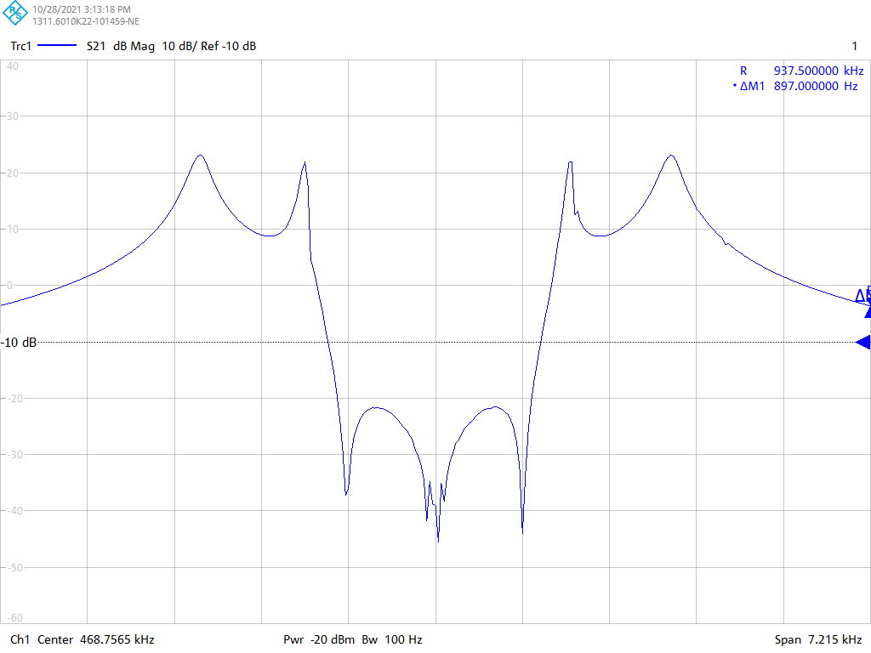
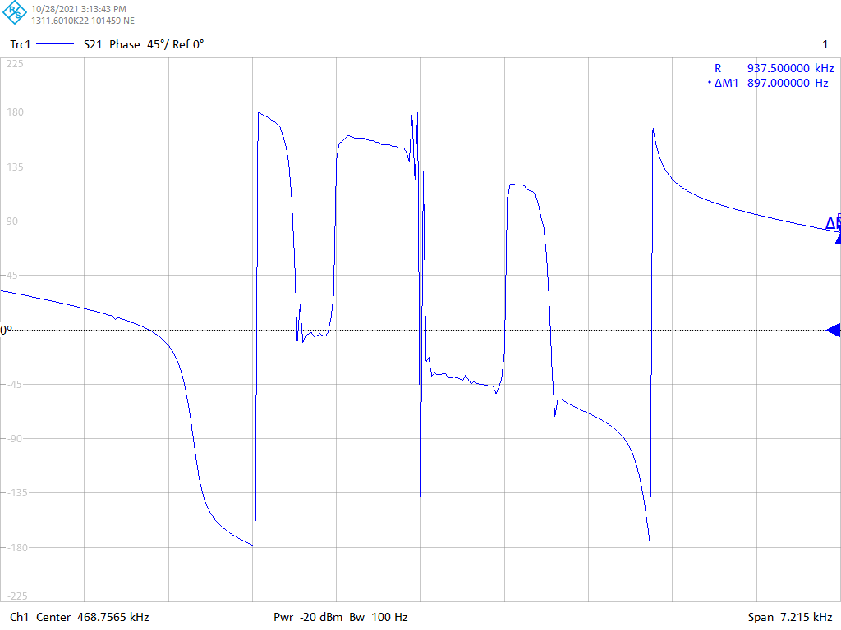
Modified Filter Configuration
Magnitude
Moved poles above quadrupole frequency
  2 poles each at 1.5*fs and 2.67*f_{s}
  Two separate peaks in an attempt to avoid a single very large peak (+14.5 dB max vs. +22.9 dB previously)
Reverted to single zero at zero frequency.
  Phase plot antisymmetric again.
≥ 30 dB rejection between 0 and f_{s}
Somewhat higher group delay:
  0.1 * quadrupole period
x-scale : 1 div = fs, y-scale : 10 dB/div
Phase
x-scale : 1 div = fs

Slide 8
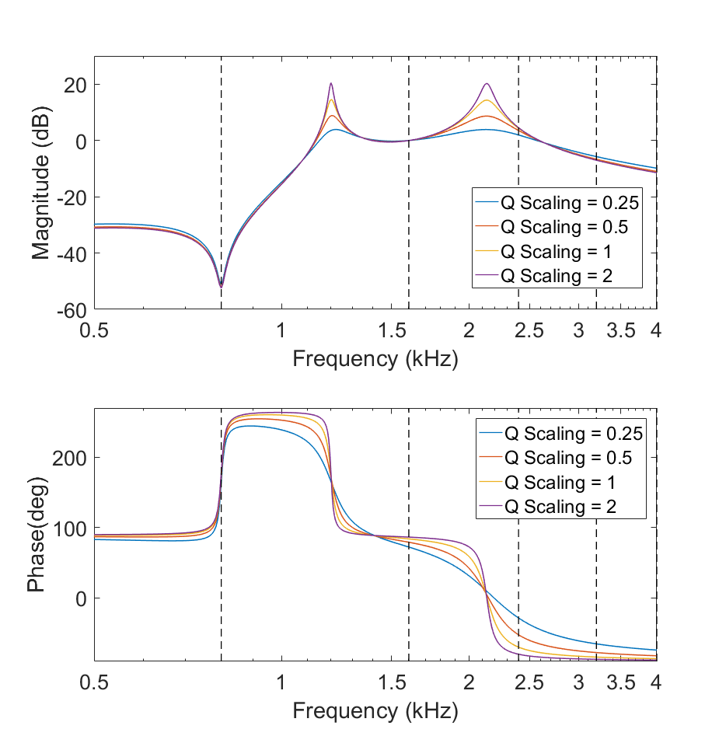
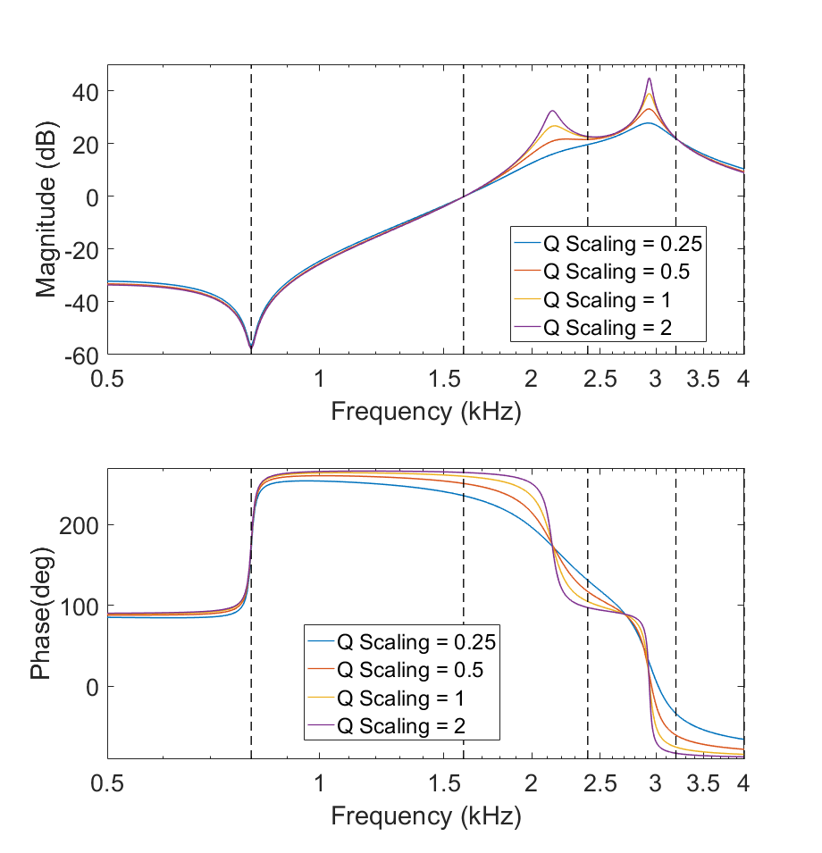
Aside: Filter Design Tradeoffs

Slide 9
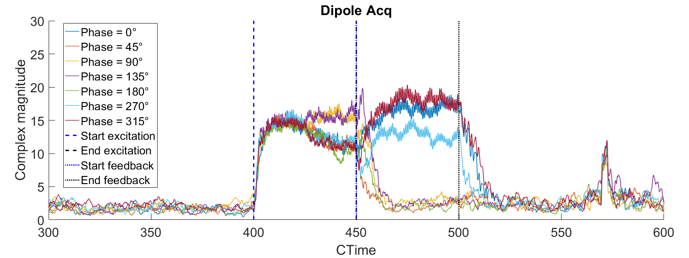
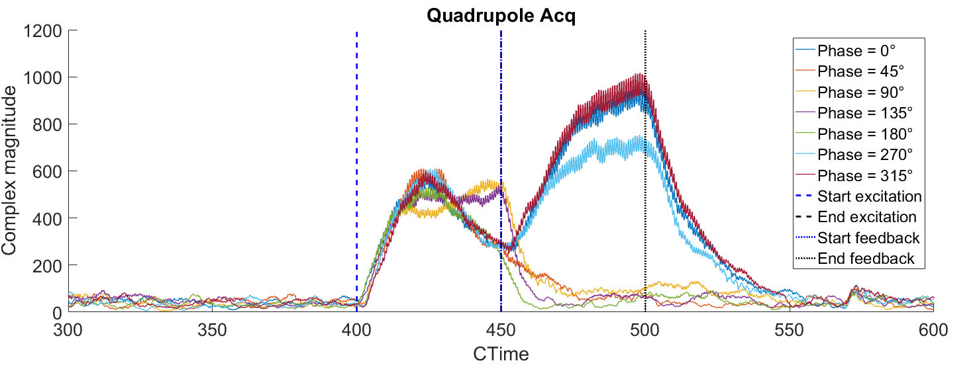
Modified Filter Configuration: Beam Test Results
Feedback on h20→h1 with sideband swapping
  Intensity 900e10
  Dipole feedback left on
Excitation at 2*fs at C2400-C2450, followed by feedback at C2450-C2500
  fs determined empirically by watching response of beam to excitation at different frequencies.
Feedback unstable for phase values 270°…360°, stable otherwise
  Beam naturally very stable, difficult to tell if stability was increased by the quadrupole feedback.

Slide 10
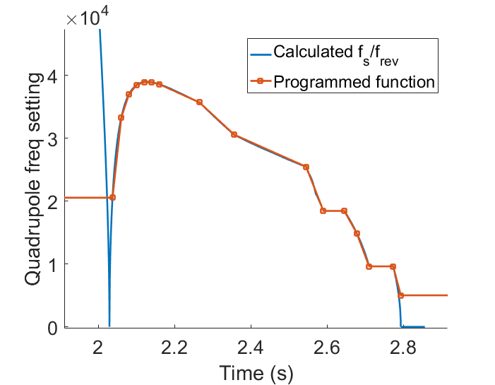
Further Iterations
Testing at higher intensity with 40 MHz cavities off
  Quadrupole oscillations appeared without excitation.
  Mode 5 appeared to be dominant based on tomoscope plots.
  Applying the new feedback (h16→h5) showed no difference.
f_{s} function was constant so far: not correct!
  Calculated expected fs from data exported from Samplers and Functions
Found bug in IQ converters
  1 cycle delay difference between I and Q channels
  Converters run at h64 : 90° difference at h16
  Cancelled out 90° shift between I and Q: no phase control
480 Hz
228 Hz

Slide 11
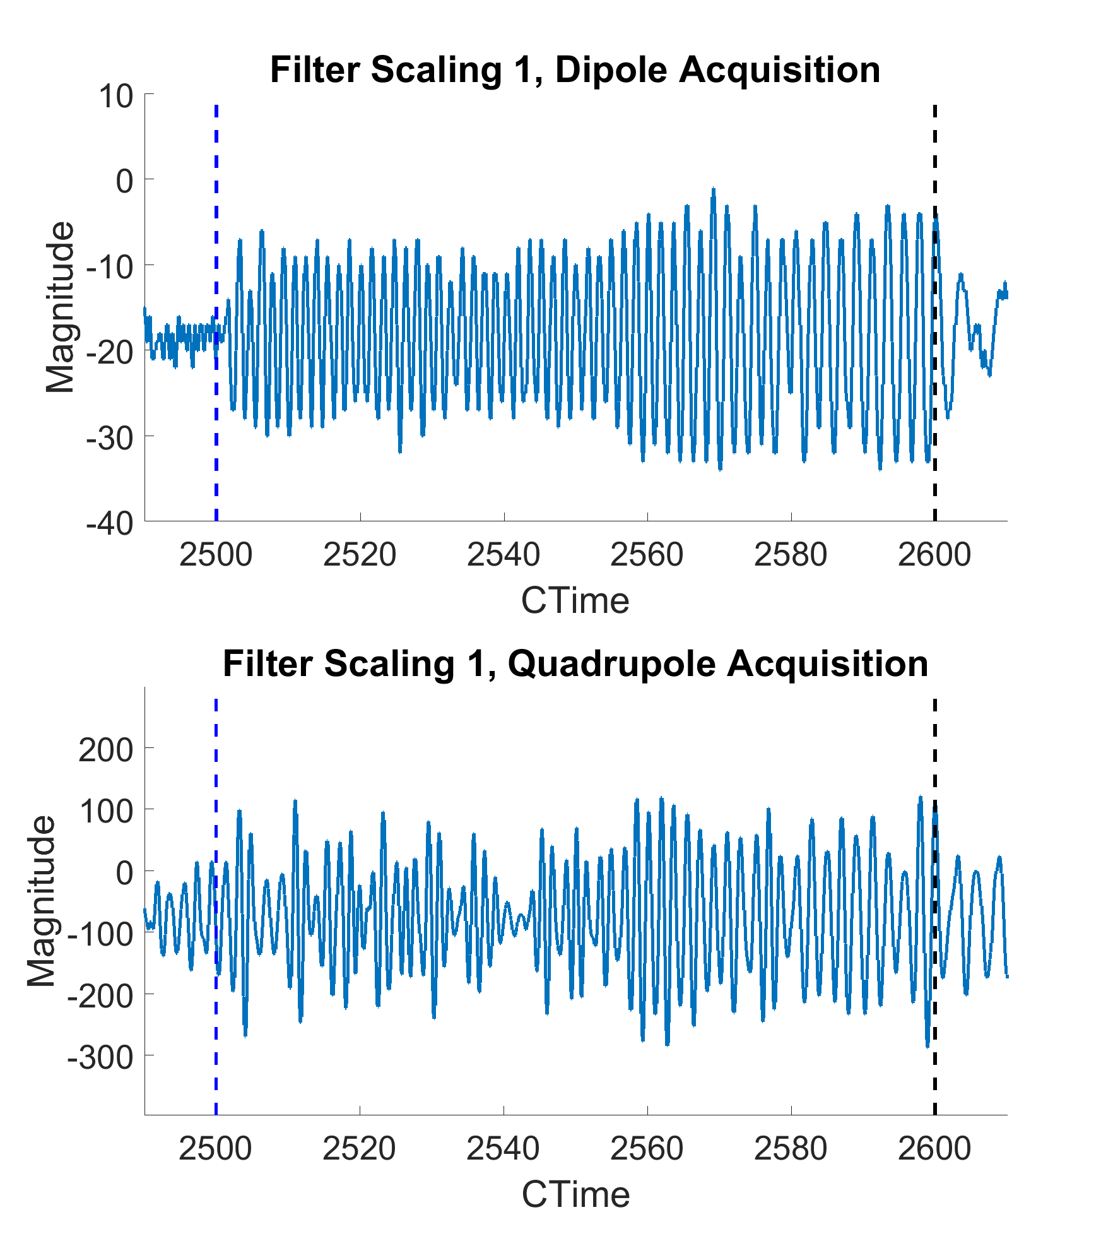
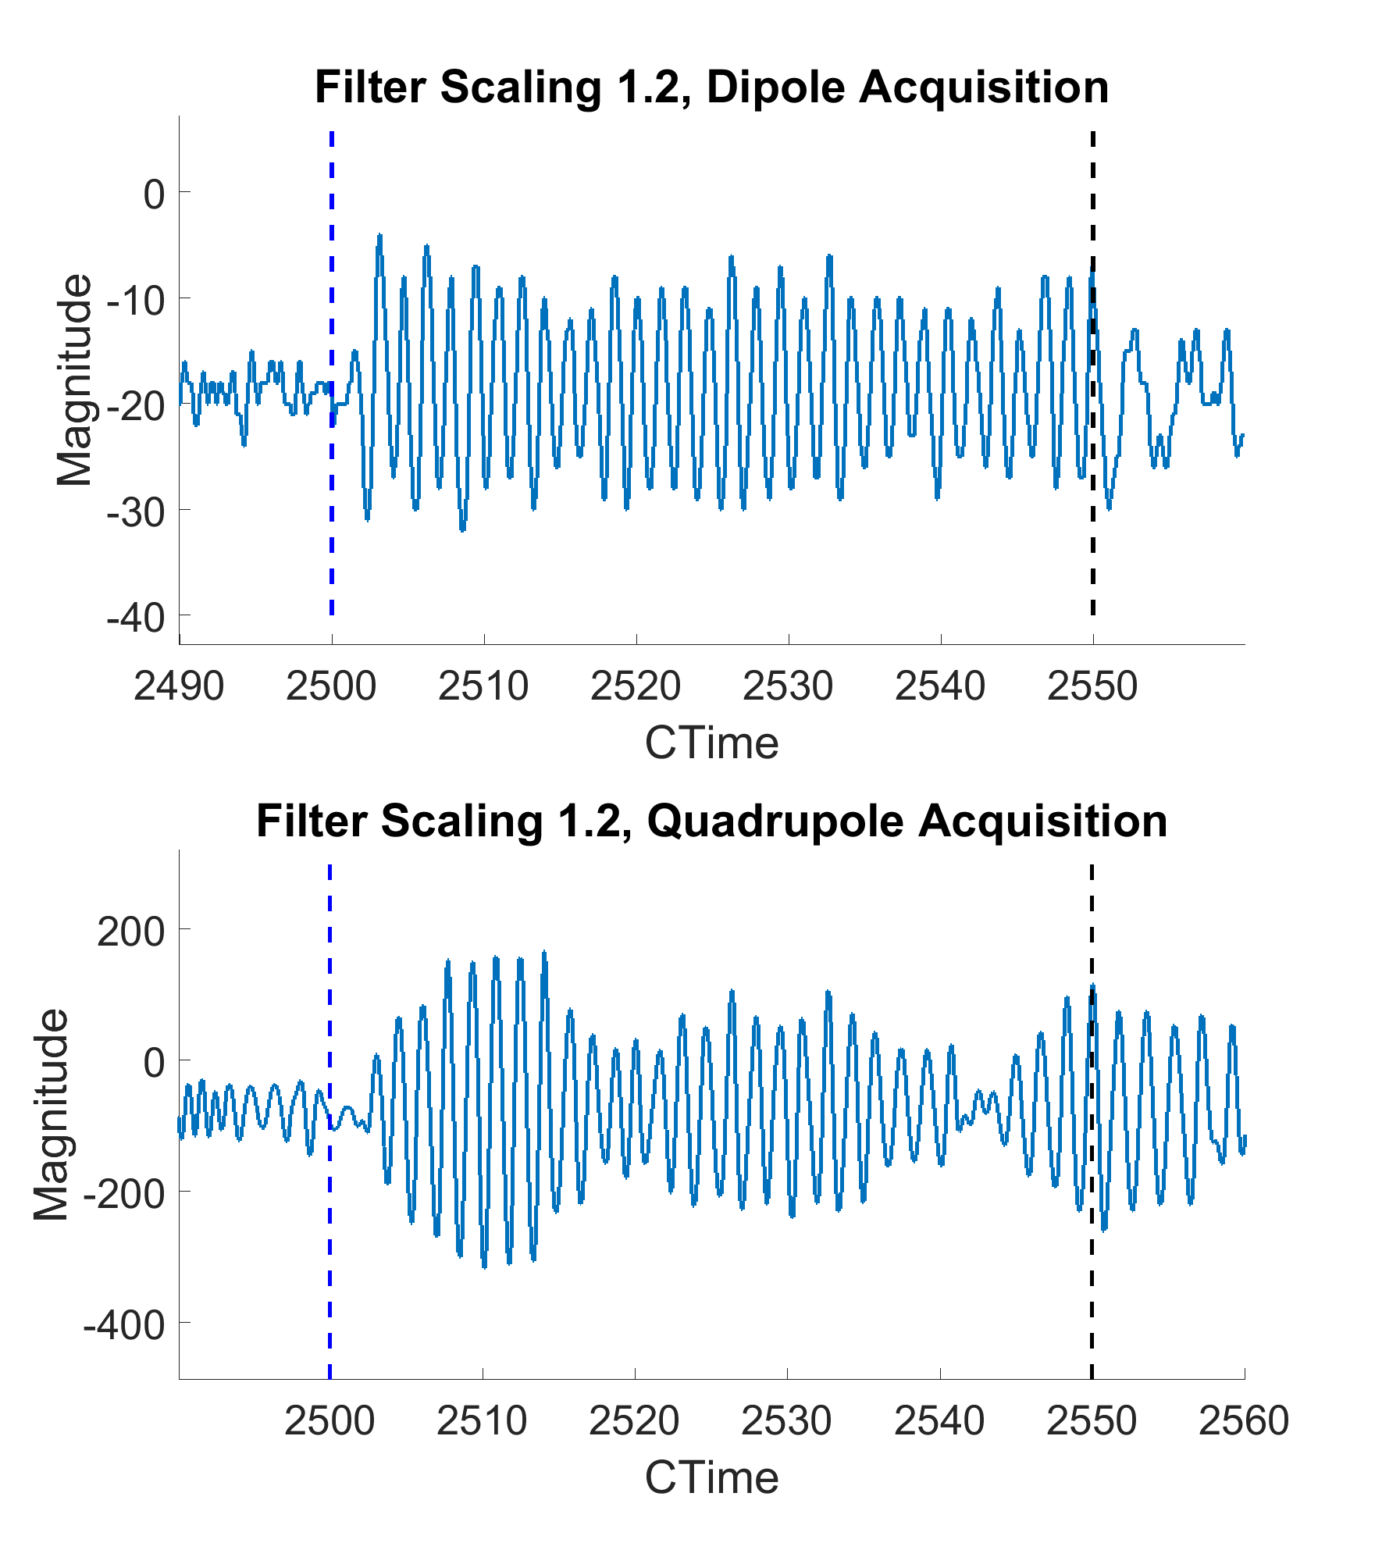
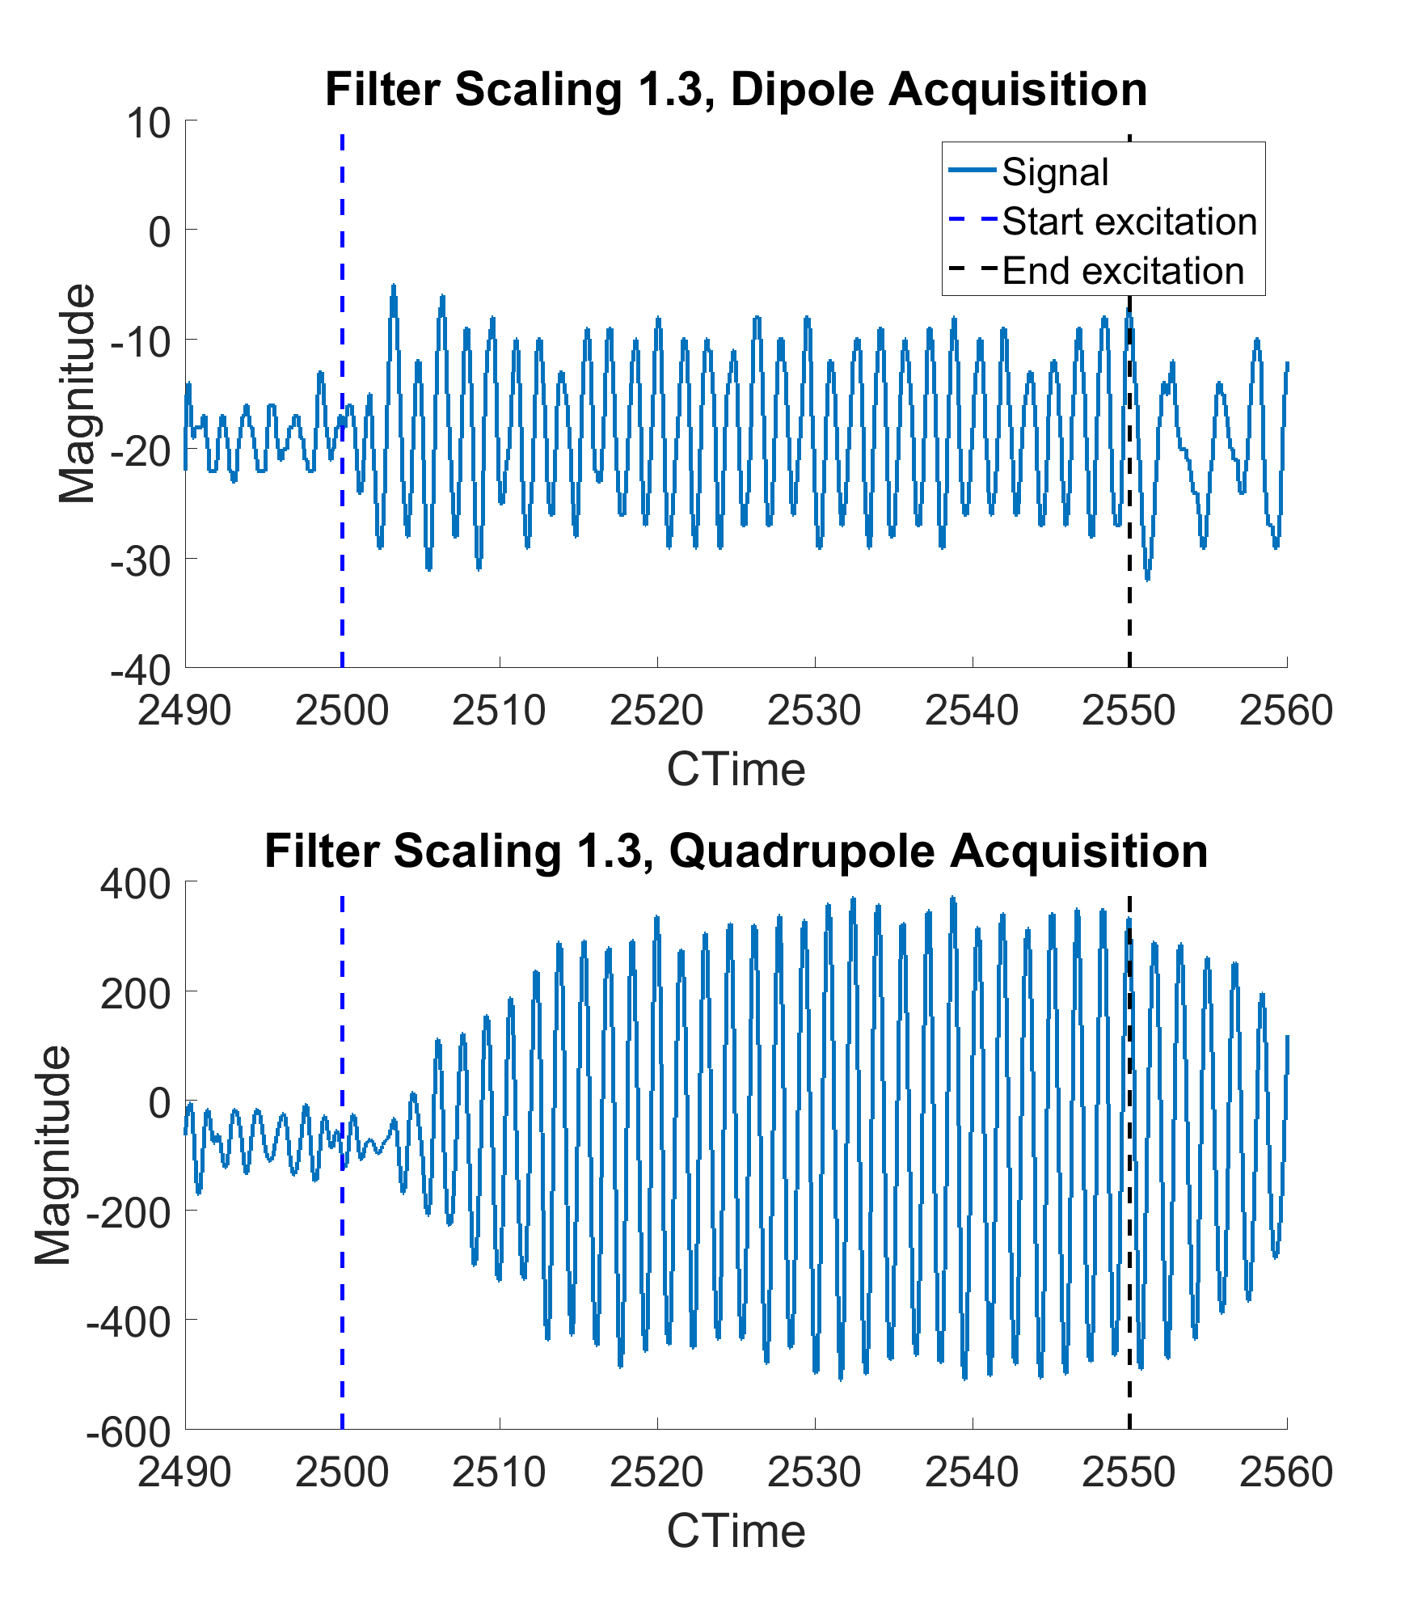
Filter Frequency Scaling
Noticed strange beating behaviour in quadrupole acquisition.
  Excitation at 2*fs, feedback off
  Oscillation amplitude as seen by dipole acquisition relatively constant.
Beating went away as filter frequency shifted from nominal value.

Slide 12
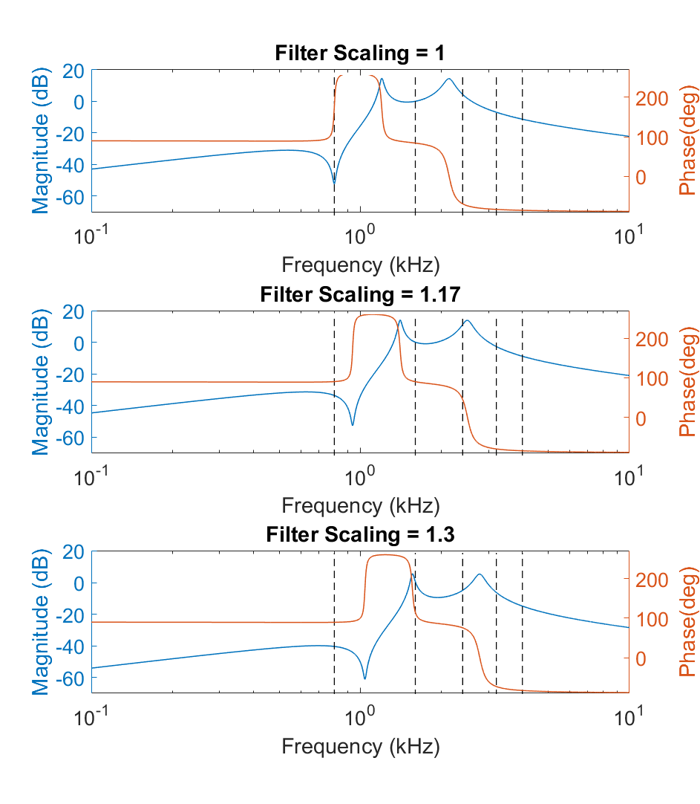
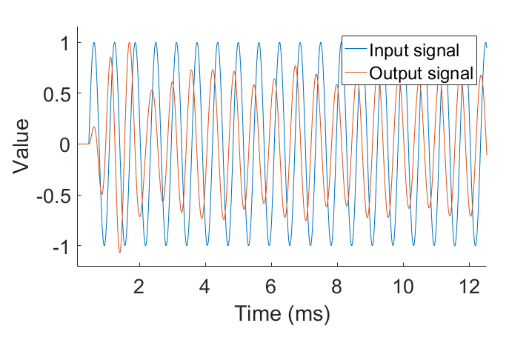
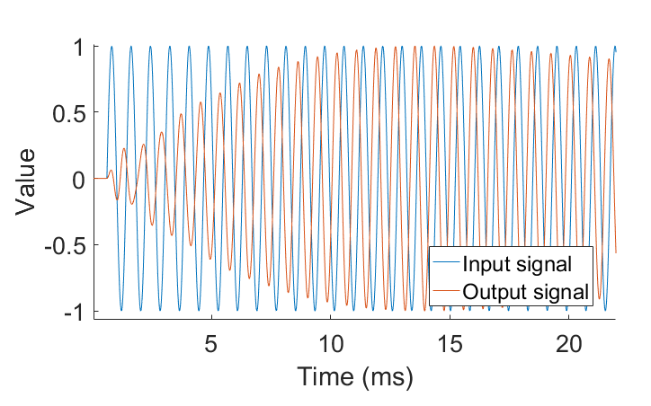
Filter Frequency Scaling: Transient Response?
Beating could be related to transients and/or noise exciting the two resonant peaks either side of 2*fs.
Effect could be somewhat replicated by simulating the transient response to a sinusoidal input.
  Multiple frequencies present in beam signal?
Scaling filter frequency increases group delay.
Filter scaling = 1
Filter scaling = 1.3

Slide 13
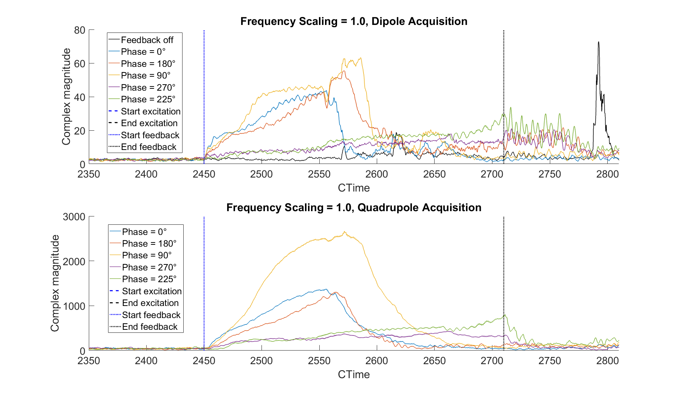
Filter Frequency Scaling: Effect on Feedback
I = 950e10
h16→h5

Slide 14
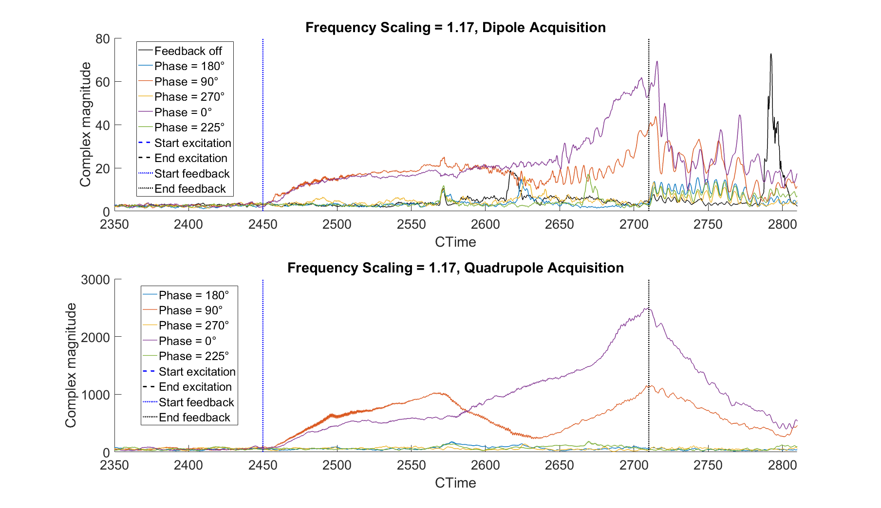
Filter Frequency Scaling: Effect on Feedback
I = 950e10
h16→h5

Slide 15
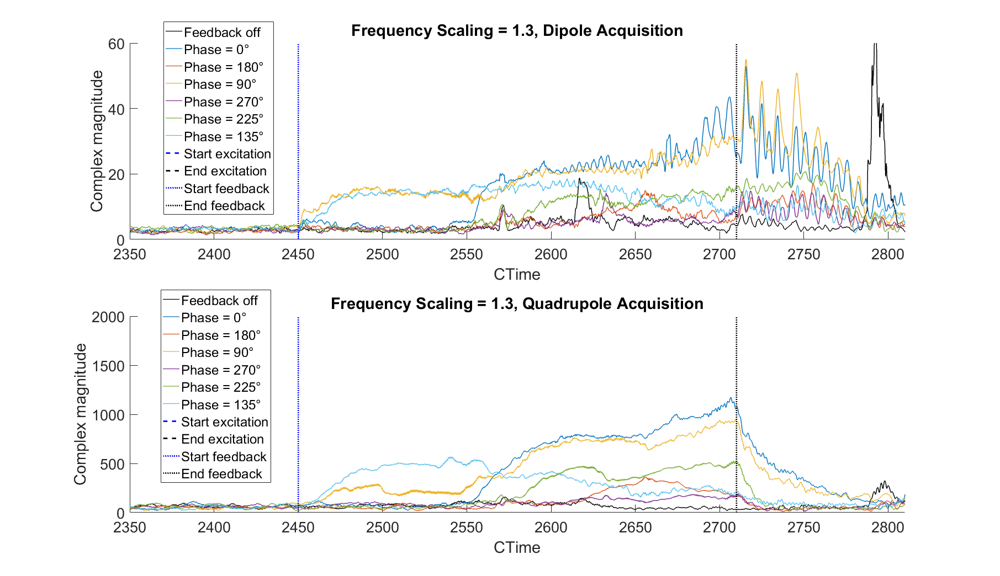
Filter Frequency Scaling: Effect on Feedback
I = 950e10
h16→h5

Slide 16
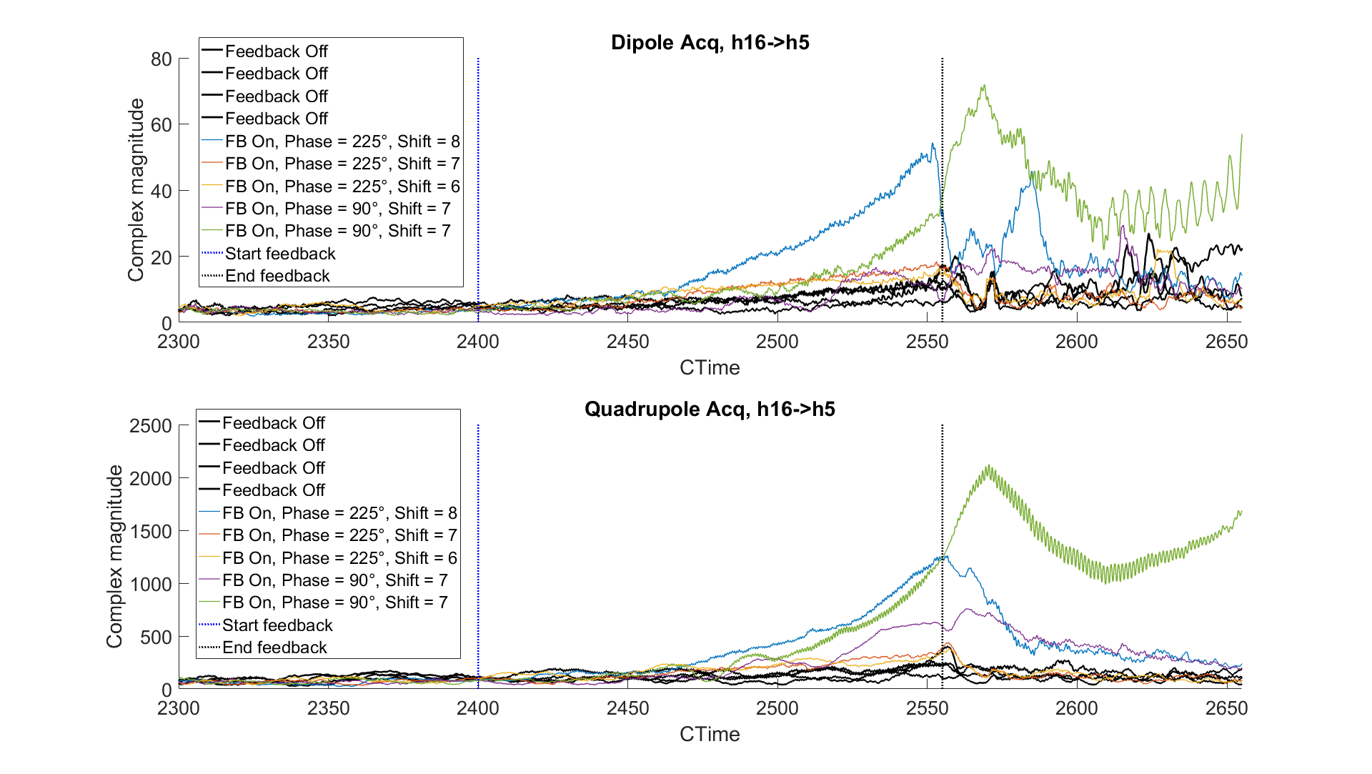
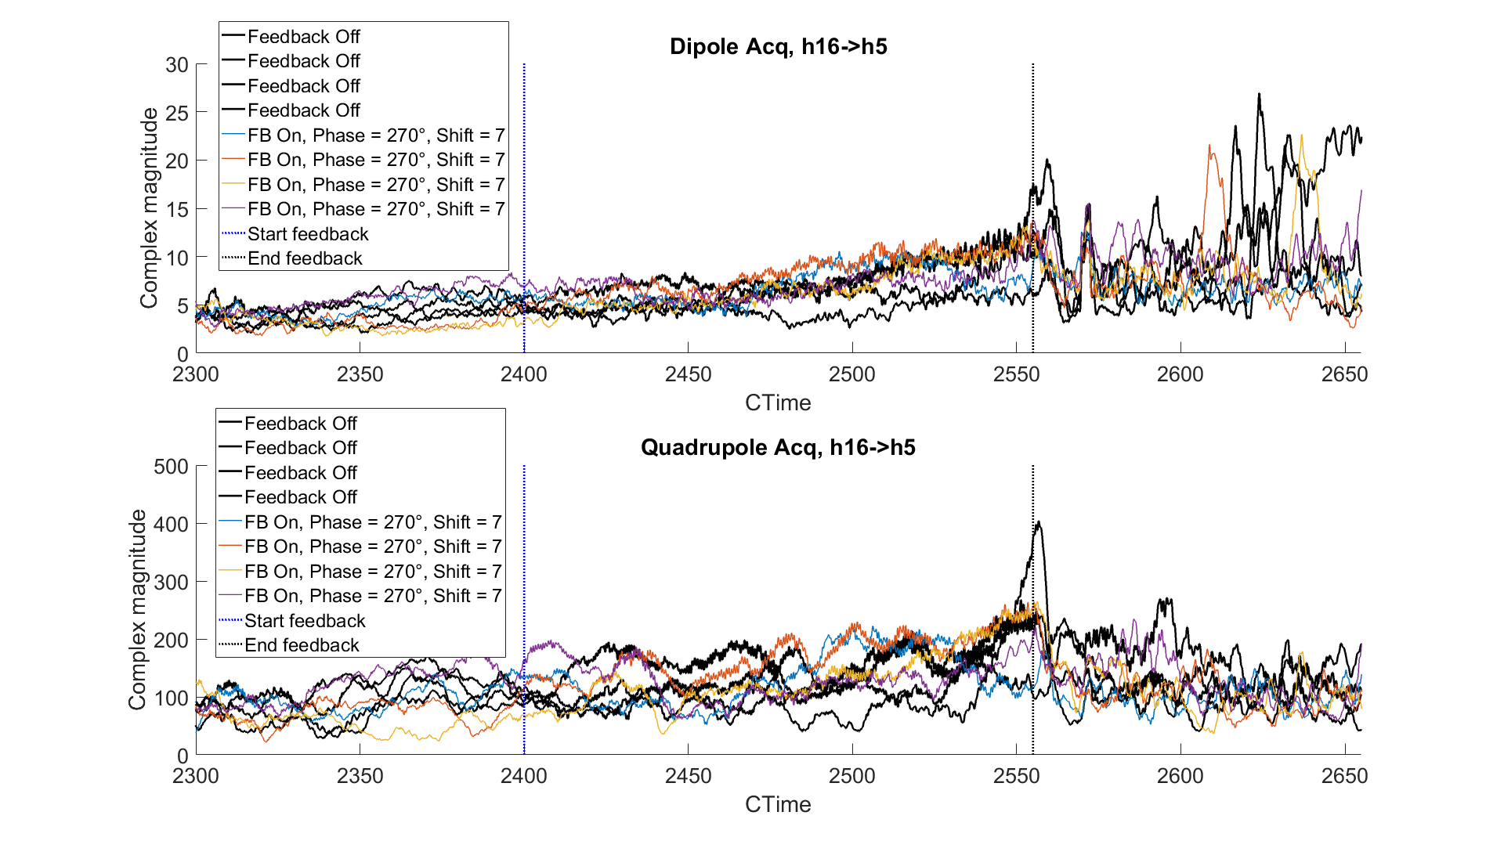
Tests at High Intensity
Intensity ≈ 2000e10
Found configuration which seemed not to go unstable.
Tried damping instability with 40 MHz cavity off, made no visible difference to beam.

Slide 17
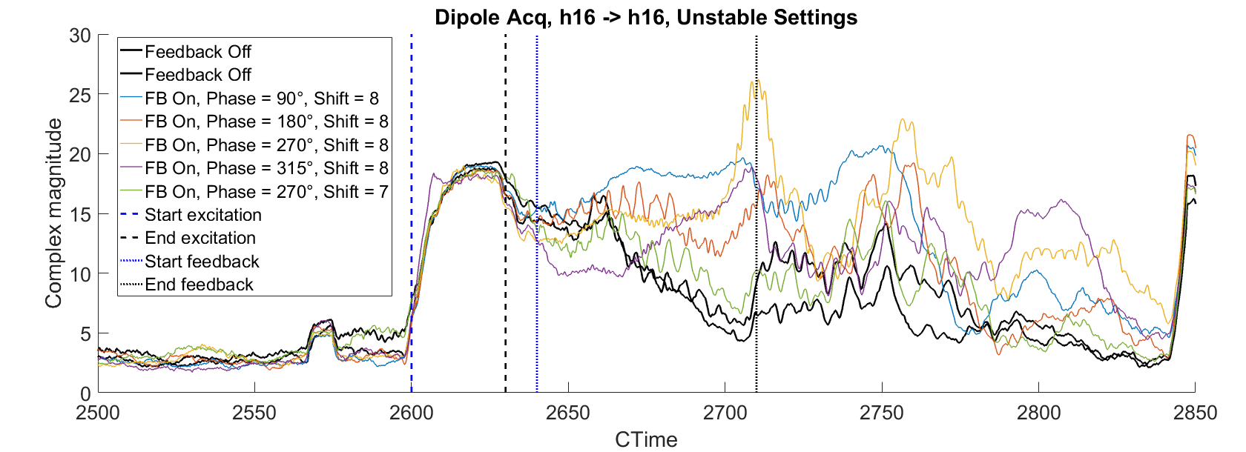
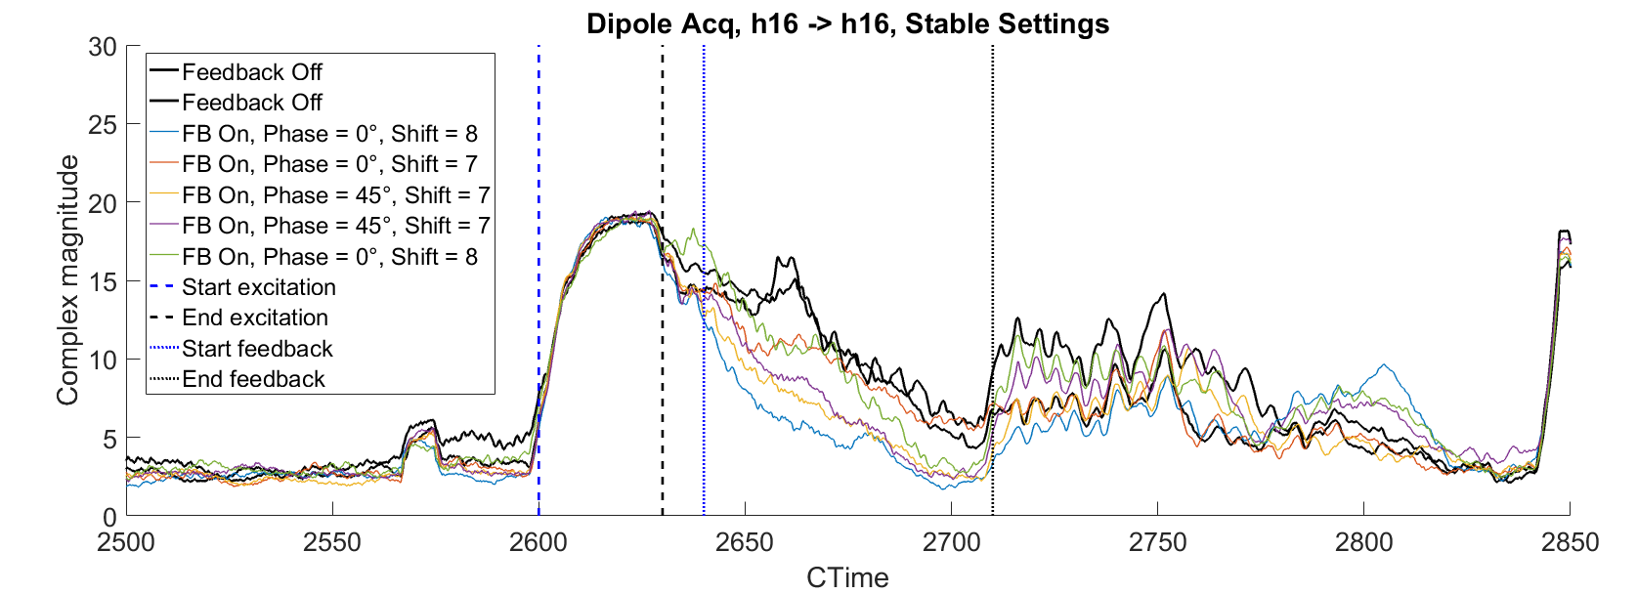
Damping after Excitation
Feedback on h16→h16 with no sideband swapping
Intensity ~950e10
Landau damping with 40 MHz cavity switched off.
Filter scaling = 1.17
Some improvement in damping rate over no feedback.

Slide 18
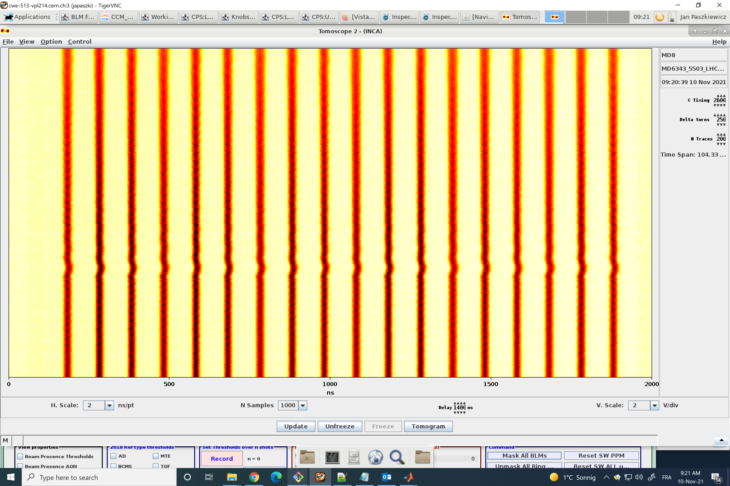
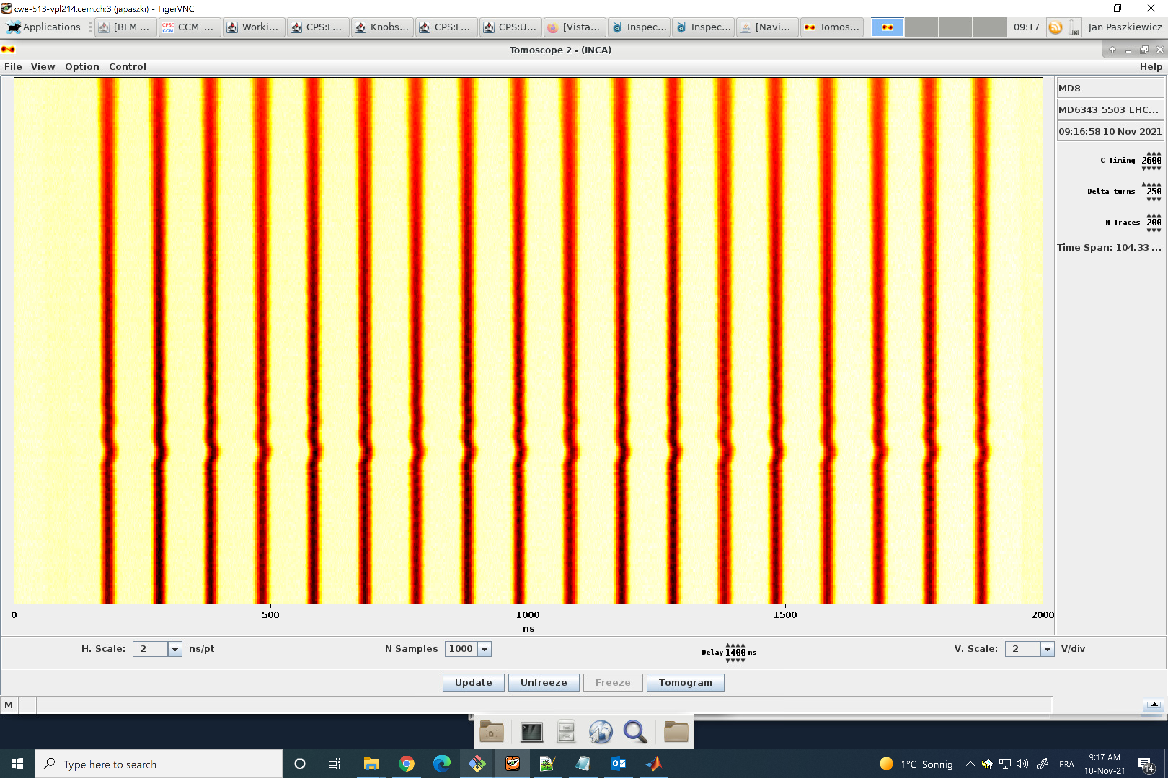
Damping after Excitation: Tomoscope
Unstable feedback
Stable feedback
Start FB: C2640
End Exc: C2630
Start Exc: C2600

Slide 19
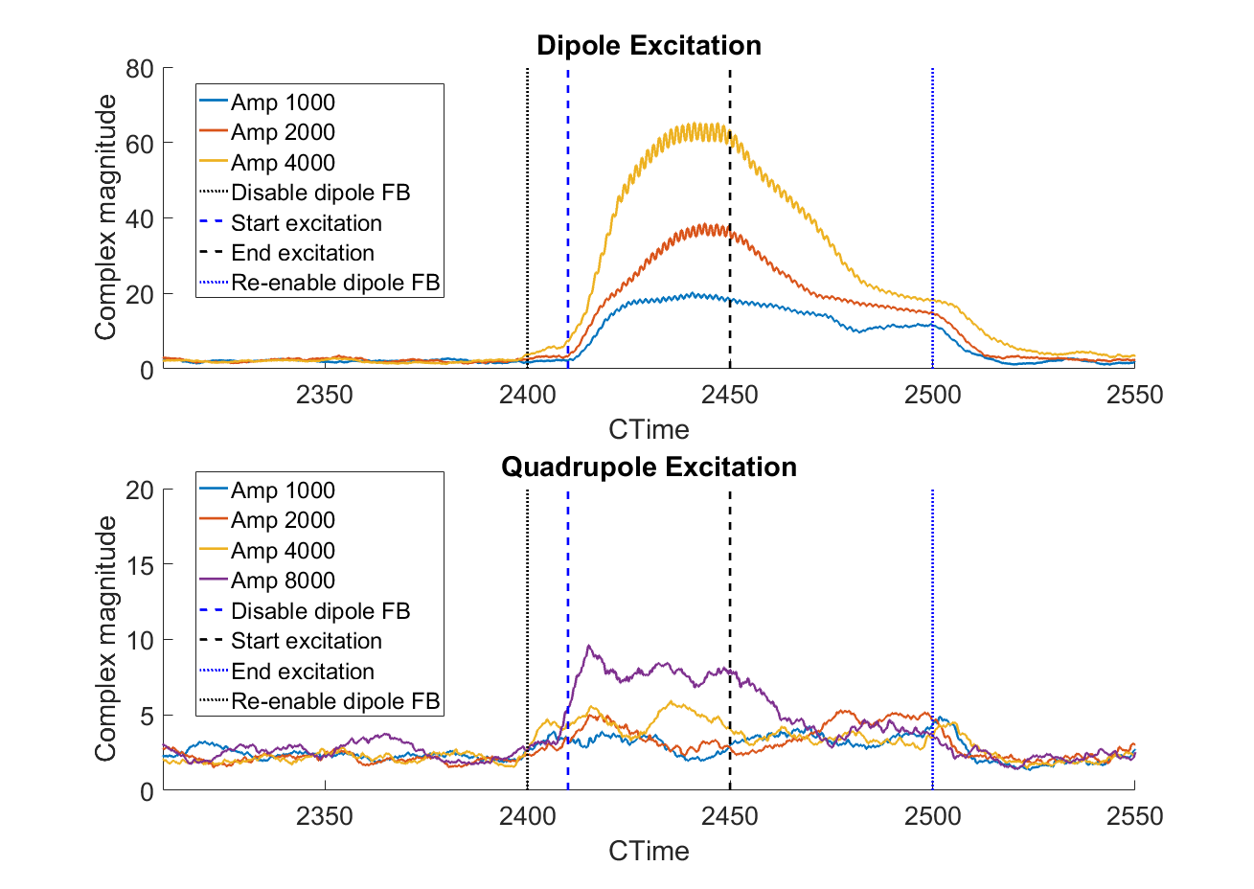
Excitation Studies
Measurements at C2400-C2500
Tested different dipole and quadrupole excitation amplitudes at 2 different times.
  Excitation at h5 LSB.
  I = 950e10
  Dipole feedback off during measurement.
  Look at signal in dipole acquisition in both cases to avoid dependence on filter transfer function.
Dipole mode much easier to excite.
  Damping rate depends on amplitude.
  Clear increase in damping rate when feedback turned on.
  Difficult to judge damping of quadrupole mode due to noise.

Slide 20
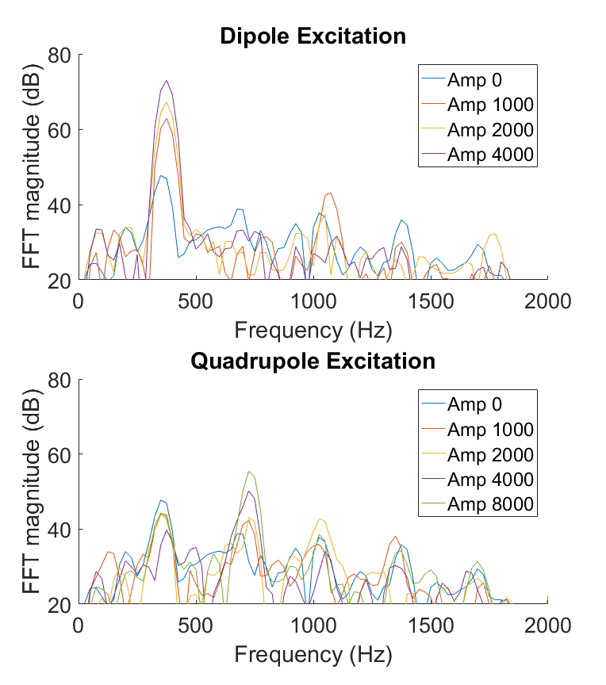
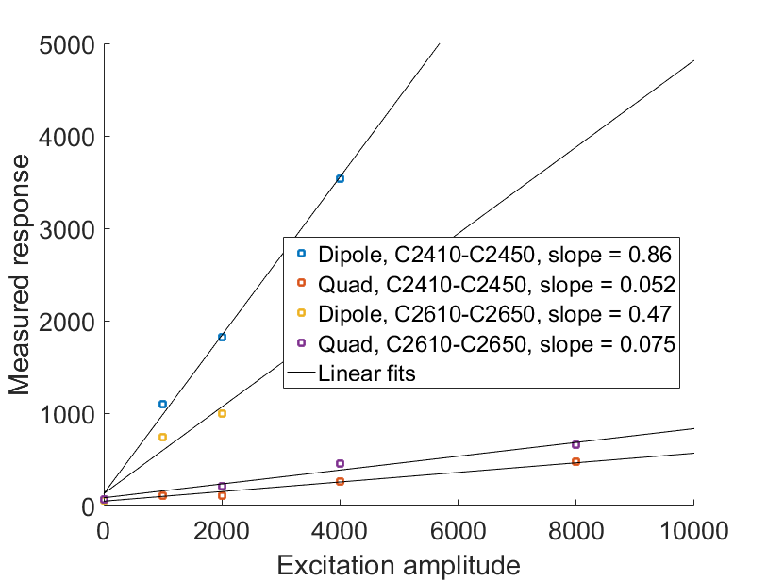
Excitation Studies
Comparison of sideband amplitude vs excitation:
  Response of dipole mode lower at C2600 than C2400
  Ratio between dipole and quadrupole: 17 at C2400, 6 at C2600
  Quadrupole excitation tends to excite dipole mode as well.
  Note: ratio comparison made after bandpass filtering.

Slide 21
Next Steps
Firmware & driver development:
  Fit 16 channels * 65535 samples in memory (currently only 32768 samples)
  Either modify acquisition core to treat 36-bit words in SRAM as 2 separate buffers of 18 bits each, or implement streaming (requires FESA class development)
  A provisional quadrupole FESA class would be useful to speed up data readout; currently several minutes per shot with PyCheby.
  Possibly have other architectures ready for testing when beam becomes available again. (eg: PLL-type scheme, hybrid time and frequency domain feedback?)
Beam simulations:
  Determine optimal frequency for feeding back on
  Interaction of dipole and quadrupole feedbacks
  Why is mode 5 the dominant one? Is it because the dipole feedback is stabilizing modes 1-4 by coincidence?
  Better way of rejecting dipole oscillations?
  See if IIR filter or other methods work in principle

Slide 23
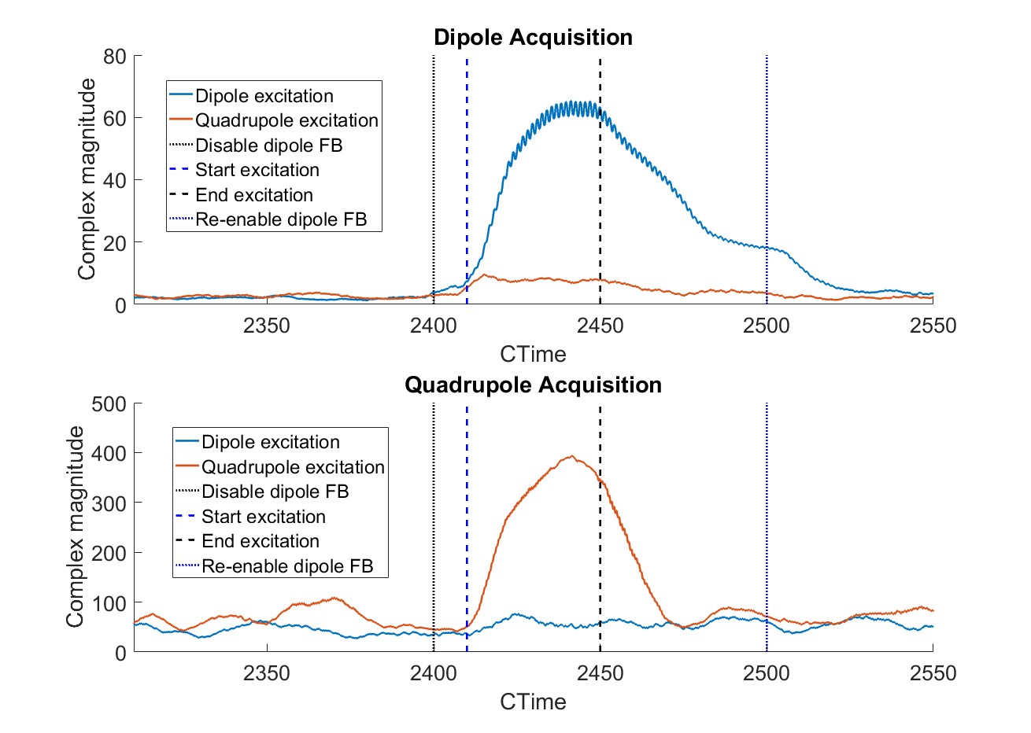
Rejection of Dipole Mode by Quadrupole Filter

Slide 24
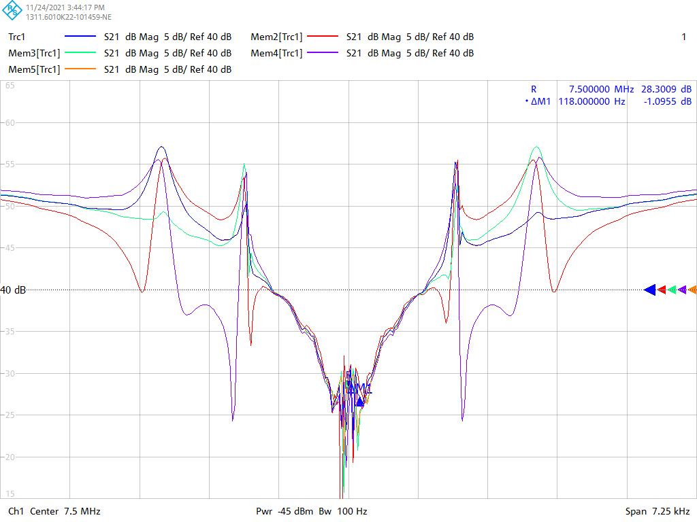
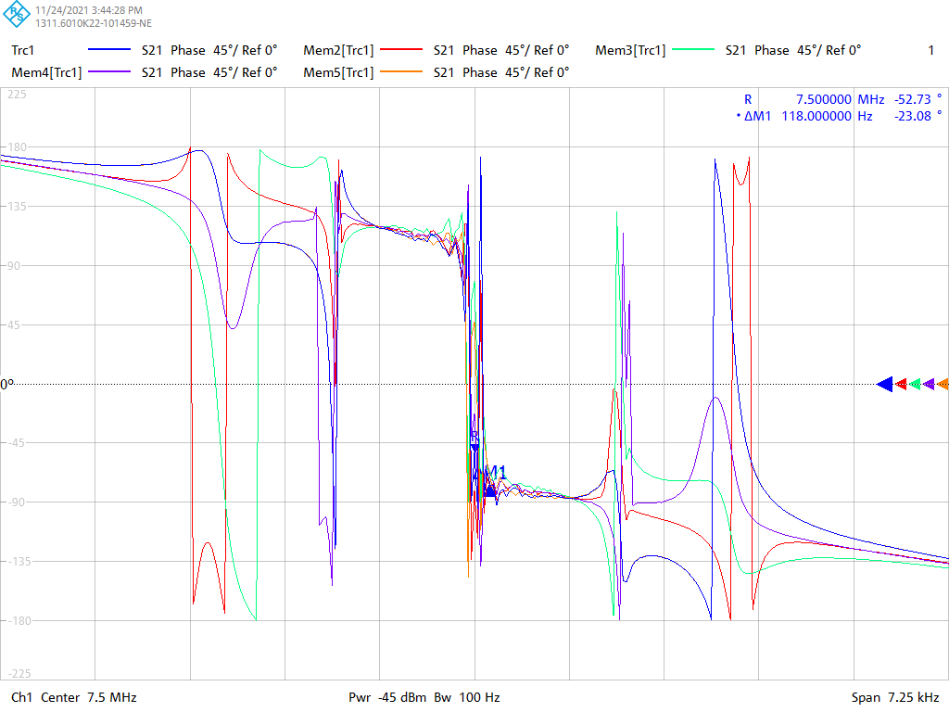
Sum of Quadrupole and Dipole Feedbacks
Magnitude
Phase
x-scale : 1 div = fs, y-scale : 5 dB/div
x-scale : 1 div = fs, y-scale : 45°/div

