Slide 1

Specifications for injection in the synchrotron
Elena Benedetto, SEEIIST

Slide 2
Synchrotron requirements
2 Gy in a 1 liter target
Max emittance from linac 0.3 mm mrad (rms)
 | particles/cycle | injection energy (as agreed)
protons | 2.6e11 | 10 MeV
He | 8.2e10 | 5 MeV/u
C | 2e10 | 5 MeV/u
…and ions for resarch | ~equivalent or as much as available

Slide 3
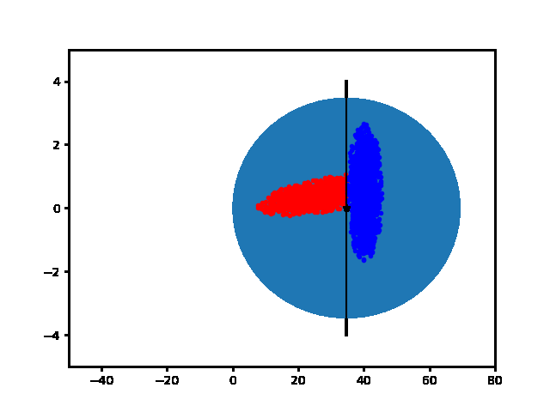
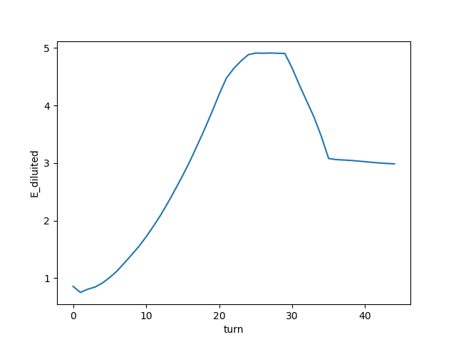
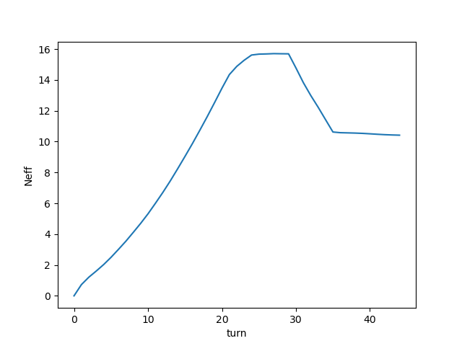
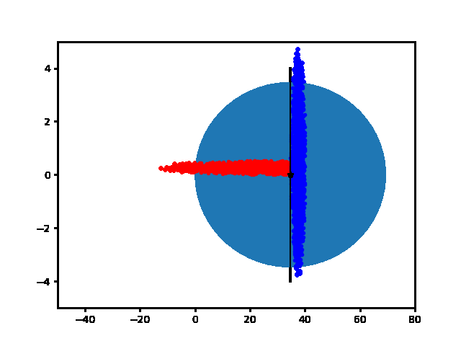
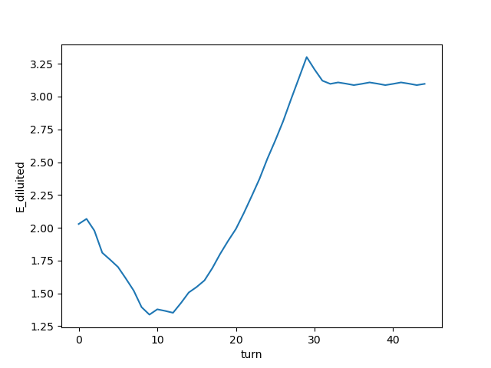
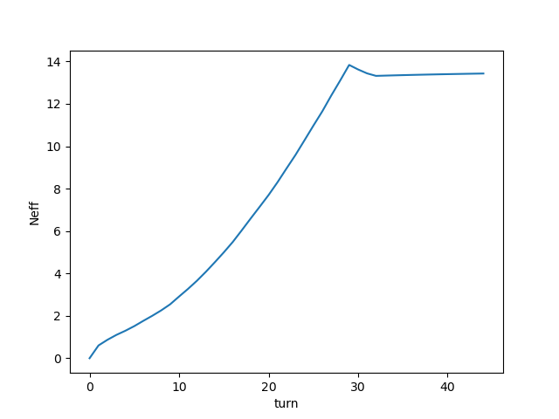
MT injection (horizontal plane only)
If Linac emi= 0.3um and Synchrotron emi = 3 um (max)
NO MORE THAN 10-13 TURNS
GO TO SLIDESHOW TO SEE ANIMATED GIF

Slide 4
How many effective turns (if 100% MT efficiency)
It is x2 = 26 effective turns for the HITRIplus superconducting synchrtotron !!!

Slide 5
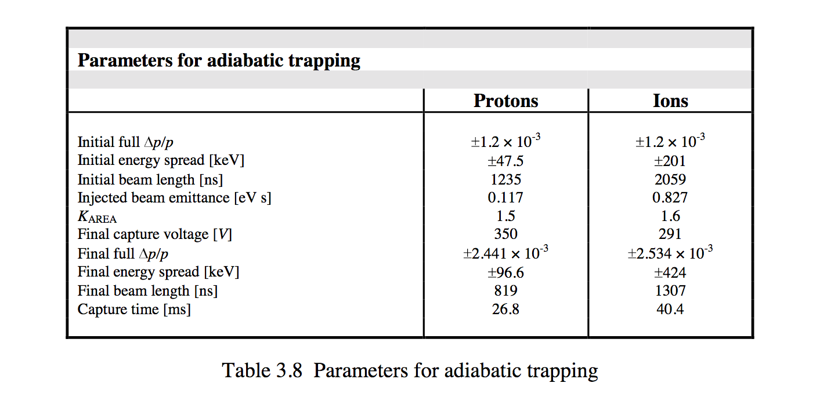
Stacking in longitudinal
Max dp/p in the synchrotron
From PIMMS
if we need 2 stacking cycles → dp/p = 1.2/2= +/-0.6e-3 (full)
if we need 4 stacking
→ need dp/p= +/-0.3e-3

Slide 6
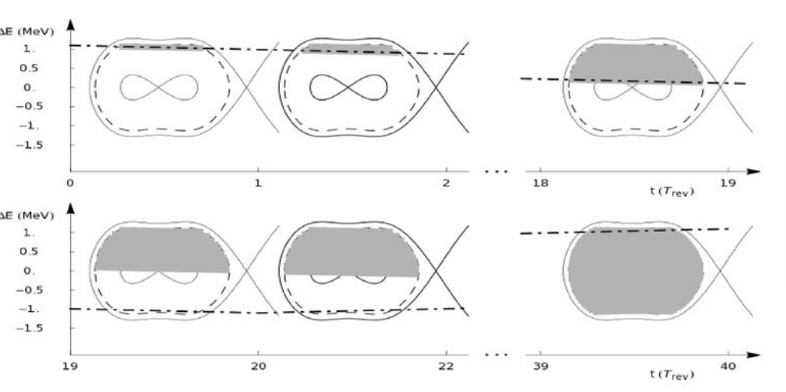
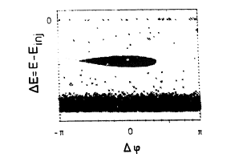
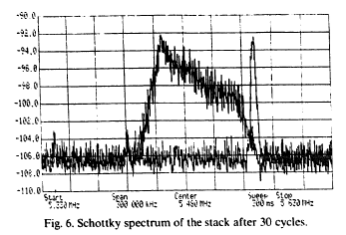
Exploring longitudinal stacking
Either by changing energy (and keeping dp/p constant with debuncher!!!) of the linac beam
Or moving energy in the synchrotron
Linac4 to CERN PSB
G.Bisoffi, Grieser et al., NIM-A, 1990
20+20 turns
30 turns

