Slide 1




n_TOF Feedback 2021
Needs 2022
25/11/2021
On behalf of the n_TOF Collaboration
Javier Praena
Prof. Universidad de Granada (Spain)
CERN Scientific Associate (EP/SME) n_TOF Physics Coordinator
1

Slide 2
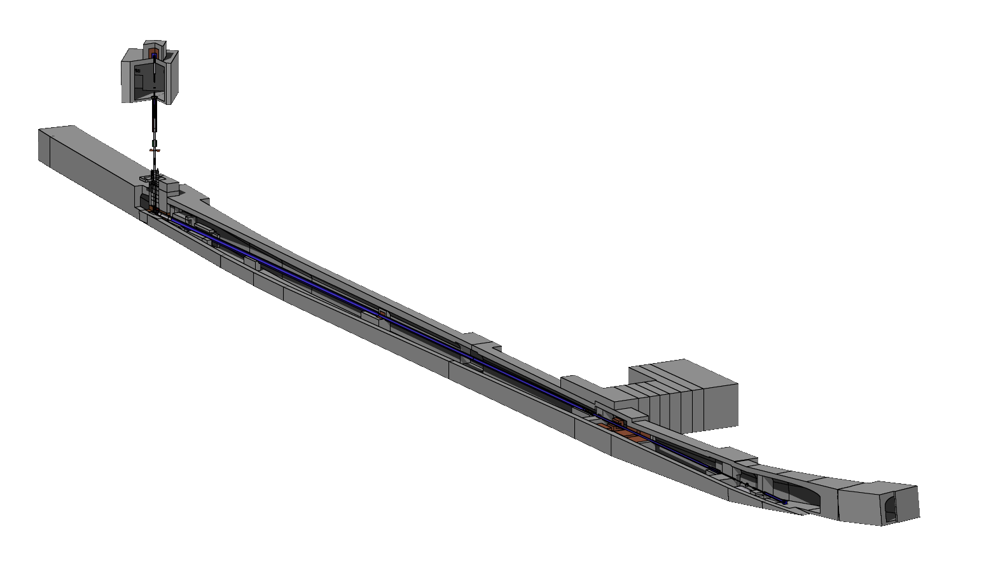
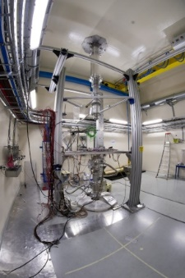
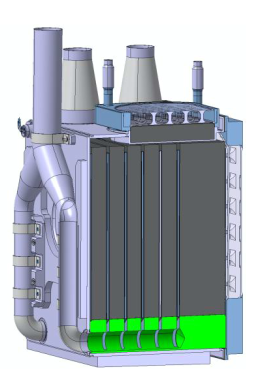
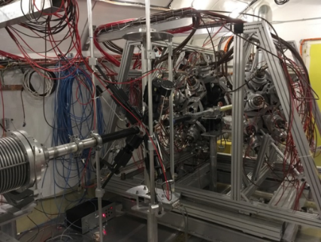
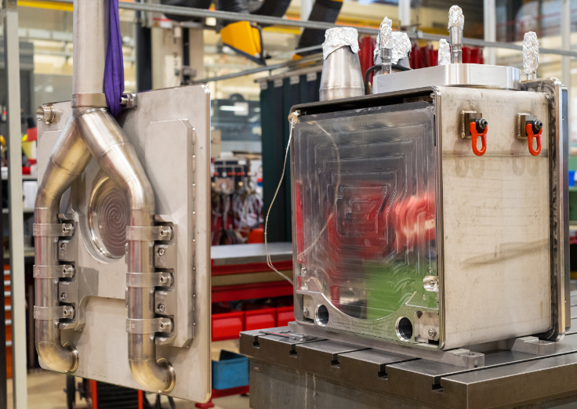



Campaign 2021: commissioning 4 parts + Physics + LoIs + MD…
65·10¹⁷ protons
20 GeV
Protons
Pulsed
EAR2 (2014)
EAR2 small collimator + Demineralized Water.
^{94,95,96}Mo(n,γ) part of EAR2 (2e18). INTC-P-569
Tarat Test (NN) INTC-I-220
Neutrons
L₂=20 m
Neutrons
53·10¹⁷ protons
NEAR (2021)
Pb target
L₁=185 m
EAR1 (2001)
Commissioning of target, INTC-P-587
NEAR commissioning, INTC-I -222.
Tarat Test (NN) INTC-I-220
¹⁷⁶Yb(n,γ)¹⁷⁷Yb→¹⁷⁷Lu. INTC-P-607
4. EAR1 small collimator + Borated Water.
5. EAR1 big collimator + Borated Water.
2
Javier Praena- U. Granada – CERN (EP/SME)
PS/SPS Meeting, 25/11/2021

Slide 3
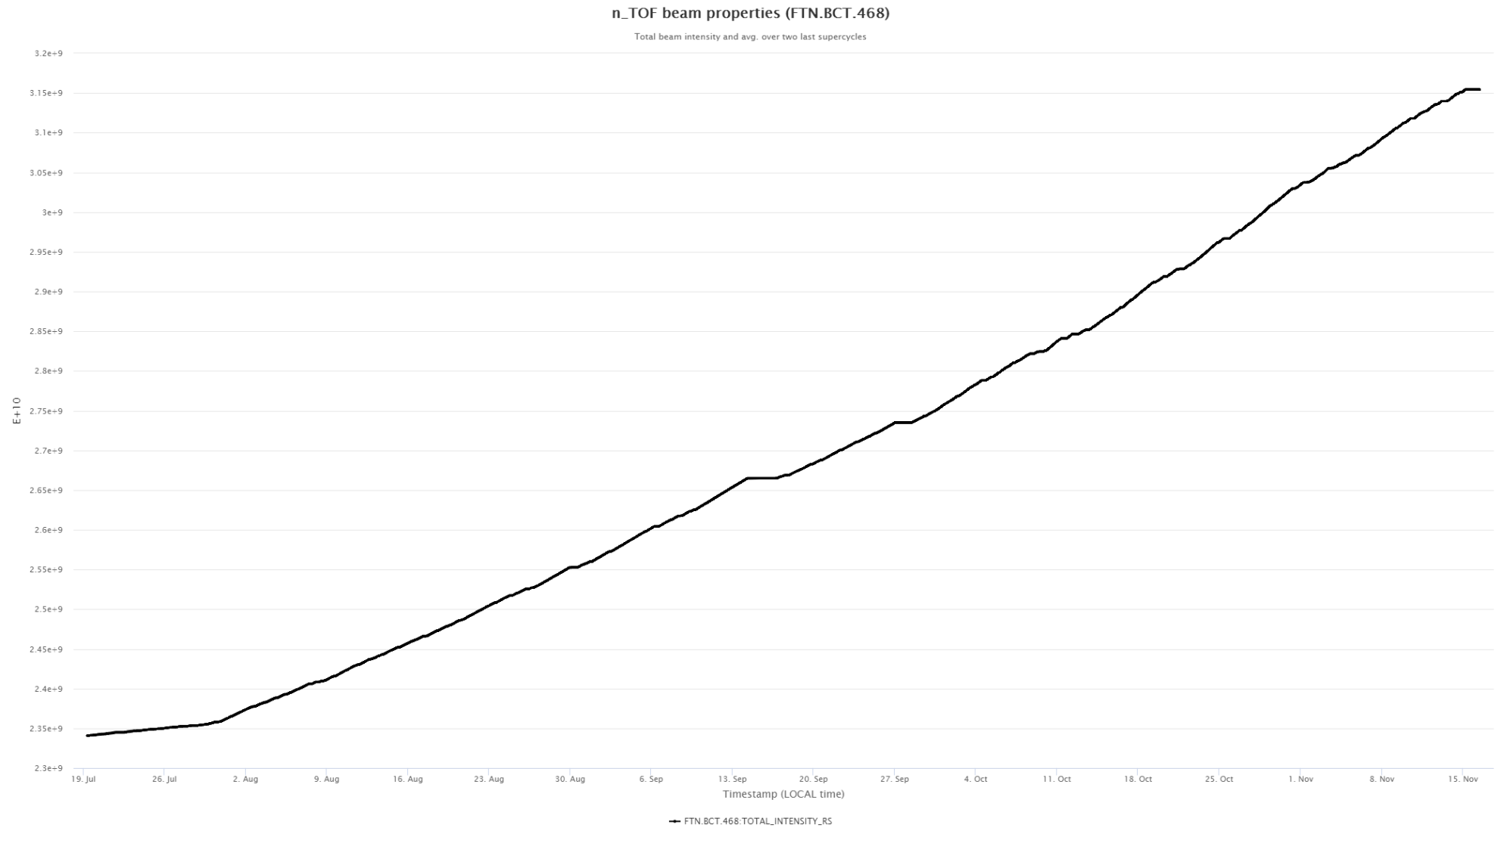
Protons in 2021. Expected=84e17 protons. Delivered=81.4e17
81.4e17 protons
19/07-15/11
Technical Stop. Check
Technical Stop
Increasing
Intensity
Javier Praena- U. Granada – CERN (EP/SME)
PS/SPS Meeting, 25/11/2021

Slide 4
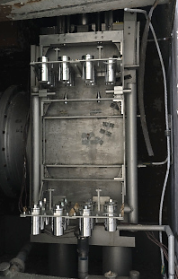
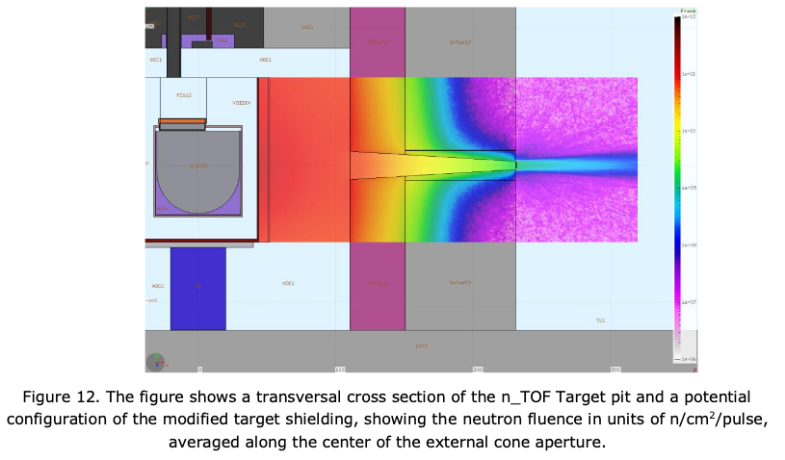
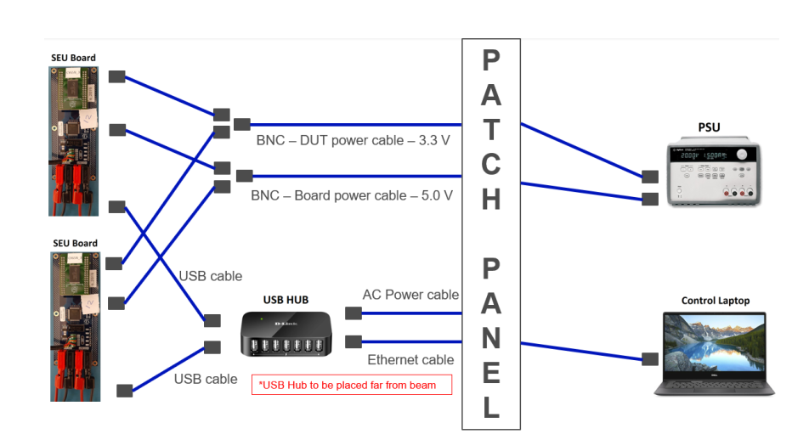
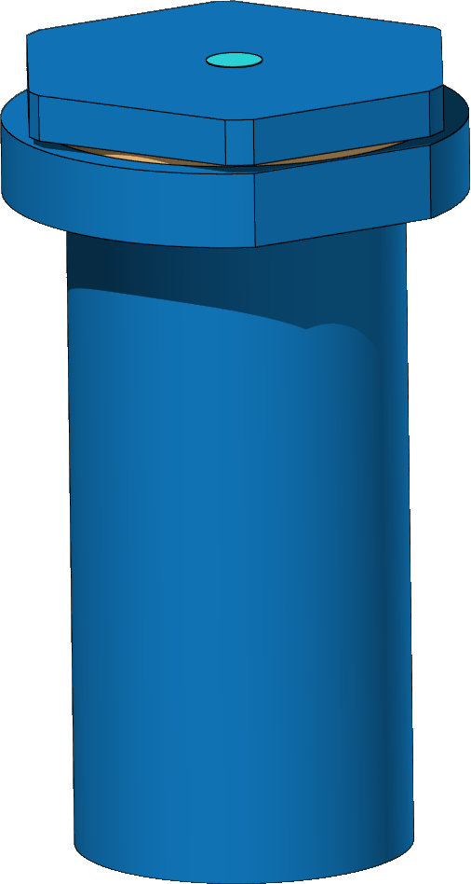
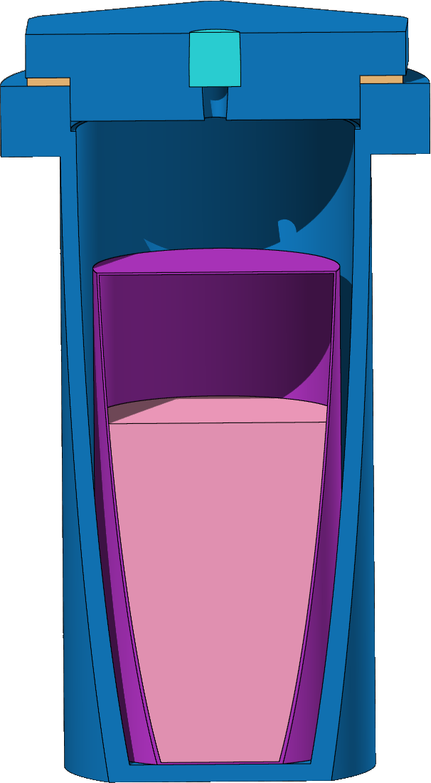
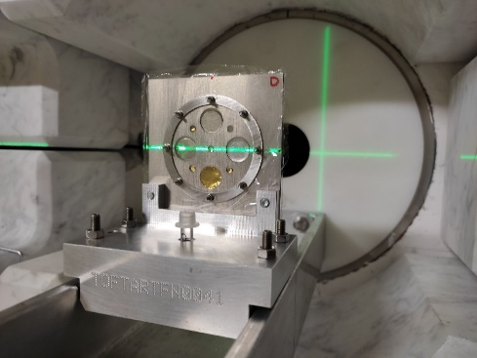
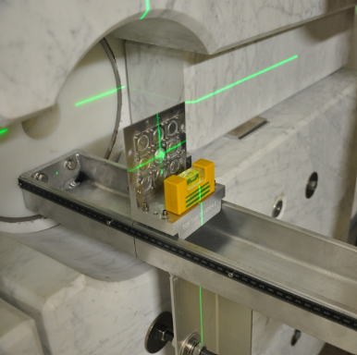
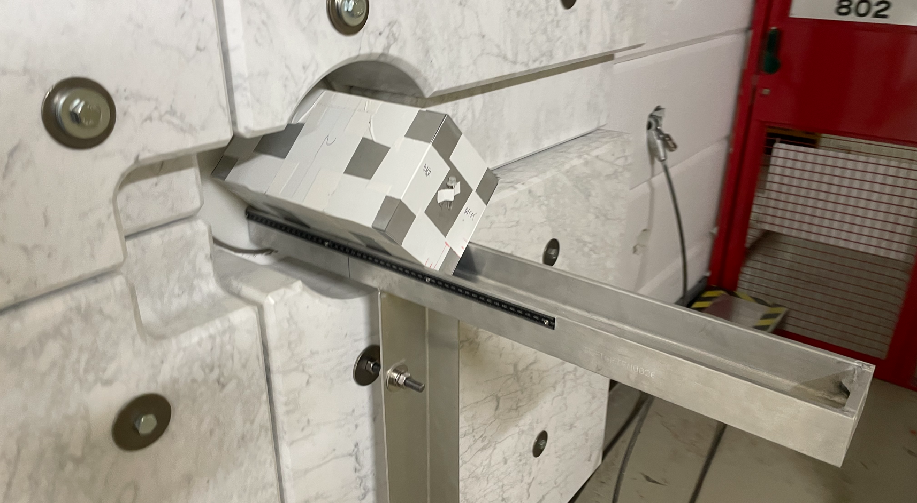
NEAR (2021): new experimental. EAR1 (2001), EAR2 (2014).
R2E
Single Event Upsets
Single Event Latch-up
R2M
Acknowledgment: M.Barbagallo
Commissioning of neutron fluence for Physics Measurements
Javier Praena- U. Granada – CERN (EP/SME)
PS/SPS Meeting, 25/11/2021

Slide 5
Summary
    2021 has been an excellent year:
      Commissioning of the facility after LS2.
      Physics Program has been advanced.
    Proton beam position on target.
      Solved. Not noticeable impact.
    Proton beam dimensions on target.
      Looks like not noticeable impact even in EAR2.
    Proton beam timing (“bad” structure of g-flash for dimensions larger than 15x7mm²)
      Seen only with fast detectors, EAR1 no impact solved.
      Seen only with fast detectors, EAR2 low impact, solved.
      However, a good timing should be desirable whatever dimensions of the proton beam.
    Target was designed for 15x15 mm².
    15x15 mm² is not possible at present due to the activation of elements at FTN (just before target).
    Work ongoing to find the best solution for 2022.
Javier Praena- U. Granada – CERN (EP/SME)
PS/SPS Meeting, 25/11/2021

Slide 6
Needs and feedback
Our Needs for Physics:
  Two different intensities:
    High intensity, interval 7.5-8.5e12ppp (dedicated)
    Low intensity, interval 2-3.5e12ppp (parasitic)
  1.05e17 protons per day, in average over 30 days (as before the LS2).
  Good timing is always reached (dedicated or parasitic) with the dimensions 15x7 mm², but it is not the desired on for target durability. Work ongoing BE-OP.
Our Constrains from Target:
  Maximum average intensity on target = 160e10 p/s
  Dimensions for high intensity pulses ≈ 215 mm². Fix impact point on target.
  Dimensions for low intensity pulses ≈ 40 mm². Fix impact point on target.
Availability of proton beam has been excellent.
Campaign 2021 has been very interesting and efficient.
Thanks to the BE-OP and PS teams for the constant feedback and help.
Javier Praena- U. Granada – CERN (EP/SME)
PS/SPS Meeting, 25/11/2021

Slide 7

Javier Praena
Prof. Universidad de Granada (Spain)
CERN Scientific Associate (EP/SME) n_TOF Physics Coordinator
Thank you
7

Slide 8
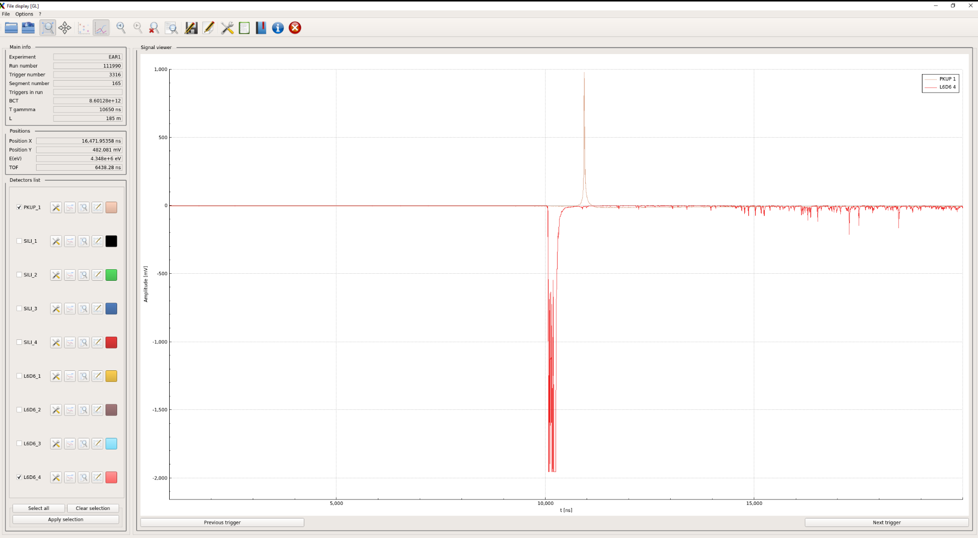
Fast detectors: what we see…
Red are signals from the detectors: all are gammas but coming from the target or from the experiment.
Brown is the pickup signal induced by the corresponding proton pulse.
Pickup signal
Gammas from the target: v=c, they are used as t=0 for time-of-flight technique
Gammas from the reaction Yb(n,γ).
The corresponding energy of the neutron producing the reaction is calculated related to the t=0
Javier Praena- U. Granada – CERN (EP/SME)
PS/SPS Meeting, 04/11/2021

Slide 9
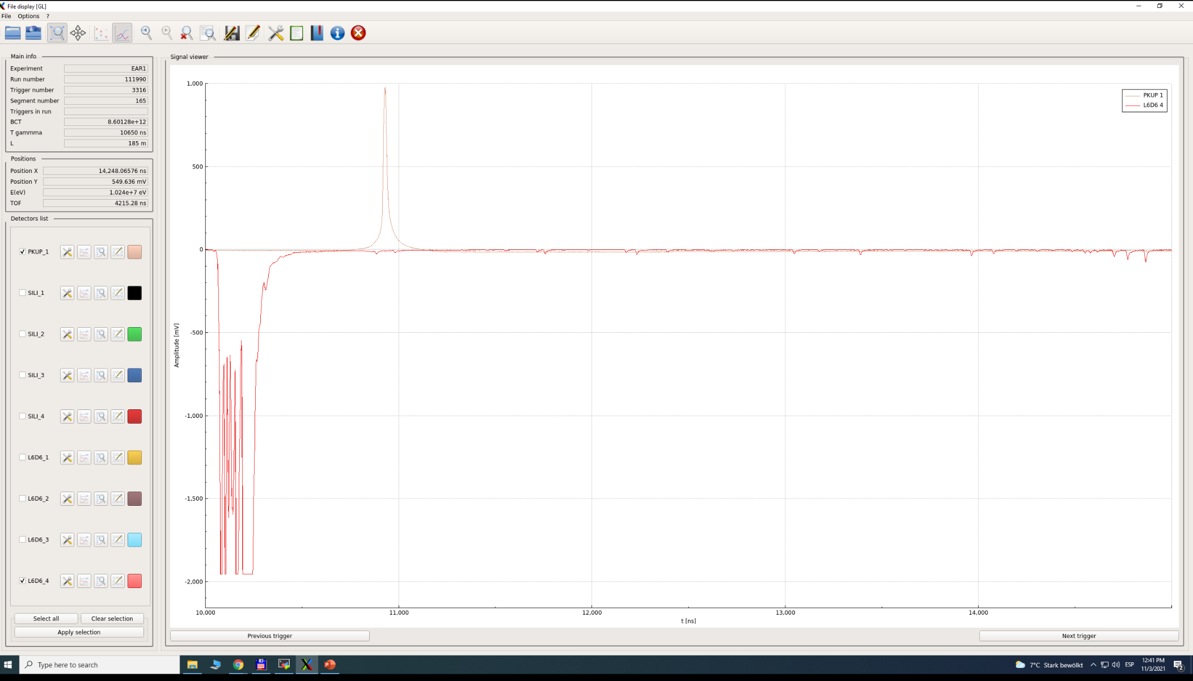
“Bad” time structure (high intensity 8.5e12ppp)
Zoom of the previous slide
Pickup signal has not a “sharp” rising
Signals from fast detectors
Time Zero of our TOF has “uncertainties”
Real Time Zero?
Javier Praena- U. Granada – CERN (EP/SME)
PS/SPS Meeting, 04/11/2021

Slide 10
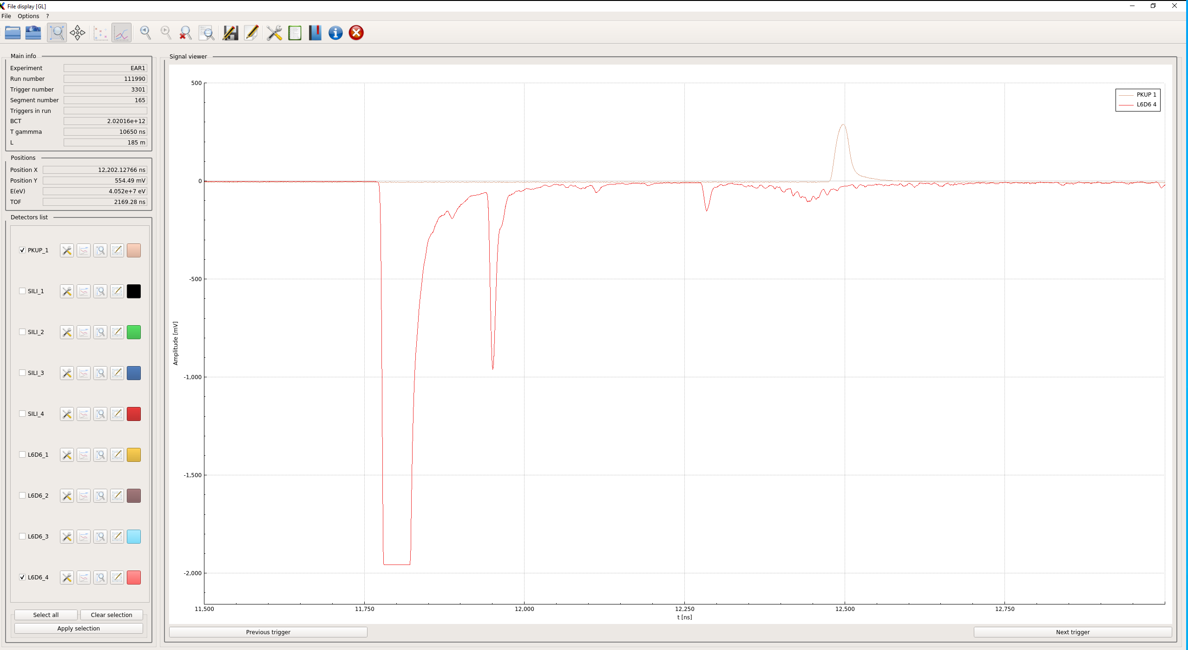
“Good” time structure (low intensity 2e12ppp)
Pickup signal with excellent and “sharp” rising
Signals from fast detectors
Real and very good Time Zero
There is a clear correlation between the pickup signal and the time structure detected
Javier Praena- U. Granada – CERN (EP/SME)
PS/SPS Meeting, 04/11/2021

Slide 11
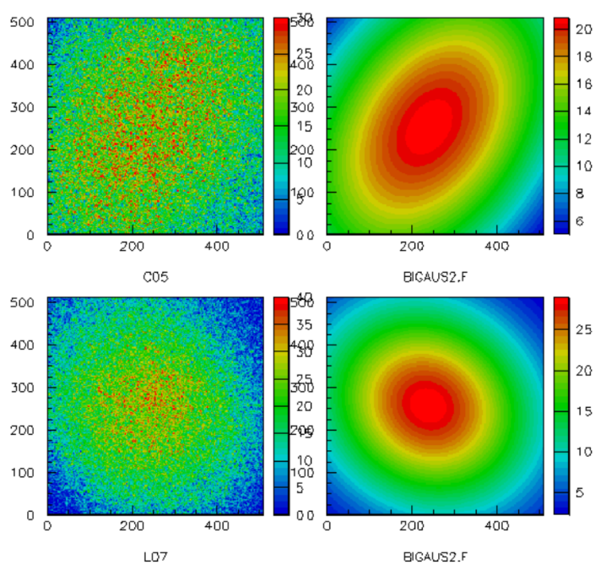
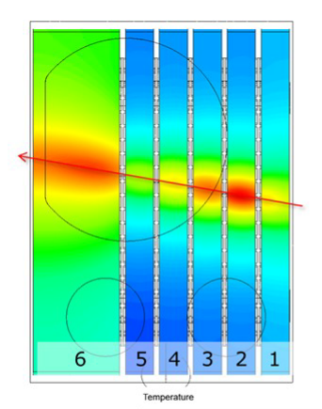
EAR2 small collimator CM beam profile: Timepix
All energies
Downstream
To be completed and extended with PPAC2 with U235(n,f)
Upstream
Zenithal/vertical view
of the target
Fabrizio Murtas, Michi Bacak
Particular important because EAR2 is closer to the target (20 m) and the beam “seen” from vertical position is not a point.
20 GeV
PS Protons
11
J. Praena – U. Granada&CERN – n_TOF Physics Report 2021
Collaboration Meeting , 25-26/11/2021

Slide 12
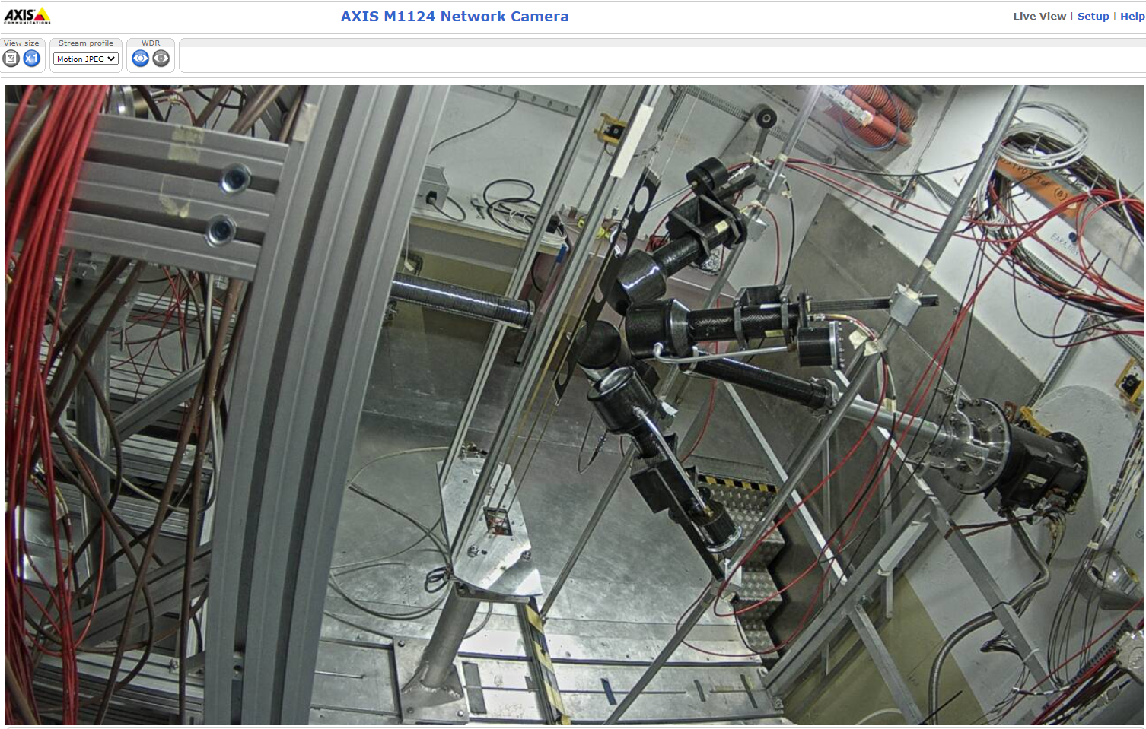
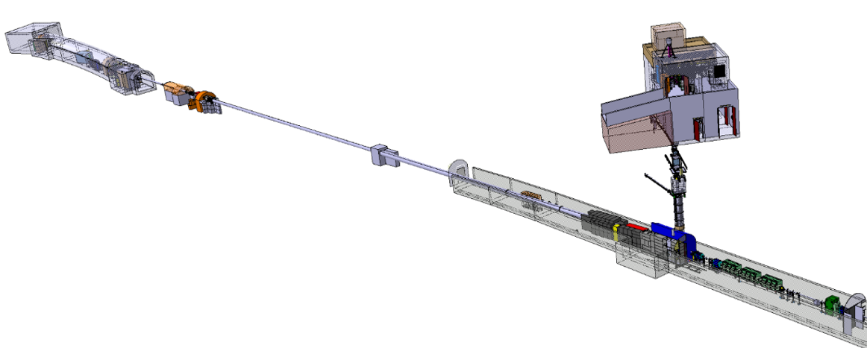

EAR1: continue commissioning time-to-energy conversion.
EAR1
@ 185 m
Neutrons
20 GeV
PS Protons
12
Javier Praena – U. Granada – CERN (EP/SME)
PS/SPS Meeting, 14/10/2021

Slide 13
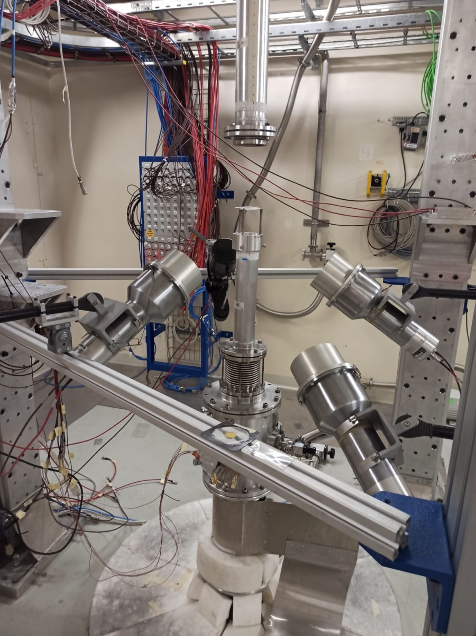
EAR2: start of Physics Measurements before expected
^{94,95,96}Mo(n,γ) with application to astrophysics
EAR2
@ 20 m
Neutrons
Neutrons
Neutrons
20 GeV
PS Protons
13
Javier Praena – U. Granada – CERN (EP/SME)
PS/SPS Meeting, 21/10/2021

Slide 14
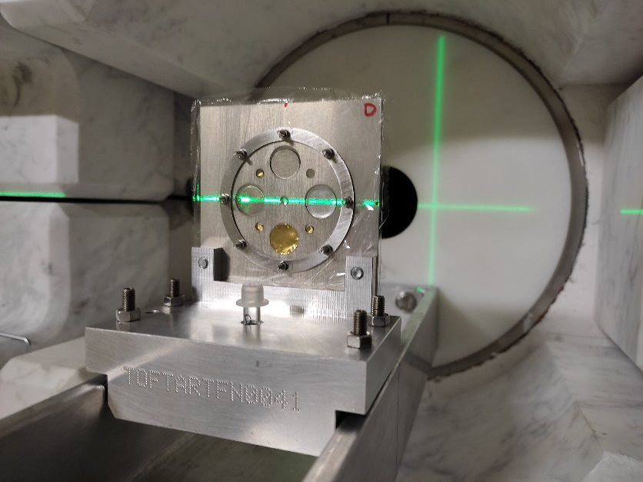
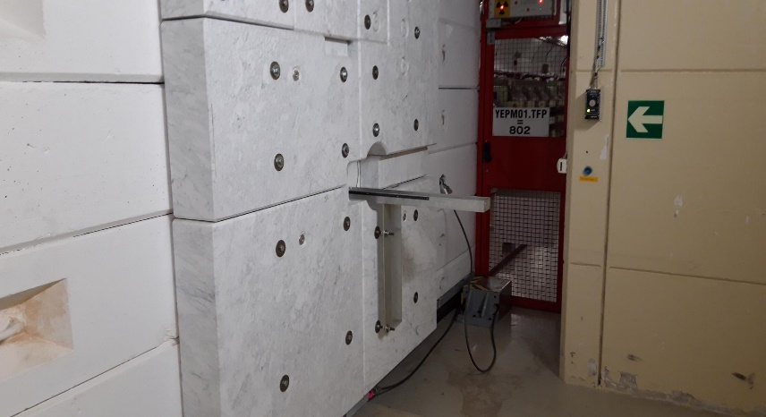
NEAR: multiactivation characterization of the neutron flux
EAR1
@ 185 m
NEAR:
N_TOF
R2M
R2E
20 GeV
PS Protons
14
Javier Praena – U. Granada – CERN (EP/SME)
FOM Meeting, 12/10/2021

Slide 15
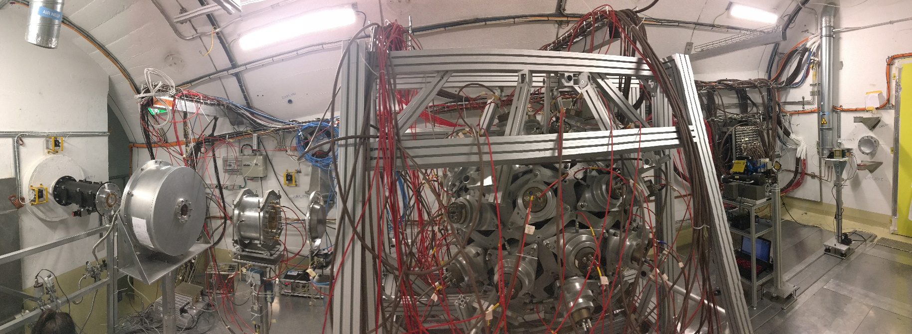
EAR1: previous setup.
EAR1
@ 185 m
PPAC1
(2x²³⁵U, gas
On-beam)
C₆D₆ and iTED
Neutrons
PTB (10x²³⁵U,gas
on-beam)
Simon1
(4 Si detectors off-beam)
Timepix1.2
(Si detector
On-beam)
MGAS1 (²³⁵U and 2x¹⁰B
(Gas Ionization on-beam)
20 GeV
PS Protons
15
Javier Praena – U. Granada – CERN (EP/SME)
PS/SPS Meeting, 30/09/2021

Slide 16
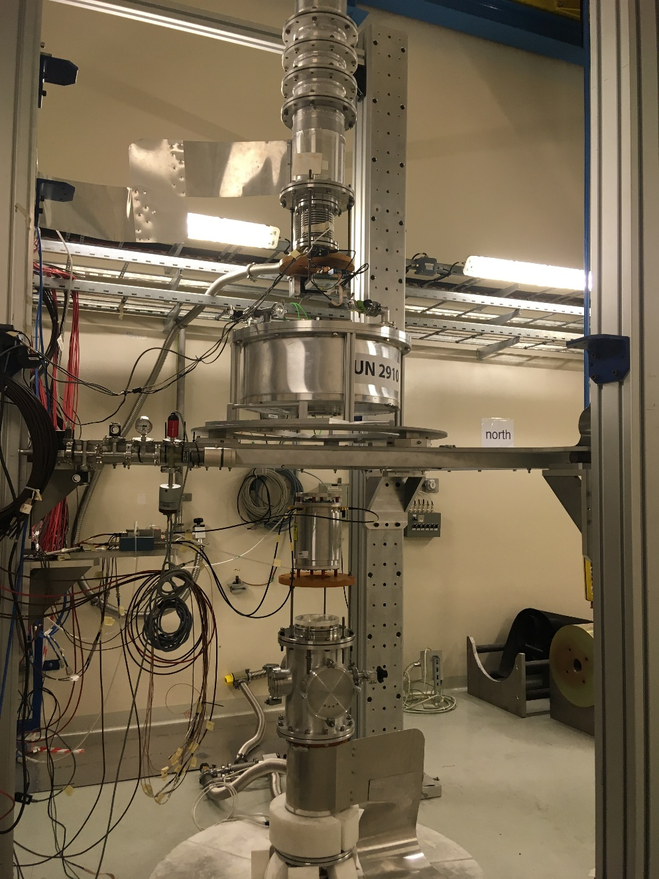
EAR2: previous setup
Neutrons
PPAC1
(²³⁸U, ²³⁷Np gas, on-beam)
EAR2
@ 20 m
Neutrons
MGAS2 (²³⁵U, ¹⁰B, gas on-beam)
Simon2
(4 Si detectors off-beam)
20 GeV
PS Protons
Neutrons
16
Javier Praena – U. Granada – CERN (EP/SME)
PS/SPS Meeting, 30/09/2021

Slide 17

NEAR: change of the setup for multiactivation
EAR1
@ 185 m
EAR2
@ 20 m
NEAR:
N_TOF
R2M
R2E
20 GeV
PS Protons
17
Javier Praena – U. Granada – CERN (EP/SME)
PS/SPS Meeting, 30/09/2021

