Slide 1
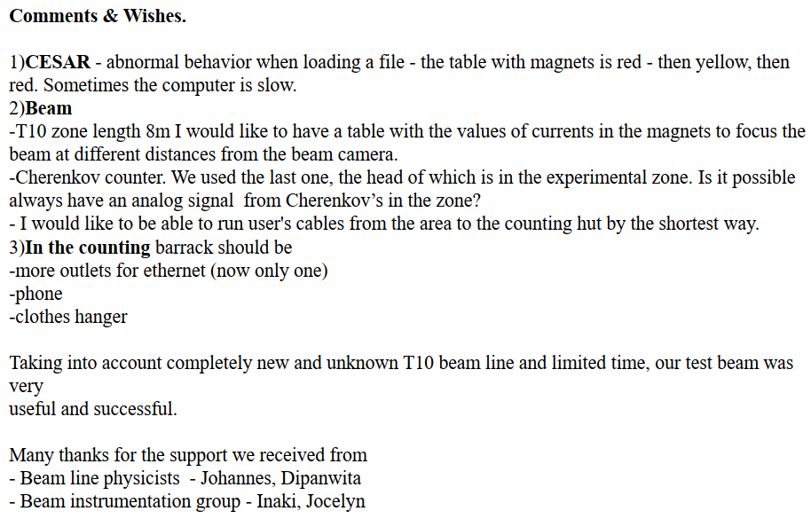
ALICE PHOS – T10 from Mikhail Ippolitov

Slide 2
LDMX – T9 from Torsten Akesson I
First we would to iterate how well LDMX perceived the East Area as testbeam environment, and the excellent support we received from the CERN staff.
On the top of our wish-list is a strengthen connection between the CERN beam instrumentation [1] and the testbeam users.
A key element here is a unified timing system, and luckily CERN has that for the beam instrumentation and accelerator systems through the White Rabbit system. We therefore suggest that the synchronized White Rabbit set-up including its TDC feature would be a standard installation in all control rooms.
Linked to this is enough cables from the beam control room to the testbeam control rooms, so there is access to both scintillators, their coincidence, the Cherenkovs, start of spill and stop of spill.
For the fibre tracker, the access is through the so-called DIP-server that can be read between the spills. Its information should be White Rabbit time-stamped, and it would be good if this DIP-server information also includes the time-stamped start of spill.
With this in place, all relevant beam instrumentation information and the user’s own data would all have the same absolute time-stamps, and therefore be unambiguously correlatable.
Our second suggestion concerns noise reducing measures. Our case is somewhat extreme with a DAQ-crate producing noise like a jet engine. Nevertheless, it could be universally useful to have one rack outside control rooms and beside that rack a slit through the control room wall allowing cables to and from the electronics inside the control room.

Slide 3
LDMX – T9 from Torsten Akesson II
Our third suggestion concerns cables. The electronics pool is very valuable, i.e., to not have to buy and/or bring all basic modules, power supplies, oscilloscopes etc to the site. However, one thing that is not available at the electronics pool, but always needed, is Lemo-cables, 50 Ohm terminators, Lemo-BNC adaptors, etc. A store from which one could borrow such cables would be very useful. Such cables are quite expensive so it would probably be quite important to label them “property of CERN” or something like that. This is of course an issue for teams coming for short testbeam campaigns, and not so relevant for more permanent installations.
Our fourth suggestion is Covid-19 related. The control rooms are small rooms with several people in them, and distancing is not always so easy. This pandemic created a paradigm shift [2] in epidemiology in that it became understood that this disease is primarily airborne, and not spread by droplets falling on parabolic paths or through fomite spread. Distance very much matters because of the obvious geometrical dilution by distance, but there is no safe distance. The quality of air is fundamental and requires ventilation. In a closed space like a control room the accumulation of air pollution with aerosols carrying the disease, could arise quickly if ventilation goes off/is blocked etc. Monitoring of the air quality is therefore warranted. Luckily that is quite simple to implement by measuring the CO2 level. We therefore suggest that all control rooms are equipped with CO2 monitors and posted criteria of what to do if CO2-thresholds are exceeded.

Slide 4
ALICE ITS3 – T10 Francesca Carnesecchi
On behalf of ALICE-ITS3, I can say that we have been really satisfied with the beam facilities. Indeed thanks both to the structure and to the experts (really, really always available on solving whatever problem/doubts we encountered), we managed to take a lot of data (yet under analysis).
In the following a minor wish list for the next time, regarding T10-PS:
- A phone in the control room, to call CCC and beam experts
- More ethernet ports (and possibly in different places) in the control room
- a dedicated ladder available for each beamline
- a working station (if possible) right outside the control room (I saw that quite often people were bringing their own table close to the area for this purpose), possibly with an electrical outlet

