Slide 1
BLM – QPS test II
Combined measurement of beam loss with BLM and nQPS

Slide 2
nQPS Setup
Special version of DQQDS board which is able to trigger internal buffer at specified level
DQQDS board are installed in
B14R2 → MQ13R2, MQ15R2 and
B15R2 →MQ14R2, MQ16R2
Trigger level can be set from CCC
If magnet shows a “quenchino” which exceeds the buffer’s trigger level, we’ll record it

Slide 3
Experiment
3 tests in campaign: 2 and 3 bunches vertical Bump with maximum in MQ14R2
2 bunches horizontal bump
Operation mode: circulating beam
Beam intensity up to 2.4e11
(3 bunches + pilot)
BLM on MQ14R2 records radiation level
Goal: correlation between BLM levels and eventual quench of magnet

Slide 4
Result: test1 3b + pilot vertical bump beam 3
Intensity of beam 2.4e11
BLM could monitor increasing losses at MQ14R2
DQQDS triggered internal buffer
DQQBS exceeded threshold and opened the switch (artifact due to inductive compensation inside BS board)
“Quenchino lasted for ~6s until stopped by EE
Umag rose up to 155mV

Slide 5
Test 1: SymQ buffer + logging data

Slide 6
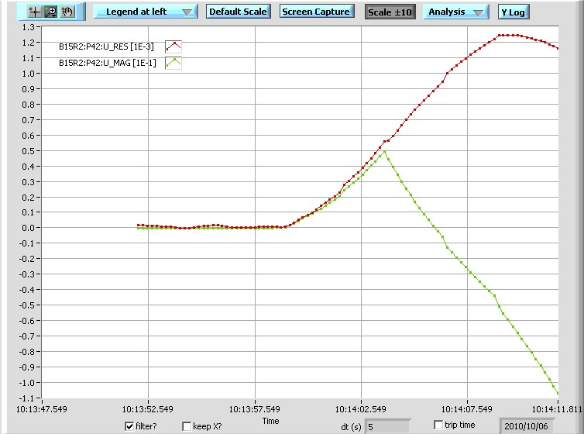
Test 1: DQQBS postmortem
~5s

Slide 7
Result: test2 2b + pilot vertical bump beam 2
Intensity of beam 1.6e11
BLM could monitor increasing losses at MQ14R2
DQQDS triggered internal buffer
DQQBS exceeded threshold and opened the switch (artifact due to inductive compensation inside BS board)
“Quenchino lasted for ~6s until stopped by EE
Umag rose up to 140mV

Slide 8
12:29

Slide 9
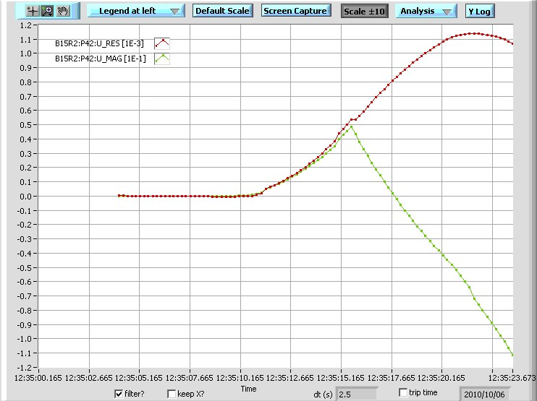
Test 1: DQQBS postmortem
~6s

Slide 10
Result: test3 2b + pilot horizontal bump beam 1
Intensity of beam 1.7e11
BLM could monitor increasing losses at MQ14R2
DQQDL triggered quench in dipole C14R2
DQQDS in MQ14R2 didn’t trigger

Slide 11
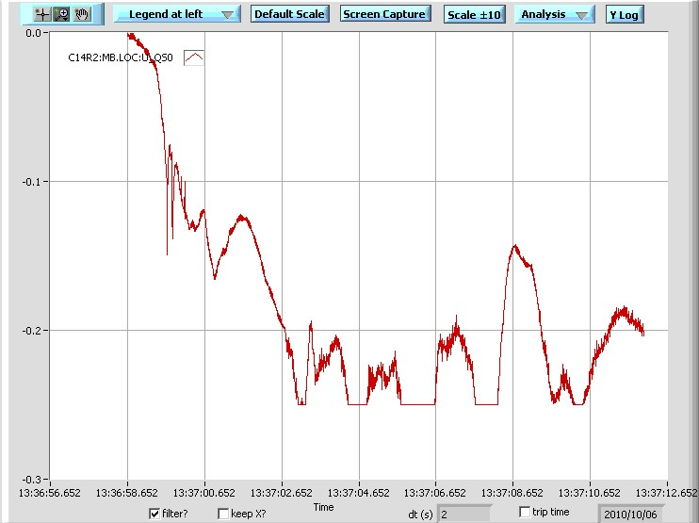
Test 1: DQQDL postmortem
~0.5s
MB14R2 quenched asymmetrically, detected by oQPS

Slide 12
Conclusion
Two successful tests (1+2) with nQPS recordings
DQQBS provided “heater firing protection”
(will not work with more bunches)
Quenches with vertical bump in MQ rather slow events ~5-6s until ~150mV is reached
Quenches with horizontal bump in MB rather fast →0.5s until heaters fired by oQPS

